Slide 1
DDoS Attack Prediction Using Machine Learning
Group 3 :
Jonathan Christian Wongso
Kenneth Maximillian Pranata
Sisilia Annabel Aileen

Slide 2
Motivation
DDoS attacks are becoming more frequent and sophisticated.
Early detection can reduce service downtime, financial losses, and security risks.
Machine learning can learn traffic patterns and detect attacks more effectively than static rule-based methods.
The project aims to provide real-time attack detection and monitoring through a user-friendly dashboard.

Slide 3
Problem Statement
DDoS attacks can disrupt online services by flooding networks with malicious traffic.
Traditional rule-based detection systems struggle to identify new and evolving attack patterns.
The large volume of network traffic makes manual monitoring ineffective for real-time threat detection.
An automated and intelligent detection system is needed to identify DDoS attacks quickly and accurately.

Slide 4
Dataset Description
Dataset Name : BCCC-cPacket-Cloud-DDoS-2024
Author Introduction about the dataset :
The 'BCCC-cPacket-Cloud-DDoS-2024' dataset collaboratively with cPacket from the States to address challenges identified in previous datasets through a cloud infrastructure. The dataset contains over eight benign user activities and 17 DDoS attack scenarios. The dataset is fully labeled (with a total of 26 labels) with over 300 features extracted from the network and transport layers of the traffic flows using NTLFlowLyzer.
Paper Reference : https://www.mdpi.com/2078-2489/15/4/195

Slide 5
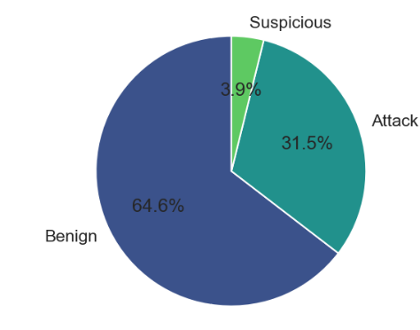

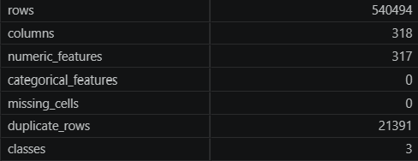
Exploratory Data Analysis
Class Distribution
Dataset Shape
Missing Values
Duplicated Rows
Dataset Summary
Dataset Info

Slide 6
ML Problem Formulation
How can machine learning techniques be utilized to detect DDoS attacks from network traffic data?
Which machine learning algorithm provides the best performance for DDoS attack detection in terms of accuracy, precision, recall, F1-score, and ROC-AUC?
How effectively can the proposed system classify network traffic into benign and DDoS categories in a near real-time monitoring environment?
How can a machine learning-based intrusion detection system be integrated into a real-time monitoring dashboard to provide timely attack alerts and historical traffic analysis?

Slide 7
Model a & Rationale
Logistic Regression (floor)
Simplest model to set the minimum acceptable accuracy
Any model that can't beat it is considered a failure
Creates a benchmark ladder: simple → moderate → complex
SVM (baseline)
Represents a different algorithm family (margin-based) outside of tree-based methods
Used to measure whether tree-based models genuinely outperform non-ensemble approaches
KNN (baseline)
Represents instance-based, non-parametric learning
Tests how distance-based methods degrade under high-dimensional network features — expected to underperform, strengthening the case for primary models
Random Forest (primary)
Handles high-dimensional features natively
Captures non-linear relationships in traffic patterns
Robust against noisy data through tree averaging
Optimizable for speed — fits the "Live Listen" near real-time requirement
XGBoost (primary)
All Random Forest strengths, plus gradient boosting for higher accuracy
Recognized as the best-in-class for tabular data
Built-in regularization prevents overfitting across varied attack types
Supports parallel processing for lightweight, fast deployment

Slide 8
Training & Validation Setup
Dataset split ratio 80% train : 10 % validation : 10% testing
Imputation: Safely handles missing data
Scaling dataset after split
Dimensionality Reduction (Curse of Dimensionality) → PCA
Hyperparameter tuning Cross-Validation
Handling class imbalance → implementing class_weight=”balanced” and “balanced_subsample”
Tuning Metric → “f1_macro” finding hyperparameter for predicting all classes equally
implemented multi-dimensional evaluation (F1-Score, accuracy, precision, accuracy, recall, ROC-AUC score)

Slide 9
Evaluation Metric
Accuracy
Precision
Recall
F1-Score
F1-Macro vs F1-Weighted
ROC-AUC

Slide 10
Result

Slide 11
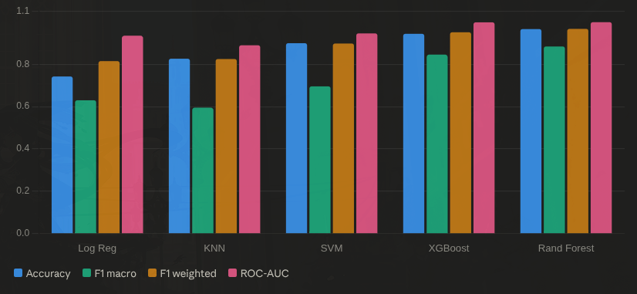
Overall performance

Slide 12
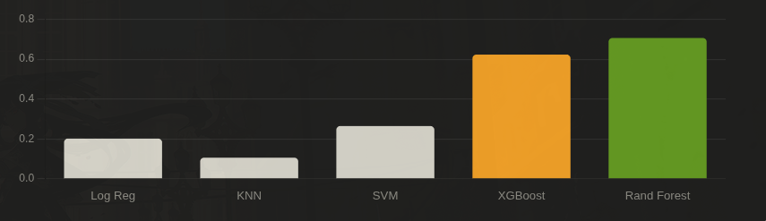
Per-class F1 score (Suspicious)

Slide 13
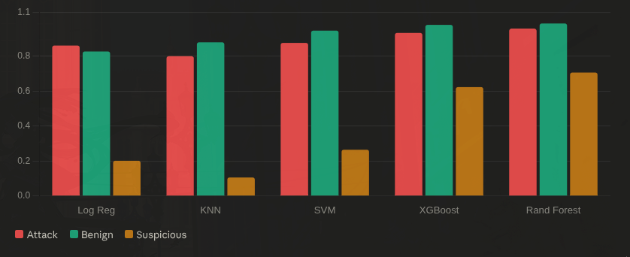
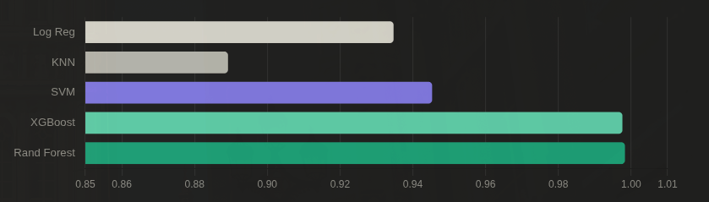
Per-class F1 — all classes
ROC-AUC comparison

Slide 14





Deployment Architecture
Client-Server Architecture
The Frontend (Client Tier)
Role: Acts as the User Interface (UI).
Action: It captures the user's input, sends those inputs via an HTTP request to the backend, and visually displays the returned prediction and data to the user.
The Backend (Server & Inference Tier)
Role: Acts as the brain and the API.
it loads the saved model file. When it receives a request from the frontend, it processes the data, runs the predict() function, and sends the result back to the frontend as a JSON response.

Slide 15
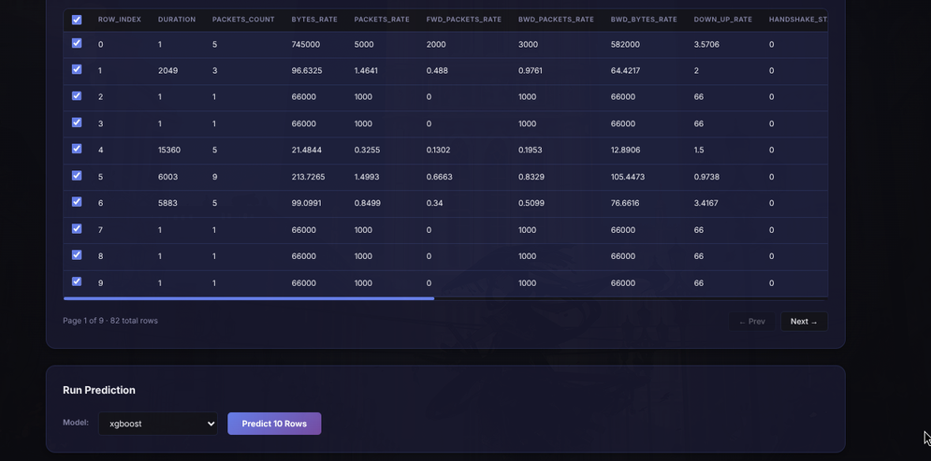
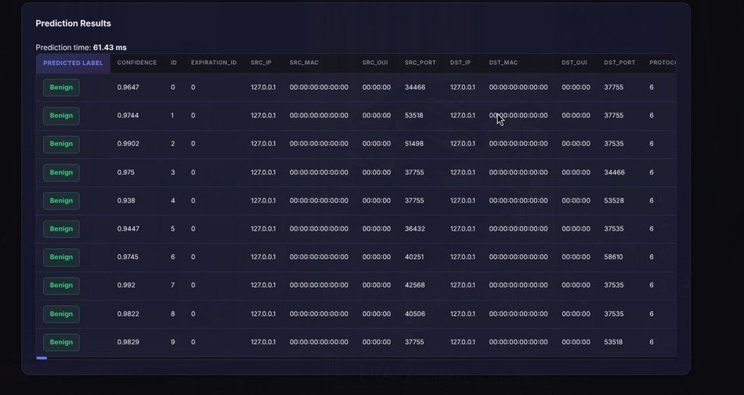
Application

Slide 16
User Testing
User Testing Design
Likert scale to measure the Usability and Usefulness from the proposed application.
Ask the user on their feed back on the application
User Testing Result
The user testing results demonstrate strong overall performance with an average score of 4.3/5 for both usability and usefulness, highlighting the system's high responsiveness, stable backend, and intuitive design for both technical and non-technical users. However, constructive feedback indicates minor areas for improvement, specifically regarding color contrast for attack indicators and the potential addition of a data export feature

Slide 17
Analysis

Slide 18
Baseline model
Logistic Regression
performance floor at 74.19% accuracy and 0.6295 macro F1.
Interesting Suspicious class recall of 80.03%, high with terrible precision (11.51%) indicates over-predicting the Suspicious cause inability to draw non-linear decision boundaries.
Its ROC-AUC of 0.9347 is surprisingly competitive, showing it can rank samples decently even if it can't classify them precisely.

Slide 19
The Challengers
KNN
KNN's results macro F1 of 0.5949 and Suspicious class F1 of 0.1056 (the worst), breaks down under high-dimensional, imbalanced data.
Distance calculations unreliable when features number in the dozens, and the minority Suspicious class gets effectively ignored.
Its ROC-AUC of 0.8892 is also the lowest, making it unsuitable as anything more than a comparison reference.
SVM
SVM achieves 89.91% accuracy and Attack precision of 98.11%, good labeling attack.
However, its Suspicious class F1 of only 0.2643 is a significant weakness.
The macro F1 of 0.6953 confirms SVM's margin-based approach struggles under class imbalance.
It is also worth noting its ROC-AUC of 0.9453 is far below both primary models.

Slide 20
Champions
XGBoost
XGBoost trails Random Forest slightly on accuracy (94.34%) and weighted F1 (95.07%), but it stands out in one critical area — the Suspicious class recall reaches 97.94%, the highest of any model. This means XGBoost almost never misses a suspicious packet, at the cost of lower precision (45.66%). If the deployment priority is minimizing false negatives (i.e., never letting a suspicious event slip through), XGBoost is the better choice despite the tradeoff.
Random Forest
Random Forest is the clear winner across almost every metric. It achieves the highest accuracy (96.57%), F1 weighted (96.67%), F1 macro (88.35%), and ROC-AUC (99.83%). Notably, it also handles the Suspicious class the best among all models in terms of balanced F1 (70.61%), making it the most production-ready candidate. Its performance validates the initial hypothesis that tree-based ensemble methods are best suited for this task.

Slide 21
Limitations
Dataset Imbalance: The "Suspicious" traffic class makes up only 3.9% of the dataset, compared to 64.6% for Benign and 31.5% for Attack. This lack of representation makes it inherently difficult for any algorithm to perfectly classify edge-case anomalies
The Precision vs. Recall Trade-off: This means the system might be overly cautious, occasionally generating "False Positives" by flagging normal network spikes as suspicious. Even our champion model, Random Forest, peaked at a 70.61% balanced F1 score for this specific minority class.

Slide 22
Conclusion
1. Model Performance Ranking
Random Forest (Champion): Balanced F1-score of 70.61%.
XGBoost (High Recall Alternative): It rarely misses a threat but generates more false positives (45.66% Precision).
2. Why Tree-Based Models Won
Linear models (Logistic Regression) and distance-based models (KNN) performed poorly (Macro F1 of 62.95% and 59.49%, respectively). This proves that the network traffic data contains complex, non-linear relationships and high-dimensional features that only ensemble methods like Random Forest and XGBoost can effectively navigate.

Slide 23
Future Work
Data Rebalancing: Apply advanced sampling techniques (e.g., SMOTE) or collect more real-world traffic logs to better train the model on the minority "Suspicious" class (currently only 3.9%)
Feature Expansion: Implement a data export feature allowing cybersecurity analysts to download prediction logs in PDF/CSV format for post-incident reporting.

Slide 24
Appendix
Random Forest - Full Classification Report
Attack: Precision: 0.9676 | Recall: 0.9479 | F1-Score: 0.9576
Benign: Precision: 0.9878 | Recall: 0.9857 | F1-Score: 0.9867
Suspicious: Precision: 0.6465 | Recall: 0.7778 | F1-Score: 0.7061
Global Metrics: * Accuracy: 0.9657
Macro F1: 0.8835
ROC-AUC: 0.9983

