Slide 1

Dine@myTime
Team Members :
Avani Sanghvi-170410107099
Sarvesh Purohit-170410107091
Dhruv Bhavsar-170410107006
Internal Guide : Prof. Nitin R. Patel

Slide 2
SODH YATRA
1) How do we find our definition on project?
By discussing amongst ourselves and with friends and relatives , we get to know the real time problem faced by people regarding the restaurant long waiting especially on occasions and functions.
Thus we selected this definition.

Slide 3
2) To whom we contacted for project definition?
->We talked with few Restaurant Managers of different restaurants and we opted the project by knowing the problems faced by their customers and their staff as well and we will try to resolve them all.
3) What are the data or information we collected ?
-> Both the customers and restaurants told us about the issues of waiting queue for table reservation and managing the queue respectively.
-> Due to long waiting, social distancing is not being followed so customers avoid going much in restaurants and so the restaurants are also at loss.

Slide 4
4) What are the problems people(customers) are facing?
->As there is increasing demand for restaurant food but there is a big queue and customers have to wait for table to be vacant and even after acquiring the table they have to wait for the food to be served at their table so this results into their time waste.
->As far as the current situation of COVID-19 is concerned , people are not able to follow “social distancing” due to rush at restaurants. So it is also a big problem nowadays for both customers and restaurants.

Slide 5
5) What are the solutions be provided by our project to overcome the problems faced by people?
(Main motto: TIME SAVING)
->Advance Restaurant and Table Booking
->Prior Menu Ordering

Slide 6
Abstract
Our app will give the users the easiness of booking table according to their convenience, viewing menu ,order their food in advance from anywhere at any time and a Take Away facility too.
Our goal is to save our customers’ time and also to maintain social distancing by not having rush of people at restaurant . We will also display the top most pick items in the restaurant being selected by the user.

Slide 7
Introduction
As nowadays demand for restaurant food is increasing. The youngsters and elders love to go to restaurants and enjoy the food .But as we know that there is a long waiting (especially during special occasions) to acquire a table in restaurant and having the food at our table.
So, here our aim is to resolve these problems through our system or application by booking a table in any restaurant from anywhere and can also order their meal in advance. (Main motto: TIME SAVING). Also an alert message facility is provided if vacant table available before booked timings.
We will use ML concepts for recommendation of top picks through the analysis of customer’s liking history. We will also provide the view of tables so people can book tables according to their likings and privacy.
Our product is very beneficial in this COVID-19 pandemic as there won’t be waiting and rush to acquire a table in restaurant and so social distancing is followed.

Slide 8
Requirement Gathering
FUNCTIONAL REQUIREMENTS:
Registration/Login and Profile: View Profile, Edit Profile , View Order History
Table Booking and Menu Ordering: View Table Layout and book table according to their convenience . View menu and place order in advance
Take away: Order status
Payment
Management System: Admin will manage customers and restaurant account. Also provide help regarding our app working issues if needed.
Reviews and Ratings

Slide 9
NON-FUNCTIONAL REQUIREMENTS:
Security
Admin has highest authority to manage customers and restaurants.
Restaurant has the authority for managing the orders.
Users can view booked order detail and take a report of that.
Passwords should be stored in encrypted form.
Usability
The navigation in the app will be user-friendly i.e. table layout , menus and each and every detail will be presented in a simple way.
Reliability
Our app will be available for users but in some maintenance days, it will not be available. Data validation and verification need to be done whenever required at any stage of activity.
Validating user input.
Performance
Our app will not take longer than 10 seconds to respond to a request, when using 3G or 4G Internet connection.

Slide 10
Supportability
Our app will be supportable in every android mobiles.
Safety Requirement
The database may get crashed at any certain time due to viruses or operating system failures. Therefore, it is required to take the database backup.
Interface
Our application will accessible through any android mobile.

Slide 11
HARDWARE REQUIREMENTS:
Smart phone/tablet
Secondary Storage: 4 GB (Minimum)
RAM : 2 GB(Minimum)
Computer/laptop
Secondary Storage: 100 GB
RAM : 2 GB(Minimum)
SOFTWARE REQUIREMENTS:
Android Studio 3.0.1
MySQL 5.6.12
PHP 5.4.16
Sublime Text
XAMPP Server

Slide 12
Feasibility Study
A feasibility study is an analysis that takes all of the projects relevant factors into account including economic, technical, legal, scheduling considerations – to ascertain the likelihood of completing the project successfully.

Slide 13
Technical Feasibility:
The technical feasibility is worked for the project is done with the present equipment, manual procedures, existing software technology and available technical hardware. This assessment focuses on the technical resources available to the organization. Technical feasibility also involves the evolution of the hardware, software, and other the technical requirements of the proposed system.

Slide 14
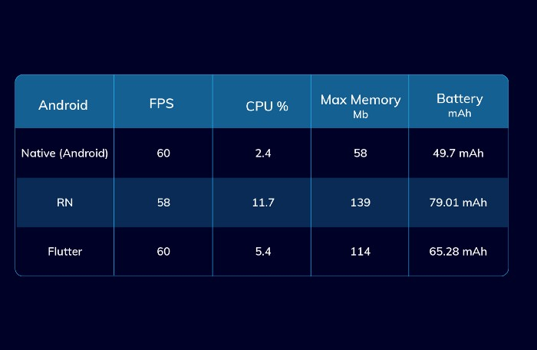
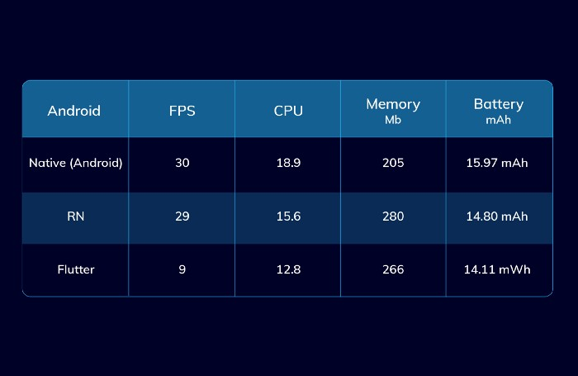
For Loading and Caching Images
For Heavy Animation

Slide 15
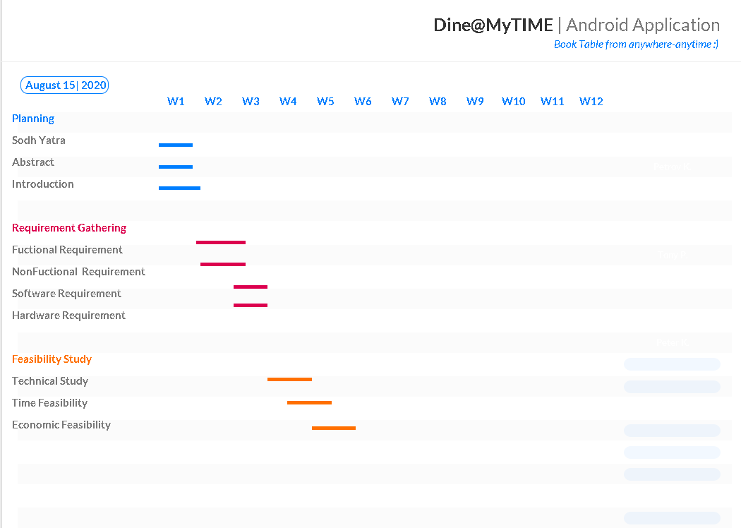
Time Feasibility

Slide 16
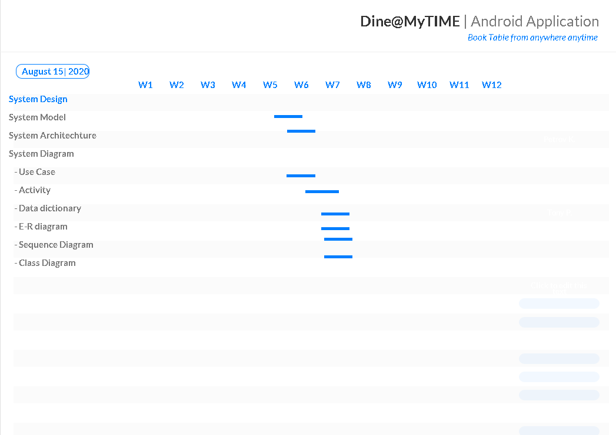

Slide 17
Economic feasibility
This assessment typically involves a cost/benefits analysis of the project, helping the organization determine the viability, cost, and benefits associated with a project before financial resources are allocated. The proposed system economically feasible as it removes manual work, reduces the manual mistake, decreases the number of people working. Economic feasibility is the system where the users have economic to this system the agency has to provide the required software.

Slide 18
System Design

Slide 19
System Model
We are going to use “SPIRAL MODEL”.
Spiral model is one of the most important Software Development Life Cycle models, which provides support for Risk Handling.
Advantages of the Spiral Model
Best for a high-risk project
Good for large and mission-critical projects
Strong approval and documentation control
Continuous or repeated development helps in risk management Development is fast and features are added in a systematic approach
Additional functionality or change can be done at a later stage.
Cost estimation becomes easy as the prototype building happens in small fragments. There is always space for Customer feedback.

Slide 20
System Model
Why we chose Spiral Model?
Ø This model strengthens risk management.
Ø This model uses a software iteration an approach that is extremely useful in the software development stages.
Ø This model can combine other methods such as waterfall and incremental methods.
Ø Assume that a project with little risk does not fulfill the user needs and on the other hand, that there is a high the risk that the waterfall approach will be adopted so that this model will avoid risk, get a solution quickly, and associations like the whole model to correct the a mistake in the previous stage, if any.
Ø Reviewing the previous phase can correct the errors and take care of the new requirement.

Slide 21
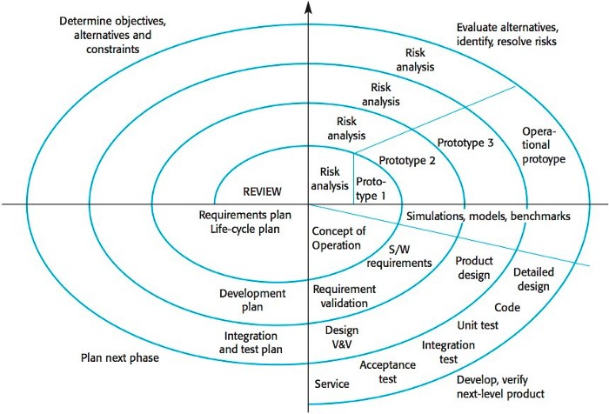

Slide 22
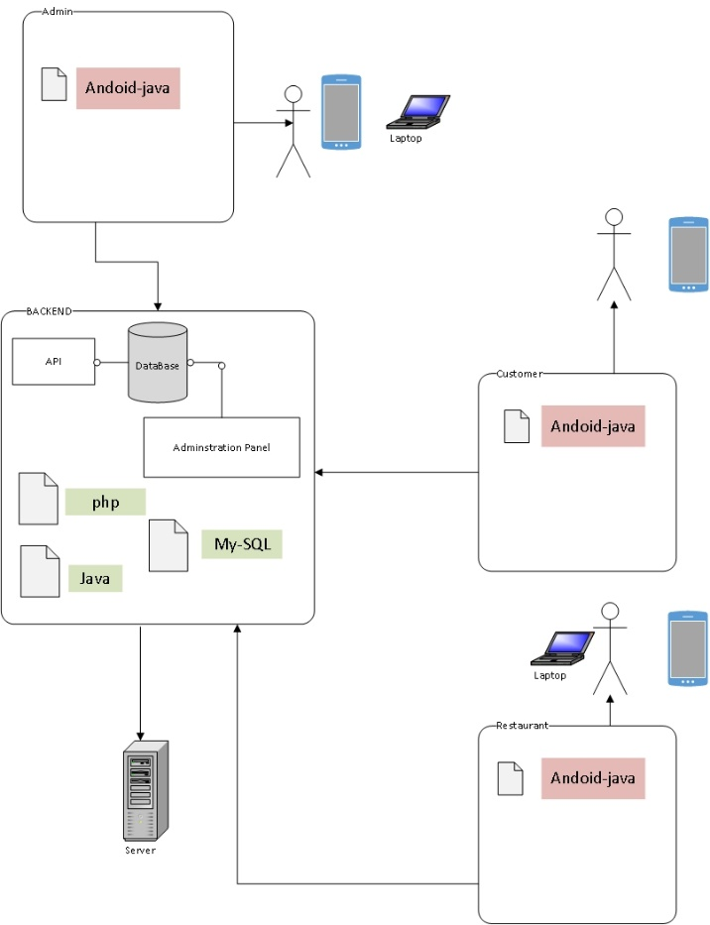
System Architecture

Slide 23
System Diagrams
We have made variety of diagrams based on our project and they are :
Use Case diagrams
Activity Diagrams
E-R Diagram
Sequence Diagrams
Class Diagram

Slide 24
USE CASES

Slide 25
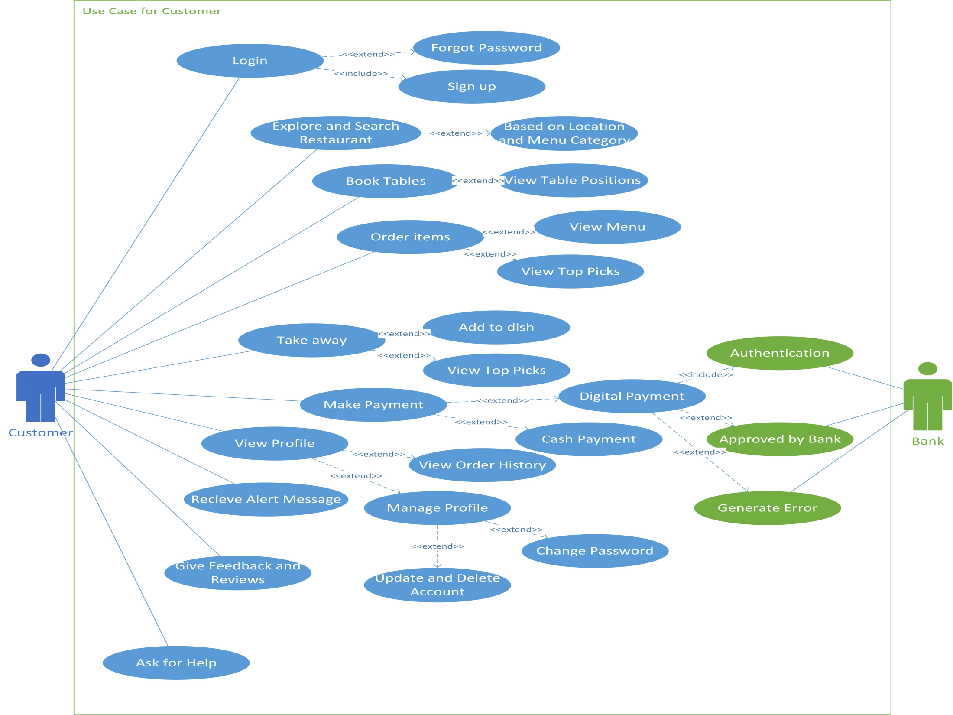

Slide 27
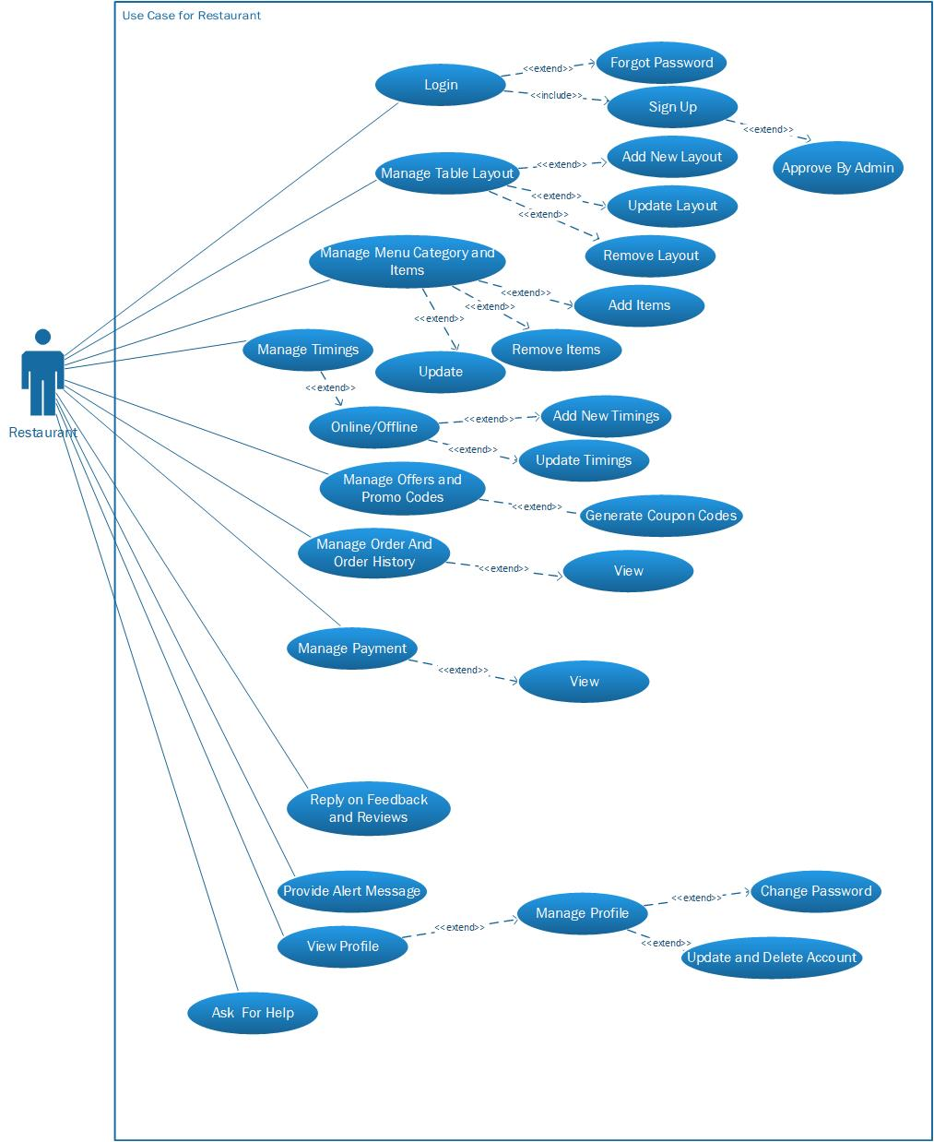

Slide 28
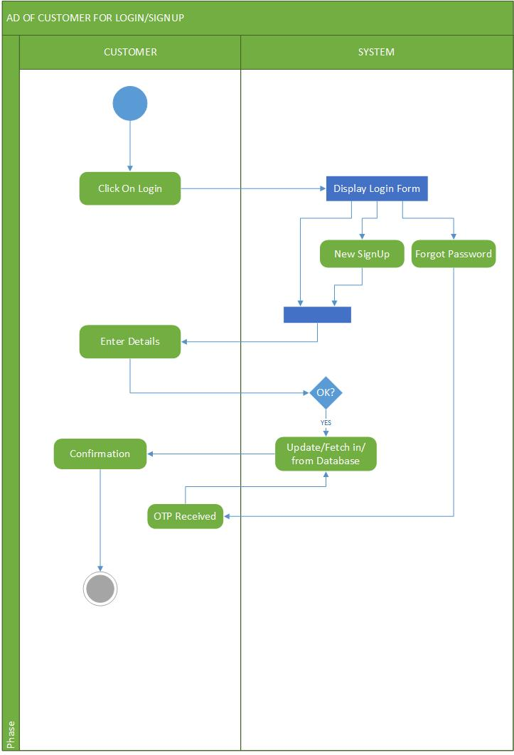
Activity Diagrams

Slide 29
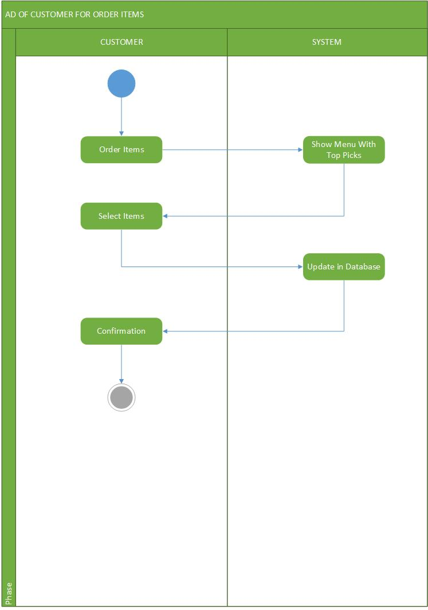

Slide 30
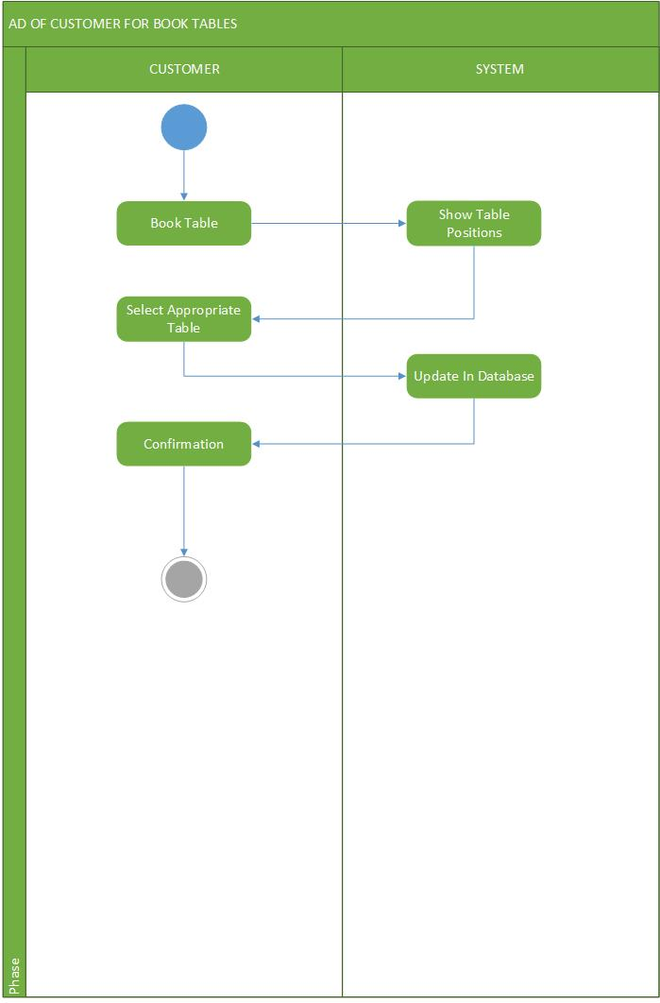

Slide 31
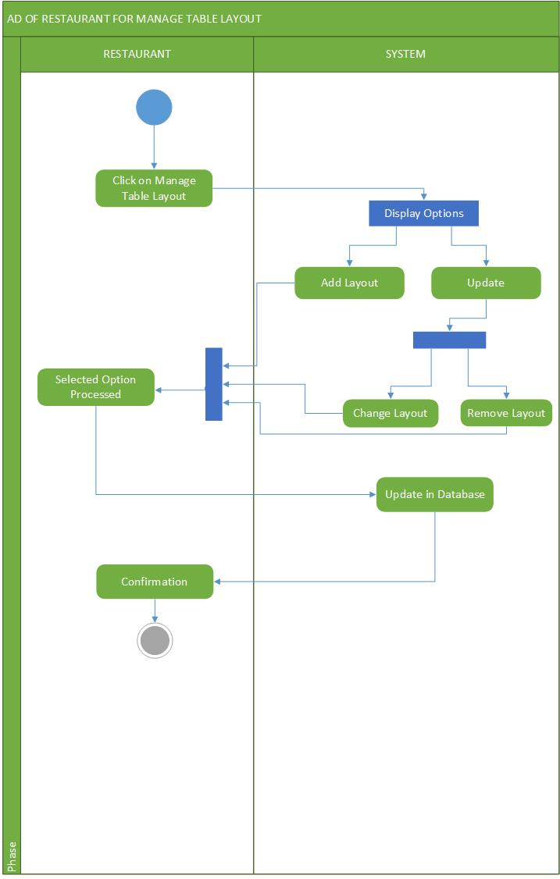

Slide 32
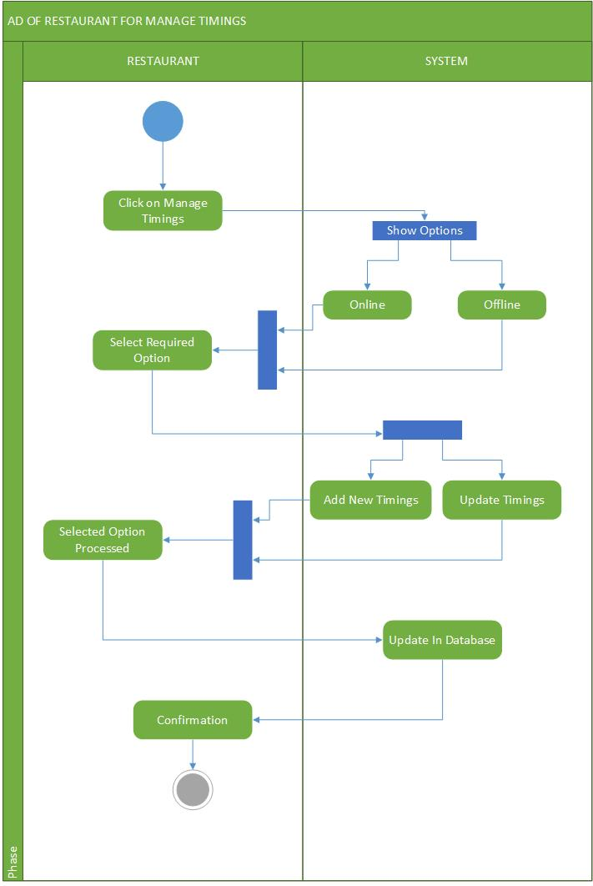

Slide 33
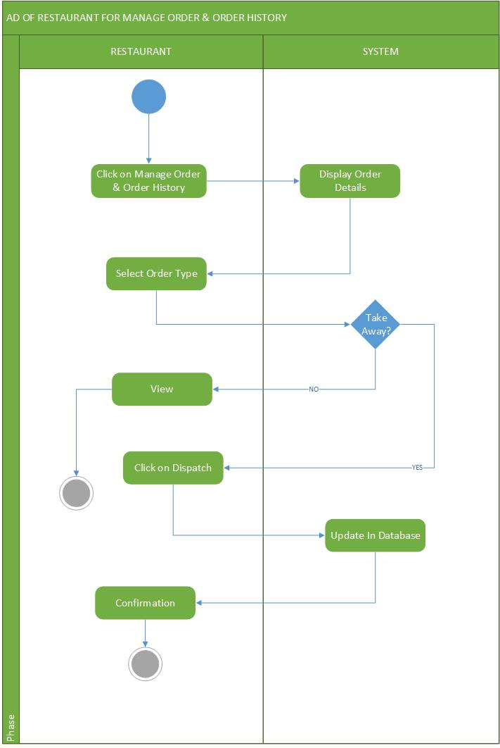

Slide 34
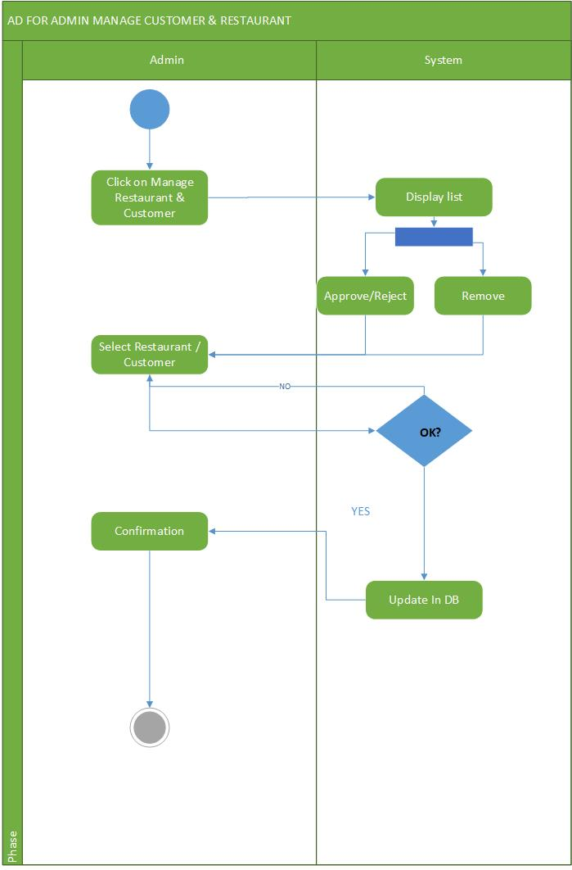

Slide 35
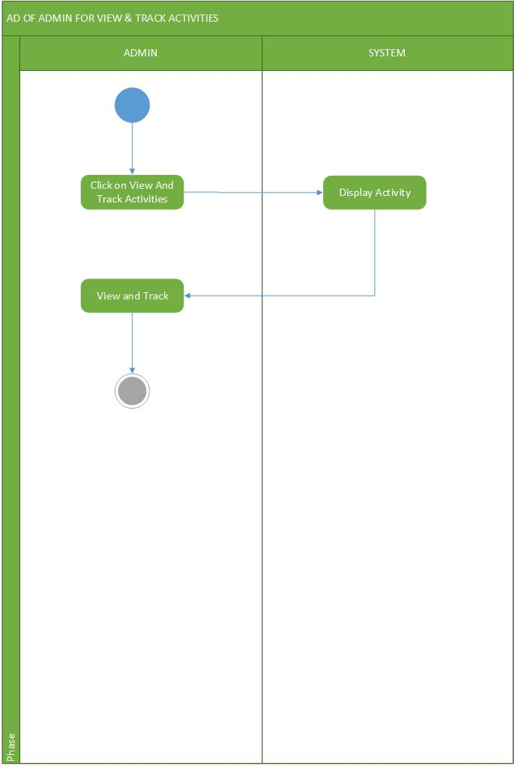

Slide 36
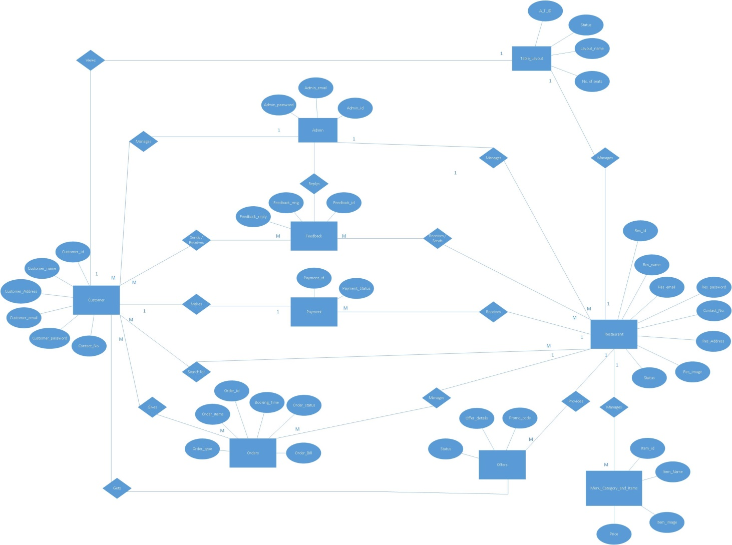
E-R Diagram

Slide 37


Slide 38
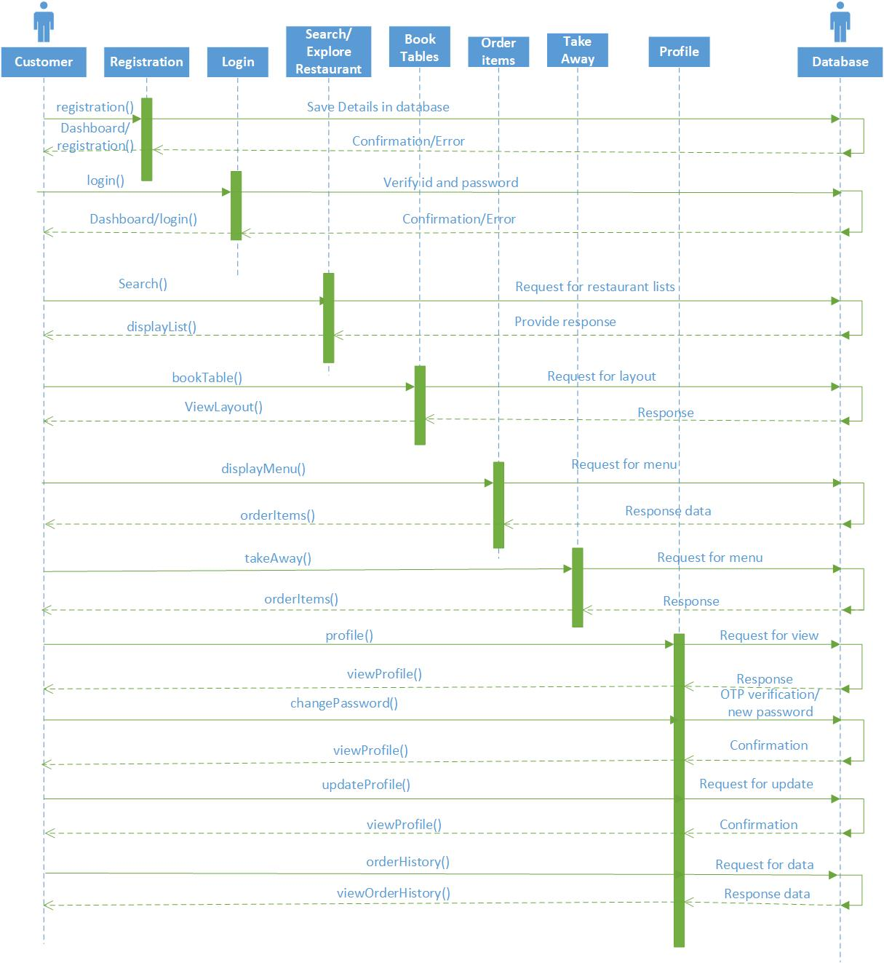
Sequence Diagrams

Slide 39
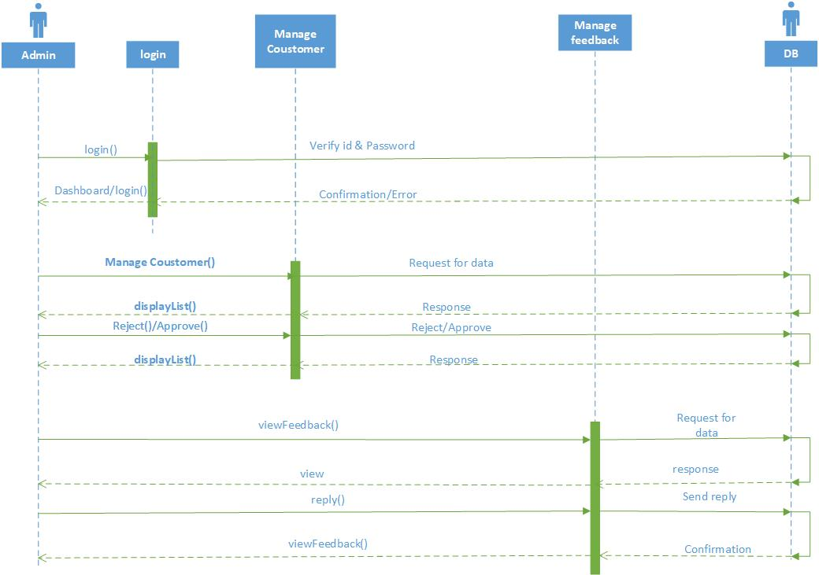

Slide 40
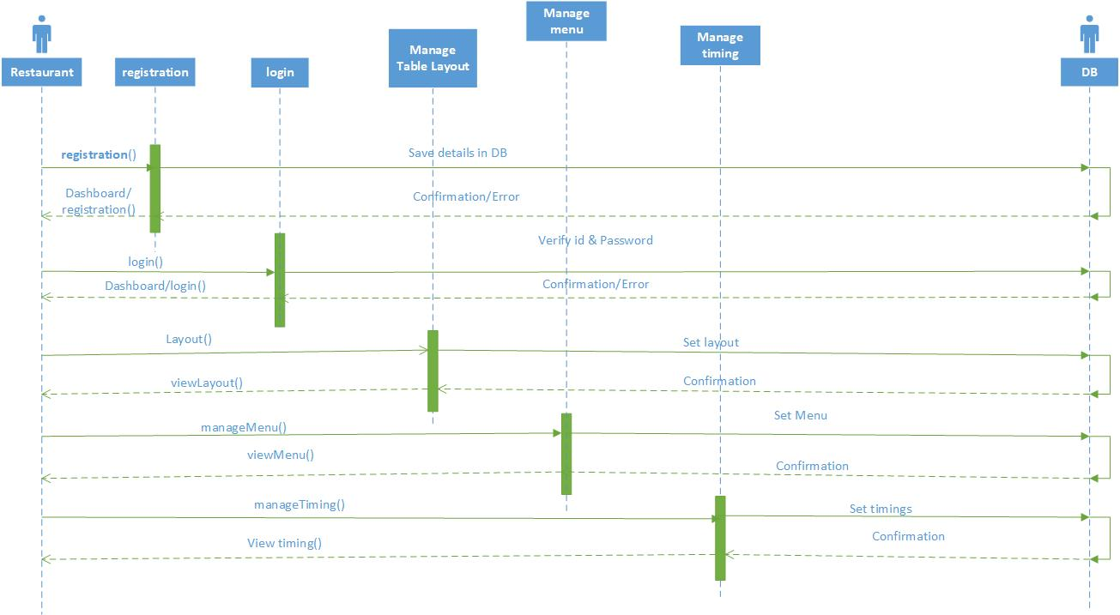

Slide 41
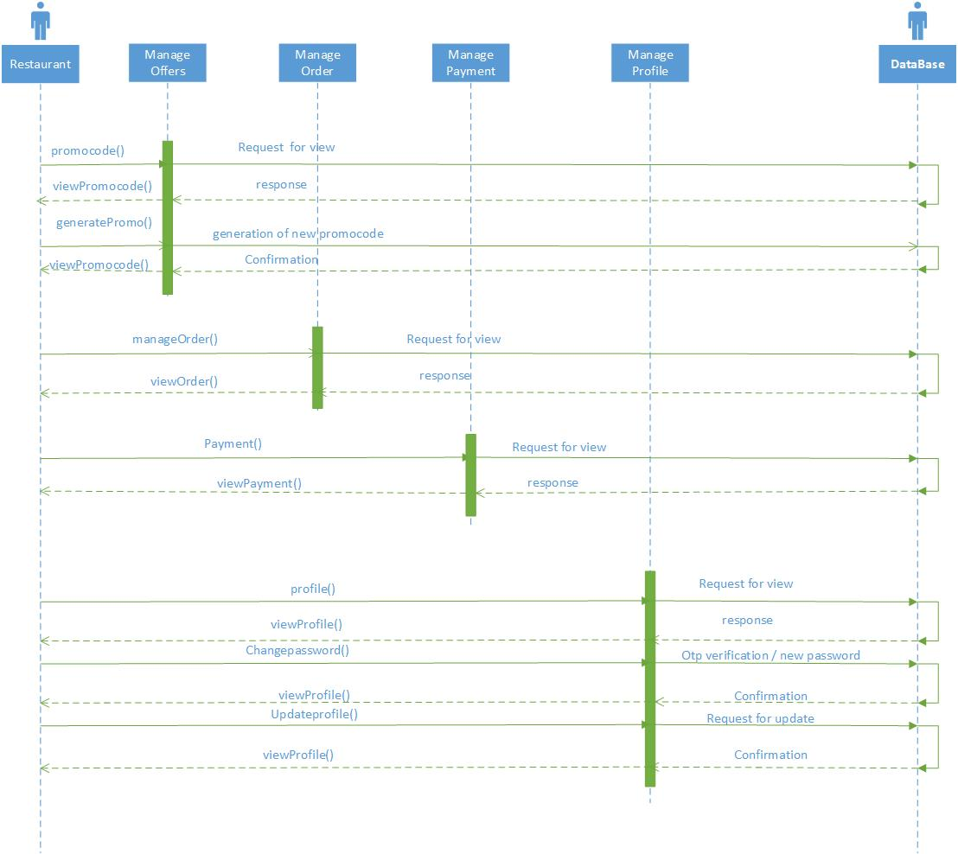

Slide 42
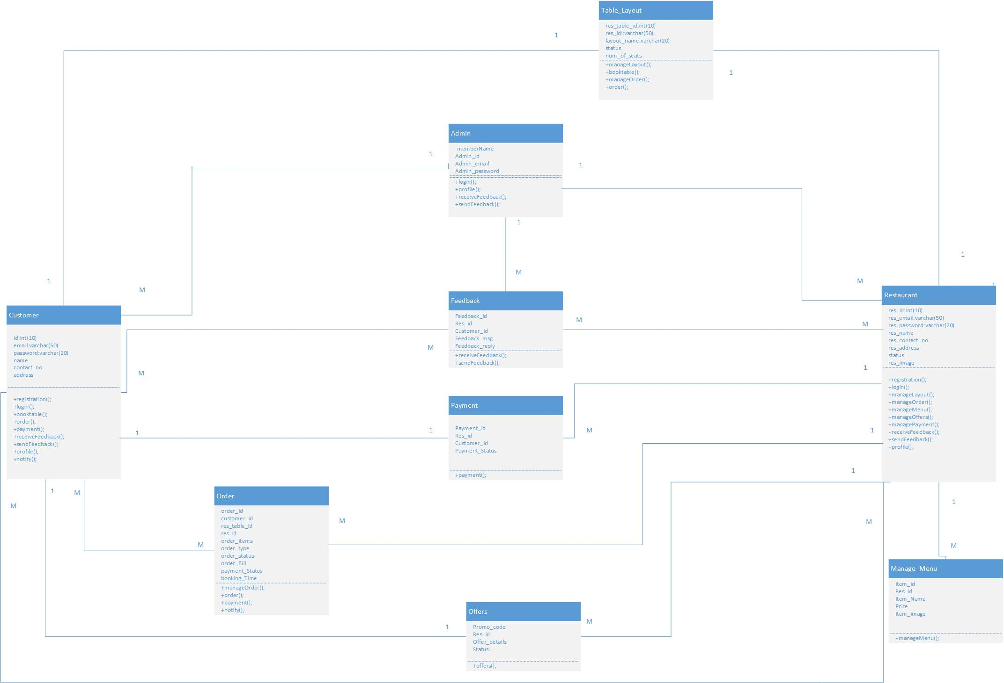
Class Diagram

Slide 43
Thank You

