Slide 1

Financial Performance Review
Financial Trends, Customer Segmentation, A/B Testing
Saabir J. Parvez

Slide 2






Agenda
1 Business Objective 2 Financial Overview
3 Customer Overview
4 Product Overview
5 RFM Analysis
6 A/B Testing

Slide 3
Business Objective
Challenge: The client from Quantium needs in-depth analysis to drive marketing strategy. They have collected transaction data for one year (250k+ records) and asked Quantium to provide actionable insights including customer segments and campaign testing.
Solution: Conducted in-depth data analysis on customer behavior, transaction KPIs and A/B testing for store layouts utilizing SQL and Python.
Analysis
Baseline metrics, MoM trend, store trend and product trend.
Analyzed customer distribution by Life-stage and Level
Data
Data Cleaning (duplications, missing values, outliers)
Feature Engineering: (brands, pack size)
A/B Testing
Test/Control stores selection (correlation, magnitude)
Run trial and assess uplift
Perform t-test
RFM Analysis
Calculated recency, frequency and monetary scores for each customer
Created 8 customer segments (Champions, Potential Loyalists, Promising, New, About to Sleep, At Risk, Cannot Lose, Hibernating)

Slide 4
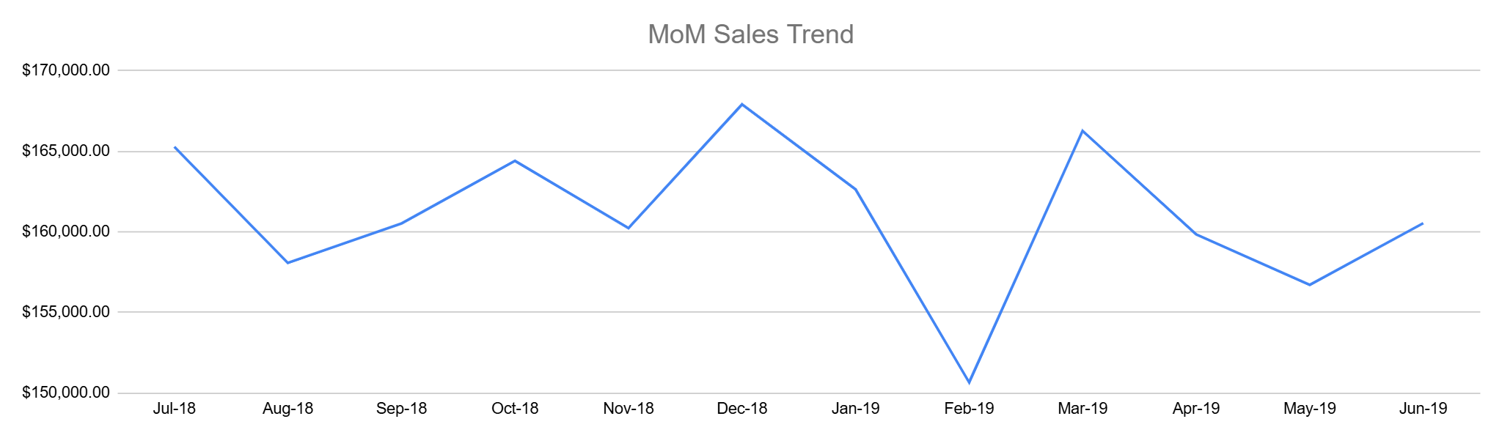
Financial Overview
Monthly sales trend is stable, with an average sales of $161,000/month.
There appears to be a seasonal trend with sales peaking in December around the holiday season and sales were lowest in February.
Annual Revenue was $1,933,109 with 504,722 total units sold and the avg price per bag as $3.83.
Average transaction amounts: $7.3 with 1.9 bags sold.
Average store had 973 transactions with average revenue as of $7,100 per store.
Total sales
MoM Sales Trend
Top performance month
Holiday seasonal impact
Low performance month after holiday seasons

Slide 5

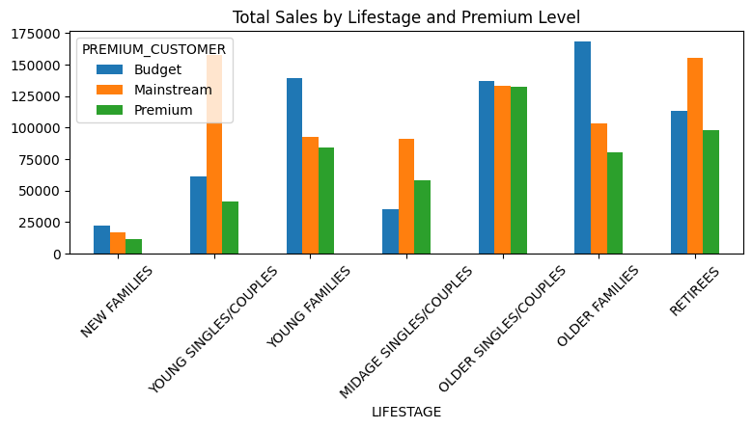

Customer Overview
Customer segmentation based on purchasing behavior and lifestage.
Behavior Segmentation:
Mainstream: Average customers with regular purchases
40% customers, $750K revenue
Budget: Cost sensitive customers
33% customers, $676K revenue
Premium: 26% customers, $506K revenue
Lifestage Segmentation:
Older Life Stages are the top contributors to revenue (53% contribution) but they spend less per transaction and have a lower count.
$7.31 AOV vs. $7.25 baseline
The Young lifestage has more mainstream buyers, are 11% of the population and spend the most per transaction ($7.52)
The young lifestage customers look promising in future revenue.
Tyrrells chips is their preferred brand among yough lifestage customers.

Slide 6
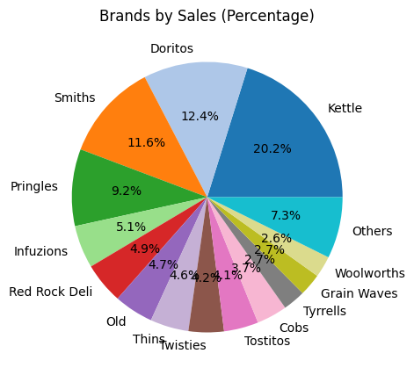
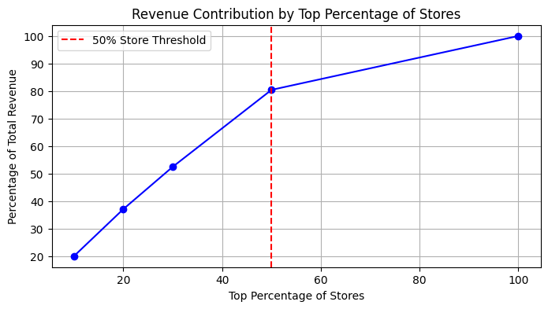
Product Overview
Top 4 brands make up 50%+ of revenue
Kettle is the most popular brand making $390K and 20% of the revenue.
Top 50% stores contribute 80% of revenue.
Significant performance difference between high and low performed stores
The avg revenue for a top 10 store is ~ $15,700 vs $24.6 for the bottom 10 stores.
Notes:
Avg top 10 store revenue v. bottom 10

Slide 7
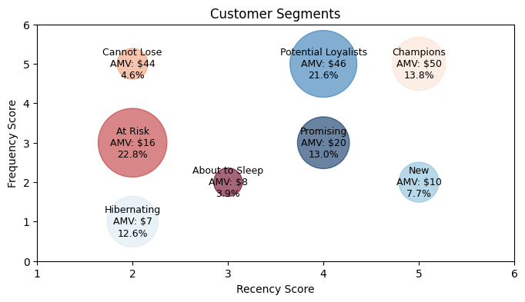
RFM Analysis
8 customer segments based on customers’ historical transaction patterns (recency, frequency, monetary)
36% of our customers are considered Champions or Potential Loyalists.
For Potential Loyalists the average recency is 53 days
Regular reminders or customer care messages could increase Potential Loyalists’ recency.
28% of our customers are categorized as Cannot Lose or At Risk.
Offering heavy discount coupons as incentive could retain Cannot Lose or At Risk customers
Segment | Count | Percentage | Recency (days) | Frequency (visits) | Monetary (spend)
Champions | 10,002 | 14% | 11 | 7 | $50
P. Loyalists | 15,693 | 22% | 53 | 7 | $46
Promising | 9,445 | 14% | 53 | 3 | $20
New | 5581 | 8% | 25 | 2 | $10
About to Sleep | 2860 | 4% | 81 | 2 | $8
Cannot Lose | 3359 | 5% | 149 | 6 | $44
At Risk | 16572 | 23% | 188 | 3 | $16
Hibernating | 9124 | 13% | 241 | 1 | $7

Slide 8
A/B Testing
Goal: Client wants to evaluate the revenue impact of new store layout using 3 trial stores. Analytics process include selecting matched control stores, calculating performance lift with statistial testing.
Testing period: Feb/2019 to Jun/2019
Testing and Control Stores:
Testing stores: 77, 86, 88
Control stores: 233, 155, 40
Analytics Process:
Control Stores Selection
For control store selection, created a similarity score by combining Pearson Correlation with a distance magnitude to identify the most similar control stores.
Success Metric
Null hypothesis is that new layout has no effect. Tested hypothesis on basis of revenue and customer count during the trial period to identify any changes.
Performance Evaluation
Used t-testing to assess statistical significance of results.

Slide 9
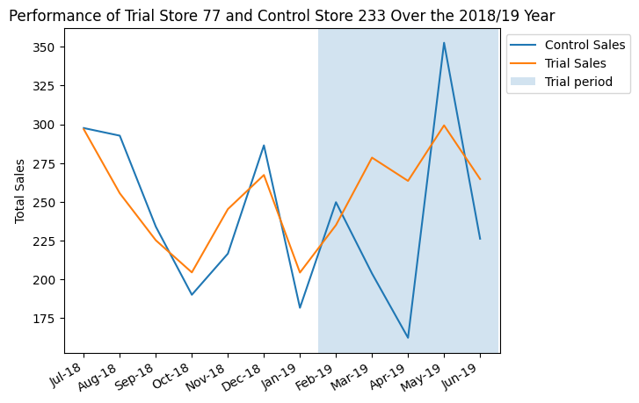
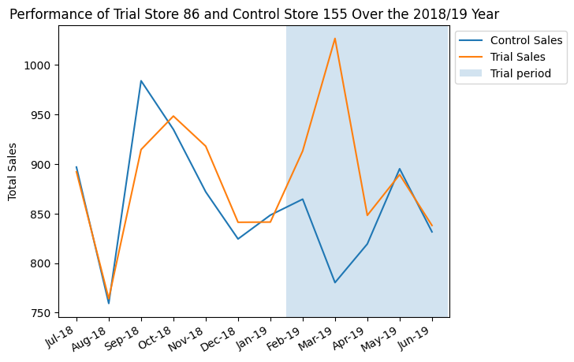
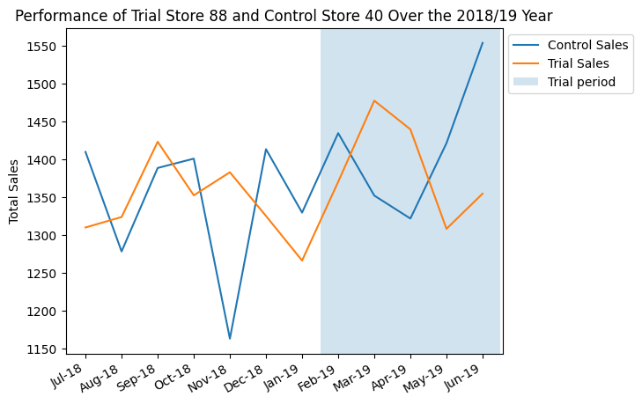
A/B Testing Results (Revenue)
Stores 77 and 86 showed great success with the new layout but store 88 had no significant changes.
For trial store 77 and control store 233, there is a statistically significant revenue increase in March (31%) and April (48%).
For trial store 86 and control store 155, there is a 27% revenue increase in March.
For trial store 88 and control store 40 there is no significant change.
The trial was more successful initially but the effect of new layout tapered off. We recommend shortening trial window for future testing.
Month | t-stat | p-value | % diff
201902 | -0.7171 | 0.5003 | -6%
201903 | 3.0353 | 0.0229 | 31%
201904 | 4.7089 | 0.0033 | 48%
201905 | -1.754 | 0.13 | -16%
201906 | 1.4866 | 0.1877 | 16%
Month | t-stat | p-value | % diff
201902 | 1.4134 | 0.2073 | 5%
201903 | 7.1231 | 0.0004 | 27%
201904 | 0.8864 | 0.4095 | 3%
201905 | -0.1947 | 0.852 | -1%
201906 | 0.1818 | 0.8617 | 1%
Month | t-stat | p-value | % diff
201902 | -0.5482 | 0.6034 | -4%
201903 | 1.009 | 0.3519 | 8%
201904 | 0.971 | 0.369 | 8%
201905 | -0.9769 | 0.3663 | -8%
201906 | -1.6027 | 0.1601 | -13%

Slide 10
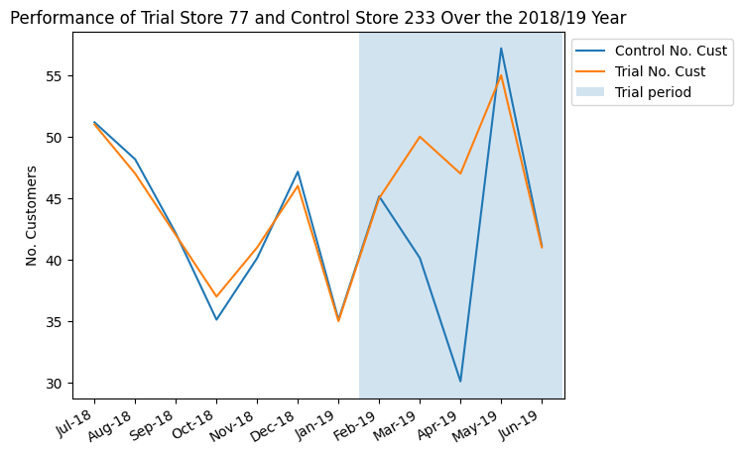
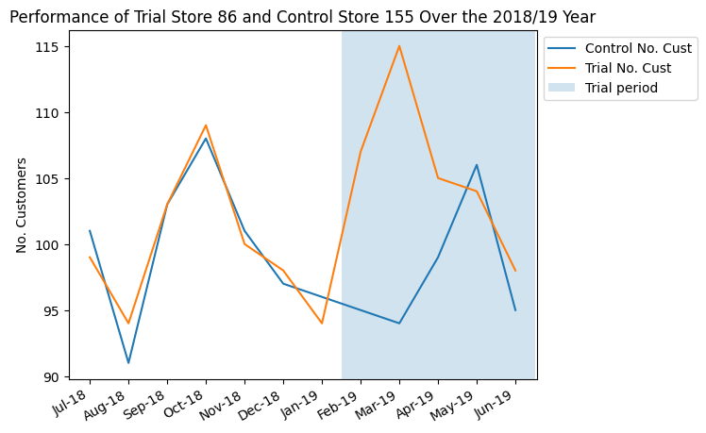
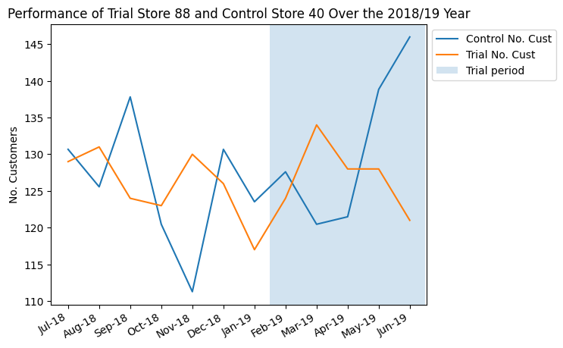
A/B Testing Results (Customer count)
Stores 77 and 86 showed great success with the new layout but store 88 had no significant changes.
For trial store 77 and control store 233, there is a statistically significant customer increase in March (21%) and April (43%).
For trial store 86 and control store 155, there is a statistically significant customer increase in February (12%), March (20%) and April (6%).
For trial store 88 and control store 40 there is no significant change.
Month | t-stat | p-value | % diff
201902 | -0.1988 | 0.8489 | -0.3%
201903 | 8.009 | 0.0002 | 21%
201904 | 16.114 | 0.00000363 | 43%
201905 | -1.5177 | 0.1799 | -3%
201906 | -0.1988 | 0.8489 | 0%
Month | t-stat | p-value | % diff
201902 | 6.2205 | 0.0008 | 12%
201903 | 10.526 | 4.32E-05 | 20%
201904 | 3.0764 | 0.0218 | 6%
201905 | -1.0051 | 0.3536 | -1%
201906 | 1.6227 | 0.1558 | 3%
Month | t-stat | p-value | % diff
201902 | -0.3593 | 0.7317 | -2%
201903 | 1.2575 | 0.2553 | 10%
201904 | 0.6093 | 0.5647 | 5%
201905 | -0.9882 | 0.3612 | -8%
201906 | -2.256 | 0.0649 | -18%

Slide 11
Appendix

Slide 12
RFM Analysis
Segment | Count | Monetary | Recency | Frequency | Percentage
Champions | 10002 | $50 | 11 | 7 | 14%
Potential Loyalists | 15693 | $46 | 53 | 7 | 22%
Promising | 9445 | $20 | 53 | 3 | 14%
New | 5581 | $10 | 25 | 2 | 8%
About to Sleep | 2860 | $8 | 81 | 2 | 4%
Cannot Lose | 3359 | $44 | 149 | 6 | 5%
At Risk | 16572 | $16 | 188 | 3 | 23%
Hibernating | 9124 | $7 | 241 | 1 | 13%

Slide 13
A/B Testing Results (Revenue)
For trial store 77 and control store 233, there is a statistically significant increase in March (31%) and April (48%).
Month | t-stat | p-value | % diff
201902 | -0.7171 | 0.5003 | -6%
201903 | 3.0353 | 0.0229 | 31%
201904 | 4.7089 | 0.0033 | 48%
201905 | -1.754 | 0.13 | -16%
201906 | 1.4866 | 0.1877 | 16%
95th percentile value: 1.9431802805153018
Notes:
Add appendix showing trial v control, t-test and p-value | SQL, python

Slide 14
A/B Testing Results (Revenue)
For trial store 86 and control store 155, there is a 27% increase in March.
Month | t-stat | p-value | % diff
201902 | 1.4134 | 0.2073 | 5%
201903 | 7.1231 | 0.0004 | 27%
201904 | 0.8864 | 0.4095 | 3%
201905 | -0.1947 | 0.852 | -1%
201906 | 0.1818 | 0.8617 | 1%
95th percentile value: 1.9431802805153018
Notes:
Add appendix showing trial v control, t-test and p-value | SQL, python

Slide 15
A/B Testing Results (Revenue)
For trial store 88 and control store 40
Month | t-stat | p-value | % diff
201902 | -0.5482 | 0.6034 | -4%
201903 | 1.009 | 0.3519 | 8%
201904 | 0.971 | 0.369 | 8%
201905 | -0.9769 | 0.3663 | -8%
201906 | -1.6027 | 0.1601 | -13%
95th percentile value: 1.9431802805153018

Slide 16
A/B Testing Results (Customer Count)
For trial store 77 and control store 233
Month | t-stat | p-value | % diff
201902 | -0.1988 | 0.8489 | -0.3%
201903 | 8.009 | 0.0002 | 21%
201904 | 16.114 | 0.00000363 | 43%
201905 | -1.5177 | 0.1799 | -3%
201906 | -0.1988 | 0.8489 | 0%
95th percentile value: 1.9431802805153018

Slide 17
A/B Testing Results (Customer Count)
For trial store 86 and control store 155
Month | t-stat | p-value | % diff
201902 | 6.2205 | 0.0008 | 12%
201903 | 10.526 | 4.32E-05 | 20%
201904 | 3.0764 | 0.0218 | 6%
201905 | -1.0051 | 0.3536 | -1%
201906 | 1.6227 | 0.1558 | 3%
95th percentile value: 1.9431802805153018

Slide 18
A/B Testing Results (Customer Count)
For trial store 88 and control store 40
Month | t-stat | p-value | % diff
201902 | -0.3593 | 0.7317 | -2%
201903 | 1.2575 | 0.2553 | 10%
201904 | 0.6093 | 0.5647 | 5%
201905 | -0.9882 | 0.3612 | -8%
201906 | -2.256 | 0.0649 | -18%
95th percentile value: 1.9431802805153018

