Slide 1

Business background and benefits
首先，MBS系统基础架构环境GuestOS,IBM MQ,IBM WAS软件原厂不再提供维护技术支持,并且不再符合企业信息安全要求。其次，持续优化企业端E-client,实现技术可持续更新迭代，并实现服务化部署。此外，用户需求实现新的企业MBS服务接入模式，简化企业之间对接流程，提升效率并降低客户企业对接成本。
First of all, the original MBS system infrastructure environment GuestOS, IBM MQ, and IBM WAS software no longer provide maintenance technical support, and no longer meet enterprise information security requirements. Secondly, continue to optimize the enterprise-side E-client to achieve sustainable technology updates and service-oriented deployment. In addition, users need to implement new enterprise MBS service access models, simplify the docking process between enterprises, improve efficiency and reduce customer enterprise access costs.

Slide 2
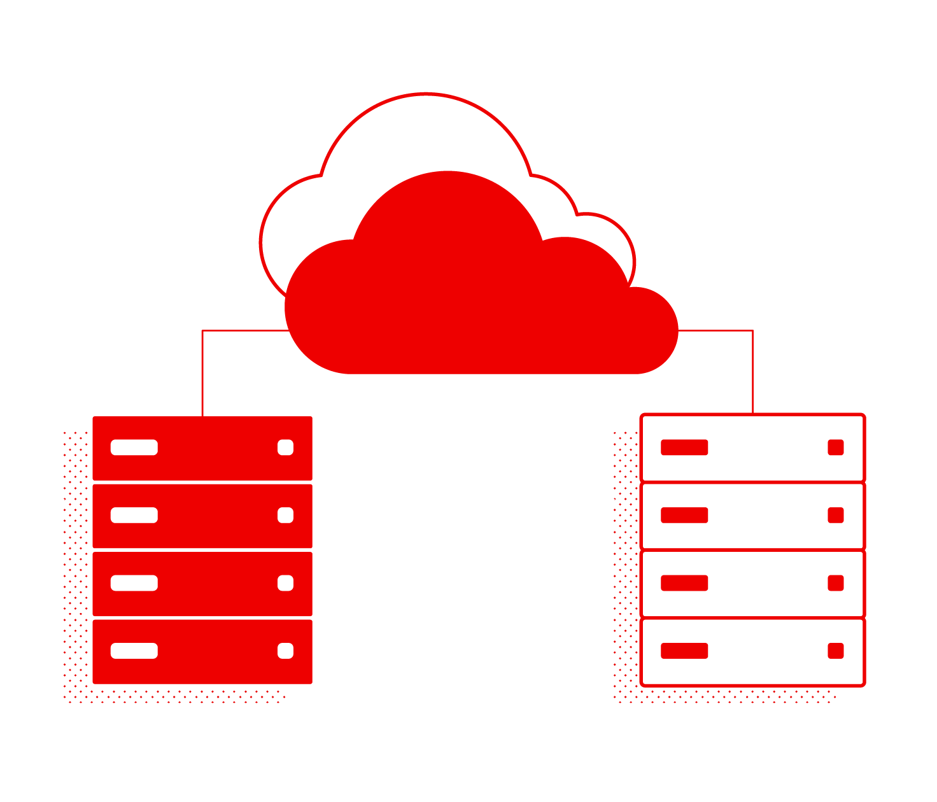
Benefits of cloud architecture
首先，它可以为企业提供灵活性和可扩展性。云计算平台允许根据需要增加或减少计算资源，使企业能够快速适应变化的业务需求。其次，上云可以提高数据的安全性。云服务提供商通常具备丰富的安全措施，包括数据加密和访问控制，使得企业的数据更加安全可靠。此外，上云还可以减少企业的IT管理成本。云服务商可以负责维护和升级基础设施，企业只需要支付使用的资源，无需投资大量资金购买和维护自己的服务器和软件。
First, it can provide flexibility and scalability for businesses. Cloud computing platforms allow computing resources to be increased or decreased as needed, allowing businesses to quickly adapt to changing business needs. Second, going to the cloud can improve data security. Cloud service providers often have a wealth of security measures, including data encryption and access control, to make the enterprise's data more secure and reliable. In addition, migrating to the cloud can also reduce the IT management costs of enterprises. Cloud service providers can be responsible for maintaining and upgrading infrastructure, and enterprises only need to pay for the resources used

Slide 3
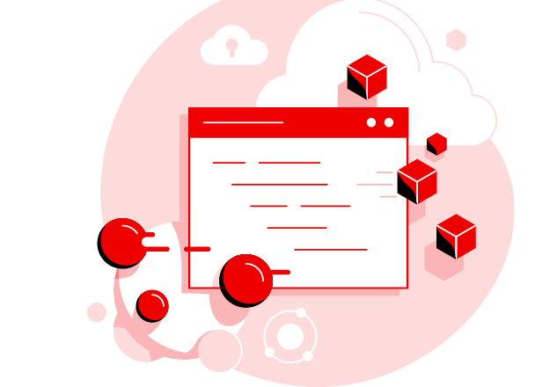
Cost effective
上云服务的成本效益体现在多个方面，主要是因为上云能够减少企业在IT基础设施上的投资与运维开销。采用云服务，企业通常只需为实际使用的服务和资源付费。
首先，企业无需进行硬件投资，减少了对IT设备的初始投资。其次，由云服务提供商负责系统的维护和升级，因此企业可以节省在这些方面的人力成本。再者，云服务的能源利用效率通常高于传统数据中心，从而能够减少电力消耗，实现绿色环保
The cost-effectiveness of cloud services is reflected in many aspects, mainly because cloud migration can reduce the investment and operation and maintenance overhead of enterprises in IT infrastructure. With cloud services, companies typically only pay for the services and resources they actually use.
First, there is no need for companies to make hardware investments, reducing the initial investment in IT equipment. Second, the cloud service provider is responsible for the maintenance and upgrade of the system, so enterprises can save on labor costs in these areas. In addition, cloud services are often more energy-efficient than traditional data centers, reducing power consumption and making them greener.

