Slide 1
Retrieval-Augmented Generation (RAG)
Enhancing Large Language Models with External Knowledge

Slide 2
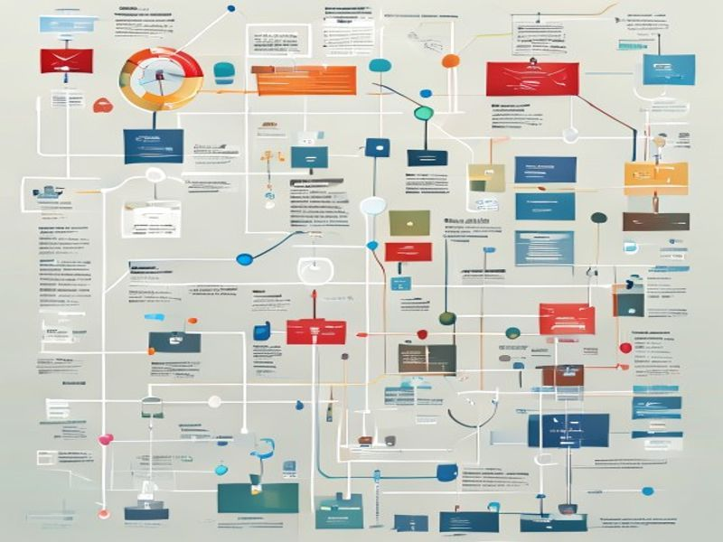
What is RAG?
• Combines retrieval with generation.
• Accesses external knowledge sources.
• Improves factual accuracy.
• Reduces model hallucinations.

Slide 3
How RAG Works
• User query is processed.
• Relevant documents are retrieved.
• Retrieved context augments the prompt.
• LLM generates response with context.

Slide 4
Benefits of RAG
• Up-to-date information access.
• Domain-specific knowledge integration.
• Enhanced response relevance.
• Increased user trust and confidence.

Slide 5
Applications of RAG
• Customer support chatbots.
• Internal knowledge base search.
• Content creation assistance.
• Research and analysis tools.

Slide 6
The Future of RAG
• More sophisticated retrieval methods.
• Real-time knowledge updates.
• Personalized information access.
• Deeper integration into workflows.

