Slide 1

SMART INDIA HACKATHON 2026
OceanSight
Seeing 1000 m beneath the ocean surface — from satellites alone
Problem Statement ID – SIH26066
Problem Statement Title – OceanEmbed – Satellite Embedding-Based Deep Learning Framework for Reconstruction of Subsurface Ocean Temperature from Surface Satellite Observations
Theme – Space Technology
PS Category – Software
Team ID – 135494
Team Name (Registered on portal) – CodeCrafters

Slide 2

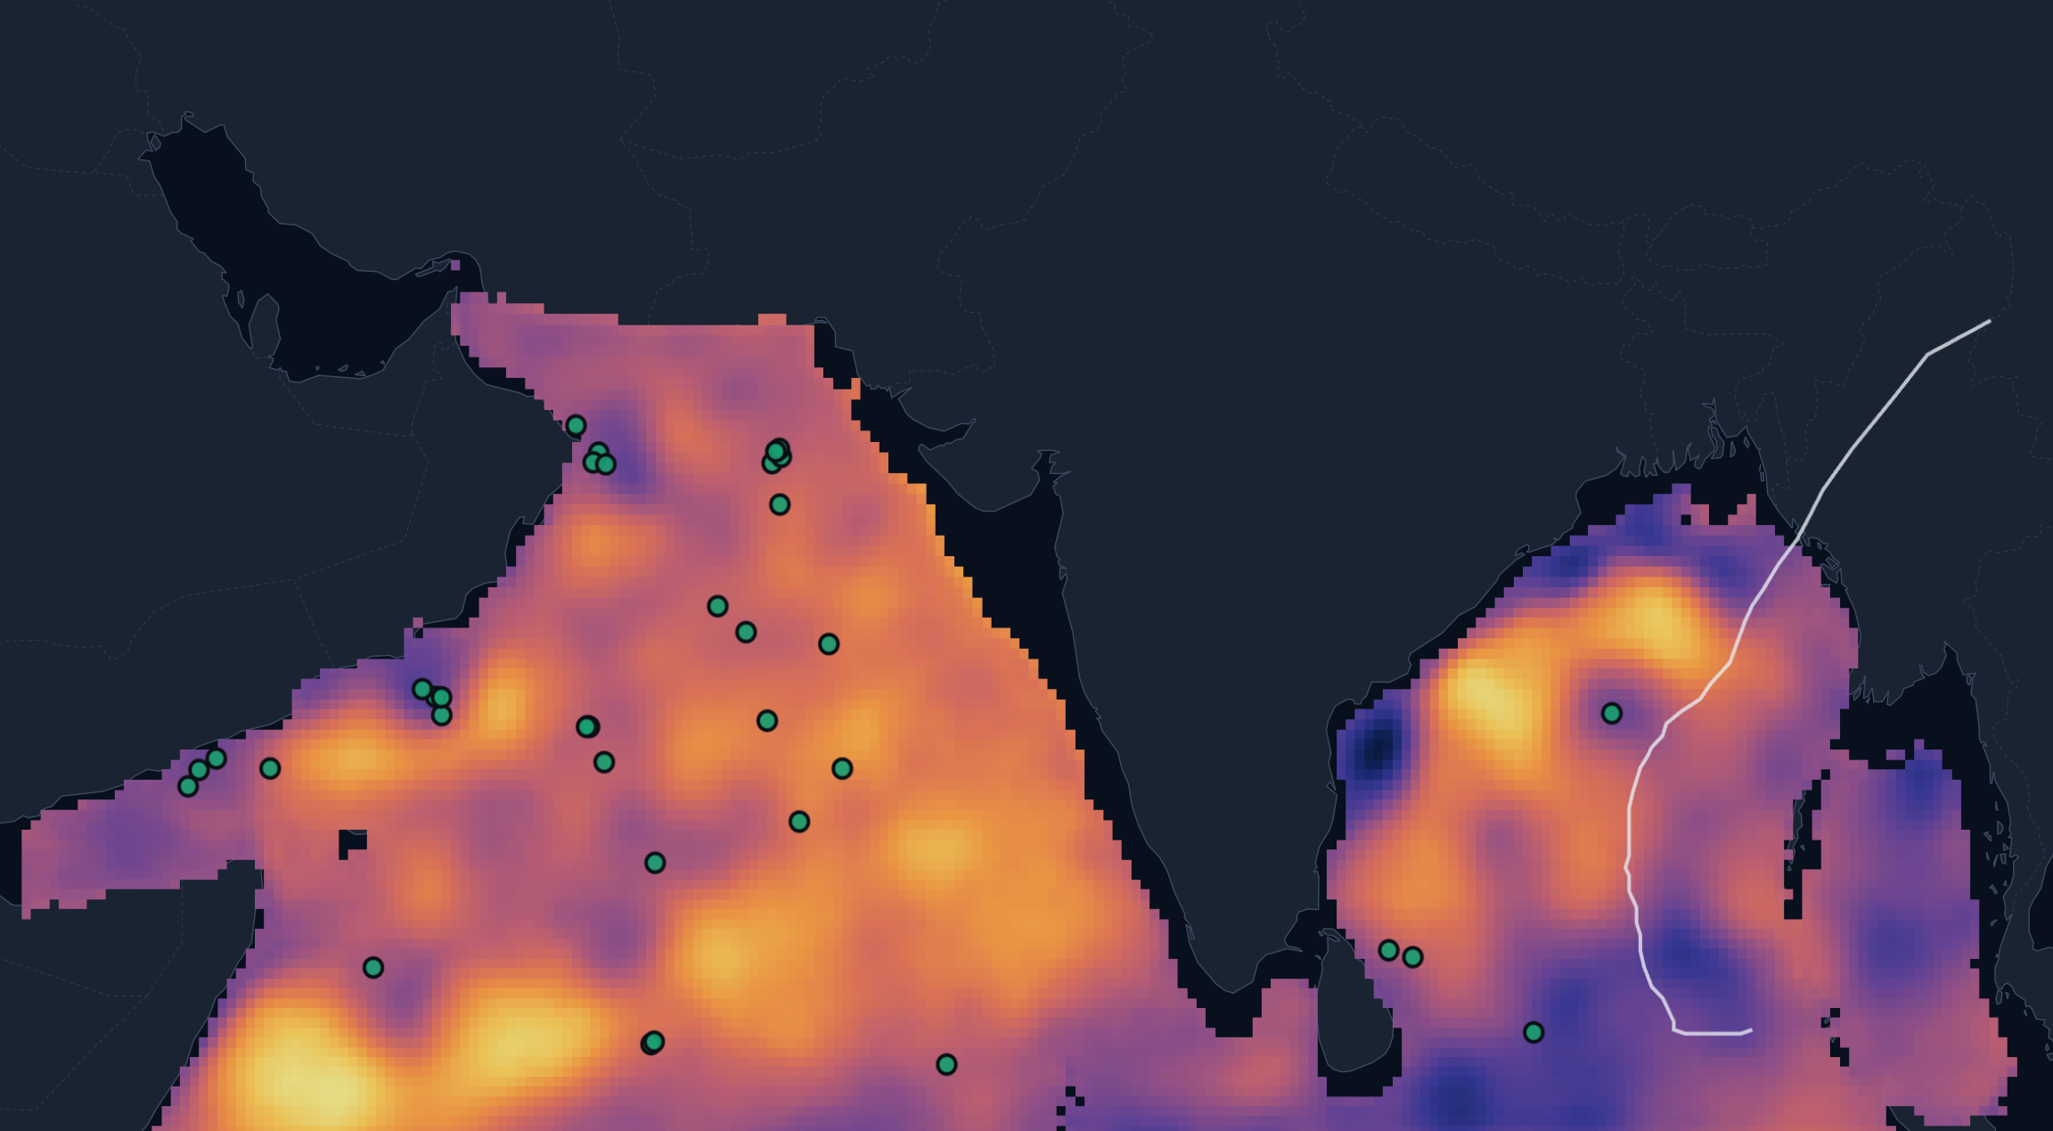











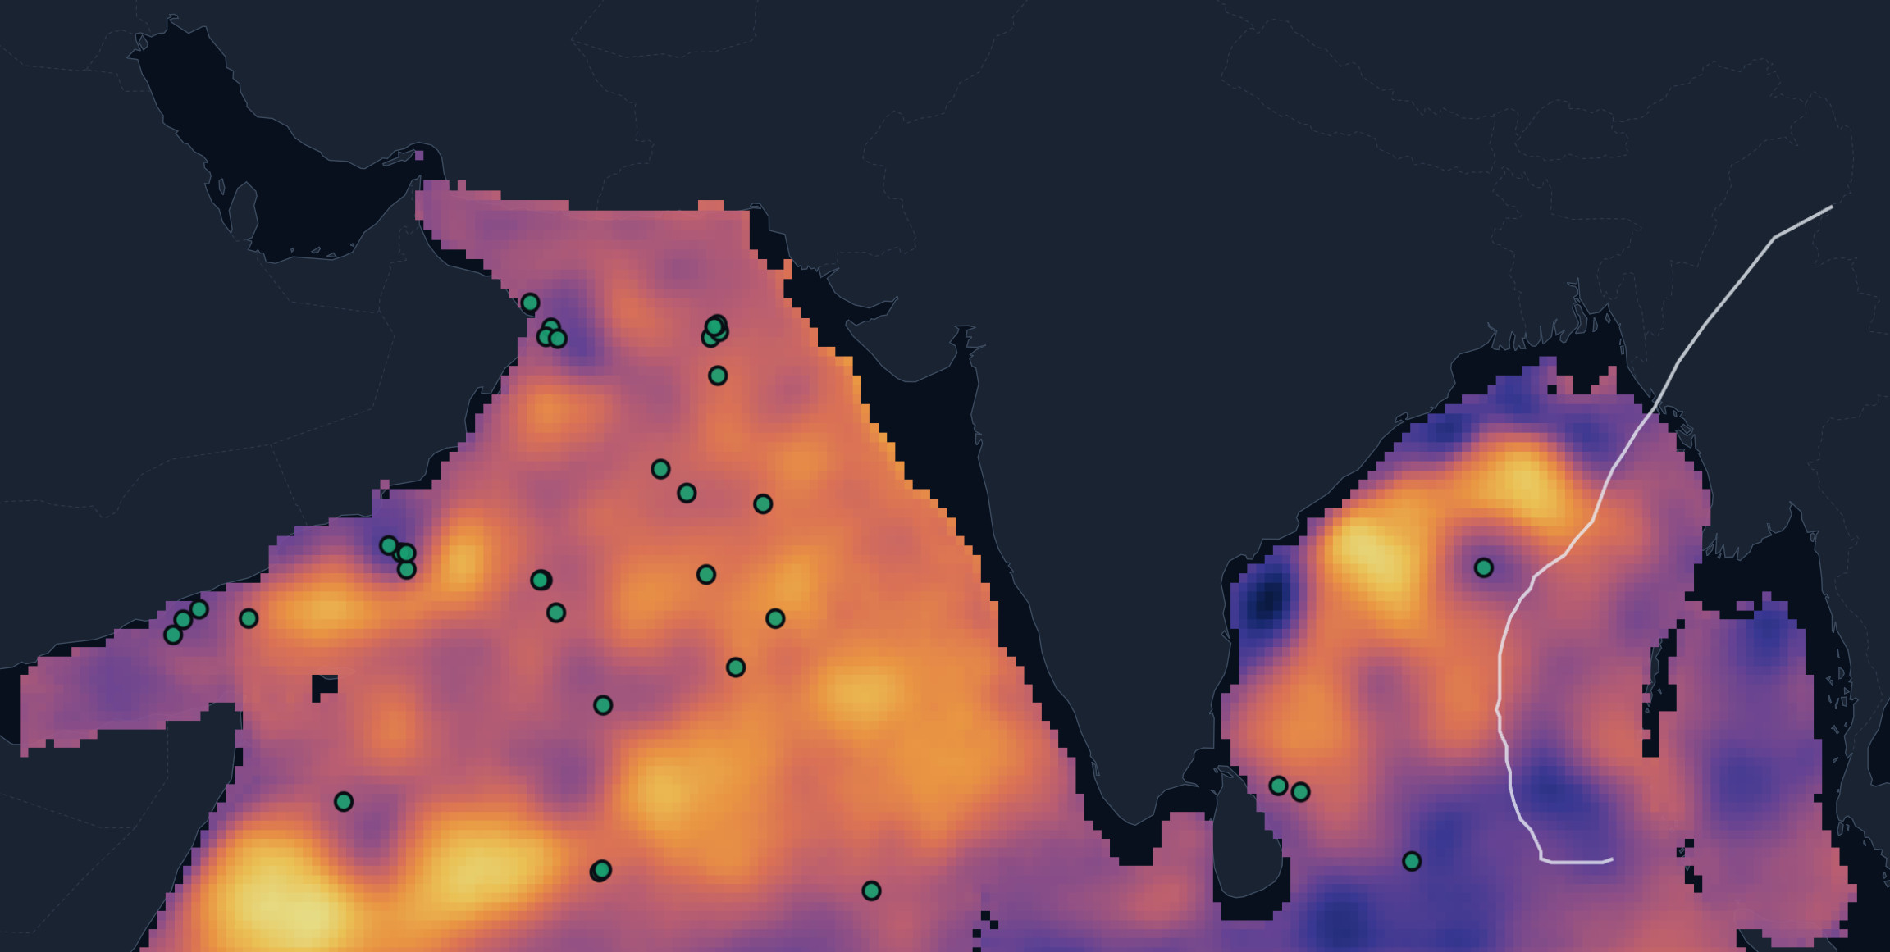
OceanSight
Daily 0–1000 m ocean temperature for the North Indian Ocean — from satellites alone
CodeCrafters
Proposed Solution Detailed explanation of the proposed solution
OceanSight reconstructs ocean temperature at 15 depths (0–1000 m), every day, on a 0.25° grid over the Bay of Bengal & Arabian Sea — using only 5 satellite surface fields — and turns it into cyclone-heat and mixed-layer products for ocean analysts and forecasters.
How it addresses the problem
THE GAP
Floats, buoys & ships sample the subsurface only at scattered points and times
OCEANSIGHT
Satellites see the whole basin daily; a deep network learns the physical surface → subsurface link (e.g. sea-level anomaly → thermocline depth)
Working prototype: reconstructed temperature at 100 m on 11 May 2023 (held-out year) — dark purple ≈ 17 °C to yellow ≈ 28 °C; green dots = Argo floats; white line = Cyclone Mocha track (IBTrACS)
Satellite inputs
Harmonise
Satellite embedding
Reconstruct
Derive
Deliver
SST · SSS · SLA ·
currents · winds
QC + regrid to
0.25°, daily
U-Net encoder
compresses the basin
15 depths, 0–1000 m
+ uncertainty
TCHP · MLD ·
D20 · D26
GIS dashboard ·
API · reports
INNOVATION AND UNIQUENESS OF THE SOLUTION — why OceanSight is different
USP 01
USP 02
USP 03
Validated beyond training data
Calibrated to the real ocean
Reconstruction → decisions
Scored against real Argo floats from a year it never saw — next to the training product's own error ceiling and an independent EN4 cross-check.
Every profile carries an error bar calibrated on 2022 floats that holds on 2023 — analysts can see when not to trust a value.
Daily cyclone heat potential, mixed-layer and isotherm depths at 0.25°, replayed on real IBTrACS cyclone tracks.
2,639 held-out Argo profiles (2023)
70% of Argo values within ±1σ (ideal 68%)
TCHP · MLD D20 · D26 — every day, 2019–2023
Satellite surface fields → validated, uncertainty-aware 3-D ocean temperature → INCOIS decision products

Slide 3
















TECHNICAL APPROACH
CodeCrafters
Technologies to be used
Methodology and process for implementation
Satellite data
NOAA OISST (SST) · SMAP + SMOS (SSS) · NOAA altimetry (SLA, currents) · NCEI Seawinds
1
2
3
4
5
6
Satellite data
Harmonise
Features
U-Net model
Validate
Serve
Target & validation
HYCOM 1/12° analysis (GLORYS adapter built) · Argo via argopy · Met Office EN4
5 fields · 1,826 days
(2019–2023)
QC · gap-fill ·
regrid to 0.25°
7 channels + lat/lon
+ season
embedding → 15 depths
+ uncertainty (σ)
held-out Argo · EN4
· σ calibration
Zarr + PostGIS +
FastAPI → GIS app
ML / AI
PyTorch U-Net (satellite embedding) · LightGBM baseline
Honest evaluation — split by whole years, never random days
2019
2020
2021
2022
2023
Data engineering
Python · xarray · Zarr (daily cubes) · NumPy regridding
TRAIN — model fitting, normalisation, climatology
VALIDATE — early stop
TEST — fully held out
Models, compared side by side — the deep model has to earn its place
Geospatial / DB
PostgreSQL + PostGIS (spatial indexes, nearest-float queries)
Seasonal climatology
harmonic fit per cell & depth — the floor to beat
LightGBM
one model per depth — fast, interpretable baseline
U-Net encoder–decoder
bottleneck = satellite embedding; 1.09 M parameters; mean + σ per depth
Backend
FastAPI — typed REST API, PDF/CSV reports
Frontend / GIS
Next.js · MapLibre GL · deck.gl · Recharts
VALIDATION — against the real ocean, not just the training data
15,018
2,639
per depth
EN4
Engineering
Docker · GitHub Actions CI · 44 automated tests · CPU-only
Argo profiles, QC flags 1/2
in the held-out 2023 test
RMSE · bias · r · skill vs climatology
independent Met Office cross-check

Slide 4












FEASIBILITY AND VIABILITY
CodeCrafters
Analysis of the feasibility of the idea working prototype, validated on the held-out year 2023
2,639
0.89 °C
1.31 °C
70%
independent Argo profiles from 2023 — a year the model never trained on
mean temperature error (RMSE, 15 depths) vs 1.10 °C for climatology
error at 100 m (thermocline) vs 1.80 °C for climatology
of Argo values within ±1σ after calibration (ideal 68%; raw 41%)
FEASIBLE BECAUSE
Potential challenges and risks
Strategies for overcoming these challenges
Data
Every input, target and validation source used is open; Copernicus/ERA5 need only free sign-up
Training target (a reanalysis) assimilates Argo → validation not fully independent
Hold out a whole year; show the target product's own error as the ceiling (0.79 °C); cross-check against EN4
HIGH
Technical
Built and running end to end: ingestion → models → API → dashboard
Raw model uncertainty was over-confident (41% of values within ±1σ)
Per-depth calibration fitted on 2022 floats, verified on 2023 → 70% within ±1σ, 94% within ±2σ
HIGH
Compute
U-Net (1.09 M params) trained on a laptop CPU — no GPU
Satellite salinity is gappy; removing it showed no measurable change in skill
Merged SMAP + bias-corrected SMOS (absent days 209 → 1); re-test with Copernicus SSS
HIGH
Cost
No paid data or services used
GLORYS / Copernicus data need an account
Credentialed adapters already built — switching source is a config change, no code change
₹0
IMPLEMENTED
pipeline · models · validation · API · dashboard · Docker
Thermocline (20–150 m) is the hardest layer to reconstruct
Report error per depth, never one number; the uncertainty band widens where skill drops
PLANNED
hosted deployment · re-run on Copernicus/GLORYS with credentials

Slide 5





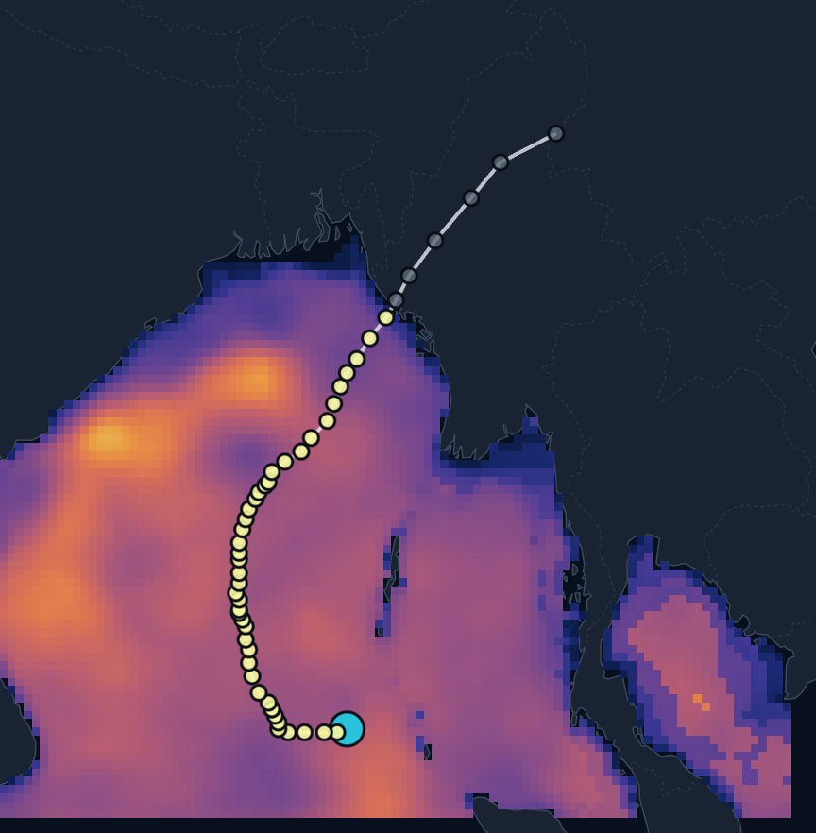
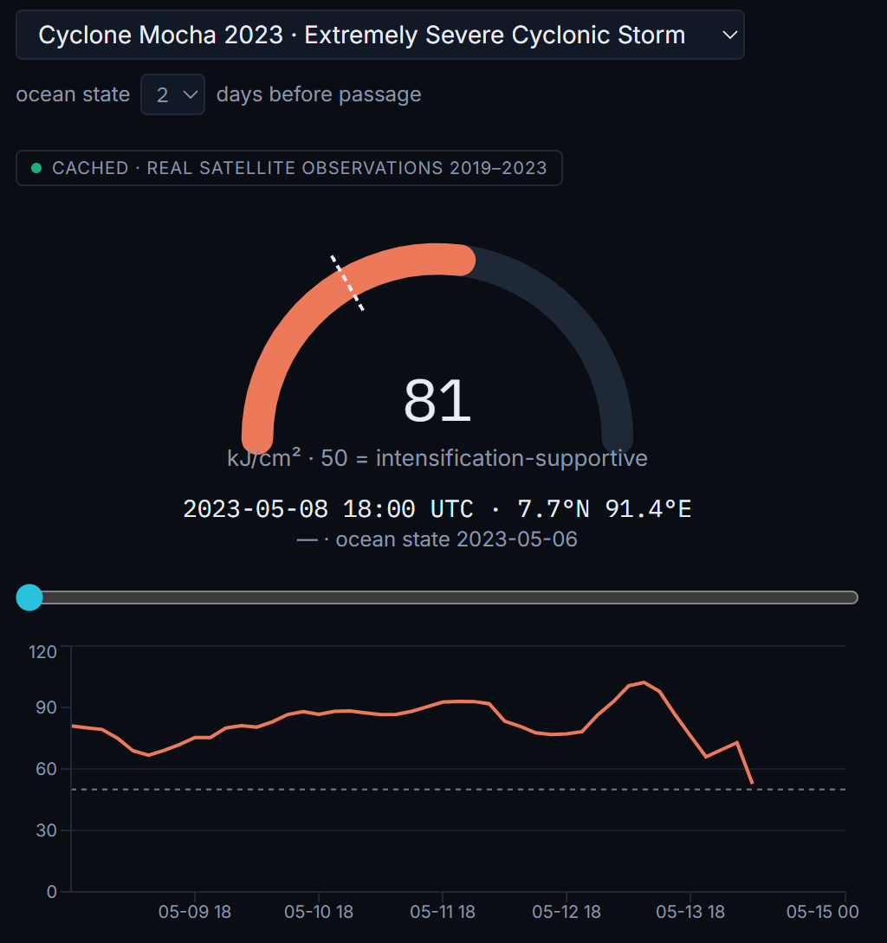








IMPACT AND BENEFITS
CodeCrafters
Potential impact on the target audience
Working prototype real event, held-out year
Ocean analysts &
forecasters
INCOIS-style
Cyclone
forecasters
heat available to storms
Fisheries-advisory
analysts
mixed layer & thermocline
Ocean
researchers
daily 3-D record
Decision support — not a replacement for operational ocean models
Benefits of the solution social · economic · environmental · operational
SOCIAL
ECONOMIC
Basin-wide cyclone heat potential (TCHP) and mixed-layer maps for every day and every 0.25° cell of the domain.
Built only on free satellite data; the model trains on a CPU; products are precomputed, so viewing needs no heavy compute.
Cyclone Fuel Gauge — reconstructed TCHP along Cyclone Mocha's real IBTrACS track (May 2023, ocean state 2 days before passage): 52.7–102 kJ/cm² over the ocean, above the 50 kJ/cm² level commonly linked to intensification. Prototype output, not an operational forecast.
ENVIRONMENTAL / CLIMATE
OPERATIONAL
A continuous daily record of upper-ocean heat and stratification for the North Indian Ocean (2019–2023).
Each profile ships with a calibrated error bar and the nearest independent Argo float — trust is visible, not assumed.
KEY OUTCOME
full-basin subsurface view · daily · 0–1000 m · with measured confidence
Click any cell
Argo overlay
Export
full 0–1000 m profile + σ
nearest independent float
PDF / CSV report per point

Slide 6


RESEARCH AND REFERENCES
CodeCrafters
Details / Links of the reference and research work
# | Reference | Organisation | What it supports | Link
1 | SIH26066 OceanEmbed problem statement | SIH · MoES / INCOIS | Scope, domain, 15 standard depths | sih.gov.in
2 | INCOIS Tropical Cyclone Heat Potential service | INCOIS | Operational relevance of TCHP | incois.gov.in/site/services/tchp.jsp
3 | GLORYS12V1 global ocean reanalysis (PS-named target) | Copernicus Marine | Training-target specification | doi.org/10.48670/moi-00021
4 | Argo float profiles via argopy | Argo programme · Euro-Argo | Independent validation | argopy.readthedocs.io
5 | NOAA OISST v2.1 · NCEI Blended Seawinds | NOAA NCEI | Satellite inputs used | ncei.noaa.gov
6 | EN4 quality-controlled ocean analysis | UK Met Office Hadley Centre | Independent cross-check | metoffice.gov.uk/hadobs/en4
7 | Bay of Bengal barrier layer (Vinayachandran et al., 2002) | JGR Oceans · AGU | Why salinity is an input | doi.org/10.1029/2001JC000831
8 | Subsurface temperature reconstruction, ConvLSTM vs LightGBM (2022) | MDPI Remote Sensing | Model choice; thermocline is hardest | doi.org/10.3390/rs14133198
9 | IBTrACS v04r01 best-track archive | NOAA NCEI | Real cyclone tracks | ncei.noaa.gov/products/ international-best-track-archive
Prototype source code & full research artifact: github.com/saad-46/oceanembed · all reported metrics are generated by the pipeline (docs/RESULTS.md)

