Slide 1

Trigonometry for : A Journey into Angles and Ratios

Slide 2
Introduction to Trigonometry
What is Trigonometry?
Ancient Origins
Trigonometry is a branch of mathematics that studies the relationships between the sides and angles of triangles, particularly right triangles.
Trigonometry has roots in ancient civilizations like the Babylonians and Egyptians, who used it for surveying, astronomy, and architectural calculations.

Slide 3



Right Triangles and Trigonometric Ratios
Right Triangle
1
A triangle with one right angle.
Sides
2
Hypotenuse, opposite, adjacent.
Ratios
3
Sine, cosine, tangent.

Slide 4
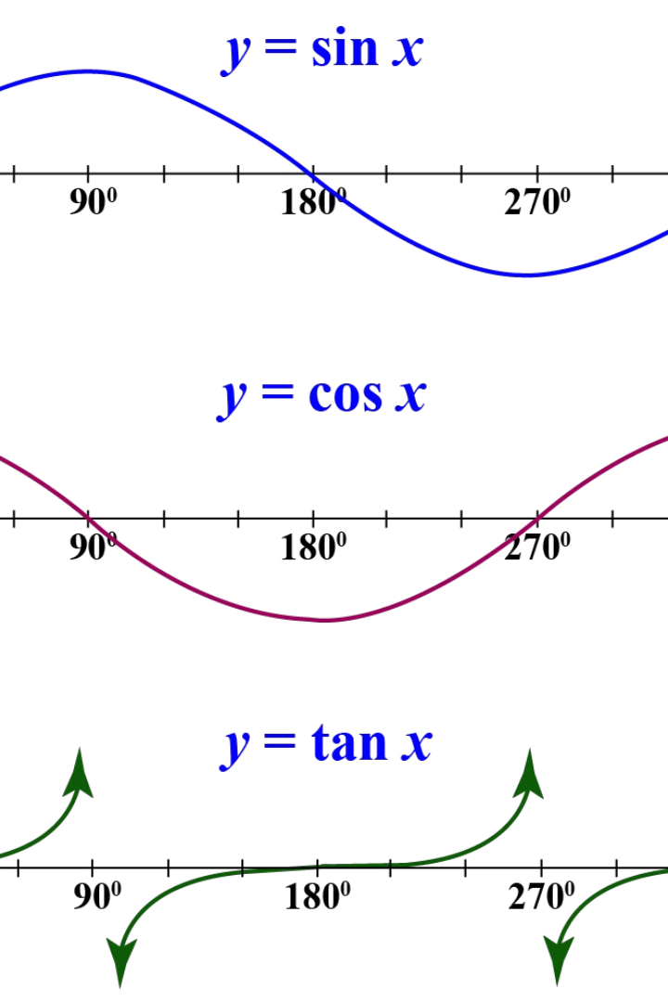
Trigonometric Functions: Sine, Cosine, and Tangent
Sine
Cosine
Opposite side / Hypotenuse
Adjacent side / Hypotenuse
Tangent
Opposite side / Adjacent side

Slide 5
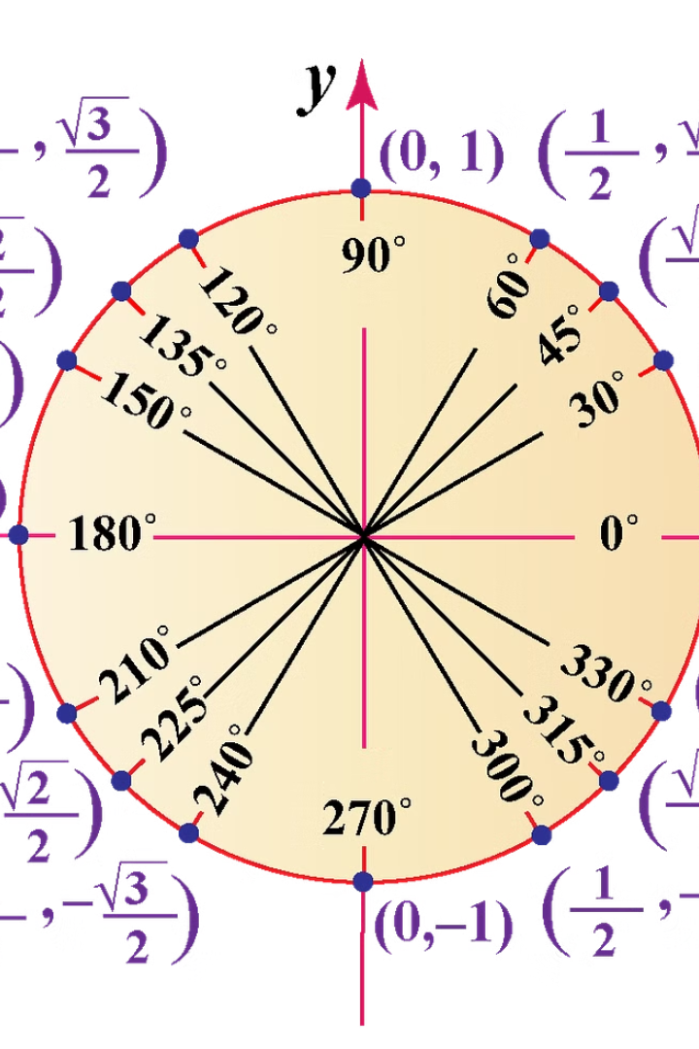
Angles and the Unit Circle
1
Angles in standard position
2
Measuring angles in degrees and radians
3
Trigonometric ratios on the unit circle

Slide 6
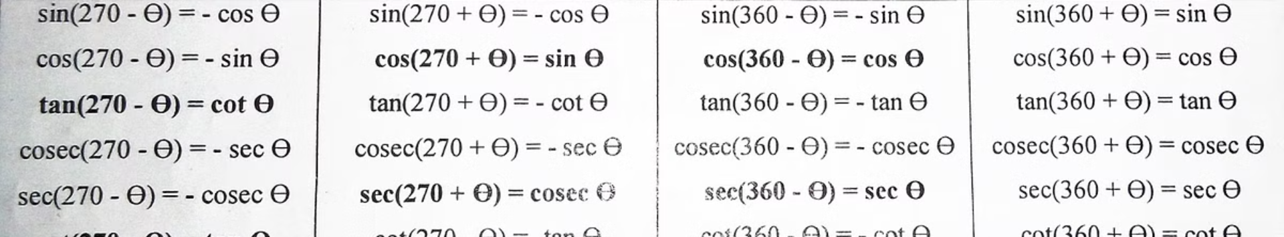
Trigonometric Identities
Pythagorean Identity
Quotient Identities
Reciprocal Identities
sin²θ + cos²θ = 1
tanθ = sinθ / cosθ
cscθ = 1/sinθ, secθ = 1/cosθ, cotθ = 1/tanθ

Slide 7
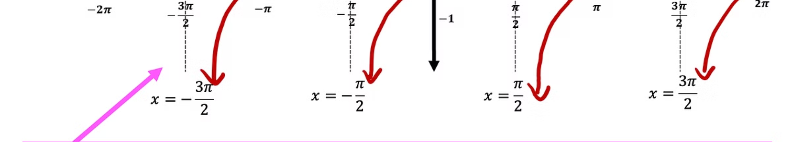


Solving Trigonometric Equations
Basic Equations
Solve for the angle using inverse trigonometric functions.
Advanced Equations
Use identities, factoring, or other techniques to isolate the variable.

Slide 8
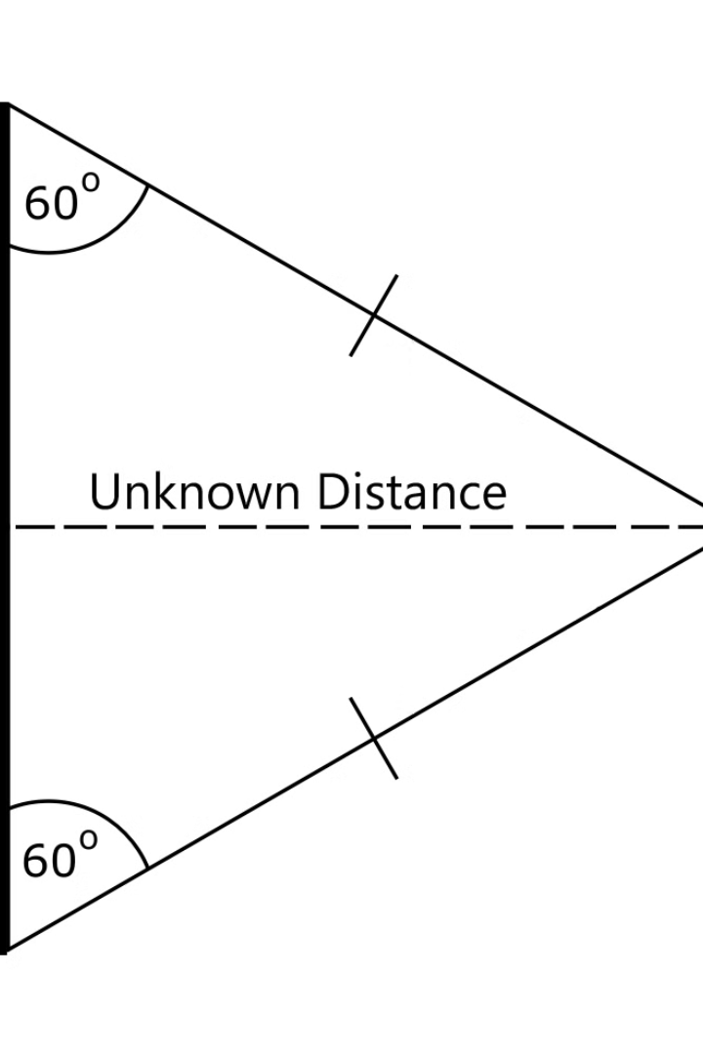



Applications of Trigonometry
Navigation
Used in ships, planes, and satellites.
Engineering
Designing structures and machines.
Science
Modeling waves, sound, and light.

Slide 9
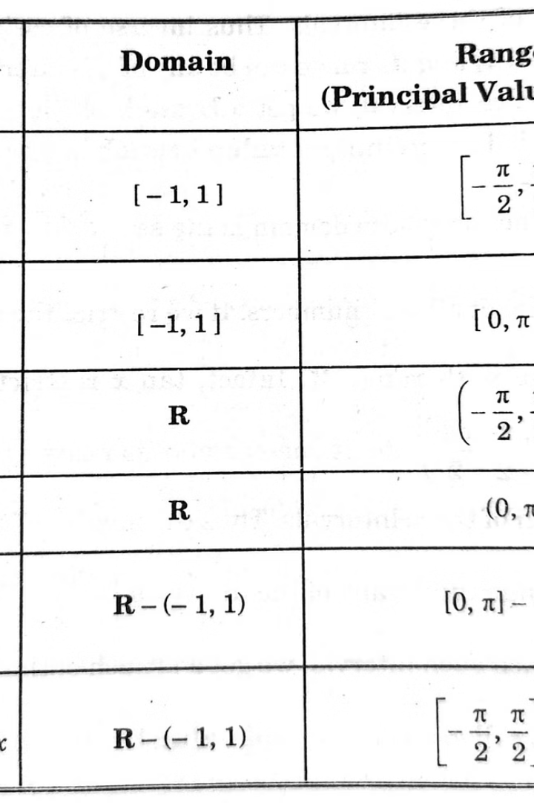
Inverse Trigonometric Functions
1
Inverse Sine (arcsin)
Finds the angle whose sine is a given value.
2
Inverse Cosine (arccos)
Finds the angle whose cosine is a given value.
3
Inverse Tangent (arctan)
Finds the angle whose tangent is a given value.

Slide 10

Conclusion
Trigonometry is a powerful tool for understanding the relationships between angles and sides of triangles. It plays a crucial role in various fields and helps us solve real-world problems. As you continue your journey in mathematics, remember the fundamental principles of trigonometry and how they can be applied to solve complex problems.

