Slide 1
Mastering Django From Scratch – Step By Step
KAMESWARA SARMA UPPULURI
MICROSOFT CERTIFIED TRAINER

Slide 2
Python Version History
Version | Release Date
1.0 | 1994-01-26
2.0 | 2000-10-16
3.0 | 2018-12-03
3.8 | 2019-10-14
3.9 | 2020-10-05
3.10 | 2021-10-04
3.11 | 2022-10-24
3.12 | 2023-10-02

Slide 3
Django Version History
Version | Release Date
0.9 | 16-Nov-2005
1.0 | 3-Sep-2008
2.0 | 2-Dec-2017
3.0 | 2-Dec-2019
3.1 | 4-Aug-2020
4.0 | 7-Dec-2021
5.0 | 4-Dec-2023

Slide 4
Sites developed using Django
Disqus
Instagram
Knight Foundation
MacArthur Foundation
Mozilla
National Geographic
Open Knowledge Foundation
Pinterest
Open Stack

Slide 5
Virtual Environment
It is a space that allows you to isolate the dependencies and configurations of one project from another.
With this, we can create different projects with different versions of libraries on the same system and they wont interfere with each other.
Venv is an in-built module that comes with Python versions 3.3 and later.
It is a simple and lightweight way to create virtual environment.
python –m venv myenv (-m stands for Module)
Always use lower case letters at the time of naming VE and avoid spaces. Dashes are allowed though.
Run \Scripts\activate.bat file to active the VE.
Run \Scripts\deactivate.bat file to deactivate the VE.

Slide 6
Advantages of Virtual Environment
Isolation of Dependencies
Version Compatibility
Ease of Deployment

Slide 7
Overview of PIP
PIP is a Package Installer for Python.
It is used to download, install and manage software packages.
Pip is included by default, if we have python version 3.4 or later.
It is almost like NPM,Nuget,gem package managers.
Pip --version

Slide 8
Django Installation
Pip install django==5.0
Python –m django –-version
Pip uninstall Django==5.0

Slide 9
List Of Installed Packages
Pip freeze
Outputs installed packages in requirements format.
Pip list
Lists installed packages
Pip freeze > requirements.txt
pip list --format=freeze > requirements.txt
Pip install –r requirements.txt

Slide 10
MVT Design Pattern
MVT architecture is a software design pattern used by the Django web framework.
MVT stands for Model – View – Template.
1. Model
The Model in MVT, much like in MVC, provides the interface for data stored in the database
2. Views
Views in Django serve as the bridge between the Model data and Templates.
3.Templates
Templates are responsible for the entire User Interface.

Slide 11
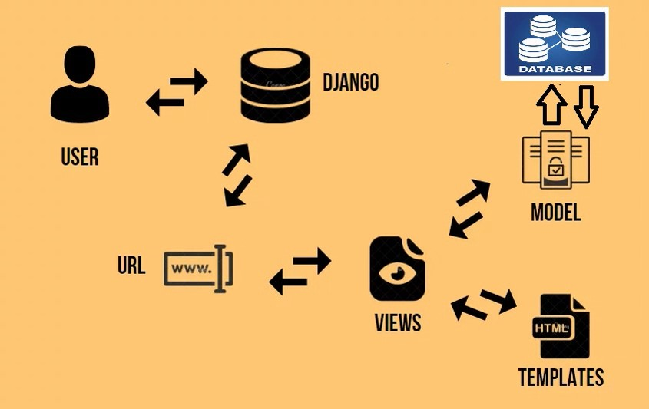
MVT Design Pattern

