Slide 1
Convolutional Neural Networks
The BEST Resource for Understanding and Creating
Convolutional Neural Networks (CNN) Apps

Slide 2
Quick Refresher
Neural Networks (NN)

Slide 3
Epochs
This is the Learning Process of NNs
By repeating FFPs and BP-GDs
Until Convergence of accuracy metrics
Keep an eye on training and validation results

Slide 4




Epochs
x1
n1
With Learning rate
Σ $w_{1}x$
f()
$$b_{1}$$
,
Target Value
Y
# times until convergence
Inputs
x2
n2
Y^
BP
Σ $w_{2}x$
f()
$$b_{2}$$
Outputs
x3
nodes
(Hidden Layers)
Loss(Y^, Y)
GD

Slide 5
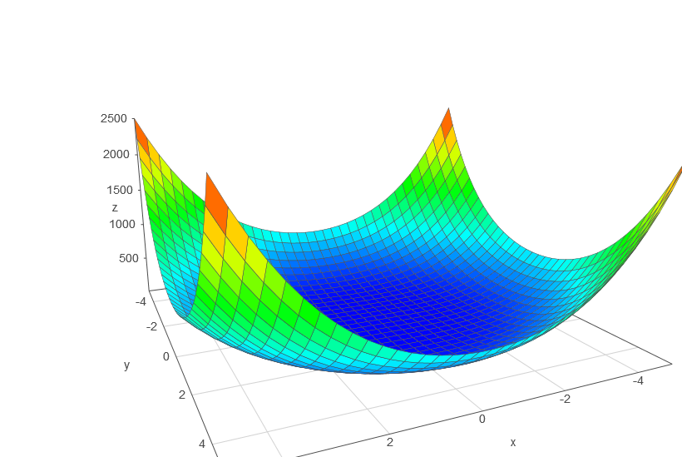
Epochs

