Slide 1
Convolutional Neural Networks
The BEST Resource for Understanding and Creating
Convolutional Neural Networks (CNN) Apps

Slide 2
Motivation
Convolutional Neural Networks (CNN)

Slide 3
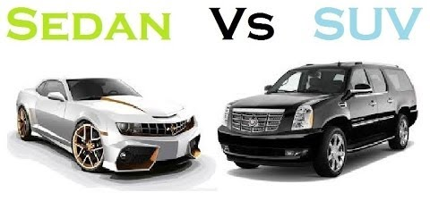
Special and Unique
Analogy:
If NNs are sedans, CNN are SUVs
With added effectiveness and efficiency
Best of both worlds!
Highly successful for Image Recognition tasks
Classification, Localization, Object Detection, Segmentation

Slide 4
Special and Unique
2012: Krizhevsky, Sutskever and Hinton
Considered a pioneer paper
Over complex dataset ImageNet LSVRC-2010: ~1,2 M images
~60 million parameters and ~650,000 neurons
Convolutional Layers, Max-Pooling Layers, FC and Softmax final act.
Used 2 different GPUs (Nvidia), training took 5-6 days straight

Slide 5
Special and Unique
2012: Krizhevsky, Sutskever and Hinton
“To learn about thousands of objects from millions of images, we need a model with a large learning capacity.”
This is why I say CNNs are the SUVs!
“(…) compared to standard feedforward neural networks with similarly-sized layers, CNNs have much fewer connections and parameters (…)”

Slide 6
Special and Unique
2012: Krizhevsky, Sutskever and Hinton
They achieved by far the best results ever reported on these datasets
A milestone for sure!
Note: Hinton also contributed with a milestone overfitting procedure called “Dropout”
They also used it here

Slide 7
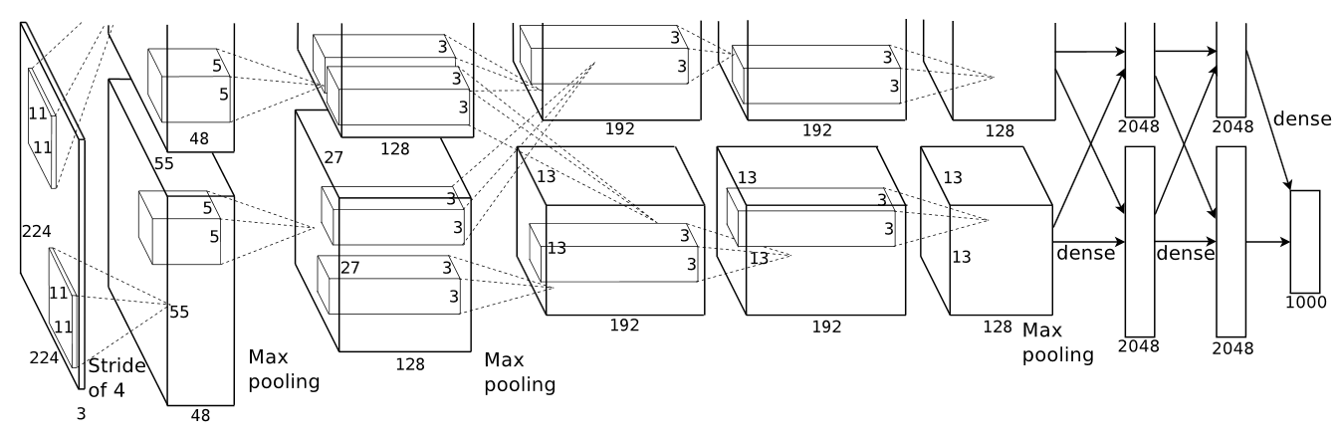
Special and Unique
Note: picture cropped in original paper

Slide 8
Special and Unique
Applications
Transport: Autonomous car driving
Medical: Detecting cancer in cells
Nature: Classify leaves species
Videogames: Nvidia Institute, mimic human player behavior
Audio: Recognize songs, speech
Whatever industry it uses images (or not), and that’s a lot!

Slide 9
Special and Unique
More relevant papers:
Zeiler, M. D. and Fergus, R. (2013) Visualizing and Understanding Convolutional Networks
Karen Simonyan and Andrew Zisserman. Very deep convolutional networks for large-scale image recognition. ICLR, 2015.
Christian Szegedy, Wei Liu, Yangqing Jia, Pierre Sermanet, Scott Reed, Dragomir Anguelov, Dumitru Erhan, Vincent Vanhoucke, Andrew Rabinovich; Going Deeper With Convolutions. The IEEE Conference on Computer Vision and Pattern Recognition (CVPR),
Kaiming He, Xiangyu Zhang, Shaoqing Ren, and Jian Sun. Deep Residual Learning for Image Recognition, CVPR 2016

