Slide 1
Convolutional Neural Networks
The BEST Resource for Understanding and Creating
Convolutional Neural Networks (CNN) Apps

Slide 2
Concepts, Layers, Architectures and more
Convolutional Neural Networks (CNN)

Slide 3
Activations
Just like FC nodes
It’s needed to fire nodes (a-la human brain)
If we want the nonlinear discovery of features
According to researcher’s choice
After each convolutional layer, or after each 2 layers

Slide 4
Activations
Example 1: 6X6X1 image, kernel 3X3X1, slide-1, pad-0
1
1
1
0
1
1
1
1
0
7
4
2
5
1
1
0
0
0
0
f( )
*
0
2
1
=
3
4
3
4
1
0
0
1
0
1
2
0
1
3
2
6
3
0
0
0
1
0
0
3
2
5
4
0
0
1
0
0
1
1
Linear, tanh, relu, sigmoid, etc.
0
0
1
0
1
1

Slide 5
Activations
Types
Linear: Synonym of no activation
Useful as Final Activation for Regression
Or when you don’t want to activate nodes (efficiency)

Slide 6
Activations
Types
ReLu: max(x, 0)
Popular
7
4
2
5
0
4
0
5
f( ) =>
3
4
3
4
3
0
3
4
3
2
6
3
3
0
6
0
3
2
5
4
0
0
5
0

Slide 7
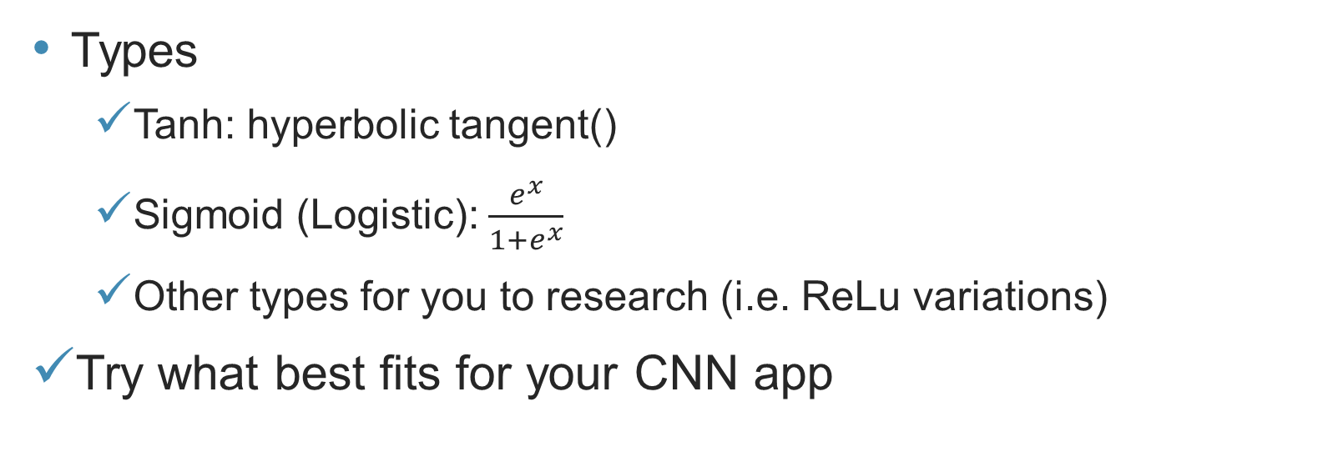
Activations
Types
Tanh: hyperbolic tangent()
Sigmoid (Logistic): $\frac{e^{x}}{1+e^{x}}$
Other types for you to research (i.e. ReLu variations)
Try what best fits for your CNN app

Slide 8
Activations
Key Takeaways:
Activations are needed for nonlinear feature discovery
Just like normal NNs
However, the researcher’s decision will define when, where and with what?
Pooling Layer
Next lecture!

