Slide 1
MNIST Handwritten Digit Recognition
Saad Mahmood(Fa22-bcs-015)
Jawad Iqbal(Fa22-bcs-008)

Slide 2
Project Overview
Objectives:
Develop a machine learning model to classify handwritten digits(between 0-9) accurately.
Dataset: MNIST (70,000 grayscale images of digits 0-9).
Training Set: 60,000 images
Testing Set: 10,000 images

Slide 3
Approach
1. Preprocessing:
Normalized pixel values to the range [0 to 1] instead of [0 to 255].
Flattened images into 1D arrays (28x28 = 784 features).
2. Model: Feedforward Neural Network (FNN)
Input Layer: 784 neurons
Hidden Layers:
Layer 1: 50 neurons, ReLU activation
Layer 2: 50 neurons, ReLU activation
Output Layer: 10 neurons, sigmoid activation
3. Training:
Optimizer: Adam
Loss Function: Sparse Categorical Cross-Entropy
Metrics: Accuracy

Slide 4
Results
Performance Metrics:
Training Accuracy: 99.04%
Testing Accuracy: 97.18%
Visual Insights:
Confusion matrix revealed minor misclassifications (e.g., 7 vs. 9).

Slide 5
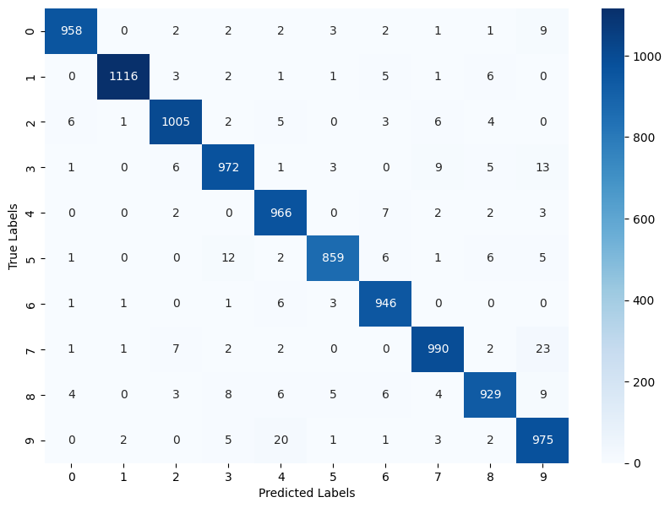
Heatmap

