Slide 1
Banking Transaction Failure Detection and Analysis
Using GCP - Cloud SQL, Dataproc, and BigQuery

Slide 2
MySQL Instance Setup
Create a new Cloud SQL instance (MySQL)
Configure access credentials:
– Username: your_username
– Password: your_password
Create a database:
– new_database
Create a table:
– failed_transactions

Slide 3

Create Dataproc Cluster
Use gcloud command to create single-node Dataproc cluster
Region: us-central1, Zone: us-central1-c
Image version: 2.0-debian10

Slide 4
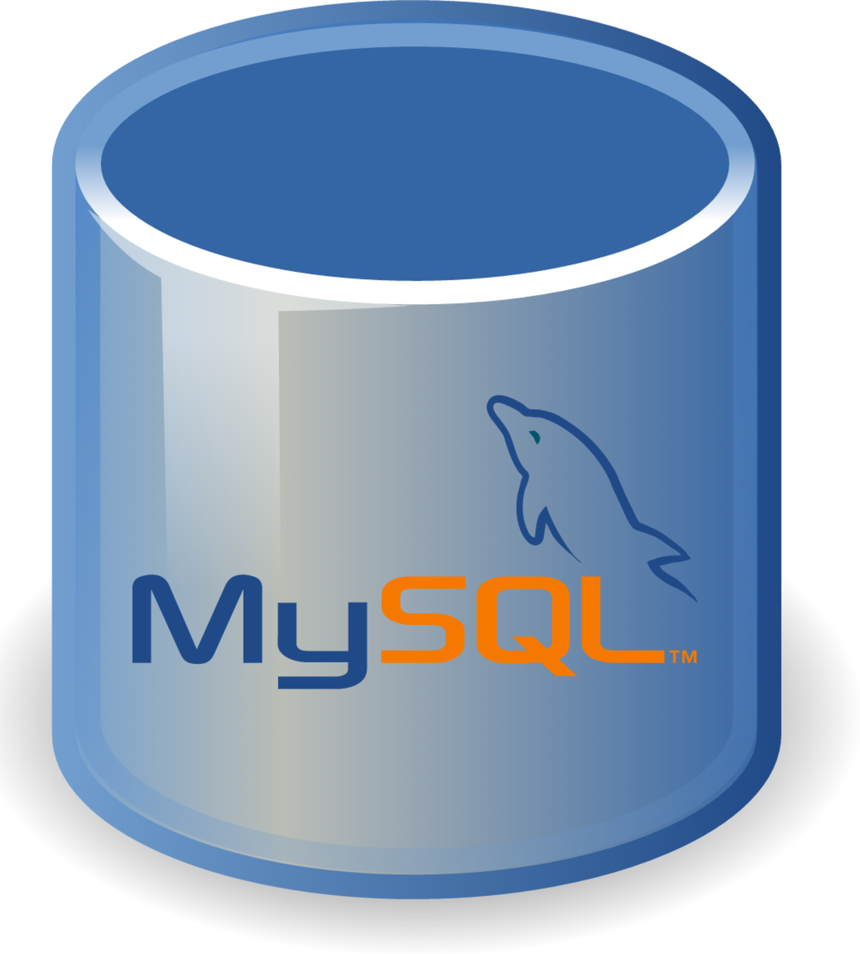

Connect Dataproc to MySQL
Copy VM instance external IP Add to Cloud SQL connections (Add Network)
Addressw

Slide 5
Prepare Data and Scripts
Upload CSV files to bucket/transactions
Upload Python scripts to bucket/scripts
Visualize data using BigQuery charts or Looker Studio

Slide 6

Run PySpark Job on Dataproc
Use gcloud command to submit PySpark job
Script: clean_merge_data_and_filter_failed_txns.py
Cluster: new-cluster, Region: us-central1

Slide 7
Verify Data in Cloud SQL
Check failed_transactions table and data insertion
Verify using BigQuery > Add Data > External Connection

Slide 8
Federated Connection: BigQuery to MySQL
Connect Cloud SQL to BigQuery
Query federated tables, export results to CSV/JSON

Slide 9
Configure IAM Permissions
Copy service account from external connection
Add to IAM with 'Cloud SQL Client' role

Slide 10

BigQuery Analysis and Visualization
Query federated tables
Export results and visualize using BigQuery or Looker Studio

Slide 11

Conclusion
Successfully integrated GCP services for data analysis
Automated pipeline from ingestion to visualization
Scalable and secure architecture
Actionable insights for decision-making

