Slide 1
Navigation in simulierter PyGame-Umgebung
Intelligente Robotik
Master Künstliche Ingelligenz
Saad Awan, Truong Cong Phan

Slide 2
Agenda
Einleitung
Umsetzung
Data Preparation
Model Development
Google Cloud: Setup
Google Cloud: Modell Deployment
Pipeline-Automation (optional)
Fazit und Ausblick

Slide 3
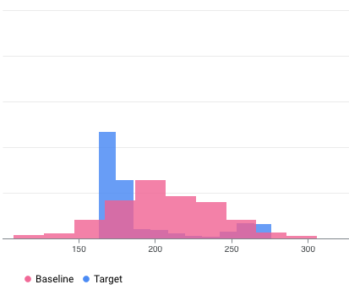
Fazit & Ausblick
Fazit
Effektive Automatisierung und Wiederholbarkeit
Theoretisch durch mehr Quota stark skalierbar
Modellversionierung
Ausblick
Integration von Monitoring und Modellüberwachung
Trigger einbauen
Hyperparameter Tuning automatisieren
API robuster bauen

Slide 4
Quellen
https://cloud.google.com/blog/topics/developers-practitioners/pytorch-google-cloud-how-train-and-tune-pytorch-models-vertex-ai?hl=en
https://cloud.google.com/vertex-ai/docs/training/pre-built-containers#pytorch
https://docs.ultralytics.com/models/yolo11/
https://pytorch.org/vision/master/models/faster_rcnn.html
https://pytorch.org/vision/master/models/ssdlite.html
https://github.com/GoogleCloudPlatform/vertex-ai-samples/blob/main/community-content/pytorch_text_classification_using_vertex_sdk_and_gcloud/pytorch-text-classification-vertex-ai-train-tune-deploy.ipynb
https://github.com/GoogleCloudPlatform/vertex-ai-samples/blob/main/community-content/pytorch_text_classification_using_vertex_sdk_and_gcloud/pytorch-text-classification-vertex-ai-pipelines.ipynb
https://medium.com/@oredata-engineering/yolov8-deployment-on-vertex-ai-endpoints-1a79fd1d4ae0
https://cloud.google.com/vertex-ai/docs/start/training-guide
https://flask.palletsprojects.com/en/stable/quickstart/#a-minimal-application
https://medium.com/google-cloud/how-to-train-custom-model-and-deploy-on-vertex-ai-b6ee6f1c529d
https://cloud.google.com/vertex-ai/docs/pipelines/migrate-kfp?hl=de
https://cloud.google.com/vertex-ai/docs/pipelines/build-pipeline?hl=de
https://docs.streamlit.io/

