Slide 1
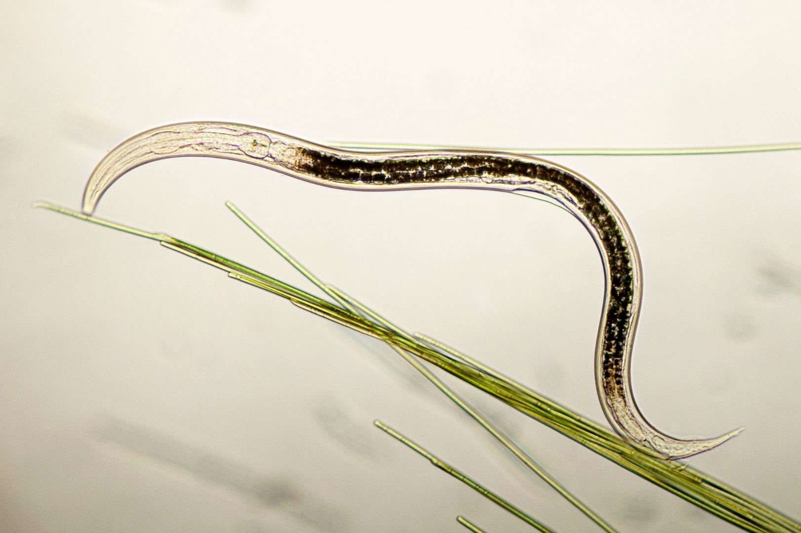
Topic:
Plant-Parasitic Nematodes
Classification using Self-Supervised Learning (SSL)

Slide 2
Presented By:
Name | ID
Sharifuzzaman Mazumder | 2022-1-60-003
Moumita Akter | 2022-1-60-105
Marjuk ibna belated | 2022-1-60-383
Ripon Hasan | 2022-1-60-054

Slide 3

Introduction & Problem Statement
Goal: Plant-parasitic nematodes pose a serious threat to agricultural productivity and crop health. Early and accurate identification of nematode species is essential for effective pest management. However, traditional classification methods rely heavily on large labeled image datasets, which are time-consuming, expensive, and require expert knowledge. This study aims to leverage self-supervised learning to enable accurate nematode classification while reducing dependency on extensive labeled data..
Our Approach: We explore self-supervised learning to overcome the challenge of limited labeled data. We use SimCLR,BYOL,MOCO to train a model on unlabeled images and then use the learned representations for a downstream classification task

Slide 4
Problem Statement
We aim to develop a robust and high-performing plant-parasitic nematode classification model using microscopic image data. The primary objectives of this work are to:
Train a model on a large collection of unlabeled nematode images using self-supervised learning (SSL) techniques.
Transfer the learned feature representations to a small, labeled nematode dataset for downstream classification.
Demonstrate that the SSL-based approach can achieve high classification accuracy even when the availability of labeled data is limited.

Slide 5
Project Workflow
Our project follows a three-stage pipeline:
Self-Supervised Pre-training: We use three SSL methods, SimCLR,BYOL,MoCo to train a feature extractor on a large, unlabeled dataset.
Feature Extraction: We extract meaningful feature vectors from both labeled and unlabeled images using the pre-trained encoder.
Downstream Classification: We trained Linear probe on frozen features, Shallow heads (MLP, SVM, DT, RF), Full fine-tuning on the extracted features using varying percentages of labeled data and Comparison (Linear vs Fine-tune).

Slide 6
Literature Review
Literature Review Existing Work on Nematode Classification
Traditional & Deep Learning Methods:
  CNNs, ResNet, EfficientNet, MobileNet used for nematode image classification
  Transformer-based models also explored
Performance Benchmarks:
  Accuracy up to ~98% on labeled nematode datasets
Limitations:
  Supervised models require large, annotated datasets
  Dataset scarcity and class imbalance are common
Emerging Trends:
  Self-Supervised Learning (SSL) can learn features from unlabeled data
  SSL reduces dependency on expert labeling while maintaining performance

Slide 7
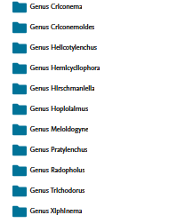
Dataset Description
Overview:
This dataset contains microscopic images of plant-parasitic nematodes, providing a valuable resource for AI-based identification and agricultural pest management:
11 genera, 1016 images
Images captured from diverse crops and soil samples
Details:
Image size: 1280 × 1024 px | Format: .jpg
Classes: Xiphinema, Meloidogyne, Trichodorus, Hirschmanniella, Hoplolaimus, Criconemoides, Hemicycliophora, Radopholus, Pratylenchus, Criconema, Helicotylenchus

Slide 8
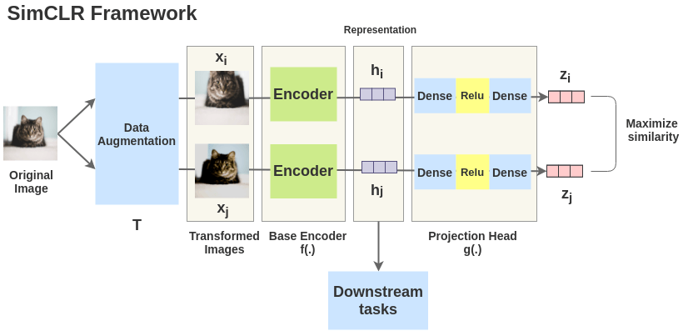
Self-Supervised Learning Models
SimCLR: Simple Framework for Contrastive Learning
Aims to maximize agreement between different augmented views of the same image.
Uses a contrastive loss function to pull positive pairs (augmentations of the same image) closer in the embedding space and push negative pairs (other images in the batch) further apart.

Slide 9
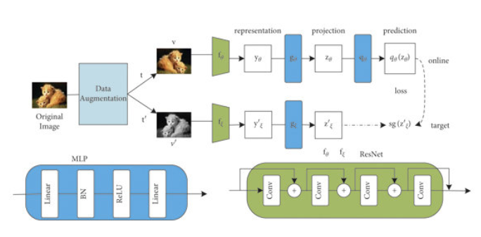
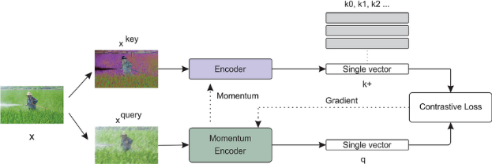
Self-Supervised Learning Models
BYOL: Bootstrap Your Own Latent
Aims to learn meaningful representations without negative samples.
Uses online and target networks to predict the representation of augmented views of the same image.
Contrastive-free approach: pulls different augmentations of the same image closer in embedding space without explicitly using negatives.
MoCo: Momentum Contrast
Builds a dynamic dictionary of representations using a momentum-updated encoder.
Uses a contrastive loss to bring positive pairs (augmented views of the same image) closer and push negative pairs (from dictionary) apart.
Designed to maintain a large and consistent set of negatives efficiently, enabling scalable contrastive learning.

Slide 10
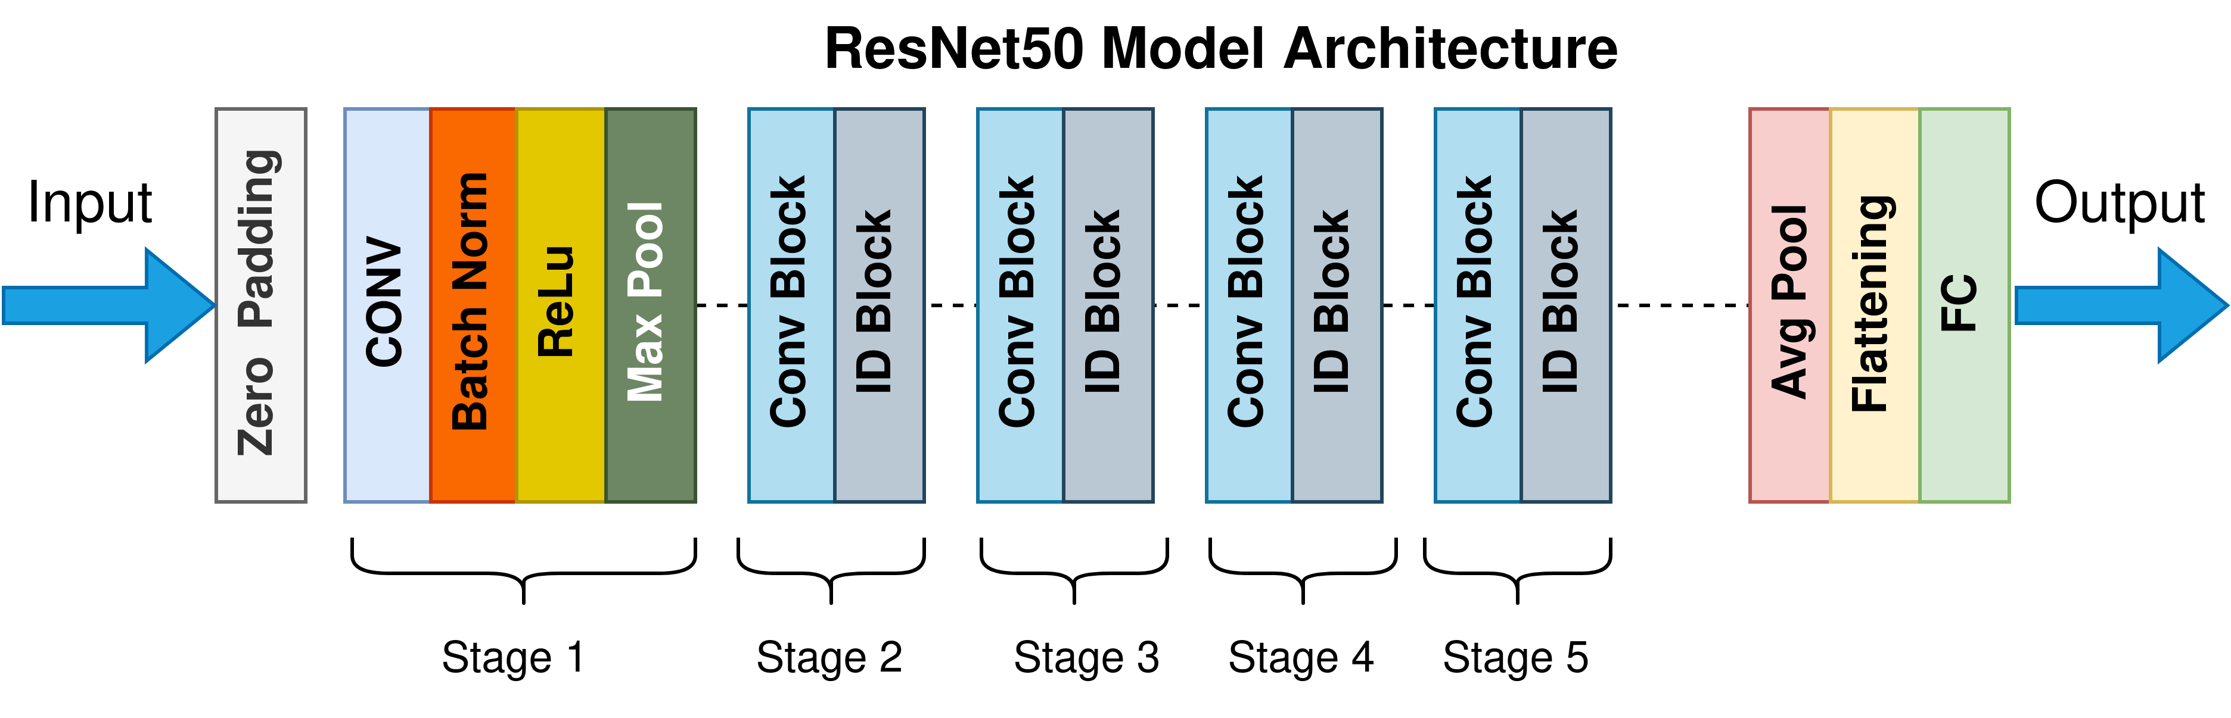
Backbone Architectures
We selected two powerful, pre-trained models to extract meaningful features from nematode images:
1. ResNet-50
Classic convolutional neural network with residual connections.
Effective for deep feature extraction and widely used in image classification tasks.
Captures hierarchical patterns from low-level textures to high-level structures.
2. Vision Transformer (ViT)
Uses self-attention mechanisms instead of convolutions to model global relationships.
Splits images into patches and learns contextual feature representations.
Effective for capturing long-range dependencies in images, complementing CNN features.

Slide 11
Downstream Classifiers
After extracting features with our pre-trained SSL models, we explored three downstream strategies to classify plant-parasitic nematodes:
1. Linear Probe on Frozen Features
Only train a simple linear classifier on top of frozen SSL features.
Purpose: Evaluate the quality of the learned representations without modifying the SSL model.
Benefit: Fast and computationally cheap; good for quick performance checks.
2. Shallow Heads / Classical ML Classifiers
Train small models using SSL features as input:
  Random Forest (RF): Ensemble of decision trees for stable, high-accuracy predictions.
  Support Vector Machine (SVM): Separates classes via optimal hyperplane.
  Decision Tree (DT) & Multi-Layer Perceptron (MLP): Alternative shallow classifiers.
Purpose: Compare traditional ML classifiers on SSL features.
3. Full Fine-Tuning
Train the entire SSL model on labeled nematode images.
Purpose: Adapt learned representations specifically to the downstream task.
Benefit: Often achieves the highest accuracy, but more computationally expensive.

Slide 12
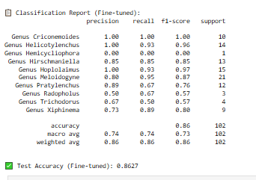
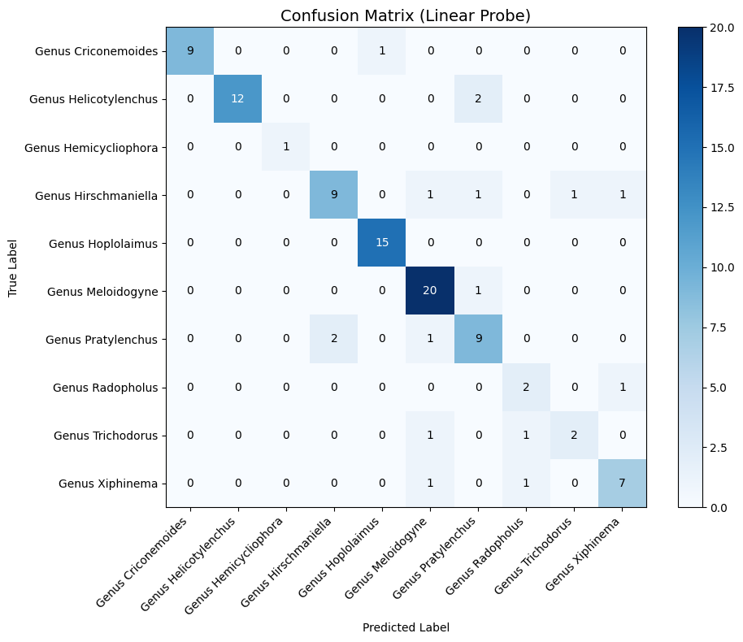
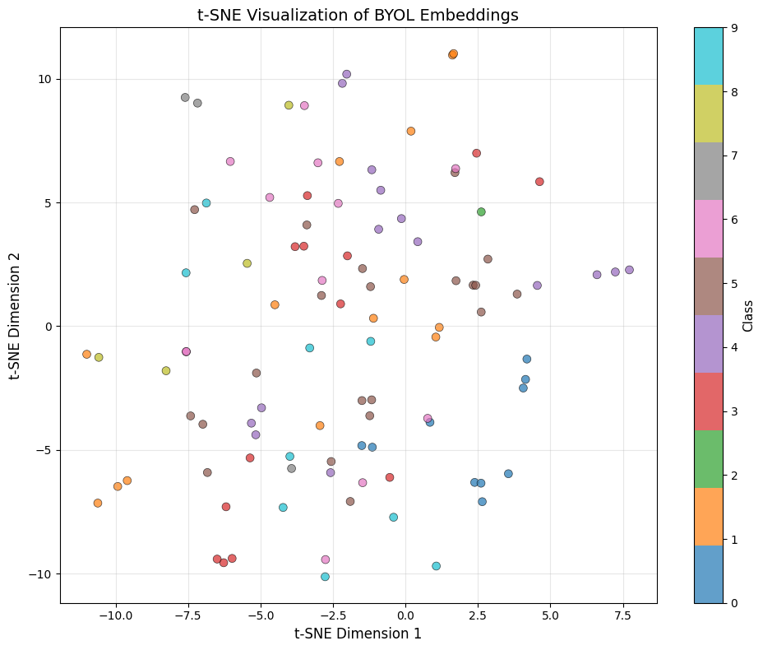
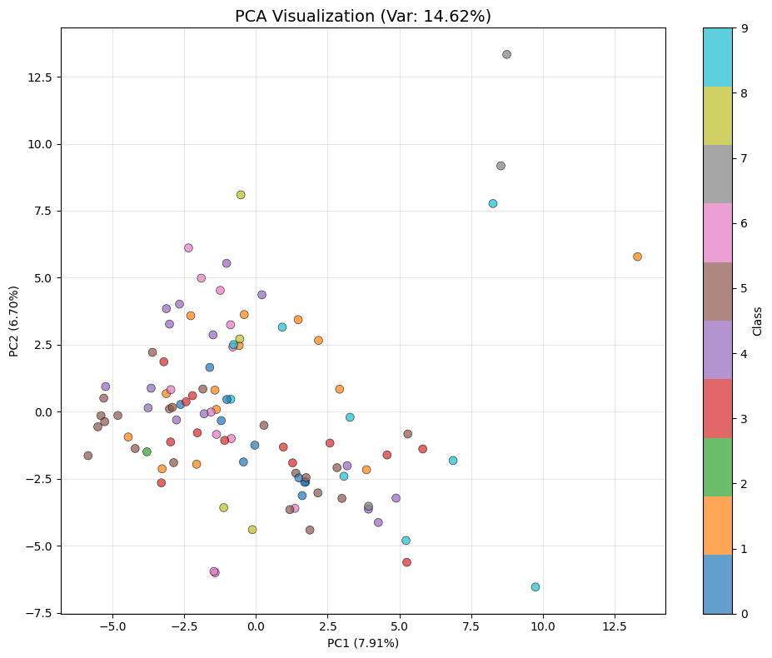
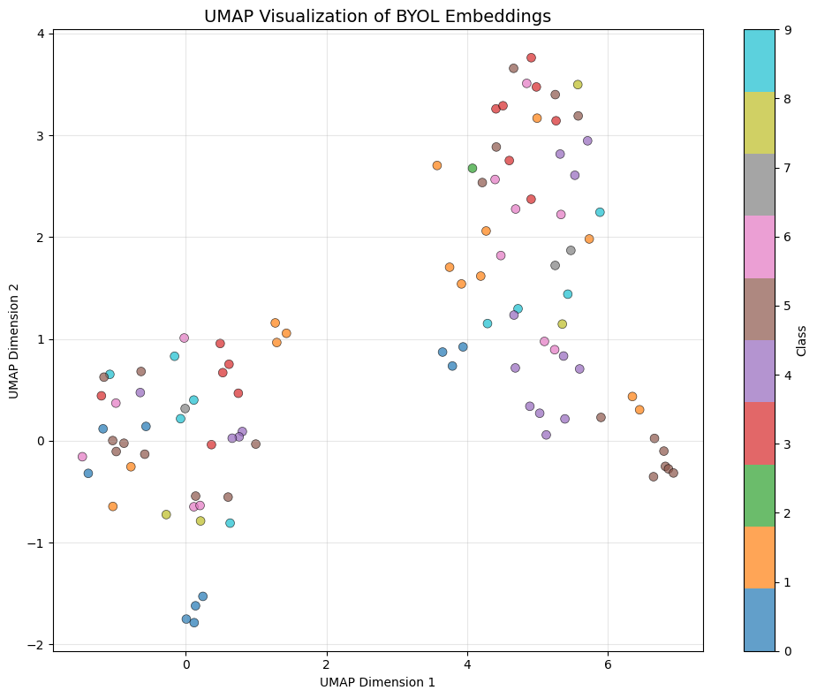
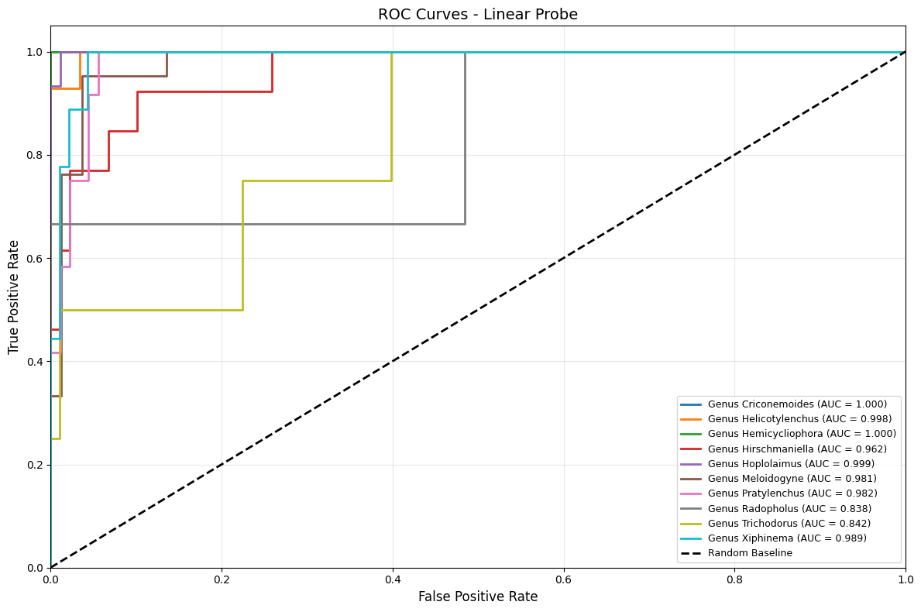
Visualizing Byol

Slide 13
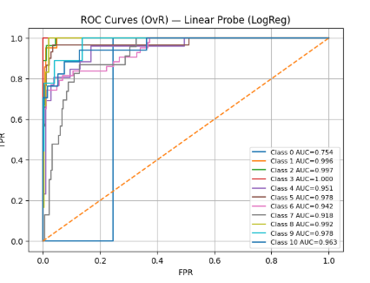
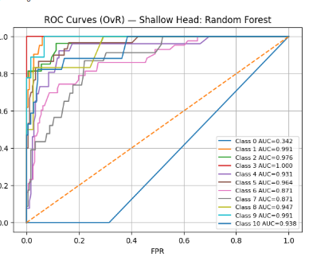
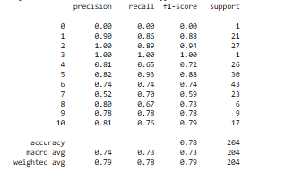
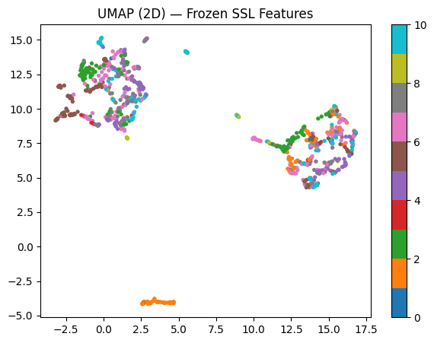
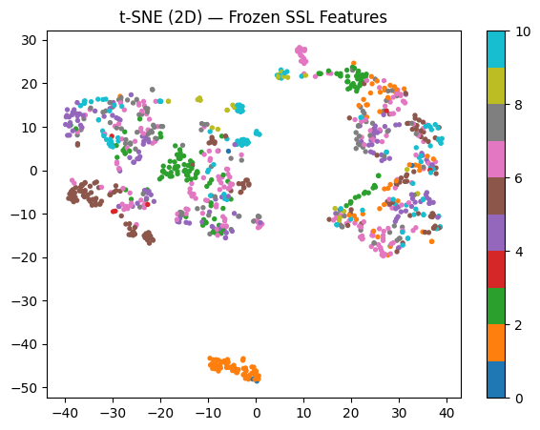
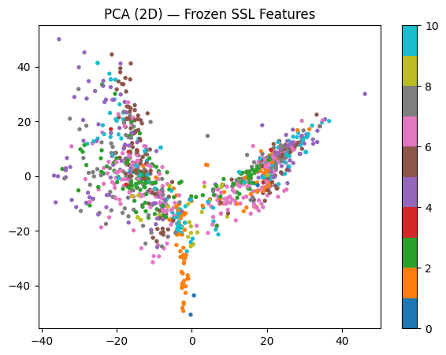
Visualizing SimCLR

Slide 14
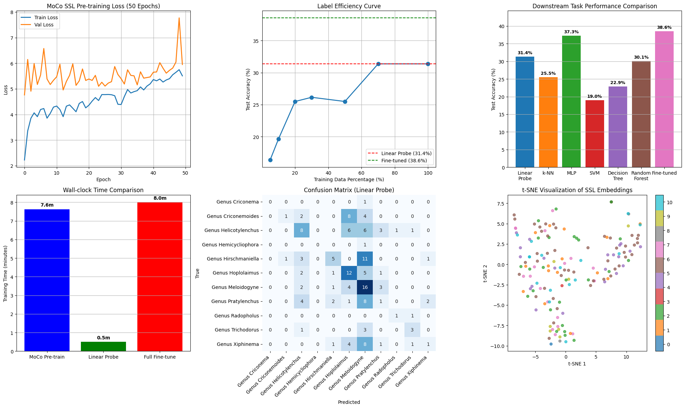
Visualizing Moco

Slide 15

Future Work
Explore
Explore Other SSL Methods: Investigate other state-of-the-art SSL frameworks.
Evaluate
Larger Datasets: Evaluate the model on larger, more diverse datasets.
Model
Model Fine-Tuning: Fine-tune the entire pre-trained network with labeled data for a potential boost in performance.

Slide 16

Thank You

