Slide 1
Advancements in Elderly Care: A Machine Learning Approach to Automated Fall Detection Using Smartphone Sensors
Machine Learning
21K-4703 ALI RAZA
21K-3100 MUHAMMAD SAMEED
21K-4736 SYED SAADULLAH HUSSAINI
(BAI-5A)

Slide 2
Abstract
This report introduces a machine learning framework for detecting falls in the elderly using smartphone and smartwatch sensors. It emphasizes automated systems for early detection and prevention, utilizing statistical features and raw sensor data for model training.

Slide 3
Introduction
The project focuses on addressing the risk of falls in the elderly through real-time monitoring solutions. It leverages smartphone and smartwatch sensors for an automated fall detection system, employing machine learning techniques for activity classification and fall detection.

Slide 4
Methodology: Data Utilization
The study utilizes the UP-Fall Detection Dataset, a comprehensive resource in fall detection research. This dataset includes a variety of activities and falls captured through accelerometers and infrared sensors, providing a robust foundation for machine learning applications.

Slide 5
Methodology: Data Preprocessing
Data preprocessing involves normalizing and standardizing sensor data. Histograms of accelerometer readings from various body locations are analyzed to guide feature engineering, revealing distinct movement patterns.

Slide 6
Methodology: Feature Engineering
Feature engineering involves extracting statistical features and using raw sensor data. The comprehensive feature set captures subtle differences in sensor readings across activities, enhancing the model's ability to detect falls.

Slide 7
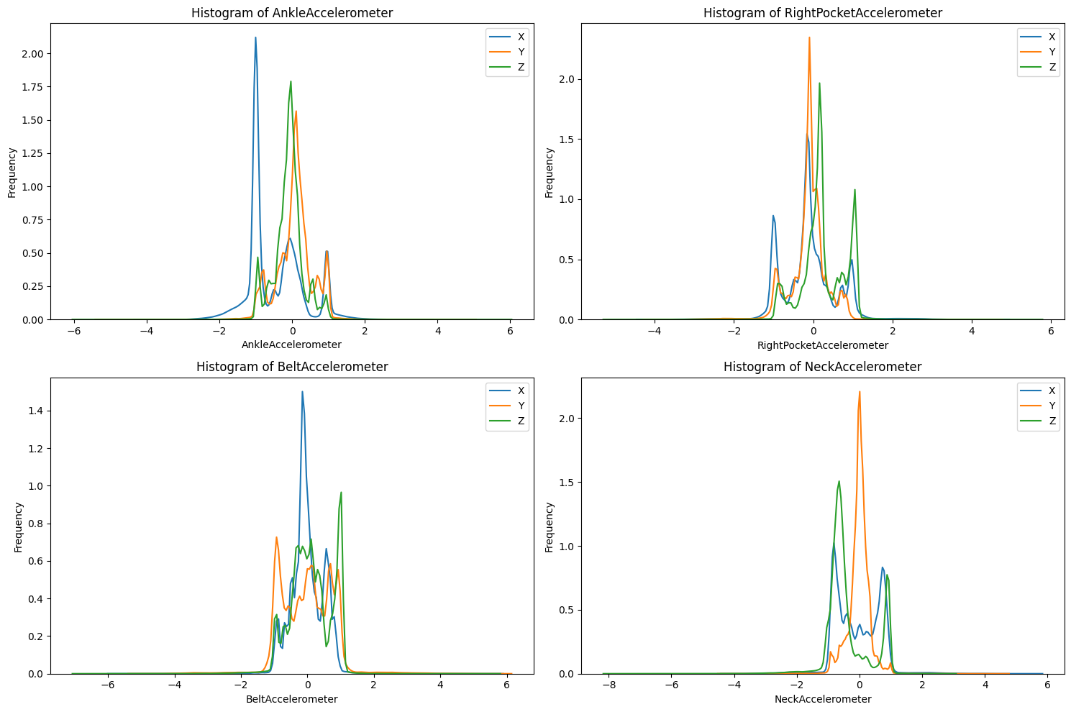
Visual Data Analysis: Accelerometers
Visual analysis includes histograms of accelerometer data from the ankle, belt, right pocket, and neck. These graphs show movement frequency and intensity, aiding in understanding fall-related movements. [Space for Graphs]

Slide 8
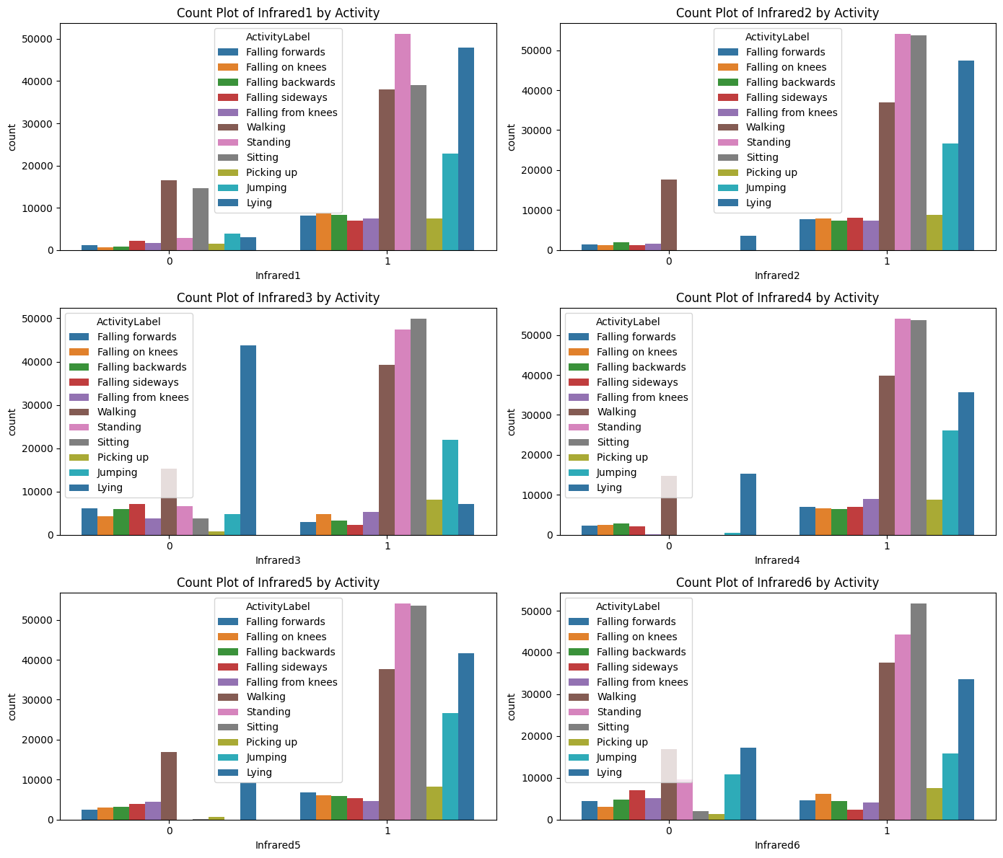
Visual Data Analysis: Infrared Sensors
Count plots of infrared sensor observations are analyzed against activity labels, providing insights into the association between specific activities and sensor states.
Ankle Accelerometer: Sharp peaks indicate swift changes, capturing footfall impact or sudden positional shifts.
Belt Accelerometer: Less sharp distribution signifies varied torso movement during different activities.
Right Pocket Accelerometer: Captures mixed leg and upper body movement with multiple prominent peaks.
Neck Accelerometer: Less variability suggests a more uniform motion in the neck during monitored activities.

Slide 9
Model Training and Evaluation
Models like Random Forest, Logistic Regression, and SVM are trained and evaluated using accuracy, precision, recall, and F1-score. The impact of feature selection on model performance is critically analyzed.

Slide 10
Results
Model | Cross-Validation Accuracy | Test Set Accuracy | F1-Score Range
Random Forest | ~99.98% | 99.98% | 1.00
Logistic Regression | 95.91% | 96.27% | 0.85 - 1.00
Support Vector Machine (SVM) | 99.58% | 99.87% | ~1.00
Deep Learning (Neural Network) | (Validation) 93.47% | 93.87% | Not Specified
The study finds high accuracy and F1-scores in models like Random Forest and SVM, indicating their effectiveness in fall detection. The deep learning model also shows promising results, highlighting the potential of these techniques in elderly care.

Slide 11
Conclusion
Summing up, machine learning methods are highly effective for fall detection using smartphone sensors. It underscores the practical application of Random Forest and SVM models in healthcare for the elderly.

