Slide 1
Customer Segmentation Using Machine Learning
Group Members:
21K-4703 Ali Raza
21K-3100 Muhammad Sameed
21K-4736 Syed Saadullah Hussaini
Supervisor: Dr. Muhammad Farrukh Shahid

Slide 2
Introduction
In this project, we aim to improve our marketing strategies and enhance customer service by implementing machine learning techniques for customer segmentation. By categorizing customers based on their diverse characteristics, we can gain valuable insights into their preferences, behaviors, and needs.
Through this segmentation process, we can tailor our marketing campaigns to specific customer segments, ensuring that our messages resonate with their interests and motivations. Additionally, by understanding the unique characteristics of each segment, we can provide personalized customer service experiences that meet their individual needs.
By leveraging machine learning algorithms and advanced analytics, we can uncover hidden patterns and relationships within our customer data. This allows us to create more accurate and meaningful customer segments, leading to more targeted marketing efforts and improved customer satisfaction.

Slide 3

Methodology
Phase I: RFM(Recency, Frequency, Monetary) analysis
Phase II: Kmeans
Phase III: Apriori Algorithm for association

Slide 4
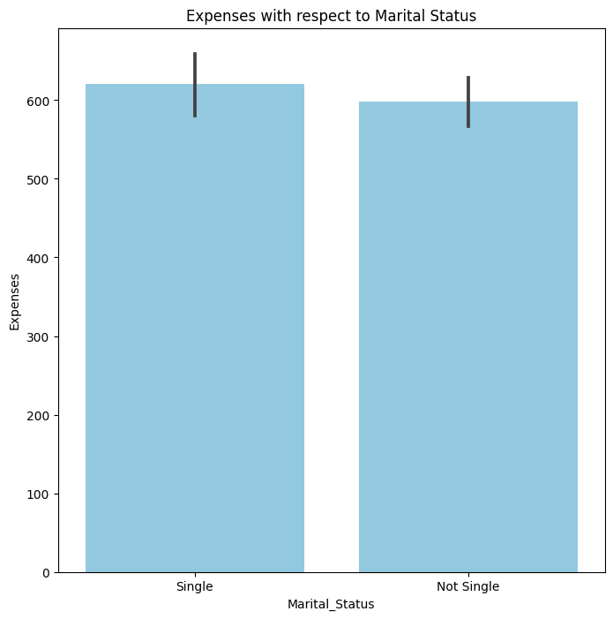
Phase I: RFM analysis
The initial graph scrutinizes the recency aspect of the RFM analysis. Notably, customers categorized as 'Single' display a slightly higher frequency of recent purchases compared to 'Not Single' counterparts, suggesting a potentially higher responsiveness to new offers and heightened engagement with the brand.

Slide 5
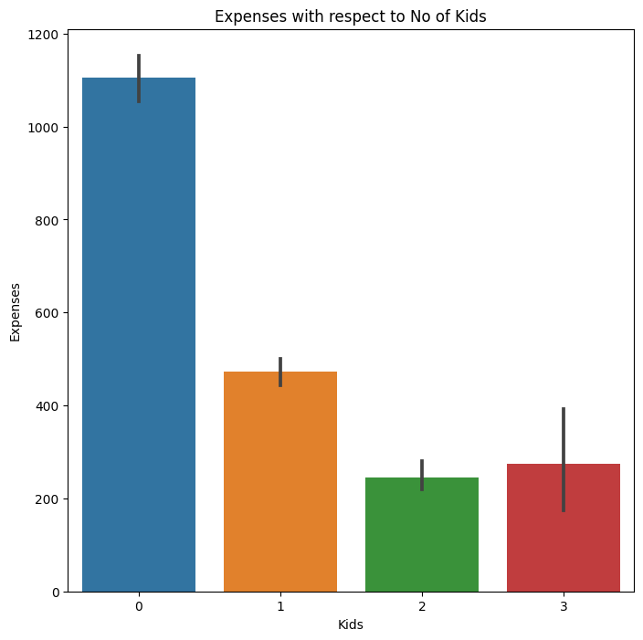
Frequency Analysis
The graph delves into the frequency of purchases concerning the number of kids. Evidently, customers with no kids exhibit the highest frequency of purchases, gradually declining as the number of kids increases. This could signify that customers with larger families might have less disposable income or time for frequent purchases.

Slide 6
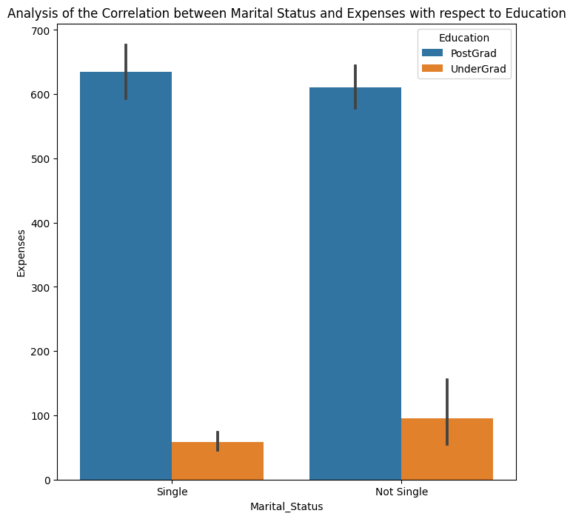
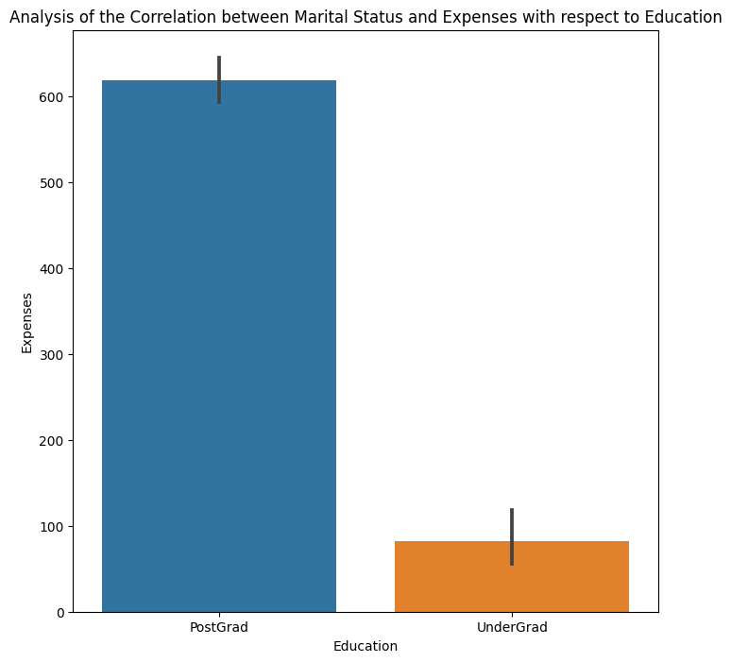
Monetary Analysis with respect to Marital Status and Education
Analysis of customer expenses by marital status and education level.
First graph:
Single customers with postgraduate education have the highest expenses.
Possible reflection of greater financial freedom and a preference for premium products.
Second graph:
Comparison based on education levels.
Postgraduates, in general, incur higher expenses than undergraduates.
Suggests that educational attainment strongly influences spending behavior.
Postgraduates exhibit a higher spending capacity, possibly linked to higher income levels associated with advanced degrees.

Slide 7
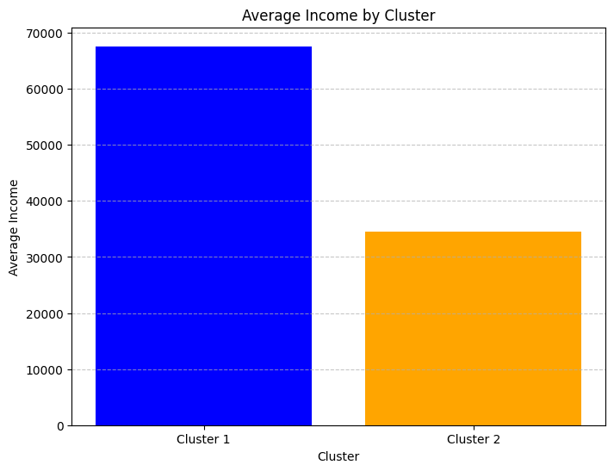
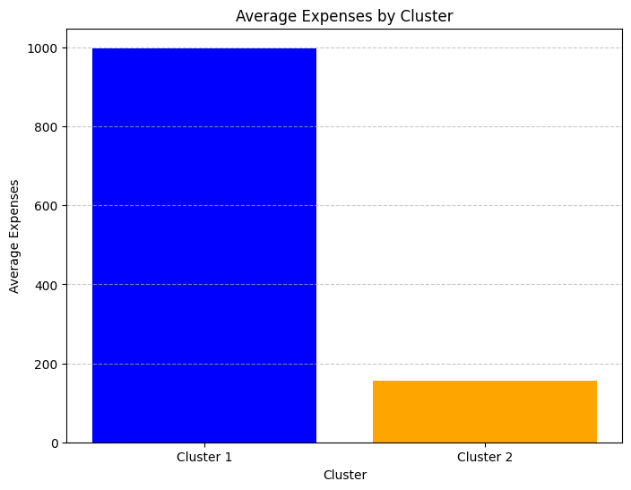
Phase II: Kmeans
Cluster 1 - Highly Active Customers:
Customers in this cluster exhibit high expenses, correlating with a higher average income.
These customers are highly engaged and contribute significantly to revenue, making them ideal targets for up-selling and premium services. (see Average Income by Cluster and Average Expenses by Cluster graphs below).
2. Cluster 2 - Least Active Customers:
This cluster comprises customers with lower expenses and income.
While less active than Cluster 1, these customers still represent a substantial portion of the customer base.
Strategies focused on retention and value-oriented offerings may be effective for this segment.

Slide 8
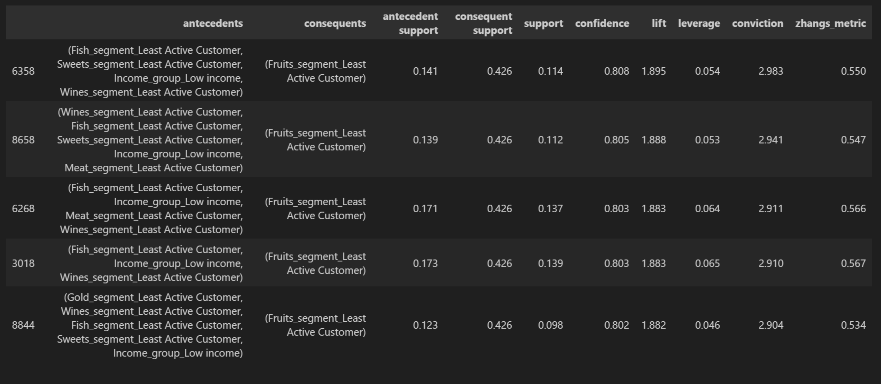
Phase III: Apriori Algorithm for association
The Apriori algorithm, focusing on market basket analysis, uncovers associations and relationships between different products purchased by customers. Segmentation based on age, income, and engagement levels is extended to product categories, identifying customers as 'Least Active' or 'Highly Active' based on their purchasing activity.
After preprocessing and applying one-hot encoding, the Apriori algorithm was employed with a minimum support threshold of 0.08 and a maximum length of 10 to mine for frequent itemsets and generate association rules with a lift metric.

Slide 9
Insights from Association Rules
Two key insights emerged from the association rules generated:
1) Patterns Among Least Active Customers in Fruit Purchases
The analysis revealed a strong association between customers who are categorized as 'Least Active' in purchasing fruits and other product segments. For instance, Customers categorized as 'Least Active' in purchasing fruits showed a strong association with being 'Least Active' in other product segments. This suggests a significant probability that customers less active in certain categories will exhibit similar behavior in fruit purchases.
2) Correlations with Highly Active Wine Purchasers:
The segment of 'Highly Active' wine purchasers exhibited a robust link with being 'Highly Active' in buying fruits, meats, and fish. This indicates that a customer active in one high-value product category is very likely to be active in others, especially wines.

Slide 10

Conclusion
Successful customer categorization achieved through sophisticated data analytics.
Impactful contribution to marketing endeavors.
RFM analysis and K-Means clustering played a crucial role in distinctly grouping customers.
Unveiled actionable insights into purchasing patterns.
The Apriori algorithm enriched precision in marketing strategies through valuable product associations.
Rigorous data processing and feature engineering empowered a data-driven approach.
Customization of customer service and marketing endeavors for a customer-centric business growth strategy.

