Slide 1
PHOTO EDITING
CSE 611 – MS Project Development
Professor – Jinjun Xiong

Slide 2
TEAM MEMBERS
Pavana Lakshmi Venugopal
Saad Ahmed
Taraka Rohit Adusumilli
Ayesha Humaera

Slide 3
Overview
The Photo Editor project is a web application designed to enhance and manipulate digital images. It allows users to edit and enhance their photos with a variety of tools and features, including cropping, resizing, adjusting brightness and contrast.The Photo Editor project, now advancing into its Fall 2023 phase, stands as a refined web application tailored to transform and elevate digital imagery. Empowering users with a multifaceted toolkit, this platform simplifies tasks from basic cropping and resizing to intricate brightness and contrast adjustments. Prioritizing user experience, our interface focuses on intuitiveness with flexibility, offering precise edit controls.
‹#›

Slide 4
Key Features
Resize and Crop
Photo collage
Image Format conversion
Passport photo creation tool
Noise Removal
Brightness/Contrast
‹#›

Slide 5
Product Functions
Cropping
Empowers users to trim photos, removing undesired components or emphasizing a particular section.
Resizing
Adapt images to desired dimensions fitting a range of uses - from social media posts to print media.
Brightness/Contrast Adjustment
Fine-tune brightness and contrast levels to bring out the best in photos.
Upload/Download
Seamless integration for users to upload images from local storage and download post-edit.
Collage Creation
Craft aesthetic collages with multiple images, with options to select specific portions from each.
‹#›

Slide 6
Product Functions
Mosaic Generation
Design intricate mosaics using any given template, like the UB logo, with a set of input images.
Noise Removal
Enhance image clarity by effectively reducing noise and disturbances.
Format Conversion
Transmute image formats effortlessly; options include jpg, png, jpeg, and more.
PDF Integration
Combine multiple images into a singular, easily shareable PDF document.
Background Alteration
Transition between backgrounds, choosing from White, Black, or a preferred color.
‹#›

Slide 7
Observations and Feedback
General Observations:
Performance Issues
Notable sluggishness during image drag; potential for optimization.
Assessment of existing features
Some features require significant improvement
Testing Concerns
Comprehensive testing required to ensure robustness and to mitigate any overlooked bugs
‹#›

Slide 8
Performance Issues
Image Interaction Lag
Drag Delay: Users are experiencing slow response times when dragging within an image.
Impact: Delays can disrupt the flow of editing, potentially decreasing user satisfaction.
Recommendation: Optimize image rendering and processing to ensure a smoother drag experience.
UI Console Concerns
Error Overflow: A significant number of errors are popping up in the UI console.
Impact: Console errors might lead to unexpected behavior, crashes, or compromised user experience.
Recommendation: Conduct a thorough code review, prioritize error resolution, and improve error handling mechanisms to ensure a seamless user interface experience.
‹#›

Slide 9
Specific Feedback on Existing Features
Passport Photo Tool
'Apply End Features' Dilemma: Current non-functionality when using 'apply end features'.
Design Revamp: A more user-friendly design for the side pane is suggested to enhance user experience.
Format Conversion
Format Challenges: Specific formats are not converting as expected. The need for a comprehensive review of all supported formats to pinpoint and rectify issues.
Background Change
Operational Concerns: The tool is currently non-functional, undermining its utility. Critical need for troubleshooting and resolution.
‹#›

Slide 10
Specific Feedback on Existing Features
Resize Tool
UI Enhancements: Introducing size metrics within the UI to provide a clearer, more informed resizing process for users.
Collage Tool
Template Redesign: Incorporate modern and versatile templates as per feedback.
Usability Additions: Integrate an image deletion option and ensure consistent zoom functionality during scrolling.
Mosaic Tool
Functionality Hurdle: Current version is not delivering desired outcomes. A thorough assessment and necessary modifications are required.
‹#›

Slide 11
Collage Feedback
Template Design
Feedback: The current template designs received feedback for modifications.
Impact: A template's design can influence user engagement and satisfaction levels. Effective designs can streamline photo editing and increase aesthetic appeal.
Recommendation: Reevaluate design choices based on user feedback and industry best practices. Consider involving users in the redesign process.
‹#›

Slide 12
Collage Feedback
UI Interaction
Image Management: Users are currently unable to remove images from the collage.
Recommendation: Integrate a delete or remove option for better flexibility in image placement.
Drag Functionality: Improvements are needed to enhance the dragging experience within the collage.
Recommendation: Refine drag-and-drop algorithms and consider providing visual feedback (like animations) to guide users.
Zoom Feature: Zoom controls become inaccessible when scrolling down.
Recommendation: Ensure that zoom controls are always within reach, possibly by introducing a floating zoom control bar.
‹#›

Slide 13
Additional Features (Suggested)
Country-Specific Passport Photos Improvement
Rationale: Different countries have specific dimensions, backgrounds, and other requirements for passport photos. Offering this customization can drastically improve the user experience.
Implementation Idea: A drop-down menu for countries. Upon selection, the app adjusts dimensions, background, and other requirements.
Video Compression
Rationale: With the increasing demand for video sharing on various platforms, compressing videos without significant quality loss is crucial.
Implementation Idea: Offer multiple compression levels, and possibly a preview feature to assess quality post-compression.
And More: As we move forward, we should keep a keen eye on evolving user needs introduce relevant and impactful features.
‹#›

Slide 14
New Functionalities (Proposed)
Filter Effects
Description: Allow users to add various filters like sepia, grayscale, vintage, etc., to enhance image aesthetics.
Benefit: Enables users to set the mood or tone of their images effortlessly.
Red-Eye Removal
Description: Automated tool to detect and correct red eyes caused by flash photography.
Benefit: Ensures more natural-looking portraits, enhancing image quality.
Text on Photos
Description: Provide tools for adding, editing, and stylizing text over images.
Benefit: Enhances personalization and allows for easy creation of memes, greetings, and promotional content.
‹#›

Slide 15
New Functionalities (Proposed)
Background Blur
Description: Introduce depth-of-field effects, enabling users to blur the background while keeping the subject in sharp focus.
Benefit: Offers DSLR-like photo quality, enhancing subject emphasis.
Batch Processing
Description: Allow users to select multiple photos and apply the same filter or effect to all of them simultaneously.
Benefit: Saves time and effort for users who need consistent edits across multiple images.
Sharpness and Saturation
Description: Allow users to adjust the sharpness and saturation of image in addition to adjusting the brightness.
Benefit: Enhances image details and clarity
‹#›

Slide 16
Possible Challenges
Video Editing
Description: Basic video editing tools like trimming, and merging clips.
Benefit: A one-stop solution for users, integrating photo and video editing.
Country-Specific Passport Photos
Challenge: Keeping up-to-date with changing global requirements.
Solution: Periodic review of international guidelines and user feedback.
Video Compression
Challenge: Balancing compression ratio with quality retention.
Solution: Incorporate adaptive algorithms and provide users with previews to set their preferences.
Filter Effects & Advanced Features
Challenge: Ensuring smooth performance without compromising image quality.
Solution: Optimize backend processing and leverage advanced image processing libraries.
‹#›

Slide 17
Possible Challenges
Red-Eye Removal
Challenge: Accurate detection of red-eye in varying photo conditions.
Solution: Use machine learning models trained on diverse datasets for better accuracy.
Batch Processing
Challenge: Handling large numbers of files simultaneously without crashing or slowing down.
Solution: Efficient memory management and leveraging cloud-based solutions for scalability.
Video Editing
Challenge: Addressing diverse video formats and sizes.
Solution: Implement a robust video processing backend and set limitations on acceptable formats and sizes for optimal performance.
‹#›

Slide 18
Possible Challenges
Security & Privacy Concerns
Challenge: Protecting user data, especially with increased functionalities and broader file types.
Solution: Strengthen security protocols, regularly update encryption standards, and maintain transparency about data handling policies.
User Experience & Interface Complexity
Challenge: With added features, the user interface might become cluttered or overwhelming.
Solution: Prioritize user-centric design, conduct regular user testing, and potentially introduce a customizable dashboard for advanced users.
‹#›

Slide 19
Conclusion & Next Steps
Recap: Our Photo Editor project, initiated in Spring 2023, aims to provide users with a comprehensive suite of photo editing tools. From the base functionalities like cropping and resizing to our ambitious plans of video editing and advanced image manipulations, we've come a long way.
Observations: Feedback and observations from the last semester provided valuable insights into areas for improvement, leading to an enhanced user experience and product functionality.
Challenges: While the journey ahead holds the promise of exciting new features, we recognize the challenges that accompany these innovations. We're committed to navigating these hurdles with due diligence and expertise.
‹#›

Slide 20
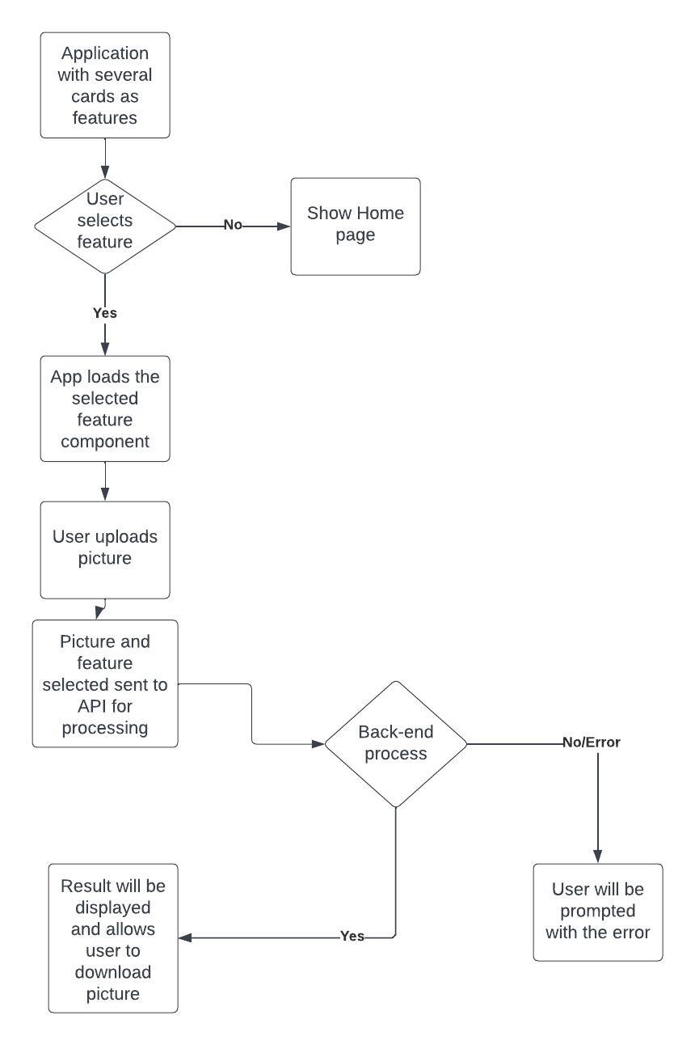
Front End WorkFlow (Existing)
‹#›

Slide 21
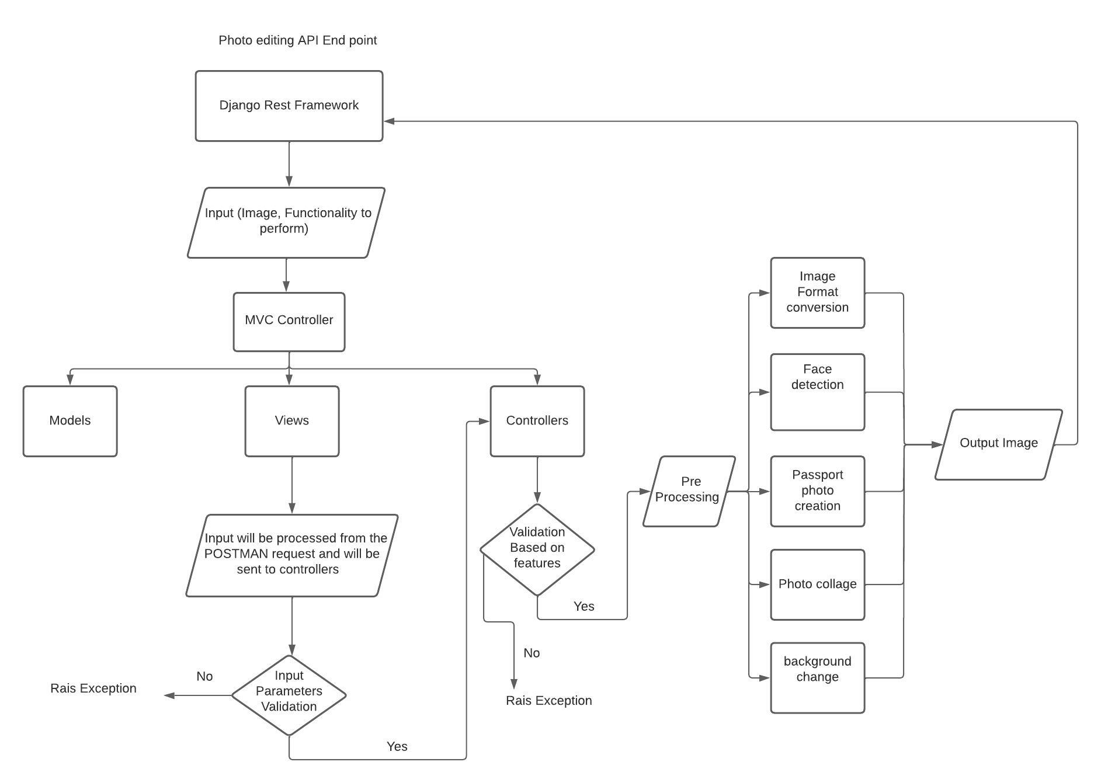
Backend Work Flow (Existing)

Slide 22
Thank You

