Slide 1
AI for illegal parking and vendors detection

Slide 2


Group Members
Muhammad Saad Akmal
2022-CS-148
Shehroz Ahmed
2022-CS-157

Slide 3
Problem Statement
In Pakistan Traffic congestion is a major issue in urban areas, impacting daily commutes, emergency services, and overall city functionality.
One significant cause of congestion is illegal parking, which obstructs traffic flow and reduces road capacity.
Another contributor is the presence of roadside vendors, who often occupy sidewalks and roads, creating bottlenecks for both vehicles and pedestrians.
These challenges lead to delays, inefficiencies, and increased frustration for city residents.

Slide 4
Previous Works
AI-powered systems for detecting illegal parking and monitoring traffic have been implemented in various cities globally, such as Seoul and London.
Relevant projects have also been implemented before like “AI powered Illegal Parking” by Algo Vision.
In Pakistan, no AI-based system for detecting illegal parking or monitoring roadside vendors has been implemented, leaving a significant gap in traffic management solutions.

Slide 5
ML Model to Business Model Mapping

Slide 6
ML to BL Mapping
Baseline:
Currently, traffic wardens and human enforcement handle illegal parking and vendor management in Pakistan, which is less efficient and error-prone.
Limited automation exists globally, but no specific solutions address vendors and illegal parking together in Pakistan.
Confidence Threshold:
The system provides faster detection compared to human observation.
Reduces workload by automating the process of incident detection and alert generation.

Slide 7
ML to BL Mapping
Interpretability
The AI system generates visual evidence (snapshots/videos), making results interpretable for both admins and traffic authorities.
False Negatives VS False Positives:
False Negatives: Missed detection of illegal parking or vendors could lead to persistent issues such as traffic congestion and lack of enforcement, which undermines urban management efforts
False Positives: While occasional false detections may occur, their impact is minimal as authorities can quickly verify and dismiss them, ensuring the overall system's reliability is maintained.

Slide 8
Methodology

Slide 9




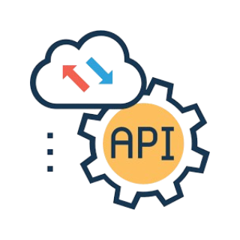

YOLO Model
Images
Trained Model
Request
Fronted
Post Processing
Reponse
Model Integration

Slide 10
Class Imbalance

Slide 11
Handling class imbalance
The model struggled to correctly identify "cart" images specifically.
Added more labeled "cart" images to improve identification.
Addressed class imbalance by ensuring the model learns to distinguish "cart" vendors more effectively.

Slide 12
Model Evaluation Metrices

Slide 13
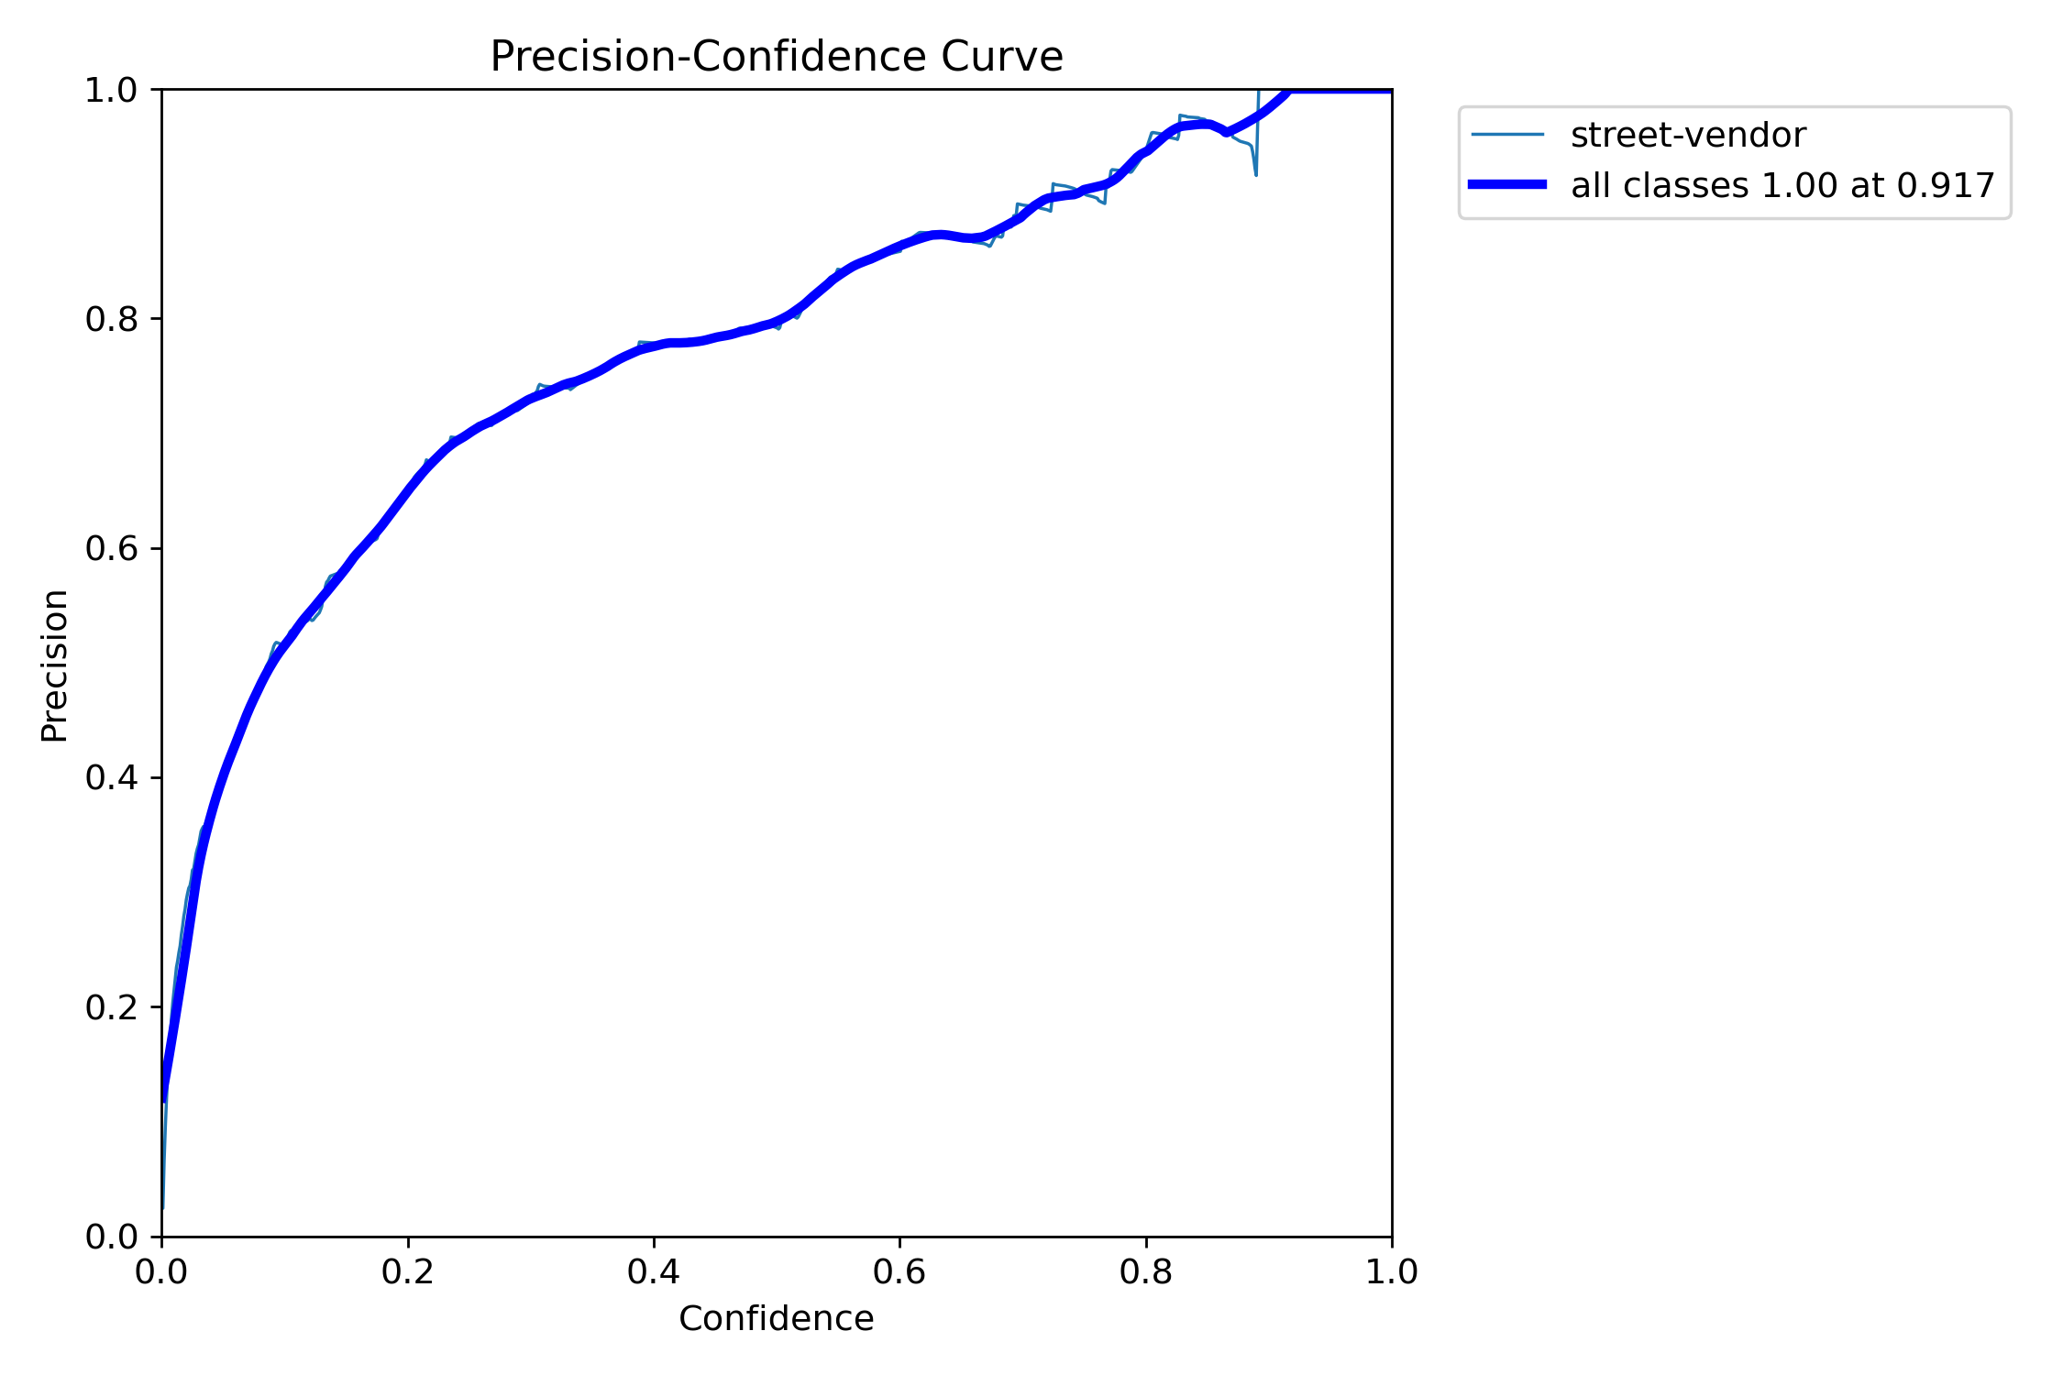
Precision-Confidence Curve

Slide 14
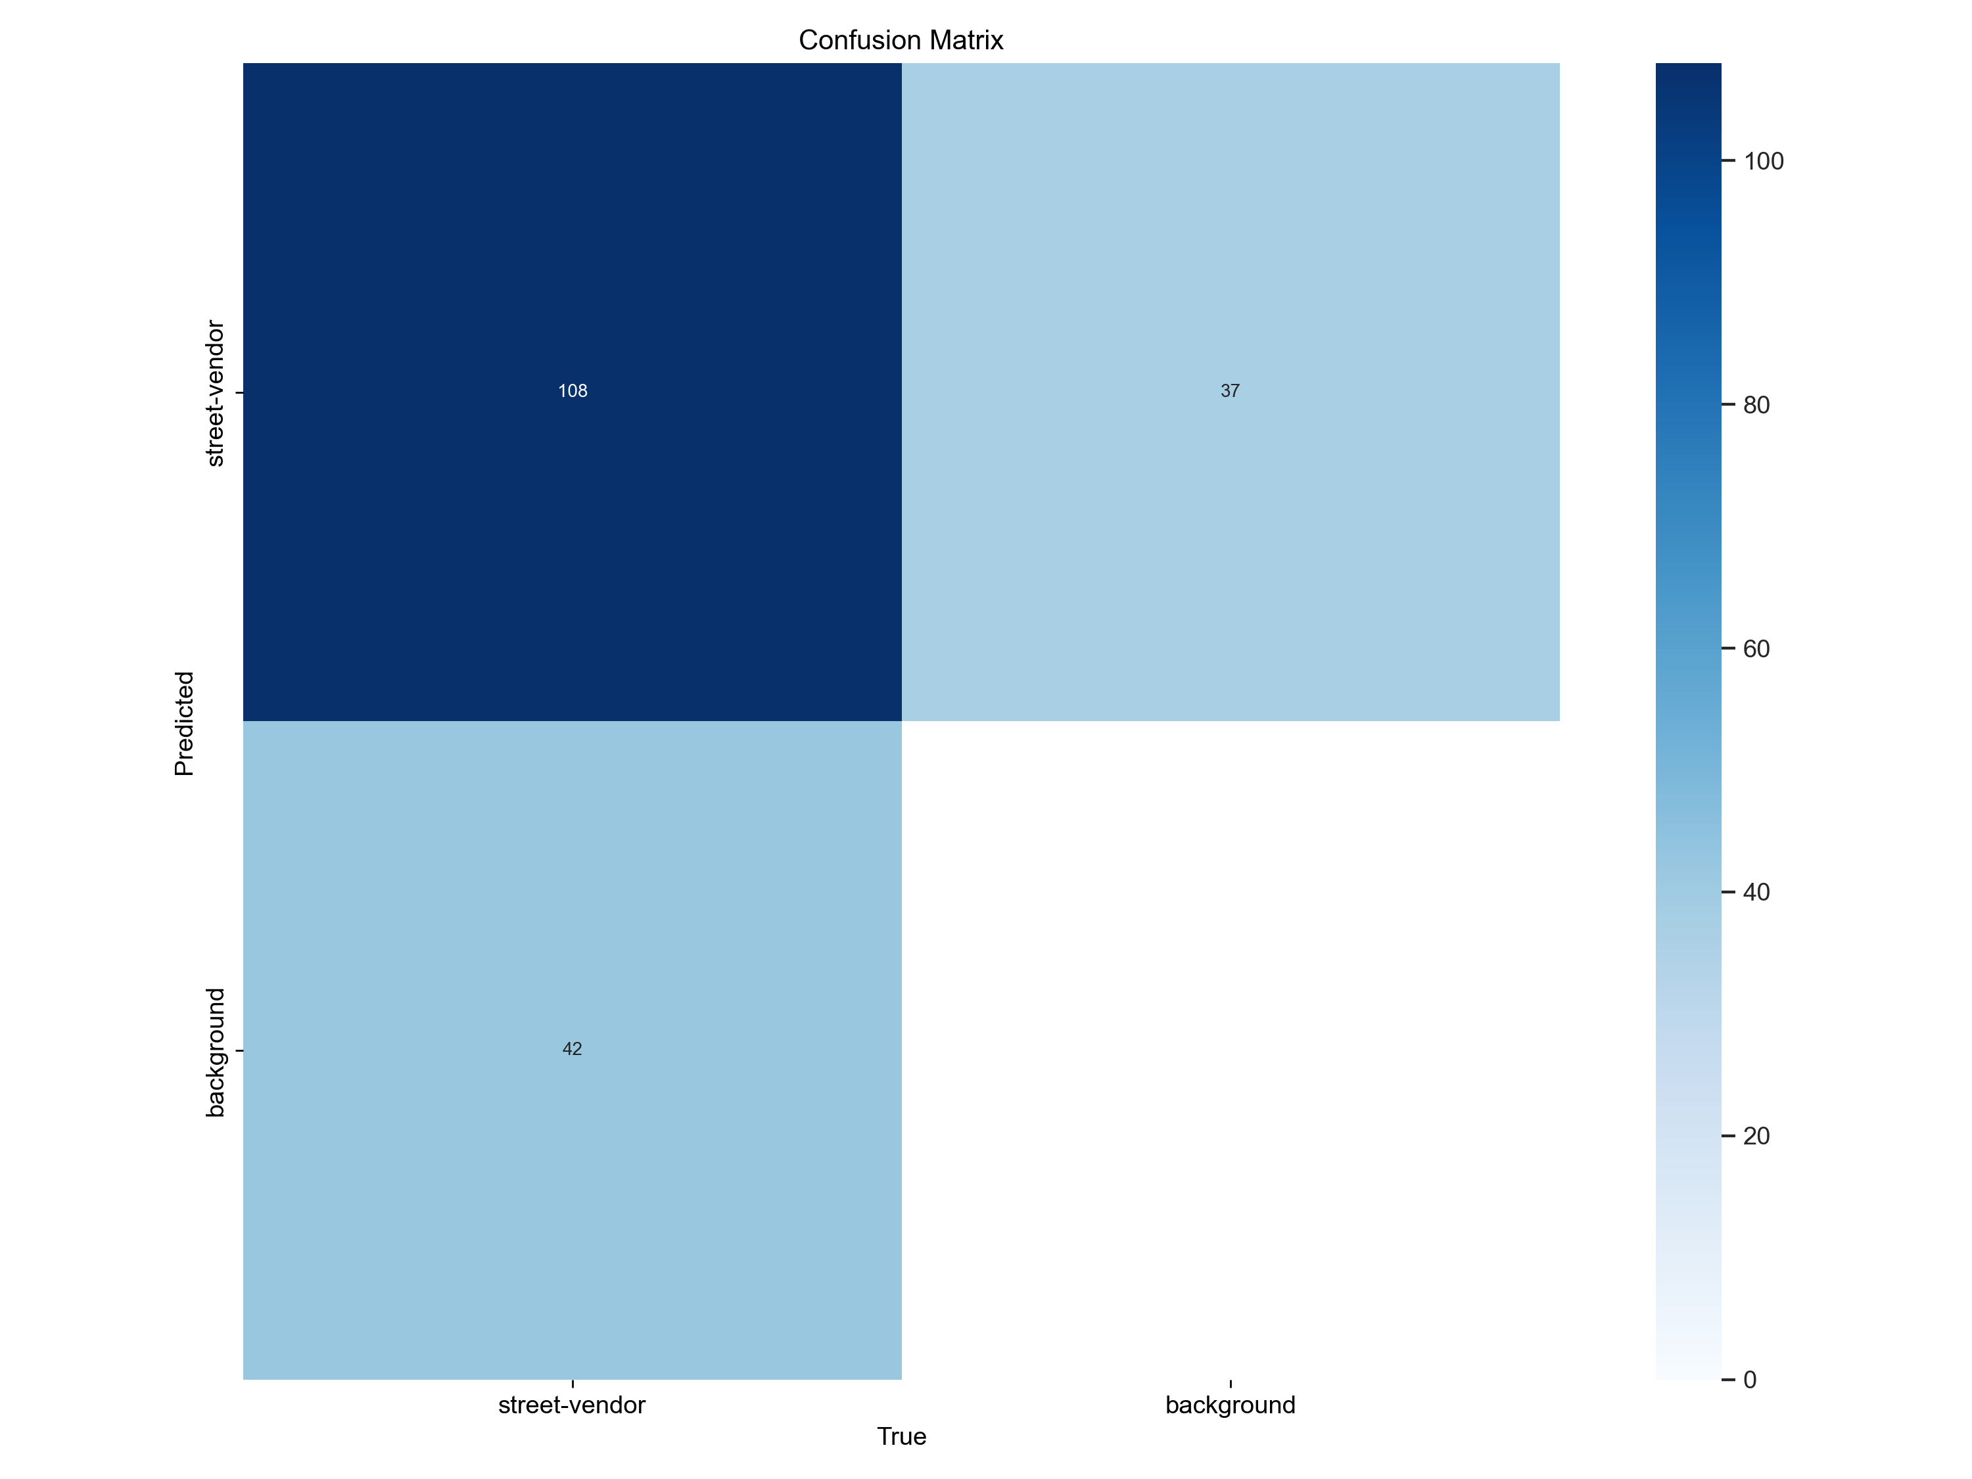
Confusion Matrix

Slide 15
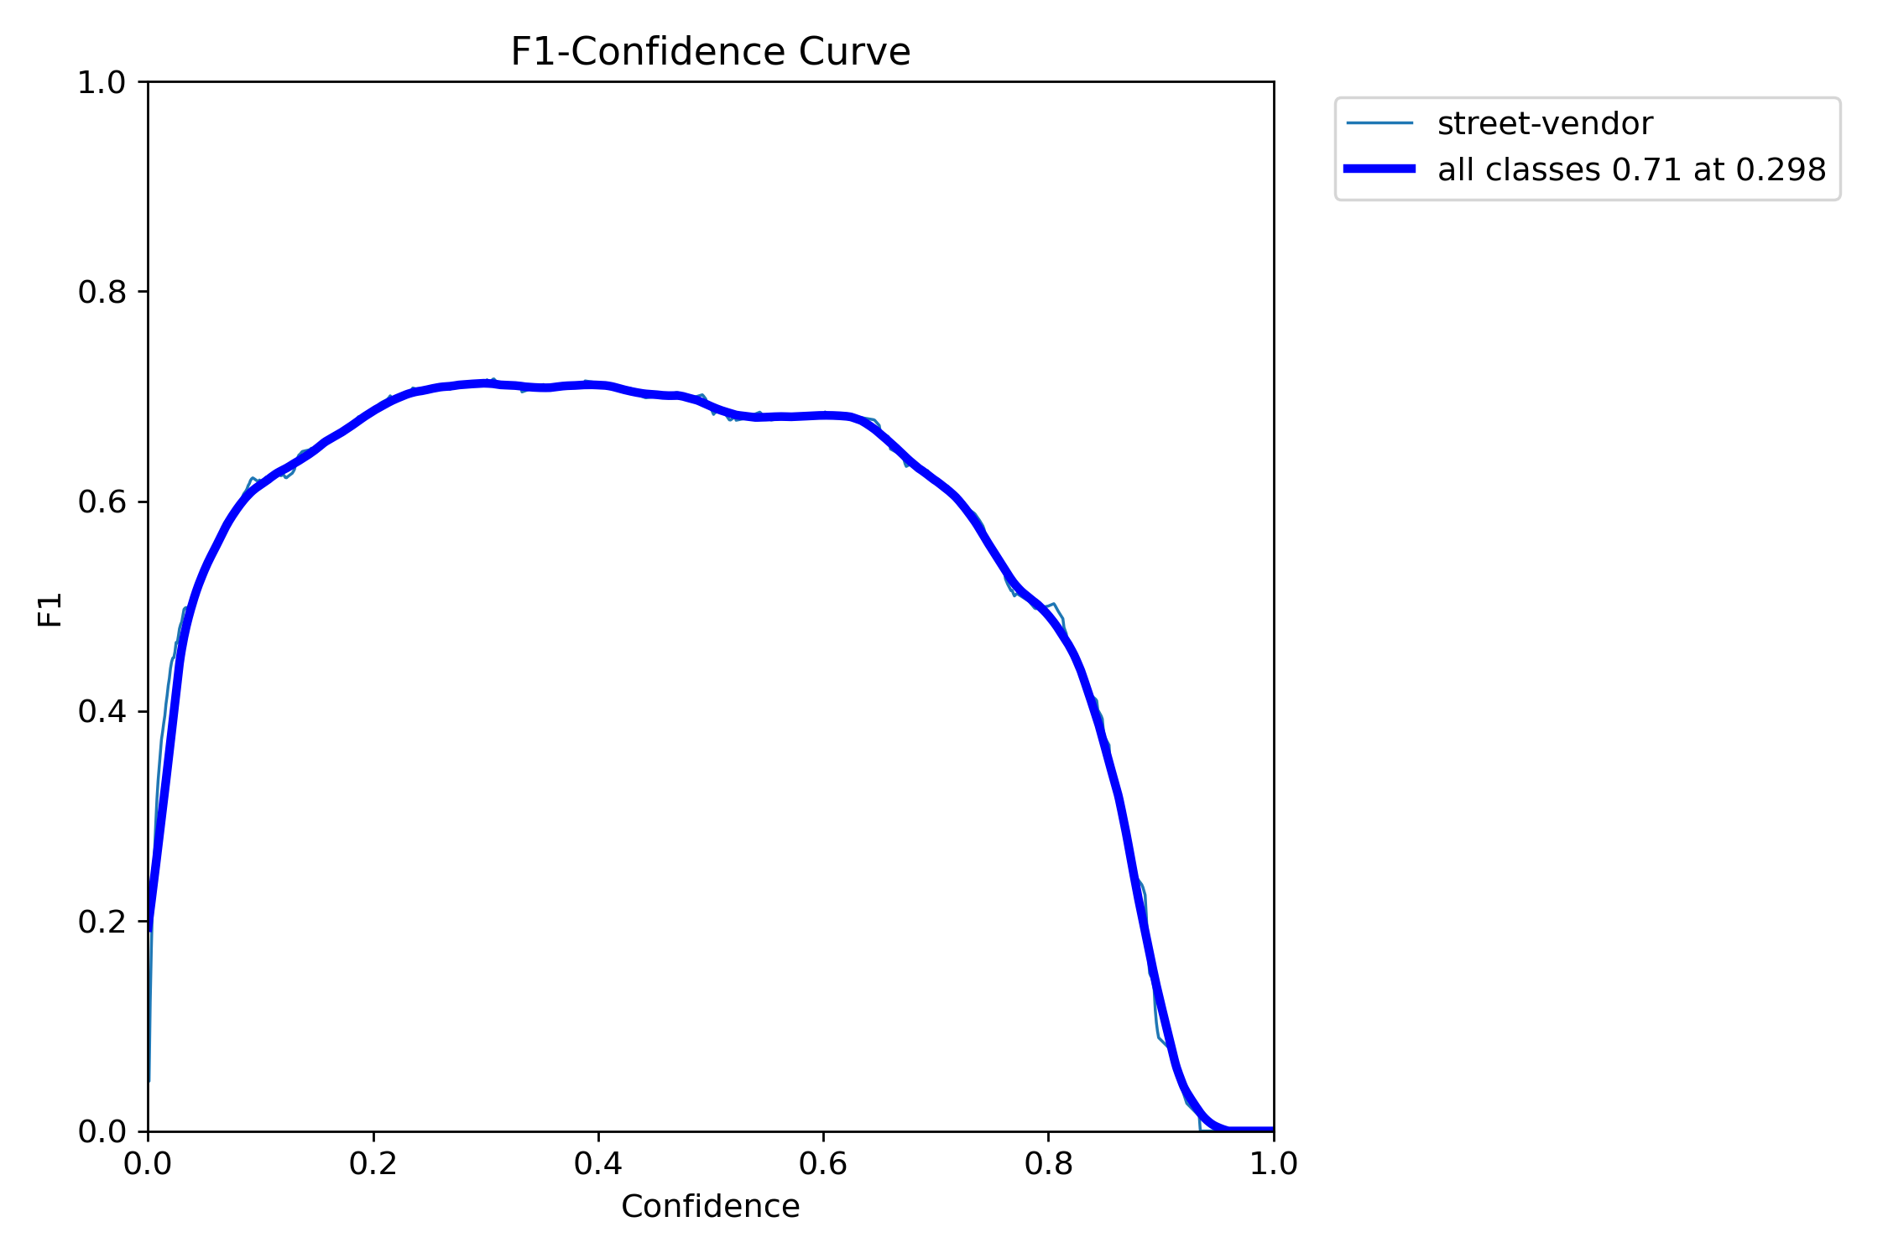
F1-Confidence Curve

Slide 16
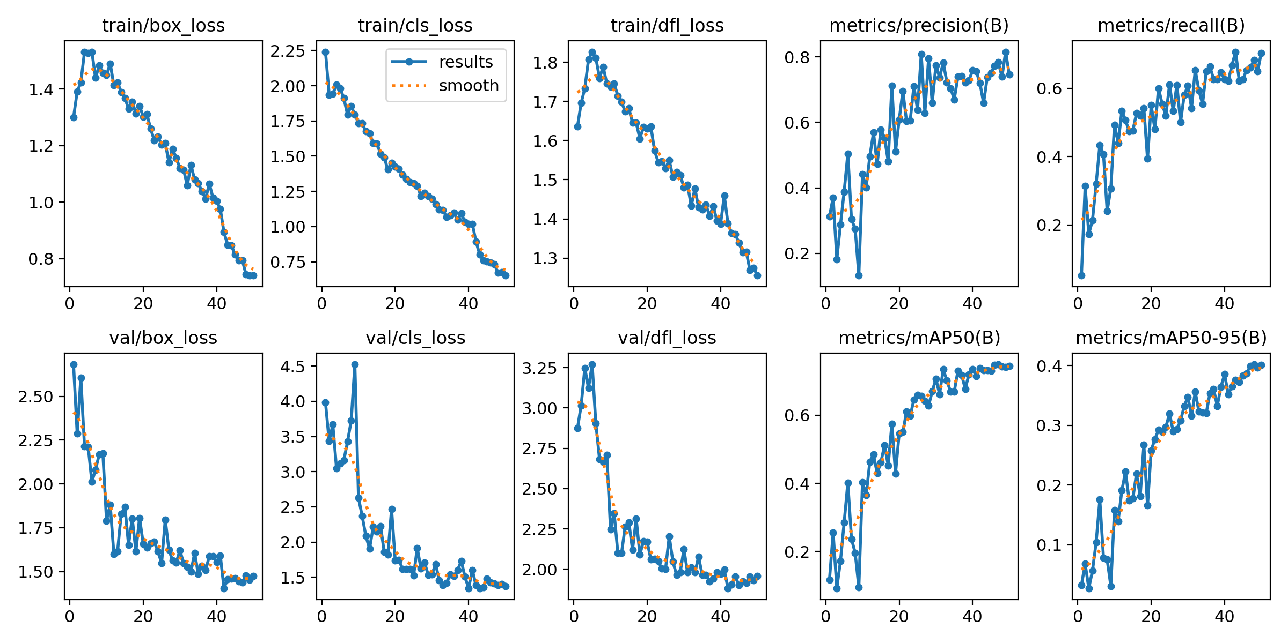
Results

Slide 17
Conclusion
This project provides an easy and effective way to detect illegal parking and street vendors using AI.
It reduces the need for manual work and helps manage traffic better.
The system focuses on being accurate, ensuring important cases are not missed.
This solution supports making cities smarter and improving urban life in Pakistan.

Slide 18
Thank you

