Slide 1
Conditional Processing
Computer Organization and Assembly Languages
with slides by Kip Irvine

Slide 2
Announcements
Midterm exam: Room 103, 10:00am-12:00am next Thursday, open book, chapters 1-5.
Assignment #2 is online.

Slide 3
Assignment #2 CRC32 checksum
unsigned int crc32(const char* data,
size_t length)
{
// standard polynomial in CRC32
const unsigned int POLY = 0xEDB88320;
// standard initial value in CRC32
unsigned int reminder = 0xFFFFFFFF;
for(size_t i = 0; i < length; i++){
// must be zero extended
reminder ^= (unsigned char)data[i];
for(size_t bit = 0; bit < 8; bit++)
if(reminder & 0x01)
reminder = (reminder >> 1) ^ POLY;
else
reminder >>= 1;
}
return reminder ^ 0xFFFFFFFF;
}

Slide 4
Boolean and comparison instructions
CPU Status Flags
AND Instruction
OR Instruction
XOR Instruction
NOT Instruction
Applications
TEST Instruction
CMP Instruction

Slide 5
Status flags - review
The Zero flag is set when the result of an operation equals zero.
The Carry flag is set when an instruction generates a result that is too large (or too small) for the destination operand.
The Sign flag is set if the destination operand is negative, and it is clear if the destination operand is positive.
The Overflow flag is set when an instruction generates an invalid signed result.
Less important:
The Parity flag is set when an instruction generates an even number of 1 bits in the low byte of the destination operand.
The Auxiliary Carry flag is set when an operation produces a carry out from bit 3 to bit 4

Slide 6
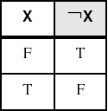
NOT instruction
Performs a bitwise Boolean NOT operation on a single destination operand
Syntax: (no flag affected)
NOT destination
Example:
mov al, 11110000b
not al
NOT

Slide 7
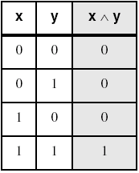
AND instruction
Performs a bitwise Boolean AND operation between each pair of matching bits in two operands
Syntax: (O=0,C=0,SZP)
AND destination, source
Example:
mov al, 00111011b
and al, 00001111b
AND
bit extraction

Slide 8
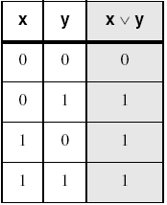
OR instruction
Performs a bitwise Boolean OR operation between each pair of matching bits in two operands
Syntax: (O=0,C=0,SZP)
OR destination, source
Example:
mov dl, 00111011b
or dl, 00001111b
OR

Slide 9
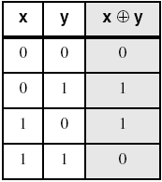
XOR instruction
Performs a bitwise Boolean exclusive-OR operation between each pair of matching bits in two operands
Syntax: (O=0,C=0,SZP)
XOR destination, source
Example:
mov dl, 00111011b
xor dl, 00001111b
XOR
XOR is a useful way to invert the bits in an operand and data encryption

Slide 10
Applications (1 of 5)
Task: Convert the character in AL to upper case.
Solution: Use the AND instruction to clear bit 5.
mov al,'a' ; AL = 01100001b
and al,11011111b ; AL = 01000001b

Slide 11
Applications (2 of 5)
Task: Convert a binary decimal byte into its equivalent ASCII decimal digit.
Solution: Use the OR instruction to set bits 4 and 5.
mov al,6 ; AL = 00000110b
or al,00110000b ; AL = 00110110b
The ASCII digit '6' = 00110110b

Slide 12
Applications (3 of 5)
Task: Turn on the keyboard CapsLock key
Solution: Use the OR instruction to set bit 6 in the keyboard flag byte at 0040:0017h in the BIOS data area.
mov ax,40h ; BIOS segment
mov ds,ax
mov bx,17h ; keyboard flag byte
or BYTE PTR [bx],01000000b ; CapsLock on
This code only runs in Real-address mode, and it does not work under Windows NT, 2000, or XP.

Slide 13
Applications (4 of 5)
Task: Jump to a label if an integer is even.
Solution: AND the lowest bit with a 1. If the result is Zero, the number was even.
mov ax,wordVal
and ax,1 ; low bit set?
jz EvenValue ; jump if Zero flag set

Slide 14
Applications (5 of 5)
Task: Jump to a label if the value in AL is not zero.
Solution: OR the byte with itself, then use the JNZ (jump if not zero) instruction.
or al,al
jnz IsNotZero ; jump if not zero
ORing any number with itself does not change its value.

Slide 15
TEST instruction
Performs a nondestructive AND operation between each pair of matching bits in two operands
No operands are modified, but the flags are affected.
Example: jump to a label if either bit 0 or bit 1 in AL is set.
test al,00000011b
jnz ValueFound
Example: jump to a label if neither bit 0 nor bit 1 in AL is set.
test al,00000011b
jz ValueNotFound

Slide 16
CMP instruction (1 of 3)
Compares the destination operand to the source operand
Nondestructive subtraction of source from destination (destination operand is not changed)
Syntax: (OSZCAP)
CMP destination, source
Example: destination == source
mov al,5
cmp al,5 ; Zero flag set
Example: destination < source
mov al,4
cmp al,5 ; Carry flag set

Slide 17
CMP instruction (2 of 3)
Example: destination > source
mov al,6
cmp al,5 ; ZF = 0, CF = 0
(both the Zero and Carry flags are clear)
The comparisons shown so far were unsigned.

Slide 18
CMP instruction (3 of 3)
The comparisons shown here are performed with signed integers.
Example: destination > source
mov al,5
cmp al,-2 ; Sign flag == Overflow flag
Example: destination < source
mov al,-1
cmp al,5 ; Sign flag != Overflow flag

Slide 19
Setting and clearing individual flags
and al, 0 ; set Zero
or al, 1 ; clear Zero
or al, 80h ; set Sign
and al, 7Fh ; clear Sign
stc ; set Carry
clc ; clear Carry
mov al, 7Fh
inc al ; set Overflow
or eax, 0 ; clear Overflow

Slide 20
Conditional jumps

Slide 21
Conditional structures
There are no high-level logic structures such as if-then-else, in the IA-32 instruction set. But, you can use combinations of comparisons and jumps to implement any logic structure.
First, an operation such as CMP, AND or SUB is executed to modified the CPU flags. Second, a conditional jump instruction tests the flags and change the execution flow accordingly.
CMP AL, 0
JZ L1
:
L1:

Slide 22
Jcond instruction
A conditional jump instruction branches to a label when specific register or flag conditions are met
Jcond destination
Four groups: (some are the same)
based on specific flag values
based on equality between operands
based on comparisons of unsigned operands
based on comparisons of signed operands

Slide 23
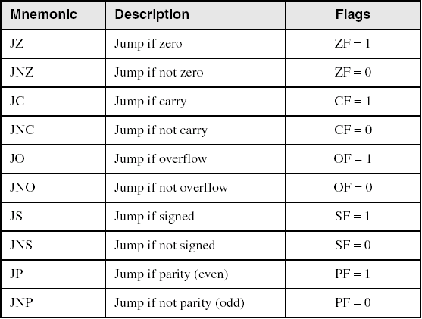
Jumps based on specific flags

Slide 24
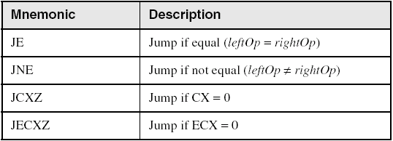
Jumps based on equality

Slide 25
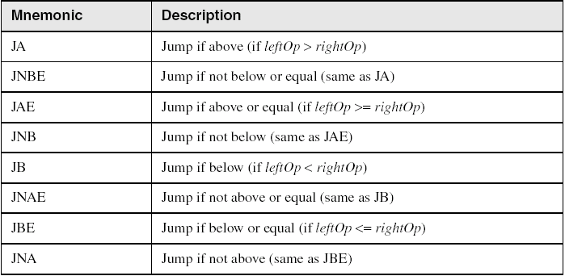
Jumps based on unsigned comparisons
＞≧＜≦

Slide 26
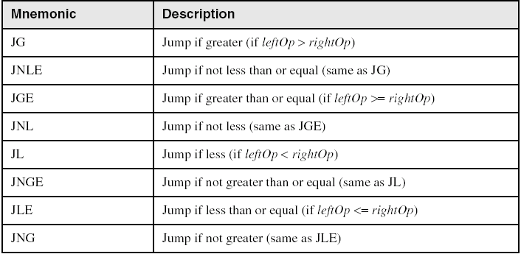
Jumps based on signed comparisons

Slide 27
Examples
Compare unsigned AX to BX, and copy the larger of the two into a variable named Large
mov Large,bx
cmp ax,bx
jna Next
mov Large,ax
Next:
Compare signed AX to BX, and copy the smaller of the two into a variable named Small
mov Small,ax
cmp bx,ax
jnl Next
mov Small,bx
Next:

Slide 28
Examples
Find the first even number in an array of unsigned integers
.date
intArray DWORD 7,9,3,4,6,1
.code
...
mov ebx, OFFSET intArray
mov ecx, LENGTHOF intArray
L1: test DWORD PTR [ebx], 1
jz found
add ebx, 4
loop L1
...

Slide 29
String encryption
key
encoder
message
(plain text)
unintelligible string
(cipher text)
encoder
message
(plain text)
key

Slide 30
Encrypting a string
KEY = 239
.data
buffer BYTE BUFMAX DUP(0)
bufSize DWORD ?
.code
mov ecx,bufSize ; loop counter
mov esi,0 ; index 0 in buffer
L1:
xor buffer[esi],KEY ; translate a byte
inc esi ; point to next byte
loop L1
Message: Attack at dawn.
Cipher text: «¢¢Äîä-Ä¢-ïÄÿü-Gs
Decrypted: Attack at dawn.

Slide 31
Conditional loops

Slide 32
LOOPZ and LOOPE
Syntax:
LOOPE destination
LOOPZ destination
Logic:
ECX ← ECX – 1
if ECX > 0 and ZF=1, jump to destination
The destination label must be between -128 and +127 bytes from the location of the following instruction
Useful when scanning an array for the first element that meets some condition.

Slide 33
LOOPNZ and LOOPNE
Syntax:
LOOPNZ destination
LOOPNE destination
Logic:
ECX ← ECX – 1;
if ECX > 0 and ZF=0, jump to destination

Slide 34
LOOPNZ example
The following code finds the first positive value in an array:
.data
array SWORD -3,-6,-1,-10,10,30,40,4
sentinel SWORD 0
.code
mov esi,OFFSET array
mov ecx,LENGTHOF array
next:
test WORD PTR [esi],8000h ; test sign bit
pushfd ; push flags on stack
add esi,TYPE array
popfd ; pop flags from stack
loopnz next ; continue loop
jnz quit ; none found
sub esi,TYPE array ; ESI points to value
quit:

Slide 35
Your turn
Locate the first nonzero value in the array. If none is found, let ESI point to the sentinel value:
.data
array SWORD 50 DUP(?)
sentinel SWORD 0FFFFh
.code
mov esi,OFFSET array
mov ecx,LENGTHOF array
L1: cmp WORD PTR [esi],0 ; check for zero
quit:

Slide 36
Solution
.data
array SWORD 50 DUP(?)
sentinel SWORD 0FFFFh
.code
mov esi,OFFSET array
mov ecx,LENGTHOF array
L1: cmp WORD PTR [esi],0 ; check for zero
pushfd ; push flags on stack
add esi,TYPE array
popfd ; pop flags from stack
loope next ; continue loop
jz quit ; none found
sub esi,TYPE array ; ESI points to value
quit:

Slide 37
Conditional structures

Slide 38
Block-structured IF statements
Assembly language programmers can easily translate logical statements written in C++/Java into assembly language. For example:
if( op1 == op2 )
X = 1;
else
X = 2;
mov eax,op1
cmp eax,op2
jne L1
mov X,1
jmp L2
L1: mov X,2
L2:

Slide 39
Example
Implement the following pseudocode in assembly language. All values are unsigned:
if( ebx <= ecx )
{
eax = 5;
edx = 6;
}
cmp ebx,ecx
ja next
mov eax,5
mov edx,6
next:

Slide 40
Example
Implement the following pseudocode in assembly language. All values are 32-bit signed integers:
if( var1 <= var2 )
var3 = 10;
else
{
var3 = 6;
var4 = 7;
}
mov eax,var1
cmp eax,var2
jle L1
mov var3,6
mov var4,7
jmp L2
L1: mov var3,10
L2:

Slide 41
Compound expression with AND
When implementing the logical AND operator, consider that HLLs use short-circuit evaluation
In the following example, if the first expression is false, the second expression is skipped:
if (al > bl) AND (bl > cl)
X = 1;

Slide 42
Compound expression with AND
if (al > bl) AND (bl > cl)
X = 1;
This is one possible implementation . . .
cmp al,bl ; first expression...
ja L1
jmp next
L1:
cmp bl,cl ; second expression...
ja L2
jmp next
L2: ; both are true
mov X,1 ; set X to 1
next:

Slide 43
Compound expression with AND
if (al > bl) AND (bl > cl)
X = 1;
But the following implementation uses 29% less code by reversing the first relational operator. We allow the program to "fall through" to the second expression:
cmp al,bl ; first expression...
jbe next ; quit if false
cmp bl,cl ; second expression...
jbe next ; quit if false
mov X,1 ; both are true
next:

Slide 44
Your turn . . .
Implement the following pseudocode in assembly language. All values are unsigned:
if( ebx <= ecx
&& ecx > edx )
{
eax = 5;
edx = 6;
}
cmp ebx,ecx
ja next
cmp ecx,edx
jbe next
mov eax,5
mov edx,6
next:
(There are multiple correct solutions to this problem.)

Slide 45
Compound Expression with OR
In the following example, if the first expression is true, the second expression is skipped:
if (al > bl) OR (bl > cl)
X = 1;

Slide 46
Compound Expression with OR
if (al > bl) OR (bl > cl)
X = 1;
We can use "fall-through" logic to keep the code as short as possible:
cmp al,bl ; is AL > BL?
ja L1 ; yes
cmp bl,cl ; no: is BL > CL?
jbe next ; no: skip next statement
L1: mov X,1 ; set X to 1
next:

Slide 47
WHILE Loops
A WHILE loop is really an IF statement followed by the body of the loop, followed by an unconditional jump to the top of the loop. Consider the following example:
while( eax < ebx)
eax = eax + 1;
_while:
cmp eax,ebx ; check loop condition
jae _endwhile ; false? exit loop
inc eax ; body of loop
jmp _while ; repeat the loop
_endwhile:

Slide 48
Your turn . . .
Implement the following loop, using unsigned 32-bit integers:
while( ebx <= val1)
{
ebx = ebx + 5;
val1 = val1 - 1
}
_while: cmp ebx,val1 ; check loop condition
ja _endwhile ; false? exit loop
add ebx,5 ; body of loop
dec val1
jmp while ; repeat the loop
_endwhile:

Slide 49
Example: IF statement nested in a loop
while(eax < ebx)
{
eax++;
if (ebx==ecx)
X=2;
else
X=3;
}
_while: cmp eax, ebx
jae _endwhile
inc eax
cmp ebx, ecx
jne _else
mov X, 2
jmp _while
_else: mov X, 3
jmp _while
_endwhile:

Slide 50
Table-driven selection
Table-driven selection uses a table lookup to replace a multiway selection structure (switch-case statements in C)
Create a table containing lookup values and the offsets of labels or procedures
Use a loop to search the table
Suited to a large number of comparisons

Slide 51
Table-driven selection
Step 1: create a table containing lookup values and procedure offsets:
.data
CaseTable BYTE 'A' ; lookup value
DWORD Process_A ; address of procedure
EntrySize = ($ - CaseTable)
BYTE 'B'
DWORD Process_B
BYTE 'C'
DWORD Process_C
BYTE 'D'
DWORD Process_D
NumberOfEntries = ($ - CaseTable) / EntrySize

Slide 52
Table-driven selection
Step 2: Use a loop to search the table. When a match is found, we call the procedure offset stored in the current table entry:
mov ebx,OFFSET CaseTable ; point EBX to the table
mov ecx,NumberOfEntries ; loop counter
L1:cmp al,[ebx] ; match found?
jne L2 ; no: continue
call NEAR PTR [ebx + 1] ; yes: call the procedure
jmp L3 ; and exit the loop
L2:add ebx,EntrySize ; point to next entry
loop L1 ; repeat until ECX = 0
L3:
required for procedure pointers

Slide 53
Application: finite-state machines
A finite-state machine (FSM) is a graph structure that changes state based on some input. Also called a state-transition diagram.
We use a graph to represent an FSM, with squares or circles called nodes, and lines with arrows between the circles called edges (or arcs).
A FSM is a specific instance of a more general structure called a directed graph (or digraph).
Three basic states, represented by nodes:
Start state
Terminal state(s)
Nonterminal state(s)

Slide 54
Finite-state machines
Accepts any sequence of symbols that puts it into an accepting (final) state
Can be used to recognize, or validate a sequence of characters that is governed by language rules (called a regular expression)

Slide 55
FSM Examples
FSM that recognizes strings beginning with 'x', followed by letters 'a'..'y', ending with 'z':
FSM that recognizes signed integers:

Slide 56
Your turn . . .
Explain why the following FSM does not work as well for signed integers as the one shown on the previous slide:

Slide 57
Implementing an FSM
The following is code from State A in the Integer FSM:
StateA:
call Getnext ; read next char into AL
cmp al,'+‘ ; leading + sign?
je StateB ; go to State B
cmp al,'-‘ ; leading - sign?
je StateB ; go to State B
call IsDigit ; ZF = 1 if AL = digit
jz StateC ; go to State C
call DisplayErrorMsg ; invalid input found
jmp Quit

Slide 58
Isdigit
Isdigit PROC
cmp al,’0’
jb L1
cmp al,’9’
ja L1
test ax,0
L1: ret
Isdigit ENDP

Slide 59
Your turn
StateB:
call Getnext ; read next char into AL
call Isdigit ; ZF = 1 if AL is a digit
jz StateC
call DisplayErrorMsg ; invalid input found
jmp Quit

Slide 60
Implementing an FSM
StateC:
call Getnext ; read next char into AL
jz Quit ; quit if Enter pressed
call Isdigit ; ZF = 1 if AL is digit
jz StateC
cmp AL,ENTER_KEY ; Enter key pressed?
je Quit ; yes: quit
call DisplayErrorMsg ; no: invalid input
jmp Quit

Slide 61
Finite-state machine example
[sign]integer.[integer][exponent]
sign → {+|-}
exponent → E[{+|-}]integer

Slide 62
High-level directives
.IF, .ELSE, .ELSEIF, and .ENDIF can be used to create block-structured IF statements.
Examples:
.IF eax > ebx
mov edx,1
.ELSE
mov edx,2
.ENDIF
.IF eax > ebx && eax > ecx
mov edx,1
.ELSE
mov edx,2
.ENDIF
MASM generates "hidden" code for you, consisting of code labels, CMP and conditional jump instructions.

Slide 63
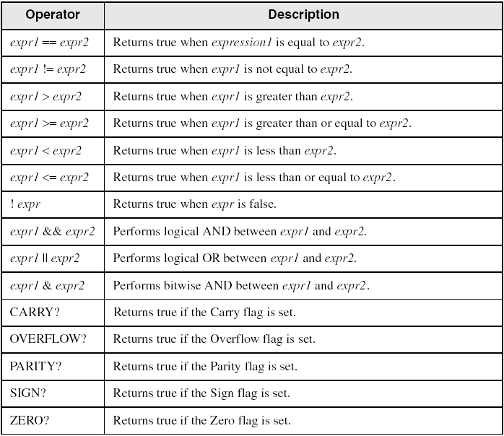
Relational and logical operators

Slide 64
MASM-generated Code
.data
val1 DWORD 5
result DWORD ?
.code
mov eax,6
.IF eax > val1
mov result,1
.ENDIF
Generated code:
mov eax,6
cmp eax,val1
jbe @C0001
mov result,1
@C0001:
MASM automatically generates an unsigned jump (JBE).

Slide 65
.REPEAT directive
Executes the loop body before testing the loop condition associated with the .UNTIL directive.
Example:
; Display integers 1 – 10:
mov eax,0
.REPEAT
inc eax
call WriteDec
call Crlf
.UNTIL eax == 10

Slide 66
.WHILE directive
Tests the loop condition before executing the loop body The .ENDW directive marks the end of the loop.
Example:
; Display integers 1 – 10:
mov eax,0
.WHILE eax < 10
inc eax
call WriteDec
call Crlf
.ENDW

