Slide 1
Introduction to
Artificial Intelligence
with Python
By M. Saad Amjad Khan

Slide 2
Artificial Intelligence
Notes:
What is AI? …….. AI performs tasks that require human intelligence….. There are a lot of fields in which AI is being used but today we are going to talk about Search problems

Slide 3
Search
Notes:
We need an AI that can help us to search a solution no matter what problem might be
Driving from point A to point B
Solving maze
Playing Tic Toc Toe etc

Slide 4

Notes:
We will learn about search solutions using maze as an example

Slide 5
agent
entity that perceives its environment and acts upon that environment

Slide 6
state
a configuration of the agent and its environment

Slide 7
initial state
the state in which the agent begins

Slide 8
actions
choices that can be made in a state

Slide 9
actions
Actions(s) returns the set of actions that can be executed in state s

Slide 10
transition model
a description of what state results from performing any applicable action in any state

Slide 11
transition model
RESULT(s, a) returns the state resulting from performing action a in state s

Slide 12
state space
the set of all states reachable from the initial state by any sequence of actions

Slide 13
goal test
way to determine whether a given state is a goal state

Slide 14
path cost
numerical cost associated with a given path

Slide 15
Search Problems
initial state
actions
transition model
goal test
path cost function

Slide 16
solution
a sequence of actions that leads from the initial state to a goal state

Slide 17
optimal solution
a solution that has the lowest path cost among all solutions

Slide 18
node
a data structure that keeps track of
a state
a parent (node that generated this node)
an action (action applied to parent to get node)
a path cost (from initial state to node)

Slide 19
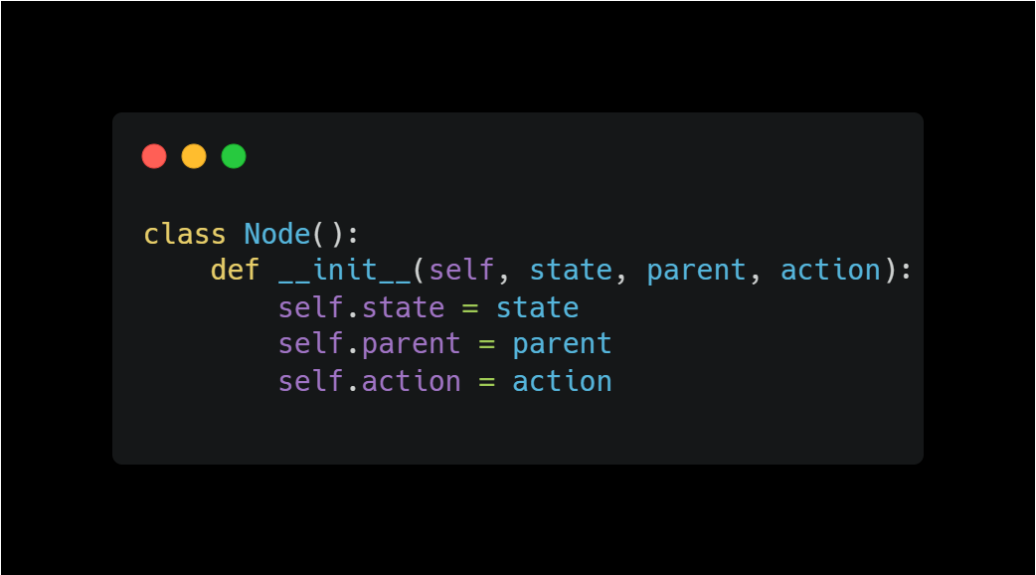

Slide 20
Approach
Start with a frontier that contains the initial state.
Repeat:
  If the frontier is empty, then no solution.
  Remove a node from the frontier.
  If node contains goal state, return the solution.
  Expand node, add resulting nodes to the frontier.

Slide 21
Find a path from A to E.
A
B
Frontier
C
D
Start with a frontier that contains the initial state.
Repeat:
  If the frontier is empty, then no solution.
  Remove a node from the frontier.
  If node contains goal state, return the solution.
  Expand node, add resulting nodes to the frontier.
E
F

Slide 22
Find a path from A to E.
A
B
Frontier
A
C
D
Start with a frontier that contains the initial state.
Repeat:
  If the frontier is empty, then no solution.
  Remove a node from the frontier.
  If node contains goal state, return the solution.
  Expand node, add resulting nodes to the frontier.
E
F

Slide 23
Find a path from A to E.
A
B
Frontier
C
D
Start with a frontier that contains the initial state.
Repeat:
  If the frontier is empty, then no solution.
  Remove a node from the frontier.
  If node contains goal state, return the solution.
  Expand node, add resulting nodes to the frontier.
E
F

Slide 24
Find a path from A to E.
A
B
Frontier
B
C
D
Start with a frontier that contains the initial state.
Repeat:
  If the frontier is empty, then no solution.
  Remove a node from the frontier.
  If node contains goal state, return the solution.
  Expand node, add resulting nodes to the frontier.
E
F

Slide 25
Find a path from A to E.
A
B
Frontier
C
D
Start with a frontier that contains the initial state.
Repeat:
  If the frontier is empty, then no solution.
  Remove a node from the frontier.
  If node contains goal state, return the solution.
  Expand node, add resulting nodes to the frontier.
E
F

Slide 26
Find a path from A to E.
A
B
Frontier
C
D
C
D
Start with a frontier that contains the initial state.
Repeat:
  If the frontier is empty, then no solution.
  Remove a node from the frontier.
  If node contains goal state, return the solution.
  Expand node, add resulting nodes to the frontier.
E
F

Slide 27
Find a path from A to E.
A
B
Frontier
D
C
D
Start with a frontier that contains the initial state.
Repeat:
  If the frontier is empty, then no solution.
  Remove a node from the frontier.
  If node contains goal state, return the solution.
  Expand node, add resulting nodes to the frontier.
E
F

Slide 28
Find a path from A to E.
A
B
Frontier
E
D
C
D
Start with a frontier that contains the initial state.
Repeat:
  If the frontier is empty, then no solution.
  Remove a node from the frontier.
  If node contains goal state, return the solution.
  Expand node, add resulting nodes to the frontier.
E
F

Slide 29
Find a path from A to E.
A
B
Frontier
D
C
D
Start with a frontier that contains the initial state.
Repeat:
  If the frontier is empty, then no solution.
  Remove a node from the frontier.
  If node contains goal state, return the solution.
  Expand node, add resulting nodes to the frontier.
E
F

Slide 30
Find a path from A to E.
A
B
Frontier
D
C
D
Start with a frontier that contains the initial state.
Repeat:
  If the frontier is empty, then no solution.
  Remove a node from the frontier.
  If node contains goal state, return the solution.
  Expand node, add resulting nodes to the frontier.
E
F

Slide 31
What could go wrong?

Slide 32
Find a path from A to E.
A
B
Frontier
C
D
E
F

Slide 33
Find a path from A to E.
A
B
Frontier
A
C
D
E
F

Slide 34
Find a path from A to E.
A
B
Frontier
C
D
E
F

Slide 35
Find a path from A to E.
A
B
Frontier
B
C
D
E
F

Slide 36
Find a path from A to E.
A
B
Frontier
C
D
E
F

Slide 37
Find a path from A to E.
A
B
Frontier
A C D
C
D
E
F

Slide 38
Find a path from A to E.
A
B
Frontier
C D
C
D
E
F

Slide 39
Revised Approach
Start with a frontier that contains the initial state.
Start with an empty explored set.
Repeat:
  If the frontier is empty, then no solution.
  Remove a node from the frontier.
  If node contains goal state, return the solution.
  Add the node to the explored set.
  Expand node, add resulting nodes to the frontier if they aren't already in the frontier or the explored set.

Slide 40
Revised Approach
Start with a frontier that contains the initial state.
Start with an empty explored set.
Repeat:
  If the frontier is empty, then no solution.
  Remove a node from the frontier.
  If node contains goal state, return the solution.
  Add the node to the explored set.
  Expand node, add resulting nodes to the frontier if they aren't already in the frontier or the explored set.

Slide 41
stack
last-in first-out data type

Slide 42
Find a path from A to E.
A
B
Frontier
C
D
Explored Set
E
F

Slide 43
Find a path from A to E.
A
B
Frontier
A
C
D
Explored Set
E
F

Slide 44
Find a path from A to E.
A
B
Frontier
C
D
Explored Set
A
E
F

Slide 45
Find a path from A to E.
A
B
Frontier
B
C
D
Explored Set
A
E
F

Slide 46
Find a path from A to E.
A
B
Frontier
C
D
Explored Set
A B
E
F

Slide 47
Find a path from A to E.
A
B
Frontier
C
D
C
D
Explored Set
A B
E
F

Slide 48
Find a path from A to E.
A
B
Frontier
C
C
D
Explored Set
A B
D
E
F

Slide 49
Find a path from A to E.
A
B
Frontier
C
F
C
D
Explored Set
A B
D
E
F

Slide 50
Find a path from A to E.
A
B
Frontier
C
C
D
Explored Set
A B
D
F
E
F

Slide 51
Find a path from A to E.
A
B
Frontier
C
D
Explored Set
A B
D
F
C
E
F

Slide 52
Find a path from A to E.
A
B
Frontier
E
C
D
Explored Set
A B
D
F
C
E
F

Slide 53
Find a path from A to E.
A
B
Frontier
C
D
Explored Set
A B
D
F
C
E
F

Slide 54
Depth-First Search

Slide 55
depth-first search
search algorithm that always expands the deepest node in the frontier

Slide 56
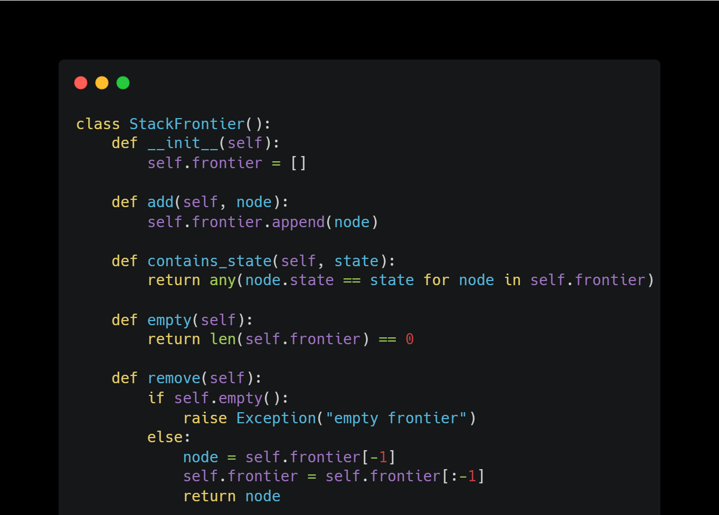

Slide 57
Breadth-First Search

Slide 58
breadth-first search
search algorithm that always expands the shallowest node in the frontier

Slide 59
queue
first-in first-out data type

Slide 60
Find a path from A to E.
A
B
Frontier
C
D
Explored Set
E
F

Slide 61
Find a path from A to E.
A
B
Frontier
A
C
D
Explored Set
E
F

Slide 62
Find a path from A to E.
A
B
Frontier
C
D
Explored Set
A
E
F

Slide 63
Find a path from A to E.
A
B
Frontier
B
C
D
Explored Set
A
E
F

Slide 64
Find a path from A to E.
A
B
Frontier
C
D
Explored Set
A B
E
F

Slide 65
Find a path from A to E.
A
B
Frontier
C
D
C
D
Explored Set
A B
E
F

Slide 66
Find a path from A to E.
A
B
Frontier
D
C
D
Explored Set
A B
C
E
F

Slide 67
Find a path from A to E.
A
B
Frontier
D
E
C
D
Explored Set
A B
C
E
F

Slide 68
Find a path from A to E.
A
B
Frontier
E
C
D
Explored Set
A B
C
D
E
F

Slide 69
Find a path from A to E.
A
B
Frontier
E
F
C
D
Explored Set
A B
C
D
E
F

Slide 70
Find a path from A to E.
A
B
Frontier
F
C
D
Explored Set
A B
C
D
E
F

Slide 71
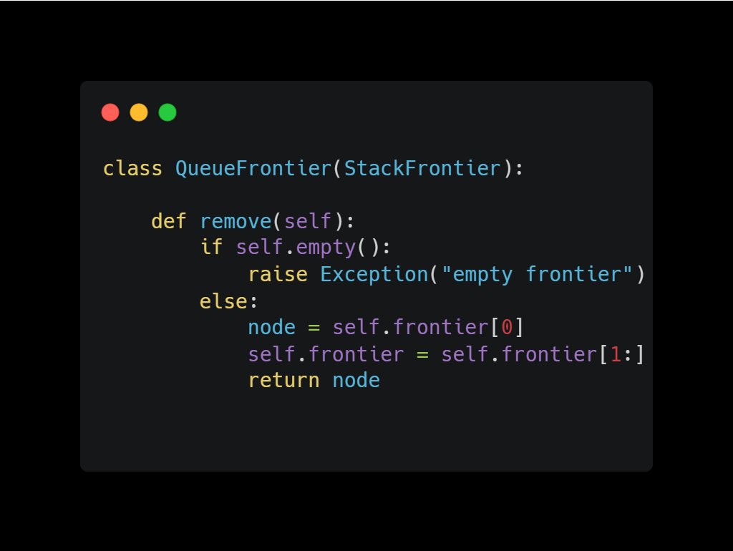

Slide 72
Depth-First Search
 |  |  |  |  |  |  |  |  |  |  | B
A

Slide 73
Depth-First Search
 |  |  |  |  |  |  |  |  |  |  | B
A

Slide 74
Depth-First Search
 |  |  |  |  |  |  |  |  |  |  | B
A

Slide 75
Depth-First Search
 |  |  |  |  |  |  |  |  |  |  | B
A

Slide 76
Depth-First Search
 |  |  |  |  |  |  |  |  |  |  | B
A

Slide 77
Depth-First Search
 |  |  |  |  |  |  |  |  |  |  | B
A

Slide 78
Depth-First Search
 |  |  |  |  |  |  |  |  |  |  | B
A

Slide 79
Depth-First Search
 |  |  |  |  |  |  |  |  |  |  | B
A

Slide 80
Depth-First Search
 |  |  |  |  |  |  |  |  |  |  | B
A

Slide 81
Depth-First Search
 |  |  |  |  |  |  |  |  |  |  | B
A

Slide 82
Depth-First Search
 |  |  |  |  |  |  |  |  |  |  | B
A

Slide 83
Depth-First Search
 |  |  |  |  |  |  |  |  |  |  | B
A

Slide 84
Depth-First Search
 |  |  |  |  |  |  |  |  |  |  | B
A

Slide 85
Depth-First Search
 |  |  |  |  |  |  |  |  |  |  | B
A

Slide 86
Depth-First Search
 |  |  |  |  |  |  |  |  |  |  | B
A

Slide 87
Depth-First Search
 |  |  |  |  |  |  |  |  |  |  | B
A

Slide 88
Depth-First Search
 |  |  |  |  |  |  |  |  |  |  | B
A

Slide 89
Depth-First Search
 |  |  |  |  |  |  |  |  |  |  | B
A

Slide 90
Depth-First Search
 |  |  |  |  |  |  |  |  |  |  | B
A

Slide 91
Depth-First Search
 |  |  |  |  |  |  |  |  |  |  | B
A

Slide 92
Depth-First Search
 |  |  |  |  |  |  |  |  |  |  | B
A

Slide 93
Depth-First Search
 |  |  |  |  |  |  |  |  |  |  | B
A

Slide 94
Depth-First Search
 |  |  |  |  |  |  |  |  |  |  | B
A

Slide 95
Depth-First Search
 |  |  |  |  |  |  |  |  |  |  | B
A

Slide 96
Depth-First Search
 |  |  |  |  |  |  |  |  |  |  | B
A

Slide 97
Depth-First Search
 |  |  |  |  |  |  |  |  |  |  | B
A

Slide 98
Depth-First Search
 |  |  |  |  |  |  |  |  |  |  | B
A

Slide 99
Depth-First Search
 |  |  |  |  |  |  |  |  |  |  | B
A

Slide 100
Depth-First Search
 |  |  |  |  |  |  |  |  |  |  | B
A

Slide 101
Depth-First Search
 |  |  |  |  |  |  |  |  |  |  | B
A

Slide 102
Depth-First Search
 |  |  |  |  |  |  |  |  |  |  | B
A

Slide 103
Depth-First Search
 |  |  |  |  |  |  |  |  |  |  | B
A

Slide 104
Depth-First Search
 |  |  |  |  |  |  |  |  |  |  | B
A

Slide 105
Depth-First Search
 |  |  |  |  |  |  |  |  |  |  | B
A

Slide 106
Depth-First Search
 |  |  |  |  |  |  |  |  |  |  | B
A

Slide 107
Depth-First Search
 |  |  |  |  |  |  |  |  |  |  | B
A

Slide 108
Depth-First Search
 |  |  |  |  |  |  |  |  |  |  | B
A

Slide 109
Depth-First Search
 |  |  | B
A

Slide 110
Depth-First Search
 |  |  | B
A

Slide 111
Depth-First Search
 |  |  | B
A

Slide 112
Depth-First Search
 |  |  | B
A

Slide 113
Depth-First Search
 |  |  | B
A

Slide 114
Depth-First Search
 |  |  | B
A

Slide 115
Depth-First Search
 |  |  | B
A

Slide 116
Depth-First Search
 |  |  | B
A

Slide 117
Depth-First Search
 |  |  | B
A

Slide 118
Depth-First Search
 |  |  | B
A

Slide 119
Depth-First Search
 |  |  | B
A

Slide 120
Breadth-First Search
 |  |  | B
A

Slide 121
Breadth-First Search
 |  |  | B
A

Slide 122
Breadth-First Search
 |  |  | B
A

Slide 123
Breadth-First Search
 |  |  | B
A

Slide 124
Breadth-First Search
 |  |  | B
A

Slide 125
Breadth-First Search
 |  |  | B
A

Slide 126
Breadth-First Search
 |  |  | B
A

Slide 127
Breadth-First Search
 |  |  | B
A

Slide 128
Breadth-First Search
 |  |  | B
A

Slide 129
Breadth-First Search
 |  |  | B
A

Slide 130
Breadth-First Search
 |  |  | B
A

Slide 131
Breadth-First Search
 |  |  | B
A

Slide 132
Breadth-First Search
 |  |  |  |  |  |  |  |  |  |  | B
A

Slide 133
Breadth-First Search
 |  |  |  |  |  |  |  |  |  |  | B
A

Slide 134
Breadth-First Search
 |  |  |  |  |  |  |  |  |  |  | B
A

Slide 135
Breadth-First Search
 |  |  |  |  |  |  |  |  |  |  | B
A

Slide 136
Breadth-First Search
 |  |  |  |  |  |  |  |  |  |  | B
A

Slide 137
Breadth-First Search
 |  |  |  |  |  |  |  |  |  |  | B
A

Slide 138
Breadth-First Search
 |  |  |  |  |  |  |  |  |  |  | B
A

Slide 139
Breadth-First Search
 |  |  |  |  |  |  |  |  |  |  | B
A

Slide 140
Breadth-First Search
 |  |  |  |  |  |  |  |  |  |  | B
A

Slide 141
Breadth-First Search
 |  |  |  |  |  |  |  |  |  |  | B
A

Slide 142
Breadth-First Search
 |  |  |  |  |  |  |  |  |  |  | B
A

Slide 143
Breadth-First Search
 |  |  |  |  |  |  |  |  |  |  | B
A

Slide 144
Breadth-First Search
 |  |  |  |  |  |  |  |  |  |  | B
A

Slide 145
Breadth-First Search
 |  |  |  |  |  |  |  |  |  |  | B
A

Slide 146
Breadth-First Search
 |  |  |  |  |  |  |  |  |  |  | B
A

Slide 147
Breadth-First Search
 |  |  |  |  |  |  |  |  |  |  | B
A

Slide 148
Breadth-First Search
 |  |  |  |  |  |  |  |  |  |  | B
A

Slide 149
Breadth-First Search
 |  |  |  |  |  |  |  |  |  |  | B
A

Slide 150
Breadth-First Search
 |  |  |  |  |  |  |  |  |  |  | B
A

Slide 151
Breadth-First Search
 |  |  |  |  |  |  |  |  |  |  | B
A

Slide 152
Breadth-First Search
 |  |  |  |  |  |  |  |  |  |  | B
A

Slide 153
Breadth-First Search
 |  |  |  |  |  |  |  |  |  |  | B
A

Slide 154
Breadth-First Search
 |  |  |  |  |  |  |  |  |  |  | B
A

Slide 155
Breadth-First Search
 |  |  |  |  |  |  |  |  |  |  | B
A

Slide 156
Breadth-First Search
 |  |  |  |  |  |  |  |  |  |  | B
A

Slide 157
Breadth-First Search
 |  |  |  |  |  |  |  |  |  |  | B
A

Slide 158
Breadth-First Search
 |  |  |  |  |  |  |  |  |  |  | B
A

Slide 159
Breadth-First Search
 |  |  |  |  |  |  |  |  |  |  | B
A

Slide 160
Breadth-First Search
 |  |  |  |  |  |  |  |  |  |  | B
A

Slide 161
Breadth-First Search
 |  |  |  |  |  |  |  |  |  |  | B
A

Slide 162
Breadth-First Search
 |  |  |  |  |  |  |  |  |  |  | B
A

Slide 163
Breadth-First Search
 |  |  |  |  |  |  |  |  |  |  | B
A

Slide 164
Breadth-First Search
 |  |  |  |  |  |  |  |  |  |  | B
A

Slide 165
Breadth-First Search
 |  |  |  |  |  |  |  |  |  |  | B
A

Slide 166
Breadth-First Search
 |  |  |  |  |  |  |  |  |  |  | B
A

Slide 167
Breadth-First Search
 |  |  |  |  |  |  |  |  |  |  | B
A

Slide 168
Breadth-First Search
 |  |  |  |  |  |  |  |  |  |  | B
A

Slide 169
Breadth-First Search
 |  |  |  |  |  |  |  |  |  |  | B
A

Slide 170
Breadth-First Search
 |  |  |  |  |  |  |  |  |  |  | B
A

Slide 171
Breadth-First Search
 |  |  |  |  |  |  |  |  |  |  | B
A

Slide 172
Breadth-First Search
 |  |  |  |  |  |  |  |  |  |  | B
A

Slide 173
Breadth-First Search
 |  |  |  |  |  |  |  |  |  |  | B
A

Slide 174
Breadth-First Search
 |  |  |  |  |  |  |  |  |  |  | B
A

Slide 175
Breadth-First Search
 |  |  |  |  |  |  |  |  |  |  | B
A

Slide 176
Breadth-First Search
 |  |  |  |  |  |  |  |  |  |  | B
A

Slide 177
Breadth-First Search
 |  |  |  |  |  |  |  |  |  |  | B
A

Slide 178
Let’s Take a Look at its Programming

Slide 179
We will make the Maze as a Text File.
# as Walls
A as a Starting Point
B as a Ending Point
Blank Space as a Path for the player to move

Slide 180
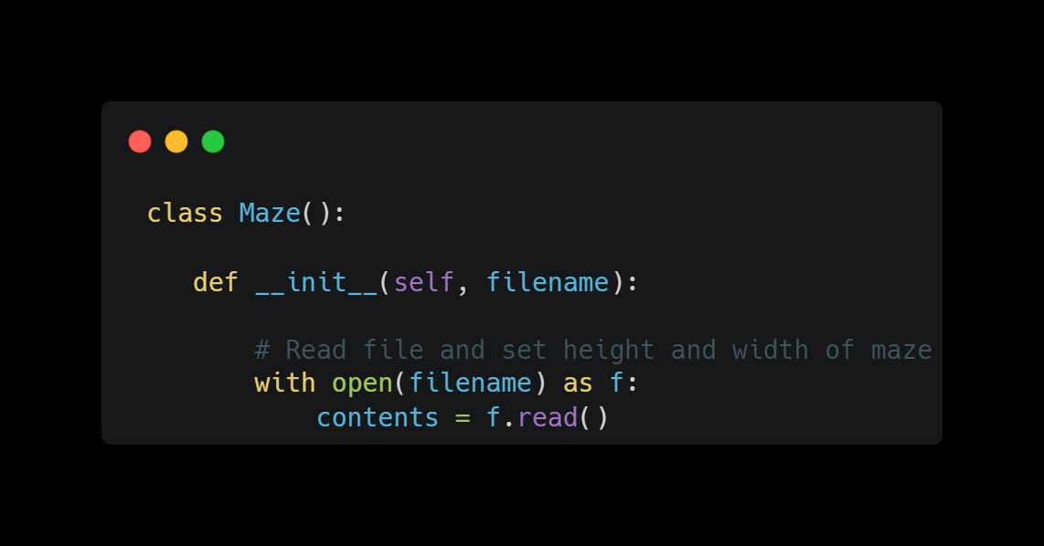
Class that will contain everything related to the Maze

Slide 181
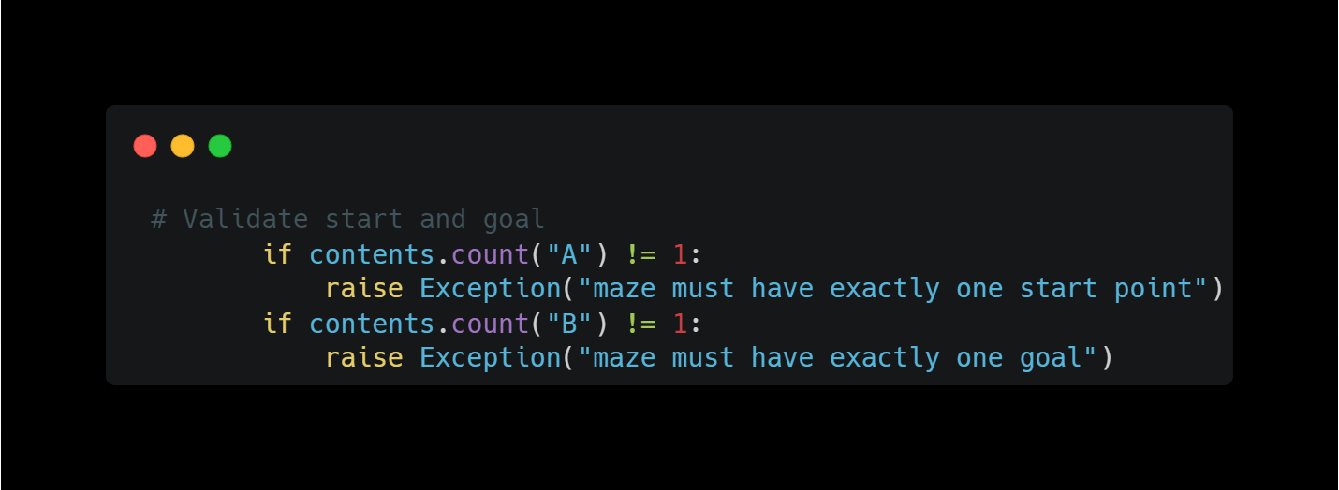

Slide 182
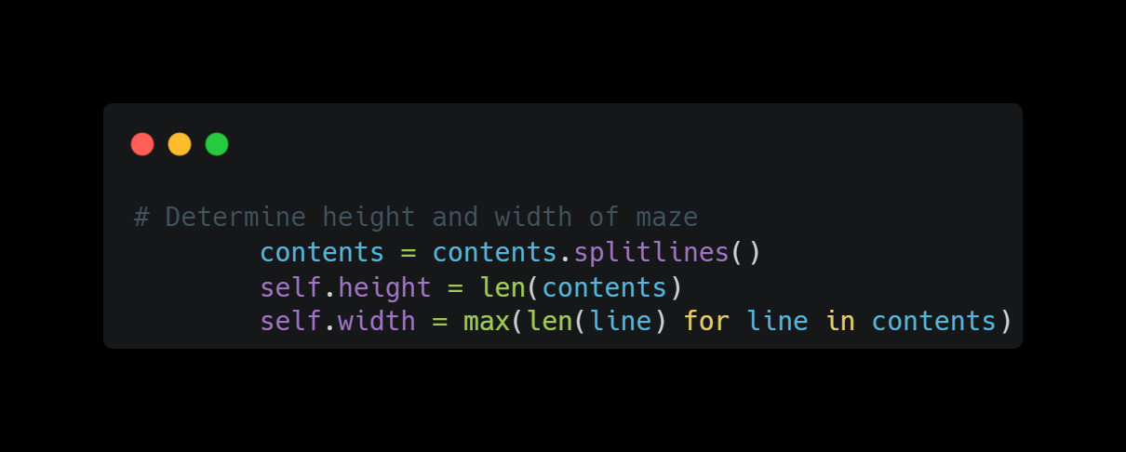

Slide 183
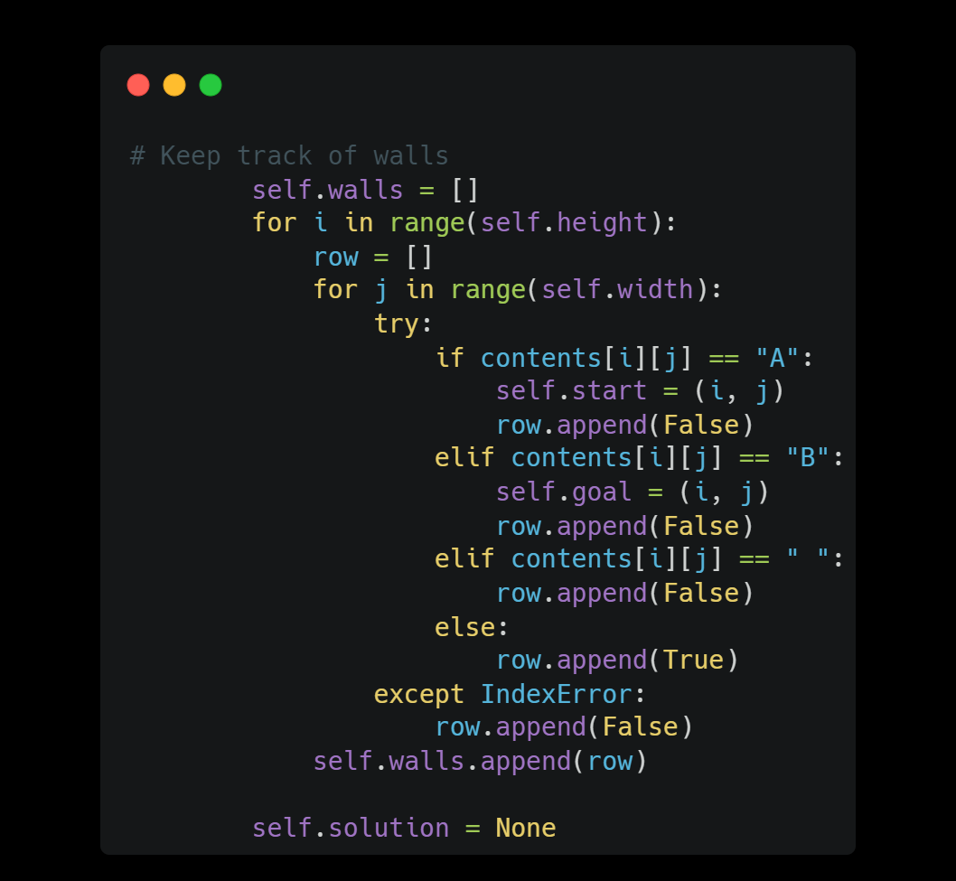

Slide 184
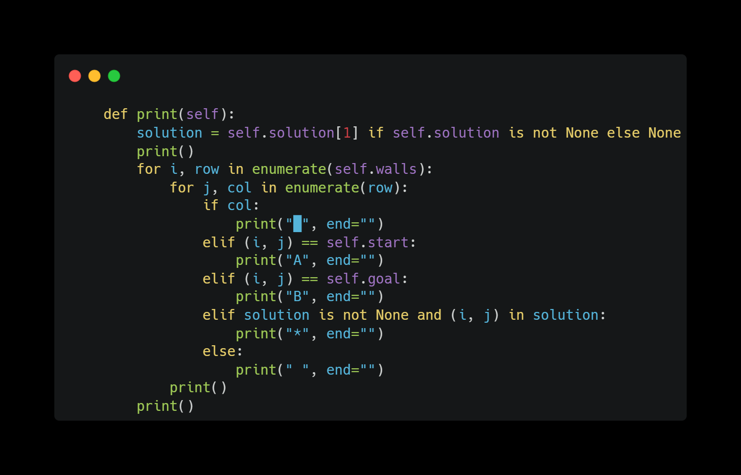

Slide 185
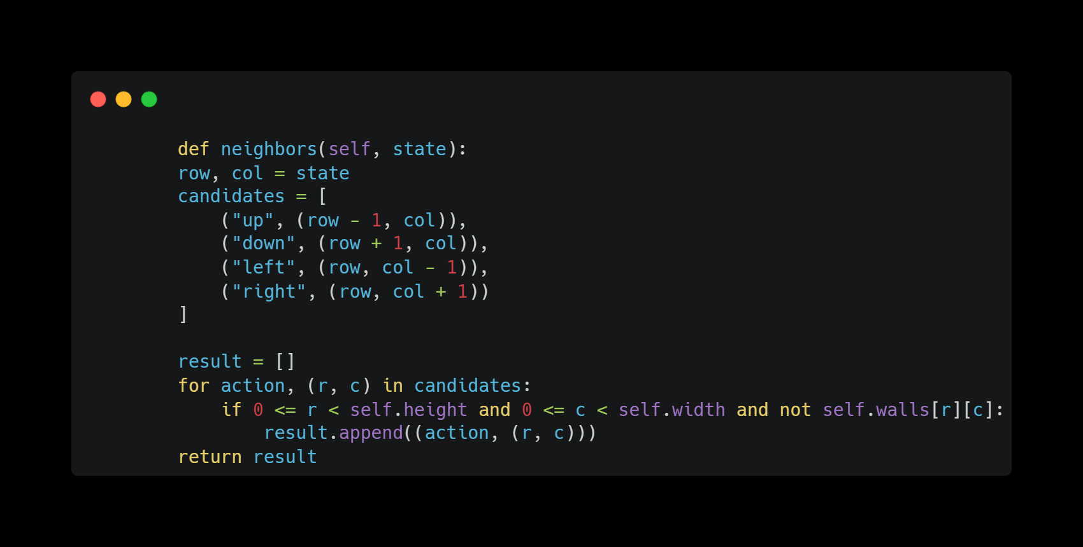

Slide 186
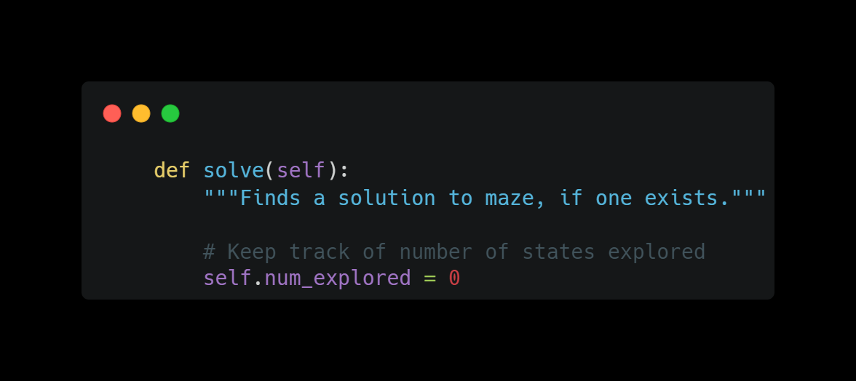

Slide 187
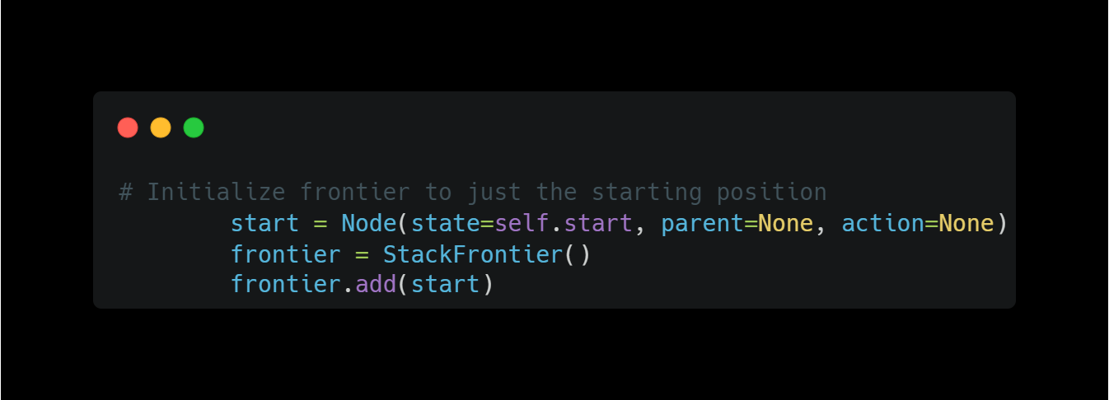

Slide 188
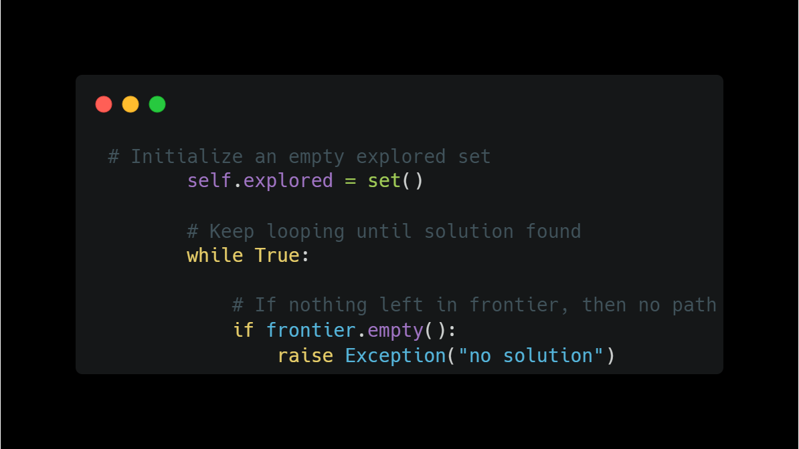

Slide 189
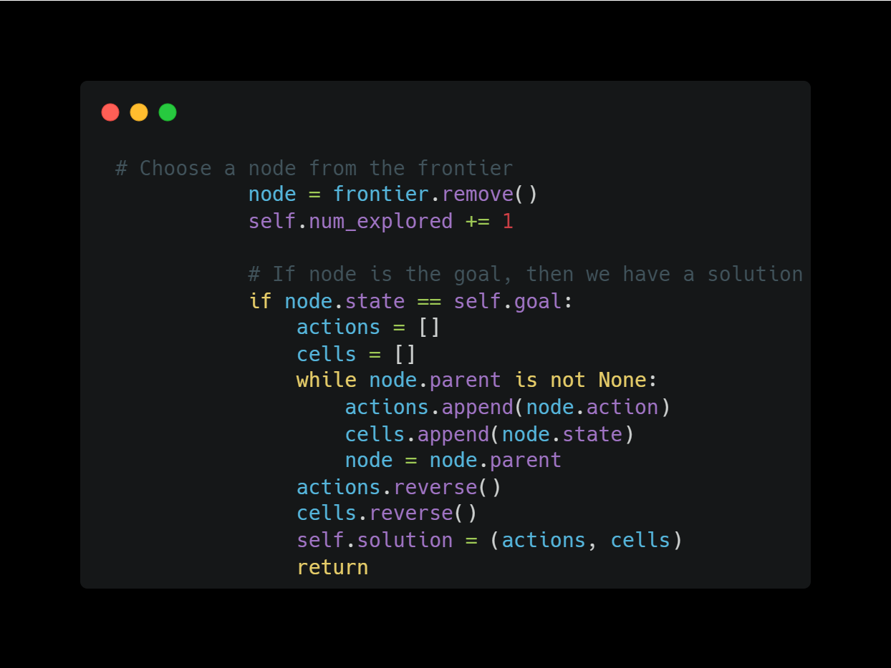

Slide 190
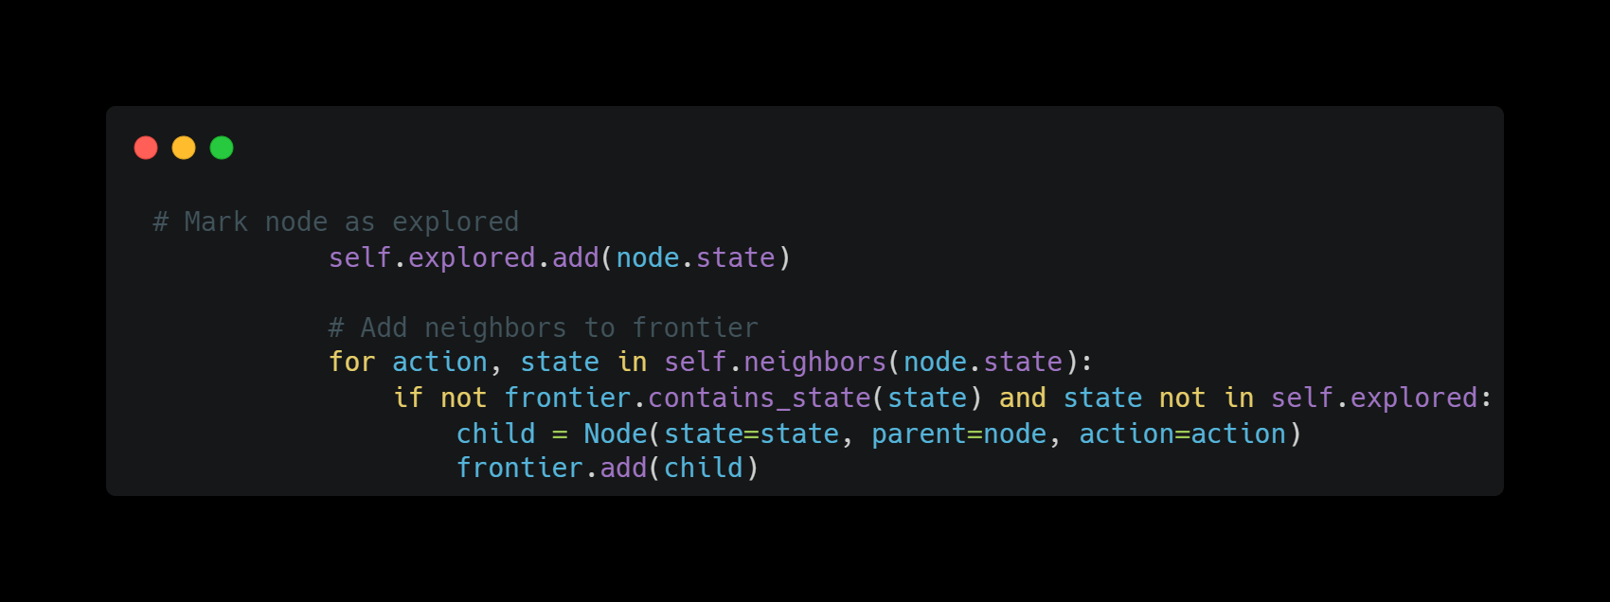

Slide 191
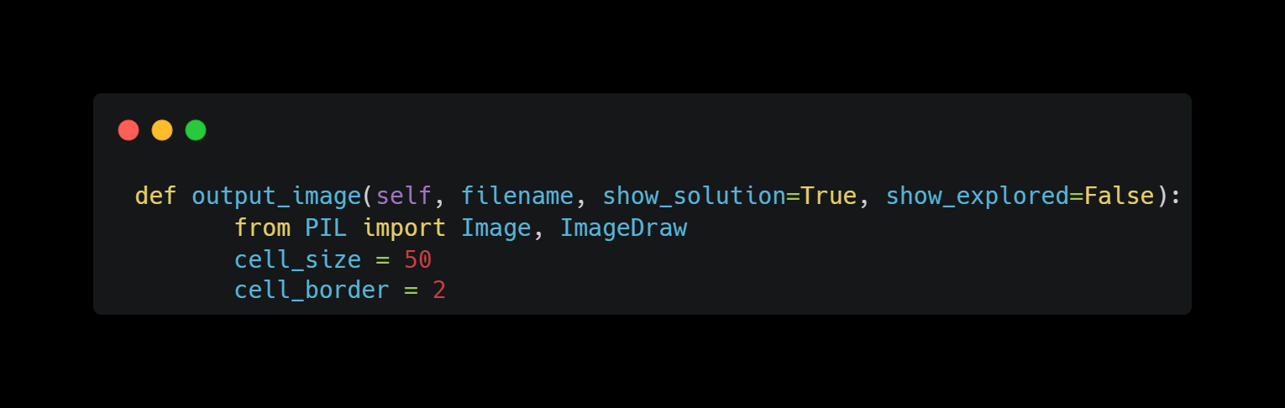

Slide 192
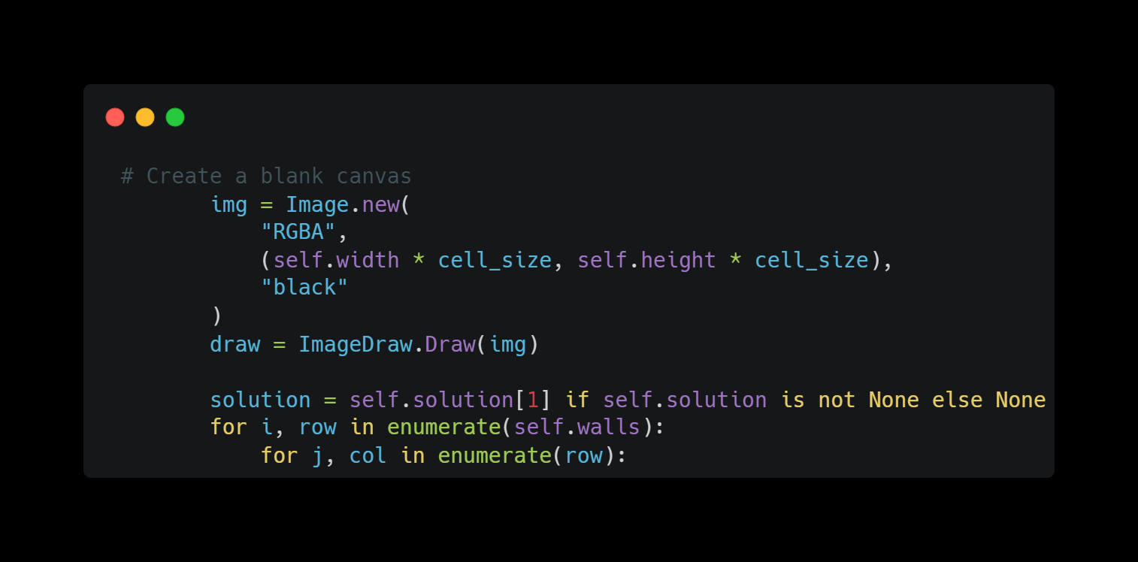

Slide 193
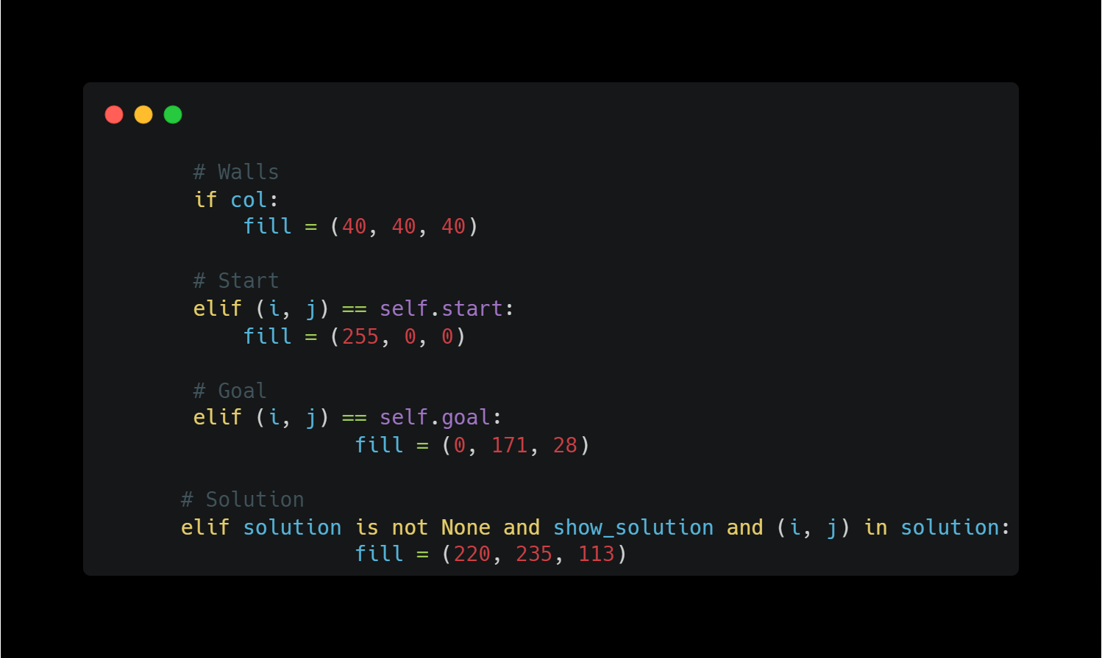

Slide 194
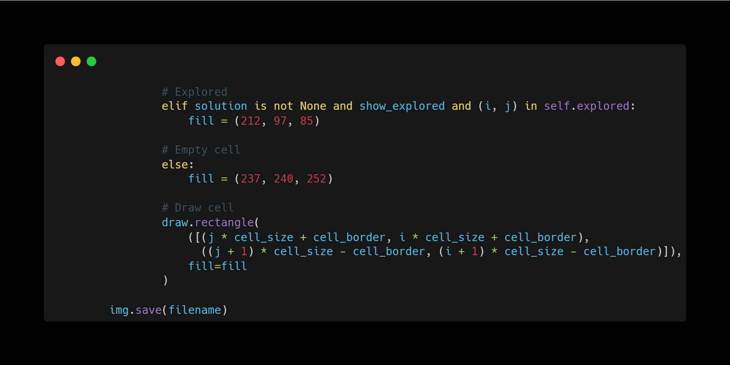

Slide 195
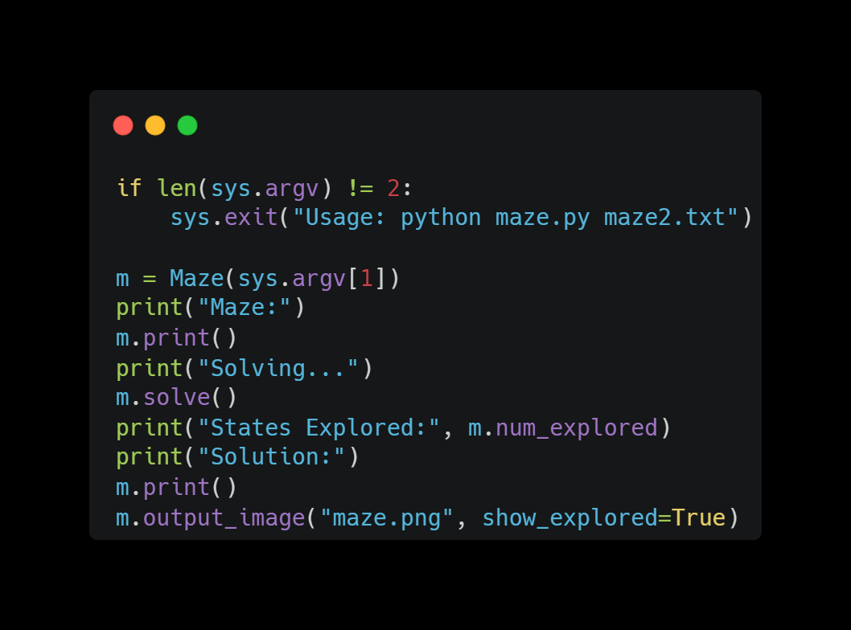
Main() Function:

Slide 196
Any Questions…?
Reference :
Harvard CS50

