Slide 1
Islamic University of Technology
Software Development
CSE 4510
1

Slide 2
Mouse Pointer Controlling through Hand Orientation
Group: B1
Mohammad Ishrak Abedin : 160041051 (Team Leader)
Saad Bin Ashraf : 160041068 (Programmer)
Rizvi Ahmed : 160041076 (Hardware and integration)
2

Slide 3
Introduction
A simple, lightweight and cheap device that is housed inside a gloves. It uses hand movement to move cursor and fingertips to generate clicks.
3

Slide 4
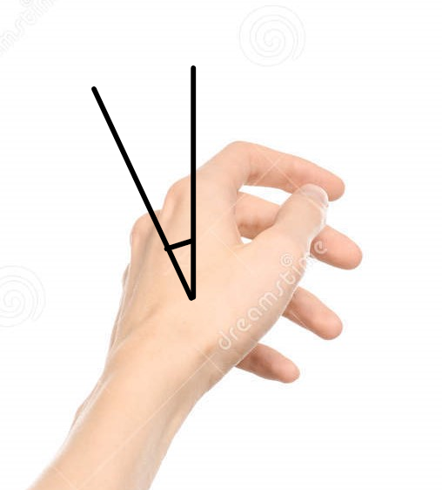
Functions (Movement)
Move the cursor left by tilting the hand 25 degrees to the left.
4

Slide 5
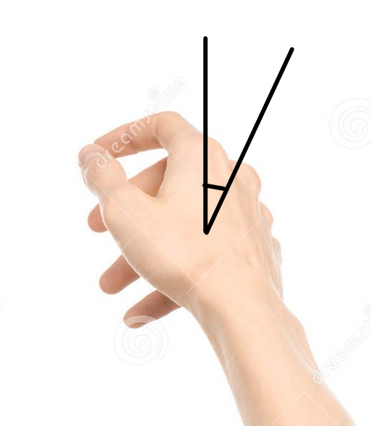
Functions (Movement)
Move the cursor right by tilting the hand 25 degrees to the right.
5

Slide 6
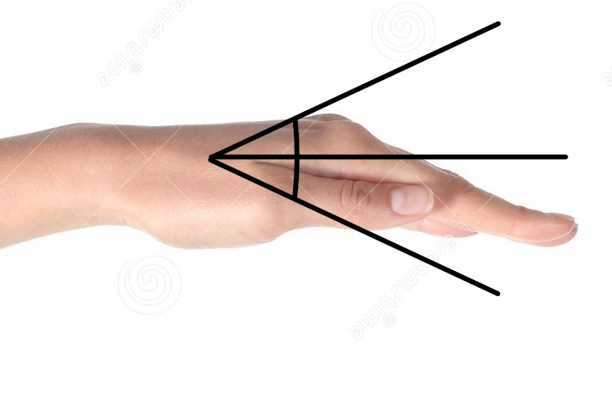
Functions (Movement)
Move the cursor up or down by tilting the hand 18 degrees up or down,
respectively.
6

Slide 7
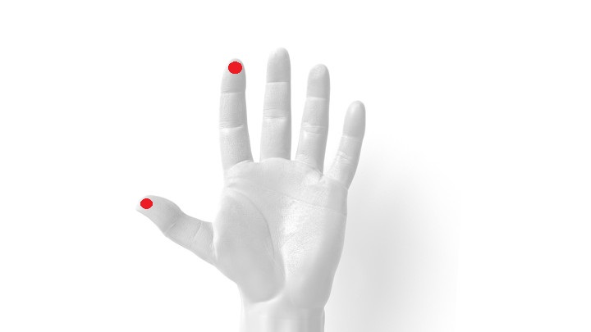
Functions (Clicking)
Touching the tip of the index finger to the tip of the thumb generates left click.
7

Slide 8
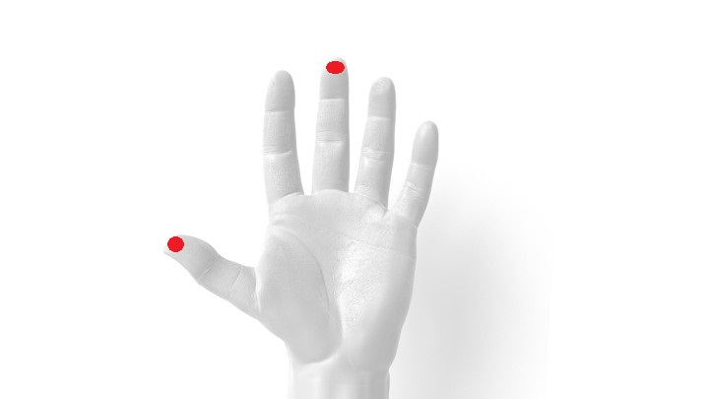
Functions (Clicking)
Touching the tip of the middle finger to the tip of the thumb generates right click.
8

Slide 9
Functions
Also Dragging and selecting multiple objects is standard, using the mouse click and movements together.
Tap and hold clicks and holds the mouse.
Double tap is registered as double click.
9

Slide 10
Mechanism
Used hardwares are Arduino nano and MPU 6050
MPU 6050 houses gyroscope and nano is used for inputs from gyroscope
Gyroscope gives the angular movement
Static signals were used to generate clicks
C# and Arduino IDE were used for coding.
10

Slide 11
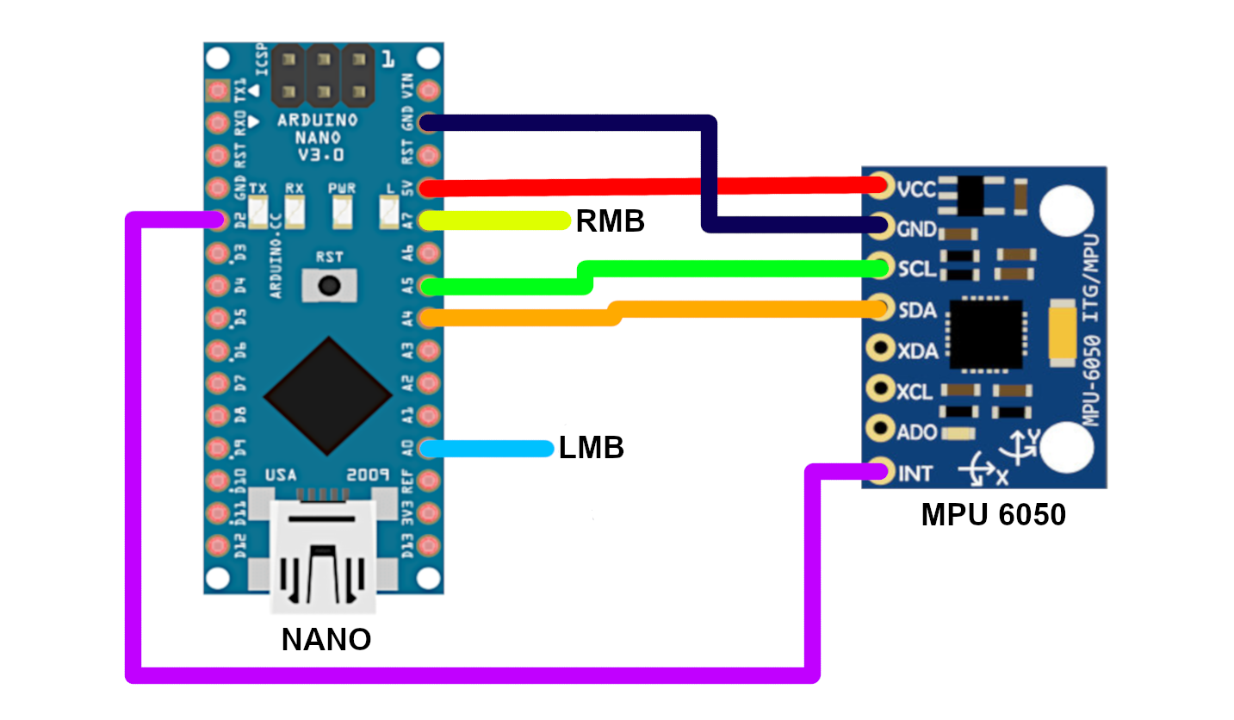
Hardware Assembly
11

Slide 12
Challenges
Gyroscope output was jittery, not possible to keep absolutely still.
Used running average to limit the values within a range to make the cursor stable.
Serial and analog both pins were picking up noises while implementing clicks.
Connected the pins to GND to get stable 0 output in order to avoid noises.
Pyautogui was very heavy for the machine to bear. So we switched to C#.
12

Slide 13
Future Planning
Making the device wireless, by adding a wireless module.
Later, combining the whole setup into one PCB including only necessary things.
Making the device small and thin to perfectly sit inside the gloves.
Adding flexibility to use it throughout all types of computers (linux, mac). Also making it plug and play.
13

Slide 14
THANK YOU!

