Slide 1

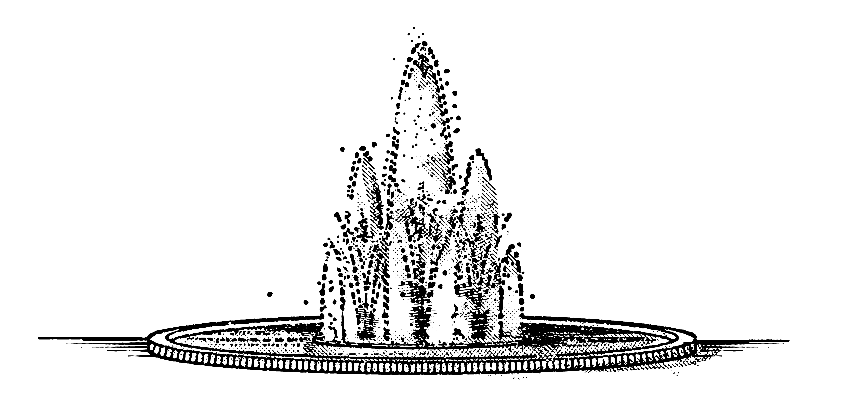

By: Farzaneh Saadati
Classification of Sentences Using BERT and t-SNE
Sentiment Classification Using OpenAI
Notes:
Today, I will be presenting my work on classifying sentences using BERT embeddings and t-SNE for visualization. We will explore how we can distinguish between bioinformatics and computer science sentences by embedding them into a high-dimensional space and then reducing their dimensions for visualization.

Slide 2
Methodology
Step 1: Collecting and Pre-classifying Sentences
Bioinformatic Sentences from “bio.txt”
CS Sentences from “cs.txt”
Notes:
Here is the outline of my presentation. We will start with a brief introduction, followed by the methodology, which includes collecting and pre-classifying sentences (In the first step, we collect and pre-classify sentences into two categories: bioinformatics and computer science. The bio sentences are stored in bio.txt and the CS sentences in cs.txt.),
2

Slide 3
Methodology
Step 2: Convert Sentences to Embeddings
Using BERT for Embeddings
Example Code Snippet
def get_embedding(sentence):
inputs = tokenizer(sentence, return_tensors="pt", padding=True, truncation=True)
outputs = model(**inputs)
return outputs.last_hidden_state.mean(dim=1).detach().numpy()
Notes:
In the second step, we convert the sentences into embeddings using BERT. This function takes a sentence, tokenizes it, and passes it through the BERT model to obtain the mean of the last hidden states as the sentence embedding.
3

Slide 4
Methodology
Step 3: Calculate Centroids
Calculate Average Location (Centroid) for Each Category
Example Code Snippet
def calculate_centroid(embeddings):
return np.mean(embeddings, axis=0)
Notes:
In the third step, we calculate the centroid of each category. The centroid represents the average location of the embeddings for each category. This function takes a list of embeddings and returns their mean.
4

Slide 5
Methodology
Step 4: Classify New Sentences
Measure Distance to Centroids
Classify Based on Proximity
Example Code Snippet
distance_to_bio=np.linalg.norm(new_embedding - bio_centroid)
distance_to_cs = np.linalg.norm(new_embedding - cs_centroid)
if distance_to_bio < distance_to_cs:
classification = "Bio“
else:
classification = "CS"
Notes:
In the fourth step, we classify new sentences by measuring their distance to the centroids of bio and CS categories. The classification is based on proximity to these centroids. If a sentence's embedding is closer to the bio centroid, it is classified as bio, otherwise as CS
5

Slide 6
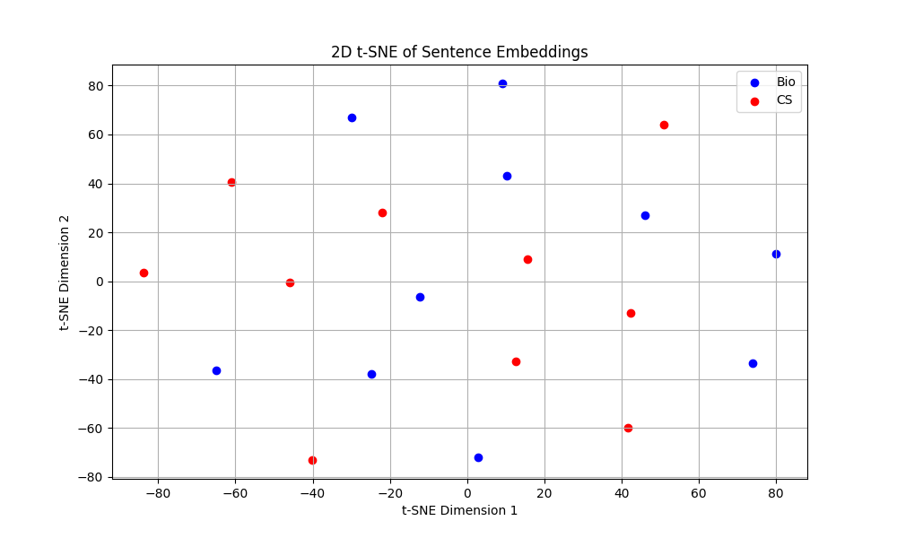
Visualization - t-SNE Embeddings
Notes:
To visualize the embeddings, we use t-SNE to reduce their dimensions to 2D. In this plot, blue points represent bio sentences, and red points represent CS sentences. Test sentences are shown with a multiplication symbol (×) in the color of the closest category.
6

Slide 7
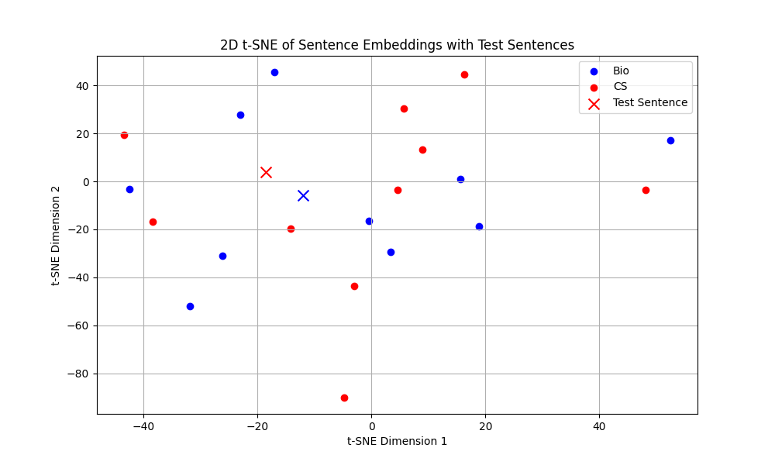
Result
 | Classification | Distance
1 | CS | 1.98
 | Bio | 2.7
Classification: CS
 | Classification | Distance
1 | CS | 2.93
 | Bio | 2.4
Classification: Bio
Notes:
Test sentences are marked with a multiplication symbol (×) and are colored based on their classification: blue if closer to the "Bio" centroid, and red if closer to the "CS" centroid.
On the right side of the figure, detailed classification results for two test sentences are presented in a tabular format, showing the classification and the distances to the centroids:
The first test sentence is classified as "CS" with a distance of 1.98 to the "CS" centroid and 2.7 to the "Bio" centroid.
The second test sentence is classified as "Bio" with a distance of 2.4 to the "Bio" centroid and 2.93 to the "CS" centroid.
7

Slide 8
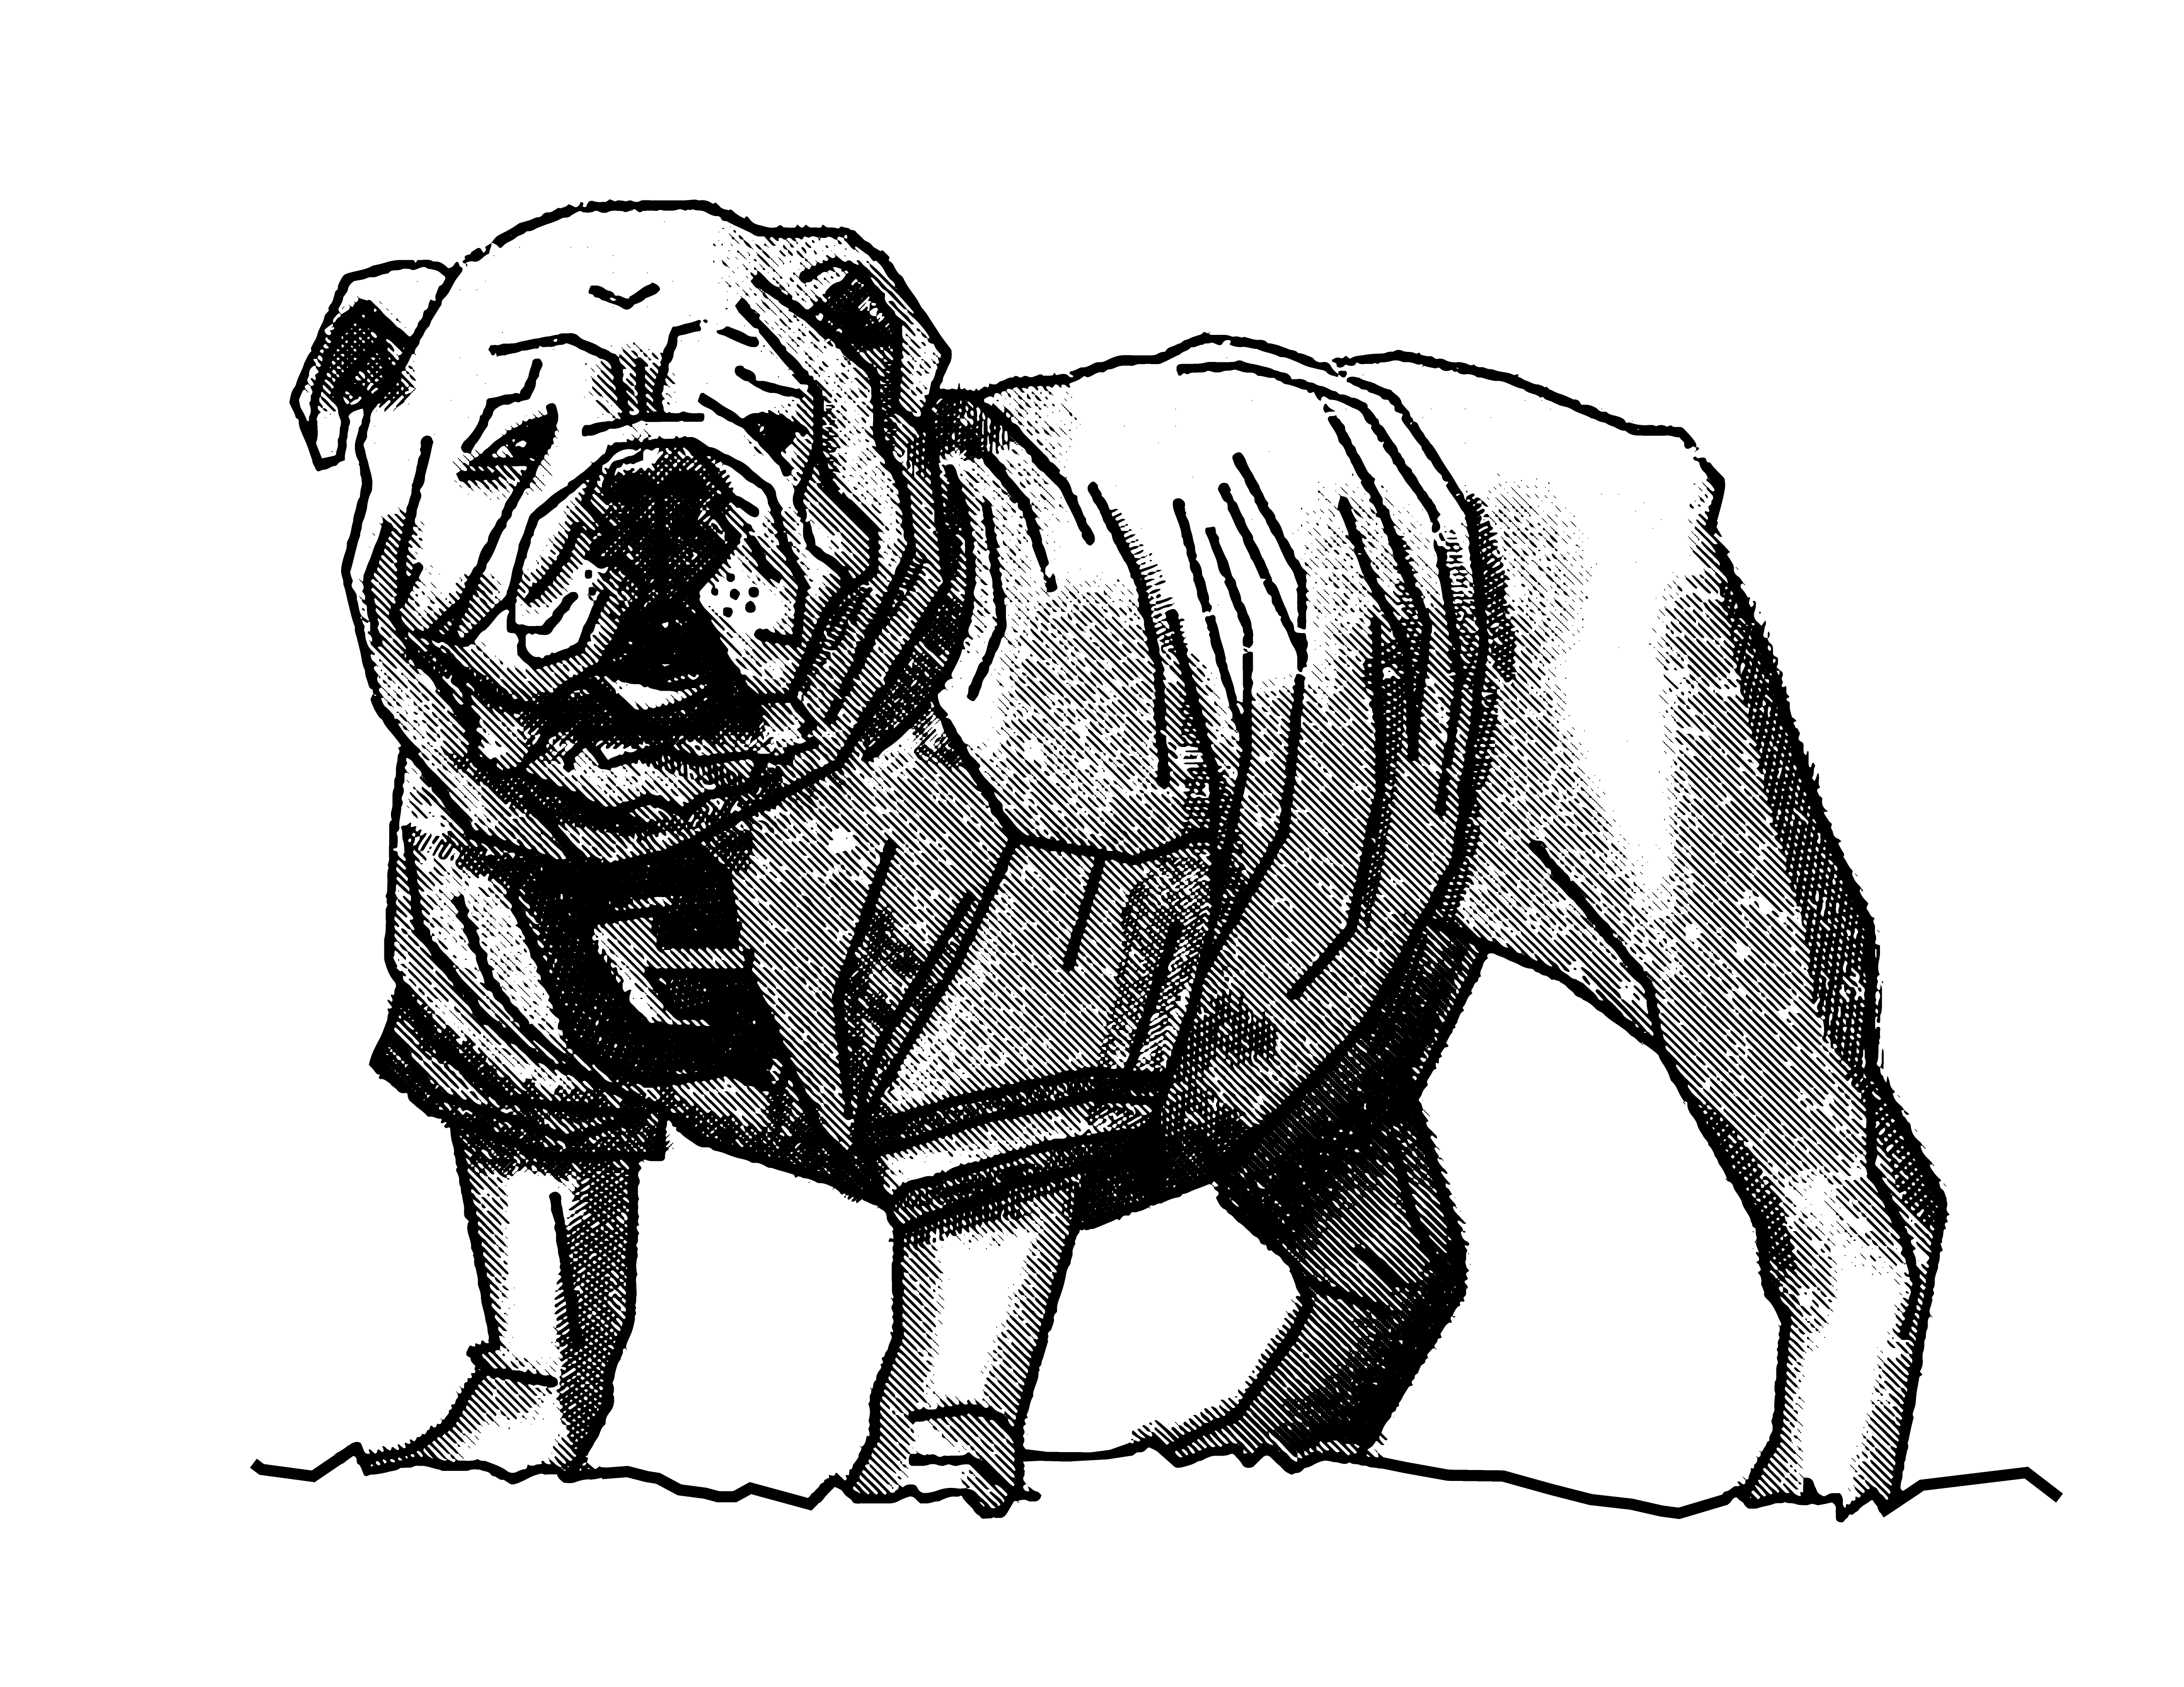
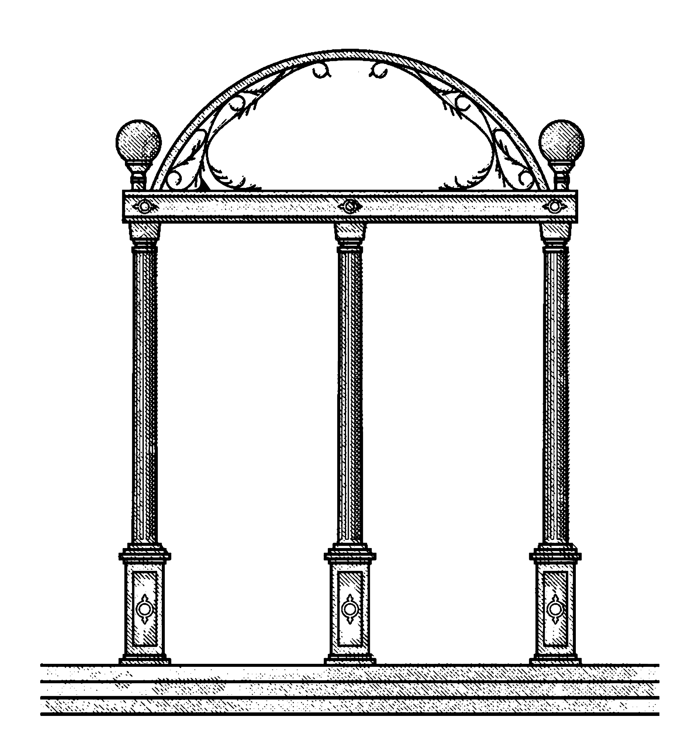
Thank you!
Notes:
Thank you for your attention. I am happy to answer any questions you might have.
8

