Slide 1


Process-Aware Model-Driven Development Environments
September 18, 2017
Levi Lúcio, Saad Bin Abid, Salman Rahman, Vincent Aravantinos (fortiss)
Ralf Kuestner, Eduard Harwardt (Diehl Aerospace)

Slide 2
Problem statement
How do we customize a Model-Driven Development environment in order to support a given process
The process should be of an advisory nature and minimally invasive regarding the modelling experience

Slide 3
Presentation plan
Framing the problem
Running example: an MDD environment for gathering requirements
Implementing process-awareness
Demos (MPS and AF3)
Summary

Slide 4
Framing the problem

Slide 5
Framing the problem: Roles
Modeller (User)
Framework customizer
(Domain-specific) tool developer
Framework Developer

Slide 6
Requirements gathering environment: The Framework Customizer Role

Slide 7
Requirements gathering environment for Cooling Controllers: The (Domain-Specific) Tool Developer role

Slide 8
Implementing Process Awareness

Slide 9
Implementing Process Awareness

Slide 10
Implementing Process Awareness

Slide 11
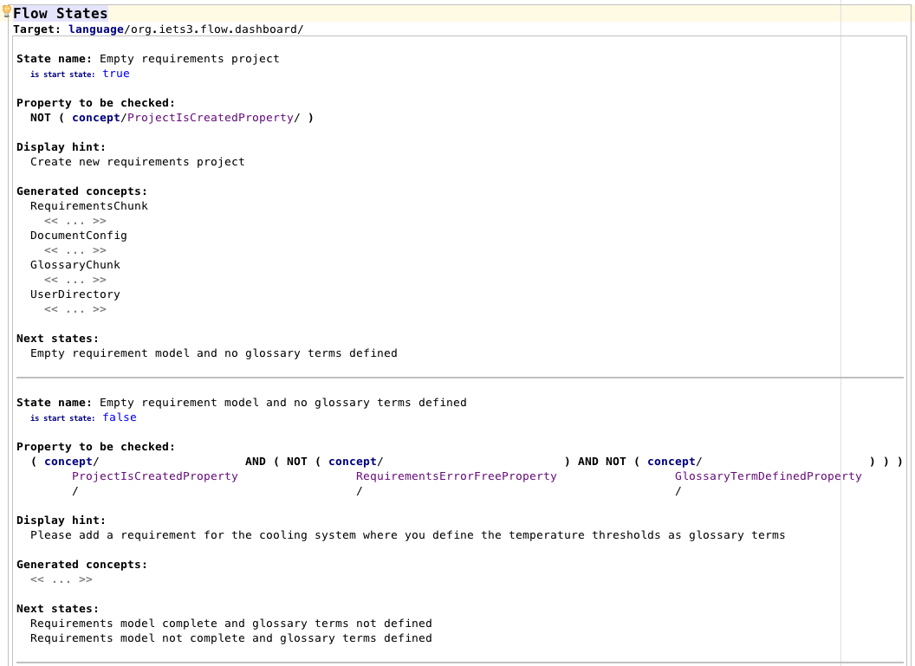
Implementing Process Awareness

Slide 12
Implementing Process Awareness

Slide 13
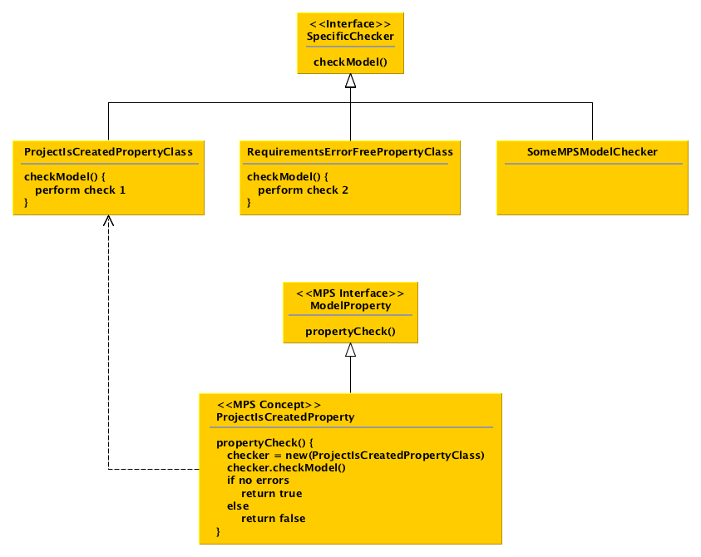
Implementing Process Awareness: Architecture of the Model Property language

Slide 14
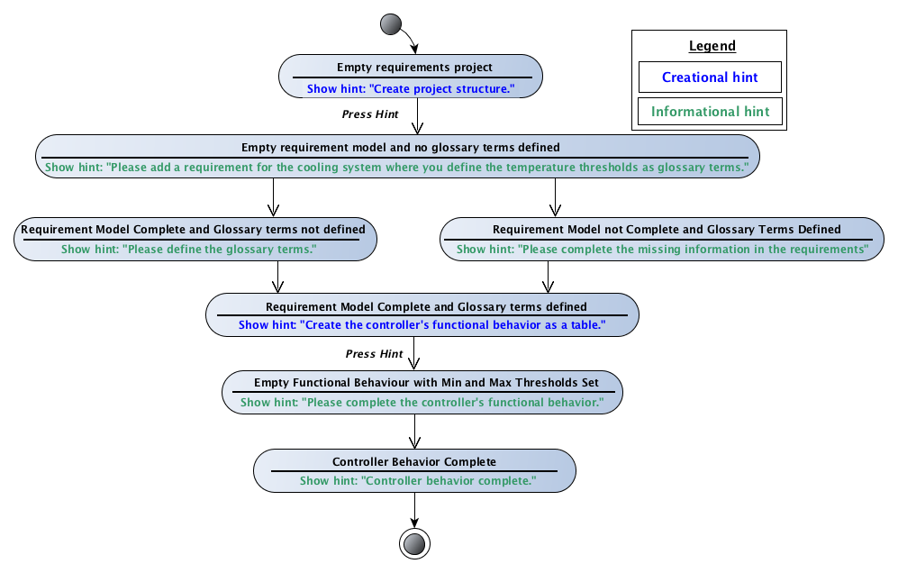
Implementing process awareness: Calculating current state of edition
Assumptions:
- Directed acyclic graph
- One start, final state
- Forks are mutually exclusive
DEMO
Starting at the initial state, recursively follow the flow model graph until no more states can be found that satisfy the model
Return last state that satisfies the model

Slide 15

Making other MDD environments process-aware?
DEMO
https://af3.fortiss.org/

Slide 16
Summary

Slide 17
Contact // Levi Lúcio
fortiss GmbH
An-Institut Technische Universität München
Guerickestraße 25 · 80805 München · Germany
tel +49 (89) 360 35 22 26 fax +49 (89) 360 35 22 50
lucio@fortiss.org
www.fortiss.org

