Slide 1

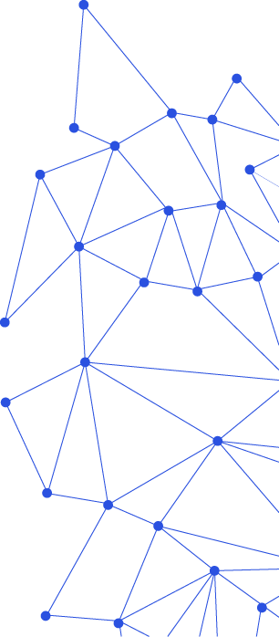
Process-Aware Model-Driven Development Environments
September 18, 2017
Levi Lúcio, Saad Bin Abid, Salman Rahman, Vincent Aravantinos (fortiss)
Ralf Kuestner, Eduard Harwardt (Diehl Aerospace)

Slide 2
Problem statement
How do we customize a Model-Driven Development environment in order to support a given process
Process should be of an advisory nature and minimall

Slide 3
Presentation plan
Framing the problem
Running example
Implementing process-awareness
Demos (in MPS and AF3)
Summary

Slide 4
Framing the problem

Slide 5
Framing the problem: Roles
Modeller (User)
Framework customizer
(Domain-specific) tool developer
Framework Developer

Slide 6
Framing the problem: Roles

Slide 7
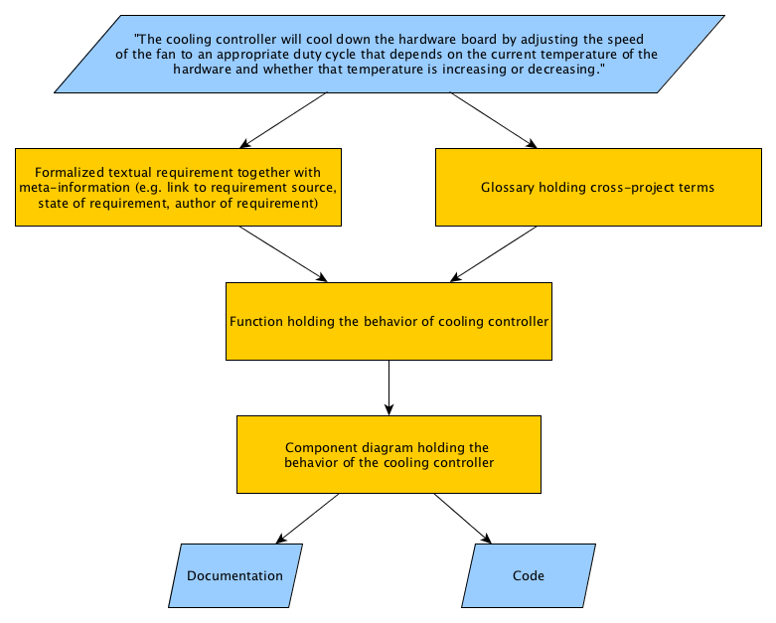
A requirements gathering scenario
“The cooling controller shall cool down the hardware board by adjusting the speed of the fan to an appropriate duty cycle that depends on the current temperature of the hardware and whether that temperature is increasing or decreasing.”

Slide 8
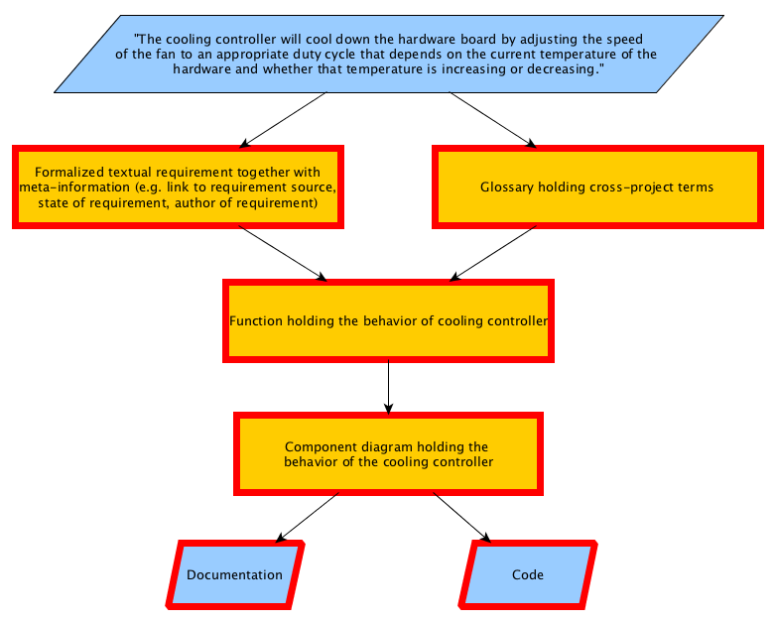
A requirements gathering scenario
“The cooling controller shall cool down the hardware board by adjusting the speed of the fan to an appropriate duty cycle that depends on the current temperature of the hardware and whether that temperature is increasing or decreasing.”
Artefacts!

Slide 9
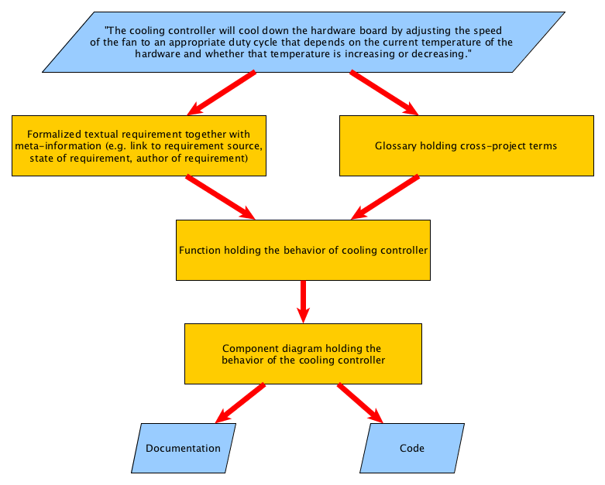
A requirements gathering scenario
“The cooling controller shall cool down the hardware board by adjusting the speed of the fan to an appropriate duty cycle that depends on the current temperature of the hardware and whether that temperature is increasing or decreasing.”
Refinements!

Slide 10

A requirements gathering scenario
“The cooling controller shall cool down the hardware board by adjusting the speed of the fan to an appropriate duty cycle that depends on the current temperature of the hardware and whether that temperature is increasing or decreasing.”
Refinements!
Automatic

Slide 11

A requirements gathering scenario
“The cooling controller shall cool down the hardware board by adjusting the speed of the fan to an appropriate duty cycle that depends on the current temperature of the hardware and whether that temperature is increasing or decreasing.”
Refinements!
Automatic
Manual

Slide 12

A requirements gathering scenario
“The cooling controller shall cool down the hardware board by adjusting the speed of the fan to an appropriate duty cycle that depends on the current temperature of the hardware and whether that temperature is increasing or decreasing.”
Refinements!
Automatic
Manual
Automatic
&
Manual

Slide 13
Other important aspects of the process
What about correctness?
Can we guide the requirements engineer?

Slide 14

Components of the framework
Artefacts
Instances of Languages
Refinements
Correctness
Automatic editor actions
Adding new data manually
Synthesis of new artefacts
Language-specific analysis
Custom analysis
Guidance
Customizable Dashboard

Slide 15
Components of the framework
Artefacts
Instances of Languages
Refinements
Correctness
Automatic editor actions
Adding new data manually
Synthesis of new artefacts
Language-specific analysis
Custom analysis
Guidance
Customizable Dashboard

Slide 16
Components of the framework
Artefacts
Instances of Languages
Refinements
Correctness
Automatic editor actions
Adding new data manually
Synthesis of new artefacts
Language-specific analysis
Custom analysis
Guidance
Customizable Dashboard

Slide 17
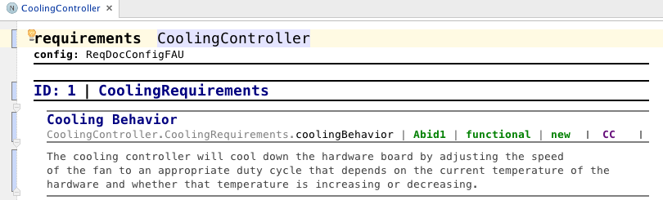
Artefacts
Requirements

Slide 18
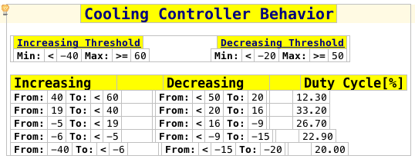
Artefacts
Requirements
Behavior

Slide 19
Components of the framework
Artefacts
Instances of Languages
Refinements
Correctness
Automatic editor actions
Adding new data manually
Synthesis of new artefacts
Language-specific analysis
Custom analysis
Guidance
Customizable Dashboard

Slide 20
Components of the framework
Artefacts
Instances of Languages
Refinements
Correctness
Automatic editor actions
Adding new data manually
Synthesis of new artefacts
Language-specific analysis
Custom analysis
Guidance
Customizable Dashboard

Slide 21
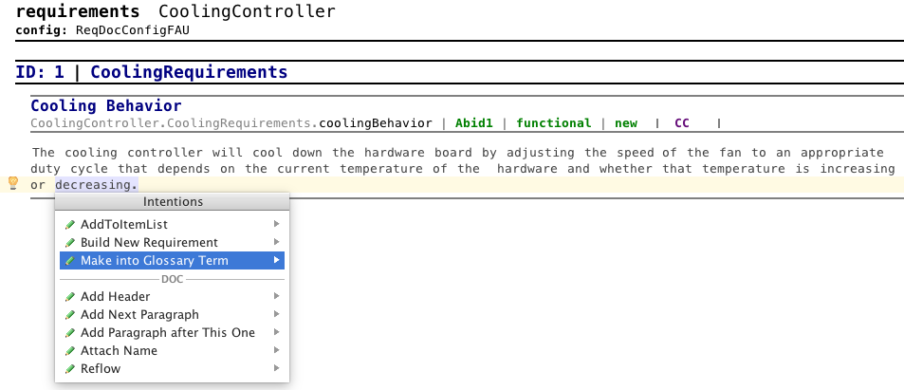
Refinements
Automatic editor actions

Slide 22
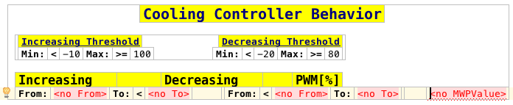
Refinements
Automatic editor actions
Adding new data manually

Slide 23
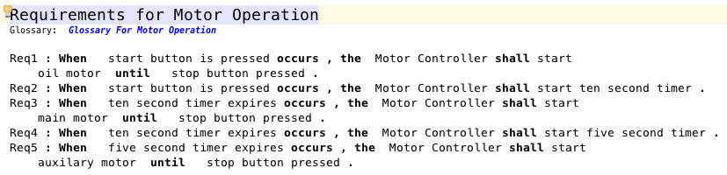
Refinements

Slide 24
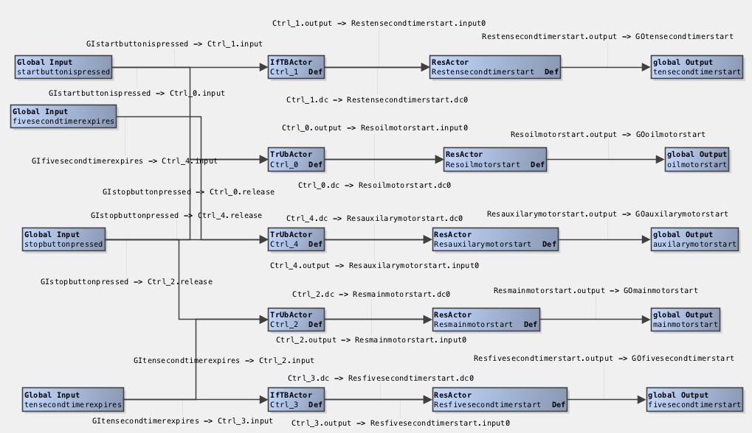
Refinements
Automatic synthesis of new artefacts

Slide 25
Components of the framework
Artefacts
Instances of Languages
Refinements
Correctness
Automatic editor actions
Adding new data manually
Synthesis of new artefacts
Language-specific analysis
Custom analysis
Guidance
Customizable Dashboard

Slide 26
Components of the framework
Artefacts
Instances of Languages
Refinements
Correctness
Automatic editor actions
Adding new data manually
Synthesis of new artefacts
Language-specific analysis
Custom analysis
Guidance
Customizable Dashboard

Slide 27
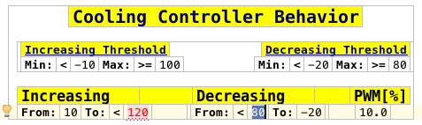
Correctness
In-built language checks

Slide 28
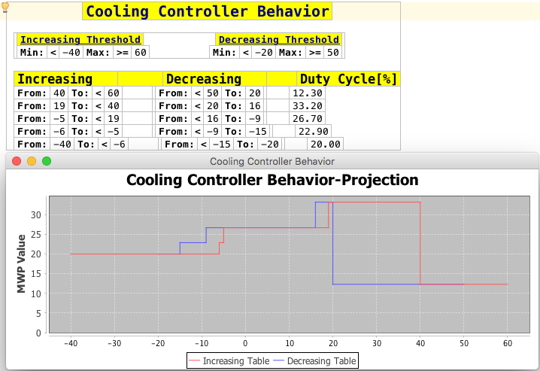
Correctness
In-built language checks
Custom analyses

Slide 29
Components of the framework
Artefacts
Instances of Languages
Refinements
Correctness
Automatic editor actions
Adding new data manually
Synthesis of new artefacts
Language-specific analysis
Custom analysis
Guidance
Customizable Dashboard

Slide 30
Components of the framework
Artefacts
Instances of Languages
Refinements
Correctness
Automatic editor actions
Adding new data manually
Synthesis of new artefacts
Language-specific analysis
Custom analysis
Guidance
Customizable Dashboard

Slide 31
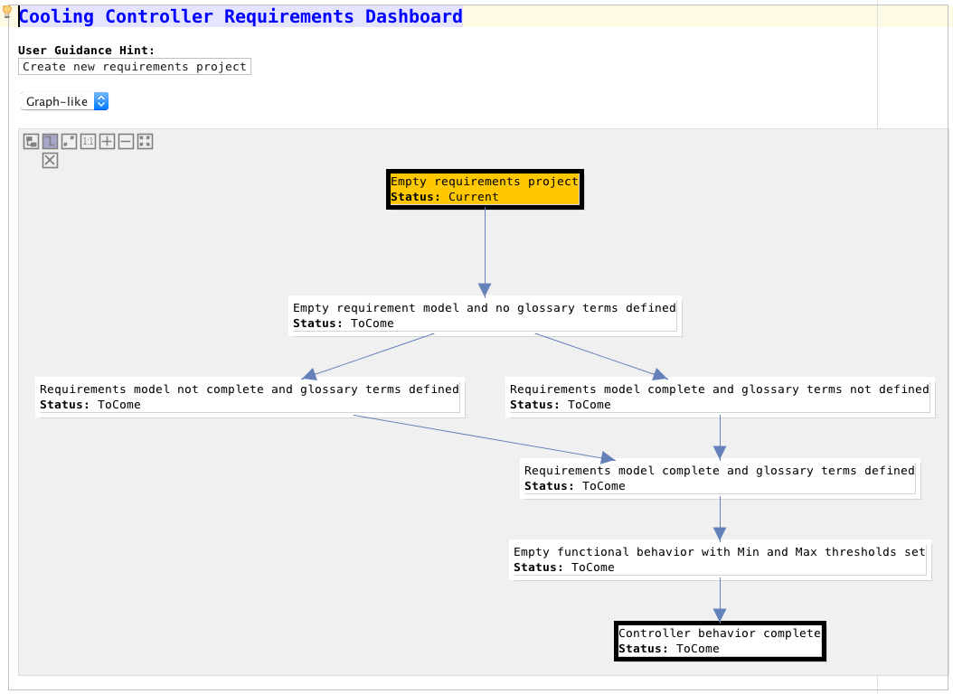
Guidance in action

Slide 32
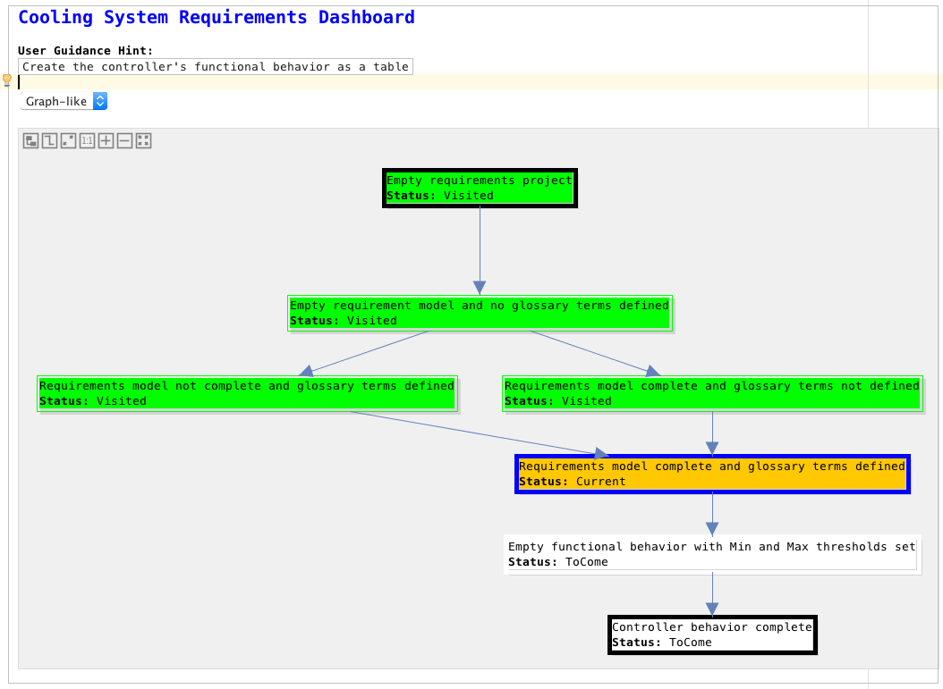
Guidance in action

Slide 33
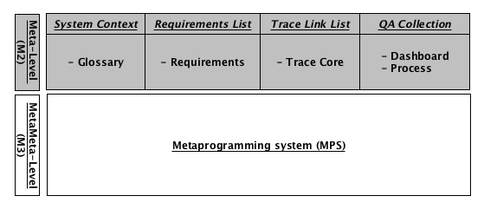
A requirements gathering framework

Slide 34
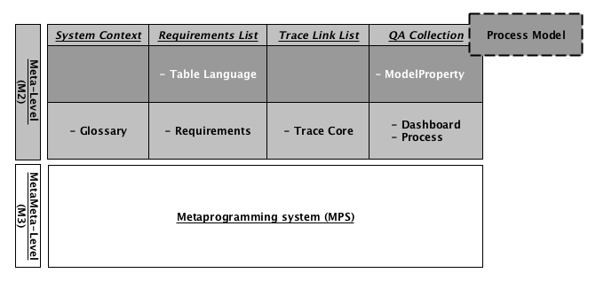
A requirements gathering framework

Slide 35
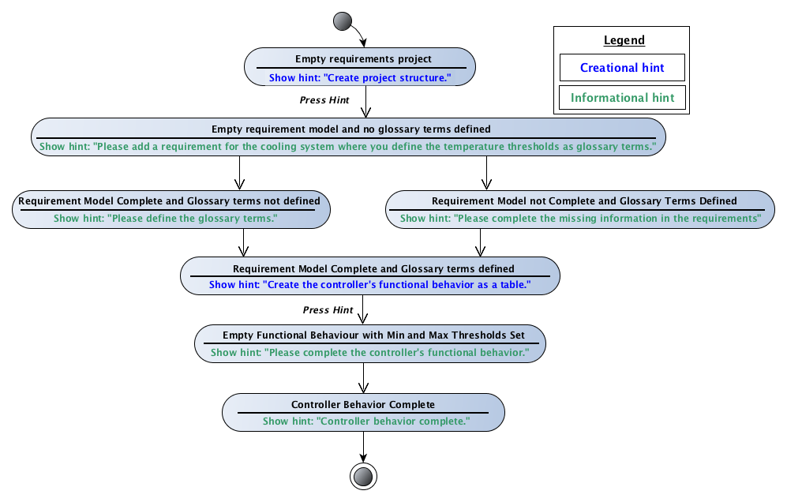

Instantiating the framework
DEMO
Process-Aware Model-Driven Development Environments , L. Lucio, S. Bin Abid, S. Rahman,
V. Aravantinos, R. Küster and E. Harwardt. Submitted to MoDELS 2017.

Slide 36
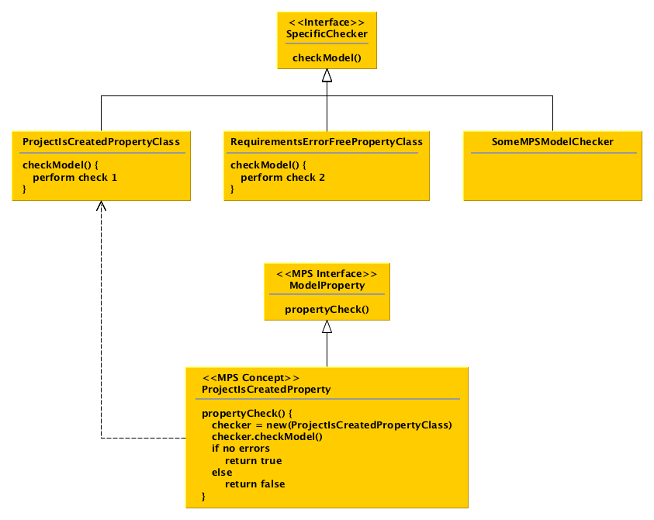
Architecture of the ModelProperty language

Slide 37
Calculating current state of edition
Assumptions:
- Directed acyclic graph
- One start, final state
- Forks are mutually exclusive
Starting at the initial state, recursively follow the flow model graph until no more states can be found that satisfy the model
Return last state that satisfies the model

Slide 38
Contact // Levi Lúcio
fortiss GmbH
An-Institut Technische Universität München
Guerickestraße 25 · 80805 München · Germany
tel +49 (89) 360 35 22 26 fax +49 (89) 360 35 22 50
lucio@fortiss.org
www.fortiss.org

