Slide 1
Snake Game Based on Android OS
Presented by:
Sk. Saad Bin Azad Siam 2211819042
Sadman Ahmed Raian 2111394642
Shakia Tasnim 2131670642
Sumayya Mehjabin Tajin 2132107642
Date: 23 December, 2024

Slide 2
Introduction
What is the Snake Game?
A classic arcade game where a snake grows by eating food.
Objective: Avoid collisions with walls and the snake’s body.
Project Goal:
Develop a 2D Snake Game for Android devices
Combining nostalgia with a user-friendly interface.

Slide 3
Motivation
Why Develop the Snake Game?
Popularity, Accessibility and Simplicity.
Learn game development concepts:
UI design.
Collision detection.
Event-driven programming.
Efficient use of graphics and animations.

Slide 4
Objectives
Key Objectives:
1. Build a visually appealing 2D game.
2. Implement responsive controls.
3. Provide dynamic scoring.
4. Ensure smooth gameplay.
5. Lay groundwork for future features.

Slide 5
Game Architecture:
UI Layer: Game interface and controls.
Logic Layer: Movement, spawning, score updates and collisions.
Data Layer: (Future) High score tracking.
Workflow:
Initialize game state.
Handle user input.
Detect collisions and update state.

Slide 6
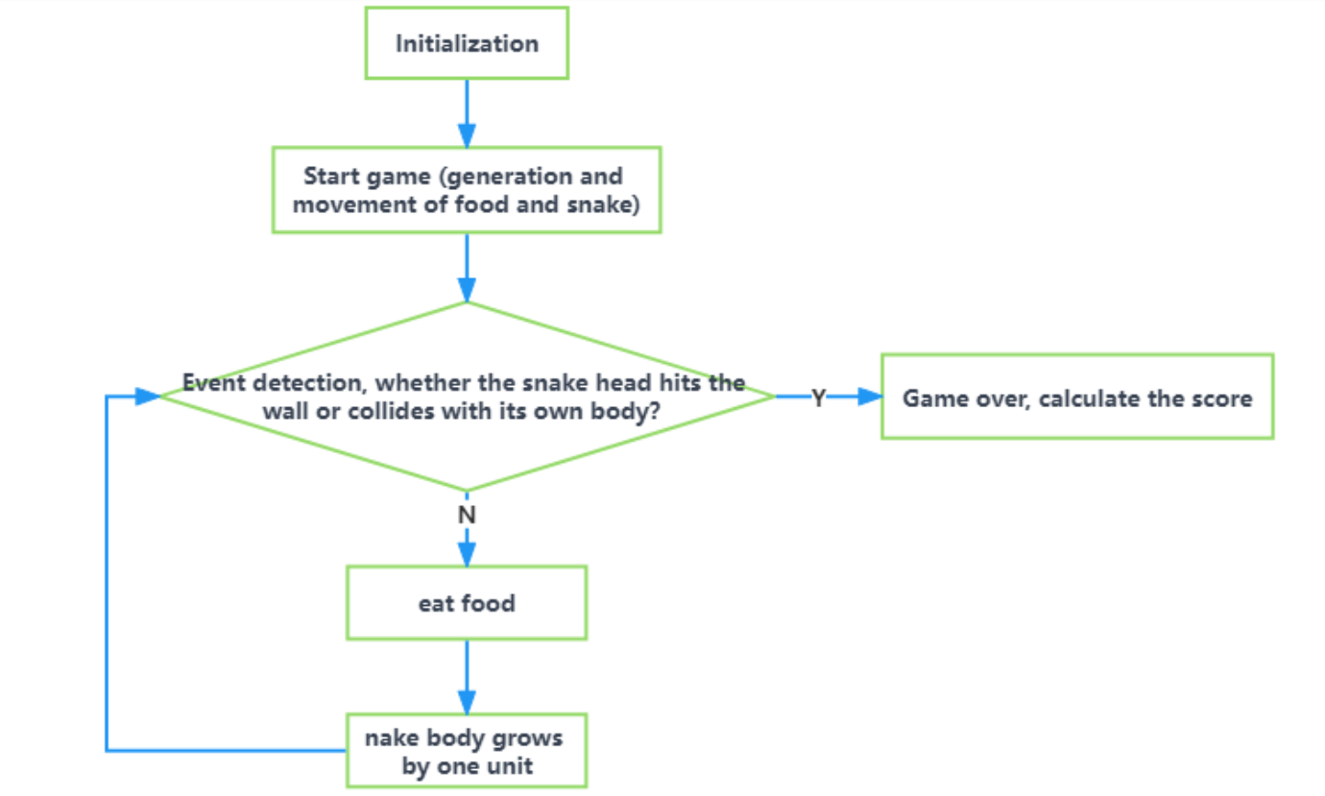
System model

Slide 7
Implementation
Development Tools:
Language: Java
Development Environment: Android Studio
Libraries: AndroidX libraries.
Features:
Timer-based movement.
Randomized food spawning.
Reliable collision detection.
Dynamic score display.
Restart option after collision.

Slide 8
Results
Achievements:
Smooth gameplay.
Reliable collision handling.
User-friendly interface.
Real-time scoring.
Challenges:
Resolving food overlap.
Optimizing rendering.

Slide 9
Conclusion
Summary:
Delivered a functional, engaging Snake Game.
Showcased game development principles.
Learning:
Enhanced programming and debugging skills.
Mastered event-driven programming.

Slide 10
Future Work
Planned Enhancements:
High Score System.
About Section with game info.
Levels with new challenges.
Improved graphics and animations.
Cross-platform availability.

Slide 11
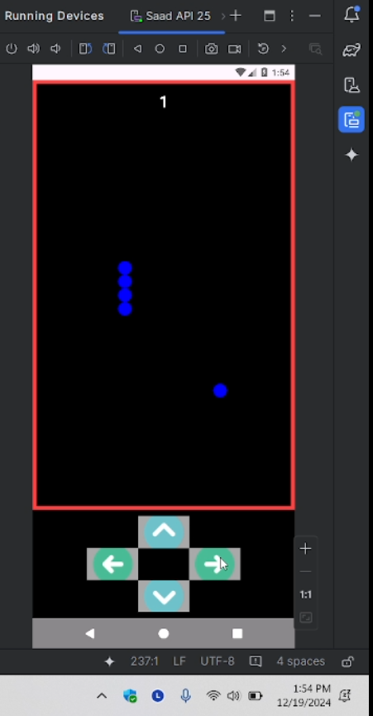
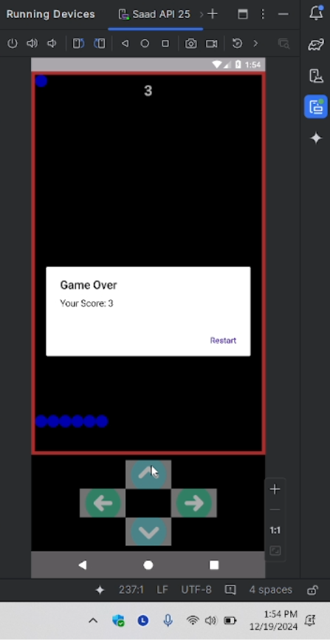
Screenshots

Slide 12
Thank you

