Slide 1
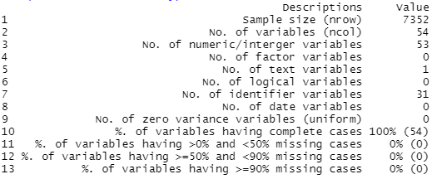
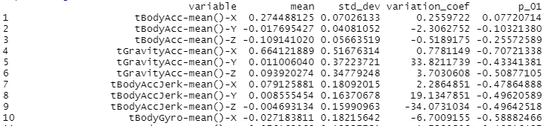
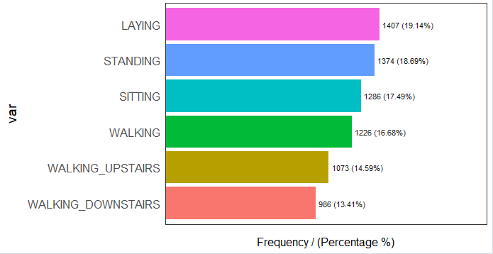
Exploratory Data Analysis with R
Saad Bin Munir, MSc Applied Data Science
Overview

Slide 2
Exploratory Data Analysis with R
Saad Bin Munir, MSc Applied Data Science
Overview

Slide 3
Exploratory Data Analysis with R
Saad Bin Munir, MSc Applied Data Science
Overview

Slide 4
Exploratory Data Analysis with R
Saad Bin Munir, MSc Applied Data Science
Overview

Slide 5
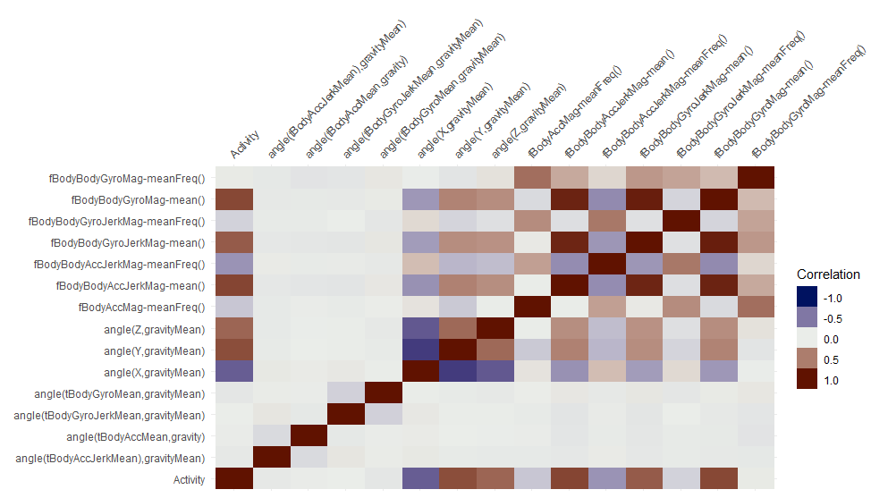
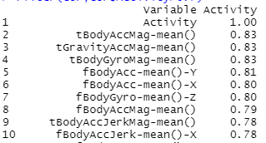
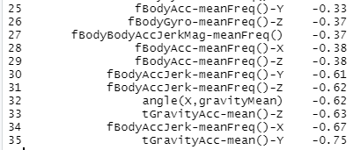
Exploratory Data Analysis with R
Correlation Coefficients

Slide 6
Exploratory Data Analysis with R
Correlation Coefficients

Slide 7
Exploratory Data Analysis with R
Correlation Coefficients

Slide 8
Exploratory Data Analysis with R
Correlation Coefficients

Slide 9
Exploratory Data Analysis with R
Correlation Coefficients

Slide 10
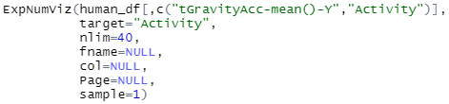
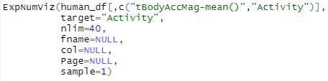
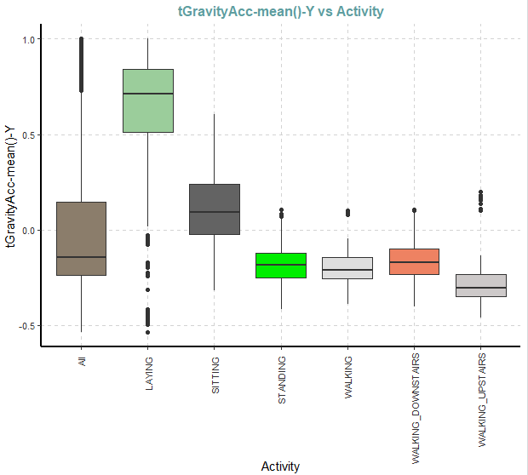
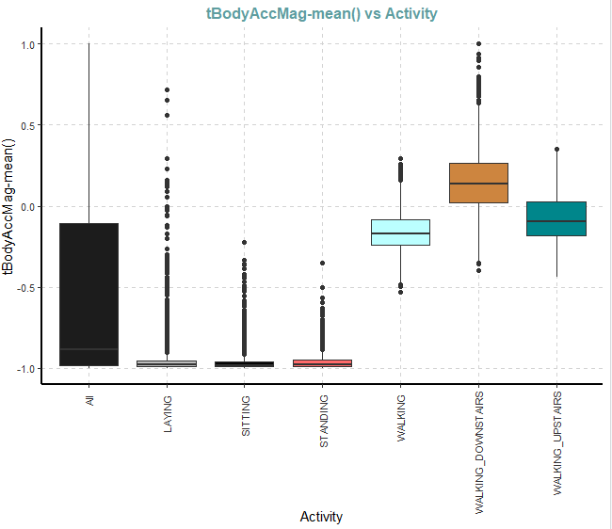
Exploratory Data Analysis with R
Results

Slide 11
Exploratory Data Analysis with R
Results

Slide 12
Exploratory Data Analysis with R
Results

Slide 13
Exploratory Data Analysis with R
Results

Slide 14

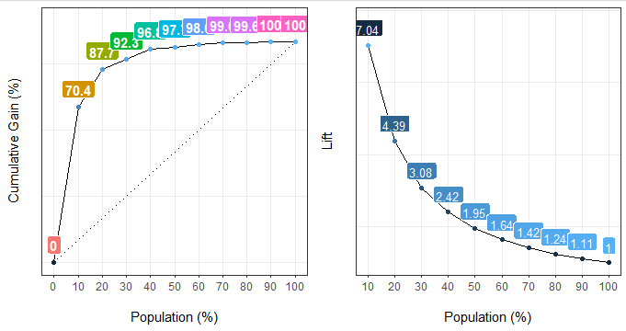
Exploratory Data Analysis with R
Performance Matrix

Slide 15
Exploratory Data Analysis with R
Performance Matrix

Slide 16
Exploratory Data Analysis with R
Performance Matrix

Slide 17
Exploratory Data Analysis with R
Performance Matrix

Slide 18
Exploratory Data Analysis with R
Performance Matrix

Slide 19
Exploratory Data Analysis with R
Conclusions
The funModeling is the most versatile package providing a variety of functions.
Visdat package gives a good correlation plot for a small dataset.
The SmartEDA package is more efficient for plots compared to funModeling package.

