Slide 1


Fr. Conceicao Rodrigues College of Engineering
Full Stack Development
Topic: Vitual Lab of Python
Project Guide: Dr. Roshni Padate
2024-2025
Team Member:
Saad Dalvi(10486)
Swapnil Kasare(10470)
Alok Shukla (10280)
Page
01

Slide 2
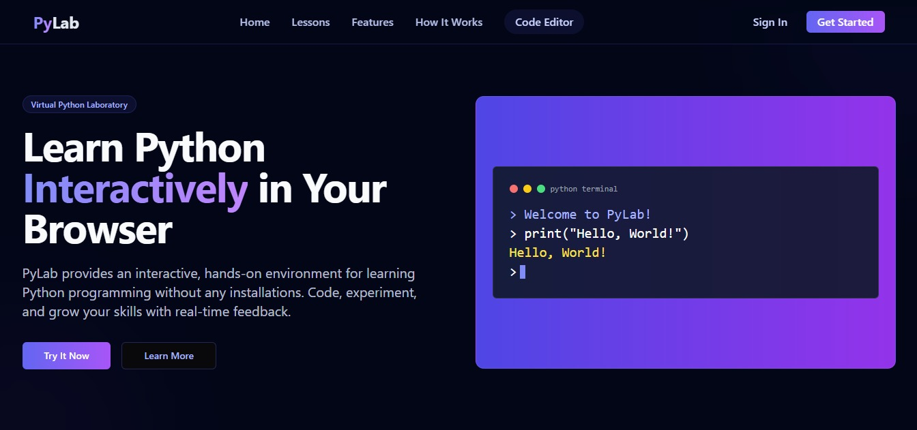
Fr. Conceicao Rodrigues College of Engineering
Home page:
Page
02

Slide 3
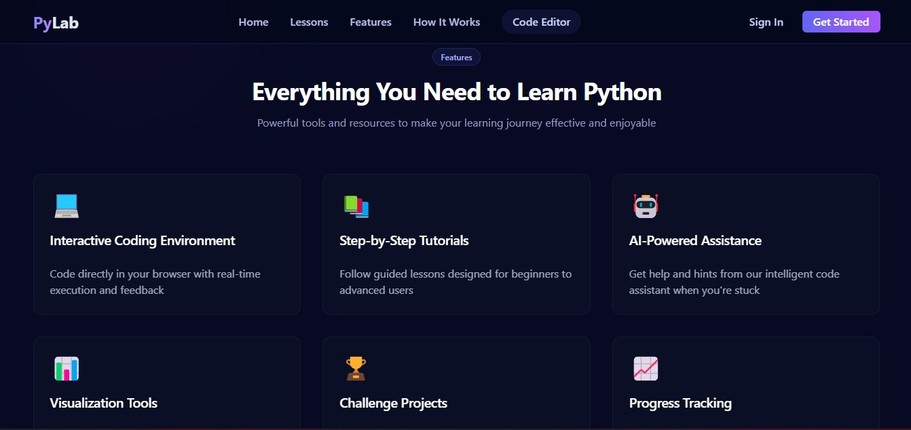
Fr. Conceicao Rodrigues College of Engineering
Features page:
Page
03

Slide 4
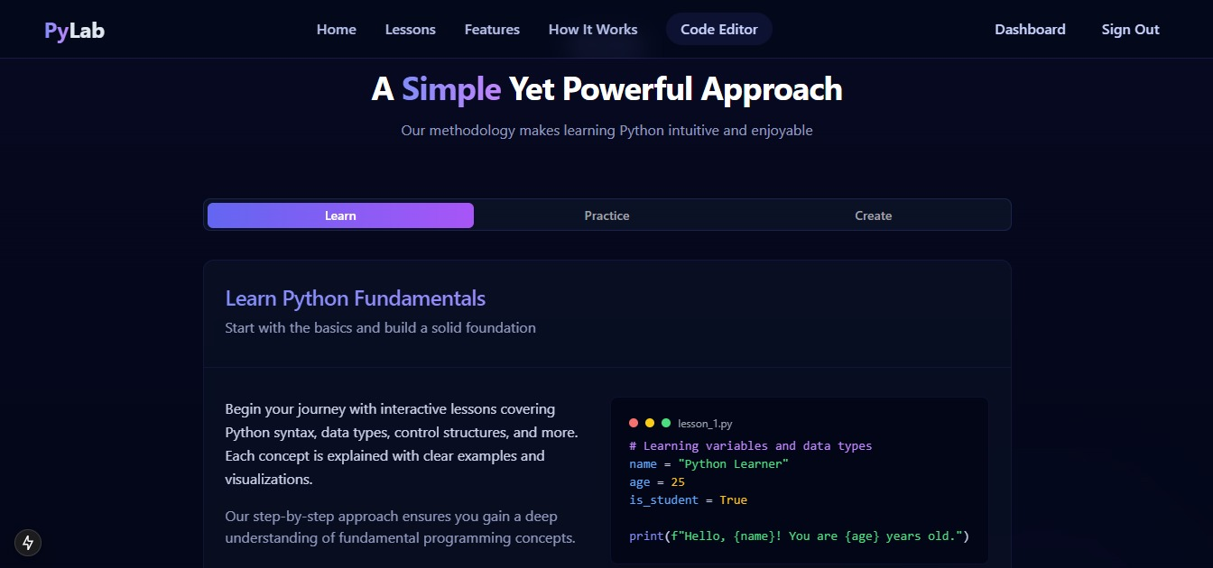
Fr. Conceicao Rodrigues College of Engineering
Dashboard page:
Page
04

Slide 5
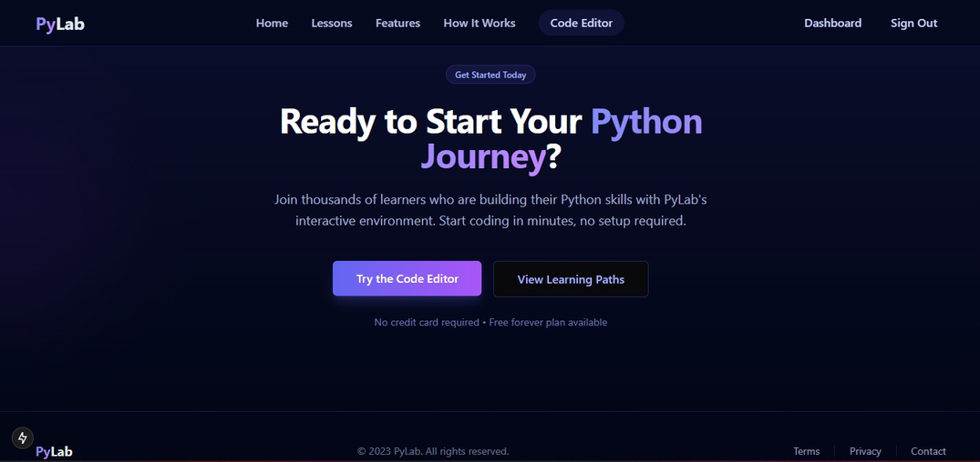
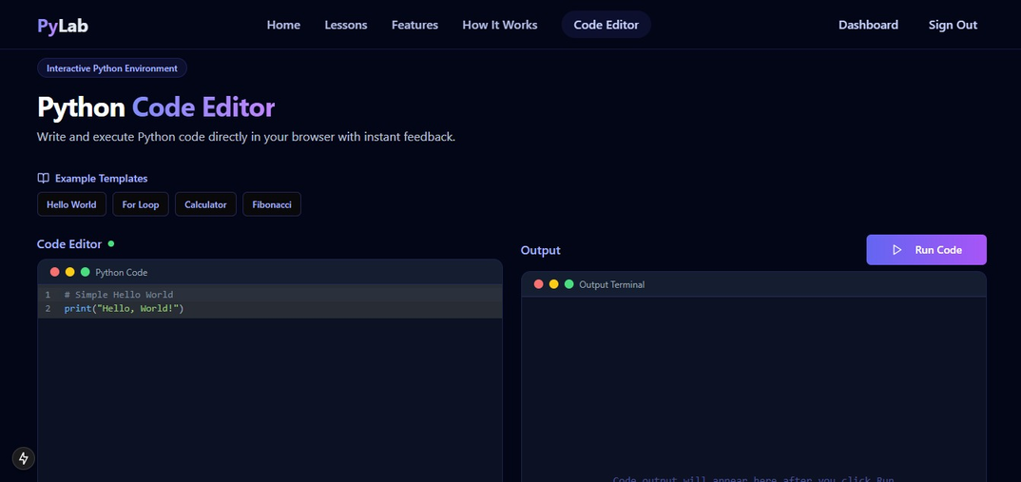
Fr. Conceicao Rodrigues College of Engineering
Code Editor page:
Page
05

Slide 6
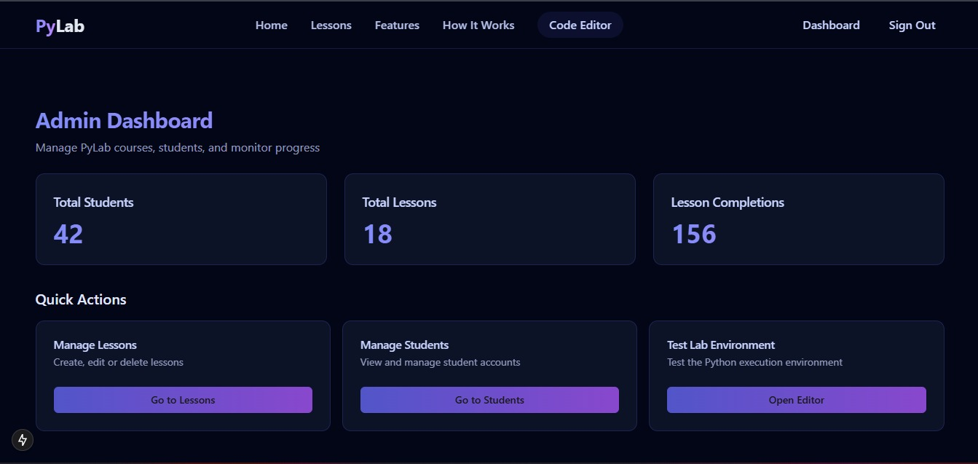
Fr. Conceicao Rodrigues College of Engineering
Admin Dashboard page:
Page
06

Slide 7
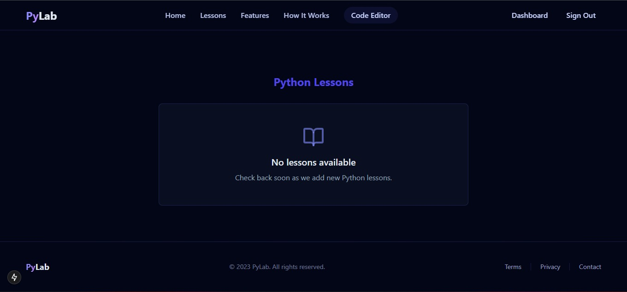
Fr. Conceicao Rodrigues College of Engineering
Lessons page:
Page
07

Slide 8
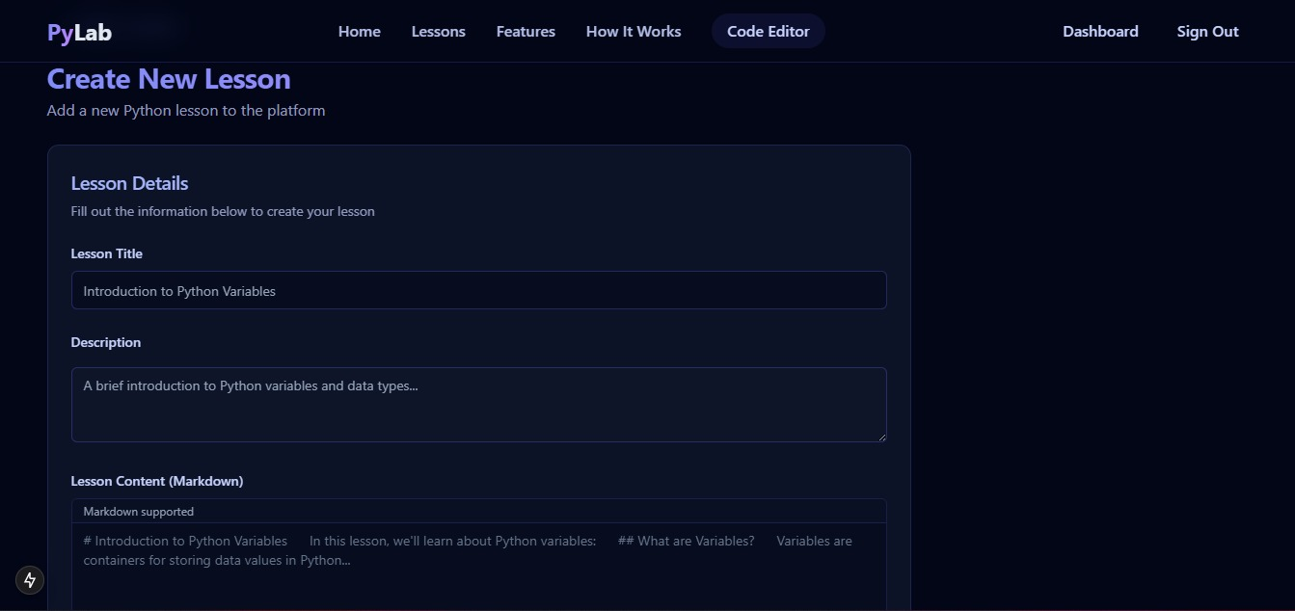
Fr. Conceicao Rodrigues College of Engineering
Create Lessons page:
Page
08

Slide 9
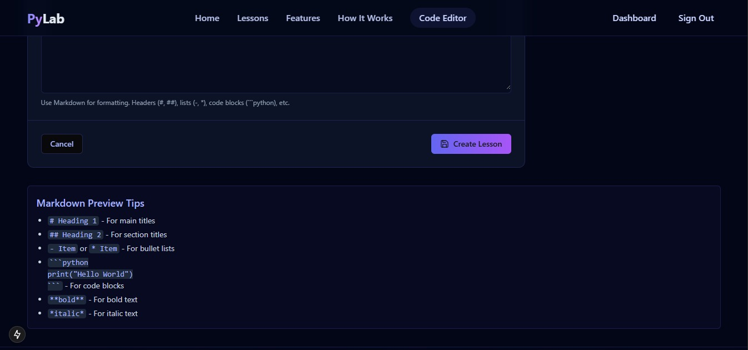
Fr. Conceicao Rodrigues College of Engineering
Create Lessons page:
Page
09

Slide 10
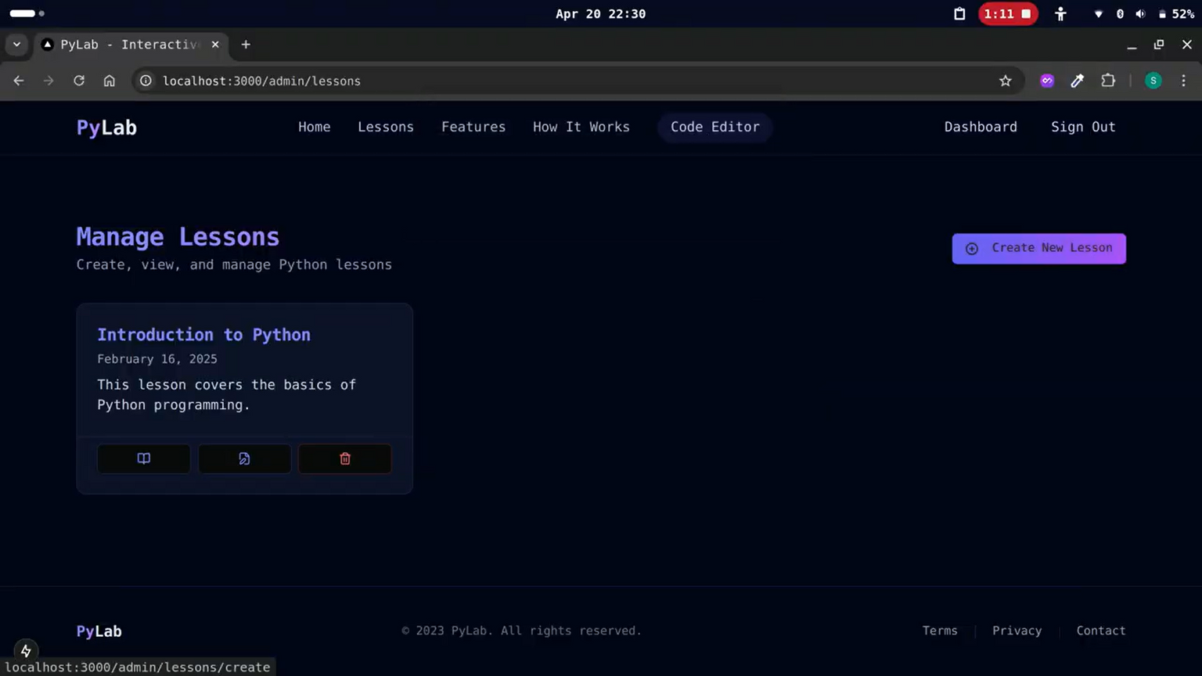
Fr. Conceicao Rodrigues College of Engineering
Manage Lessons page:
Page
10

Slide 11
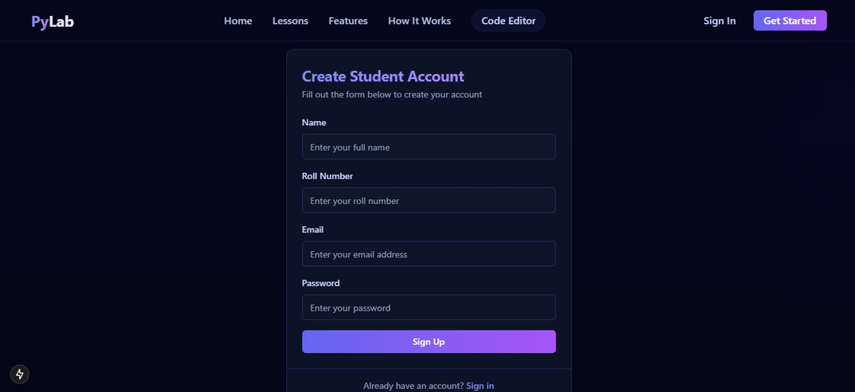
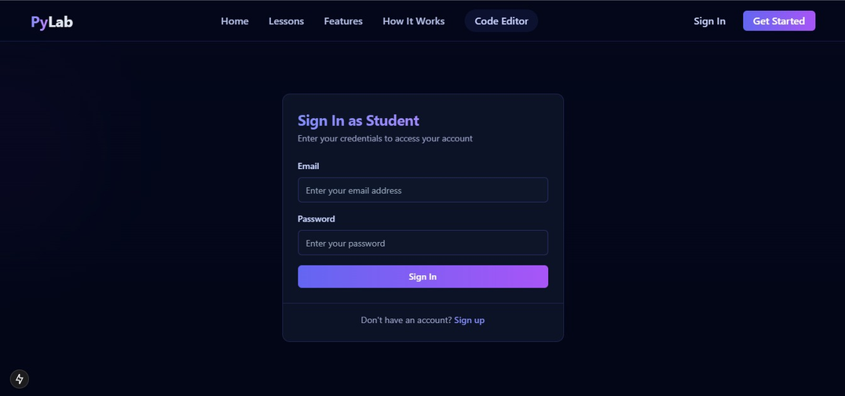
Fr. Conceicao Rodrigues College of Engineering
Create Student and Admin Account Page:
Page
11

Slide 12
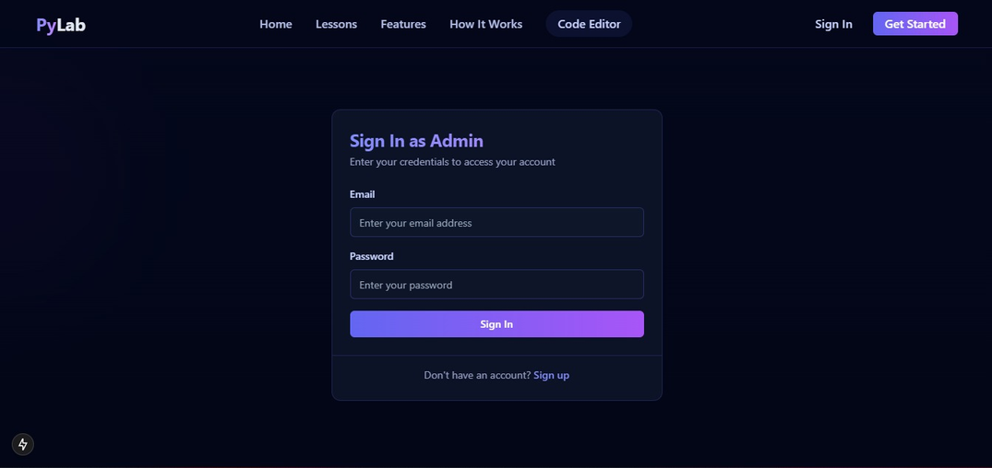
Fr. Conceicao Rodrigues College of Engineering
Login Student and Admin Account Page:
Page
12

Slide 13
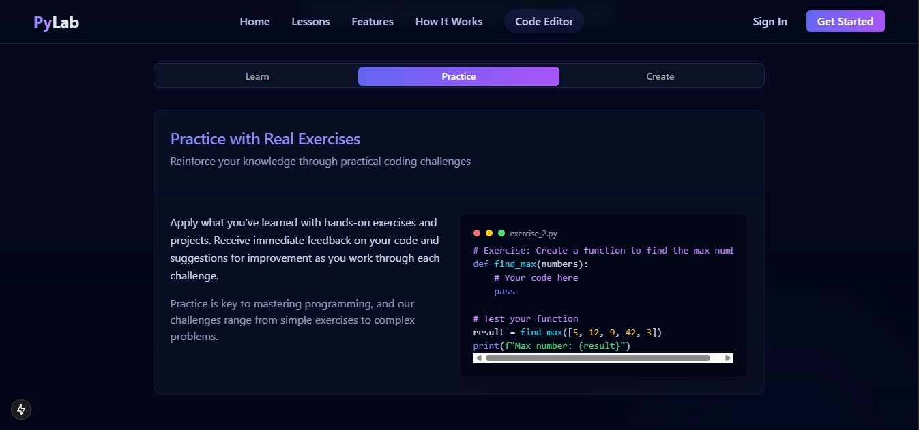
Fr. Conceicao Rodrigues College of Engineering
Practice Segment:
Page
13

Slide 14
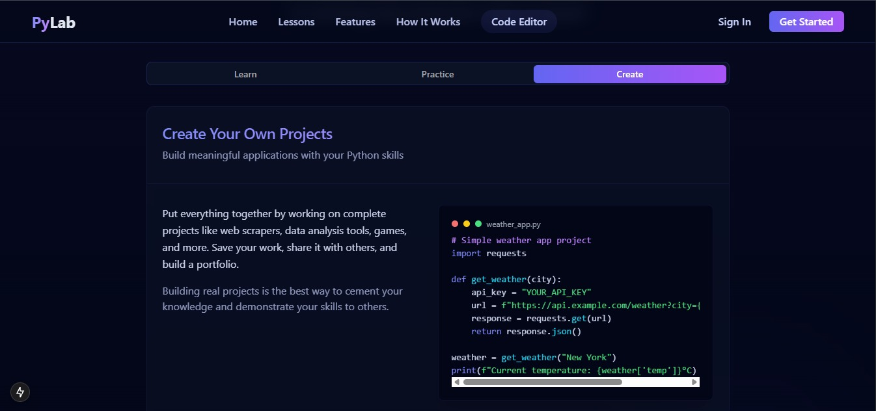
Fr. Conceicao Rodrigues College of Engineering
Create Segment:
Page
14

Slide 15
Fr. Conceicao Rodrigues College of Engineering
Thank You!
Page
15

