Slide 1
Quick Doodle Recognition
ML Project by
Saad Ejaz
M. zaman

Slide 2
Problem Statement

Slide 3
Objective: Accurately and efficiently recognize loose hand-drawn doodles by all kinds of people. Accuracy depicts how often a doodle is correctly recognized, while efficiency is inversely related to the time the algorithm takes to train and/or test.
Long-Term Goal: Recognizing the meaning of doodles is acritical first task in order to build any system that uses hand-drawn images for communication (searching and chatting without a language barrier) [1]
In This Project: Four different algorithms have been used (Logistic Regression, KNN, CNN, and SVM) and their accuracy and efficiency compared to select the most suitable model. A program has also been written to recognize drawn doodles drawn in paint using CNN.

Slide 4
Dataset
Google QuickDraw

Slide 5

The Quick Draw Dataset is a collection of 50 million drawings across 345 categories, contributed by players of the game Quick Draw. [2]
Some doodles that are part of the extensive dataset are displayed to the right.[3]
The bitmap version of the data was used (available in .npy format for NumPy). Each drawing consisted of 28 by 28 (a total of 784 features) raw pixel inputs with values ranging between 0 and 255.
We have chosen 20 of the 345 categories (owing to low computational power available). An equal number of examples were chosen from each of the classes to prevent forming a skewed dataset.
For the CNN and Logistic Regression algorithms, 35,000 doodles were chosen from each class making it a total of 7,00,000 example. 20% of these examples were kept for cross-validation while a separate dataset of 1,36,000 examples was chosen for testing.
For KNN and SVM (algorithms not optimized on GPU), a smaller dataset was selected details of which are specified in the upcoming slides.

Slide 6



















Chosen classes
The chosen 20 classes are , in order, the following:
Axe | Clock | Mountain | Skull
Triangle | Lion | Fish | Airplane
Cloud | Bat | Cup | Apple
Star | Octagon | Camel | Umbrella
Leaf | Duck | Diamond | House

Slide 7
Methodology & Results
Logistic Regression

Slide 8
Algorithm
Library used: TensorFlow-GPU
Logistic Regression is a linear fitting algorithm that uses a sigmoid activation function in conjunction with a suitable optimizer(Stochastic Gradient Descent[4] in this case) to predict a multi-class problem using the One vs All technique.
In TensorFlow, this algorithm can be estimated as a Neural Network with no hidden layers. The output layer is dense with a ‘SoftMax’[5] activation (output sums up to one) and L2 regularization[6]. Polynomial features (squares of the original 784 features) were added to counter high-bias.

Slide 9
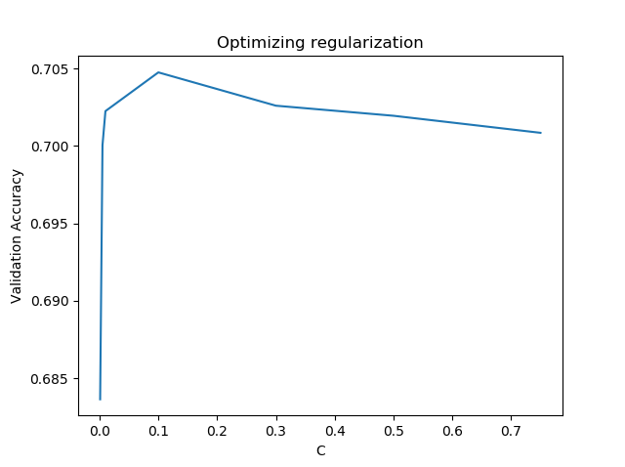
Optimization
The value of lambda (the regularization parameter) was optimized against the validation accuracy.
Since the plot shows that a value less than 0.1 is preferable, further tests were run to get 0.001 as the optimal value.

Slide 10
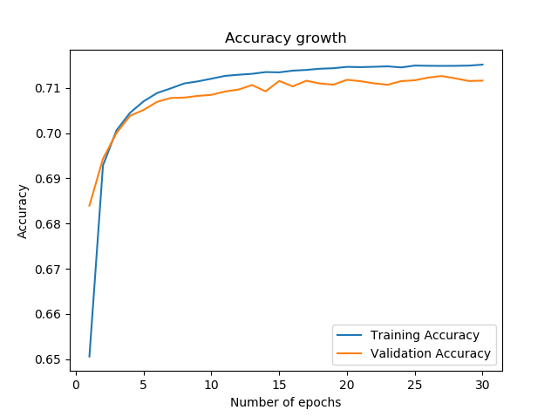
model growth

Slide 11
Results – Accuracy and efficiency
Training Data / Samples | 560000
Cross-Validation Data / Samples | 140000
Testing Data / Samples | 136000
Time / sec | 2171
Training Accuracy / % | 71.50
Cross-Validation Accuracy / % | 71.32
Testing Accuracy / % | 71.48

Slide 12
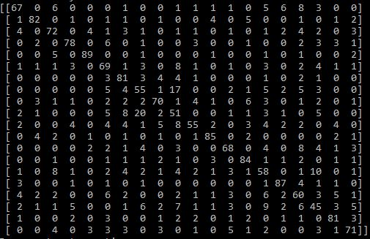
Error Analysis – Confusion matrix
This algorithm works exceptionally well (Precision > 94) for the none of the classes.
This algorithm works below par (69 < Precision < 81) on the following classes: mountain, skull, cloud, and house.
This algorithm works poorly (Precision < 70) on the following classes: lion, bat, axe, airplane, cup, star, camel, duck, and leaf.

Slide 13
Advantages and Disadvantages
ADVANTAGES:
Fast Algorithm whose computation time linearly increases with the number of samples in dataset.
Easy implementation and optimization.
DISADVANTAGES:
The algorithm is linear in nature and thus cannot fit image data with high accuracy.
Would require a huge number of polynomial features (up to the power of 6) which can be computationally very expensive and thus not efficient.

Slide 14
Methodology & results
K-Nearest Neighbors Algorithm

Slide 15
Algorithm
Library used: Scikit-Learn
The algorithm finds the Euclidean (in our case) distance between a sample in the test set to all the samples in the training set. The shortest ‘K’ distances are then selected, and the majority class out of this is predicted.
This is an algorithm with generally very high variance and is also categorized as an instance-based learning, and thus does only take time to predict. This is because no parameter are trained with respect to the training data.

Slide 16
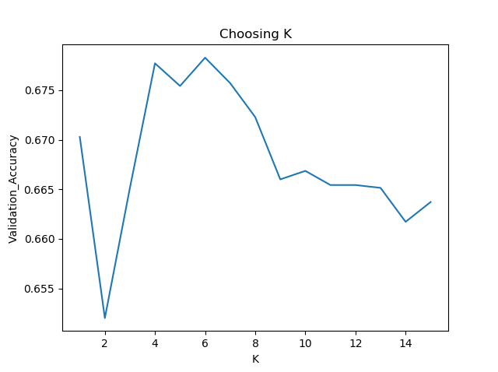
Optimization
It is essential to optimize K as this parameter is solely responsible for the accuracy outcome.
K was optimized against a validation dataset consisting of 400 samples and a training dataset of 6000 samples.
The optimum value of K as shown in the graph is 6 which was chosen for the testing phase.

Slide 17
Results – Accuracy and efficiency
Training Data / Samples | 40000
Testing Data / Samples | 8300
Time / sec | 590
Testing Accuracy / % | 78.31
We can improve the accuracy of this system to about 83% by increasing the training data; but since KNN is a lazy algorithm, the testing time would overshoot to well beyond 11000 seconds (approximately 3.1 hours)

Slide 18
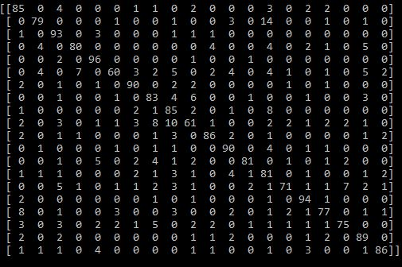
Error Analysis – Confusion matrix
This algorithm works exceptionally well (Precision > 94) for the following class: triangle
This algorithm works below par (69 < Precision < 81) on the following classes: clock, camel, leaf, and duck.
This algorithm works poorly (Precision < 70) on the following classes: lion and bat.

Slide 19
Advantages and Disadvantages
ADVANTAGES:
Performs considerably better than a linear optimizer, given enough training data.
Extremely easy implementation and optimization.
Takes no time to train, because the algorithm runs only when a test sample is provided.
DISADVANTAGES:
Performs a huge number of redundant calculations that make it computationally very expensive. (time taken is proportional to training x testing in contrast with either training or testing)
Takes more time in testing when compared with all other algorithms which is a hindrance because in contrast to training (a one-time process), testing occurs quite frequently. Thus this algorithm cannot be used in a routine detection of doodles.

Slide 20
Methodology & results
Convolutional Neural Network

Slide 21
Algorithm
Library used: TensorFlow-GPU
Model used:
Conv2D (128 filters)
MaxPooling2D (2x2)
Dropout (30%)
Flatten
Dense (128 Neurons)
Input (28,28,2)
Output (20 classes)
Squared features were added to form a 4-D tensor (to counter high-bias)
The labels were transformed using the one-hot encoding[7] for a faster computation.
The optimizer used was Stochastic Gradient Descent with a learning rate of 0.01.
The regularization used was L2 with lambda value set to 0.005. L2 adds the squares of the weights of the parameters which allows to counter the high variance problem.

Slide 22
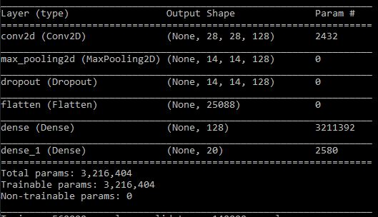
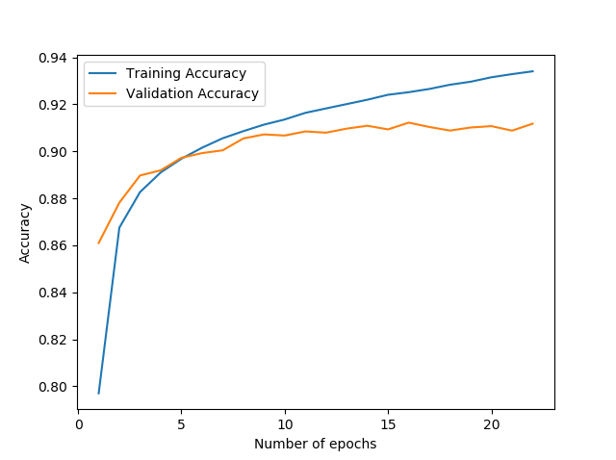
model Summary & growth

Slide 23
Results – Accuracy and efficiency
Training Data / Samples | 560000
Cross-Validation Data / Samples | 140000
Testing Data / Samples | 136000
Time / sec | 7524
Training Accuracy / % | 93.71
Cross-Validation Accuracy / % | 91.82
Testing Accuracy / % | 91.45

Slide 24
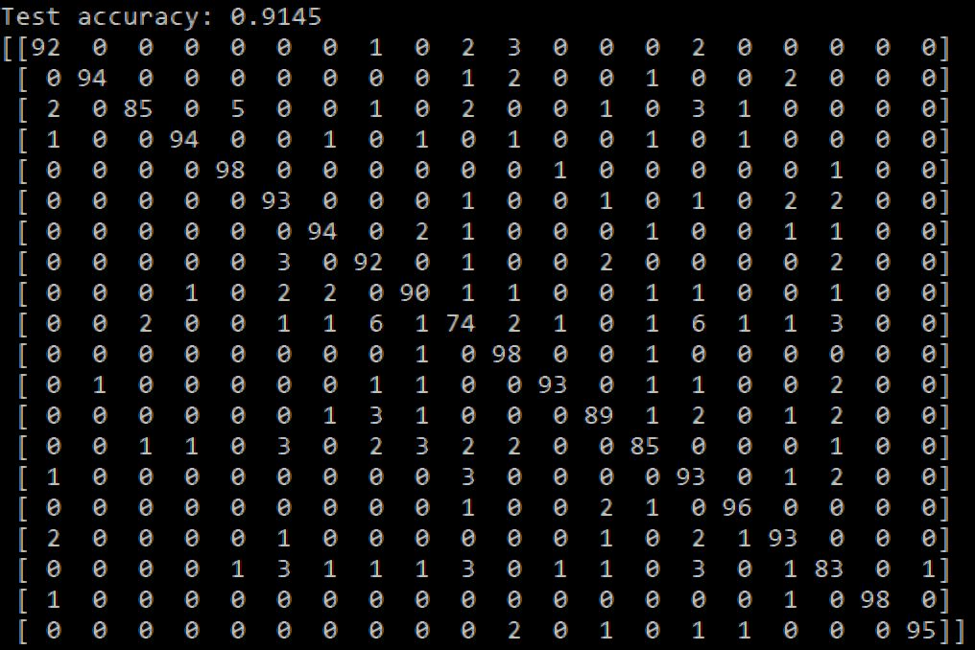
Error Analysis – Confusion matrix
This algorithm works exceptionally well (Precision > 94) for the following classes: triangle, cup, umbrella, diamond, and house.
This algorithm works below par (69 < Precision < 81) on the following class: bat.
This algorithm works poorly (Precision < 70) on none of the classes.

Slide 25
Advantages and Disadvantages
ADVANTAGES:
Has the best accuracy across all models in this project.
Testing time is extremely fast: 156 microseconds/sample.
The model reaches optimum accuracy in about 10 epochs (as shown in the growth graph). This fact can be utilized for increasing efficiency (decreasing training time)
DISADVANTAGES:
Trains more than three million parameters owing to which the algorithm runs the risk of overfitting. This is mediated by an increase in the number of samples in the training set which subsequently increases the training time.
Using CNN similar to those used in transfer learning are not feasible to run in our local machine. Therefore, improving upon this model would require a much better hardware.

Slide 26
Methodology & results
Support Vector Classifier

Slide 27
Algorithm
Library used: Scikit-Learn
Support Vector Machines is an algorithm that is commonly used for smaller but complex datasets that most linear or polynomial classifiers/regressors cannot accurately predict.
SVMs work by optimizing a hyperplane that best divides the dataset into binary categories. For multi-class problems like ours, the One vs All technique is used.
There are multiple kernel functions available to transform the data: rbf, linear, sigmoid, polynomial etc. For our dataset, RBF (radial basis function) proved to be the best. The hyperparameters C and gamma for rbf are optimized.

Slide 28
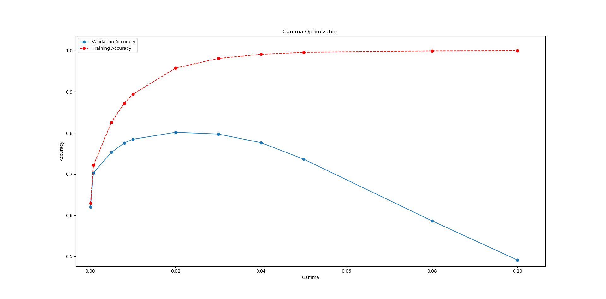
Optimization-gamma
Gamma is the free parameter of the Gaussian radial basis function.
A large value for gamma leads to high bias and low variance and vice versa.
Gamma was tuned against cross-validation accuracy
A value of 0.02 was chosen.

Slide 29
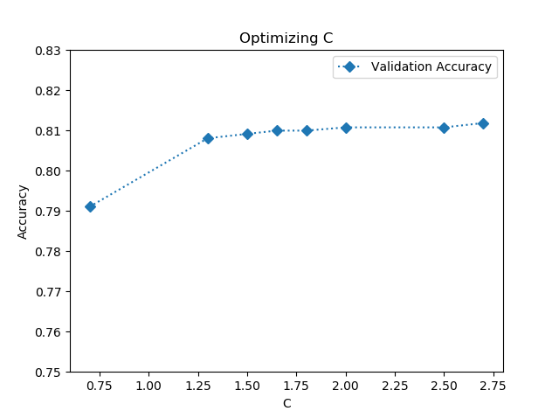
Optimization-C
C is the parameter for the soft margin cost function, which controls the influence of each individual support vector; this process involves trading error penalty for stability.
C can be thought of as a regularization parameter, as it is a measure of the extent to ignore the unusual data points.
The value of C chosen was 2.5.

Slide 30
Results – Accuracy and efficiency
Training Data / Samples | 54000
Testing Data / Samples | 14300
Time / sec | 6649
Training Accuracy / % | 99.85
Testing Accuracy / % | 84.66
If the training set size is further increased to 94000, the accuracy increases to 86.20% but this takes considerably more time: 19447 seconds.

Slide 31
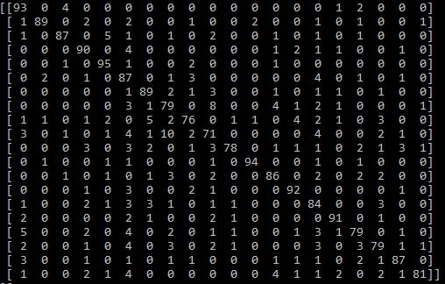
Error Analysis – Confusion matrix
This algorithm works exceptionally well (Precision > 94) for the class: triangle.
This algorithm works below par (69 < Precision < 81) on the following classes: airplane, cloud, bat, cup, leaf, and duck.
This algorithm works poorly (Precision < 70) on none of the classes.

Slide 32
Advantages and Disadvantages
ADVANTAGES:
Second highest accuracy achieved on the testing dataset even after training on only 10% of the data that CNN and Logistic Regression were trained upon.
Hyperparameter optimization allows for a very close fit to a variety of training data which is clear by the >99% training accuracy, so the algorithm doesn’t underfit.
DISADVANTAGES:
The algorithm is meant for smaller datasets. The fit time scales at least quadratically with the number of samples and SVC may be impractical beyond tens of thousands of samples.[8] Owing to this, a major solution for the high variance problem (increasing number of samples) is rendered extremely inefficient.

Slide 33
Problems faced during implementation

Slide 34
Hardware limitations did not allow for an extensive optimization of minor parameters such as the number of neurons in the hidden layer of CNN, and some regularization parameters (L2). This also did not allow using a greater number of categories (more shapes) for classification.
Some class pairs include images that are very similar for example bat and airplane, and star and leaf. Furthermore bat her is an animal while some images contain the sports good. Therefore the precision for predicting bat does not exceed 75% across all algorithms.
Scikit-Learn, the library used in two of the four algorithms implemented, is not optimized for GPU, which led to wastage of resources of the machine.
Predicting hand drawn doodles in real time (for example on paint) required image processing (already done by Google) on vector data from strokes while drawing. Unfortunately such data is not easily extracted from a simple app like Paint.

Slide 35
Choosing the best classifier

Slide 36
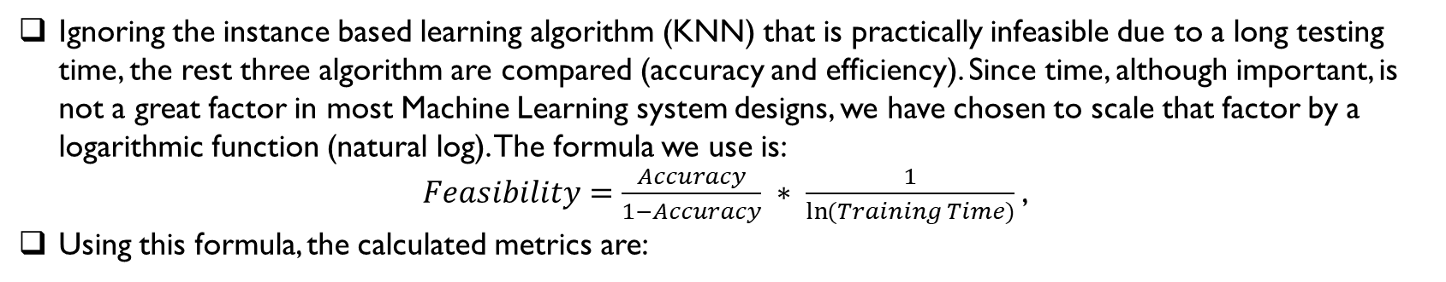
Ignoring the instance based learning algorithm (KNN) that is practically infeasible due to a long testing time, the rest three algorithm are compared (accuracy and efficiency). Since time, although important, is not a great factor in most Machine Learning system designs, we have chosen to scale that factor by a logarithmic function (natural log). The formula we use is:
$Feasibility=\frac{Accuracy}{1−Accuracy} ∗ \frac{1}{\ln{(Training Time})}$,
Using this formula, the calculated metrics are:
ML Algorithm | Feasibility
Logistic Regression | 0.326
CNN | 1.198
SVM | 0.627
It is important to note that this formula is formed only for sake of comparison in this particular project with a particular machine, and has little mathematical significance elsewhere.
The best algorithm according to this metric is the version of CNN implemented.

Slide 37
Predicting with CNN
USE MAIN.PY FOR PREDICTION WITH ALL THE ALGORITHMS

Slide 38
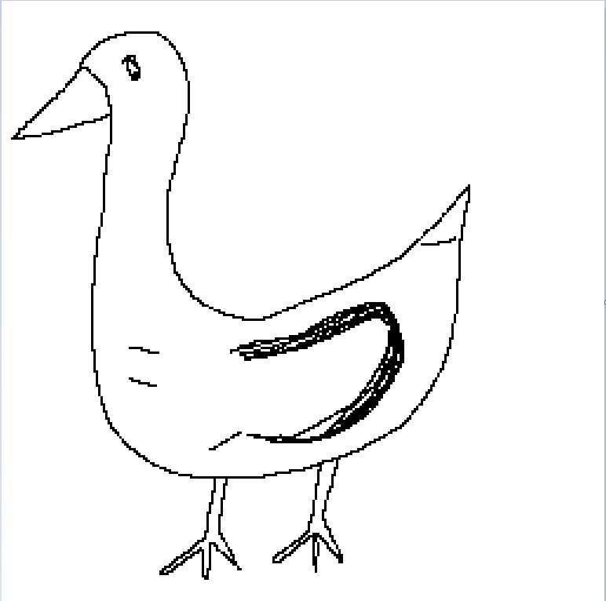
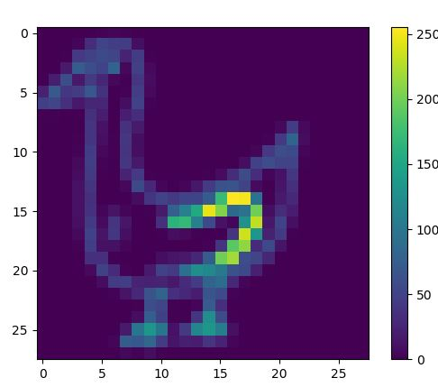
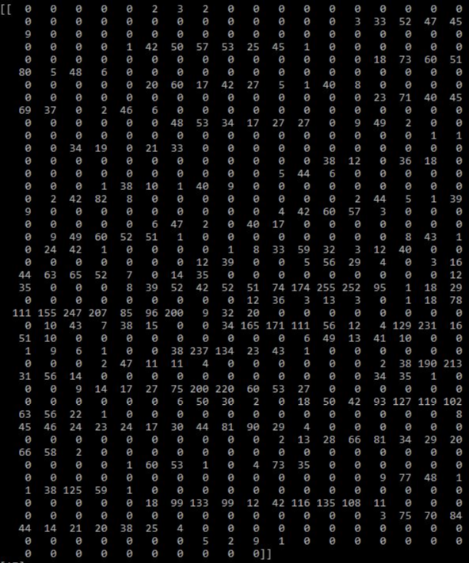

A program is written that takes an image from a file (made in paint), converts it into the format close enough to the dataset; and then predicts using the CNN model saved in the files.
Doodle drawn using mouse/stylus on Paint
Grayscale image pixel data plotted
Pixel data used to predict class

Slide 39
References
[1] http://cs229.stanford.edu/proj2018/report/33.pdf
[2] https://github.com/googlecreativelab/quickdraw-dataset
[3] https://quickdraw.withgoogle.com/data
[4] Ferguson, Thomas S. (1982). "An inconsistent maximum likelihood estimate". Journal of the American Statistical Association. 77 (380): 831–834.
[5] https://keras.io/activations/
[6] https://keras.io/regularizers/
[7] Harris, David and Harris, Sarah. Digital design and computer architecture (2nd ed.). San Francisco, Calif.: Morgan Kaufmann. p. 129.
[8] https://scikit-learn.org/stable/modules/generated/sklearn.svm.SVC.html

