Slide 1


◷ Sun, Oct 11 · 9:00 – 11:30
IARSLCE 2026 · PRE-CONFERENCE WORKSHOP
Participatory AI for Community Engagement
Nicholas Mattei & Saad Hassan
Tulane Center for Community-Engaged Artificial Intelligence
Sunday, October 11, 2026 · 9:00 – 11:30 am
Monroe Hall 152, Tulane University, New Orleans
Welcome
AI
Design
Reflect
Share
Break
Breakouts
Report
Debrief
Notes:
Welcome everyone. We're Nick Mattei and Saad Hassan from Tulane's Center for Community-Engaged AI.
Logistics: restrooms, Wi-Fi, break at 10:10. Ask people to grab sticky notes and a reflection card.
TODO before Sunday: drop the IARSLCE conference logo into the dashed box (top left). The CEAI logo has a dark background in the source file, so it sits on a white card.

Slide 2

Today's plan
◷ 9:00 – 9:10 · 10 min
9:00
Welcome and introductions
Nick & Saad
9:10
What is AI, and where are we?
Nick
9:25
Designing with, not for
Saad
9:40
Reflect: your one problem
Everyone
9:55
Share-outs
Everyone
10:10
Break
We cluster your ideas
10:25
Breakout groups: three rounds
Two groups
Slides, readings, and links
11:10
Report back
Each group
saadh.info/pace2
11:20
Debrief and next steps
Everyone
Welcome
AI
Design
Reflect
Share
Break
Breakouts
Report
Debrief
Notes:
150 minutes. Two short talks, then most of the morning is yours: individual reflection, share-outs, break, and two breakout groups. The QR code links to saadh.info/pace2 (slides and resources).

Slide 3

Introductions
◷ 9:00 – 9:10 · 10 min
Nicholas Mattei
Associate Professor of Computer Science, Tulane University
Co-Director, Tulane Center for Community-Engaged AI
AI, machine learning, and decision making with real-world stakeholders
Community projects across New Orleans: civic tech, courts, utilities
Co-author, Computing and Technology Ethics: Engaging Through Science Fiction (MIT Press)
nickmattei.net
Chair, ACM SIGAI
NSF CAREER
Prev. NASA · IBM · UNSW
Welcome
AI
Design
Reflect
Share
Break
Breakouts
Report
Debrief
Notes:
Nick introduces himself (about 1 minute).
Bio source: workshop description. Website: nickmattei.net

Slide 4
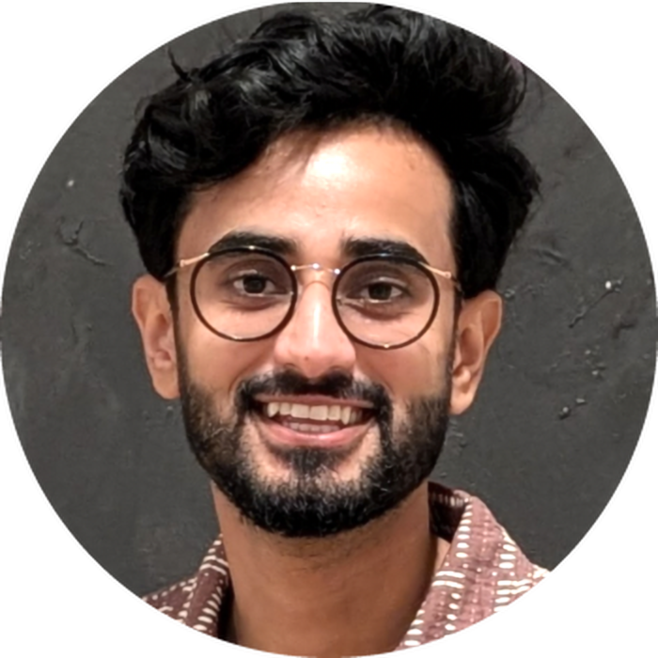
Introductions
◷ 9:00 – 9:10 · 10 min
Saad Hassan
Assistant Professor of Computer Science, Tulane University
Director, NOLA A11y Lab · Affiliate, CEAI
Human–AI systems that make communication, information, and public services accessible
Sign language and captioning technologies with Deaf and hard-of-hearing communities
Civic AI and accessibility dashboards with community organizations
saadh.info
PhD, RIT
Visiting: Google & Meta
CHI · ASSETS · NeurIPS
Welcome
AI
Design
Reflect
Share
Break
Breakouts
Report
Debrief
Notes:
Saad introduces himself (about 1 minute).
Source: saadh.info. New this summer: NSF award (as PI) on civic AI connecting residents, communities, and local governments.

Slide 5
Let's get to know you
◷ 9:00 – 9:10 · 10 min
1
2
3
Your name
Your affiliation
One community partner or project
and how you'd like to be called
institution, office, or organization
you're working with right now
About 30 seconds each
The pre-workshop survey covers the rest, so keep it short.
Welcome
AI
Design
Reflect
Share
Break
Breakouts
Report
Debrief
Notes:
~16 registrants, so 30 seconds each keeps us at 10 minutes total. Go around the room. Nick and Saad listen for partners and themes to reuse in the activity.

Slide 6
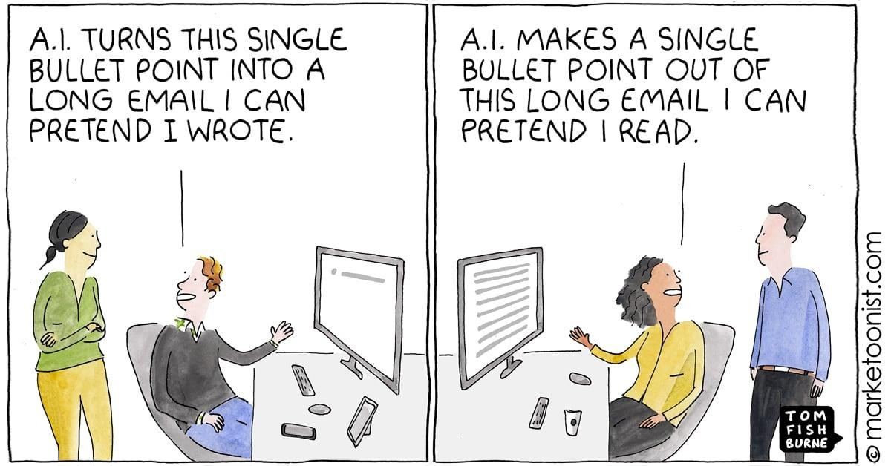
◷ 9:10 – 9:25 · 15 min
PART 1
What is AI, and where are we?
Nicholas Mattei
Welcome
AI
Design
Reflect
Share
Break
Breakouts
Report
Debrief
Notes:
15 minutes. Goal: a shared, non-technical vocabulary for the rest of the morning, then what we've learned doing AI work with community partners in New Orleans.

Slide 7












AI is already everywhere
◷ 9:10 – 9:25 · 15 min
Feeds, search, prices, matches, rides, loans: most of it has run on AI for years.
Welcome
AI
Design
Reflect
Share
Break
Breakouts
Report
Debrief
Notes:
Quick warm-up: AI is not new to people's lives. Recommendation, ranking, and matching systems have shaped what we see and buy for years. What's new since 2022 is generative AI that anyone can talk to.

Slide 8
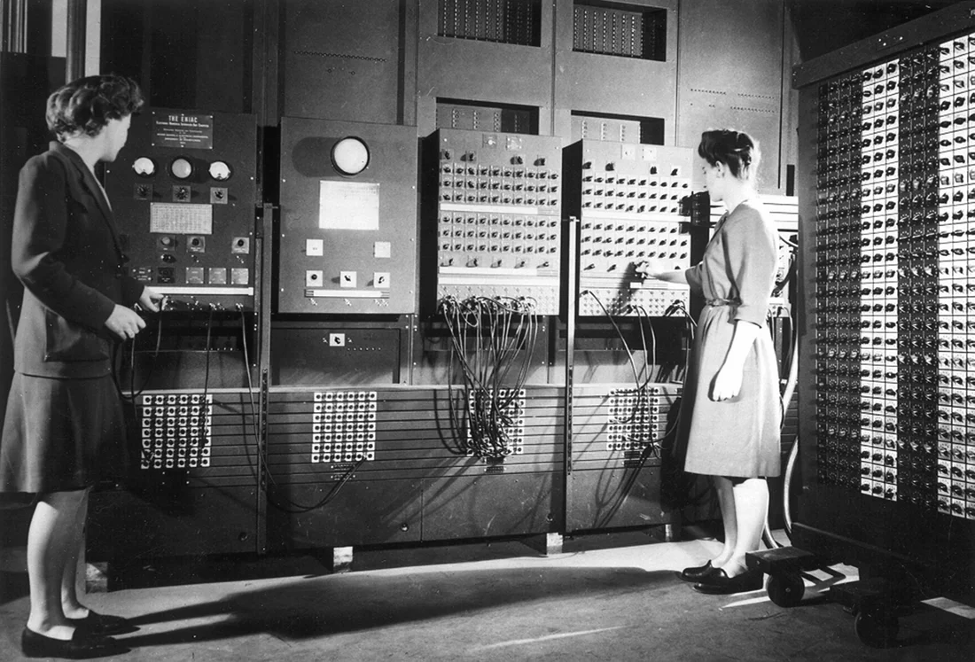
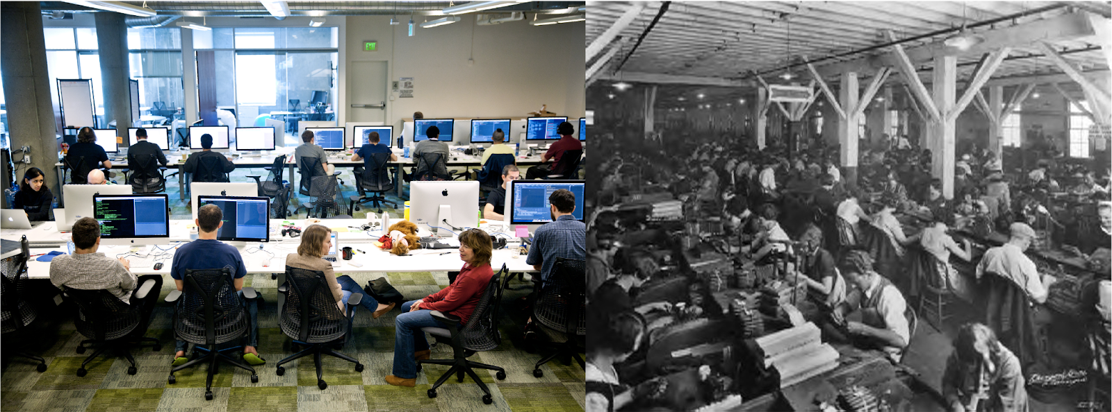
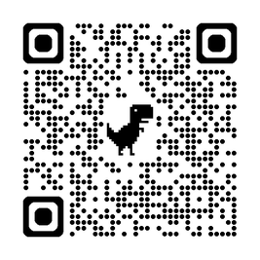
Everyone is a programmer now
◷ 9:10 – 9:25 · 15 min
THE GOAL
Make intent clear to computers!
Wires
›
Punch cards
›
Languages
›
No-code
›
Prompt as code
CS folks should embrace this!
The magic of CS is that we get to make the machine do what we want. Now everyone can!
Secondary argument: we’ve been in the bot age for a while (search, etc. is the product). People never produced this… (well, in the 90s maybe).
READ MORE
The End of Programming as We Know It (O’Reilly)
Welcome
AI
Design
Reflect
Share
Break
Breakouts
Report
Debrief

Slide 9
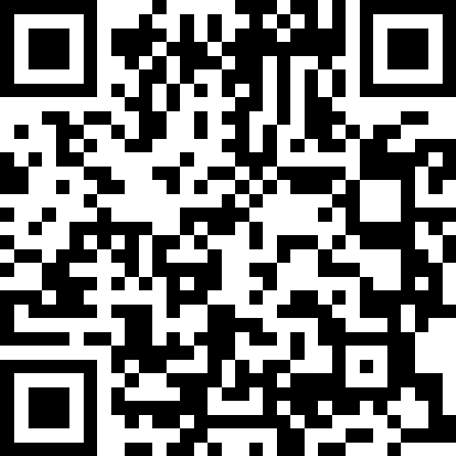

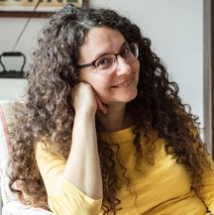
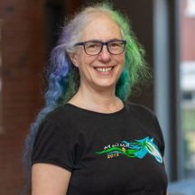

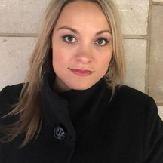
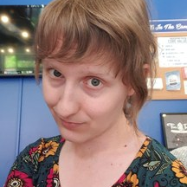
Teaching computing and technology ethics
◷ 9:10 – 9:25 · 15 min
Engaging through science fiction
AVAILABLE NOW · MIT PRESS
CHAPTERS
Ethical Frameworks
Managing Knowledge
Privacy and Personhood
Technology and Society
Professional Ethics
ANTHOLOGY
Short stories from acclaimed writers including Ken Liu, Elizabeth Bear, Paolo Bacigalupi, and T. C. Boyle animate ethical challenges in computing technology.
GET THE BOOK
rebrand.ly/SciFi-Book
Welcome
AI
Design
Reflect
Share
Break
Breakouts
Report
Debrief

Slide 10
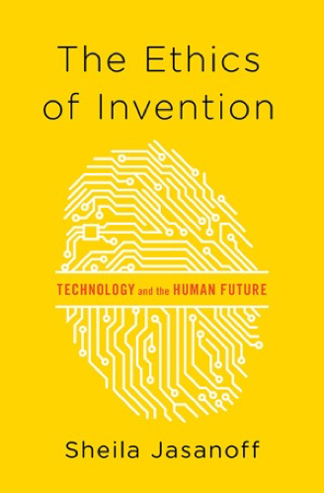

Let’s step back: what is technology?
◷ 9:10 – 9:25 · 15 min
AI and technology is not a single thing or only objects.
It does not have agency, it is not a person, and by many philosophical/religious arguments cannot be “ethical.”
Sheila Jasanoff
The Ethics of Invention
1
2
Focusing only on specific objects or artifacts: a camera, a traffic light, a gun, an app, a bike…
How technology affects society is an insufficient question of cause and effect: does a gun do bad things?
3
Technology and society are bound together in an inseparable way: our choices about which technologies to develop, or not to develop, often grow out of the society in which we live.
And those technologies, in turn, change our social settings and the subsequent technologies that are produced in the context in which we live.
Consider the stoplight…
Welcome
AI
Design
Reflect
Share
Break
Breakouts
Report
Debrief

Slide 11
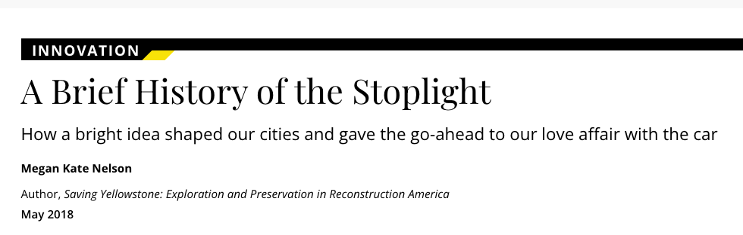
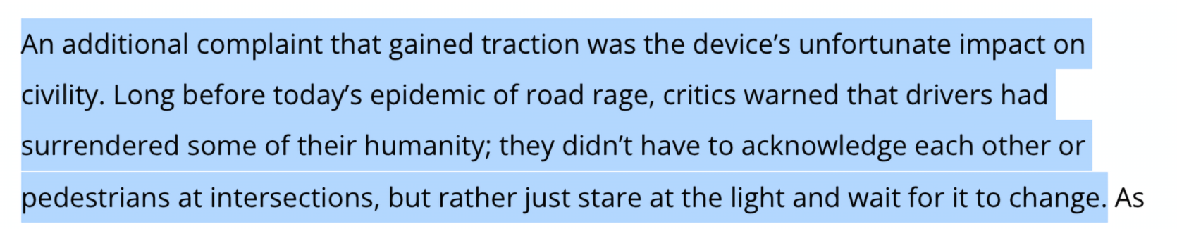
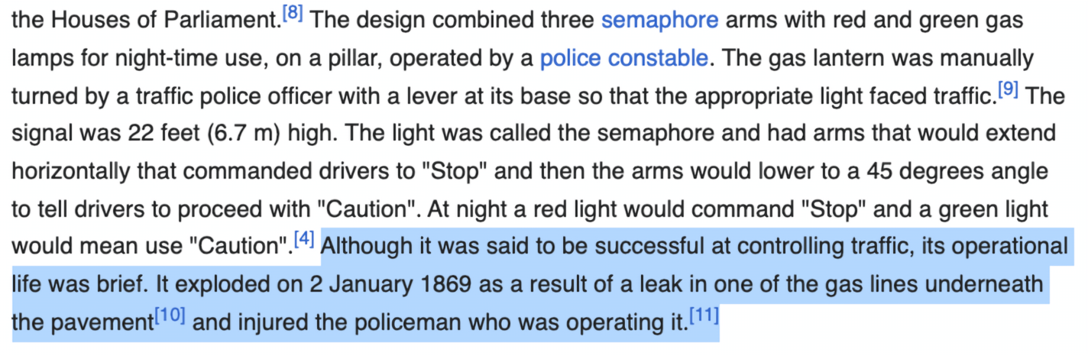
Consider the stoplight
◷ 9:10 – 9:25 · 15 min
THE FIRST SIGNAL
London, 1868. A gas-lit semaphore outside the Houses of Parliament.
Sources: Smithsonian Magazine · Wikipedia, History of traffic lights
Welcome
AI
Design
Reflect
Share
Break
Breakouts
Report
Debrief

Slide 12

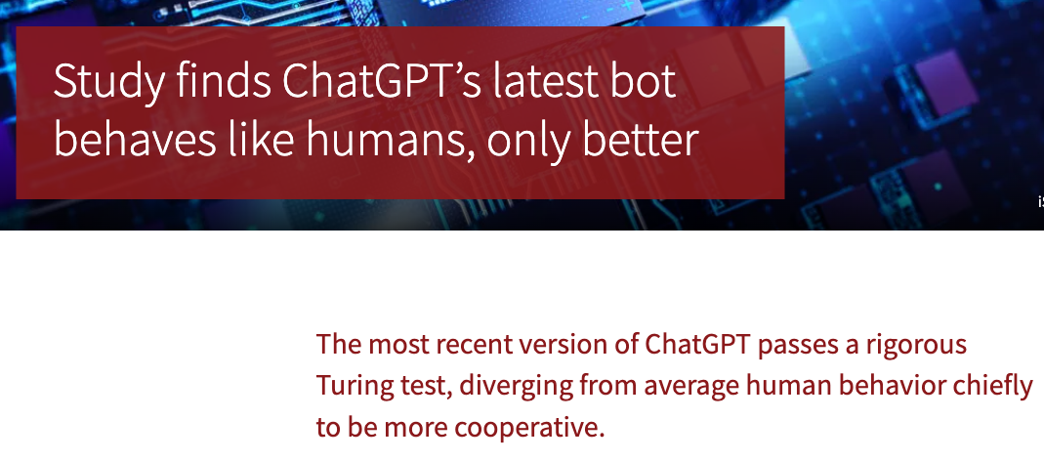
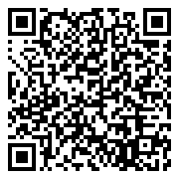
Wait, what is AI?
◷ 9:10 – 9:25 · 15 min
ALAN TURING, 1950
“I propose to consider the question, ‘Can machines think?’ … I shall replace the question by another, which is closely related to it and is expressed in relatively unambiguous words.”
TODAY
THE IMITATION GAME
“… a man (A), a woman (B) and an interrogator (C) … The object of the game for the interrogator is to determine which of the other two is the man and which is the woman.”
Passes a rigorous Turing test. Scan for the study.
Tessler’s Theorem: “Intelligence is what machines haven’t done yet.”
I.e., “If machines can do it, it isn’t intelligence.”
Welcome
AI
Design
Reflect
Share
Break
Breakouts
Report
Debrief

Slide 13
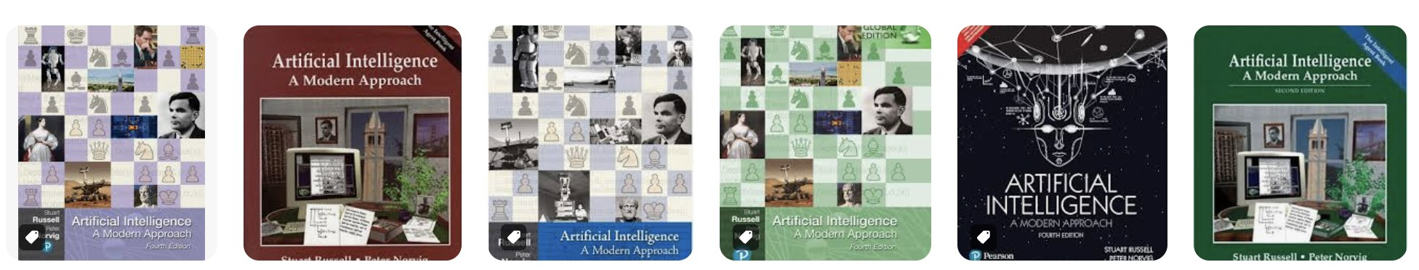

AI for AI researchers
◷ 9:10 – 9:25 · 15 min
Environment
Agent
percepts
Sensors
“‘Artificial intelligence’ is when a machine mimics ‘cognitive functions’ that humans associate with other human minds such as ‘learning’ and ‘problem solving.’”
AGENT-BASED APPROACH
“… rational agents that act so as to achieve the best outcome, or, when there is uncertainty, the best expected outcome.”
actions
TRADITIONAL GOALS
Actuators
Reasoning, planning, and knowledge representation
Machine learning and natural language processing
Perception (vision) and embodiment (robotics)
Welcome
AI
Design
Reflect
Share
Break
Breakouts
Report
Debrief

Slide 14


Text-to-text systems
◷ 9:10 – 9:25 · 15 min
give me the Gettysburg address
Four score and seven years ago our forefathers brought…
›
›
›
01
02
03
04
The data
The model
The prompt
The output
Scrape LOTS of TEXT from the internet.
Create a giant statistical model that relates how WORDS appear with other WORDS.
You type a request.
The model continues the text, one word at a time.
Welcome
AI
Design
Reflect
Share
Break
Breakouts
Report
Debrief

Slide 15
Given the words so far, keep predicting
◷ 9:10 – 9:25 · 15 min
The best thing about AI is its ability to,
The best thing about AI is its ability to create,
The best thing about AI is its ability to create worlds,
The best thing about AI is its ability to create worlds that,
The best thing about AI is its ability to create worlds that are,
The best thing about AI is its ability to create worlds that are both,
The best thing about AI is its ability to create worlds that are both exciting,
Source: Stephen Wolfram, “What Is ChatGPT Doing … and Why Does It Work?” (2023)
Welcome
AI
Design
Reflect
Share
Break
Breakouts
Report
Debrief

Slide 16

General idea: predict the next word
◷ 9:10 – 9:25 · 15 min
The best thing about AI
is its ability to …
MOST LIKELY NEXT WORDS
learn
4.5%
predict
3.5%
make
3.2%
understand
3.1%
do
2.9%
Values from Stephen Wolfram, “What Is ChatGPT Doing … and Why Does It Work?” (2023)
Welcome
AI
Design
Reflect
Share
Break
Breakouts
Report
Debrief
Notes:
stuffed teddy bear dressed like a bookie sitting behind a teller window with bars taking bets photorealistic

Slide 17
Three ways to tell a computer what to do
◷ 9:10 – 9:25 · 15 min
1
2
3
Traditional programming
Machine learning
Generative AI
The computer does exactly what you tell it, whether you meant it or not.
Learns patterns from data to predict, classify, and recommend.
Trained broadly to do many things. Wonderful new behavior, but hard to predict exactly.
Rules written by people
Rules learned from data
Text, images, code on demand
Welcome
AI
Design
Reflect
Share
Break
Breakouts
Report
Debrief
Notes:
From Nick's 'Three Major Paradigms' slide. Click to reveal each. The key shift: in (2) and (3) nobody writes the rules by hand, so the data and the objective decide behavior. That's exactly where community input matters.

Slide 18
From autocomplete to agents
◷ 9:10 – 9:25 · 15 min
01
02
03
04
Large language model
Chatbot
Reasoning model
Agentic system
Guess the next word
›
Hold a conversation
›
Work through a problem
›
Act in the world
Words in, word out. Trained on huge amounts of text.
Tuned with human feedback to follow instructions.
Writes hidden steps before it answers.
Searches the web, runs code, sends email, edits files.
Each step adds capability, and each step adds new ways to fail.
Welcome
AI
Design
Reflect
Share
Break
Breakouts
Report
Debrief
Notes:
Based on Nick's LLM → Chatbot → Reasoning → Agentic slides (credit: Brown). Point out that agentic systems can change things outside the chat window, which raises the stakes for community settings.

Slide 19



The good, the bad, and the ugl-AI
◷ 9:10 – 9:25 · 15 min
Protein structure prediction (AlphaFold)
Rising electricity costs
Question answering, but it makes things up
Real progress on language tasks
Copyright and intellectual property
Study aid, but it can block learning
Companionship, but people can spiral
Welcome
AI
Design
Reflect
Share
Break
Breakouts
Report
Debrief
Notes:
From the 'Good, Bad, Ugl-AI' sequence. The ugly column is the important one: the same feature has a good and a bad side, and it's up to us to maximize benefits and minimize costs.

Slide 20
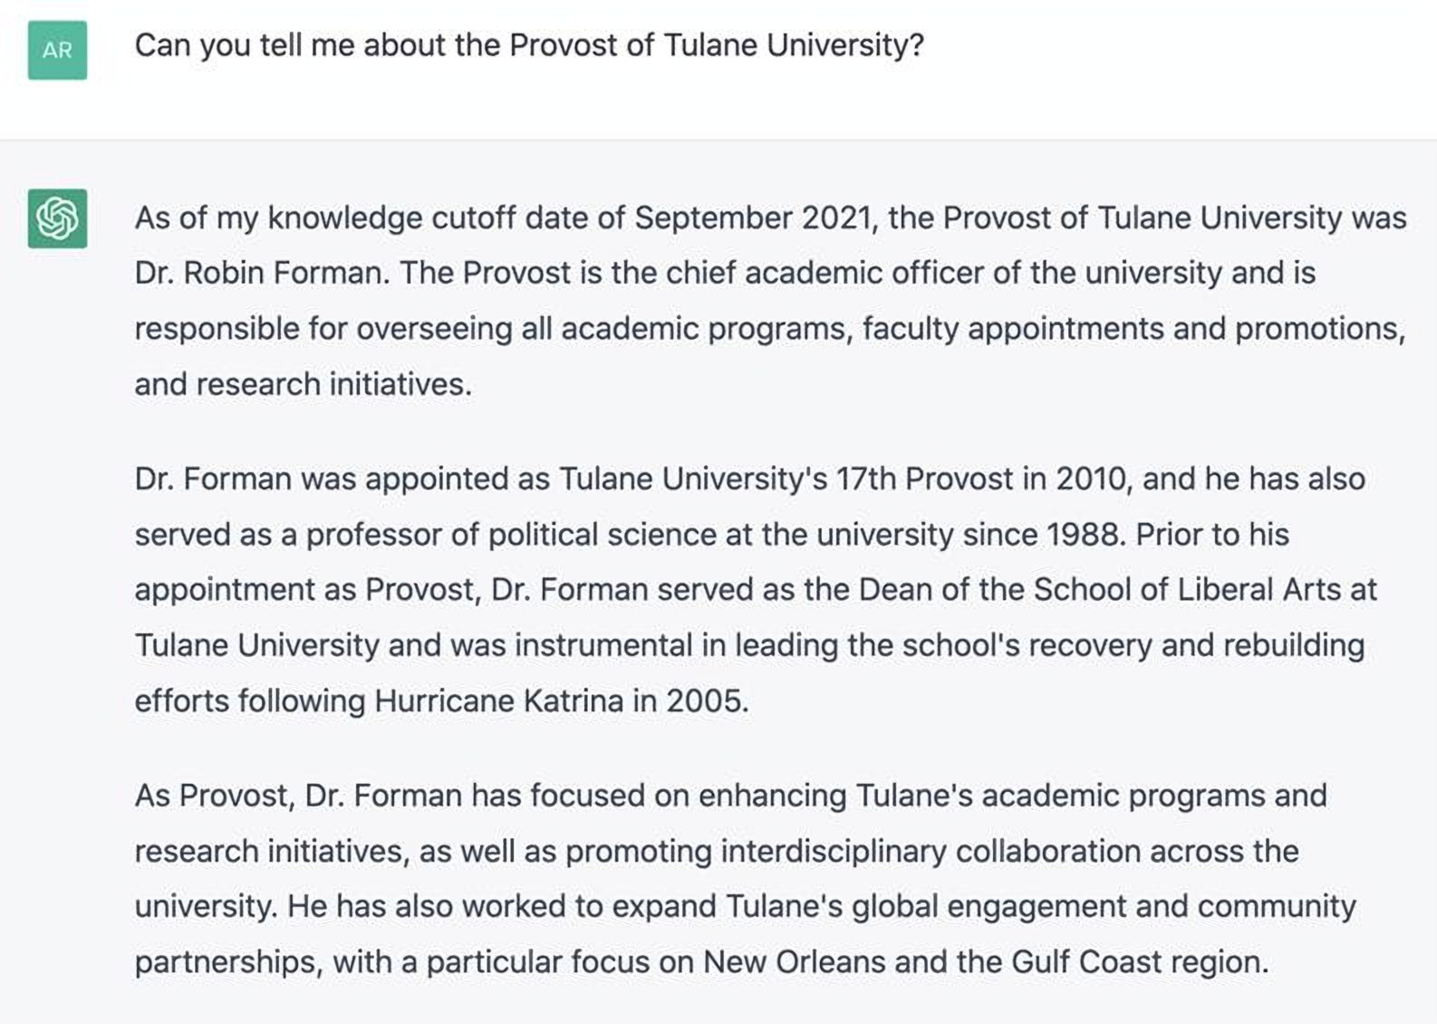
Fluent, confident, and wrong
◷ 9:10 – 9:25 · 15 min
Ask a chatbot about Tulane's provost and you get a detailed, polished biography, with details that are made up.
Often called “hallucination.” Nick avoids the word: it anthropomorphizes a random number generator.
Check every output. Test, test, and test again.
Welcome
AI
Design
Reflect
Share
Break
Breakouts
Report
Debrief
Notes:
Nick's 'Making Things Up' example. Good moment to connect to community work: a partner using a chatbot to answer public questions needs a way to verify and correct it.

Slide 21
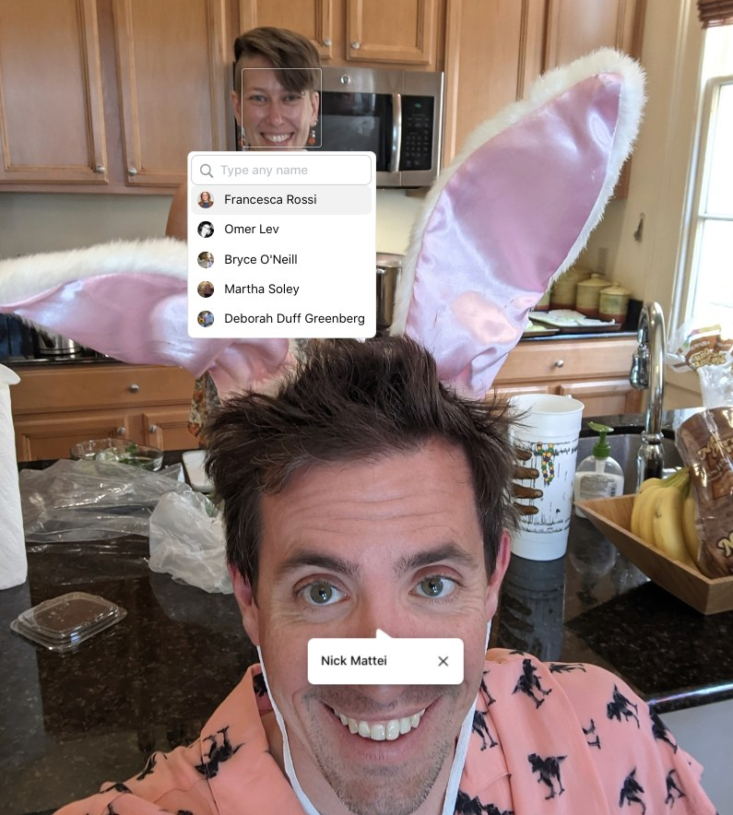
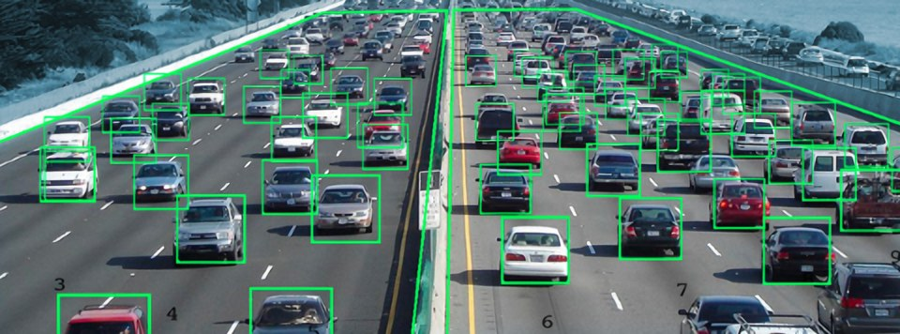
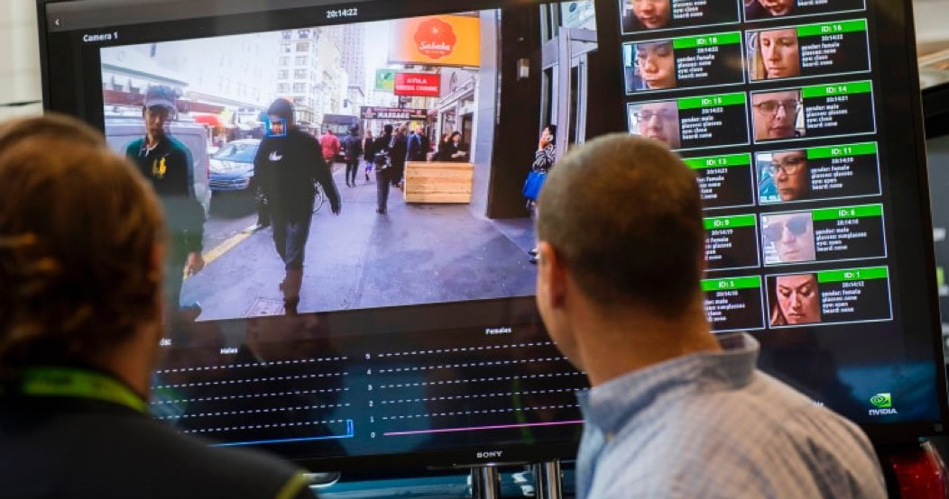
What’s at stake?
◷ 9:10 – 9:25 · 15 min
Welcome
AI
Design
Reflect
Share
Break
Breakouts
Report
Debrief

Slide 22
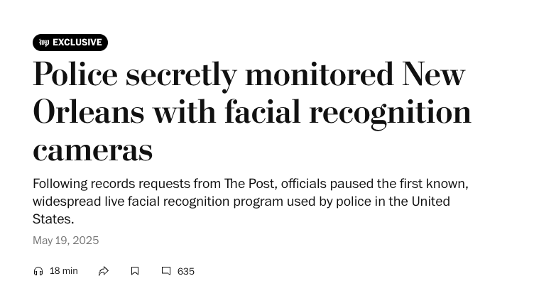
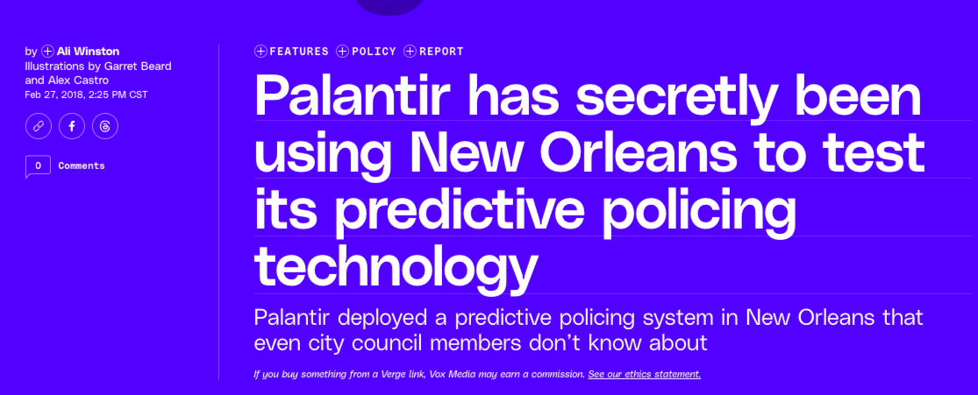
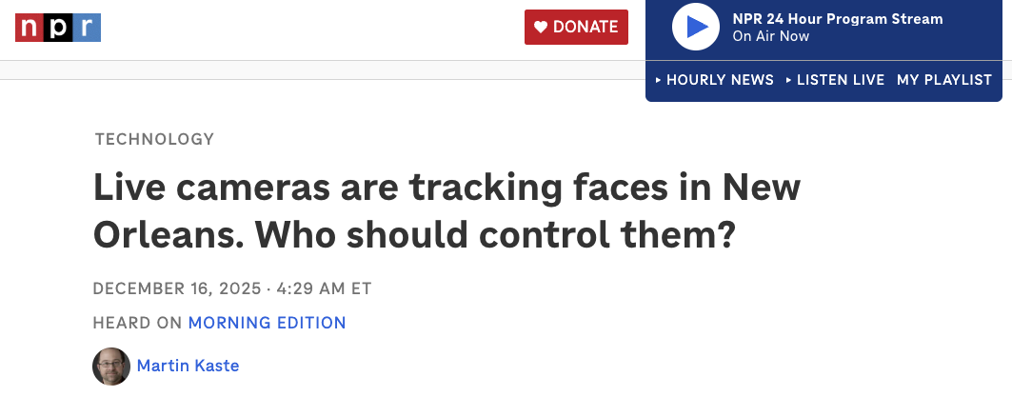
What's at stake, right here in New Orleans
◷ 9:10 – 9:25 · 15 min
Facial recognition and predictive policing were tested on New Orleans residents, often without public knowledge.
Welcome
AI
Design
Reflect
Share
Break
Breakouts
Report
Debrief
Notes:
Headlines from Nick's 'What's at Stake' slide: Washington Post on live facial recognition (2025), The Verge on Palantir's predictive policing test, NPR on live cameras. Ask: who was in the room when these were decided?

Slide 23
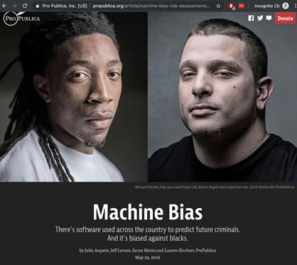

Automated decisions of consequence
◷ 9:10 – 9:25 · 15 min
Hiring
A recruiting tool learned to downgrade women's résumés and was scrapped.
Advertising
Searching Black-identifying names surfaced more ads for arrest records.
Lending
Credit models can reproduce historical patterns of exclusion.
ProPublica, Machine Bias (2016)
O'Neil, Weapons of Math Destruction (2016)
Policing and sentencing
Risk scores shape bail and sentencing decisions.
Welcome
AI
Design
Reflect
Share
Break
Breakouts
Report
Debrief
Notes:
From 'What Can Go Wrong' and 'Automated Decisions of Consequence' (Sweeney 2013, Miller 2015, Barry-Jester et al. 2015; Reuters 2018 on Amazon). These are the decisions where communities have the most at stake and the least say.

Slide 24
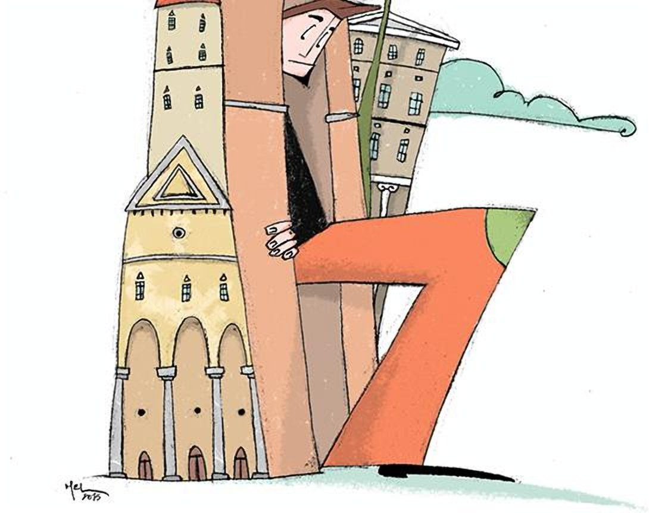
◷ 9:10 – 9:25 · 15 min
How can academia collaborate outside the ivory tower to solve problems using AI?
Illustration: Melania Bianucci, Ludicomix
Welcome
AI
Design
Reflect
Share
Break
Breakouts
Report
Debrief
Notes:
Transition to the Center for Community-Engaged AI and what we've learned.

Slide 25


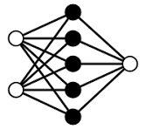

A community-led research pipeline
◷ 9:10 – 9:25 · 15 min
Community workshops
›
Service-learning capstones
›
Research teams
›
Joint funding
Learn from the community. Build relationships with non-profits.
Year-long student projects with partners. Working prototypes.
Faculty from CS, sociology, economics, public health.
Seed funds, then shared grants with partners as co-PIs.
sse.tulane.edu/cs/ceai
Welcome
AI
Design
Reflect
Share
Break
Breakouts
Report
Debrief
Notes:
Tulane CEAI's pipeline from Nick's TRICS talk. Emphasize that it's a cycle, not a pipeline where communities supply problems: partners stay involved as projects grow.
NOTE: the CEAI logo file has a dark backdrop baked in; swap for a transparent version if you have one.

Slide 26
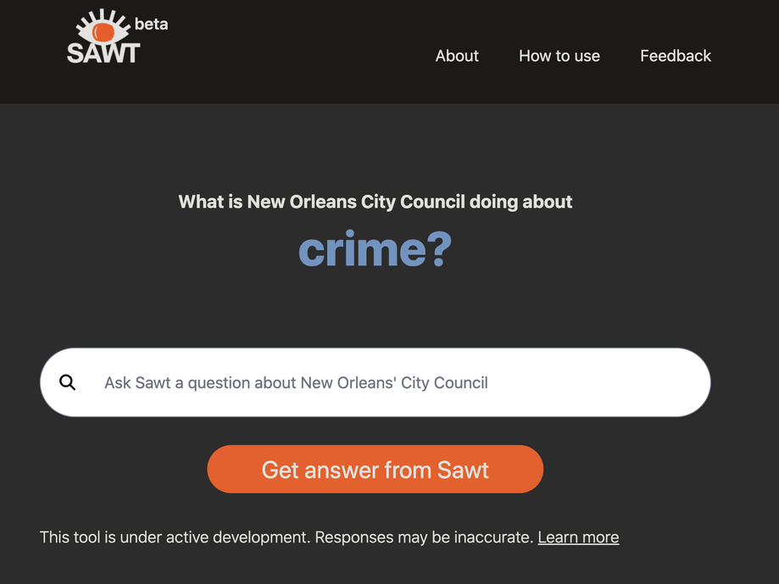
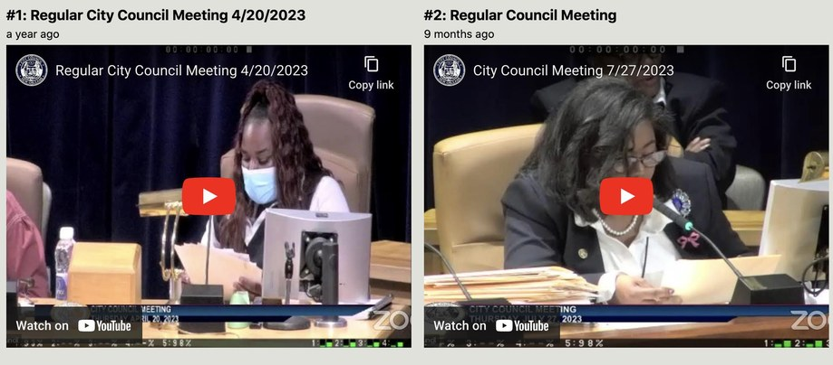
LLMs for city government
◷ 9:10 – 9:25 · 15 min
EXAMPLE 1
with Eye on Surveillance
THE CHALLENGE
City Council meetings are hours long and hard for residents to search.
WHAT WE BUILT
SAWT: ask a question, get answers drawn from council meeting records.
LEARN MORE
sawt.us
Welcome
AI
Design
Reflect
Share
Break
Breakouts
Report
Debrief
Notes:
Partners: Ayyub Ibrahim and Marvin Arnold (Eye on Surveillance); students Catherine Brooks, Hayden Outlaw, Mikey Sison.

Slide 27
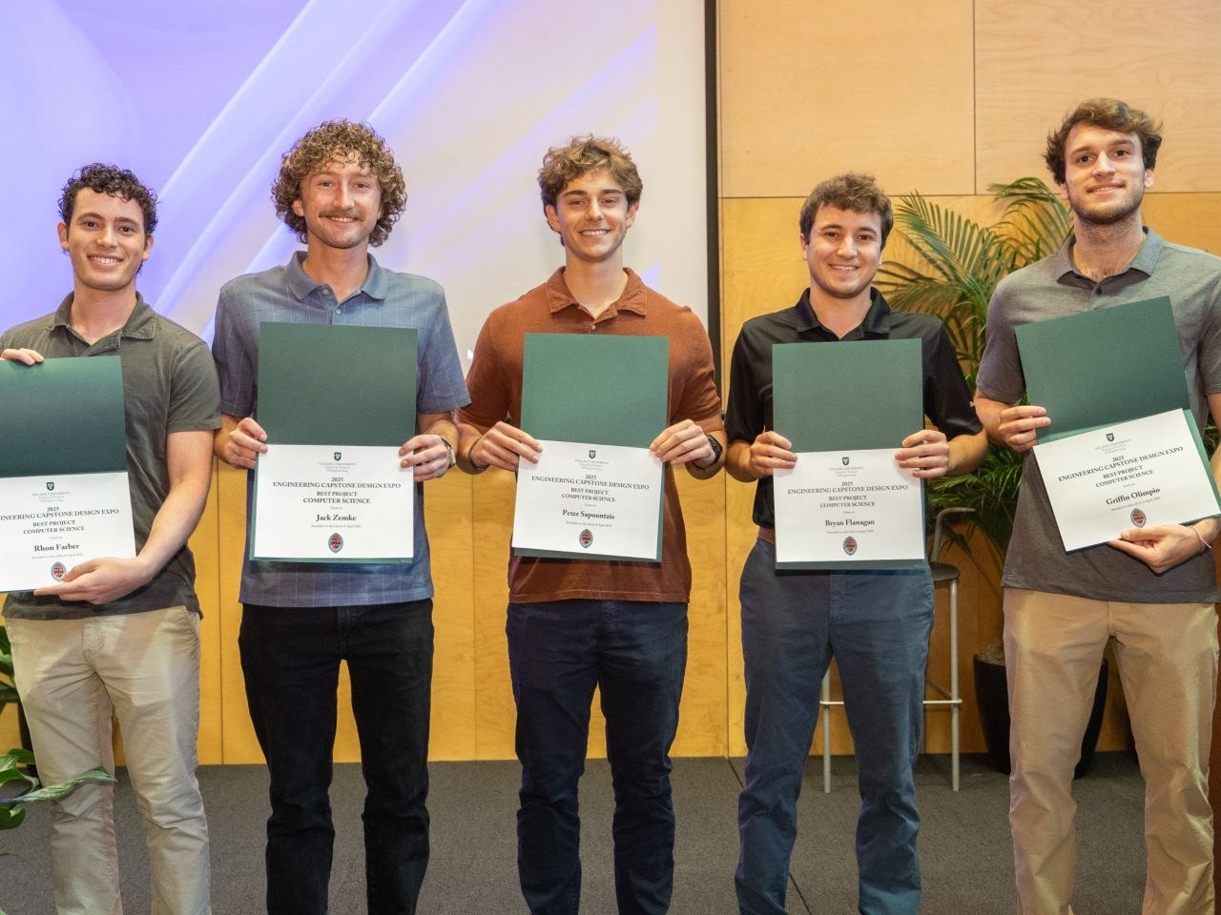

REGGIE: searchable utility meetings
◷ 9:10 – 9:25 · 15 min
EXAMPLE 2
with Entergy
THE CHALLENGE
Public Service Commission meetings: 5 jurisdictions, 5+ hour videos every month.
WHAT WE BUILT
REGGIE, a chatbot that indexes public meetings for question answering.
IMPACT
PSC research went from hours to minutes. Best CS Project, Tulane Capstone Expo.
Welcome
AI
Design
Reflect
Share
Break
Breakouts
Report
Debrief
Notes:
Same technology as SAWT, adapted with Entergy. Team: Rhon Farber, Bryan Flanagan, Griffin Olimpio, Peter Sapountzis, Jack Zemke.

Slide 28

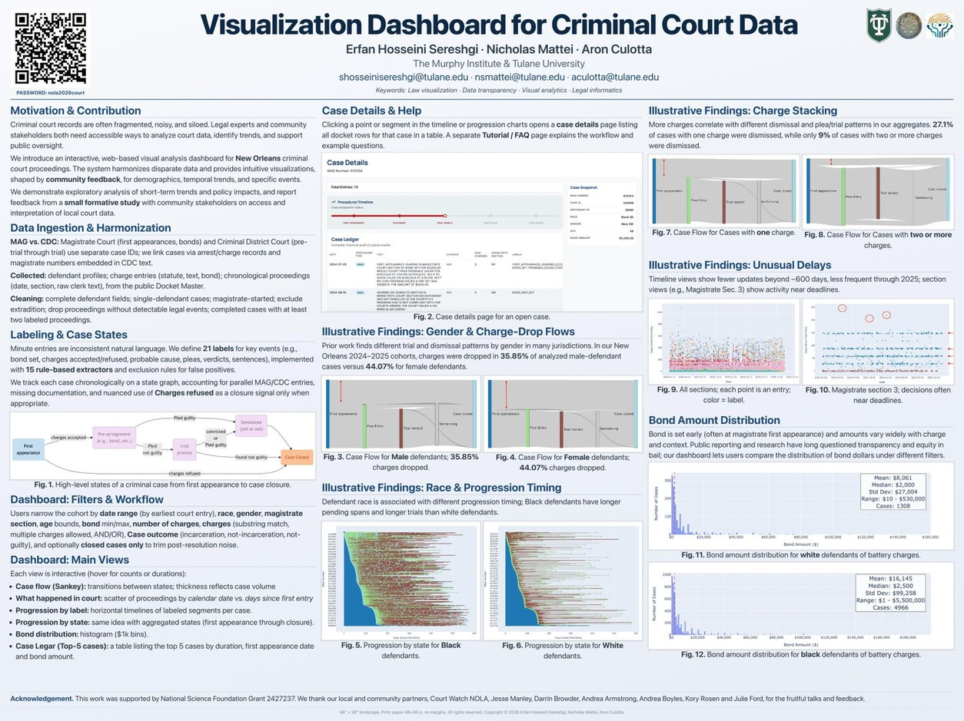
AI for monitoring criminal court
◷ 9:10 – 9:25 · 15 min
EXAMPLE 3
with Court Watch NOLA
THE PARTNER
Since 2007, trained volunteers have observed Orleans Parish criminal court.
STARTED SMALL
Student-built data infrastructure for 100K+ cases over 15 years.
GREW INTO
An NSF-funded program: anomaly detection and LLM tools for defendants, victims, and attorneys.
Welcome
AI
Design
Reflect
Share
Break
Breakouts
Report
Debrief
Notes:
Executive Director Jesse Manley. This is the clearest case of the virtuous cycle: capstone → pilot → federal funding → new research questions (safety and validation of LLMs in high-stakes settings).

Slide 29

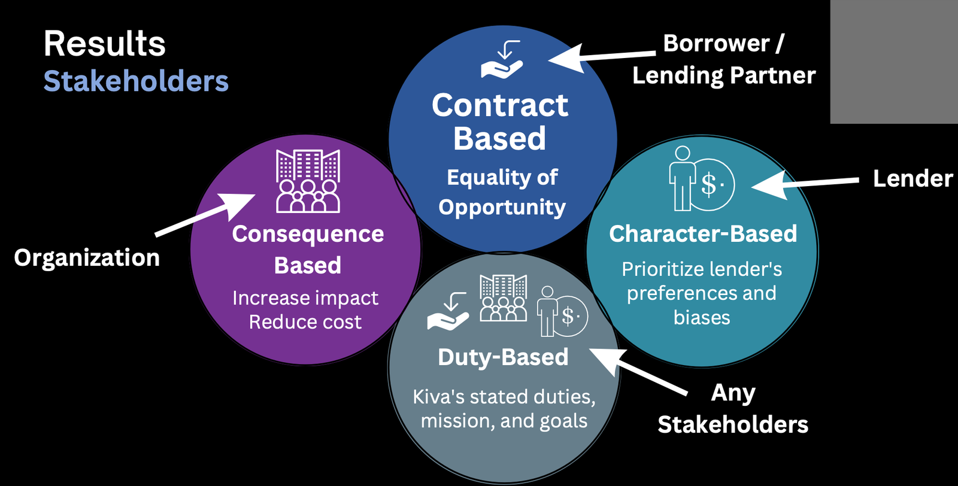
Fairness in microloan discovery
◷ 9:10 – 9:25 · 15 min
EXAMPLE 4
with Kiva.org
THE PARTNER
Kiva crowdfunds microloans: $1.74B to 4.3M borrowers in 77 countries (2022).
THE CHALLENGE
Lender attention is uneven, so some borrowers get overlooked.
WHAT WE STUDIED
Recommendations that balance fairness across borrowers, lenders, and Kiva's mission.
Welcome
AI
Design
Reflect
Share
Break
Breakouts
Report
Debrief
Notes:
Students: Hrishi Kabra, Ben Armstrong. Different stakeholders hold different notions of fairness (contract-, consequence-, duty-, and character-based).

Slide 30
Good practices we've learned
◷ 9:10 – 9:25 · 15 min
Start with conversations
Outreach and ideation meetings, with help from your public service office.
1
“Not a pipeline in which communities supply problems that are appropriated by academics.”
Start small
Data prep, websites, capstone-sized projects. Early wins build trust.
2
Share the money and the credit
Partners as co-PIs. Budget for their time.
3
Plan for years, not semesters
Hand work off between student cohorts.
4
Culotta & Mattei, Service Learning for Community-Centered AI Research
Listen deeply
Including about when not to use AI.
5
Welcome
AI
Design
Reflect
Share
Break
Breakouts
Report
Debrief
Notes:
From the 'Getting Started' section of Culotta & Mattei. Hand off to Saad: 'So how do we actually involve people in design? That's where participatory design comes in.'

Slide 31
◷ 9:25 – 9:40 · 15 min
PART 2
Designing with, not for
Saad Hassan
HCI, and user-centered, human-centered, and participatory design
Welcome
AI
Design
Reflect
Share
Break
Breakouts
Report
Debrief
Notes:
15 minutes. You already know community engagement deeply. This is the computing and design side of the same conversation: who gets to shape a technology, and how.

Slide 32
What is HCI?
◷ 9:25 – 9:40 · 15 min
“A discipline concerned with the design, evaluation, and implementation of interactive computing systems for human use.”
DRAWS ON
Computer science
ACM SIGCHI Curricula for Human-Computer Interaction, 1992
Psychology and cognitive science
Understand people
Design with them
1
2
Design
Sociology and anthropology
Build interactive systems
Evaluate in real use
3
4
Disability studies
Welcome
AI
Design
Reflect
Share
Break
Breakouts
Report
Debrief

Slide 33
AI summers, HCI winters, and vice versa
◷ 9:25 – 9:40 · 15 min
HCI has flourished in AI winters, and moved more slowly when AI was in favor.
Grudin, “AI and HCI: Two Fields Divided by a Common Focus,” AI Magazine, 2009
1960s
1970s
1980s
1990s
2000s
2010s
2020s
AI
AI summer
Dartmouth, 1956
Winter
Lighthill, 1973
Summer
Expert systems
AI winter, slow thaw
Funding cuts, quieter progress
AI summer
Deep learning, ChatGPT
HCI
Early roots
Sketchpad, 1963
Grows
Xerox PARC
Slower
SIGCHI, 1982
HCI flourishes
The web, usability, CS curricula
And now?
Who shapes AI this time?
We are in another AI summer.
This is when HCI and participatory design matter most.
Welcome
AI
Design
Reflect
Share
Break
Breakouts
Report
Debrief

Slide 34
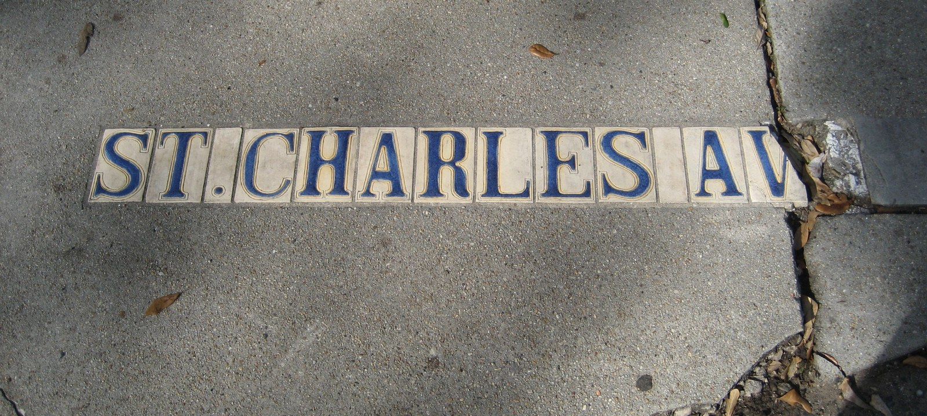
What is design?
◷ 9:25 – 9:40 · 15 min
“The transformation of existing conditions into preferred ones.”
Herbert Simon, 1969
Preferred by whom?
Community problems are wicked problems: requirements conflict or are unknown, and there is no single correct answer (Rittel & Webber, 1973).
Widen the sidewalks, and traffic shifts onto the streets.
Welcome
AI
Design
Reflect
Share
Break
Breakouts
Report
Debrief
Notes:
Design is a way of working on problems that don't have a right answer. That describes most community engagement work. Ask: in your own projects, who decides what 'preferred' means?

Slide 35
User-centered design (UCD)
◷ 9:25 – 9:40 · 15 min
Understand the context of use
Early and continual focus on users, measurement of real use, and iterative design.
Norman & Draper, 1986
Evaluate against requirements
Specify user requirements
repeat
The limitation
Users are studied and tested with, but designers still decide what counts as a requirement. Power stays with the design team.
Design solutions
Welcome
AI
Design
Reflect
Share
Break
Breakouts
Report
Debrief
Notes:
UCD is the industry default. Ask the room: can you spot the limitation? (Answer: who sets the requirements, and who is evaluated against them.)

Slide 36
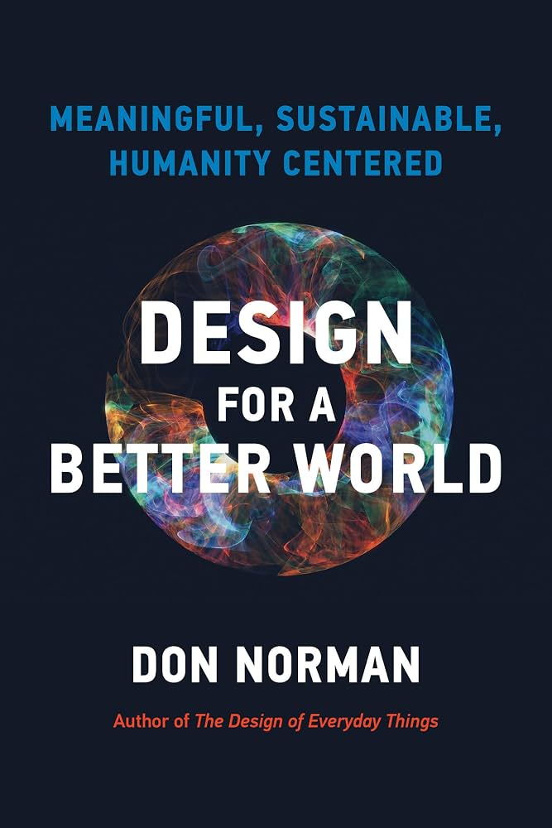
Human-centered design (HCD)
◷ 9:25 – 9:40 · 15 min
Widens the lens from users to people, communities, and the systems around them.
Immersion
Solve the root problem
1
2
Think in systems
Iterate, small and often
3
4
Welcome
AI
Design
Reflect
Share
Break
Breakouts
Report
Debrief
Notes:
Don Norman, Design for a Better World (2023). HCD asks designers to immerse themselves and think about systems. But it still assumes the designer is the one who empathizes and decides. That leads to two warnings from the research literature.

Slide 37
Two warnings from the research
◷ 9:25 – 9:40 · 15 min
Is empathy enough?
Is a seat at the table enough?
Simulating disability (for example, wearing a blindfold) can lend false confidence and lead to wrong conclusions.
Bringing people into the room does not mean they have, or see themselves as having, full status and authority.
Bennett & Rosner, “The Promise of Empathy: Design, Disability, and Knowing the ‘Other’,” CHI 2019
Harrington, Erete & Piper, “Deconstructing Community-Based Collaborative Design,” CSCW 2019
Welcome
AI
Design
Reflect
Share
Break
Breakouts
Report
Debrief
Notes:
Two papers I assign in my HCI course. Empathy exercises can substitute for actually working with people. And even when we do invite people in, status hierarchies don't disappear just because there's a workshop.

Slide 38
Participatory design (PD)
◷ 9:25 – 9:40 · 15 min
De-centers the designer. Stakeholders share decisions in every phase.
Schuler & Namioka, 1993
Needfinding
Problem definition
Developing ideas
Evaluation
›
›
›
EXAMPLES
Gig workers co-designing a collective action platform
Patients and doctors shaping medical translation tools
Older adults designing health tracking apps
Welcome
AI
Design
Reflect
Share
Break
Breakouts
Report
Debrief
Notes:
PD came out of Scandinavian workplace democracy in the 1970s. It's the design-world cousin of CBPR and reciprocity in service learning, which this audience already knows well.

Slide 39

Between Scylla and Charybdis
◷ 9:25 – 9:40 · 15 min
The Odyssey (Universal Pictures, 2025)
Too few voices
Too many, with no stopping point
“You should have included group X.” A design that misses the mark.
Is there an ethical point to stop adding voices and still make decisions?
Welcome
AI
Design
Reflect
Share
Break
Breakouts
Report
Debrief
Notes:
PD is not a panacea. The workshop is not neutral ground; status hierarchies and trust can't be fixed just by inviting people into a room. And design methods themselves can feel alien: one participant called crayons and markers 'an elementary school activity.' We have to steer between two hazards.

Slide 40
Where can communities shape AI?
◷ 9:25 – 9:40 · 15 min
1
2
3
4
5
Problem framing
Data
Design
Evaluation
Governance
What should we work on?
Whose data, collected how?
What does it look like?
Who decides it works?
Who deploys and oversees it?
And the question before all of these:
Should AI be used here at all?
Welcome
AI
Design
Reflect
Share
Break
Breakouts
Report
Debrief
Notes:
Most 'participatory AI' happens only at evaluation, if at all. Participation is most powerful at problem framing and governance. And refusal is a legitimate outcome of participation.

Slide 41
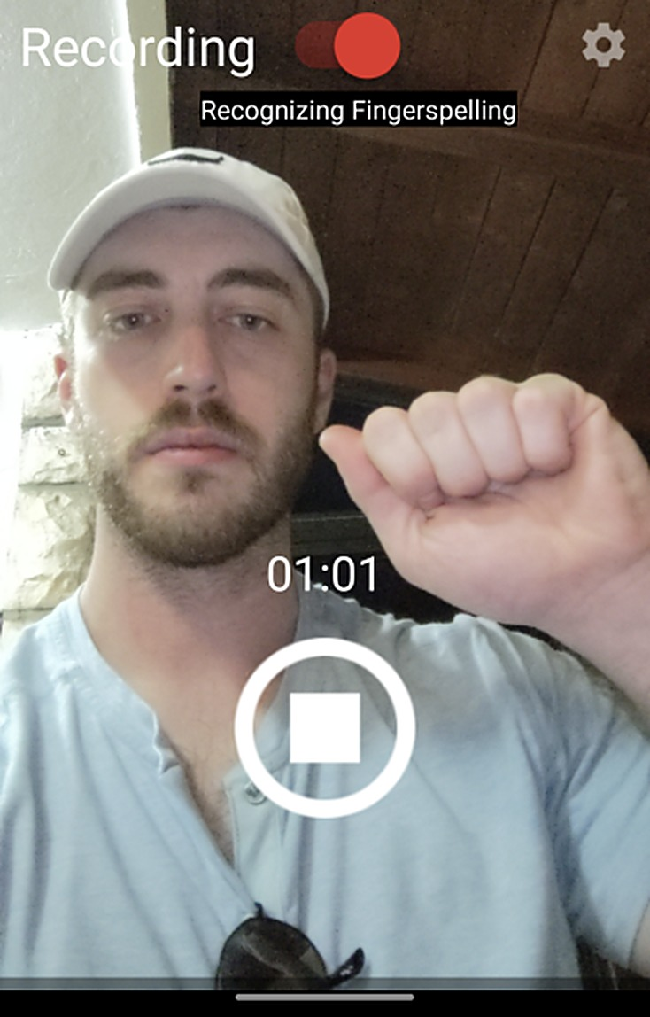
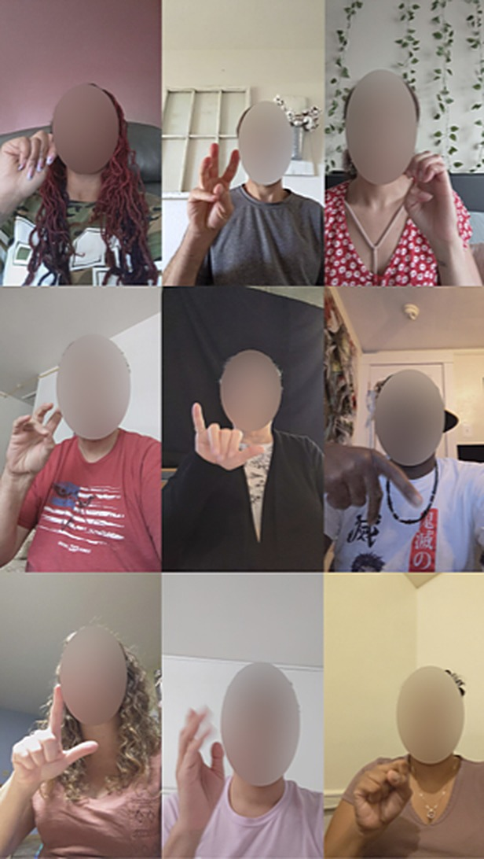
Sign language for DHH signers
◷ 9:25 – 9:40 · 15 min
EXAMPLE 1
Deaf-led, with Google and DPAN
PERSONAL ASSISTANTS
Assistants and smart speakers assume speech. We study how Deaf signers want to use them in sign language.
TEXT ENTRY · MOBILEHCI 2023
Fingerspelling on a phone camera was faster and more accurate than typing on the keyboard (Tap to Sign).
LARGE-SCALE DATA · CVPR 2025
FSboard: a large fingerspelling dataset recorded by Deaf signers on their own phones, with Google and DPAN.
DEAF-LED
Built with Deaf researchers and the Deaf Professional Arts Network (DPAN), from the questions to the data.
Tap to Sign · MobileHCI 2023
FSboard · CVPR 2025
Welcome
AI
Design
Reflect
Share
Break
Breakouts
Report
Debrief
Notes:
From my research seminar slide 27. Saad: add the key finding or a participant quote.

Slide 42

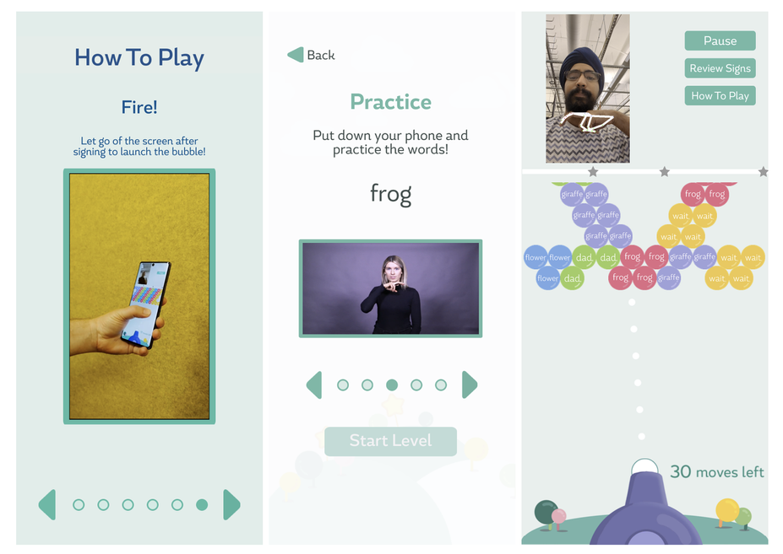
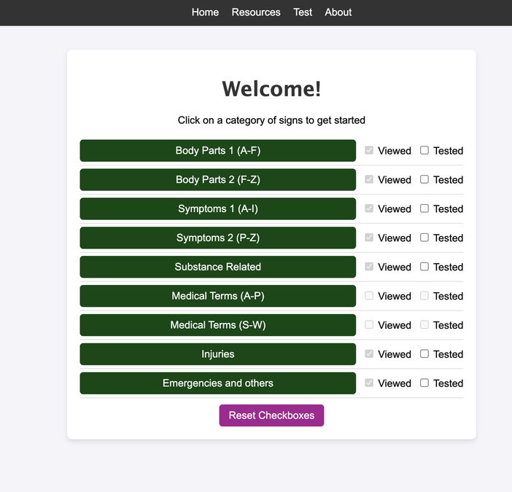
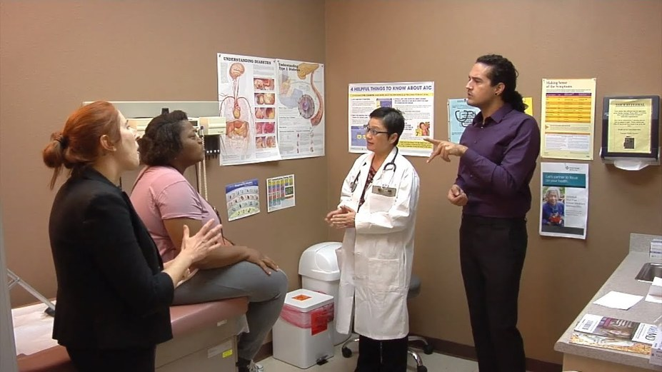
Sign language for learning
◷ 9:25 – 9:40 · 15 min
EXAMPLE 2
Families and healthcare
FAMILIES
Hearing parents learning to sign with their Deaf and DeafBlind children. PopSign game and dataset, NeurIPS 2023.
HEALTHCARE
Sign vocabulary for body parts, symptoms, and medical terms. ASSETS 2025.
PARTNER
Commission for Deaf & Hard of Hearing
DIDACTIC RECIPROCITY
Designing for people with disabilities, and also for the communities around them: Deaf signers teach, hearing families learn.
Welcome
AI
Design
Reflect
Share
Break
Breakouts
Report
Debrief
Notes:
From my research seminar slide 26. Saad: add one sentence on what families shaped in the design.

Slide 43
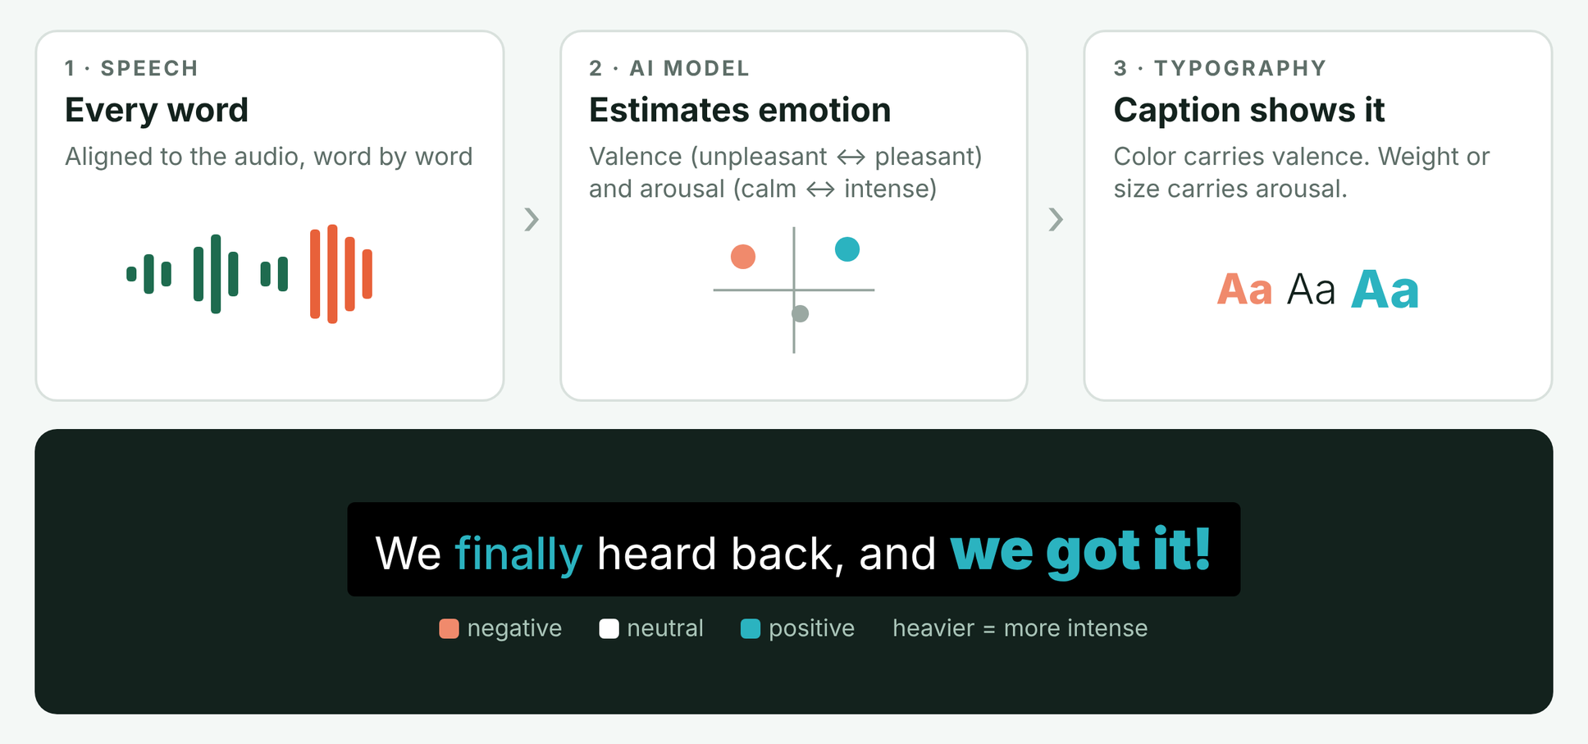
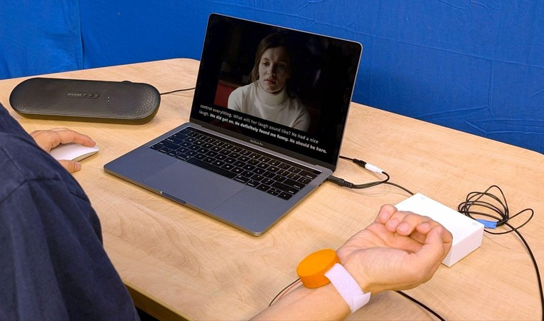
Captions that carry emotion
◷ 9:25 – 9:40 · 15 min
EXAMPLE 3
Deaf & hard-of-hearing viewers
THE CHALLENGE
Captions drop tone of voice: how something is said, not just what.
WHAT WE BUILT
Caption Royale: AI estimates emotion from each spoken word, and the caption’s typography shows it.
PUBLISHED
+ HAPTICS
CHI 2024 (Honorable Mention), ASSETS 2024, CHI 2025
A wristband adds emotion through vibration. Tactile Emotions, CHI 2025.
Welcome
AI
Design
Reflect
Share
Break
Breakouts
Report
Debrief
Notes:
Affective captions → tactile emotions → rich captions authoring. Viewers ranked and co-shaped designs (Elo/TrueSkill comparisons, best-worst scaling).

Slide 44
Civic AI for accessibility barriers
◷ 9:25 – 9:40 · 15 min
EXAMPLE 4
Civic & disability organizations
Dashboards and AI that help civic groups, residents, and local governments see and act on accessibility barriers.
“If I could ask, ‘Give me a list of all ADA sidewalk problems on North State Street between X and Y,’ and it answered accurately and verifiably, that would be game-changing.”
AI summaries with local citations
Answers linked to authoritative records.
Escalate to a human
A visible path to staff when automation falls short.
Mark where AI is used
Plain language and clear onboarding.
NO ONE SIZE FITS ALL
NEW NSF AWARD · 2026
Civic AI has to adapt to different people, roles, and access needs.
Civic AI that connects residents, communities, and local governments.
Welcome
AI
Design
Reflect
Share
Break
Breakouts
Report
Debrief
Notes:
Our most recent project, and now an NSF award (2026) on civic AI that connects residents, communities, and local governments.

Slide 45
Your one problem
◷ 9:40 – 10:10 · 30 min
Pick one community engagement challenge where AI could help, hurt, create barriers, or lower them.
1
The problem
One sentence
◯ Circle
Who is affected
Partners, students, residents
the one line you most want to dig into: a hope or a worry.
2
3
Where AI might help
Even a little
Share in 1–2 sentences
4
Where AI worries you
Risks, harms, trust
Your problem, plus what you circled. Sticky note goes on the wall.
5
Who isn't at the table yet
Voices to bring in
9:40 · 15 min to write
9:55 · 15 min to share
Welcome
AI
Design
Reflect
Share
Break
Breakouts
Report
Debrief
Notes:
Hand out reflection cards and sticky notes. Guiding questions: In community-engaged work, how could AI help expand capacity, or create challenges? What is the appropriate role for AI here? Is there one?
At 9:55 go around for share-outs (about 50 seconds each). Saad and Nick put sticky notes on the wall as people talk.

Slide 46
◷ 10:10 – 10:25 · 15 min
Break
While you're away
15
We group your sticky notes into 2–4 shared themes
1
2
Each theme becomes a breakout starting point
minutes
3
Add another sticky note if something new comes up
Back at 10:25
Welcome
AI
Design
Reflect
Share
Break
Breakouts
Report
Debrief
Notes:
Nick and Saad cluster the wall into 2–4 themes. Likely split: AI in how we run engagement (matching, reflection, assessment, reporting) vs. AI in partners' own work. Update the breakout slide with the theme names if time allows.

Slide 47
Breakout groups and share-outs
◷ 10:25 – 11:20 · 55 min
Group A · AI lens
Group B · Design lens
Pick the group closest to your problem.
with Nick
with Saad
10:25
Elaborate the problem
Add context on sticky notes. What's really going on?
15 min
10:40
Who else belongs in this conversation?
Partners and community members you could bring in.
15 min
10:55
Limits of AI
Where should human agency stay? Where does human-centered work stand after AI?
15 min
11:10
Share out: 5 min per group. One problem, one partner to bring in, one line AI shouldn't cross.
Welcome
AI
Design
Reflect
Share
Break
Breakouts
Report
Debrief
Notes:
Each facilitator keeps time and nudges the group to the next round every 15 minutes. Ask each group to pick a reporter during round 3.

Slide 48
Debrief
◷ 11:20 – 11:30 · 10 min
One idea you'll take home
1
One open question
2
What follow-up would help you?
3
saadh.info/pace2
nsmattei@tulane.edu · saadhassan@tulane.edu
Thank you!
Welcome
AI
Design
Reflect
Share
Break
Breakouts
Report
Debrief
Notes:
Close with quick popcorn answers. Point to the website for slides and resources, and collect interest in follow-up (sign-up or the survey).

