Slide 1
MODERNIZING ADVERTISING OPERATIONS THROUGH DATABASE MANAGEMENT
Presented by: - Saad Hussain - Syed Hisham Akmal - K Ramachandra Shenoy - Narendra Singh Purohith

Slide 2
INTRODUCTION
In the dynamic world of advertising, where creativity meets strategy, the efficient organization and analysis of data play a pivotal role in success. This project delves into the development and utilization of a robust database tailored for an advertising company.
DATABASE CREATION FOR ADVERTISING COMPANY:
Brief Overview: Created a database named Advertising Company for managing various aspects of an advertising agency's operations.

Slide 3
TABLES OVERVIEW
Key Tables in the Database:
Clients Table:
Fields: client_id, name, email, phone, billing_address, account_manager.
Campaigns Table:
Fields: campaign_id, client_id, name, budget, start_date, end_date, creative_director.
Advertisements Table:
Fields: advertisement_id, campaign_id, type, content, creative_team.
Employees Table:
Fields: employee_id, name, position, email, phone, salary, department.

Slide 4
Advertisement Placements Table:
Fields: placement_id, advertisement_id, placement_details, cost, duration.
Invoices Table:
Fields: invoice_id, client_id, campaign_id, invoice_date, payment_status, total_amount.
Payments Table:
Fields: payment_id, invoice_id, employee_id, payment_date, payment_method, transaction_reference.
Vendor Supplier Information Table:
Fields: vendor_id, vendor_name, contact_info, services_provided, payment_terms.

Slide 5
Vendor Invoices Table:
Fields: invoice_id, payment_id, vendor_id, invoice_date, total_amount, payment_status
Performance Metrics Table:
Fields: metric_id, advertisement_id, impressions, clicks, conversions, date
Contact Us Table:
Fields: name, email (Primary Key), message
Clients Backup Table:
Fields: Same as the Clients Table

Slide 6
RELATIONSHIPS
Database Relationships:
Relationships established through Foreign Keys:
Clients -> Campaigns
Campaigns -> Advertisements
Advertisements -> Advertisement Placements
Clients, Campaigns -> Invoices
Invoices -> Payments
Vendor Supplier Information -> Vendor Invoices
Advertisements -> Performance Metrics

Slide 7
BACKUP TABLE
Backup Table:
Created a backup table named clients_backup with the same structure as the clients table for data security and recovery.

Slide 8
Unlocking Insights: Essential SQL Queries for Advertising Agencies
Data-Driven Strategies for Optimized Campaigns and Client Satisfaction
Key points:
Harness the power of data with SQL queries.
Gain valuable insights into campaign performance and client needs.
Optimize ad spend and maximize ROI.

Slide 9
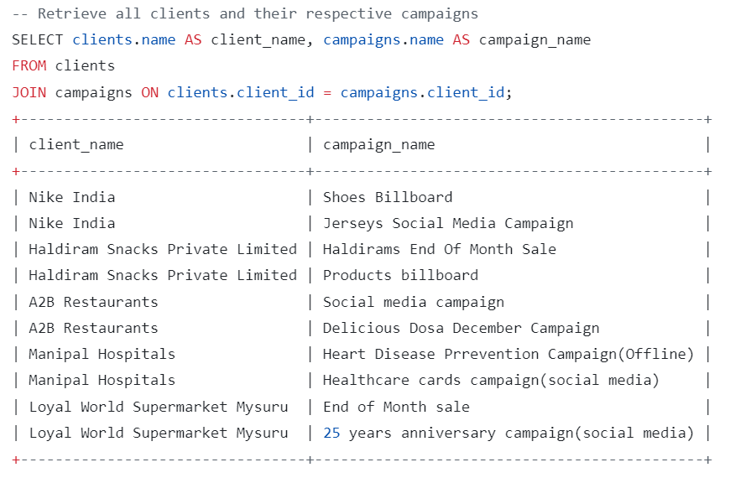
Client Management
Query: Retrieve all clients and their respective campaigns.
Benefits:
Identify key clients and their campaign portfolio.
Analyze client-specific campaign performance.
Tailor advertising strategies based on client needs.

Slide 10
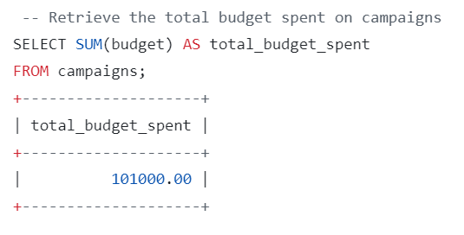
Campaign Performance
Query: Calculate the total budget spent on campaigns.
Benefits:
Track overall campaign budget allocation.
Identify budget discrepancies and optimize spending.
Allocate resources more effectively.

Slide 11
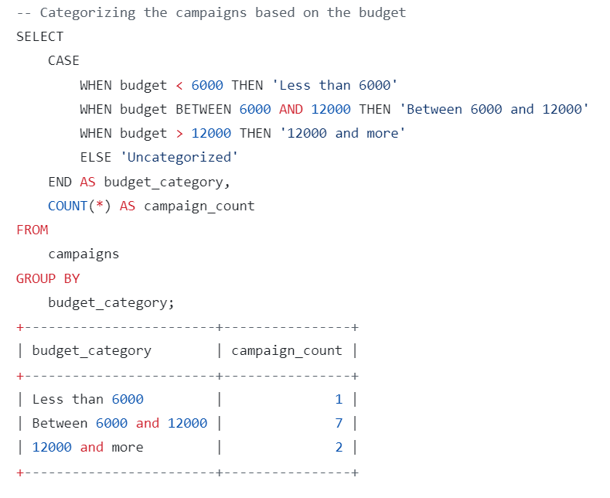
Budget Analysis
Query: Categorize campaigns based on budget.
Benefits:
Analyze campaign distribution across budget segments.
Identify under- or over-budgeted campaigns.
Optimize budget allocation for better ROI.

Slide 12
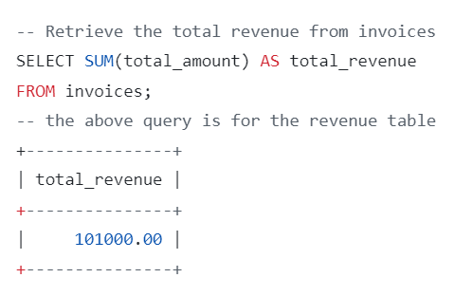
Revenue Tracking
Query: Retrieve the total revenue from invoices.
Benefits:
Track overall agency revenue generated.
Identify high-performing campaigns and clients.
Analyze revenue trends and forecast future financial performance.

Slide 13
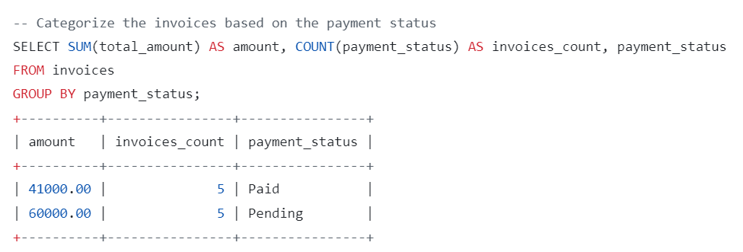
Invoice and Payment Management
Query: Categorize invoices based on payment status.
Benefits:
Monitor invoice payment status and identify overdue payments.
Improve financial tracking and cash flow management.
Identify potential collection issues and take proactive steps.

Slide 14
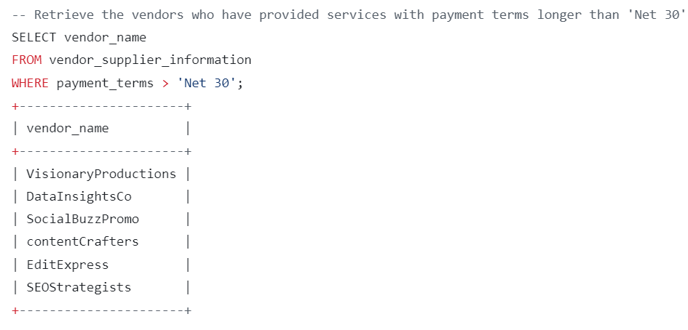
Vendor Management
Query: Retrieve vendors with payment terms longer than 'Net 30'.
Benefits:
Identify vendors with extended payment terms.
Proactively manage vendor relationships and negotiate better payment terms.
Optimize cash flow and improve financial stability.

Slide 15
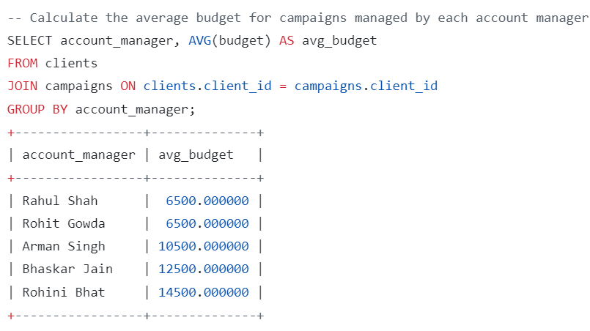
Account Manager Performance
Query: Calculate the average budget for campaigns managed by each account manager.
Benefits:
Assess the performance of account managers.
Identify top performers and areas for improvement.
Optimize account manager assignments based on skillset and client needs.

Slide 16
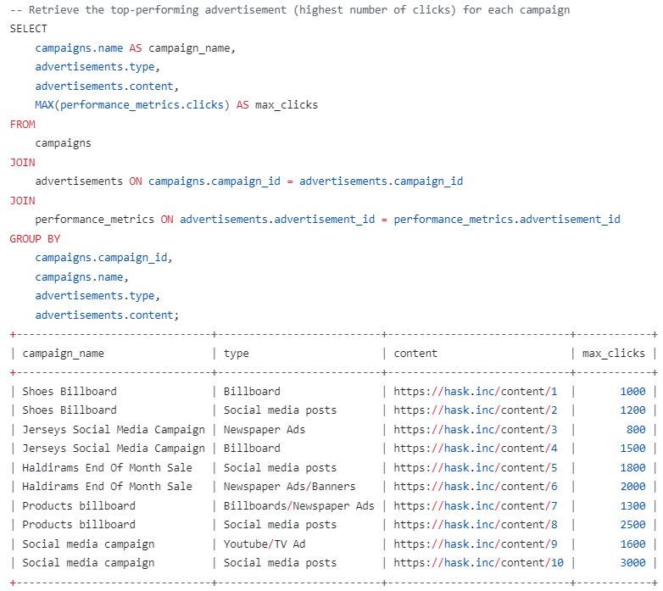
Top-Performing Ads
Query: Retrieve the top-performing advertisement for each campaign.
Benefits:
Identify the most effective advertisements within each campaign.
Analyze factors influencing advertisement success.
Replicate successful strategies for future campaigns.

Slide 17
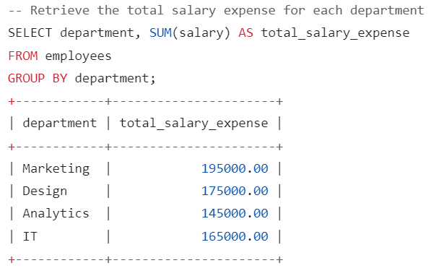
Employee Analysis
Query: Retrieve the average salary by department.
Benefits:
Analyze average employee compensation across different departments.
Identify potential salary discrepancies and address them accordingly.
Benchmark employee compensation against industry standards.

Slide 18
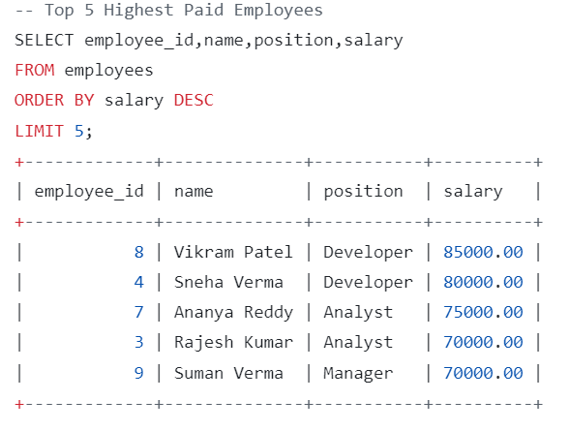
Top Talent Identification
Query: Retrieve the top 5 highest-paid employees.
Benefits:
Recognize and reward top performers within the agency.
Identify key talent to invest in and retain.
Improve employee motivation and satisfaction.

Slide 19
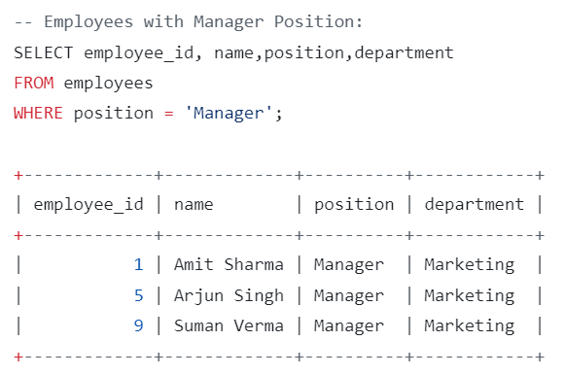
Manager Identification
Query: Retrieve employees with the "Manager" position.
Benefits:
Identify all managers within the organization.
Analyze manager distribution across different departments.
Facilitate communication and collaboration between managers and employees.

Slide 20
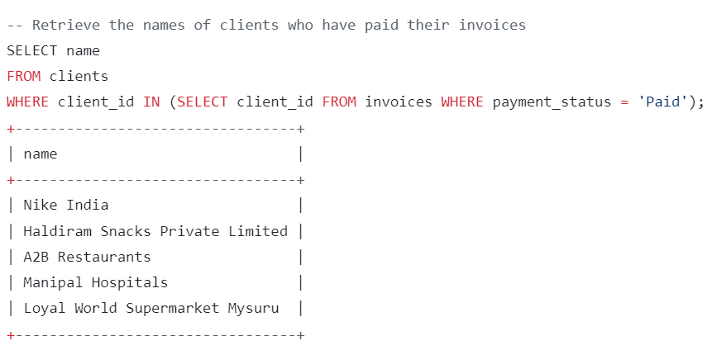
Client Payment Habits
Query: Retrieve the names of clients who have paid their invoices.
Benefits:
Identify reliable clients with good payment history.
Tailor billing and collection strategies based on client behavior.
Improve client relationships and encourage timely payments.

Slide 21
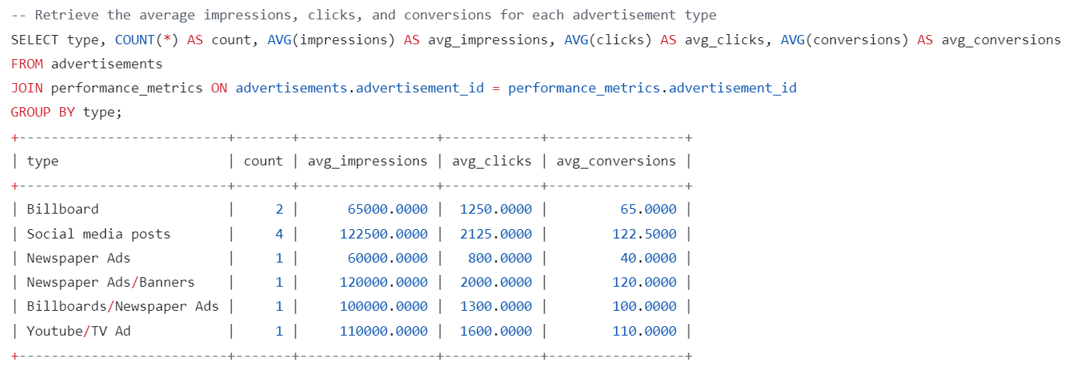
Advertisement Performance Analysis
Query: Retrieve the average impressions, clicks, and conversions for each advertisement type.
Benefits:
Analyze the effectiveness of different advertisement types.
Identify the most engaging and impactful ad formats.
Optimize future campaigns based on performance data.

Slide 22
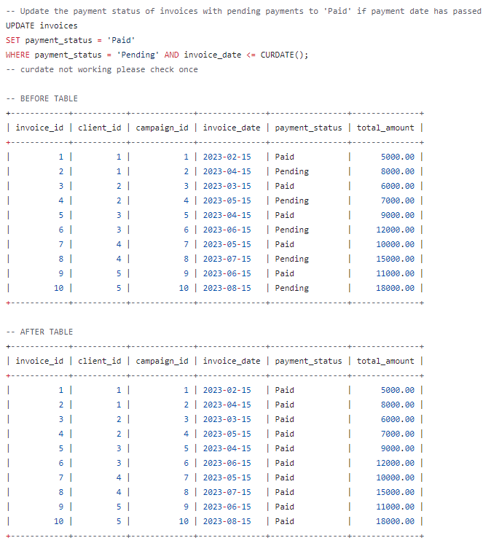
Automating Invoice Payments
Query: Update the payment status of invoices with pending payments to 'Paid' if payment date has passed.
Benefits:
Streamline invoice processing and payment procedures.
Reduce manual data entry and improve efficiency.
Ensure timely payments and avoid late payment penalties.

Slide 23
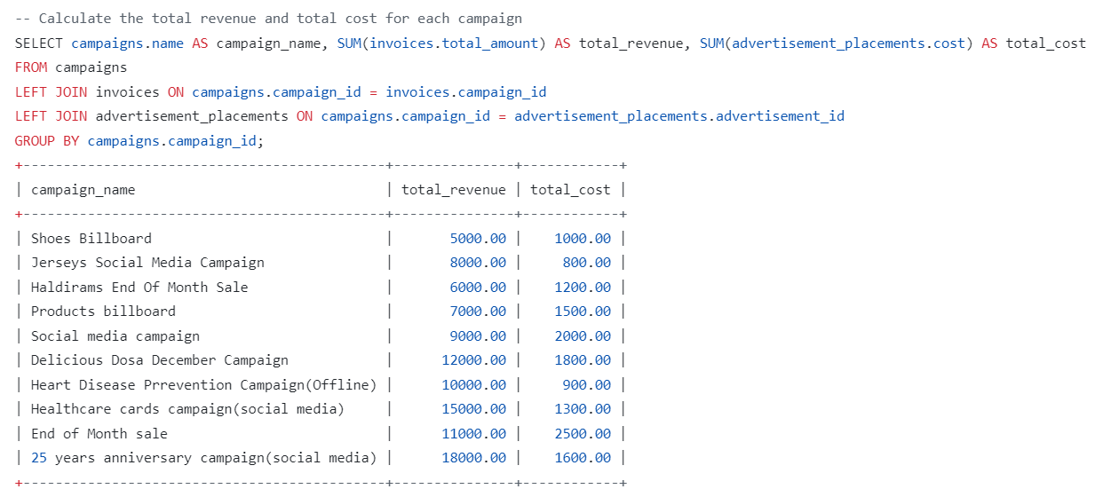
Advanced Data Analysis
Query: Calculate the total revenue and total cost for each campaign.
Benefits:
Analyze profitability of individual campaigns.
Identify underperforming campaigns requiring adjustments.
Optimize campaign budgets and pricing strategies.

Slide 24
Optimizing Advertising Data with Views and Triggers
Unleash insights, automate tasks, and enhance data integrity.
Key points:
Views provide consolidated and accessible data for analysis and reporting.
Triggers automate data updates and enforce data integrity rules.
Together, they optimize data management and decision-making.

Slide 25
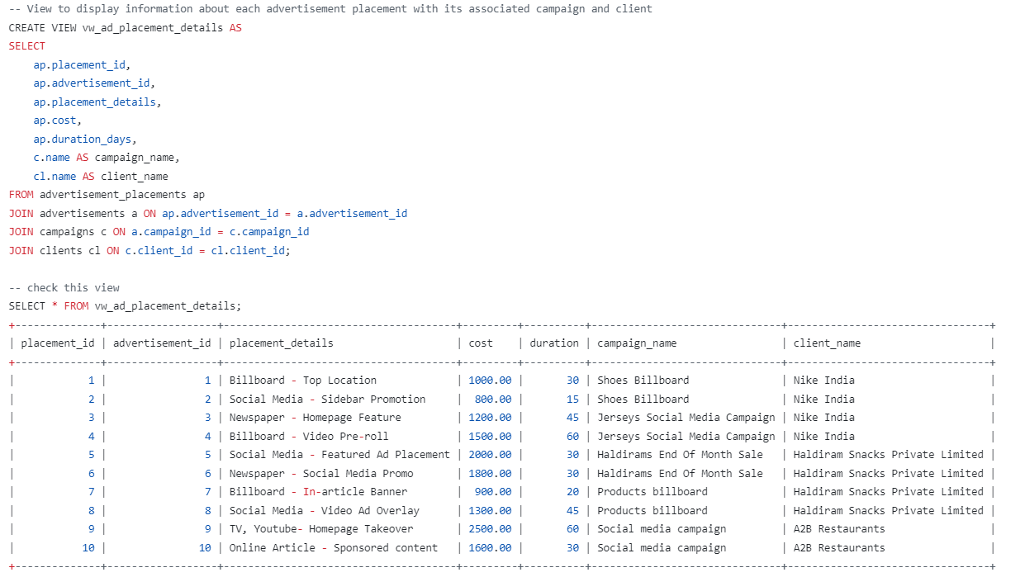
vw_ad_placement_details
Provides campaign, client, and detailed placement information.

Slide 26
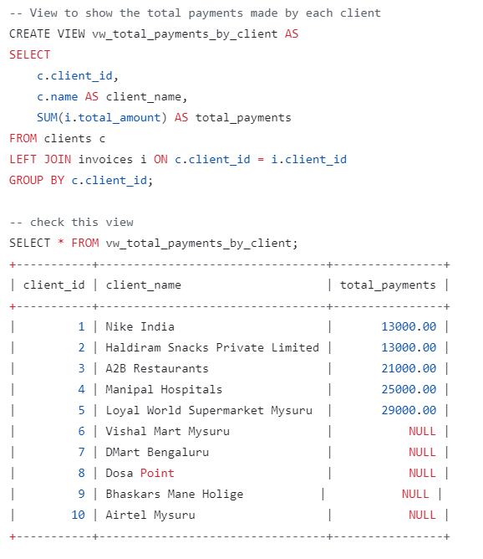
vw_total_payments_by_client
Analyzes client payment history and identifies top contributors.

Slide 27
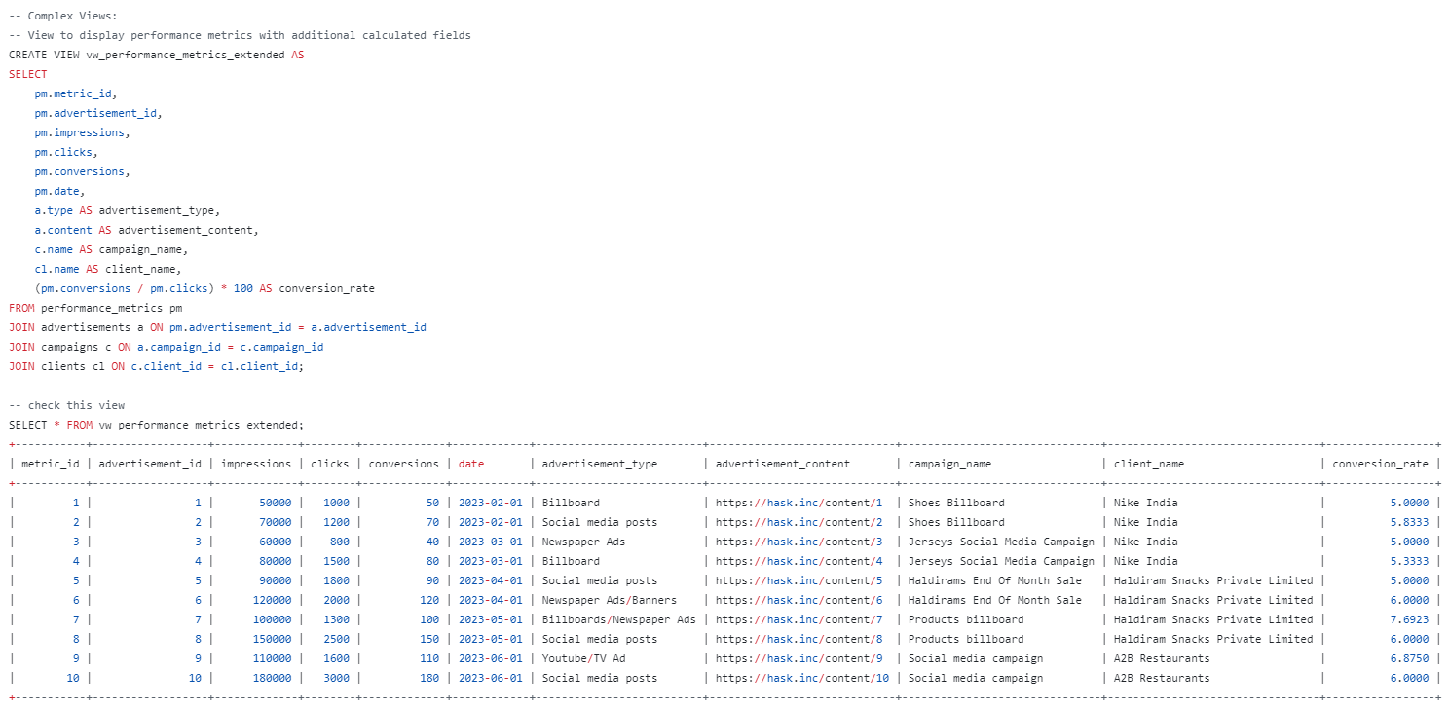
vw_performance_metrics_extended
Analyzes campaign performance with additional metrics like conversion rate.

Slide 28
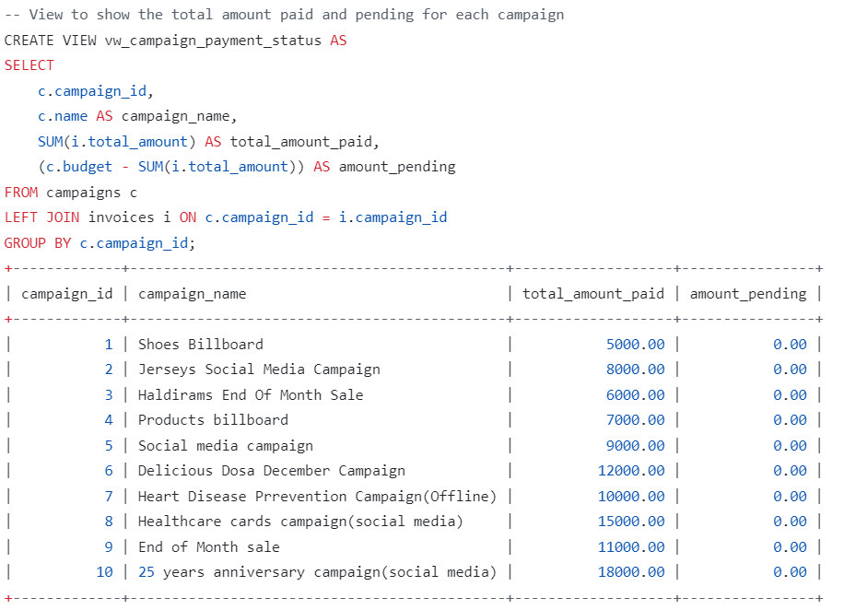
vw_campaign_payment_status
Tracks campaign budget utilization and identifies overspending campaigns.

Slide 29
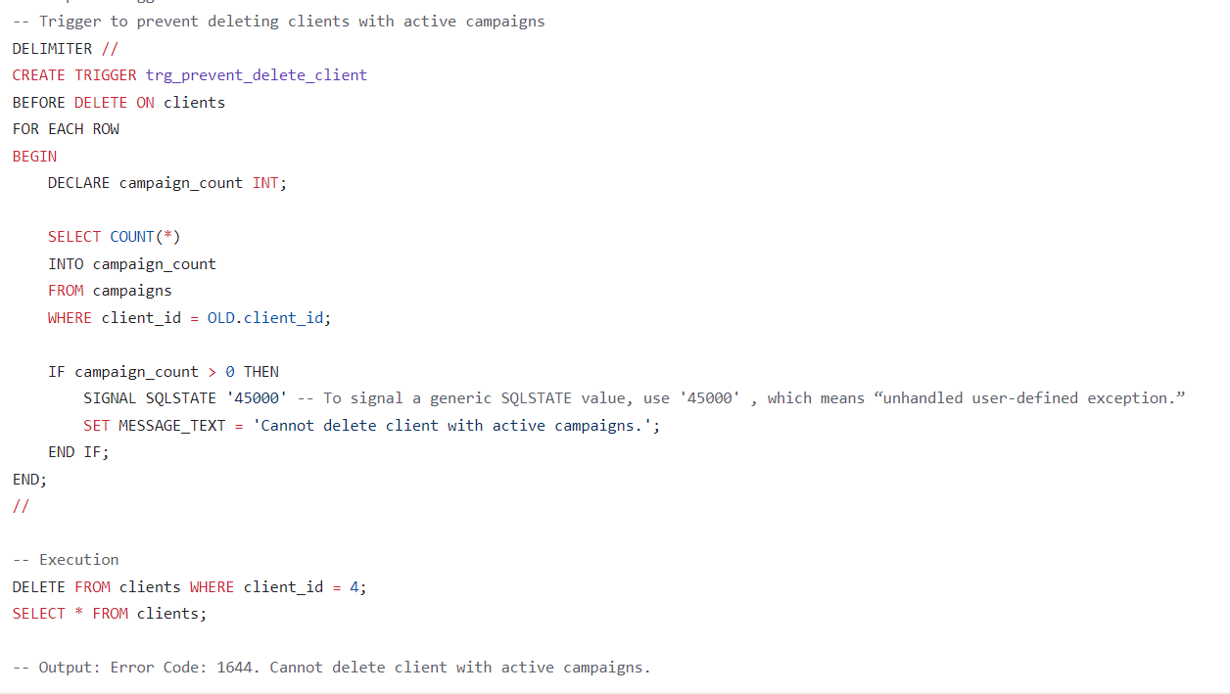
Trigger to prevent deleting clients with active campaigns

Slide 30
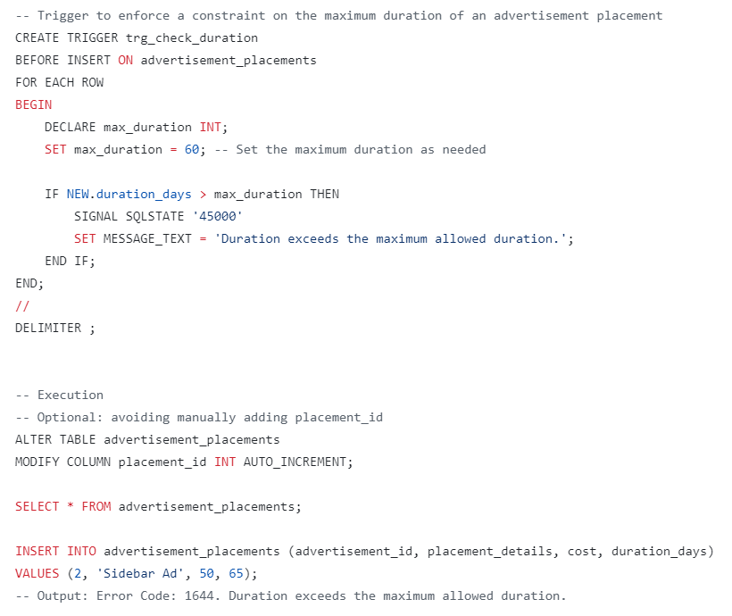
Trigger to enforce a constraint on the maximum duration of an advertisement placement

Slide 31
Importance of Views and triggers
Enhanced Data Analysis
Views enable quick identification of key insights:
Top-performing campaigns and placements.
Client spending patterns and payment trends.
Campaign performance metrics and key areas for improvement.
Efficient Data Management
Triggers automate routine tasks, saving time and resources.
Improve data accuracy and consistency by enforcing data integrity rules.data availability and security through backup triggers.

Slide 32
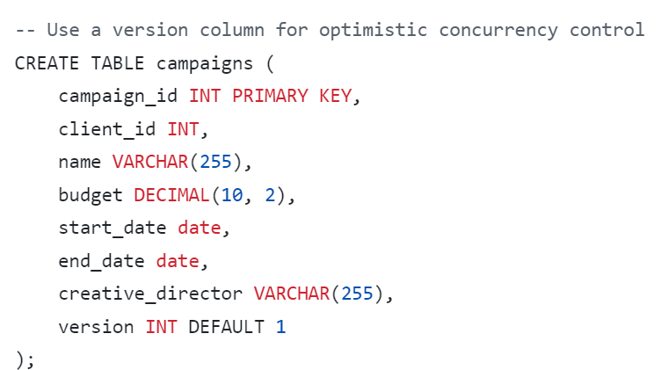
Concurrency Control with Versioning
Ensuring Data Integrity in Campaigns Management
Leveraging versioning for optimistic concurrency control.

Slide 33
Understanding Versioning
Versioning adds a version number to the table.
Each update increments the version number.
Read operations retrieve the version number.
Write operations include the version number for comparison.
Key Points:
Concurrent access to data can lead to discrepancies and data loss.
Optimistic concurrency control prevents conflicts during simultaneous updates.
Versioning is a simple and effective technique for optimistic concurrency control.

Slide 34
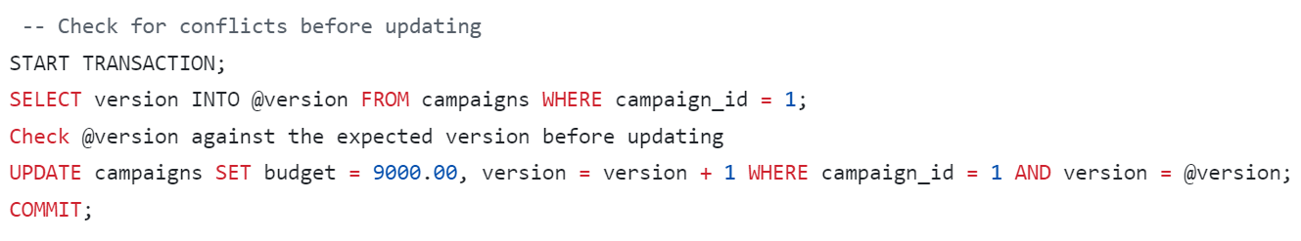
Checking Conflicts before Updating (Optimistic Concurrency Control)
This code snippet demonstrates optimistic concurrency control using versioning in a transaction.
Key points:
Versioning ensures data consistency during concurrent updates.
A transaction begins to manage updates as a single unit.
The current version is retrieved before any changes are made.
The expected version is checked against the stored version.
If versions match, the update proceeds and increments the version.
If versions mismatch, a conflict is detected and the update is rejected.
This prevents overwriting changes made by other users.

Slide 35
Powerful Parameterized Stored Procedures
Simplifying Data Management with Parameterized Stored Procedures
Unleash efficiency, security, and maintainability.
Dynamically generate reports based on user input.
Perform complex calculations and data manipulations.
Automate repetitive tasks and improve efficiency.
Ensure data integrity and security through parameterized input.

Slide 36
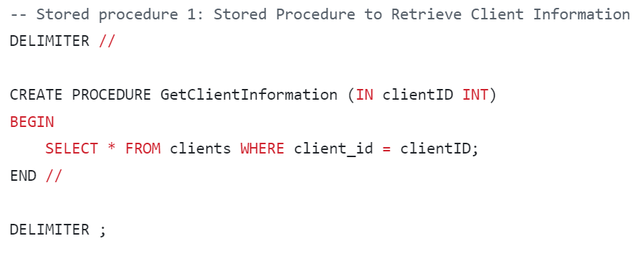
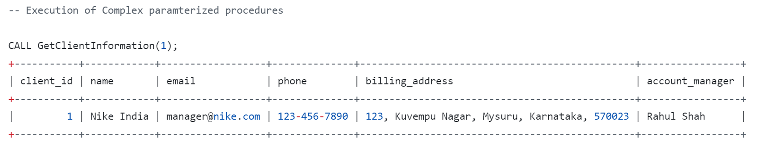
GetClientInformation(clientID INT)
Retrieves client information based on a provided ID.

Slide 37
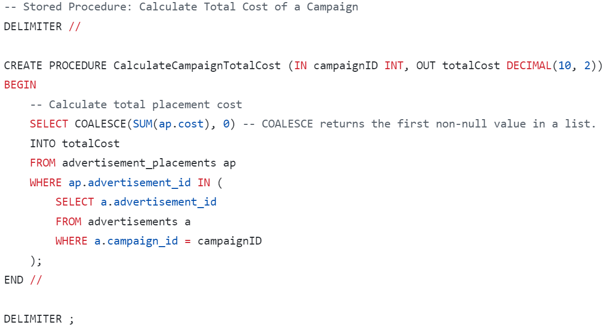
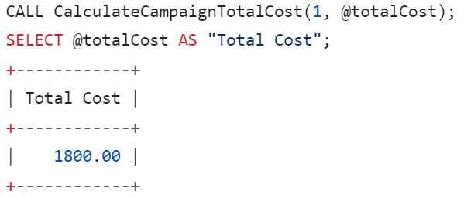
CalculateCampaignTotalCost (IN campaignID INT, OUT totalCost DECIMAL(10, 2))
Calculate Total Cost of a Campaign

Slide 38
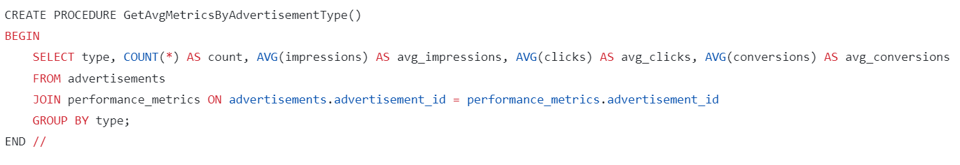
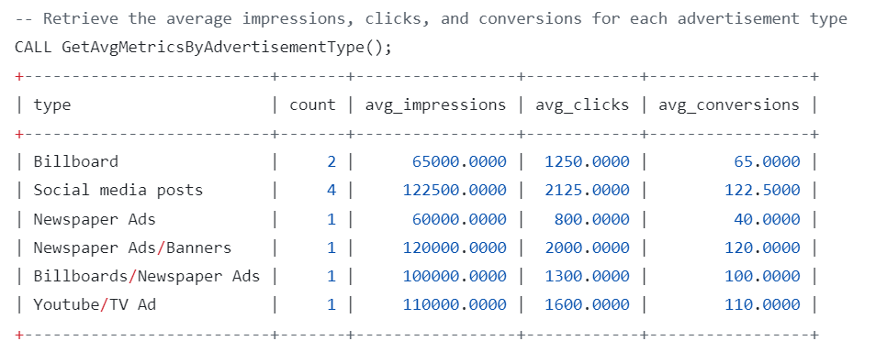
GetAvgMetricsByAdvertisementType()
Calculates average impressions, clicks, and conversions for different ad types.

Slide 39
Transaction Control for Ensuring Data Consistency
Guaranteeing Data Integrity with Transactions
Understanding and implementing transaction control mechanisms.
Key Points:
Transactions group multiple database operations into a single unit.
Ensures data consistency and atomicity by either committing or rolling back all operations.
Provides isolation from concurrent transactions to prevent data inconsistencies.

Slide 40
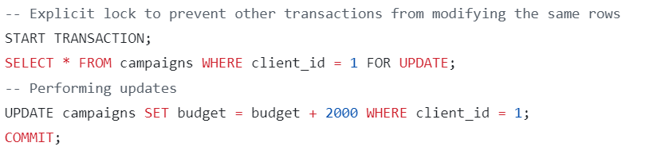
Explicit Locking for Updates
This code explicitly locks the selected rows in the campaigns table before performing updates.
Other transactions attempting to access these rows will be blocked until the current transaction commits.
This prevents data inconsistencies caused by concurrent updates to the same data.

Slide 41
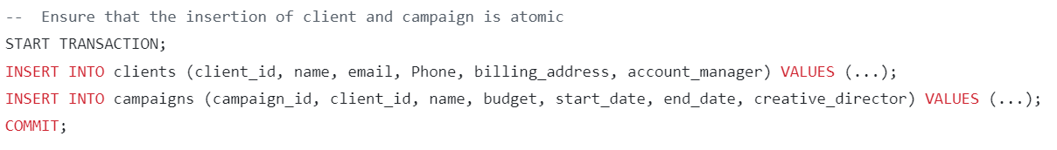
Atomic Insertion of Client and Campaign
This code ensures that the insertion of client and campaign information is atomic.
If any of the insertions fail, the entire transaction is rolled back, preventing incomplete data updates.

Slide 42
Managing User Permissions with GRANT and REVOKE
Controlling Data Access in Advertising Agency Databases
Utilizing GRANT and REVOKE for efficient user permission management.
Key Points:
GRANT assigns specific privileges to users, allowing specific operations on tables.
REVOKE removes previously granted privileges, restricting user access.
Ensuring proper user permissions safeguards sensitive data and maintains database integrity.

Slide 43
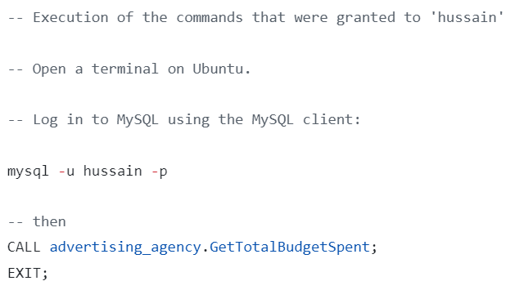
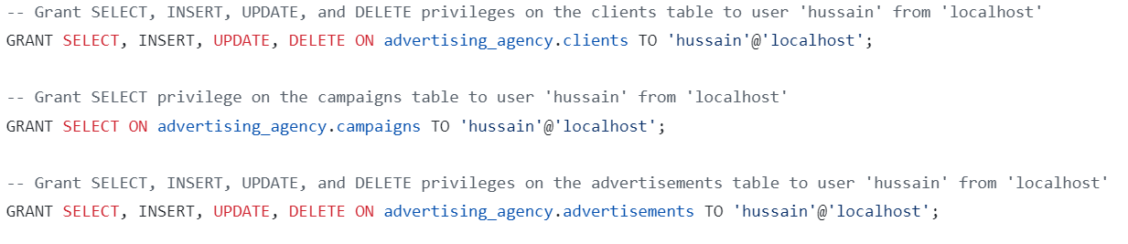
Granting Privileges to User 'hussain'
GRANT SELECT, INSERT, UPDATE
, DELETE: Assigns complete control over the 'clients' table.
GRANT SELECT: Enables viewing data in the 'campaigns' table without modification.
GRANT SELECT, INSERT, UPDATE, DELETE: Provides full access to manage the 'advertisements' table.

Slide 44
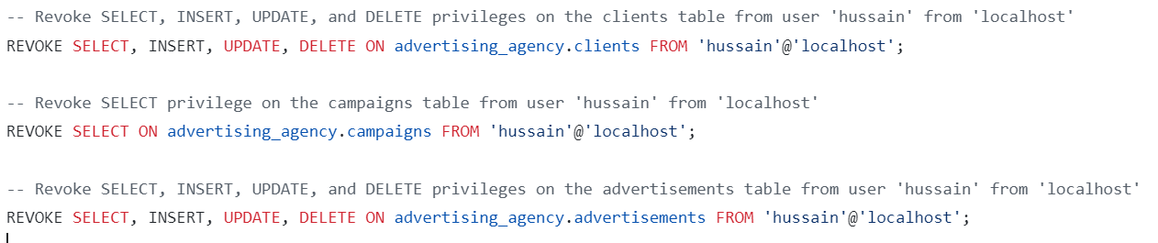
Revoking Privileges from User 'hussain'
REVOKE SELECT, INSERT, UPDATE, DELETE: Eliminates all access to the 'clients' table.
REVOKE SELECT: Removes the ability to view data in the 'campaigns' table.
REVOKE SELECT, INSERT, UPDATE, DELETE: Strips all permissions related to the 'advertisements' table.

Slide 45
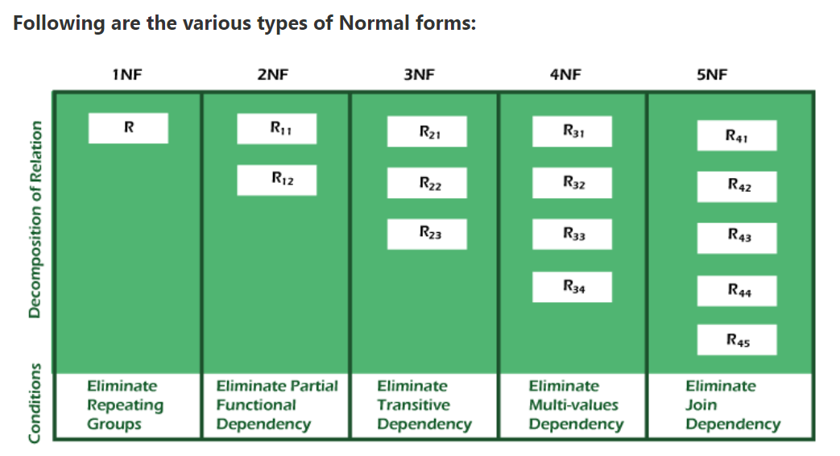
Normalization
Implementing Normalization
As per our understanding, all tables appear to be in at least 1NF, and there are no apparent violations of 2NF, 3NF, or BCNF. The tables are well-structured and free of significant normalization anomalies.

Slide 46
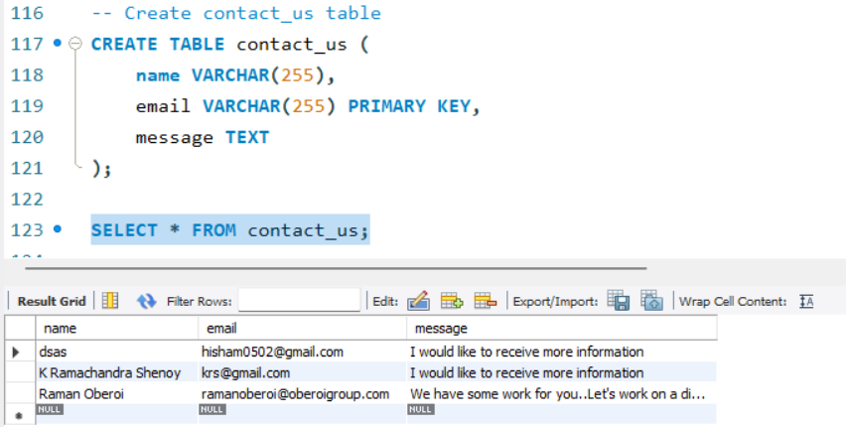
Another Real World Use Case

Slide 47
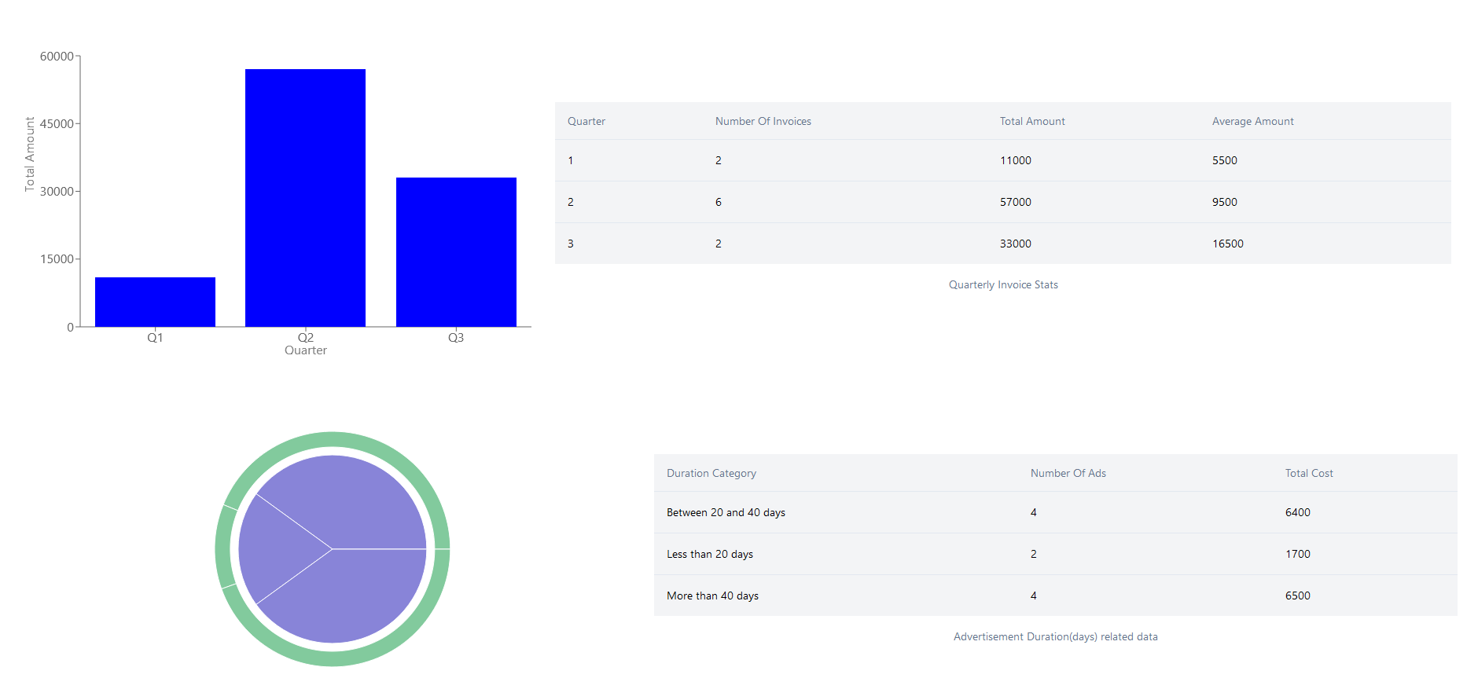
DATA ANALYTICS:-

Slide 48
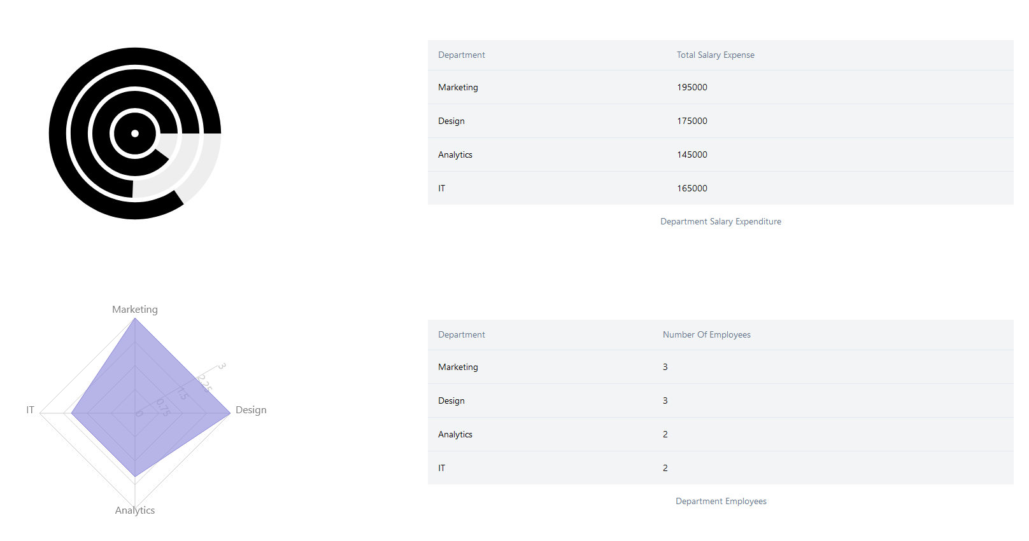

Slide 49
