Slide 1

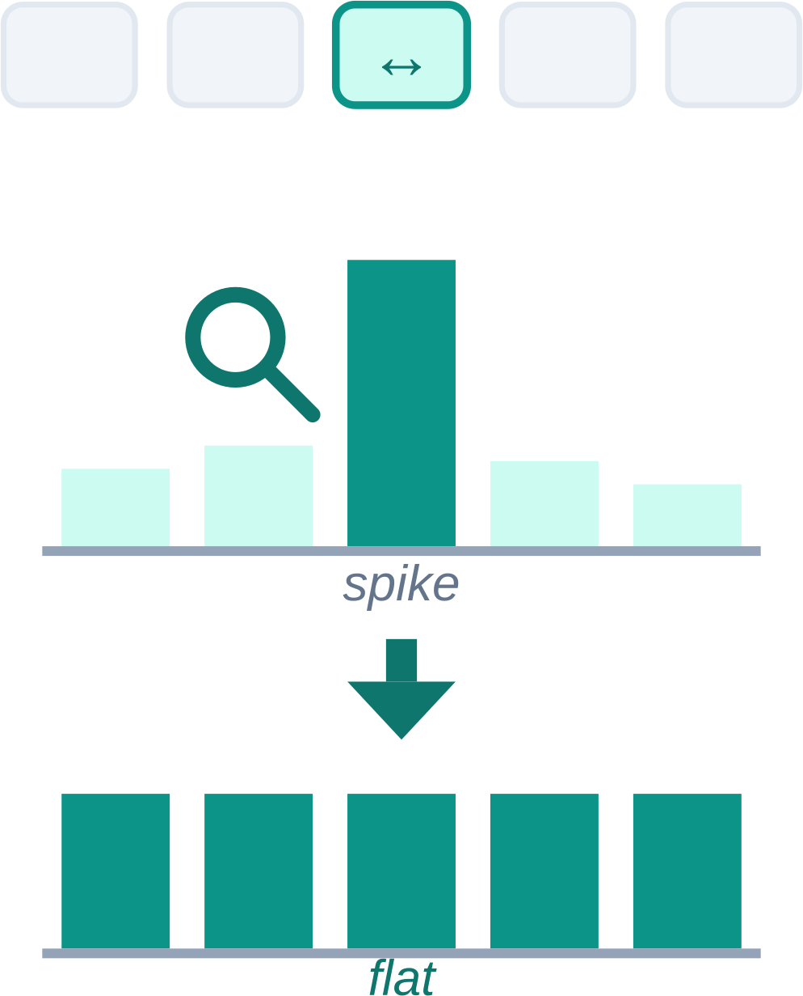


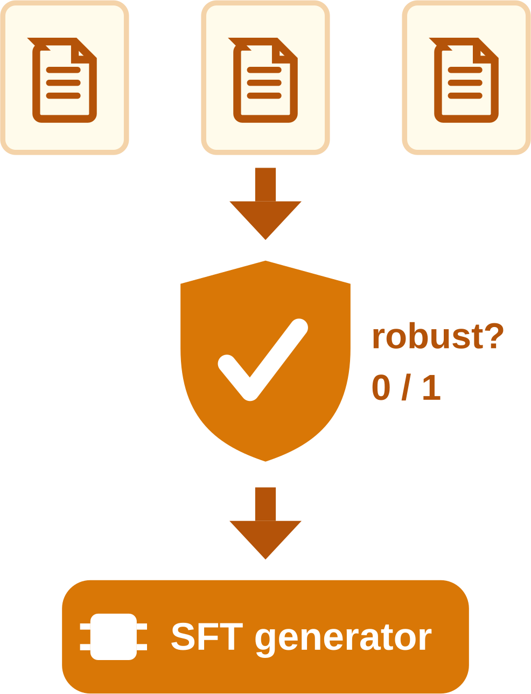


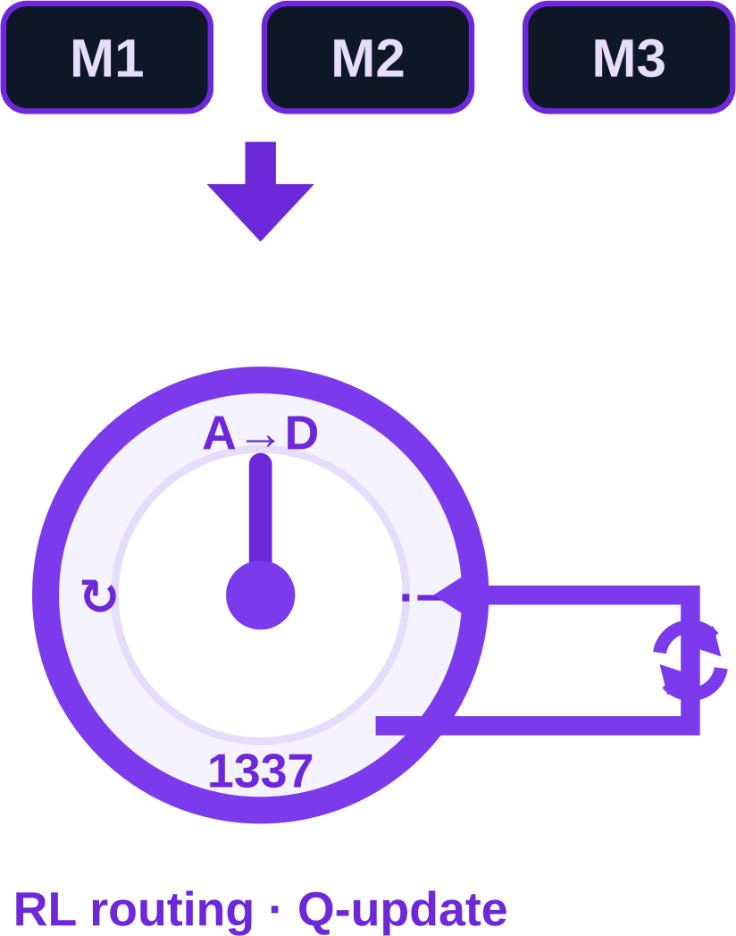



EXPERIMENTAL SETUP
EXECUTION
EVALUATION & ANALYSIS
1
Victim Models
2
Harmful Prompt Benchmarks
3
Attack Generation
4
Transfer Evaluation
5
Model Responses
6
Official Judging
7
Aggregate Analysis
Causal LLMs
HarmBench
400 prompts
cross-product design
Response record r
(a · b · m)
ASR by model
3
attack
families
Attacked
prompt x′
Llama
decoder-only AR
MaliciousInstruct
100 prompts
PiF
salience flattening
attack-specific judge
3 attacks × 6 models
Qwen
causal AR
JailbreakBench
100 prompts
×
6
victim
models
J_{PiF} → pass / fail
ASR by benchmark
Falcon-H1R
attn ∥ Mamba-2
StrongREJECT
313 prompts
Victim
model M
AR / diffusion
→
J_{Arr} → pass / fail
→
×
Diffusion LMs
ArrAttack
robust rewriting
4
benchmark
suites
J_{Meta} → pass / fail
ASR by attack
913
prompts
prompt pool
LLaDA
masked diffusion
ArrAttack
=
MetaCipher
Raw
response y
binary success
s ∈ {0, 1}
feeds ASR
Dream
diffusion · AR-init
full factorial
every combination run
PiF
MetaCipher
cipher + RL
DiffuCoder
code diffusion
72
settings

