Slide 1
An Artificial Neural Networking Model for Predicting the T20 International Cricket Match Result
Nitesh Khadka
2013331065
Nov 22, 2017
Shadman Habib
2013331026
978-1-4673-6792-9/15/$31.00©2015 IEEE

Slide 2
Acknowledgement
Currently One Day International (ODI) first inning match is predicted on the basis of Current Run Rate
In second innings there is no method to predict the outcome of the match.
In this paper a model has been proposed that has two methods.
1. predicts the score of first innings using Linear Regression Classifier
2. predicts the outcome of the match in the second innings using Naïve Bayes Classifier
It is found in the results that error in Linear Regression classifier is less than Current Run Rate method in estimating the final score and also accuracy of Naïve Bayes in predicting match outcome has been 68% initially from 0-5 overs to 91% till the end of 45th over.

Slide 3
Overview
Introduction
Related Work
Data Mining in Various Sports
Classification
Linear Regression Classifier
Naïve Bayes Classifier
Data Collection and Preparation
Training and Testing of data
Result and Discussions
Implementation of Algorithm
Linear Regression Algorithm
Naïve Bayes Algorithm
Projected Score Performance
Winning Percentage Performance
Conclusion and Future Scope
References

Slide 4
Classification
technique of recognizing to which class a new instance belongs,
on the basis of a training set of data containing observations
The algorithm that is used for implementation of classification is known as a classifier.
Here, two classifiers have been used, namely Linear Regression (LR) and Naïve Bayes classifier.

Slide 5

Classifier types: Linear Regression
USE
If the data of a class and attributes are numeric
to get the expression of the class in terms of linear combination of the predetermined weights and attributes which is been given by the equation:
$$x = w0 + w1.a1+w2.a2+…+wv.av$$
where,
a means values of attribute
w means weights
In this paper, the Linear Regression Classifier is used for the first innings datasets where the class attribute ‘x’ is the ‘Score’ and the input attribute a^{i} are the current score and wickets.

Slide 6
Data Collection and Preparation
The data has been collected from http://www.espncricinfo
For each team two separate datasets have been made, one for first innings and the other for the second innings.
For first inning, matches the runs scored, wickets fallen along with the final score at the end of the innings, have been considered.
In the second innings also those matches have been included in which the particular team has batted in the second innings.
In addition, runs scored, wickets fallen with the run target and the final result in terms of ‘Yes’ or ‘No’ depicting win or defeat have been considered.

Slide 7
Training and Testing of Data
The datasets have been analysed in Weka which contains various machine learning algorithms for implementing the data mining process.
Weka includes various tools for data clustering, visualization, classification, pre-processing, regression and association rules [3].
The dataset has been portioned separately into training and testing sets

Slide 8
Training and Testing of Data(Continued)
For the first innings of a particular team at a particular venue the Linear Regression Classifier has been implemented on the training dataset
the results have been tested with the testing set of matches of that team and venue
For the second innings of the same team and venue, Naïve Bayes Classifier has been implemented on the training dataset of the second innings,
tested the results with the testing set of matches of that team and venue.
This way Linear Regression predicts score of a particular team at the particular venue of the match in first innings and Naïve Bayes will estimate the probability of the batting team in the second innings, at a particular venue

Slide 9
Result and Discussions
Implementation of Algorithm
Discusses implementation of algorithm used by Linear Regression Classifier and Naïve Bayes classifier in our modal
Compares the projected score given by Linear Regression and the projected score given by Current Run Rate in each 5 over period up to 45th over.
Winning Performance Percentage
Calculates accuracy in matches in which a particular team has batted in the second innings.
Then the accuracy given by the Naïve Bayes classifier has been calculated which is actually the accuracy in identifying the final outcome of the match at 5 overs interval.

Slide 10
Implementation of Algorithm
Result and Discussions
Linear Regression – classifier applied on one of the teams for predicting the first innings score
Naïve Bayes – classifier applied on a particular team in particular venue to find the winning percentage or probability.
Projected Score Performance - the first innings projected score has been compared which is given by Linear Regression (LR) classifier with the projected score given by the Current Run Rate (CRR), and then,
the Error by Linear Regression (Error LR) and Error by Current Run Rate (Error CRR) have been calculated

Slide 11

Implementation of Algorithm (Continued)
Linear Regression
Using the above mentioned general linear regression equation we get the following equation to suit our modal:
$$score=\text{0.6608} \text{∗} \text{current}\text{_}\text{score}\text{ – 23.7432 ∗ }\text{wickets}\text{_}\text{fallen}\text{ + 246.434}$$

Slide 12

Implementation of Algorithm (Continued)
Naïve Bayes:
For each five over intervals for a particular team and venue in the second innings, the values for posterior(yes) and posterior(no), with ‘yes and ‘no’ have been calculated. Thus, the following calculations are done. $posterior\left(yes\right)=\frac{p\left(current score | yes\right).p\left(wickets fallen | yes\right).p\left(target | yes\right).p\left(yes\right)}{evidence}$
$$posterior\left(no\right)=\frac{p\left(current score | no\right).p\left(wickets fallen | no\right).p\left(target | no\right).p\left(no\right)}{evidence}$$
where,
$$evidence=p\left(runs | yes\right).p\left(wickets | yes\right).p\left(target | yes\right).p\left(yes\right)+p\left(runs | no\right).p\left(wickets | no\right).p\left(target | no\right).p\left(no\right)$$

Slide 13

Implementation of Algorithm (Continued)
Projected Score Performance
The first innings projected score has been compared which is given by Linear Regression (LR) classifier with the projected score given by the Current Run Rate (CRR), by calculating Error by Linear Regression (Error LR) and Error by Current Run Rate (Error CCR) by following equation:
$$Error LR=\left|final score of the match −projected score by LR at the end of nth over\right|$$
And,
$$Error CRR=|(final score of the match −projected score by CRR at the end of nth over)|$$

Slide 14
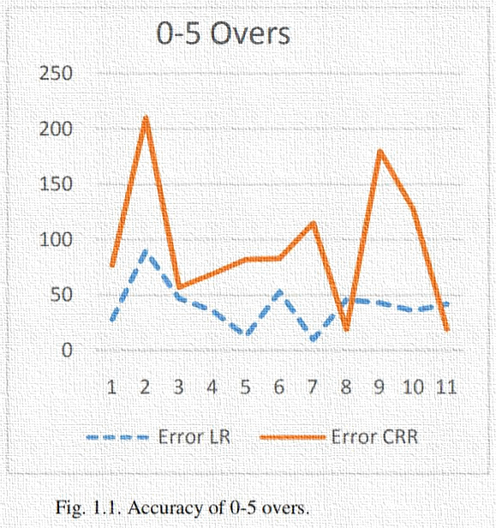
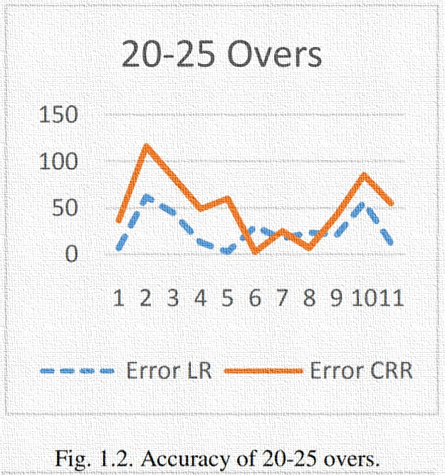
Projected Score Performance
Line Charts

Slide 15
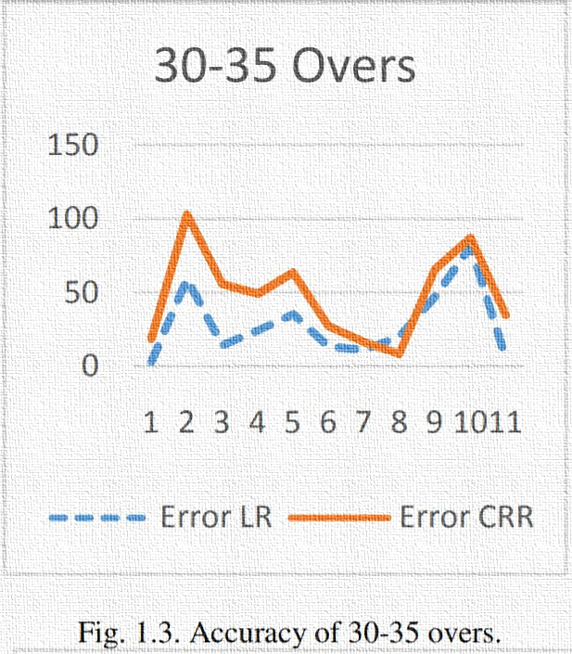
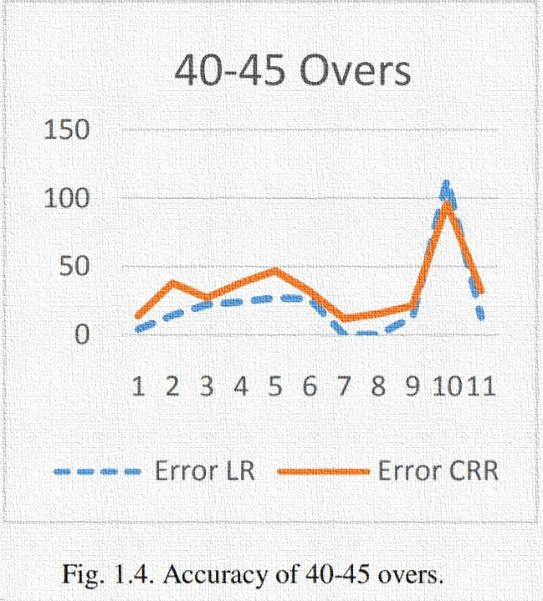
Projected Score Performance
Line Charts

Slide 16
Winning Percentage Performance
India’s ODI matches in which India have batted in the second innings have been taken. Then the accuracy given by the Naïve Bayes classifier has been calculated which is actually the accuracy in identifying the final outcome of the match at 5 overs interval is given in table below.
Overs | Accuracy(%)
0-5 | 68.6813
5-10 | 75.8242
10-15 | 75.8242
15-20 | 79.6703
20-25 | 80.2198
25-30 | 81.3187
30-35 | 80.2198
35-40 | 87.3626
40-45 | 91.2088

Slide 17
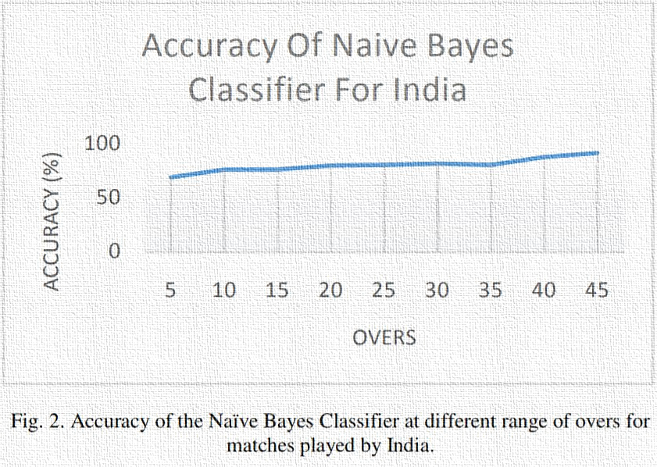
Winning Percentage Performance
The line chart has been plotted with X-axis taken as overs and Y-axis as the accuracy in terms of percentage.

Slide 18
Key Findings / Results 1

Slide 19
Key Findings / Results 3
Run number | Description | Result A | Result B
1 | Condition A | True | True
2 | Condition B | True | False
3 | Condition C | False | False

Slide 20
Conclusion
Add your conclusion here

Slide 21
Questions & Discussion

