Slide 1
Project Title: Vinegar-Food
Supervisor: Sir Muhammad Hamza

Slide 2
E-PROJECT
Batch Code:
2409C1
Team Members:
Syed Muhammad Faisal
Muhammad Saad Anwar Malick
Abdul Rehman
Hisban Shahzad
Taha

Slide 3
Problem Statement
Vinegar Food Restaurant which is the flagship brand of JADONS Ltd has spread over
its aroma in this industry over the past few decades. Known as “the Serving plates”
with 72 different rotating menus and 240000 delicacies throughout the country.
The organization wants a website to be made which should spread the aroma online.
The main Highlights of the restaurant must be highlighted in the website. The
restaurant has more than 1000 branches till date.

Slide 4
Introduction
The thirst for learning, upgrading technical skills and applying the concepts in real life environment at a fast pace is what the industry demands from IT professionals today. However busy work schedules, far-flung locations, unavailability of convenient time-slots pose as major barriers when it comes to applying the concepts into realism. And hence the need to look out for alternative means of implementation in the form of laddered approach. The above truly pose as constraints especially for our students too! With their busy schedules, it is indeed difficult for our students to keep up with the genuine and constant need for integrated application which can be seen live especially so in the field of IT education where technology can change on the spur of a moment. Well, technology does come to our rescue at such times!! Keeping the above in mind and in tune with our constant endeavour to use Technology in our training model, we at Aptech have thought of revolutionizing the way our students learn and implement the concepts using tools themselves by providing a live and synchronous eProject learning environment!

Slide 5
Scope
On a food website, include a variety of engaging content: recipes, cooking tips, ingredient guides, nutrition information, and food trends. Adding restaurant reviews, meal planning advice, or personal stories related to food can also help connect with visitors.

Slide 6
Our Site Map
Home
About Us
Meals
Catering
Contact Us

Slide 7
Conclusion
On a food website, include a variety of engaging content: recipes, cooking tips, ingredient guides, nutrition information, and food trends. Adding restaurant reviews, meal planning advice, or personal stories related to food can also help connect with visitors.

Slide 8
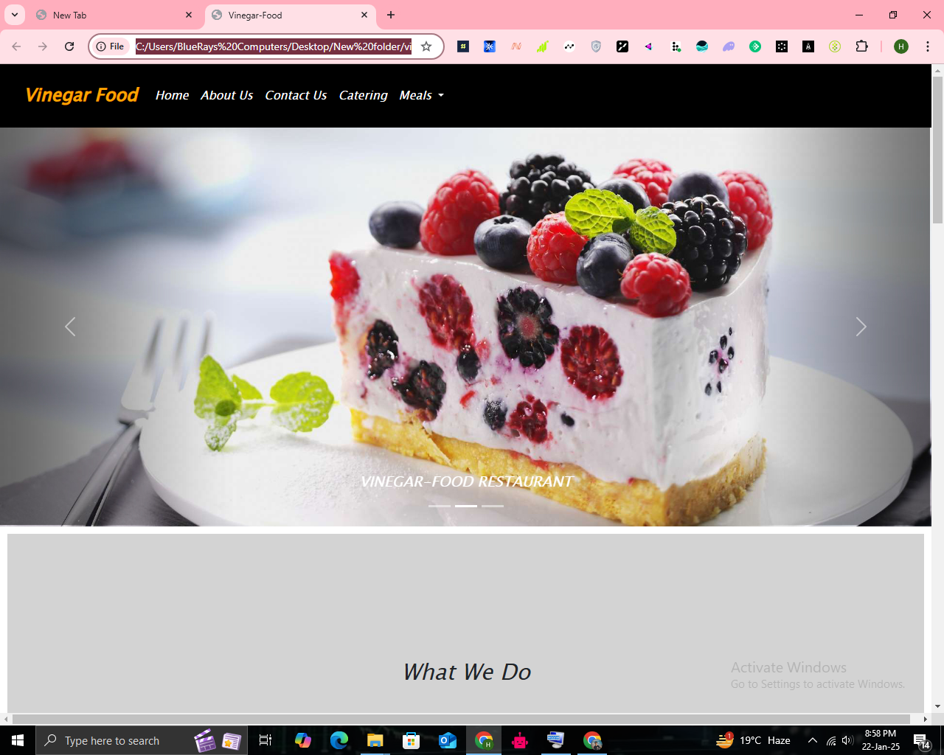

Slide 9
Thank You

