Slide 1
THE WORLD HAPPINESS REPORT
Saadman Iqbal| Steven Khong

Slide 2
THE WORLD HAPPINESS REPORT
Annual Publication by the United Nations Sustainable Development Solutions Network
Essentially a ranking based on a metric that evaluates how happy a country is.
Surveys from the population of over a 150 countries are taken on several features which factor into the final happiness score assigned to that country.
We have looked at three of these rankings from reports from 2015 to 2017.
Notes:
Insert a map of your country.

Slide 3
THE WORLD HAPPINESS REPORT
The life factors/ features that the survey draws upon in all three reports are:
GDP per capita
Family and Social relationships
Healthy life expectancy
Perceived level of freedom
The level of generosity displayed
Perceived trust in government/indicator to government corruption
The scores calculated are relative to a hypothetical country called Dystopia where the least happy people reside. This is a benchmark for all the other scores produced. Secondary features like a Dystopian Residual and Standard Error are also present in the score.
Notes:
Insert a picture of one of the geographic features of your country.

Slide 4
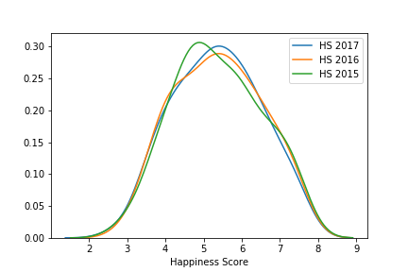
The three-year distribution
The distribution plot shows the happiness score distributed based on its relative frequency(probability of appearance on the dataset)
More recent years have seen the average score increase to ~5.5 from ~4.8.
The range of the score is from 0 to 10

Slide 5
THE HYPOTHESIS – VILLAIN AND HERO
The Question posed:
What causes countries to have a low happiness score, i.e. why are people in some countries bleaker, sadder, and less happy than the people from a happier country?
The Villain:
The features that cause the problem addressed by our question, i.e. it is the feature(s) from the survey that lead to a low happiness score.
The Hero:
The actionable changes that will reduce the negative presence of the villain, i.e. will help a country to become happier than they are.
Notes:
Insert a picture illustrating a season in your country.

Slide 6
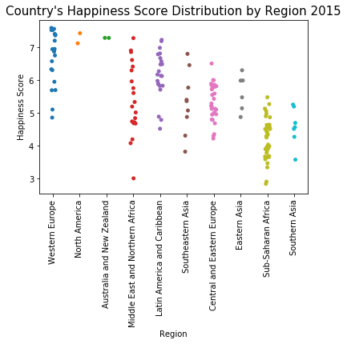
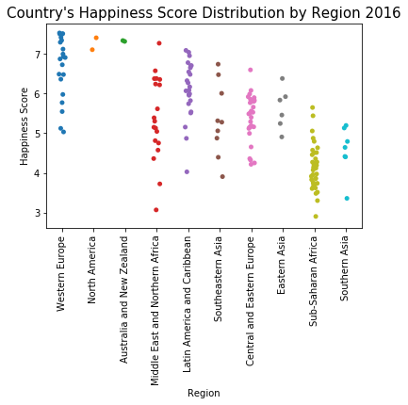
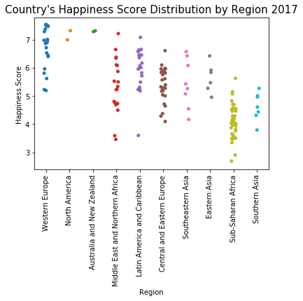
REGIONAL COMPARISONS
Countries split into 10 regions around the world. The graphs above shows the distribution based on the regions from the three different years. It is ordered from the highest score onwards.
Notice how Central Europe moves a place down to Southeastern Asia based on their highest ranked country
Notes:
Insert a picture of an animal and or plant found in your country.

Slide 7
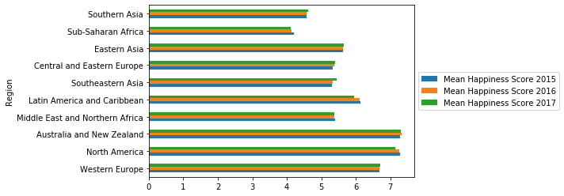
REGIONAL COMPARISONS
Mean Happiness Scores of the different regions from 2015 to 2017. Recall that the regions of Aus/NZ and North America have only two countries participating in this report.
This, however, gives a good indication of what its like around the globe, as regions are easily identifiable. There is also very little fluctuation over the years. This strengthens each region’s life factors as influencers of the score rather than a one-off anomaly due to any number of events in their countries at the time
Notes:
Add key points in the history of your country to the timeline.

Slide 8
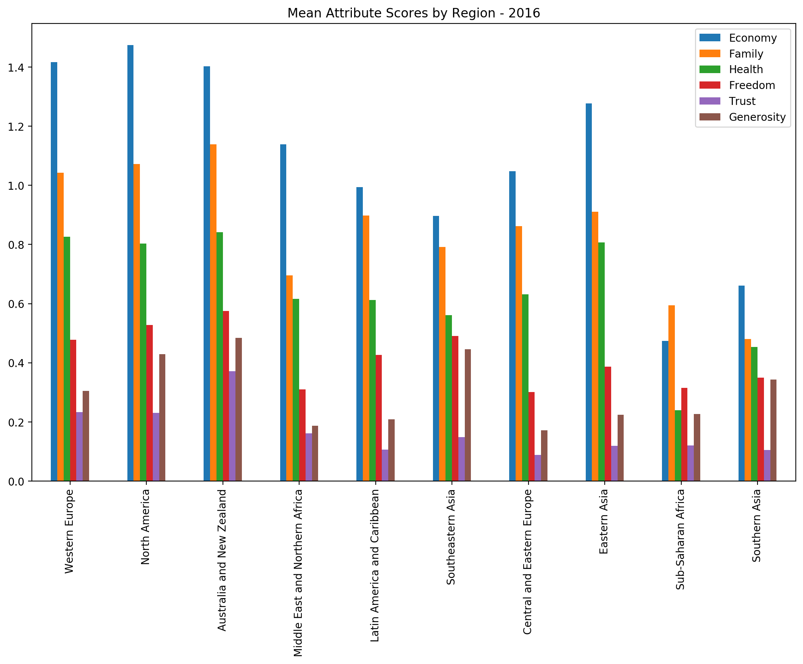
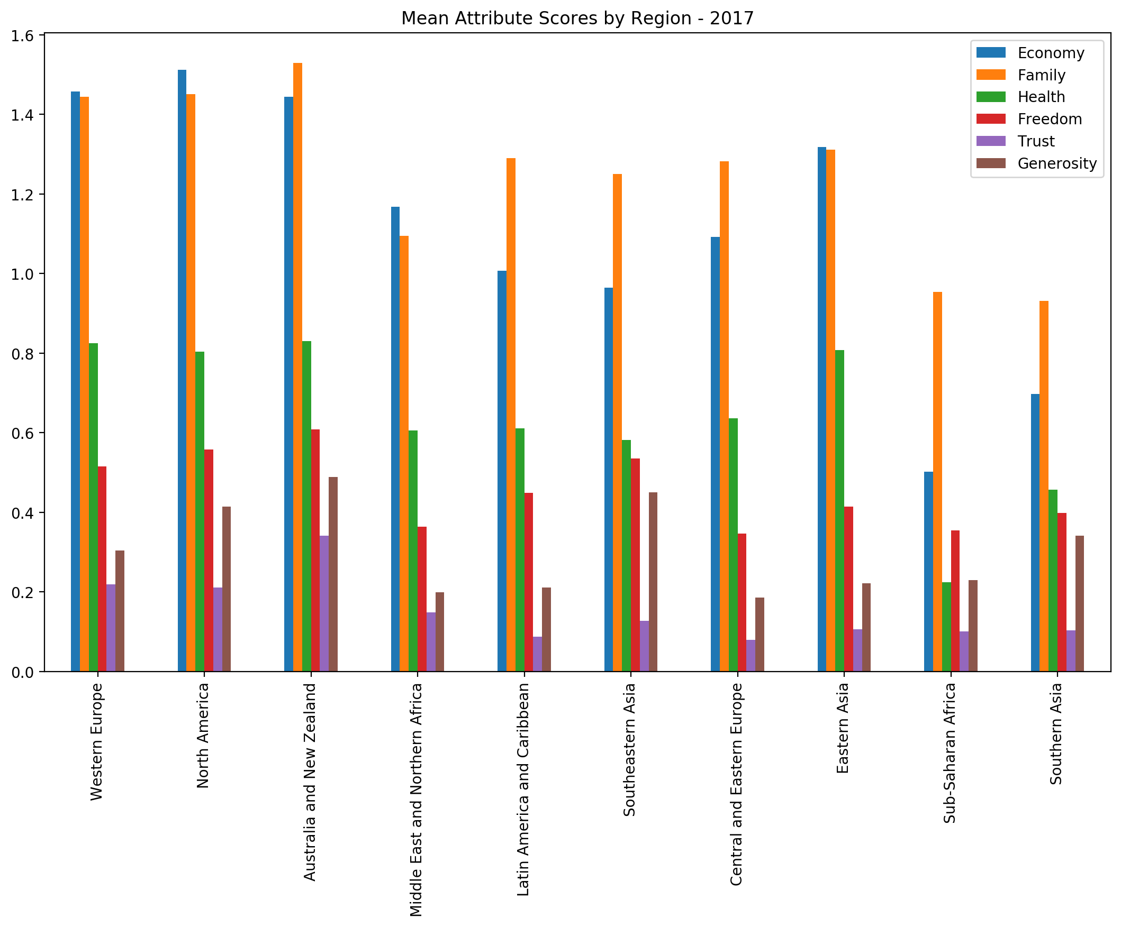
REGIONAL COMPARISONS
These are regional data from 2016 and 2017, depicting the average of each of the six attributes based on the region the country is from.
Note from earlier, that the regions that less happy have shorter bars in specific areas of the life factors than others.

Slide 9
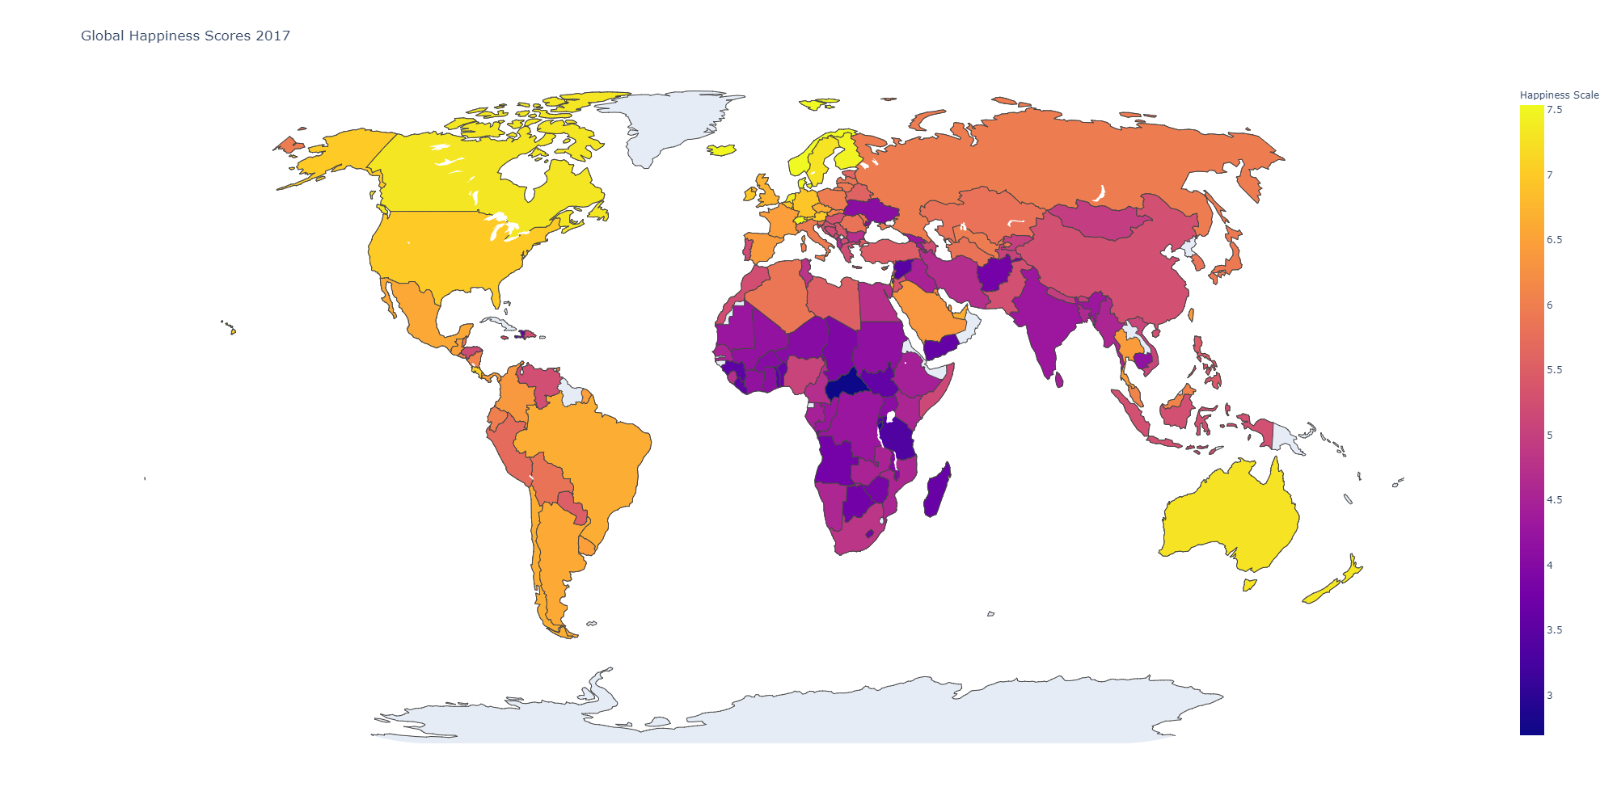
The world heat map
Notes:
Insert a picture illustrating a custom or tradition here.

Slide 10
Why show all of it- seeing the pattern based on prior knowledge
The world map, along with all the other graphs, gives a visual representation of preconceived notions that we have about different regions of the world, and try to predict what might be the causes to our question.
Developing vs Developed Countries
First and Second World vs the Third World Countries
General idea of the wealthier and more successful countries of the world.
Now, we approach the matter statistically to see which life factors influence the happiness score the most.
Notes:
Insert a picture of the head leader of your country.

Slide 11
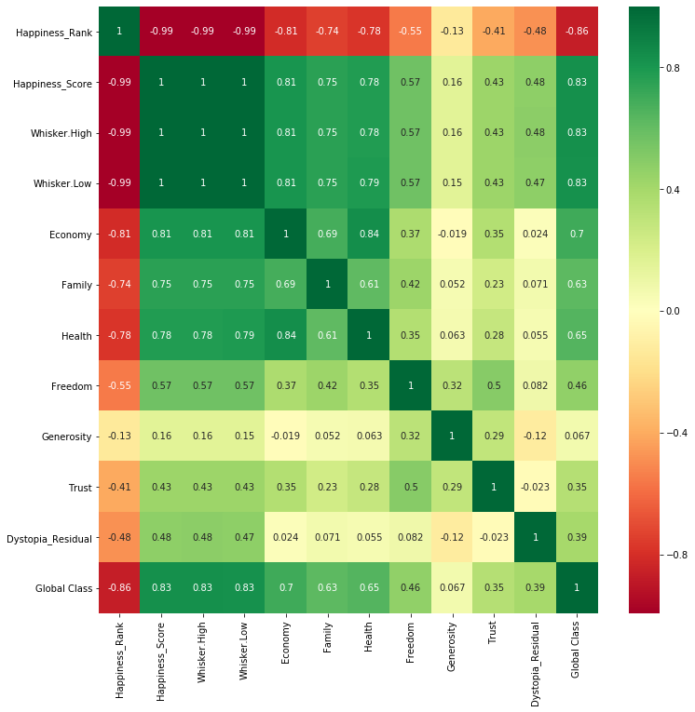
Correlation and pair plots
Using the most recent of the three reports, we create a correlation matrix, and extract the three most correlated life factors to the happiness score.
Economy (GDP/wages), Health(based on life expectancy), and Family and social life
Repeating the above with 2015 and 2016 data yield the same thing, in the same exact order.
Notes:
Insert a picture that illustrates some part of your country’s economy.

Slide 12
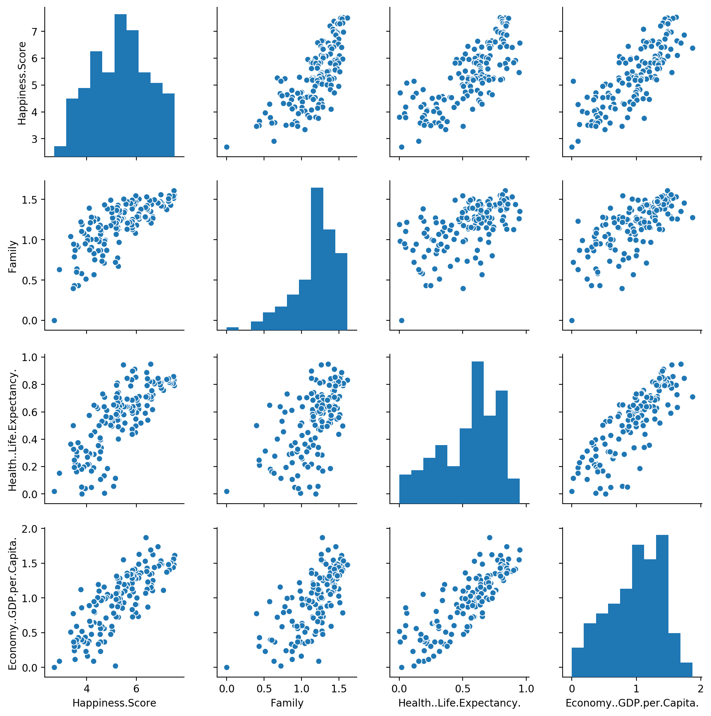
Correlation and pair plots
The left column of pair plots show the correlation between Happiness Score and the three most important life factors.
Due to this being a more intuitive approach to solving the problem, we will not consider how each of those three factors are dependent on the other. We may drop it for predictive purposes, but to people, they mean different things, and that’s how we will focus on the issue.
Notes:
Insert a picture of one of the points of interest for your country.

Slide 13
The climax – two sides of the same coin
To prove that Money, Health and Family are the most important features, and low values mean a less happy nation, we created a binary class which assigns 0 to countries below the world average happiness score, and 1 to countries above it.
Using both Support Vector Machine and Artificial Neural Networks, splitting and running classifiers on test and train sets containing only the three features yielded a cross validation score average score of ~80% and ~86% respectively, after using K-folds.
Running them with the lesser important features yield ~75% of correctly predicted class values.
Thus, we can conclude that a lesser value on Money, Health and Family/Social life leads to any country, regardless of the region, to be unhappy.

Slide 14
The hero and its solutions
The heroes in this case are improving the attributes economy, health and family.
However, the focus should be more economy because health is heavily dependent on it. While family is less dependent, it is still a factor
Providing and creating jobs and trade (more exports than imports) will generate more money within the economy. This will raise proper funding for education and healthcare. Having less to worry about your wages and your health will automatically open opportunities to improve family and social life.

Slide 15
Fin

