Slide 1
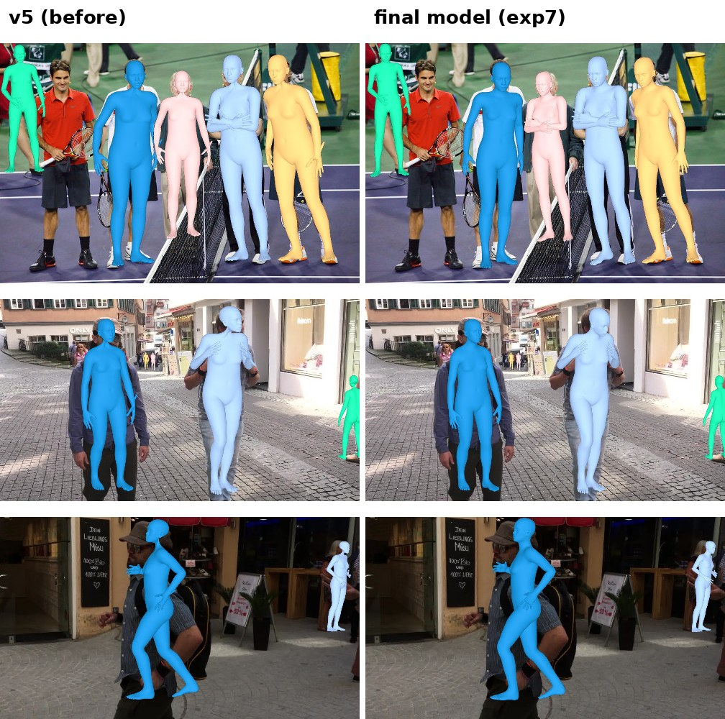
01 / INTRODUCTION
Multi-Person Human Mesh Recovery
with the Anny Body Model
A smaller student model for recovering 3D people
from a single image
Muhammad Saad Najib
Master’s thesis · Supervisor presentation
Illustration: Base/v5 and teacher overlays
These are not student predictions.
Muhammad Saad Najib · Supervisor presentation · 22 October 2026
01
Notes:
SLIDE 1: Multi-Person Human Mesh Recovery
SPEAKING SCRIPT
My thesis studies how to recover a three-dimensional body for each person visible in one photograph. A body mesh is a surface made from many connected points, like a digital mannequin. It represents body pose and shape, rather than just a few joints. The main model in this presentation is my smaller student model. It learns from labelled examples and from a larger teacher. I will explain the starting system, what the student learns, how I converted real-image labels into the Anny body format, and the measured trade-off between speed and reconstruction quality. The illustrations on this first slide show earlier Base and teacher outputs; the student results will be identified separately.
POINT / DEMO CUE
Introduce the task before using abbreviations.
TRANSITION
First, why is this problem difficult?
SOURCE
Muhammad Saad Najib · Supervisor presentation · 22 October 2026

Slide 2
02 / PROBLEM STATEMENT
One photograph, several difficult decisions
Recover a whole body
Real photographs
Reduce inference cost
Estimate pose, body shape
and distance from the camera.
People can overlap or be
partly hidden.
Synthetic images have exact
labels but differ from photos.
3DPW annotations use
a different body model.
Large models require more
computation and memory.
Can a smaller model retain
useful reconstruction quality?
Research question: how much accuracy can a smaller student retain?
Thesis revision, 22 Oct 2026
02
Notes:
SLIDE 2: One photograph, several difficult decisions
SPEAKING SCRIPT
A photograph shows a flat image, but our output must describe a three-dimensional body. Several different bodies and distances can produce a similar picture, especially when clothing or another person hides part of the body. There are two additional challenges in this project. First, synthetic training images come with detailed labels, while real photos look different and have less complete supervision. Second, the larger model is expensive to run. My question is therefore whether a smaller student can learn enough from a stronger teacher and from both datasets to provide useful results with lower inference cost. I evaluate this as a trade-off: a faster result is valuable, but I also need to show how much reconstruction accuracy is lost.
POINT / DEMO CUE
Point to the three challenges from left to right.
TRANSITION
The starting point is Multi-HMR.
SOURCE
Thesis revision, 22 Oct 2026

Slide 3
03 / ORIGINAL MULTI-HMR
Baseline: one image → multiple 3D bodies
Baseline used in this project: the released Multi-HMR model with Anny outputs.
Camera intrinsics K → geometric placement
RGB image
672 × 672
DINOv2
ViT-L encoder
Detect people
+ image offsets
Person decoder
(cross-attention)
Anny body
+ placement
Encoder: extracts image information
Decoder: predicts one body per detected person
Single-shot: process the whole image in one forward pass.
Sources: Multi-HMR (Baradel et al., 2024); released NAVER Anny checkpoint; thesis §4.2
03
Notes:
SLIDE 3: Baseline: one image → multiple 3D bodies
SPEAKING SCRIPT
This is the baseline pipeline. The RGB image is resized and padded to the model input size. The DINOv2 encoder turns it into image features, which can be thought of as descriptions of small image regions. A detection head identifies person anchors and their image offsets. The person decoder uses cross-attention to combine information about each person with the rest of the image. It predicts the parameters needed by a body model, and the body layer converts those parameters into a mesh. Camera information helps place the mesh in three-dimensional space. The original Multi-HMR work also describes an SMPL-X version; our external reference is specifically NAVER’s released Anny checkpoint. This distinction matters when comparing outputs and model sizes.
POINT / DEMO CUE
Trace the arrows. Define encoder and decoder in plain words.
TRANSITION
My student preserves this general pipeline but uses a smaller encoder.
SOURCE
Sources: Multi-HMR (Baradel et al., 2024); released NAVER Anny checkpoint; thesis §4.2

Slide 4
04 / STUDENT–TEACHER ARCHITECTURE
The student learns from labels and a frozen teacher
FROZEN: no weight updates
Teacher: ViT-L
1,024 features
Teacher heads
→ body parameters
Anny layer
→ mesh + joints
Same RGB image
+ camera K
Feature loss
Output loss
Student: ViT-B
768 features
Projector
768 → 1,024
Copied heads
→ parameters
Anny layer
→ mesh
Dataset labels → supervised losses on student predictions
Deployment uses only the student branch, including its projector.
Sources: thesis §4.1, §4.8; model.py; distill.py; train.py
04
Notes:
SLIDE 4: The student learns from labels and a frozen teacher
SPEAKING SCRIPT
Both branches receive the same image and camera information. The larger teacher has a ViT-L encoder and remains frozen, meaning training does not update its weights. The student uses a smaller ViT-B encoder. Because its feature width is 768 rather than 1,024, a small trainable projector converts its features to the width expected by the transferred prediction heads. There are three sources of learning. Dataset labels provide the supervised loss. Teacher features provide the feature-distillation loss. Teacher body parameters provide the output-distillation loss. These losses update the student, while teacher targets are detached from gradient updates. The copied heads are frozen initially, then trained. At deployment the teacher is removed, but the projector stays because the student heads need its output.
POINT / DEMO CUE
Point to gold arrows as teacher guidance and the bottom line as label supervision.
TRANSITION
Next, what exactly does the network predict?
SOURCE
Sources: thesis §4.1, §4.8; model.py; distill.py; train.py

Slide 5
04 / MODEL INPUTS AND OUTPUTS
What goes in, and what comes out?
A body model turns predicted parameters into a visible 3D surface.
Input
Predictions per person
Decoded output
RGB image + camera K
Training also supplies
per-person body labels
and anchor locations.
Detection score + 2D offset
163 bone rotations
11 body-shape parameters
Head-anchor depth
3D body mesh + joints
Pose: how the body bends
Shape: body proportions
Placement: where it stands
Sources: thesis §4.2; model.py
05
Notes:
SLIDE 5: What goes in, and what comes out?
SPEAKING SCRIPT
The input used at inference is an RGB image and camera intrinsics. When the camera calibration is unavailable, the demo uses an assumed field of view, which can affect recovered depth. For each detected person, the model predicts bone rotations, eleven Anny body-shape parameters, and quantities describing the head anchor’s image location and depth. Rotations describe articulation, while shape parameters control aspects such as height and body proportions. The Anny layer converts these parameters into a mesh and joints. The mesh is then translated so its head anchor reaches the predicted camera-space position. During training, labels provide target parameters and geometry. At inference those targets are absent: the model must estimate everything from the image and camera information.
POINT / DEMO CUE
Use pose, shape and placement as three separate ideas.
TRANSITION
The losses tell the student which parts of its answer need to improve.
SOURCE
Sources: thesis §4.2; model.py

Slide 6
04 / LOSS FUNCTIONS
Supervised losses: compare predictions with labels
Loss group | What is compared? | Plain-language purpose
Detection + offset | Person-anchor score and 2D location | Find each person correctly
Pose + shape | Bone rotations and body parameters | Recover articulation and proportions
Depth + translation | Head depth and 3D anchor position | Put the body at the right distance
3D joints + vertices | Pelvis-centred predicted / target bodies | Match the body geometry
2D projection | Predicted / target points in the image | Make the mesh line up with the photo
Ltotal = Lsupervised + Lfeature KD + Loutput KD
Sources: thesis §4.3; Table T02; exact formulas in backup slides
06
Notes:
SLIDE 6: Supervised losses: compare predictions with labels
SPEAKING SCRIPT
A loss is a numerical penalty for a mismatch during training. Here the penalties measure several different parts of the prediction. Detection and offset losses help find people and locate their anchors. Pose and shape losses compare the predicted body parameters with their labels. Depth and translation losses teach camera-space placement. The three-dimensional joint and vertex losses compare bodies after moving each pelvis to the origin, so they measure body geometry without absolute translation. The two-dimensional losses project the body back onto the image and measure alignment there. This is why a low centred body error does not automatically mean correct placement in the photo. The student receives all these supervised terms plus the two teacher-guidance terms on the next slide.
POINT / DEMO CUE
Read purposes, not every formula. Full weights and equations are in the backup.
TRANSITION
Distillation adds information from the teacher.
SOURCE
Sources: thesis §4.3; Table T02; exact formulas in backup slides

Slide 7
05 / TRAINING PROCESS
Knowledge distillation: two kinds of teacher guidance
Feature distillation
Output distillation
Compare teacher image features with
the student’s projected features.
KL divergence, temperature T = 4.
“Learn similar image representations.”
Compare corresponding people’s
rotations, shape parameters and depth.
Weighted L1 differences.
“Learn similar body predictions.”
The student learns from the true labels and the teacher; both KD weights are 1.0.
Sources: thesis §4.8; distill.py; loss.py
07
Notes:
SLIDE 7: Knowledge distillation: two kinds of teacher guidance
SPEAKING SCRIPT
Knowledge distillation means using a larger trained model to guide a smaller one. The first form is feature distillation: the student’s projected image features are encouraged to resemble the teacher’s features. The implementation turns feature channels into softened distributions and compares them with KL divergence. A temperature of four controls that softening. The second form is output distillation: the student is encouraged to predict similar rotations, body-shape parameters and depth. During training the two models use the same labelled person locations, so outputs can be compared person by person. Teacher predictions are useful guidance, but they can also contain mistakes. Ground-truth supervision remains present. The exact reductions and weights are included in the backup slides for technical questions.
POINT / DEMO CUE
Clarify that the teacher supplies guidance; it does not create new verified ground truth.
TRANSITION
Here is the training recipe used for the reported student.
SOURCE
Sources: thesis §4.8; distill.py; loss.py

Slide 8
05 / TRAINING PROCESS
Training recipe for the reported student
30
1,000
8
70 / 30
epochs
steps per epoch
images per batch
synthetic / real mix
Initialize ViT-B
+ copy teacher heads
First 5 epochs
keep copied heads frozen
Continue training
then calibrate student outputs
Learning rate: 3 × 10⁻⁵; halved every 12 epochs. Teacher stays frozen.
70/30 is the sampling ratio of images, not people. Test images are excluded.
Sources: thesis Table T11; exp8_distill_vitb.sh; job 3614191
08
Notes:
SLIDE 8: Training recipe for the reported student
SPEAKING SCRIPT
The reported student is the completed thirty-epoch ViT-B run. Each epoch has one thousand optimizer steps, with eight images in a batch, giving two hundred and forty thousand sampled image presentations over training. These are not necessarily unique images. The sampler draws about seventy percent synthetic AnnyOne images and thirty percent converted 3DPW training images. This is an image ratio; the person ratio differs because images contain different numbers of people. The student starts with an HMR-trained ViT-B backbone and copied teacher heads. The heads stay frozen for the first five epochs, then train with the student. The learning rate starts at three times ten to the minus five and halves every twelve epochs. Student-specific output calibration is estimated after training.
POINT / DEMO CUE
Emphasize this is the confirmed 30-epoch checkpoint, not an unverified longer run.
TRANSITION
I use several metrics because a single number does not describe the entire result.
SOURCE
Sources: thesis Table T11; exp8_distill_vitb.sh; job 3614191

Slide 9
05 / EVALUATION METRICS
How reconstruction quality is measured
Errors are measured on matched people. Lower error is better; higher recall is better.
Metric | Simple meaning | Unit
PVE | Average surface-point error after pelvis alignment | mm ↓
PA-PVE | Surface error after optimal rotation, translation and scale alignment | mm ↓
MPJPE | Average joint-position error after pelvis alignment | mm ↓
Recall | Share of labelled people recovered by the detector | % ↑
Latency / model cost | Time per forward pass; parameters and operations | ms / M / GFLOPs ↓
Sources: thesis §4.10; Table T07
09
Notes:
SLIDE 9: How reconstruction quality is measured
SPEAKING SCRIPT
PVE is the average distance between corresponding mesh surface points after aligning the pelvis. A value of one hundred millimetres means an average point error of ten centimetres under that evaluation alignment. PA-PVE goes further: it optimally rotates, translates and scales the predicted body before measuring error. It is therefore useful for examining pose and shape, but can hide errors in global size and orientation. MPJPE performs a similar comparison using joint positions rather than surface vertices. Recall records how many labelled people were recovered, because a geometry score on matched people cannot describe missed detections. Finally, parameters, operation count and measured latency describe computational cost. These metrics answer different questions and should be presented together.
POINT / DEMO CUE
Explain millimetres with a centimetre example. Do not call PA-PVE a placement metric.
TRANSITION
These are the measured reconstruction results.
SOURCE
Sources: thesis §4.10; Table T07

Slide 10
05 / RECONSTRUCTION RESULTS
The student loses accuracy relative to its teacher
PVE / PA-PVE, in mm. All 3DPW values use converted Anny labels.
Model | Synthetic holdout | 3DPW test | 3DPW recall
Released baseline | 60.3 / 44.6* | 126.9 / 68.8 | 97%
Teacher (Final, ViT-L) | 73.7 / 50.3 | 89.0 / 57.6 | 99%
Student (ViT-B) | 119.6 / 80.8 | 110.1 / 71.8 | 99%
* Baseline synthetic images are potentially in its training set.
Baseline real-image training exposure also differs from teacher/student.
Student: lower 3DPW PVE than the released baseline, but higher error than the teacher.
Sources: thesis Tables T16–T17; jobs 3614191, 3611336, 3614192
10
Notes:
SLIDE 10: The student loses accuracy relative to its teacher
SPEAKING SCRIPT
The teacher is the strongest of our two trained models on these reconstruction measurements. On the synthetic holdout, the student’s PVE is 119.6 millimetres compared with 73.7 for the teacher. On the converted 3DPW test set, the student reaches 110.1 millimetres compared with 89.0 for the teacher. Both recover ninety-nine percent of labelled people under this evaluation. The student has lower 3DPW PVE than the released baseline, but its PA-PVE is slightly higher than that baseline’s. There are important comparison limits: the released baseline may have seen the synthetic holdout images, and it does not have the same real-image training exposure. Also, these 3DPW numbers use Anny labels, so they should not be compared directly with published SMPL-space scores.
POINT / DEMO CUE
Read one dataset at a time. Point out the PA-PVE reversal against the baseline.
TRANSITION
The benefit of the student appears in computational cost.
SOURCE
Sources: thesis Tables T16–T17; jobs 3614191, 3611336, 3614192

Slide 11
05 / EFFICIENCY RESULTS
The student is smaller and faster
Same benchmark: 672-pixel input, one person, batch 1, fp32 with TF32.
Model | Parameters | Compute | Median forward time
Teacher | 318.38 M | 1,927.4 GFLOPs | 59.7 ms
Student | 101.38 M | 603.3 GFLOPs | 28.5 ms
3.14×
3.19×
2.10×
fewer parameters
less computation
faster forward pass
This is a model-forward benchmark, not end-to-end video FPS.
Source: thesis Table T16; paired L40S measurements, job 3614191
11
Notes:
SLIDE 11: The student is smaller and faster
SPEAKING SCRIPT
This slide compares the student with its teacher under the same recorded L40S benchmark. The student has about one hundred and one million parameters, compared with about three hundred and eighteen million for the teacher. It also uses roughly one third of the counted computation. The median model forward time falls from 59.7 to 28.5 milliseconds, giving a speedup of about 2.1 times. These measurements support the claim that the student reduces model cost. They do not prove that a complete video application runs at the reciprocal frame rate, because loading frames, preprocessing, rendering and encoding take additional time. The final conclusion combines this slide with the previous one: the student achieves substantial efficiency gains, with a measurable reconstruction-accuracy cost.
POINT / DEMO CUE
Use the paired measurements only; do not mix L40S and A100 timings.
TRANSITION
Now I will explain the data used to train these models.
SOURCE
Source: thesis Table T16; paired L40S measurements, job 3614191

Slide 12
06 / DATASETS
Two data sources with one common body format
AnnyOne: synthetic images
3DPW: real video frames
Exact Anny pose, shape and camera labels.
579,860 training images
100-image thesis holdout
70% of mixed training samples
Original labels describe SMPL bodies.
Convert them into Anny training targets.
Train 5,882 · Validation 2,622 · Test 8,190
30% of mixed training samples
The 100-image synthetic holdout contains adults only; it cannot establish child performance.
Sources: thesis Chapter 3; numbers_data.tex
12
Notes:
SLIDE 12: Two data sources with one common body format
SPEAKING SCRIPT
AnnyOne provides synthetic images generated with the Anny body model. This gives detailed pose, shape and camera supervision in exactly the format predicted by the network. My training split uses 579,860 images, while the last one hundred images form the thesis holdout. That holdout contains adults, so it cannot answer whether the model works well for children. The real-image source is 3DPW, which consists of recorded video sequences with body annotations. However, those annotations use SMPL rather than Anny. I did not create 3DPW itself: my contribution here is converting its existing annotations into usable Anny targets while keeping the official training, validation and test separation. The corrected conversion yields the image counts shown on the right.
POINT / DEMO CUE
Say “converted 3DPW labels,” not “created the 3DPW dataset.”
TRANSITION
The conversion is an optimization problem.
SOURCE
Sources: thesis Chapter 3; numbers_data.tex

Slide 13
06 / LABEL CONVERSION
How the 3DPW–Anny labels were created
1
2
3
4
Read source labels
Fit an Anny body
Share body shape
Build image labels
3DPW joints, shape,
camera and frame ID
Optimize root, pose,
then free shape values
One median shape
for each person’s sequence
Refit poses; transform
to camera coordinates
Fit every third valid frame on a shared frame grid; validate and filter the completed labels.
Sources: thesis §3.3–3.5; smpl_to_anny.py, converter v2.3
13
Notes:
SLIDE 13: How the 3DPW–Anny labels were created
SPEAKING SCRIPT
The converter begins with the source body joints and camera information from 3DPW. It searches for Anny parameters whose joints are close to those targets. The fitting proceeds in stages: root alignment first, then articulated pose, and then the shape parameters that can be supported by joint positions. A previous frame provides an initial guess for the next frame. After the first pass, the median fitted shape is assigned to the person across the sequence, and poses are fitted again with that fixed shape. This avoids treating the same actor as a different body in every frame. A label builder then transforms fits into camera coordinates and groups all labelled actors in each image. The shared sampling grid ensures both actors are represented on the same selected frames.
POINT / DEMO CUE
Walk through the four numbered stages.
TRANSITION
The difficult part is that the two skeletons do not define every joint at the same place.
SOURCE
Sources: thesis §3.3–3.5; smpl_to_anny.py, converter v2.3

Slide 14
06 / GEOMETRIC CORRESPONDENCE
Virtual joints compare equivalent body locations
A geometric offset changes the point used for fitting, while the Anny skeleton stays intact.
Anny bone head
h
Virtual point
p = h + Qδ
SMPL joint
target
Move by a fixed offset δ,
rotated with the bone by Q
Minimize the gap
to the target
Joint definitions can be aligned; limb lengths and body proportions can still differ.
Sources: thesis §3.4 and Appendix B
14
Notes:
SLIDE 14: Virtual joints compare equivalent body locations
SPEAKING SCRIPT
SMPL and Anny can place a joint with a similar name at slightly different anatomical positions. If I simply compare the names, the optimizer may try to bend or stretch the body to remove a mismatch caused by the joint definition itself. A virtual joint gives the fitting procedure a more comparable point. I take a point attached to an Anny bone and add a fixed offset measured in the aligned rest skeletons. When the bone rotates, the offset rotates with it. In the equation, h is the bone head, delta is the local offset, and Q rotates that offset into the posed frame. The resulting point p is compared with the SMPL target. This does not change Anny’s actual rig or make the two anatomies identical.
POINT / DEMO CUE
The diagram is conceptual, not a measured anatomical drawing.
TRANSITION
The completed annotations are checked independently of the fitting objective.
SOURCE
Sources: thesis §3.4 and Appendix B

Slide 15
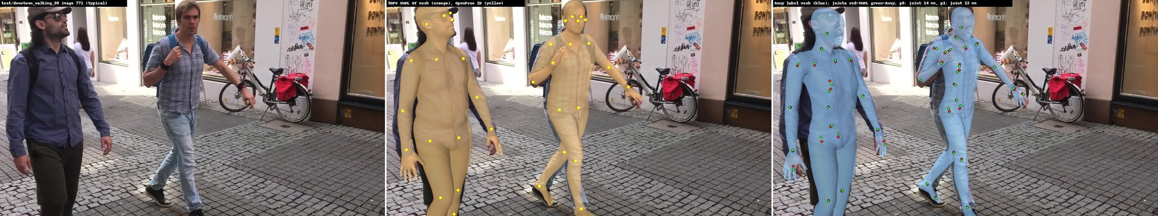
06 / LABEL VALIDATION
Converted labels: checked, with residual warnings
Original image
Source SMPL annotation
Converted Anny annotation
14.1 mm median body-joint discrepancy
WARN: remaining limb-proportion and joint-definition differences.
This label-fit discrepancy is not the model’s prediction error.
Sources: thesis §3.5, Table T05; F14_label_check_downtown_walking_00771.jpg
15
Notes:
SLIDE 15: Converted labels: checked, with residual warnings
SPEAKING SCRIPT
These pictures compare the real image, the source SMPL annotation, and the converted Anny annotation. They are label-conversion examples, not network predictions. An independent validation reads the completed labels and compares their joints and projections with the source annotations. The reported median body-joint discrepancy is 14.1 millimetres. The resulting diagnostic status is WARN, because the body models still differ in proportions and some joint definitions. Earlier label-integrity problems were corrected, but that does not guarantee every fit is perfect. It is especially important not to confuse this conversion discrepancy with the student’s prediction error or subtract it from PVE. The two quantities are measured on different objects and answer different questions.
POINT / DEMO CUE
Point to the source and converted meshes, then the discrepancy.
TRANSITION
The next slides show existing qualitative reconstruction evidence.
SOURCE
Sources: thesis §3.5, Table T05; F14_label_check_downtown_walking_00771.jpg

Slide 16
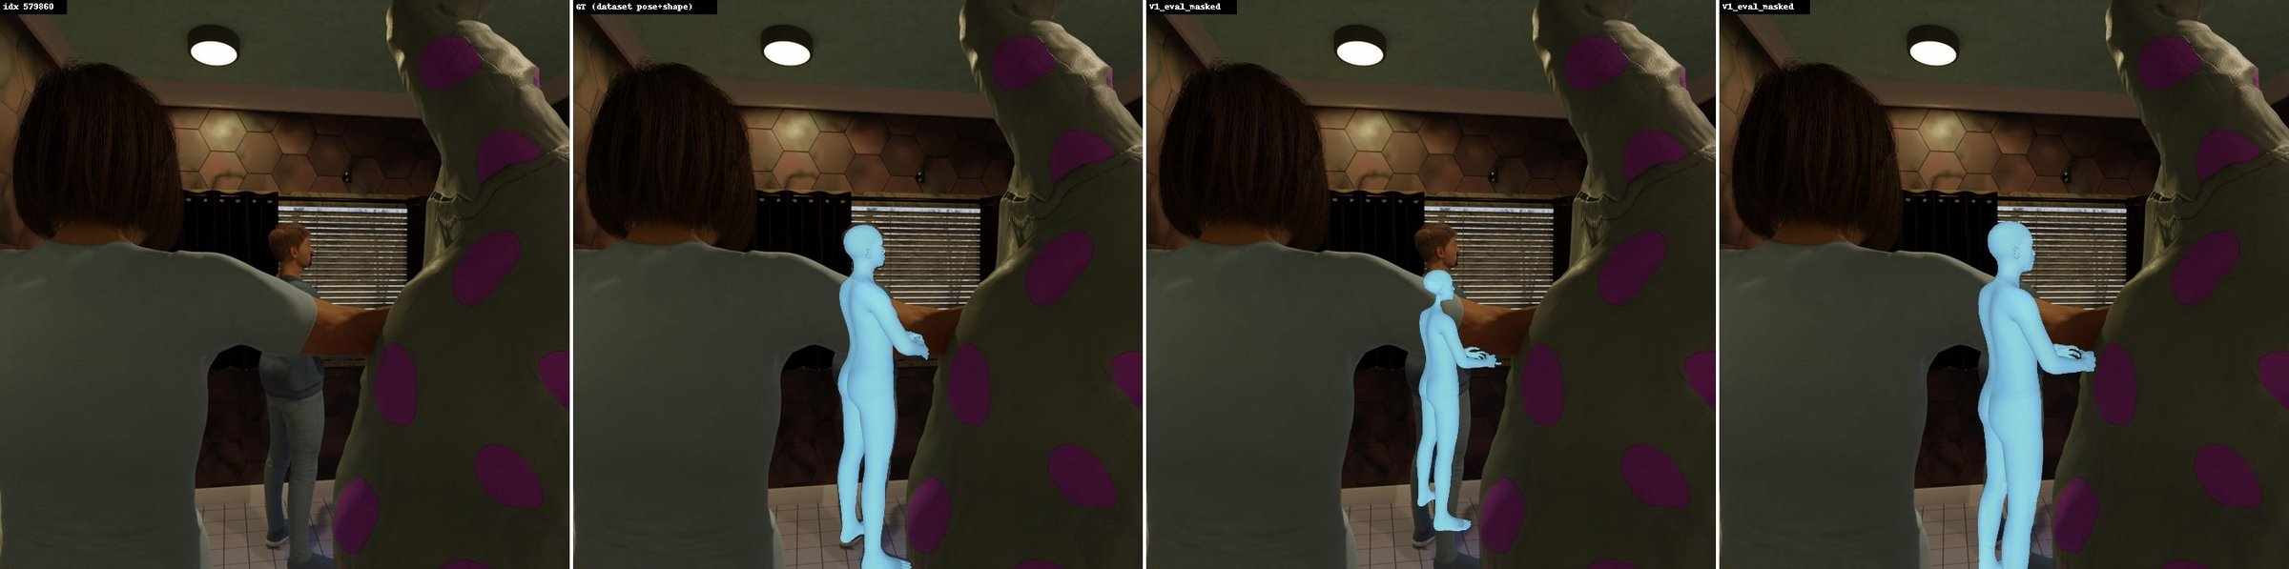
07 / PICTURES
Synthetic example: inspect placement as well as pose
Historical comparison: Base/v5 versus the larger teacher (Final).
Input image
Dataset ground truth
Base / v5
Teacher / Final
Meshes use each model’s own predicted depth. These panels are not student results.
Sources: thesis Figure F12; AnnyOne holdout image 579860, V1
16
Notes:
SLIDE 16: Synthetic example: inspect placement as well as pose
SPEAKING SCRIPT
This synthetic image allows a visual comparison with a known ground-truth mesh. The four columns are the input image, dataset ground truth, the earlier Base or v5 model, and the larger Final teacher. This comparison is useful for looking at apparent size and placement, not just whether the body bends plausibly. Each prediction is shown at its own predicted depth in the V1 evaluation setting. In this example, the teacher’s body appears closer to the ground-truth size and location than the Base prediction. This is a selected example rather than proof of improvement on every image. It also does not show student performance. I identify the models explicitly because the word Final in older experiment filenames refers to the larger teacher, while my deployed model is the student.
POINT / DEMO CUE
Point to ground truth first; compare the third and fourth panels.
TRANSITION
Real-photo demonstrations require additional caution about rendering settings.
SOURCE
Sources: thesis Figure F12; AnnyOne holdout image 579860, V1

Slide 17
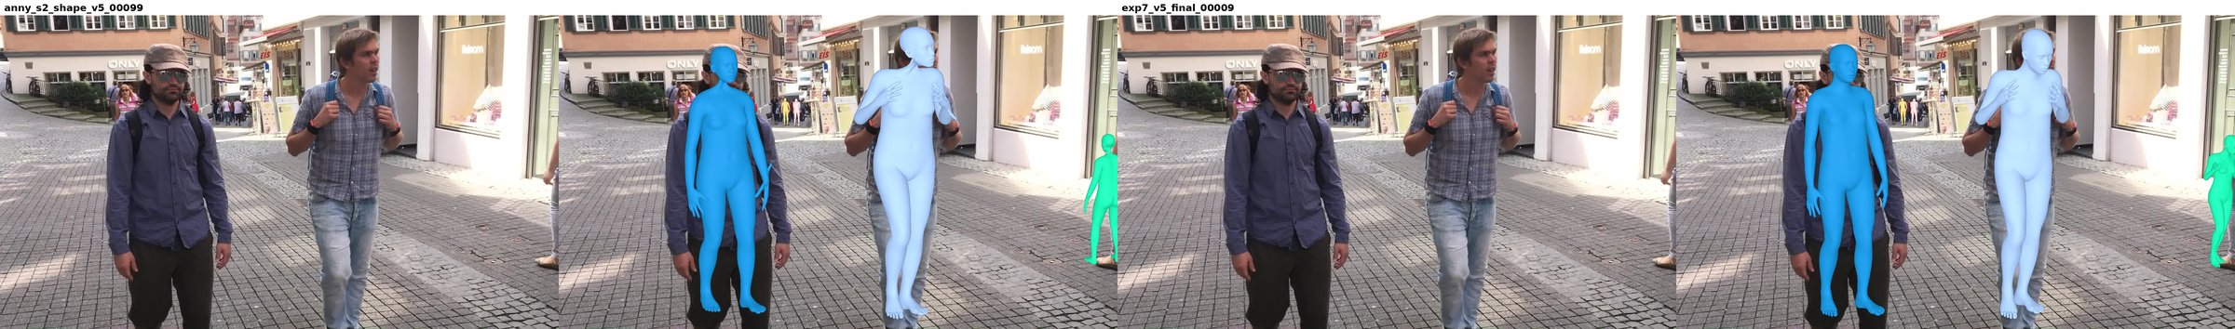
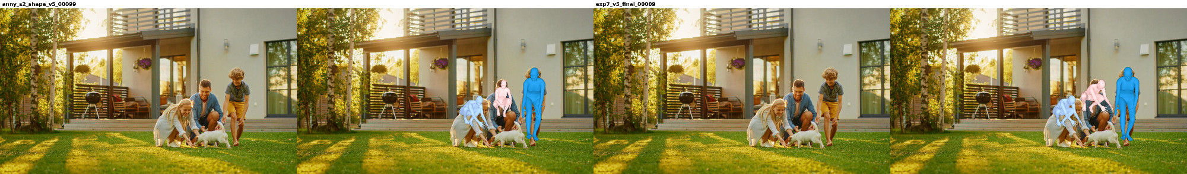
07 / PICTURES
Real-photo examples show strengths and limits
Image | Base/v5 overlay | Image | Teacher/Final overlay
Legacy demos: box-based placement and rest-pose fingers; not raw depth or hand-accuracy evidence.
Sources: thesis Figures F10; walking and garden examples; demo rendering settings
17
Notes:
SLIDE 17: Real-photo examples show strengths and limits
SPEAKING SCRIPT
These are existing real-image demonstrations of Base and the larger teacher. The top row is a 3DPW walking scene, while the lower row is a real-photo garden scene. They show that the system can place plausible whole-body surfaces on multiple people, but individual overlays are not a quantitative evaluation. These legacy demos use bounding-box-based placement and force fingers to a rest pose. Therefore I cannot use them to prove correct raw camera depth or accurate articulated fingers. The garden example also reminds us that people of different sizes and ages remain difficult, especially when partially hidden. The purpose of this slide is to show representative output and its limits. A fair student comparison requires student outputs rendered under the same settings.
POINT / DEMO CUE
Do not describe these as newly run student examples.
TRANSITION
The video pipeline provides the next comparison using the student itself.
SOURCE
Sources: thesis Figures F10; walking and garden examples; demo rendering settings

Slide 18
07 / VIDEO DEMONSTRATION
Video comparison: student and released baseline
Completed run: man_walking.mp4 · 356 frames · NVIDIA L40S
Same 356 frames · Student: 356/356 matched · Baseline: 354/356 matched
INSERT YOUR COMPARISON VIDEO HERE
Input | Student | Released baseline
Inspect jitter, sudden pose changes and changing body shape.
Frame coverage does not prove smoothness. Video FPS has not yet been verified.
Sources: video-compare-3642415.out; thesis video evidence; demo_video.py
18
Notes:
SLIDE 18: Video comparison: student and released baseline
SPEAKING SCRIPT
The completed walking-video run processes the same 356 frames with the student and NAVER’s released baseline. The tracker matched the primary person on all 356 student frames and on 354 baseline frames. These counts show successful execution and coverage, but they do not measure pose accuracy or smoothness. For the live demo, open the comparison video and inspect whether the mesh shakes, whether limbs suddenly change pose, and whether body shape varies between frames. The pipeline operates frame by frame; it does not train or apply a temporal reconstruction model. A dedicated placeholder is left on this slide so I can insert the comparison video before presenting. The newer FPS feature is implemented, but this successful log predates it and supplies no verified video FPS result.
POINT / DEMO CUE
Before presenting: replace the large placeholder with comparison.mp4 using Insert > Video > This Device. Test playback. If the clip is unavailable, report the log counts only.
TRANSITION
The remaining issues define what we can honestly conclude.
SOURCE
Sources: video-compare-3642415.out; thesis video evidence; demo_video.py

Slide 19
07 / LIMITATIONS AND NEXT STEPS
What remains unresolved
Accuracy gap
Real-image body shape
Temporal evidence
Student errors remain higher
than the teacher’s.
The 95% accuracy-retention
target is not met.
Children and body-shape
variation remain difficult.
The adult-only holdout
cannot test child performance.
Review the actual video.
Measure synchronized FPS
and frame-to-frame stability.
Sources: thesis Discussion and Conclusion; video evidence
19
Notes:
SLIDE 19: What remains unresolved
SPEAKING SCRIPT
There are three main limitations. First, the student does not retain the teacher’s reconstruction accuracy within the planned ninety-five-percent criterion. The compression succeeds computationally, but the accuracy target remains unmet. Second, body shape on real images is still difficult, particularly for children. Strong synthetic results cannot establish performance on real children, and our small synthetic holdout contains adults. Third, a successful video run does not establish temporal stability. We need to inspect the clip and report reproducible timing and motion-variation measurements. These are bounded next steps rather than claims that a large new training programme is already complete. The presentation therefore separates what was implemented, what was measured, and what still needs evidence.
POINT / DEMO CUE
Keep these as specific limitations, not a list of speculative fixes.
TRANSITION
The final slide brings the contribution and the trade-off together.
SOURCE
Sources: thesis Discussion and Conclusion; video evidence

Slide 20
07 / CONCLUSION
A smaller student with a measured trade-off
01
Converted real 3DPW annotations into checked Anny labels.
02
Trained a ViT-B student with label and teacher supervision.
03
Measured a 2.10× speedup, with higher reconstruction error.
Main result: a clear speed–accuracy trade-off, plus a working video-comparison pipeline.
Thesis revision, 22 Oct 2026
20
Notes:
SLIDE 20: A smaller student with a measured trade-off
SPEAKING SCRIPT
The contribution is a complete and evaluated pipeline around a smaller student model. The data work makes real 3DPW supervision usable in Anny format, with validation of the converted annotations. The training work combines direct labels, transferred prediction heads and two distillation signals from a larger frozen teacher. The evaluation shows that the student reduces parameters and computation by roughly a factor of three and halves the recorded forward latency, but has higher reconstruction error than the teacher. The video-comparison implementation adds a practical way to examine deployment behaviour on identical frames. My conclusion is therefore a measured speed–accuracy trade-off. The immediate priorities are reviewing the actual walking clip, collecting its timing and stability evidence, and keeping the written conclusions aligned with those observations.
POINT / DEMO CUE
Pause for questions. Use the following slides only for technical details.
TRANSITION
Backup: exact objectives and sources.
SOURCE
Thesis revision, 22 Oct 2026

Slide 21
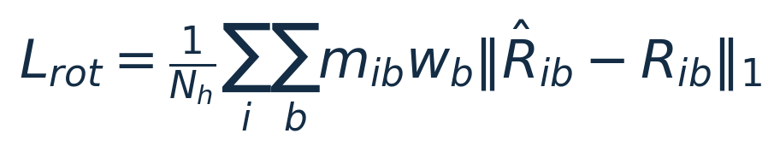
TECHNICAL BACKUP
Backup: supervised objective and exact weights
L1 = sum of absolute differences; rotations use matrix entries.
Nₕ = supervised people; m = availability mask; w = normalized bone weight.
3DPW hand rotations are masked; mesh losses still contain rest-pose hands.
Depth and translation refer to the same head anchor used for placement.
The final recipe supervises all shape entries, including converter constants.
Sources: thesis §4.3; Table T02; loss.py
21
Notes:
SLIDE 21: Backup: supervised objective and exact weights
SPEAKING SCRIPT
This backup gives the supervised weights used by the reported student. Detection has weight ten, offsets one, rotation zero point one, and shape twenty. Depth and translation each have weight five. The centred joint and vertex geometry terms each have weight one hundred, while the two-dimensional terms each have weight zero point one. These weights cannot be interpreted in isolation because the losses use different units and reductions. In the rotation expression, the mask suppresses unavailable 3DPW hand targets, and normalized per-bone weights emphasize selected regions. The mesh terms still include the rest-pose hands from converted labels. Shape supervision in the retained final configuration includes the converter’s fixed phenotype entries. These details matter when interpreting limitations or reproducing training.
POINT / DEMO CUE
Use only if asked about training loss or label masks.
TRANSITION
The next backup gives the two distillation formulas.
SOURCE
Sources: thesis §4.3; Table T02; loss.py

Slide 22
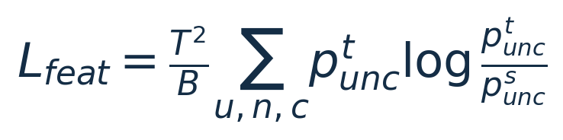
TECHNICAL BACKUP
Backup: distillation equations
B: batch size · n: image token · c: feature channel · i: person · b: bone · k: shape value
Feature KL averages over the batch and sums tokens/channels.
Output KD uses matched labelled-person locations and detached teacher predictions.
Rotation KD does not use the supervised hand mask or per-bone boost.
Sources: thesis §4.8; distill.py; loss.py rotation_distill_term
22
Notes:
SLIDE 22: Backup: distillation equations
SPEAKING SCRIPT
For feature distillation, each token’s feature channels are converted into a probability distribution using temperature four. KL divergence compares the teacher distribution with the student distribution. The implementation multiplies by temperature squared and divides by batch size. It sums over tokens and channels, so describing it as an average over tokens would change the scale. Output distillation compares teacher and student rotations, phenotype values and focal-normalized log-depth for corresponding people. The weights are zero point one, twenty and five respectively. The teacher outputs are detached, so gradients update only the student. Unlike the supervised rotation loss, rotation distillation uses all bone residuals without the missing-label hand mask or the supervised per-bone weighting.
POINT / DEMO CUE
Explain indices only if needed.
TRANSITION
The last slide lists the source papers and project evidence.
SOURCE
Sources: thesis §4.8; distill.py; loss.py rotation_distill_term

Slide 23
TECHNICAL BACKUP
Selected references and evidence
Method background
Baradel et al. (2024). Multi-HMR: Multi-Person Whole-Body Human Mesh Recovery in a Single Shot.
Brégier et al. Human Mesh Modeling for Anny Body. arXiv:2511.03589.
Oquab et al. (2023). DINOv2: Learning Robust Visual Features without Supervision.
von Marcard et al. (2018). Recovering Accurate 3D Human Pose in the Wild Using IMUs and a Moving Camera.
Hinton et al. (2015). Distilling the Knowledge in a Neural Network.
Project evidence
Revised thesis: commit 3e2f21e · Student results: job 3614191
Video execution: job 3642415 · Every pictured model is identified on its slide.
Full bibliography and run provenance: docs/thesis/
23
Notes:
SLIDE 23: Selected references and evidence
SPEAKING SCRIPT
These sources provide the architecture, body model, feature encoder, dataset and distillation background. The numerical results in this presentation come from the revised repository thesis and its traceable experiment records, rather than from the sample presentation or invented estimates. The completed student evaluation is job 3614191, and the walking-video execution is job 3642415. The accompanying source map identifies the thesis sections and image files used on each slide. Existing pictures preserve the model and rendering-setting distinctions described in the thesis. Before a final thesis defence, bibliographic metadata should be checked against the official publications, as the thesis already records that author-review step.
POINT / DEMO CUE
Keep as a reference slide for questions, not a slide to read aloud.
TRANSITION
SOURCE
Full bibliography and run provenance: docs/thesis/

