Slide 1
Multi-HMR with Anny:
what this week found
One hidden depth bug found and partly fixed.
3DPW labels: three defects found and fixed.
Neck: two bones turned half a turn; a pilot fix passes (one run).
Fingers: half the error was two flipped bones. Children: open.
Saad Najib, supervisor update, 16 October 2026
Notes:
Since last Friday I measured each stage of the pipeline separately. I will show what is not the cause, how the 3DPW labels are made, how well they match 3DPW, three defects I found in them and their fix, what I found in the neck and a first fix for it, what I measured about the fingers and the children, one depth bug nobody was looking for and its fix, and what is still open. I will say clearly what is measured and what is only a guess.

Slide 2
Where we started: three visible failures
Neck
Fingers
Children
Necks looked too long or bent wrong in the overlays.
Thesis assumption so far: a rig or body-model problem.
This week: the rig is fine. v5's neck02 and head bone are half a turn off; neck skin half as thick. A pilot fix restores it (one run; on real images by eye only).
Fingers came out claw-like; demos already zero them.
Assumption so far: a hand-resolution or hand-branch problem.
This week: test-time zoom and a loss rebalance did not help; half the error was two flipped bones.
Children reconstructed with adult proportions.
Assumption so far: age is not learned.
This week: child-like on training images, adult on real photos.
Notes:
These are the three failures we discussed last time. Until this week they were explained by guesses: a rig problem, too few pixels on the hands, or a shape head that does not learn age. None of these guesses had been tested on its own. That is what I did first. The last line on each card is what this week showed; the details follow. For the neck, two bones in the v5 models, neck02 and the head bone, are turned half a turn, and the neck skin comes out about half as thick. A first fix, in one run, restores it; holdout renders of the correction alone show normal necks, and on real images the fine-tuned fixed model's necks look normal, judged by eye only; there is no neck metric for real images. For the fingers, about half of the error came from two flipped hand bones.

Slide 3
What I did: test each stage on its own
Ground truth
Body model
1
2
Render the dataset's own parameters, no network. Does the label sit on the person?
Sweep age; move one neck or finger joint at a time. Does the mesh react correctly?
Training signal
Predictions vs truth
3
4
Do all prediction heads receive gradients? Does the mesh respond to them?
Fixed 100-image holdout plus a fixed set of adults, children, hands, hard necks.
Shape swap
Overfit test
5
6
Keep the predicted pose, put in the true shape. How much error is shape?
Can 40 images be memorised? Checks the optimiser only; not a test result.
Notes:
I built six checks, each testing one stage. I use a fixed holdout of 100 images that were never used in training, and a fixed set of test cases: 40 training images with adults, children, visible hands and hard necks, and 15 held-out images with no children. Most numbers in this talk come from these sets with the same settings.

Slide 4
What is not the cause: the structural checks pass
✓
Ground truth decodes correctly
AnnyOne labels render onto the people; camera matches on 100% of images (3DPW labels: slides 5–6).
✓
Body model is fine
All 16 single-joint moves hit the intended part. Age 0 to 1: skeletal height 0.53 m to 1.54 m.
✓
Gradients reach every bone and shape output
All 75 active bones and all 11 shape outputs get gradient; the mesh responds.
!
Optimiser works for shape and 3D joints, with two warnings
40 training images: error falls 36%; holdout error rises, as expected when memorising. But the translation and 2D losses rose while memorising (1.67 → 1.89; 58 → 75), probably the first sign of the depth bug (slide 11). The summed rotation loss over all bones barely moved (44.6 → 40.8).
Notes:
This slide changes the story. The rig, the decoding and the body model are correct, and gradients reach every bone and every shape output. The one exception: two of the three camera outputs are unused and get no gradient. The overfit test shows the optimiser works for shape and 3D joints: on 40 training images the error falls by 36 percent. It has two warnings. First, even while the images were memorised, the translation loss and the 2D losses went up, from 1.67 to 1.89 and from 58 to 75. The network could not satisfy the position targets and the 2D projection at the same time. That was probably the first sign of the depth bug on slide 11; I have not repeated the overfit test with the fix. Second, the rotation loss barely moved, from 44.6 to 40.8. That is a sum over all 75 bones, so it does not isolate the neck; it may be related to the neck flip on slide 7, but that is a guess. So the three failures are not rig or decoding problems, which is how the thesis described them until now, but training can still get stuck. One caveat on the ground-truth check: people who fill the frame lose joints at the image border. That is truncation, not a decoding error. This check covered the AnnyOne labels only; the 3DPW labels come on the next two slides.

Slide 5
3DPW to Anny: how the labels are made
1
2
3
4
5
6
3DPW ground truth
Pick frames
Fit Anny per frame
One body per person
World → camera
Label + loader
24 SMPL joints, camera, gender
valid frames, then every 3rd per person
match the 24 joints in 3D (9 torso joints via fixed offsets)
median shape, then fit the pose again
only the root bone changes
drop fits > 80 mm; one file per image; 30% of each batch
Matched
Free
Fixed
24 joint positions per frame, from 3DPW's own male or female SMPL. SMPL rotations, body-shape values and the mesh surface are not used.
Root position and rotation; 18 of the 23 mapped bones (e.g. SMPL neck → neck01). The 5 end bones get no signal: head, finger2-1, toe1-1 (L/R). Height and proportions, one per person.
Gender from 3DPW (reversed: next slide); age 0.55; the other 7 shape values 0.5. By the code, 144 of 163 bones stay at rest: neck02/03, head, jaw, fingers, twist bones.
Code: scripts/data/smpl_to_anny.py v2.2 (steps 1–4), build_threedpw_anny_labels.py (5–6), datasets/threedpw_anny.py + train.py (6).
Notes:
One more ground-truth check, now for 3DPW. 3DPW gives, per frame, 24 SMPL joint positions, the camera and the gender. I keep the valid frames and take every third one per person. Then Anny is fitted frame by frame with gradient descent, so that its 24 joints land on the SMPL joints. The two skeletons are different, so first each SMPL joint is assigned one Anny bone; the hip and spine choice is checked on the rest pose, and for nine torso joints, where the rigs differ, the fit aims at a fixed offset from the bone, not at the bone itself. Only positions are matched: SMPL rotations, shape values and the surface are not used. Each person then gets one body, the median over the frames, and the pose is fitted again. Moving into the camera changes only the root bone. When the label files are written, fits with more than 80 millimetres joint error, people less than 30 percent visible and boxes under 40 pixels are dropped. Only the root and 18 bones move. The head, finger and toe end bones are mapped, but nothing below them is matched, so they get no signal. Age is fixed at 0.55. By the code, 144 of the 163 bones stay at rest, including neck02, neck03, the head and the fingers. The check on the next slide confirms this for every person it sampled. So in these labels the head turns only through neck01.

Slide 6
3DPW labels: three defects found and fixed
Measured: pass
Defects: fixed
Limits and grades
Body joints: median 14.1 mm (p95 21.1; was 18.7), below the ~26 mm cited for 3DPW's own joints.
Surface vs SMPL: median 18.9 / 16.1 mm (was 18.9 / 18.3), nearest point, so a lower bound.
2D vs OpenPose: 11.5 px median, only +0.4 px over raw 3DPW (11.1 px); was +1.1.
Left/right, mirror: 100% pass. The loader passes labels unchanged.
All 87 fits: 22,912 frames; mean joint error per frame: median 14.0 mm, max 79.8 mm.
Gender: was reversed (men 1, women 0); now men 0, women 1, Anny's convention. Flipping it now makes the fit worse: men 13.9 → 20.0 mm (was better for 72 of 73).
Two-person images: one actor unlabelled in 407 of 960 → 0 of 1,080: both people now share one frame grid.
Labels missing: image files missing; re-extracted 16 Oct. New labels: 16,694 images, 22,749 people (fewer images, same people).
Head at rest: neck02/03, head, jaw at rest in every label; only neck01 turns.
Head turn vs chest: 19.3° in SMPL, 19.6° in the labels (median); was 9.5°.
Overall WARN (was FAIL): limb-length ratios, forearm 0.948, thigh 1.064 Anny/SMPL; FAIL in validation only (forearm 0.877).
WARN: 3.2% of people have a joint > 100 mm (worst: left hip, climbing_02). Train alone: 5.5%, FAIL.
Source: check_3dpw_conversion.sh, job 3611284 on the re-fit labels (old labels: 3575369); 3,314 people, 2,360 images, 59 sequences
Notes:
The finished labels had never been checked end to end against 3DPW. A first cluster check, on 15 October, found that joints, surface and 2D pass, but also three defects: gender was reversed, in 407 of 960 two-person images one person had no label, and eight sequences had no labels or too few. The missing labels came from missing image files; I re-extracted them on 16 October, and a second rebuild brought them back. Gender and the missing person are decided inside the fit, so I re-fitted all 87 people with two fixes: gender by Anny's convention, men 0 and women 1, and one shared frame grid for both people. That finished on 18 October, and the fit's own check passed on all 60 sequences: the men's mean joint error went from 19.0 to 14.7 millimetres, the women stayed at about 15, and the frames where one of two people was missing went from 54 percent to zero. The new labels have 16,694 images with 22,749 people: fewer images than the 18,936 before, with the same people, because both people now share each frame. Then I ran the same conversion check on the new labels, and this slide shows it. Body joints are 14.1 millimetres off at the median, was 18.7, below the about 26 millimetres cited for 3DPW's own joints. The surface is 18.9 and 16.1 millimetres off, was 18.9 and 18.3; that is a nearest-point distance, so a lower bound. In 2D the labels are only 0.4 pixels worse than raw 3DPW, was 1.1. Gender is now right: flipping it makes the fit worse, for the men 13.9 against 20.0 millimetres, where on 15 October the flip was better for 72 of 73. No two-person image misses a person now, 0 of 1,080. The overall grade went from FAIL to WARN. What is left are known differences between the Anny and SMPL bodies, the limb proportions and the hip joint, not label bugs. So the final model can train on these labels.
If asked:
- Right column: by design, the head does not turn on its own: neck02, neck03, head and jaw stay at rest in every label, and only neck01 turns. The head turn against the chest is now 19.6 degrees in the labels against 19.3 in SMPL, at the median. In the old labels it was 9.5 against 20, lost mainly in the test split. I have not checked why it came back; my guess is the gender fix, because every test person is a man and was fitted with the female body before.
- Grades: the WARN comes from two checks. Limb-length ratios: forearm 0.948 and thigh 1.064, Anny over SMPL; in the validation split alone the forearm is 0.877, so FAIL there. And 3.2 percent of people have a joint more than 100 millimetres off, mostly the left hip in outdoors_climbing_02, plus a few capoeira, freestyle and dancing frames; that is 5.5 percent in the train split, so FAIL there. Before the re-fit the limb ratios failed in test only, forearm 0.879 and thigh 1.119; the gender fix most likely removed that, but I have not shown it.
- Gender: Anny's male end is 0: at gender 0 the rest body is 1.753 metres tall, at 1 it is 1.632 metres. In the new check every man is labelled 0.000 and every woman 1.000, 2,386 and 928 people in the checked images; these count people in images, not different persons. The refit test used 118 people, 2 per sequence: men 13.9 millimetres with their label and 20.0 with the gender flipped, the flip better for 1 percent of them; women 14.8 against 15.6, the flip better for 38 percent on the joints but only 9 percent on the surface. On 15 October the flip lowered the men's median joint error from 19.2 to 15.3 millimetres, better for 72 of 73. The surface test alone cannot see a wrong gender; that is why there is a separate refit test.
- Missing labels: train had 4,451 of 6,437 expected label images, validation 2,458 of 2,777. The first rebuild, job 3579266, gave the same counts. The label builder skips every frame whose image file is missing, without a warning, so the likely cause was an incomplete unzip of the 3DPW images on the cluster. On 16 October I re-extracted the image folders of the eight sequences; captureSelfies_00 had 480 of 750 files. The second rebuild, job 3581320, gave 18,936 label images, exactly what the old fits imply. My earlier guess, that the builder ran before the fits finished, was wrong.
- Re-fit: all 87 fits ran on free GPU nodes through a small environment with a newer PyTorch, so they did not wait in the queue; 36 tasks first failed on two V100 nodes and were rerun elsewhere. New label counts: train 5,882 images, validation 2,622, test 8,190.
- outdoors_crosscountry_00 has no labels, now or before: with 3DPW's own camera its people sit behind the camera, so nothing projects into the image. The fit itself is fine, 17.8 millimetres. So 3DPW validation has 11 usable sequences.
- Joints: the 14.1 millimetres are measured at the points the fit aims at. The bare bone heads that train.py uses are 30.0 millimetres off, was 32.5, mostly a fixed torso rig gap, not a fit error. The script marks the 26 millimetres for 3DPW as likely, from von Marcard et al., 2018; I have not checked the paper.
- Still fixed by design: age 0.55 for everyone and seven more shape values at 0.5; only height and proportions are fitted, and gender comes from 3DPW.
- 2D and left/right: left and right were correct in every checked person, and the mirror test passes.

Slide 7
Neck: two half-turned bones, and a pilot fix
holdout, 100 images | v5 before | fix, no training | fix + 2-epoch fine-tune | control (no fix)
neck02 | 175.6° | 4.5° | 4.7° | 175.7°
head | 177.9° | 12.4° | 11.2° | 177.9°
neck thickness | 0.46 | 1.00 | 1.00 | 0.46
neck-skin error | 27.3 mm | 10.8 mm | 10.7 mm | 27.9 mm
body PVE | 70.5 mm | 71.3 mm | 68.8 mm | 76.9 mm
head direction | 12.0° | 19.1° | 14.4° | 13.8°
Cause, measured: in all 8 v5-line checkpoints, neck02 and head sit half a turn off. They cancel, so PVE hid it, but the neck skin is half as thick.
Fix (exp6): one constant turn of about 179° per flipped bone at the network output, estimated on 200 training images. It also turns back two hand bones (slide 9).
Fix, no training: head direction fails its 15° limit; likely a per-person head offset.
Fix + 2-epoch fine-tune: passes the fine-tune checks, each within a tolerance of its control.
Bones: median error vs truth, relative to the parent bone. Thickness: neck-skin radius, predicted / true. Neck-skin error: centred at neck01. Head direction: error of the whole head's direction.
Caveat: one run, no fixed seed (identical runs differ by up to 7.6 mm PVE), so no PVE gain is claimed.
Open: why the bones flipped. Next slide: the fix alone on a holdout image; fix + fine-tune on a real 3DPW frame.
Next: a longer fine-tune with the fix (slide 16).
Notes:
In all eight v5-line checkpoints, neck02 and the head bone are about half a turn off. The two half-turns cancel, so the head still points the right way and PVE never showed it, but the neck skin comes out half as thick. I tested a fix: one constant turn per flipped bone at the network output, estimated on 200 training images. On the holdout, the fix alone turns both bones back; neck thickness goes from 0.46 to 1.00. But head direction gets worse, 19.1 degrees, likely because the head's offset differs per person. After a two-epoch fine-tune, it passes the fine-tune checks, each within a tolerance of its control; head direction is 14.4, still worse than 12.0 before. One run, no fixed seed: I claim no PVE gain, only no sign of a PVE cost, 68.8 against 76.9 for the control. The next slide shows the correction alone on a holdout image, and the fine-tuned model on a real 3DPW test frame.
If asked: After the fine-tune, neck02 is 4.7 degrees and the thickness 1.00. The flip is there from the first training stage, frozen_bb_v2, and in v3, v4, v5, v9 and every pilot checked. A two-epoch geodesic loss barely moved it, 175.6 to 175.0 degrees. Its origin is not known: the singular start value of the rotation output would start a bone with a tilt, like v5's left index base, not this twist. v10 has no neck flip. The constants are 178.8 degrees for neck02 and 179.2 for the head. Before the test, the script's guard predicted the head-direction rise, 8.4 to 17.9 degrees on the training sample: a compensated chain, since the head's offset differs per person and one constant cannot undo it. Without training, the head-and-neck surface error also rose, 52.3 to 63.1 millimetres; after the fine-tune it is 51.8. The fine-tune checks, against the control: corrected bones under 15 degrees, thickness at least 0.9, PVE at most 8 millimetres higher, recall at most 2 points lower, head direction at most 3 degrees worse. Recall passed by only 0.3 points, 89.4 against a limit of 89.1. Against the control: PVE 68.8 against 76.9, PA-PVE 50.9 against 55.2, recall 89.4 against 91.1, head direction 14.4 against 13.8. Against v5 before: PVE 68.8 against 70.5, PA-PVE 50.9 against 53.3, recall 89.4 against 90.2. Identical configs differ by up to 7.6 millimetres PVE, so none of these PVE differences is certain. Last week's group errors, 63 degrees for the neck and 90 for the head, are now 5.9 and 6.7. The script wrote 12 side-by-side panels, without and with the correction alone; the next slide shows one of them, next to a real-image demo of the fine-tuned checkpoint, which carries the fix. Next: a longer fine-tune with the fix.

Slide 8
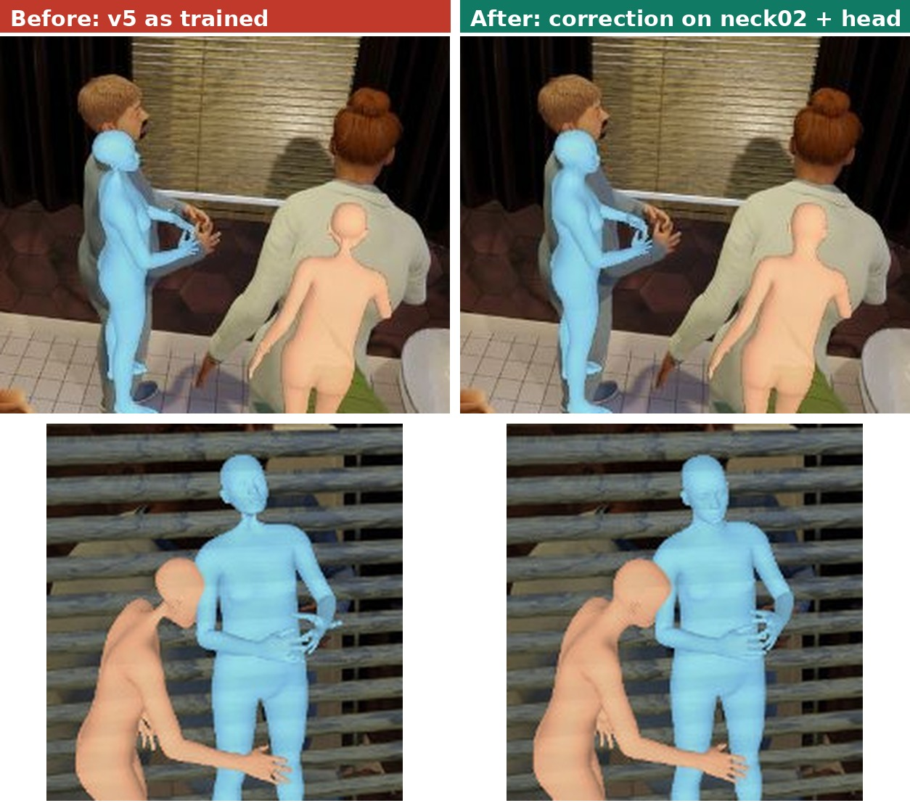
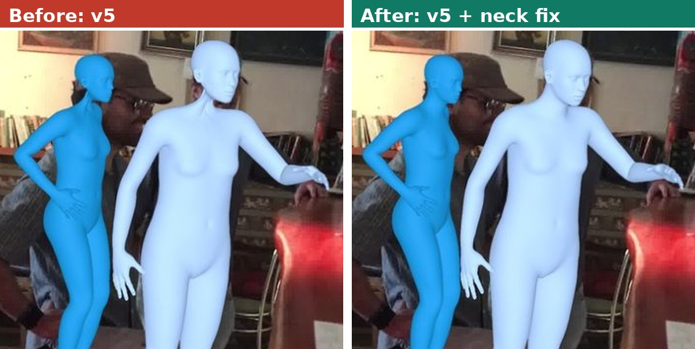
Neck: before and after the fix
Before (v5)
as trained
After (correction)
no training
Before (v5)
real image
After (fixed model)
fix + 2-epoch fine-tune
Synthetic holdout 579862 (correction only, no training)
3DPW test frame (real, never trained on), downtown_bar_00
Left: same model, no training; on the neck, only neck02 and the head are corrected. Right: fixed model, fine-tuned 2 epochs.
Neck skin thickness on the 100-image holdout: 0.46 → 1.00 of the true value (job 3579014). Real-image demo: job 3581312.
Limits: without fine-tuning the head points 19° off (12° before); the 2-epoch fine-tune brings it to 14°.
Holdout bodies are still too small (separate depth bug). Real images judged by eye only: no neck ground truth, no metric.
Notes:
Two pairs. On the left, a synthetic holdout image: v5 as trained, then the same model with the correction alone, no training. On the right, a real 3DPW test frame, never trained on: v5, then the fine-tuned fixed model. Look at the necks, ringed in yellow. With v5 they are thin stalks, pinched under the head; with the fix they have normal width. On the holdout this is measured: thickness 0.46 to 1.00 over 100 images. On real images I can only judge by eye. The change is clearest here and on an office frame, and also visible on two more 3DPW sequences and three photos. Head direction stays a limit: 14 degrees after the fine-tune, against 12.
If asked:
- The right column is the fine-tuned checkpoint, so it differs from v5 by the correction and by two epochs of training; this pair cannot separate the two. On the holdout, the same 2-epoch fine-tune without the fix keeps thickness 0.46, so the correction is the likely cause; not tested on real images. The demo log shows the fix on for four bones. Demo: job 3581312, person detector, each body placed from its detection box, 4 example photos and 8 3DPW test frames. I have looked at 8 of these 12 images so far; the other four, the runForBus, sitOnStairs and fencing frames and one photo, not yet.
- Men: in both models, adult men on real photos get female-looking bodies, with breasts and narrow shoulders, for example the male tennis players. v5 never saw 3DPW, so this is not the gender defect in our 3DPW labels. The demo log shows predicted gender near the training median, about 0.6, while Anny's male end is 0: the same pull to the median as for age (slide 10). On Relative Human, measured on 932 real people, men get 0.535 on average and women 0.551: no gender signal. Whether the gap between synthetic and real images or the loss causes it is not settled.
- Also in both models: some bodies are still small or misplaced in depth, although the demo places them from the detection box, and a figure in a painting is detected as a person.
- The correction also turns back two hand bones, so the hands differ too; I have not judged them (slide 9).
- All twelve holdout panels show the thin neck and its fix wherever a neck is visible.

Slide 9
Fingers: about half the error was two flipped bones
17.3°
8.3°
15.1°
finger error, v5 with predicted fingers
with the bone fix, fine-tuned 2 epochs (8.2° with no training)
fingers set to rest pose, before the fix (the index-base flip stays)
hand size at the network input | median | under 2 tokens
full image, 672 px | 2.3 tokens | 41%
person crop (box ×1.3), test time | 4.2 tokens | 0%
children's hands, full image | 0.7 tokens | 80%
Two flipped bones: left index base and finger4-1.R, each about half a turn off. Turning them back halves the error; not yet checked by eye.
Test-time zoom: 17.2° vs 17.3°; body error nearly doubles.
Loss rebalance (hands 33% of the rotation loss): 17.5° vs 17.4°.
Table: median hand size (2.3 → 4.2 tokens). Per person the median gain is 1.6×; 26% of people get no magnification, a quarter 2.5× or more.
Notes:
With predicted fingers the finger error is 17.3 degrees; with the fingers left at rest it is 15.1. The new result: about half of the 17.3 came from two hand bones turned half a turn, the left index base and one right finger bone. The same correction as for the neck turns them back: the error falls to 8.2 degrees with no training and 8.3 after the fine-tune. I have not yet looked at the hands in the renders. The rest-pose number still contains the index-base flip, because rest pose does not reset that bone, and I have not measured it with the fix. What I tested before did not help: magnifying the person at test time gave 17.2 against 17.3, and a rebalanced loss gave 17.5 against 17.4 for its control.
If asked: The finger error is a mean over the hand bones of each person, so two bones at half a turn raise it a lot. The left index base is 180 degrees off on the holdout. The other bone, finger4-1.R, at 178.8 degrees, was seen only on the 200 training images, because the earlier holdout dump did not cover finger bones; with the fix it is 10.2 degrees on the holdout. Hands are small: about two tokens at 672 pixels. Cropping around the person at test time, without retraining, magnifies the hands by 1.6 times on median per person, and by 2.5 times or more for a quarter; 26 percent are not magnified. The table compares median hand sizes, so it shows a slightly larger factor. For the most magnified quarter the finger error went from 17.7 to 17.5. The body error nearly doubles on these crops, because the model never saw such a camera in training. The rebalanced loss cut the hands' share of the rotation loss from about 70 percent, which includes the four-times hand boost, to 33 percent; without the boost it would be 40. So it does not test giving the fingers more weight; more weight and training on larger hand crops are untested. v10 has at least five flipped hand bones. Correcting three of them, with no training, took its finger error from 32.0 to 17.8 degrees and PVE from 74.1 to 69.9 millimetres; PA-PVE went from 55.6 to 51.1, while head direction and recall did not change. Two more, finger2-1.L and finger5-2.L, seen on training images, are not corrected yet; they may be part of why v10's fingers are still at 17.8, but that is a guess. The demos zero the fingers, but rest pose does not reset the hand bases, so the bent index base is likely visible there.

Slide 10
Children: child-like in training, adult on real photos
2% → 10%
0.10
0.61 vs 0.63
children in supervised training with the balanced sampler: unproven after 2 epochs
predicted age of training babies; true 0.015 (child-like, but too old)
predicted age of 127 real children vs 821 adults (Relative Human val); separation AUC 0.61
The model can make a child: no shape output is clamped; training babies come out child-like, but too old. True shape: 10 training children 47.8 → 41.6 mm.
Children are read as short adults: height 0.45 kid / 0.39 baby vs 0.51 adult; age unchanged (Relative Human val).
Gender: men 0.535, women 0.551: no gender signal on real photos.
Diagnosis: the shape head falls back to the training median, in both synthetic tails and on real photos. 2-epoch sampler pilot: inconclusive. Domain gap or loss: not yet separable.
Caveat: synthetic child numbers are in-sample (no children in the holdout); real-photo numbers cover detected people only (47%). Ages are Anny's 0–1 value, not years.
Notes:
On training images the model can make child-like bodies, but on real photos it does not. I measured this on Relative Human, a public set of real photos with age-group labels: 635 validation images with 2,130 labelled people. The detected kids get a predicted age of 0.61 and the babies 0.62, against 0.63 for adults, so age barely separates them: the AUC is 0.61, where 0.5 is chance, and none of the 89 detected kids and only one of the 38 babies falls below our child threshold of 0.45. The model does see that they are small, but it puts that into height, not age: height goes from 0.51 for adults to 0.45 for kids and 0.39 for babies. So it reads children as short adults; in Anny, a low height at an adult age is a short, broad-shouldered adult. Gender carries no signal either: men get 0.535 on average and women 0.551, while Anny's male end is 0. This is the same pull to the training median we see on synthetic data, and it replaces my earlier by-eye reading of a few people in our own photos. The decision for today: write it up as a limitation, or add weak age labels from the Relative Human training set, as the BEV paper did, which is one to two weeks of code after the final model. Separately, a flag can stop the 3DPW labels from training every real person toward one fixed average body; it is off by default, and whether the final model uses it is also a decision for today.
If asked: Recall: the model detects only 47 percent of the labelled people, 33 percent of the babies and 43 percent of the kids; the photos are crowded and the model runs at 672 pixels. So every number covers detected people only. Matching: each detection is paired with a labelled box by overlap, IoU at least 0.3. In crowded scenes a few child labels may get an adult detection; that would blur the height drop and any age gap, but it cannot create the height drop, and the clear height drop says most matches are real children. The fine-tuned model with the neck and finger fix gives the same numbers within noise: AUC 0.613, kids 0.62, adults 0.64, gender 0.533 for men and 0.562 for women. That is expected: the fix turns bones, not the shape output. Teens sit in between, age 0.60 and height 0.49. Our own photos agree: the one real child, a standing boy, gets age 0.60 and height 0.48; the five small people I quoted before were mostly crouching or seated adults, because the skeletal height I used is measured on the posed body. On synthetic data the same pull shows at both ends: holdout people with a true age of 0.6 to 0.8 come out at 0.57, and the youngest training people at 0.10 instead of 0.015. Showing about five times more synthetic children for two epochs was inconclusive, 48.5 against 53.1 millimetres on ten training children, and it has no mechanism for real photos. So I cannot yet say whether the cause is the gap between synthetic and real images, or the loss, an L1 through a sigmoid on rare values. In Anny a child is mainly narrow shoulders relative to the head, and only a low age gives that; a low height at age 0.6 gives a short, broad-shouldered adult, at least 1.22 metres tall. I do not convert ages to years: our code uses three different scales, and the dataset most likely does not follow Anny's own calibration. Relative Human has about 24,800 people with age-group labels, among them 2,720 children and 1,534 babies, plus gender; its training split is where weak labels would come from. The 3DPW labels fix age at 0.55 and seven more shape values at 0.5 for everyone; only height and proportions are fitted, and gender comes from 3DPW. With the flag on, the final model's 3DPW error can change for a reason unrelated to the depth and bone fixes, because the 3DPW ground-truth meshes keep that average body. Anny-Fit, from the group that made Anny, refits bodies at test time from a vision-language model's age and gender; it could give better figures, but it is not our model.

Slide 11
The hidden bug: head anchored, pelvis targeted
predicted depth =
0.33 × true + 2.36 m
v5: predicted vs true depth; all 222 holdout people too far
Confirmed: with targets at the head, bodies are drawn much closer to the right size; a same-schedule control does not improve (10 epochs: size 0.59, root error 1.44 m).
Size: 3D height right, but drawn at 0.63 of true size; head 64 px off.
Hidden from pelvis-centred PVE and from the box-placed demos. v9 and v10 have it too.
Model: anchor = head
Training target = pelvis
model.py places the mesh by its head joint
train.py built transl / dist / heatmap / offset at joint 0
Notes:
This is the main result of the week. The model attaches the mesh to the detected pixel by its head joint and reports the head as its position. The training code built the position, distance, heat-map and offset targets at joint 0, the root joint at the pelvis. Those two can never agree. The cause is confirmed: with targets at the head the bodies are drawn much closer to the right size, and a control run with the same schedule does not improve; after 10 epochs its drawn size is 0.59 and its root error 1.44 metres. The likely mechanism is that the 2D losses solve the conflict by pushing the body farther away, so it is drawn smaller. Measured on the holdout for v5: predicted depth is 0.33 times the true depth plus 2.36 metres, all 222 people too far, and the bodies are drawn at about two thirds of their true size in the image, a size ratio of 0.63. Their 3D height is right, 1.405 against 1.409 metres; they are only placed too far away. Our standard error is pelvis-centred, so it never saw this. That is why the thesis numbers looked normal. The real-photo demos did not show it either, because they place each body from its detection box. The synthetic demo and the trace panels use the model's own depth, and there you can see it, as on the next slide. The bug is in the training code, so v9 and v10 have it too: the same kind of depth fit and size ratio, and v10 is slightly worse.

Slide 12
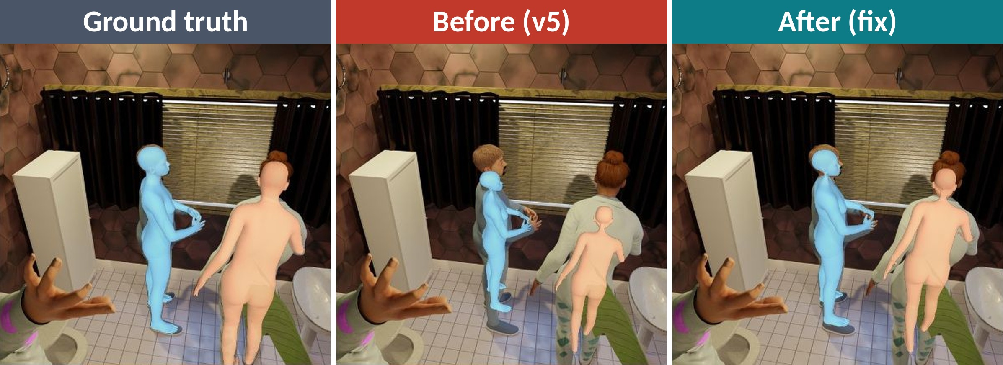
Depth fix: bodies drawn much closer to true size
Synthetic holdout image 579862, model's own depth (no box placement).
v5, whole holdout: root error 1.21 m, median drawn size 0.63
Fix + depth ×5, 10 epochs, whole holdout: root error 0.54 m, median drawn size 0.84
Not fully fixed: near and far people still get similar depths (depth slope 0.38; 1 = perfect, 0 = same depth for everyone), and bodies are still drawn about 16% too small (median). All 12 rendered images show the same change; I picked this one because no ground-truth person is missed. After the fix the blue mesh is 0.95 of its true height (before: 0.76).
Notes:
This is the bug on a synthetic holdout image, using the model's own depth, not the box placement of the real-photo demos. Left is the truth. In the middle, the old model: the bodies are drawn too small, the real man's head sticks out above the mesh, and the mesh floats. On the right, the fix with the depth loss five times stronger, trained for 10 epochs. The blue mesh is now 95 percent of the true height; the woman's mesh is closer to her size but still narrower. I chose this image because no person with a ground-truth mesh is missed, so it is a good case, not a typical one; the arm at the bottom left has no ground-truth mesh, so it is not counted as a miss. On the whole holdout the median drawn size is 84 percent of the truth, so bodies are still about 16 percent too small, and near and far people still get similar depths: in the slope, 1 means perfect and 0 means the same depth for everyone. All 12 holdout images we rendered, in all three prediction settings, show the same change. In 4 of them both models miss people very close to the camera; since both miss them, the fix did not cause it. It is likely a detection problem, but not yet counted. Mesh colours follow detection order.

Slide 13
Depth fix: much better size, near vs far still weak
 |  | 10-epoch fine-tunes |  |  | 2-epoch fine-tunes
holdout, 100 images | v5 | control | fix | fix + ×5 | control | fix | fix + ×5 | fix + ×20
root error, 3D (pelvis) | 1.21 m | 1.44 m | 0.73 m | 0.54 m | 1.11 m | 0.69 m | 0.66 m | 0.53 m
depth slope (1 = perfect) | 0.33 | 0.34 | 0.30 | 0.38 | 0.33 | 0.30 | 0.44 | 0.43
drawn size (1 = right) | 0.63 | 0.59 | 0.78 | 0.84 | 0.66 | 0.78 | 0.80 | 0.87
head pixel error | 64.5 px | 64.0 px | 7.6 px | 7.2 px | 58.1 px | 9.6 px | 8.5 px | 8.8 px
pelvis pixel error | 23.4 px | 24.3 px | 38.5 px | 33.1 px | 23.3 px | 37.3 px | 38.1 px | 31.4 px
PVE (pelvis-centred) | 70.5 mm | 72.2 mm | 75.5 mm | 74.8 mm | 72.3 mm | 77.3 mm | 76.8 mm | 75.7 mm
recall | 90.2% | 89.4% | 87.0% | 87.8% | 89.8% | 87.8% | 87.8% | 87.4%
Fix: targets at the head; ×5 / ×20 = depth loss weight. Controls: root targets, depth ×1, same schedule. No control was run at ×5 or ×20.
Not fixed: depth slope 0.30 with the switch alone, 0.38–0.44 with a stronger depth loss; predictions are pulled toward 2.5–2.9 m, cause unknown. With ×5, 10 epochs gave a lower root error than 2 epochs (0.66 → 0.54 m) but no better slope (0.44 → 0.38); with the switch alone neither improved (0.69 → 0.73 m, slope 0.30 → 0.30).
Likely cost: every fix run is worse than its control: PVE +2.6 to +4.9 mm (inside noise, ~10 mm), recall −1.6 to −2.4 points (about the 2-point noise limit). The five runs share two controls.
Notes:
The fix is one switch: build the training targets at the head, the joint the model anchors. Each fix run has a control with the same schedule and the switch off. The root error is the 3D distance between the predicted and the true root joint, at the pelvis. Drawn size is the predicted head-to-pelvis distance in pixels over the true one; 1 is right. With the depth loss five times stronger for 10 epochs, the root error falls from 1.21 to 0.54 metres, and bodies are drawn at 84 percent of their true size. The controls stay at 1.11 to 1.44 metres. But near and far are still not separated: the slope is 0.30 with the switch alone and 0.38 to 0.44 with the stronger depth loss. Predictions are pulled toward about 2.5 to 2.9 metres, and I do not know why. The fix likely has a cost: every fix run is worse than its control, by 2.6 to 4.9 millimetres PVE and 1.6 to 2.4 recall points. That is inside or at the edge of pilot noise, so I call it a likely cost, not a proven one. The twenty-times 10-epoch run has no result yet.
If asked: The switch is gt_center_joint person_center. The stronger-loss runs have no control at the same weight. The mean signed depth offset fell from 1.08 to 0.39 metres, but after the fix near people are too far and far people too near, and these cancel in that mean, so it flatters the fix. The head now lands within about 7 to 10 pixels, as expected, because the target moved to the head. Twenty times for 2 epochs ties with five times for 10 epochs. The pull toward 2.5 to 2.9 metres is close to the estimated training average; holdout people are nearer, 1.9 metres on average, so this pull becomes a large error here. Longer training is not clearly better: with five times, going from 2 to 10 epochs lowered the root error from 0.66 to 0.54 metres but did not improve the slope; with the switch alone neither improved, the root error went from 0.69 to 0.73 metres, and the control also got worse, from 1.11 to 1.44 metres. Root error has no measured noise floor, so I do not read a trend into this. The PVE gaps, 2.6 to 4.9 millimetres, are inside pilot noise; the recall drops, 1.6 to 2.4 points, are at the edge of what one pilot can detect; and the five fix runs share only two controls, so they are not five independent tests. The pelvis 2D error clearly got worse, from about 23 pixels to between 31 and 39 pixels; probably because the body is still drawn too small while the head is now pinned, but I have not checked that.

Slide 14
Four experiments: results
experiment | what it changes | success rule | result
1 depth anchor | targets at the head joint (+ depth loss ×5 or ×20) | depth slope toward 1; PVE ≤ 71.5 mm, recall ≥ 89.2% | Rule not met: PVE and recall miss in every run, controls too (×5, 10 epochs: 74.8 mm, 87.8%); slope 0.30–0.44, far from 1. Outside the rule, clearly better: root error 1.21 → 0.54 m, size 0.63 → 0.84
2 children | age-balanced sampler | child error on the manifest, adults unchanged | Inconclusive after 2 epochs: 10 training children 48.5 vs 53.1 mm (both arms: age loss ×3, height ×2). v5 on 127 real children (Relative Human): adult age, AUC 0.61 (slide 10)
3 neck | loss on the global head orientation | global head error below 12° | 11.3° passes, but the controls give 11.7–13.6° (inside the ~3° noise). Safety limit (PVE ≤ 71.5 mm, recall ≥ 89.2%) just missed: 71.8 mm, 89.0%. All five control runs miss it too.
4 fingers | region-normalised rotation loss | finger error vs rest pose (about 15°) | No effect: 17.5° vs 17.4° for the control
Pilot noise. No fixed random seed: two identical runs differed by 7.6 mm PVE and 1.9° head error, so one pilot only detects about 10 mm PVE, 3° head error or 2 recall points. Restarting the fine-tune alone costs about 2.4 mm (controls average 72.9 vs 70.5 mm). Root error has no measured noise floor, but every fix run (0.53–0.73 m) is below every control (1.11–1.44 m). All runs: same holdout and manifest, helper bones masked.
Notes:
All four experiments are done, each next to a control with the main switch off. Depth: by its own success rule the experiment failed, because every run, the controls too, misses the limit of 71.5 millimetres PVE and 89.2 percent recall. The 10-epoch run with the stronger loss has 74.8 millimetres and 87.8 percent. The slope is 0.30 with the switch alone and 0.38 to 0.44 with the stronger depth loss, against 0.33 for v5: far from 1. What clearly improved is outside the rule: the root error went from 1.21 to 0.54 metres and the drawn size from 0.63 to 0.84. I say that openly instead of changing the rule afterwards. Neck and fingers: no measurable effect. Children: inconclusive after two epochs, 48.5 against 53.1 millimetres on ten training children; on real photos, v5 still gives children an adult age (slide 10). The neck loss gave 11.3 degrees of head error, which passes the rule of below 12, but the two controls gave 11.7 and 13.6, so that is inside the noise. With no fixed seed, one pilot only detects about 10 millimetres PVE, 3 degrees or 2 recall points. No new architecture, because the diagnostics do not justify one.
If asked: The stronger age loss and the stronger depth loss were not separately controlled: both children arms used the same age and height weights, and the depth runs at five and twenty times have no control at the same weight. Depth PVE: 74.8 for the 10-epoch run with the stronger loss, 72.2 for the 10-epoch control, 70.5 for v5. Two identical runs differed by 7.6 millimetres PVE and 1.9 degrees of head error. The slope part of the depth rule only asks for any move toward 1 with a smaller intercept: it passed for the three stronger-loss runs and even for the 2-epoch control, and failed with the switch alone. All runs used the same 100-image holdout and manifest, with helper bones masked. The neck experiment has the same safety limit, PVE at most 71.5 millimetres and recall at least 89.2 percent. The neck run just missed it, with 71.8 millimetres and 89.0 percent, but all five control runs miss it too, mostly because of the restart cost; its PVE is even 4.5 millimetres better than its own control, which is also inside the noise. Its neck bones stayed at 62.5 degrees. For the fingers, the rest-pose floor is 15.2 degrees in this evaluation and 15.1 on slide 9; the difference is only which people are matched. Restarting the fine-tune alone costs about 2.4 millimetres. A 2-epoch pilot trains in about 12 minutes, a 10-epoch run in about one hour.

Slide 15
Corrections made, and still to make
Headline number
Demos
Done: the README gives AnnyOne holdout PVE 70.5 mm, helper bones masked, as in the demos.
To do: replace the thesis draft's 74 mm, the unmasked evaluation (+3.8 mm on the same people).
Done: all demo scripts zero the fingers and the README says so: finger renders are the rest pose, not predictions.
Wording
Repository
Done: neck, fingers, children no longer called rig or decoding problems; the README's Known-defects section documents the depth bug.
To do: README and findings still carry last week's neck story; I will fix them next week.
Done: reorganised, one shared cluster setup, diagnostics and experiments documented so the work can be rerun.
Notes:
Some corrections are already in. The headline AnnyOne number is 70.5 millimetres, measured with the helper bones masked, as in the demos. That is the evaluation setting V1, not the demo's own number: the demo setting gives 68.5 at a lower recall. The 74 millimetres in the thesis draft came from the unmasked evaluation; on the same people that adds 3.8 millimetres. The README already uses 70.5; the thesis draft I still have to change. The demos now say that the fingers are the rest pose. The text no longer blames the rig. The Known-defects section in the README documents the depth bug. But the README and the findings document still carry last week's neck story, that the long neck comes from weak supervision and from the depth bug, and some old depth wording, for example that the overlays look wrong and that no improvement is claimed yet. I will correct them next week. The repository is reorganised with everything scripted, so any of these numbers can be produced again.

Slide 16
Still open, and what I test next
1
Bone flips: confirm the pilot fix
2
Depth slope stuck at 0.3–0.4
Neck: a longer run; real images by eye only (slide 8). v10's left arm: two-sided fix, not built yet.
Cause unknown. Next: measure training depths properly, and the fix run's slope on training images.
3
Depth fix: cost and the ×20 run
4
Pilot noise
Paired PVE on the same people; recall for visible heads. No result yet for the ×20 run at 10 epochs.
No fixed seed. Fix it, or repeat the key run, before trusting differences under about 10 mm.
5
People very close to the camera
6
Children and fingers
Both v5 and the depth fix miss them (4 of 12 holdout renders): not the fix. Likely detection; not counted.
Children: measured on Relative Human (AUC 0.61, read as short adults); decision: limitation or weak labels. Fingers: bone-fix hands, then larger crops.
7
3DPW labels: three defects fixed (slide 6)
Missing labels fixed 16 Oct (images re-extracted). Re-fit of all 87 tasks (gender m → 0, f → 1; one shared frame grid) and re-check done 18 Oct: WARN (was FAIL), no actor missing. Proposed: use these labels in the final model.
Notes:
Seven things are still open. First, the bone flips. The neck fix passes in one run; the holdout renders of the correction alone show normal necks, and so, by eye, do the 8 real images I have seen so far from a first demo of the fine-tuned model. I still need a longer run, and real images have no neck metric. v10's left arm has the same kind of flip, but a bone further down the arm undoes it, so it needs a two-sided correction, not built yet. Second, the depth slope is stuck at 0.3 to 0.4, cause unknown. Third, the cost of the depth fix, paired on the same people. Fourth, pilot noise: fix the seed or repeat key runs. Fifth, people very close to the camera. Sixth, children and fingers: children are now measured on real photos with age labels, the Relative Human dataset: the model reads them as short adults, and age separates them from adults with an AUC of only 0.61 (slide 10); the decision is a limitation or weak age labels. For fingers, a look at the hands with the bone fix. Seventh, 3DPW: the labels had three defects. The missing labels came back on 16 October, when I re-extracted the images of eight sequences; train went from 4,451 to 6,437 label images. The re-fit with the gender and frame-grid fixes finished on 18 October, and the check on the new labels passes with a warning, with no defect left (slide 6). What stays open is to use them: the final model would be the first run on these labels.
If asked: Neck: the fine-tuned checkpoint carries the fix in its saved settings, so the demo applies it on load; the demo comparison, job 3581312, ran it next to v5 on 4 example photos and 8 3DPW test frames (slide 8); I have looked at 8 of these 12 images so far. In the 12 side-by-side holdout panels, with the correction alone and no training, the necks have normal width wherever a neck is visible (slide 8). v10: correcting three of its flipped hand bones passed without training; two more finger bones, seen on training images, are not corrected yet; shoulder01.L at 166 degrees and upperarm02.L at 180 stay flipped, because one constant per bone would break the chain that compensates them. Depth: the training depths so far come from small samples, batch means of about 2.5 to 3.2 metres. I will also measure the fix run's slope on training images; for v5 it was just as low there. Cost: I will report the root error next to PVE in the thesis. Testing the depth fix on 3DPW comes with the final model, on the new labels. The twenty-times 10-epoch run has no result yet. Close people: v5 and the depth-fix model both miss them in 4 of the 12 rendered holdout images (slide 12). Children and fingers: one 2-epoch test is not enough to close them; for children it is inconclusive, not a proof that more synthetic children cannot help, and a 10-epoch sampler run stays a low-priority option. 3DPW labels: the rebuild, into a new folder, gave the same counts, so my old guess that the builder ran before the fits finished is wrong. The builder skips every frame without an image file. So I re-extracted the image folders of the eight affected sequences on 16 October: captureSelfies_00 had 480 of 750 files; for the other seven the counts before were not recorded. The second rebuild, job 3581320, confirmed it: train rose from 4,451 to 6,437 label images and validation from 2,458 to 2,777, exactly what the fits imply; test stayed at 9,722. Those labels still had the reversed gender and the missing second person. Gender and the frame grid are different: men to 0 and, by Anny's convention, women to 1, and both people's frames on one shared grid. Both happen inside the fit, so all 87 conversion tasks were fitted again, into a new folder, because the task script skips every person that already has a file; the task script now refuses to mix old and new fits. That was an 87-task array job: about 28 GPU hours at the measured 4.4 seconds per frame (the 17 October test, on an H100), done on 18 October. The rebuilt labels have 16,694 images with 22,749 people, and the check on them confirms both fixes: flipping the gender now makes the fit worse, and no two-person image misses a person.

Slide 17
What I claim today, and what I do not
Claimed, measured: the failures are not rig or decoding problems. A training-target bug puts people too far away in v5, v9 and v10; the fix draws bodies closer to their true size. In all 8 v5-line checkpoints, neck02 and the head bone sit half a turn off; in one pilot run, a fixed correction plus a 2-epoch fine-tune restores the neck and passes the fine-tune checks. Two flipped hand bones were half the finger error. 3DPW labels: three defects found and fixed by a re-fit (slide 6).
Not claimed: a proven neck fix (one run, no seed; head direction 14.4° vs 12.0°) or why the bones flipped; better children; correct depths for near and far people; a depth fix without cost (likely 2.6 to 4.9 mm PVE, 1.6 to 2.4 recall points); head turn, age or limb lengths in the 3DPW labels.
Question for you
Fine-tune v9 (best on our old 3DPW-Anny labels, which had the gender defect: slide 6) with the fixed targets and depth ×5? Or first fix gender and frame grid, re-fit all 3DPW tasks (done 18 Oct), then fine-tune?
v9 also has the neck flip (measured at epoch 149) and needs its own bone fix; v10 has a similar left-arm flip.
Notes:
What I claim, measured. The failures are not rig or decoding problems. A training-target bug puts people too far away in v5, v9 and v10; the fix draws bodies much closer to their true size. In the v5 line, neck02 and the head bone sit half a turn off. One pilot run with a fixed correction and a short fine-tune restores the neck thickness and passes the fine-tune checks. Two flipped hand bones were about half the finger error. The 3DPW labels had three defects; a re-fit fixed them, and the new labels pass the check with a warning (slide 6). What I do not claim: that the neck fix is proven, since it is one run without a fixed seed; better children; correct depth for near and far people; a depth fix without cost. My question: fine-tune v9 now, or first fix the 3DPW labels and re-fit? The re-fit is now done, so the second waits only for the training queue. I propose the second, as on slide 16, but want your view.
If asked:
- Depth fix: it does not separate near and far people well, and it likely has a cost: every fix run is worse than its control, by 2.6 to 4.9 millimetres PVE and 1.6 to 2.4 recall points. The PVE gaps are inside pilot noise, the recall drops are at the edge of what one pilot can detect, and the five runs share two controls, but all point the same way. In v5 the depth bug affects all 222 holdout people. The ViT-S students use the same training code and are probably affected too; not measured.
- Neck: the two half-turned bones cancel, so the head points the right way. A 2-epoch geodesic loss did not undo it. The fixed correction with a 2-epoch fine-tune did, in one run: neck02 4.7 degrees, thickness 1.00, head direction 14.4 against 13.8 for its control and 12.0 before. One run without a seed is not proof; the holdout renders of the correction without training show normal neck width, and in a first real-image demo the fine-tuned model's necks look normal in the 8 of its 12 images I have seen, judged by eye only; there is no neck metric on real images. The origin of the flip is not known; the singular start value of the rotation output would start a bone turned about its sideways axis, a tilt like the one in v5's left index base, not the twist in neck02 and the head.
- Fingers: two flipped hand bones were about half the finger number, 17.3 to 8.3 degrees; I have not looked at the hands, so I do not claim better-looking fingers.
- 3DPW labels: 6 train sequences, part of a seventh, and one validation sequence had no labels, because their image files were missing on the cluster. On 16 October I re-extracted them, and a second rebuild, job 3581320, brought the labels back. The re-fit fixed gender and the missing second person on 18 October; the check on the new labels confirms both: flipping the gender now makes the fit worse, and no two-person image misses a person. In the 3DPW labels the head, neck02 and neck03 stay at rest; only neck01 turns. Age is fixed at 0.55. The remaining warnings are the limb proportions and the hip joint, where Anny and SMPL differ.
- Option 1, v9 now: the fine-tune is about 1 to 2 hours of training; that is not measured with 3DPW batches, and the v9 script expects 8 to 10 minutes per epoch. From v5 I expect a drawn size of about 0.84 and a root error of about half a metre; on v5 that run cost 2.6 millimetres PVE and 1.6 recall points against its control. Five, not twenty, because the twenty-times 10-epoch run has no result yet. v9 is best on our old 3DPW-Anny labels, but those labels had the gender and two-person defects, so that score is not a clean measure. On the AnnyOne holdout v9 is not the best: 75.0 at epoch 62, the planned start, and 77.0 at epoch 149, against 70.5.
- Option 2, labels first: the re-fit is done. Men to 0, women to 1 by Anny's convention, one shared frame grid, all 87 conversion tasks fitted again into a new folder, about 28 GPU hours at the measured 4.4 seconds per frame, finished on 18 October; the labels are rebuilt, 16,694 images, and the check on them passes with a warning (slide 6). Rebuilding the labels alone would not have been enough, because the gender and the frame choice are fixed inside the fit. The fine-tune after it would start from v5 with v5's own bone fix and the depth fix, run 10 epochs, and have a control run without the two fixes; it has not run yet. I prefer this option: 3DPW is 30 percent of each batch, so a fine-tune on the old labels would keep learning the wrong body for the men.
- Bone flips in v9 and v10: a v9 fine-tune keeps the neck flip unless it carries the bone fix, estimated on v9 first; the v5 constants belong to v5. The flip was measured on v9 epoch 149; epoch 62, the planned start, was never measured per bone, so there it is likely, not shown. v10 has no neck flip, but the same kind of flip in the left shoulder and upper arm, which is likely most of why its shoulders and arms are worse; not shown.
- Both options: either fine-tune should also mask the 3DPW finger labels, which are set to the rest pose, with mask_3dpw_hands. A new flag can also leave out the eight 3DPW shape values that are constants, age 0.55 and seven at 0.5; it is off by default, and on or off is a decision for today (slide 10). With it on, the 3DPW error can change for a reason unrelated to the two fixes.

Slide 18
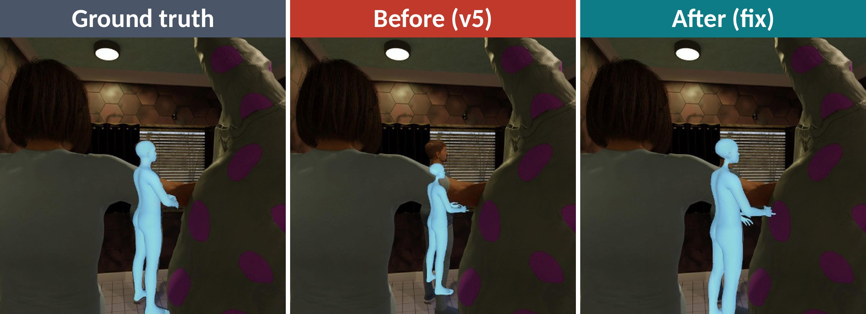
Backup: before and after, holdout image 579860
Synthetic holdout image 579860. Predictions use the model's own depth.
v5: the real head sticks out above a shrunken mesh
Fix + depth ×5, 10 epochs: head level with the truth; mesh cut off at the image edge
Not an exact fit: here the fixed mesh is a little larger and wider than the ground truth. The two people in front have no ground-truth mesh, so they are not counted as misses.
Notes:
A second holdout example, in case there is a question. Before the fix the boy's real head sticks out above a shrunken mesh that floats. After the fix the top of the head is level with the truth; the after mesh is cut off at the bottom of the image, so I cannot measure its full height. Here the fixed mesh is a little larger and wider than the ground truth, so I do not call it an exact fit. The two large people in front have no ground-truth mesh, so they are not counted as misses.

