Slide 1
MySQL For Beginners

Slide 2


List of Topics
Introduction to Database, Relational Database & SQL
MYSQL Installation on Windows
How to create database in MYSQL
Data Types in SQL
Create, Insert and Select Statements in SQL
Operators in SQL (AND, OR, IN, Between, Like etc)
Aggregate Functions in SQL with Group by Clause
Having and Where Clause differences
Subquery in SQL
Corelated Subquery in SQL
Joins in SQL (Inner, LEFT, Right, Self, Cross)
Window Functions (Row number, Rank, Dense Rank)
Case Statement Example in SQL
Views in SQL
CTE (Common Table Expressions) in SQL

Slide 3

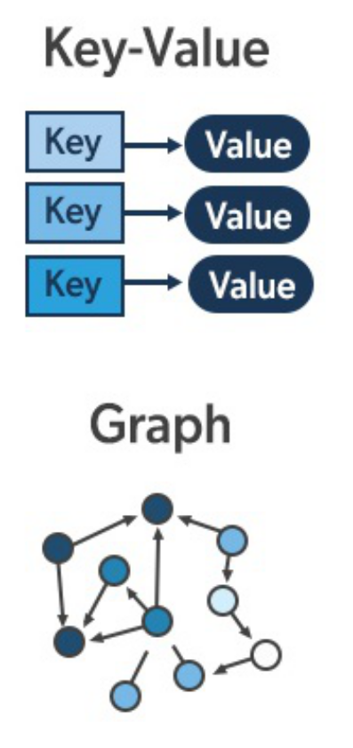
What is Database?
A database is an electronically stored, systematic collection of data. It can contain any type of data, including images, videos, and files.
Databases are designed to manage, store, retrieve, and manipulate large amounts of information efficiently
Relational Database
Non-Relational

Slide 4
What is Relational Database?
A Relational Database Management System (RDBMS) is a type of database management system (DBMS) that stores data in a structured format using rows and columns.
Columns
No | Course Name | Credit Hours
1212 | Intro to C++ | 4
1213 | Database | 3
1214 | Intro to JAVA | 4
1215 | Networking | 4
Rows

Slide 5
Features of Relational Database
The key features of RDBMS are:
Tables (Relations): Data is organized into tables, which consist of rows and columns
Schema: The schema defines the structure of the database, including the tables, fields (columns),datatypes, and constraints (such as primary keys and foreign keys)
Primary Key: A unique identifier for each record in a table
Foreign Key: Foreign keys establish relationships between tables

Slide 6



Relational Database Management Systems

Slide 7


What is SQL?
SQL (Structured Query Language) is a programming language used for managing and manipulating relational databases
It allows users to perform various operations on the data stored in a database, such as querying, updating, inserting, and deleting data

