Slide 1
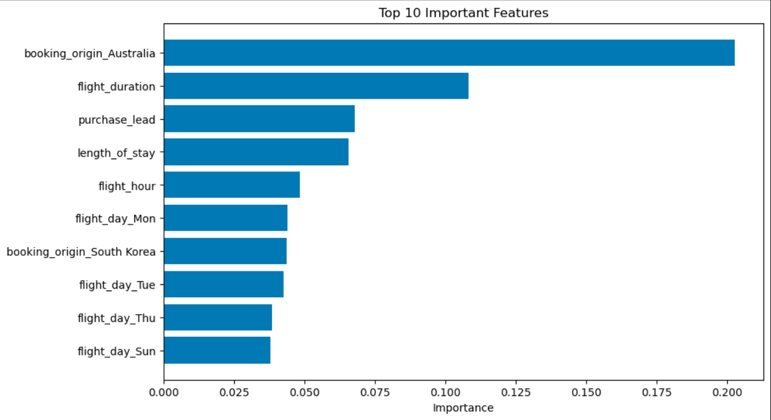
British Airways | Predicting Customer Buying Behaviour
Objective
Predict whether a customer completes a booking before travel.
Model
Random Forest + SMOTE + RandomizedSearchCV (5-Fold CV)
Performance
• Train Accuracy: 93.35% • Test Accuracy: 81.57% • CV F1 Score: 82.13%
Business Insights
• Booking origin was the strongest predictor of customer booking behaviour.
• Flight duration and purchase lead strongly influenced bookings. • Length of stay and departure timing also impacted customer behaviour.
Recommendation
Use the model to target high-probability customers with personalised offers before departure.
Top 10 Feature Importance from the Tuned Random Forest Model

