Slide 1
Seizure Prediction
Preprocessing, Regularisation & Generalisation
A Logistic Regression Study on EEG Datasets
Muhammad Saad Ur Rahman | IMSciences

Slide 2
Agenda
01
Datasets & Justifications
05
Overfitting & Underfitting
Why each dataset was chosen — size, imbalance direction, clinical context
Intentional extremes — learning curve analysis
02
Preprocessing — Pipeline A
06
Regularisation Study
Signal-clean approach: step-by-step with data example
L1 · L2 · Elastic Net — sparsity, F1, heatmap explained
03
Preprocessing — Pipeline B
07
Class Imbalance Handling
Representation-first approach: step-by-step with data example
SMOTE, undersampling, class weighting — with graph explanation
04
Baseline Results
08
Comparative Analysis
Accuracy, F1, PR-AUC — why numbers differ across pipelines
4 research questions answered with evidence

Slide 3
01 | Datasets — Overview
Dataset | Source | Samples | Features | Feature Type | Imbalance | Size
D1 — UCI Epileptic | Bonn University | 11,500 | 178 | 178 EEG time-points per row | 4:1 non-seizure heavy | ~17 MB
D2 — BEED Bangalore | Bangalore Neuro Centre | 8,000 | 16 | 16 raw scalp channel readings | 1:3 seizure heavy (inverted) | ~1 MB
D3 — CHB-MIT Clinical | Boston Children's Hosp. | 3,546 | 5,888 | 23ch × 256 time-points | ~1:1 balanced | ~167 MB
D1
D2
D3
Why D1? Negative-class imbalance
Why D2? Inverted imbalance
Why D3? Closest to real-world
4:1 skew in favour of non-seizure. A naive model scores 80% accuracy by predicting 'no seizure' every time. This dataset exists to prove that accuracy is a broken metric under imbalance — and to stress-test recall recovery via resampling and class weighting.
Seizures are the majority class (3:1). This deliberately flips the common assumption that 'minority = seizure'. It reveals that SMOTE — designed for the opposite scenario — actively hurts performance here, forcing the analysis to treat imbalance direction as a variable.
Neurologist-annotated clinical EEG, 23 channels, balanced 1:1. This is what an actual hospital dataset looks like — high-dimensional, carefully labelled, no artificial skew. Results here reflect the true difficulty of the task, not artefacts of class distribution.

Slide 4
02 | Pipeline A — Signal-Clean First
idea: clean the raw signal(data), then select the best features from it.
1
Min-Max Normalisation
2
Noise Removal
3
Feature Selection
Scale every feature to [0,1].
Removes amplitude differences between channels.
Smoothing / band-pass filter.
Keep top-k most discriminative raw features.
→
→
df1: 50 features selected
df2: 10 features selected
df3: 100 features selected
Data Example — what a single sample looks like at each step
RAW INPUT
(178 features)
AFTER
NORMALISATION
AFTER NOISE
REMOVAL
AFTER FEATURE
SELECTION (top 50)
[0.23, −1.4, 0.87, 3.1, −0.6 … 178 values]
Amplitudes vary wildly across channels (mV scale differs)
→
[0.48, 0.02, 0.62, 1.00, 0.27 … all in [0,1]]
All channels now on the same scale
→
[0.47, 0.04, 0.60, 0.95, 0.29 …]
High-frequency spikes smoothed; signal shape preserved
→
[0.47, 0.60, 0.95 … 50 values]
Only statistically discriminative features kept

Slide 5
03 | Pipeline B — Representation First
Philosophy: summarise the signal into meaningful statistics first, then compress with PCA.
1
Feature Extraction
2
Standard Scaling
3
PCA
Compute statistical descriptors per channel:
mean, variance, skewness, kurtosis, zero-crossing rate.
Converts raw waveform → compact numeric summary.
Z-score: subtract mean, divide by std deviation.
Ensures extracted features are comparable — mean=0, std=1.
Principal Component Analysis.
Projects data into orthogonal axes of maximum variance.
Removes correlated redundancy.
→
→
df1: 50 PCA comps · 82.9% var
df2: 10 PCA comps · 92.9% var
df3: 100 PCA comps · 67.7% var
Data Example — what a single sample looks like at each step
RAW INPUT
(178 features)
AFTER FEATURE
EXTRACTION
AFTER STANDARD
SCALING
AFTER PCA
(50 components)
[0.23, −1.4, 0.87, 3.1, −0.6 … 178 values]
Raw voltage at each time-point
→
[mean=0.12, var=1.4, skew=0.3, kurt=2.1, zcr=18 …]
Waveform → 5 stats × N channels = compact descriptor
→
[−0.11, 0.82, −0.44, 1.03, 0.27 …]
All descriptors centred (mean≈0, std≈1)
→
[0.71, −0.34, 1.12 … 50 values]
Uncorrelated axes capturing 82.9% variance

Slide 6
02–03 | Why Pipeline Order Matters
 | Pipeline A | Pipeline B
Starts with | Raw signal (178 voltage values) | Computed statistics (mean, var, zcr…)
Scaling type | Min-Max → [0,1] | Z-score → mean=0, std=1
Reduction method | Univariate feature selection | PCA (orthogonal compression)
Handles correlation? | No — correlated raw features survive | Yes — PCA removes redundancy
Noise sensitivity | High — raw values carry noise | Low — stats average over noise
df1 F1 score | 0.051 ← collapsed to majority class | 0.856 ← learns seizure pattern
The critical difference:
Pipeline A applies normalisation to raw EEG voltages that still carry inter-channel correlation and noise. Feature selection then picks statistically significant features — but they remain correlated and noisy. Pipeline B first compresses each waveform into interpretable statistics (mean, variance, etc.), stripping out temporal noise before scaling and PCA remove any remaining redundancy. The model in Pipeline B receives a clean, compact, decorrelated input — which is why it works.

Slide 7
04 | Baseline Results — Logistic Regression
0.984
0.034
0.999
Best F1 · Pipeline B · df2
Worst F1 · Pipeline A · df1 test
Best PR-AUC · Pipeline B · df2 val
Pipeline | Dataset | Split | Accuracy | F1-Score | PR-AUC
A | df1 | Val | 0.805 | 0.051 | 0.439
A | df1 | Test | 0.803 | 0.034 | 0.465
A | df2 | Val | 0.807 | 0.886 | 0.740
A | df2 | Test | 0.812 | 0.888 | 0.734
A | df3 | Val | 0.526 | 0.452 | 0.547
A | df3 | Test | 0.491 | 0.399 | 0.517
B | df1 | Val | 0.946 | 0.856 | 0.948
B | df1 | Test | 0.943 | 0.845 | 0.934
B | df2 | Val | 0.976 | 0.984 | 0.999
B | df2 | Test | 0.976 | 0.984 | 0.998
B | df3 | Val | 0.712 | 0.683 | 0.804
B | df3 | Test | 0.754 | 0.727 | 0.847
Why these results?
Pipeline A df1 F1=0.051
178 correlated raw features, high noise. Model cannot find a clean boundary — defaults to predicting majority class (non-seizure). Precision=1.0, Recall≈0 tells the whole story.
Pipeline B df2 F1=0.984
16 channels → compact statistics → 10 PCA components capturing 93% variance. Clean, decorrelated input on a balanced-ish dataset. Logistic regression works perfectly here.
df3 mid-range (F1~0.45–0.73)
5,888 features from 23 channels × 256 time-points. Even after PCA (100 comps, 67.7% var), the task is genuinely hard — EEG is high-dimensional and seizures have complex waveform patterns.
Blue = Pipeline A · Green = Pipeline B

Slide 8
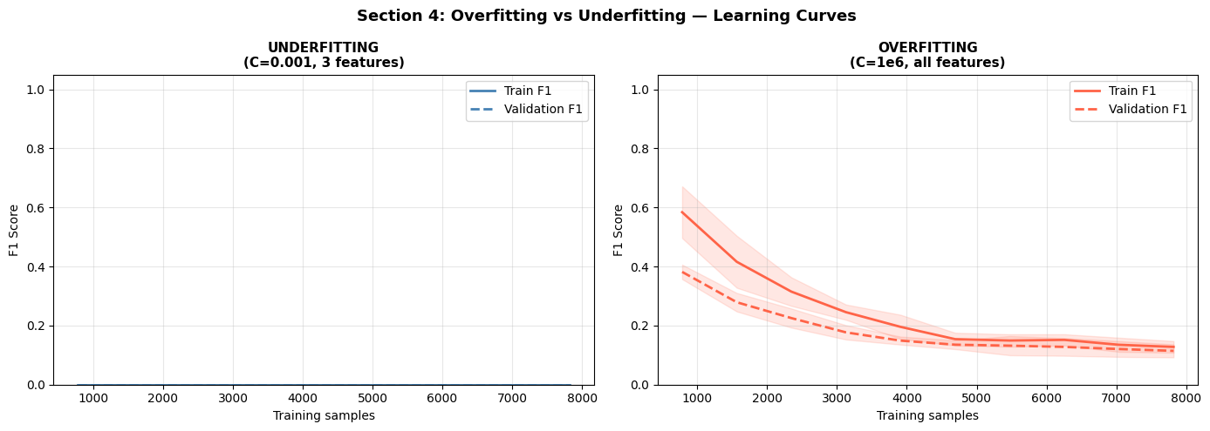
05 | Overfitting & Underfitting — Learning Curves
How to read this graph:
X-axis = training set size. Y-axis = F1 score. Solid line = training score; dashed = validation score. A wide gap between solid and dashed means the model memorises training data but fails to generalise. Coincident flat lines near zero means the model is too simple to learn anything.
UNDERFITTING
OVERFITTING
C=0.001 · 3 features only
C=1,000,000 · all 178 features
0.800
0.000
0.447
0.813
0.120
0.497
Accuracy
F1-Score
PR-AUC
Accuracy
F1-Score
PR-AUC
[Insert learning_curves.png — UNDERFITTING panel]
[Insert learning_curves.png — OVERFITTING panel]
Both curves are flat and coincident near zero — classic high-bias signature. The model is too constrained to fit either class, defaulting to predicting non-seizure 100% of the time. Strong regularisation (small C) combined with only 3 features gives the model no room to learn.
Training F1 starts high but validation F1 is substantially lower, especially at small sample sizes. The gap closes as training data grows, but never fully. The model fits noise in the training data — 178 correlated EEG features with near-zero regularisation is a perfect recipe for overfitting.

Slide 9
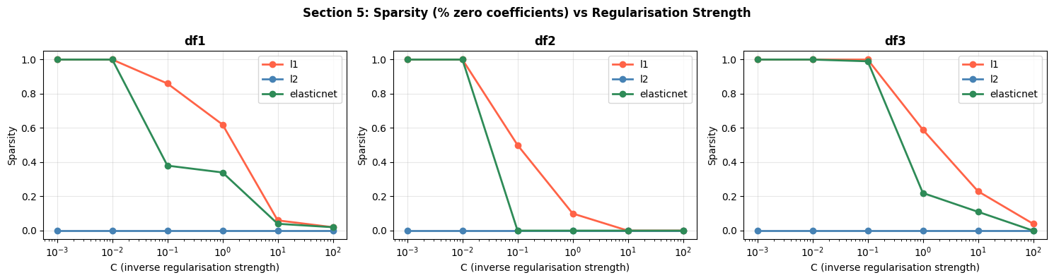
06 | Regularisation — Sparsity Analysis
How to read this graph:
X-axis = C (inverse regularisation strength; larger C = less regularisation). Y-axis = % of model coefficients that are exactly zero (sparsity). High sparsity = model uses fewer features. L2 never creates zeros. L1 and Elastic Net zero-out features aggressively at low C.
L2 (Ridge)
At C ≥ 10 all three methods converge toward low sparsity. The real differences appear between C=0.001 and C=1 — the regularisation-dominant zone.
Sparsity = 0% at ALL C values. It shrinks every coefficient proportionally but never eliminates any. This is why L2 is stable but not interpretable — all 178 features contribute something to every prediction.
L1 (Lasso)
Elastic Net
100% sparsity at C ≤ 0.01 — effectively a null model. As C increases, features are switched on one by one. This enables automatic feature selection but is unstable on df3 (high-dimensional).
Mirrors L1 on df1 and df2. On df3, stays at 100% sparsity longer before dropping sharply. The combined penalty is more conservative — needs higher C to activate features than pure L1.

Slide 10
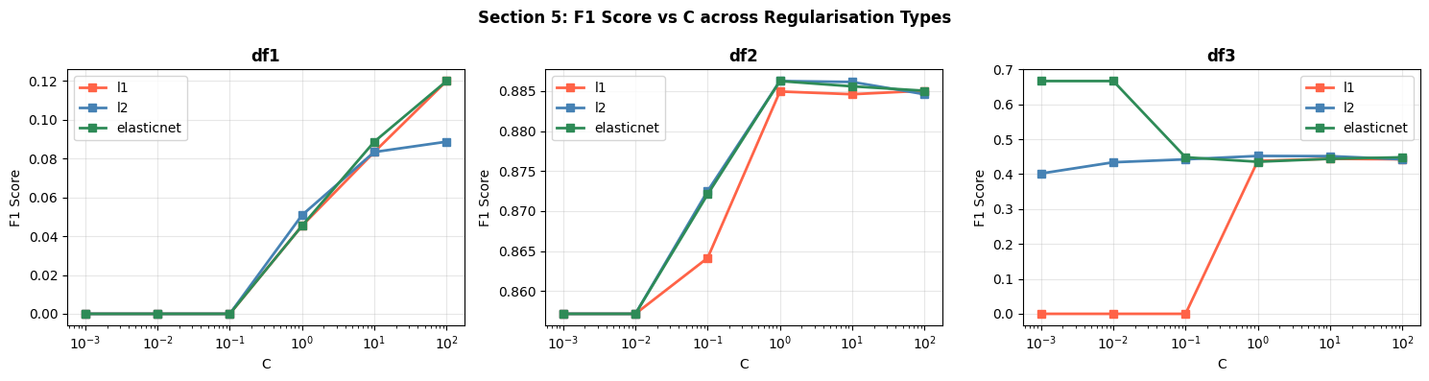
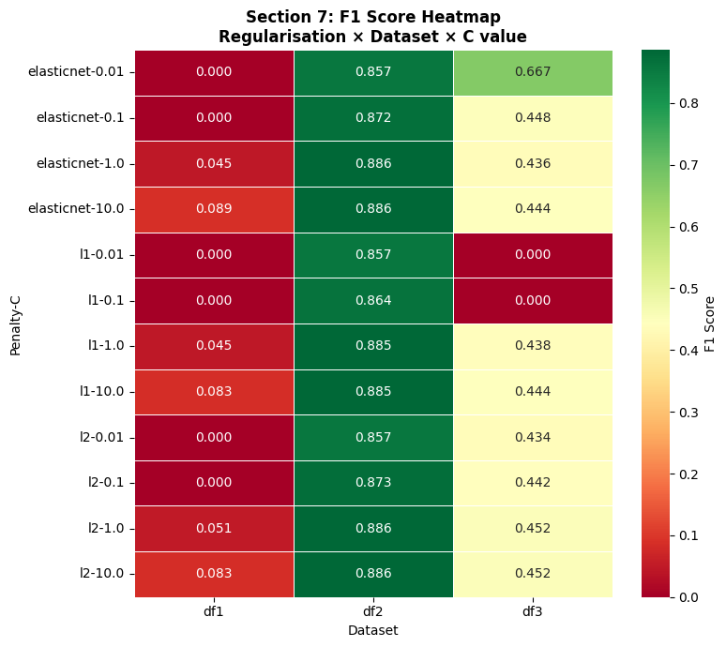
06 | Regularisation — F1 Score & Heatmap
F1 graph: X = C value (log scale), Y = F1 score. Each line is a regularisation type. Rising lines mean the model improves as regularisation loosens. Flat lines mean regularisation type doesn't matter at that C.
Heatmap: rows = penalty-C combinations, columns = datasets. Green = high F1, red = low. A fully green column means that dataset is easy for any setting; a red row means that penalty-C combo fails everywhere.
df2
df3
Best configuration per penalty (Validation F1)
Dataset | L1 | L2 | ElasticNet
df1 | 0.120 | 0.089 | 0.120
df2 | 0.885 | 0.886 | 0.886
df3 | 0.444 | 0.452 | 0.448
Mean F1 | 0.456 | 0.463 | 0.456
L2 wins on mean F1 (0.463) — its dense, stable shrinkage outperforms sparse methods across heterogeneous datasets.

Slide 11
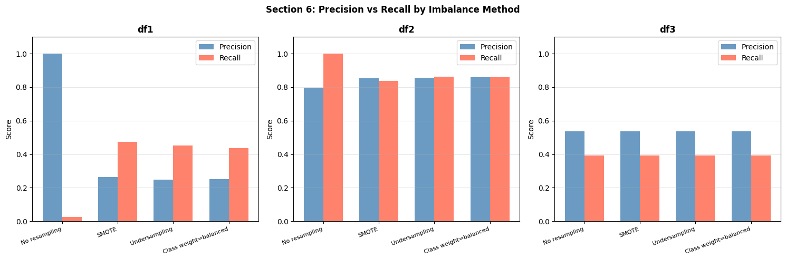
07 | Class Imbalance Handling
How to read this graph:
Each group of bars is one imbalance method. Blue bar = Precision (how often a seizure prediction is correct). Orange bar = Recall (how many actual seizures are caught). High recall but low precision means many false alarms; high precision but low recall means missed seizures. The goal is balance.
df3 (balanced 1:1): all methods produce identical results — resampling has no effect on an already-balanced dataset.
SMOTE
Undersampling
df1: Recall jumps to 0.47 at cost of Precision dropping to 0.26. df2: SMOTE hurts — seizures are already the majority class, so synthesising more is counter-productive.
Discards majority class samples to match minority. df1: similar recall to SMOTE but slightly lower F1. A safe method when you can afford to throw away data.
No Resampling
Class Weighting
df1: Precision=1.00 but Recall=0.026. The model predicts 'no seizure' almost always — looks accurate, but misses 97% of actual seizures. Useless clinically.
Penalises misclassifying the minority class more heavily in the loss function. No synthetic data — cleanest intervention. Results match SMOTE closely across all datasets.

Slide 12
08 | Comparative Analysis — 4 Research Questions
Q1 Does preprocessing order affect results?
SIGNIFICANT
Q2 Which regularisation generalises best?
L2 WINS
YES — strongly
L2 (Ridge)
Mean |ΔF1| = 0.378. Worst case df1: A=0.051 vs B=0.856 (gap of 0.805). Feature extraction before scaling is the decisive difference — it strips noise and correlation before the model ever sees the data.
Mean F1: L2=0.463 · L1=0.456 · ElasticNet=0.456. L2's continuous, dense shrinkage is most stable across datasets with different dimensionality and imbalance profiles. L1 collapses on df3 at low C.
Q3 Does Elastic Net consistently beat L1/L2?
DOES NOT
Q4 How does imbalance handling interact with regularisation?
DIRECTION MATTERS
NO
It depends on imbalance direction
Wins only 5/18 comparisons (28%). Without tuning l1_ratio and without structured feature correlation in the data, Elastic Net adds complexity without benefit. Default l1_ratio was used throughout.
df1 (non-seizure heavy): SMOTE gives +0.30 gain for all penalties. df2 (seizure heavy): SMOTE hurts (L1 loses −0.10, L2 loses −0.04). L2 is most robust to the reversal. df3 (balanced): no effect from any method.

Slide 13
Conclusion
1
Preprocessing is the dominant factor — Pipeline B outperforms A by 0.378 mean F1 (max gap 0.805 on df1). Feature extraction before scaling transforms the input space; the model never sees noisy correlated raw EEG.
2
L2 regularisation generalises most stably (mean F1=0.463). Dense shrinkage avoids L1's instability on high-dimensional data and Elastic Net's need for tuning.
3
Elastic Net wins only 28% of comparisons. Without tuned l1_ratio it collapses toward L1 or L2 — adding complexity without benefit.
4
Imbalance handling must account for direction. SMOTE helps when non-seizure is dominant, hurts when seizure is. L2 is most robust to this reversal.
IMSciences · Final Year Project · 2026

