Slide 1
Introduction to Basic Data Analytics Tools
Sa-ad Mahmud

Slide 2
What is Data Analytics?
Data Analytics Pipeline
Data analytics is the science of analyzing raw data in order to make conclusions about that information.
Collect
Refine
Store
Analyze
Presentation

Slide 3
Data Acquisition

Slide 4
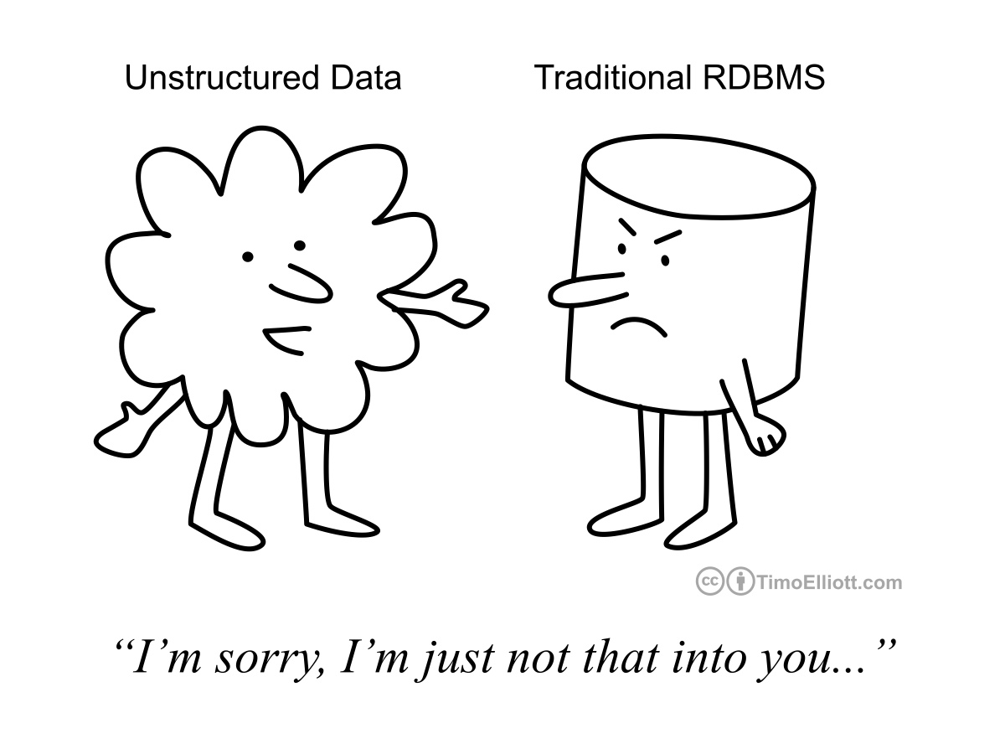
How To Collect Data!
REST API
From end users
Web scrape
Email and cloud storage
Client’s server

Slide 5
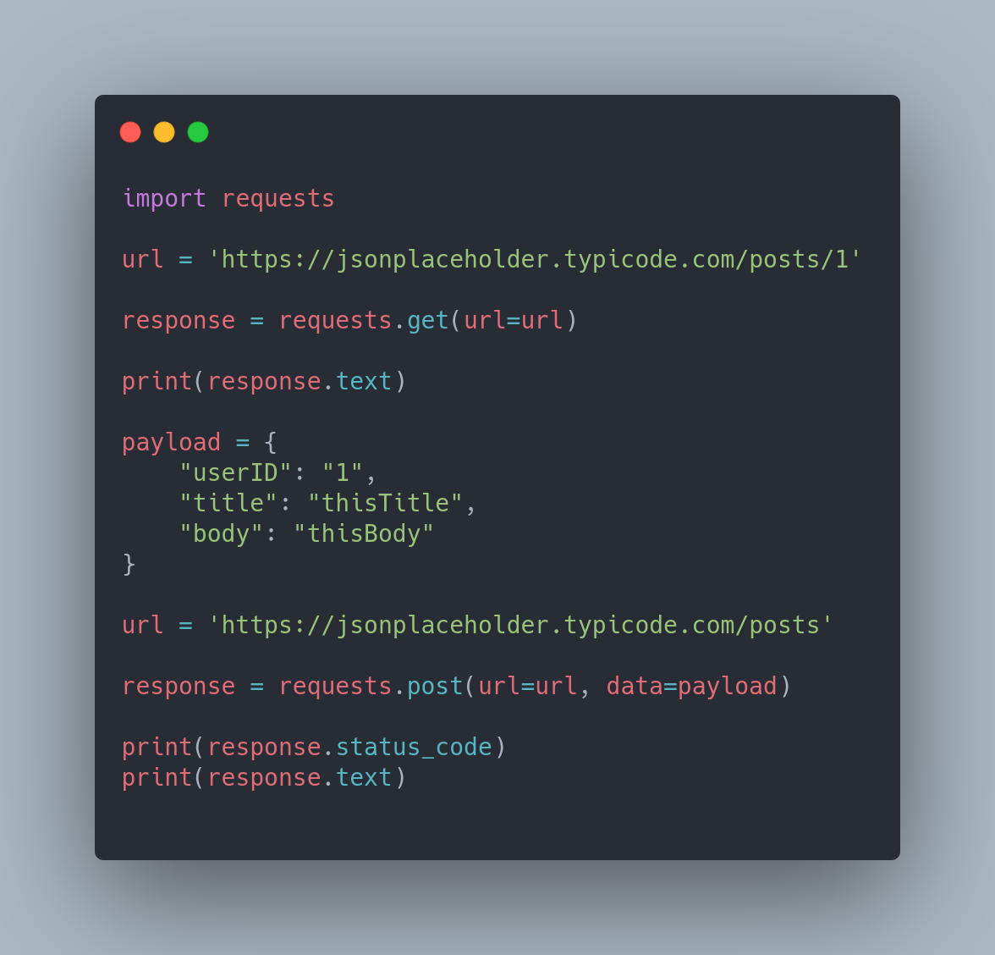
Tool for Data Acquisition:
Requests
A library for making HTTP requests in Python.
Key Features:
Keep-alive & Connection Pooling
Sessions with Cookie Persistence

Slide 6
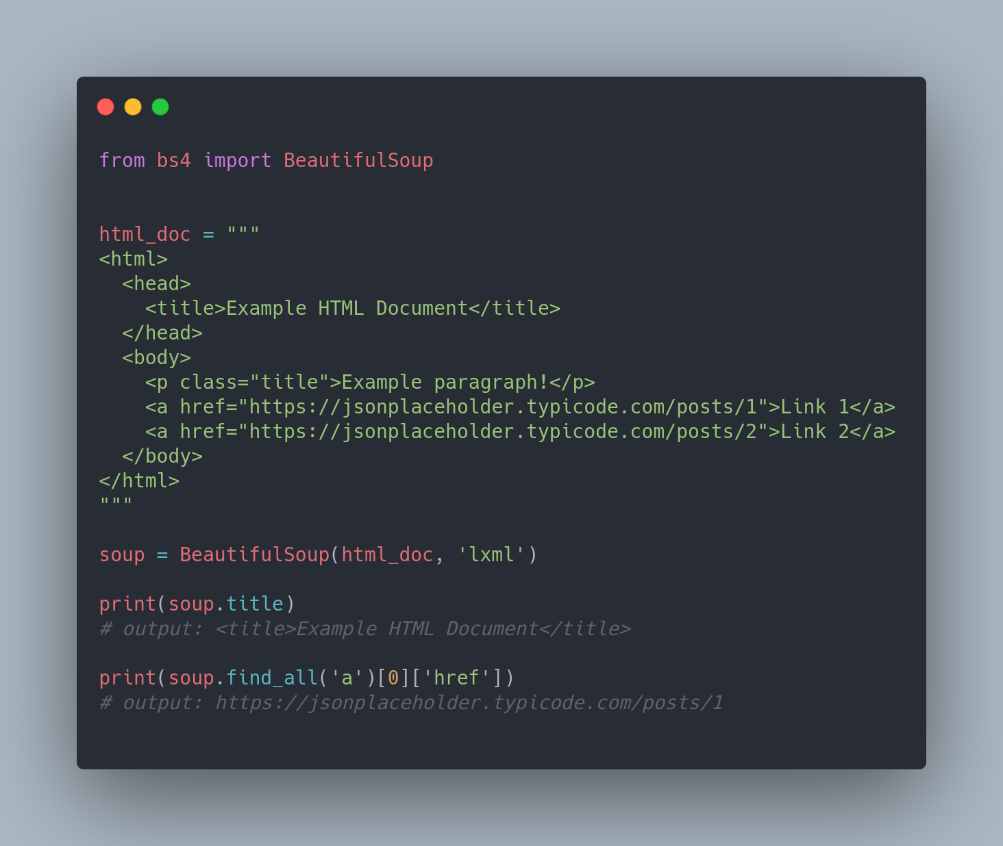
Tool for Data Acquisition:
BeautifulSoup
A library for parsing HTML and XML documents.
Key Features:
Multiple parser support (e.g., lxml, html5lib, and others)
Creates parse tree which is easy to navigate

Slide 7
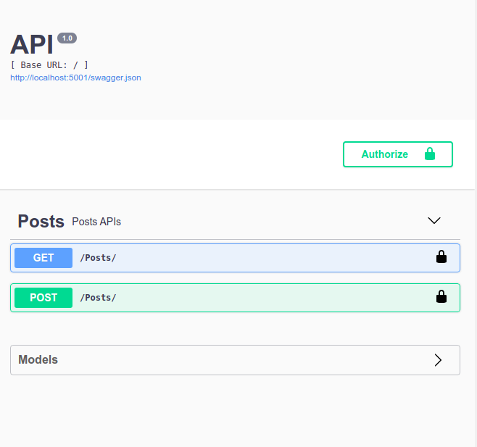
Tools for Data Acquisition:
Flask, Flask-RESTPlus and Swagger UI
Flask is a micro web framework written in Python.
Flask-RESTPlus is an extension for Flask that adds support for quickly building REST APIs. It automatically documents the APIs which is visible in Swagger UI.

Slide 8
Data Pre-Processing and Storage

Slide 9
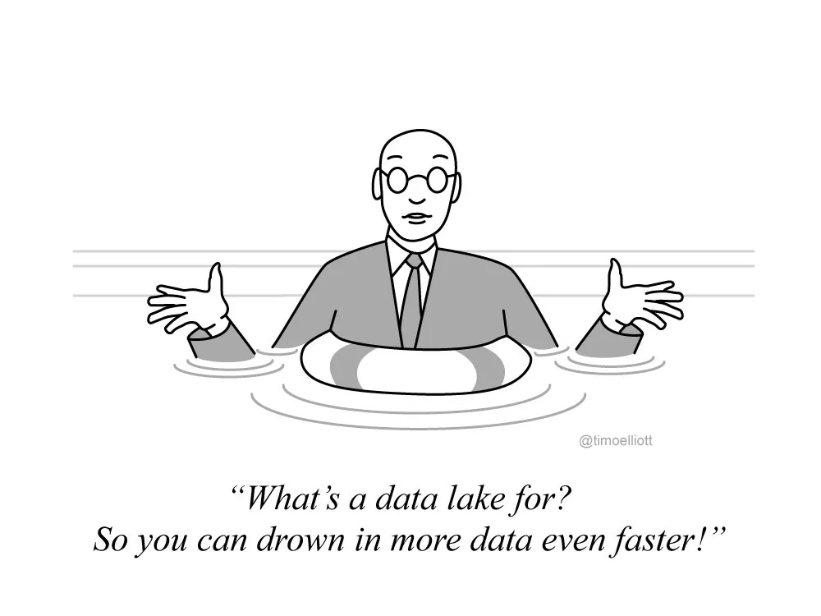
How To Clean Data!
How To Store Data!
Remove duplicate
Validate
Handle missing data
Fix errors
Filter outliers
RDBMS
ORM

Slide 10
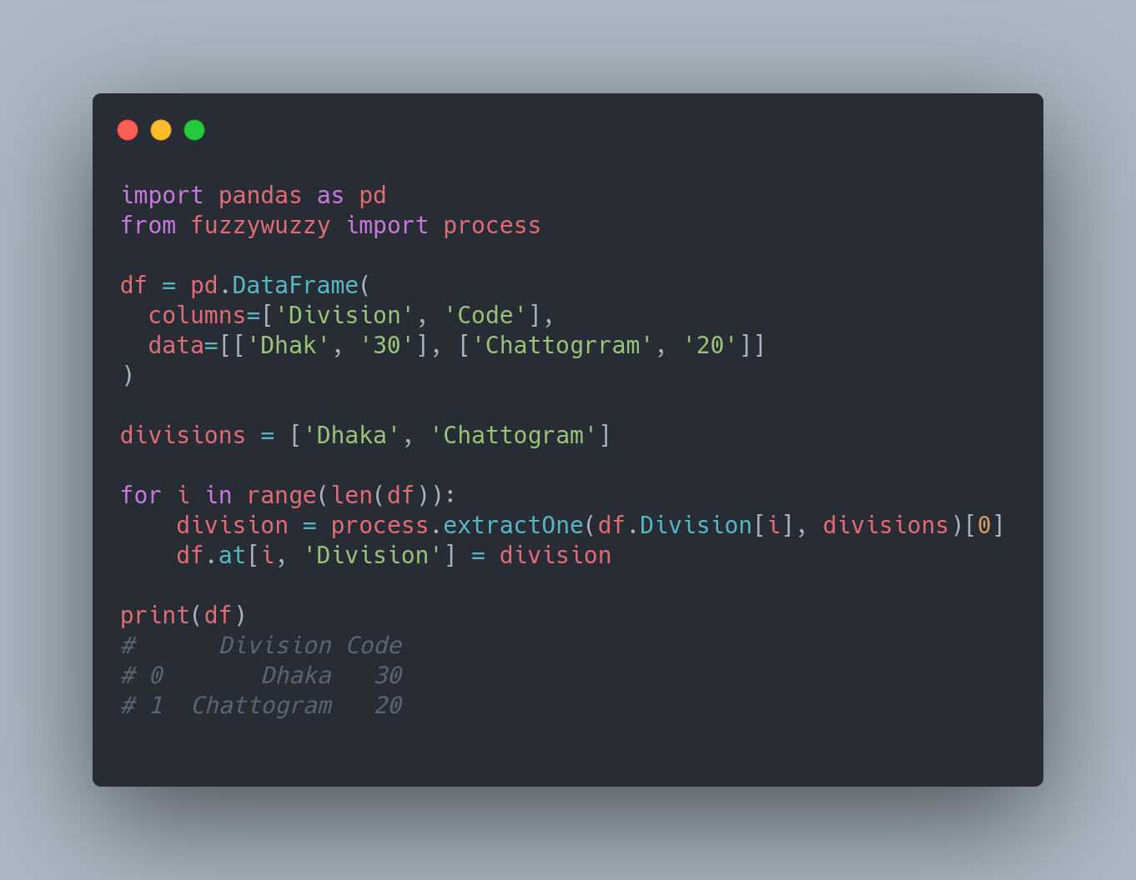
Tool for Data Manipulation:
Pandas
A library for data manipulation and analysis.
Key Features:
Loading data into in-memory data objects from different file formats.
Data alignment and integrated handling of missing data.

Slide 11
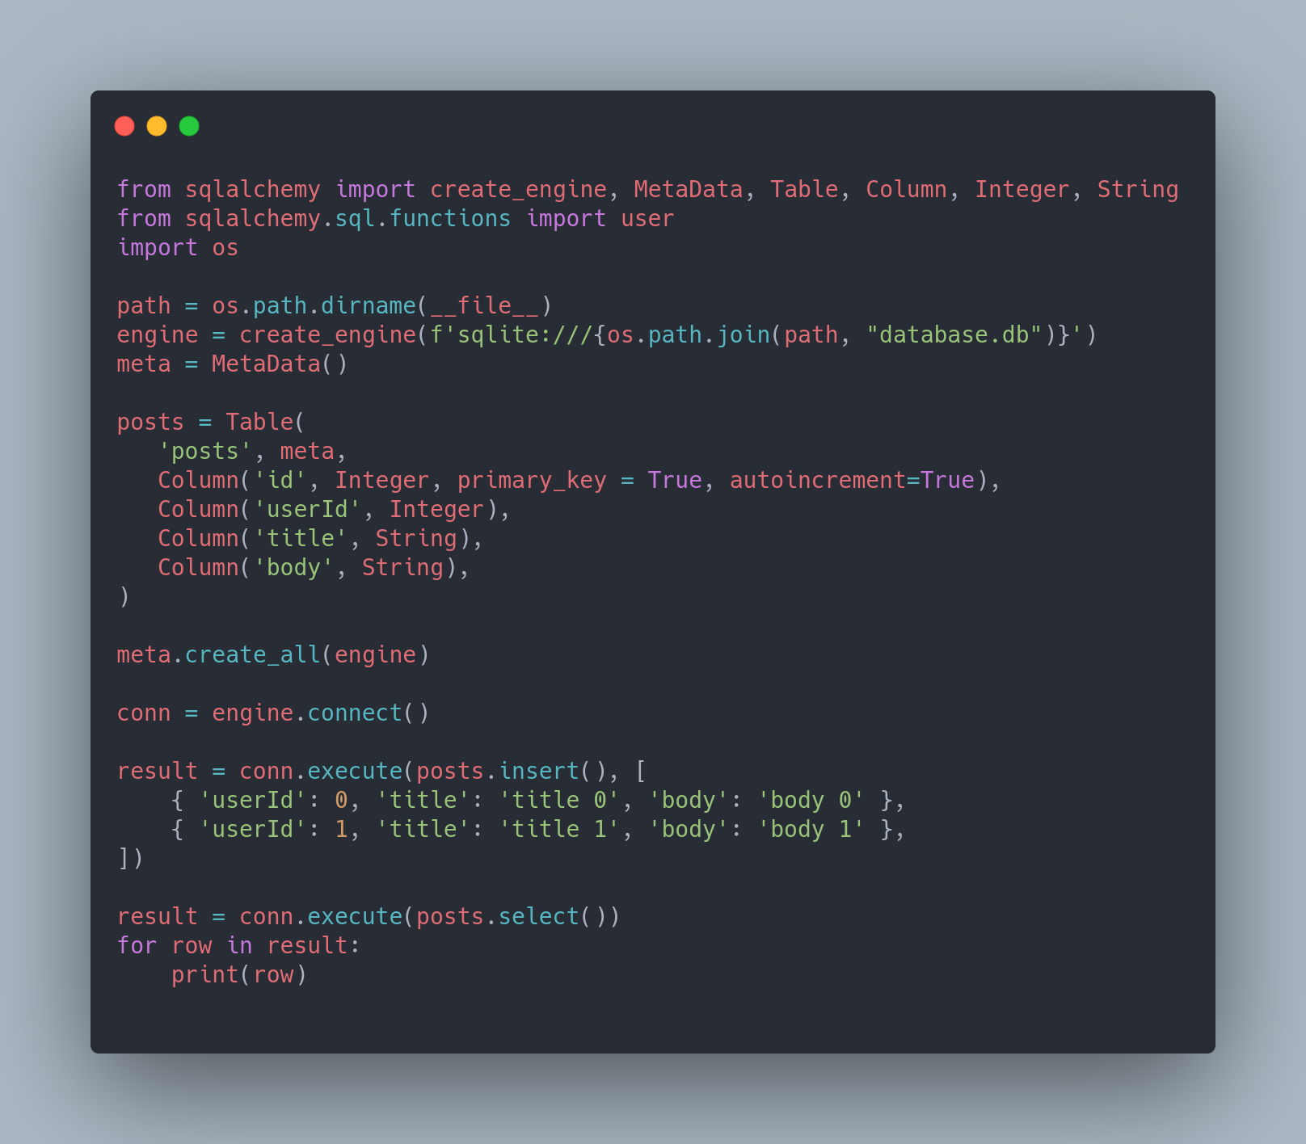
Tool for Database Operations:
SQLAlchemy
SQLAlchemy is a popular SQL toolkit and Object Relational Mapper.
Key Features:
Function-based query construction.
Multiple database support (e.g., SQLite, Postgresql, MySQL, Oracle, MS-SQL, Firebird, Sybase and others).

Slide 12
Data Analysis

Slide 13
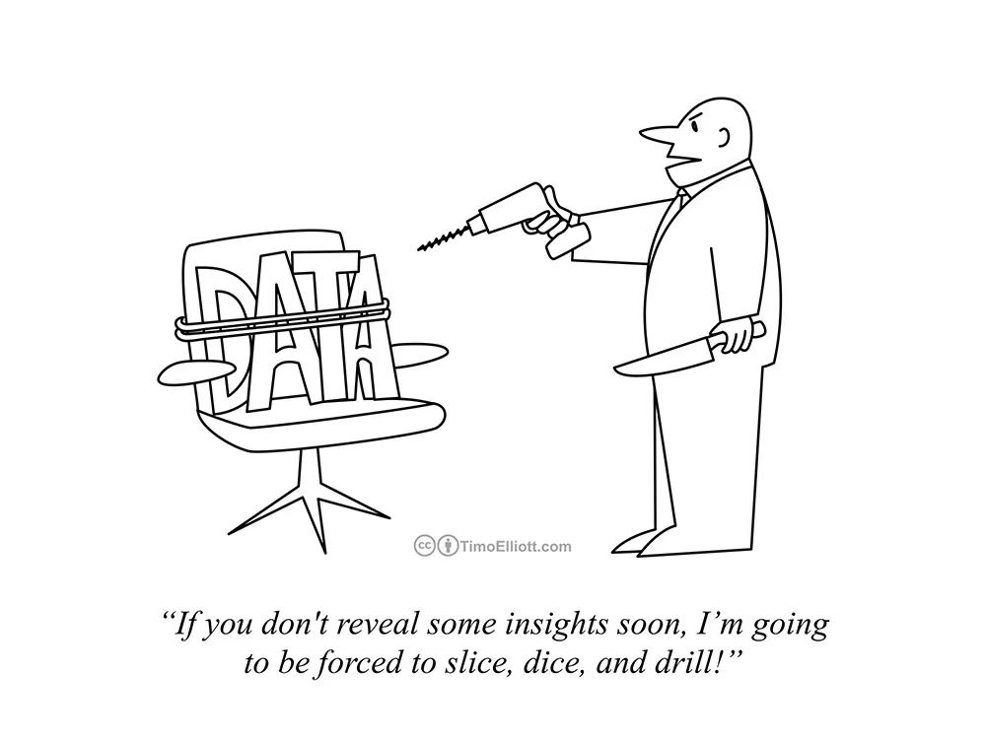
How To Analyze Data!
Five number summary (maximum, minimum, median, 1st quartile, 3rd quartile)
Average
Standard Deviation
Ratio
Interval
Trends
Aggregate and group by
Regression
Clustering

Slide 14
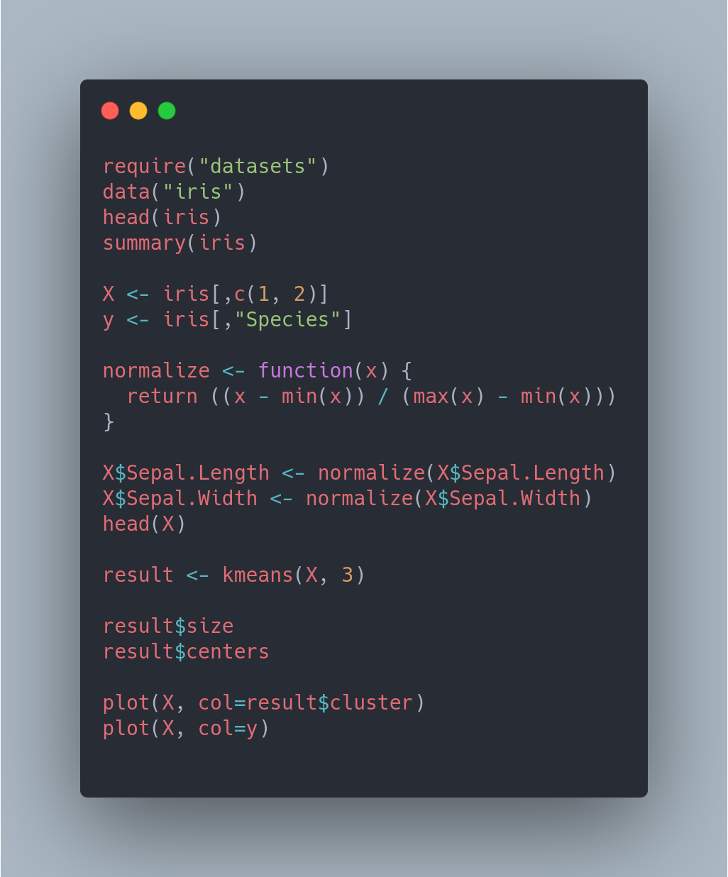
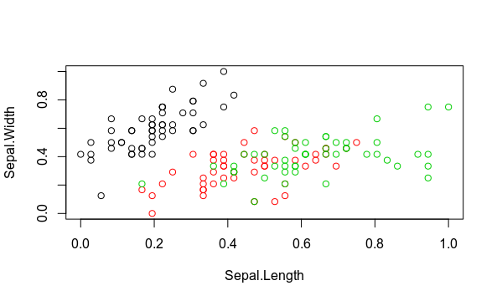
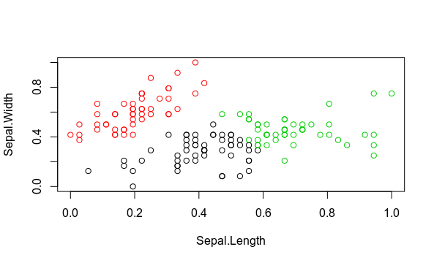
Tools for Data Analysis:
R and RStudio
Original Classes
Clusters by k-means
R is a popular programming language for data analysis. RStudio is an IDE for R.

Slide 15
Data Presentation

Slide 16
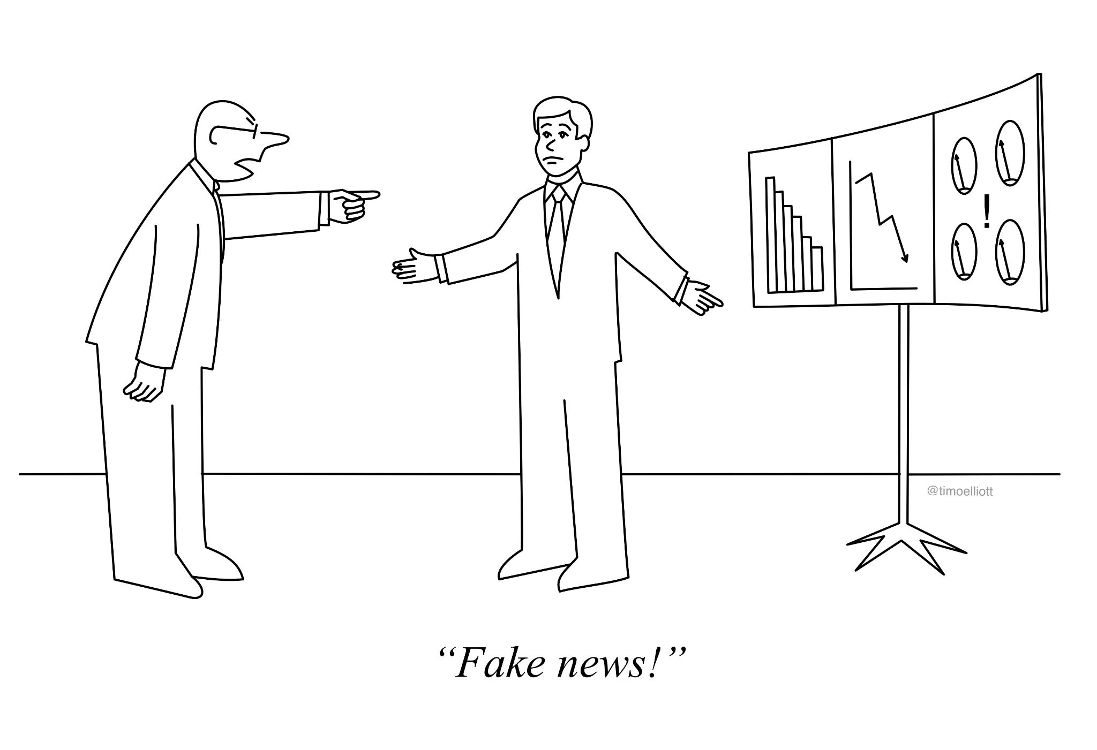
How To Visualize Data!
Charts
Line
Bar
Pie
Scatter
Graphs
Maps
Bubble
Polygon
Dashboards

Slide 17
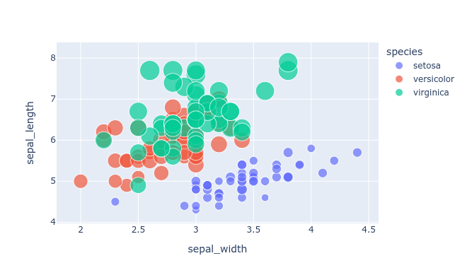
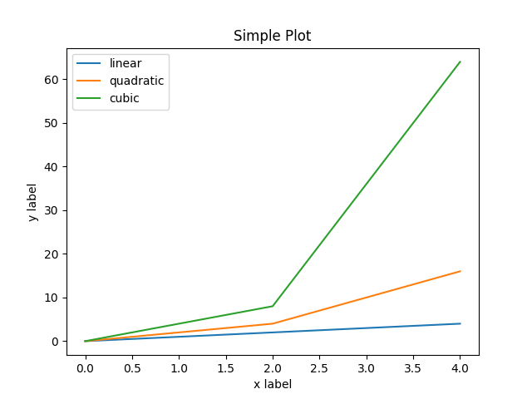
Tools for Data Visualization:
Plotly
Matplotlib
An interactive graphing library.
A plotting library for Python.

Slide 18
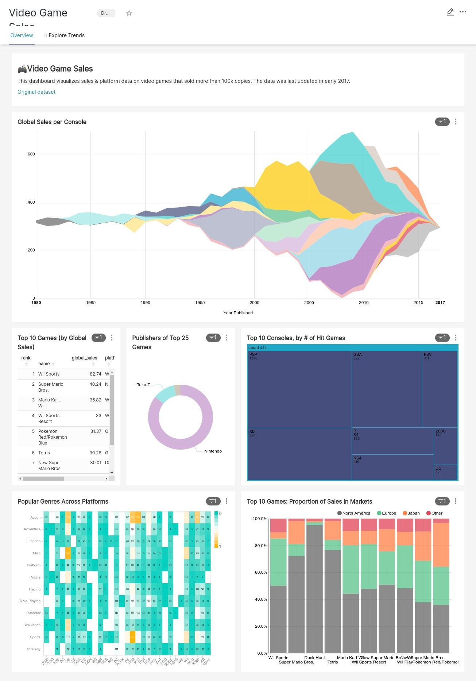
Tool for Data Visualization:
Apache Superset
A Data Visualization and Data Exploration Platform.
Key Features:
It supports all the data sources that support SQL Alchemy and supports querying using SQL.
Superset allows sharing dashboards.
It comes with security features like Authentication, User Management and Roles.

Slide 19
Other Notable Tools
Excel
Tableau Public
Grafana
Microsoft Power BI
And many more . . .

Slide 20
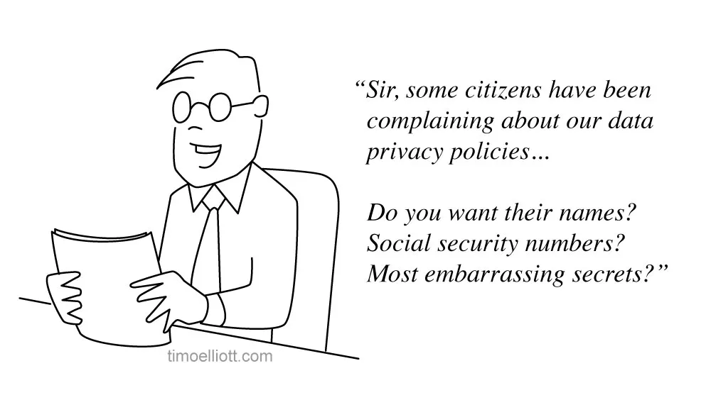
Challenges
Poor quality data
Data privacy and security
Weak infrastructure
Data from multiple sources
Scaling data analysis

Slide 21
Links
Flask: https://flask.palletsprojects.com/en/2.0.x/
Flask-RESTPlus: https://flask-restplus.readthedocs.io/en/stable/
SQLAlchemy: https://www.sqlalchemy.org/
R Programming Language: https://www.r-project.org/
k-means Clustering: https://en.wikipedia.org/wiki/K-means_clustering
Plotly: https://plotly.com/
Superset Docs: https://superset.apache.org/docs/intro
Presentation GitHub Link: https://github.com/saadrumon/basic-data-analytics-tools-presentation.git

Slide 22
Thank You
Any Questions?
“Information is the oil of the 21st century, and analytics is the combustion engine.”
- Peter Sondergaard

