Slide 1
Analyzing the Impact of Health Indicators on Diabetes Diagnosis
Group 10
December 14, 2023

Slide 2
Introduction
Motivation and Problem Statement
Develop a predictive model to determine whether an individual has diabetes
The goal of this study is to understand the leading factors to diabetes in the United States
This is vital for resource allocation and mitigating risk factors

Slide 3
Introduction
Dataset - Diabetes
Behavioral Risk Factor Surveillance System (BRFSS), an annual health-related telephone survey administered by the CDC
The total number of observations is 253680 with 21 features
17 categorical and 4 numerical
Some key features are:
Demographic data
Blood pressure and cholesterol Levels
BMI
Income
Smoking status
Physical and mental health and history
Dietary habits and alcohol consumption

Slide 4
Methods
Preprocessing and Visualization
3 Sets of the same dataset were used
First dataset included pre-diabetes as a third group in the target variable
Second one had a binary target but balanced with a 50/50 split
Third dataset was binary but not balanced
Data was already tidied which simplified preprocessing
No missing values were found.
Correlation analysis was done on all 3 sets.

Slide 5
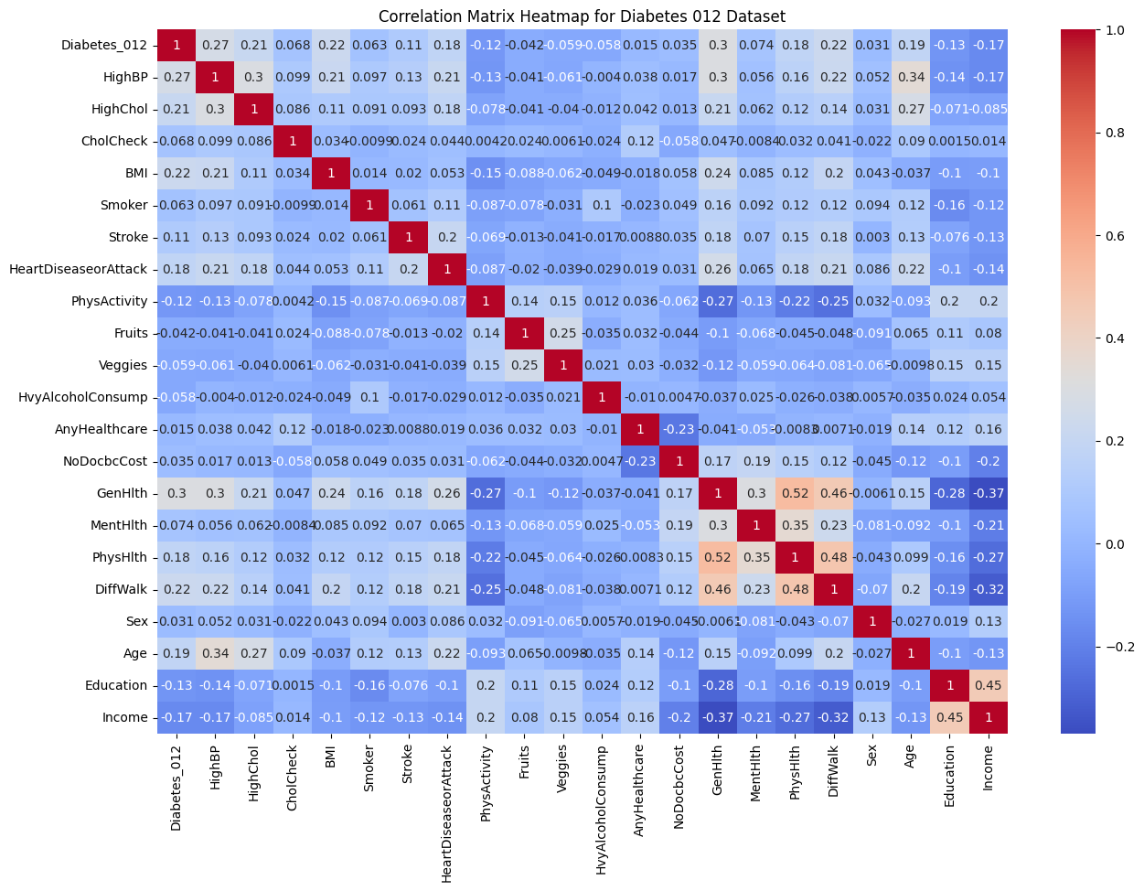
Methods
Preprocessing and Visualization

Slide 6

Methods
Preprocessing and Visualization

Slide 7

Methods
Preprocessing and Visualization

Slide 8
Methods
Preprocessing and Visualization
Based on the correlation analysis, the following features had higher positive correlations with diabetes:
BMI
High BP
High Cholesterol
This can be attributed to common relationship between physical health and diabetes
The following features had higher negative correlations with diabetes:
Income
Education
Can be interpreted as access to resources whether monetary or educational mitigates diabetes risks

Slide 9
Methods
Classifiers
Decision Trees | Logistic Regression | Random Forests | Support Vector Machines
Supervised learning | Supervised learning | Ensemble learning | Supervised learning
Suitable for both linear and non-linear data | Primarily for linear data | Suitable for both linear and non-linear data | Suitable for both linear and non-linear data
Prone to overfitting, especially with deep trees | Less prone to overfitting, regularization can be applied | Helps reduce overfitting compared to a single decision tree | Can be prone to overfitting, but regularization can mitigate it
Relatively easy to interpret and visualize | Relatively easy to interpret coefficients | Difficult to interpret individual trees, but feature importance can be assessed | Less intuitive to interpret compared to decision trees and logistic regression

Slide 10
Methods
Hyperparameter Tuning
Decision Trees | Logistic Regression | Random Forests | Support Vector Machines
- Tree depth | - Regularization strength (C) | - Number of trees | - Regularization strength (C)
- Minimum samples per split | - Penalty type (l1 or l2) | - Max features per split | - Kernel type
- Minimum samples per leaf |  | - Min samples per split | - Kernel-specific parameters (e.g., gamma)

Slide 11
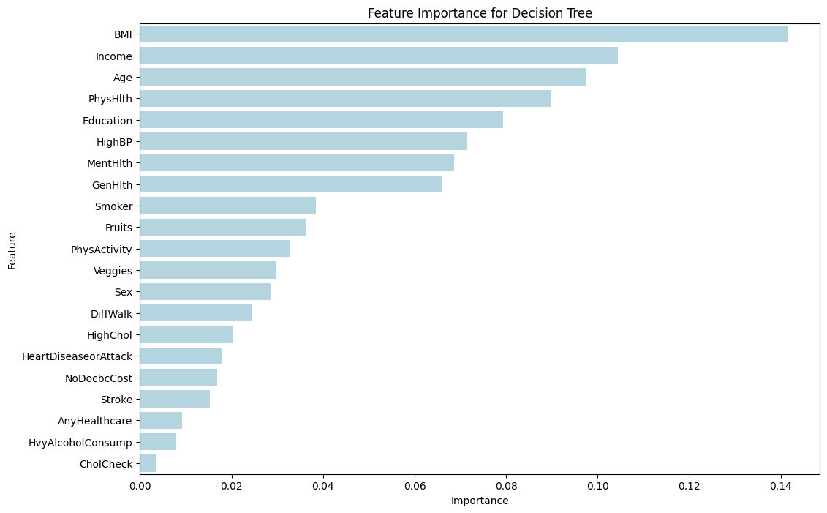
Results
Feature Importance

Slide 12
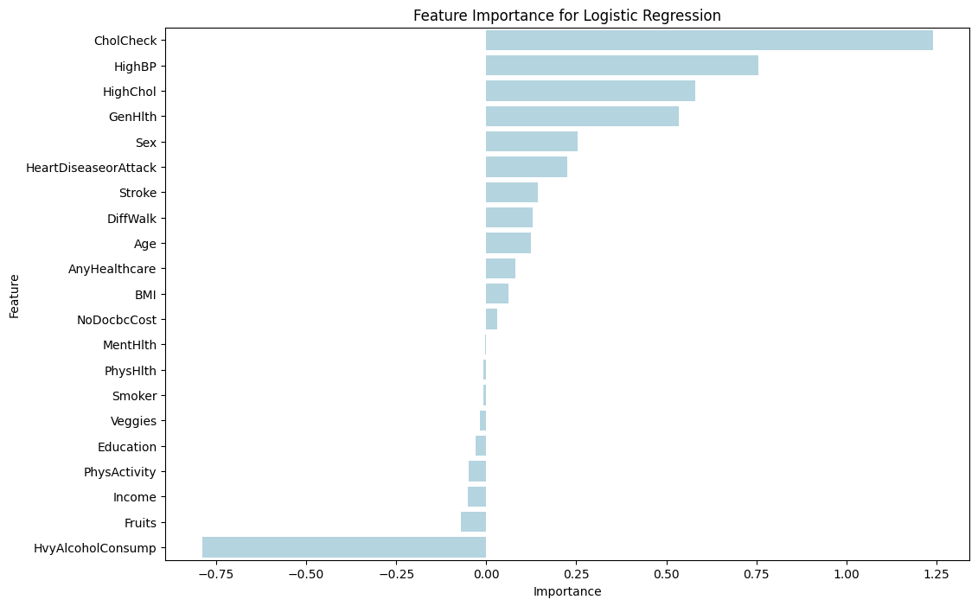
Results
Feature Importance

Slide 13
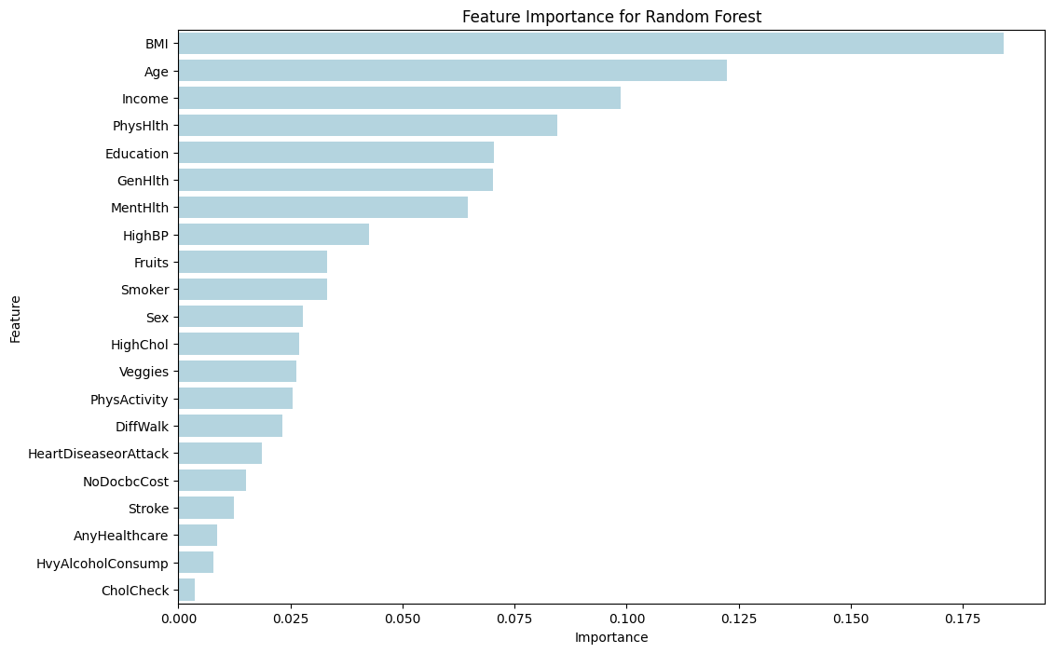
Results
Feature Importance

Slide 14
Results
Feature Importance
Decision Tree Feature Importance
The top three features are BMI, Income, and Age
Logistic Regression Feature Importance
Features like CholCheck, HighBP, and HighChol show the highest positive importance.
HvyAlcoholConsump has large negative importance
Random Forest Feature Importance
The top three features are BMI, Age, and Income similar to Decision Tree

Slide 15
Results
So, what performed better?
Logistic Regression showed an accuracy of approximately 0.86 but performed poorly for the positive diabetes class with a low recall.
The Decision Tree model shows a balanced approach but with lower overall accuracy of 0.80.
Two sets of metrics for Random Forest were provided, both indicating good accuracy (around 0.84 to 0.86) but poor recall for the positive class.
The SVM model had high accuracy of 0.86 but completely failed to predict the positive class, indicating a potential bias towards the negative class.
Computationally, SVM took the longest time to run while Decision Trees took the least amount of time

Slide 16
Discussion
Random Forest performed the best but was significantly slower and was more computationally intensive
More medical features should be used in this study; future work may involve more variables found in other datasets
Such as: Blood Glucose Level, family history, Insulin Resistance, etc.
Considering Diabetes as binary and modelling based on that might be inaccurate as different types of diabetes have different factors
Data collection could include different types and clustering can be utilized

Slide 17
References
[1] Diabetes, CDC. 2020. “National Diabetes Statistics Report.” https://diabetesresearch.org/wp-content/uploads/2022/05/national-diabetes-statistics-report-2020.pdf.
[2] Teboul, Alex. 2015. “Diabetes Health Indicators Dataset.” Kaggle: Your Machine Learningand Data Science Community. https://archive.ics.uci.edu/dataset/891/cdc+diabetes+ health+indicators
[3] Hastie T. Friedman, J. and R. Tibshirani. The Elements of Statistical Learning. Springer series in statistics New York, 2001.
[4] L. Breiman. Random forests. Machine Learning, 45(1):5–32, 2001.
[5] I. Guyon and A. Elisseeff. An introduction to variable and feature selection. Journal of Machine Learning Research, 3:1157–1182, 2003.
[6] D.M.W. Powers. Evaluation: from precision, recall and f-measure to roc, informedness, markedness & correlation. Journal of Machine Learning Technologies, 2(1):37–63, 2011.
[7] N.V. Chawla, K.W. Bowyer, L.O. Hall, and W.P. Kegelmeyer. Smote: synthetic minority over-sampling technique. Journal of artificial intelligence research, 16:321–357, 2002.
[8] J. Bergstra and Y. Bengio. Random search for hyper-parameter optimization. In Journal of Machine Learning Research, pages 281–305, 2012.
[9] R. Kohavi. A study of cross-validation and bootstrap for accuracy estimation and model selection. In Proceedings of the 14th International Joint Conference on Artificial Intelligence, 2:1137–1145, 1995.
[10] A. Esteva, A. Robicquet, B. Ramsundar, V. Kuleshov, M. DePristo, K. Chou, C. Cui, G. Corrado, S. Thrun, and J. Dean. A guide to deep learning in healthcare. Nature Medicine, 25(1):24–29, 2019.

