Slide 1
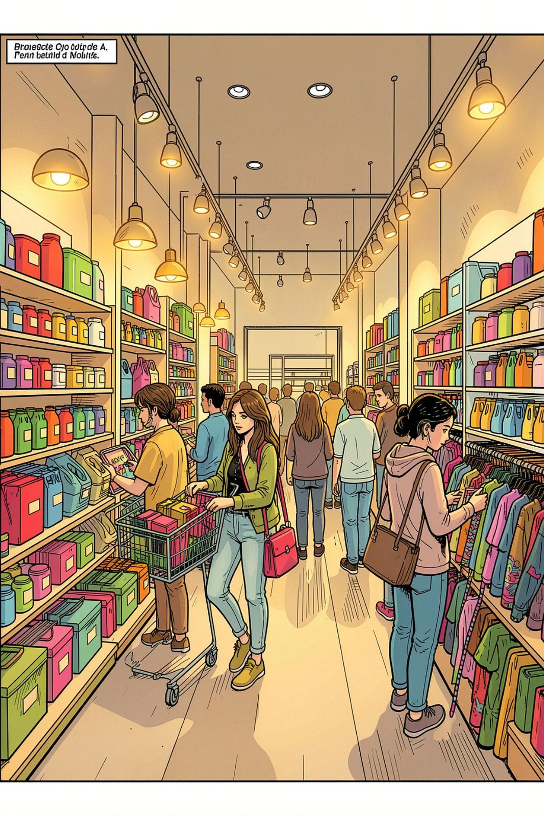
Customer Shopping Behavior Analysis
Uncovering spending patterns, customer segments, product preferences, and subscription behavior from 3,900 transactions across multiple product categories.

Slide 2

Dataset at a Glance
3,900
18
Transactions
Columns
Rows in the dataset
Features tracked
37
Missing Values
In Review Rating only
Key features span demographics (Age, Gender, Location, Subscription), purchase details (Item, Category, Amount, Season), and shopping behavior (Discount, Promo Code, Frequency, Review Rating, Shipping Type).

Slide 3



Exploratory Data Analysis in Python
Data Loading & Exploration
Imported via pandas; used df.info() and .describe() for structure and summary statistics.
Missing Data Handling
Imputed missing Review Rating values using the median rating per product category.
Feature Engineering
Created age_group (binned ages) and purchase_frequency_days; dropped redundant promo_code_used.
Database Integration
Loaded cleaned DataFrame into PostgreSQL for SQL-based analysis.

Slide 4
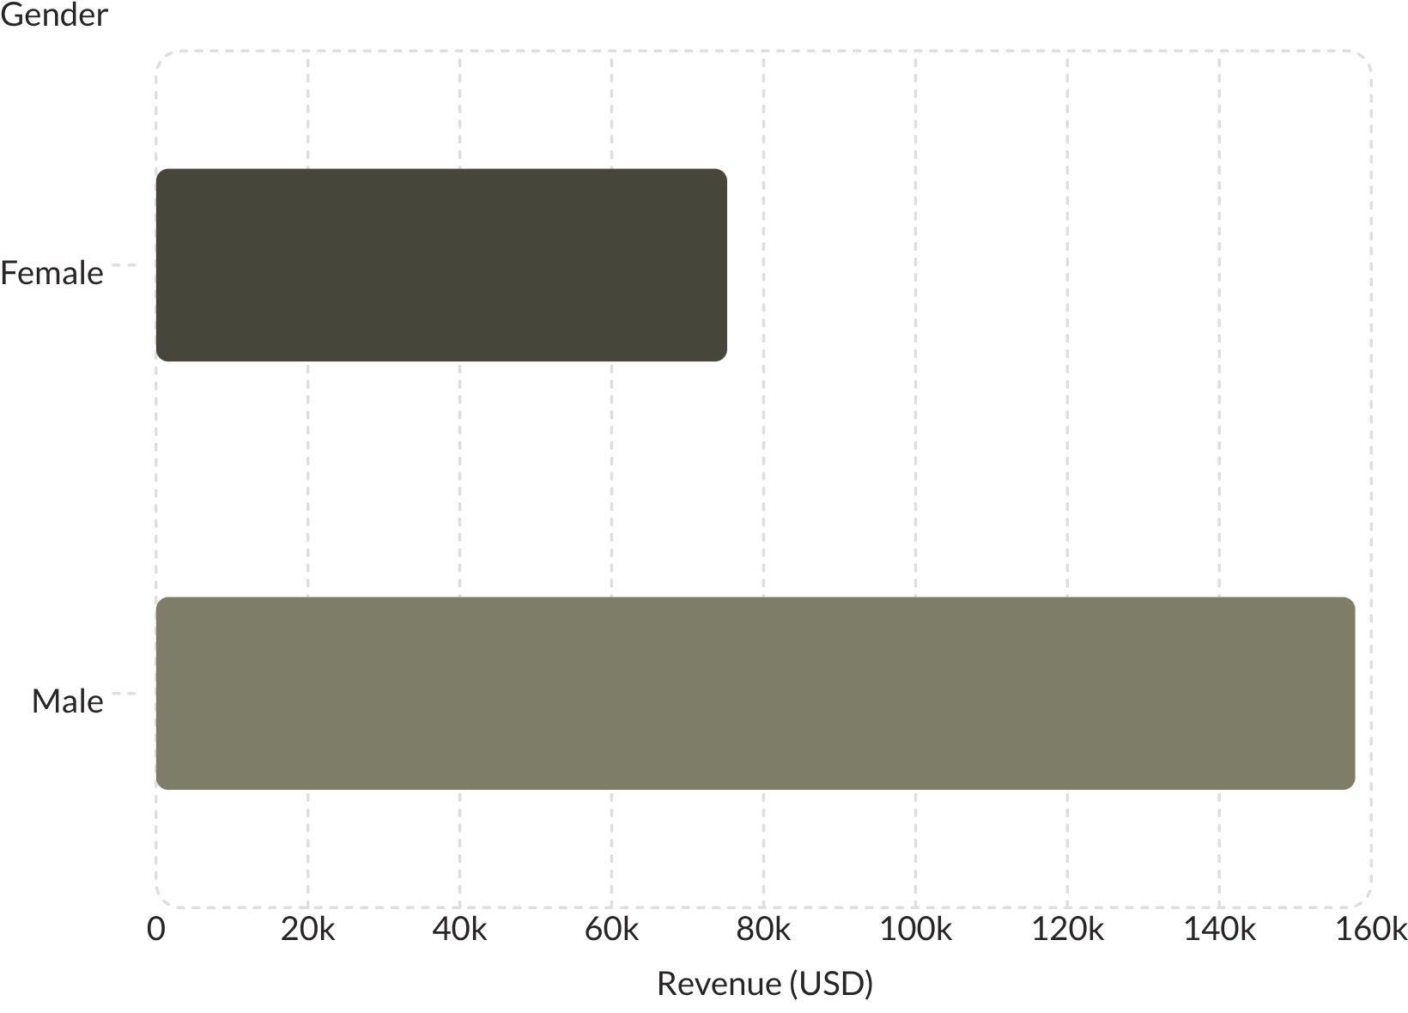
Revenue & Spending Insights
Revenue by Gender
Male customers generated $157,890 in revenue — more than double the $75,191 from female customers.
Shipping Type Comparison
Express shipping averaged $60.48 per order vs. $58.46 for Standard — a modest but consistent premium.
High-Spending Discount Users
839 customers used discounts yet still spent above the average purchase amount.

Slide 5
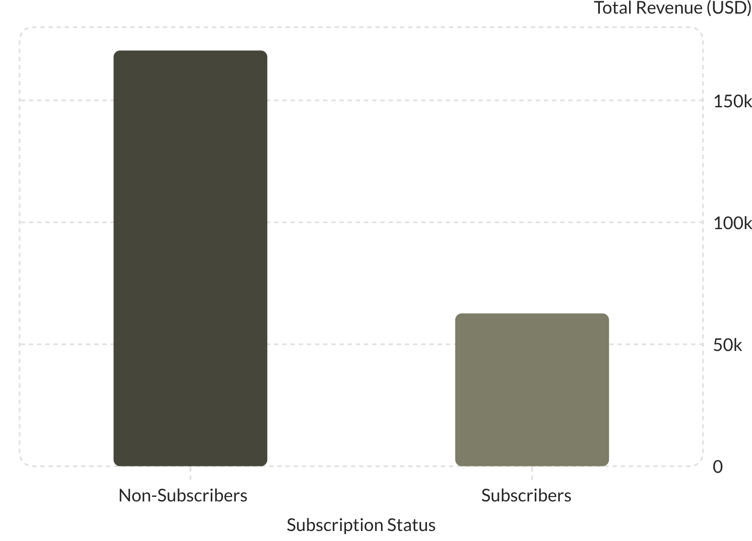
Subscribers vs. Non-Subscribers
Subscribers represent only 27% of customers but show strong repeat-purchase potential — 958 repeat buyers (5+ purchases) are subscribers.
Non-Subscribers
Subscribers
2,847 customers · Avg spend $59.87 · Total revenue $170,436
1,053 customers · Avg spend $59.49 · Total revenue $62,645

Slide 6
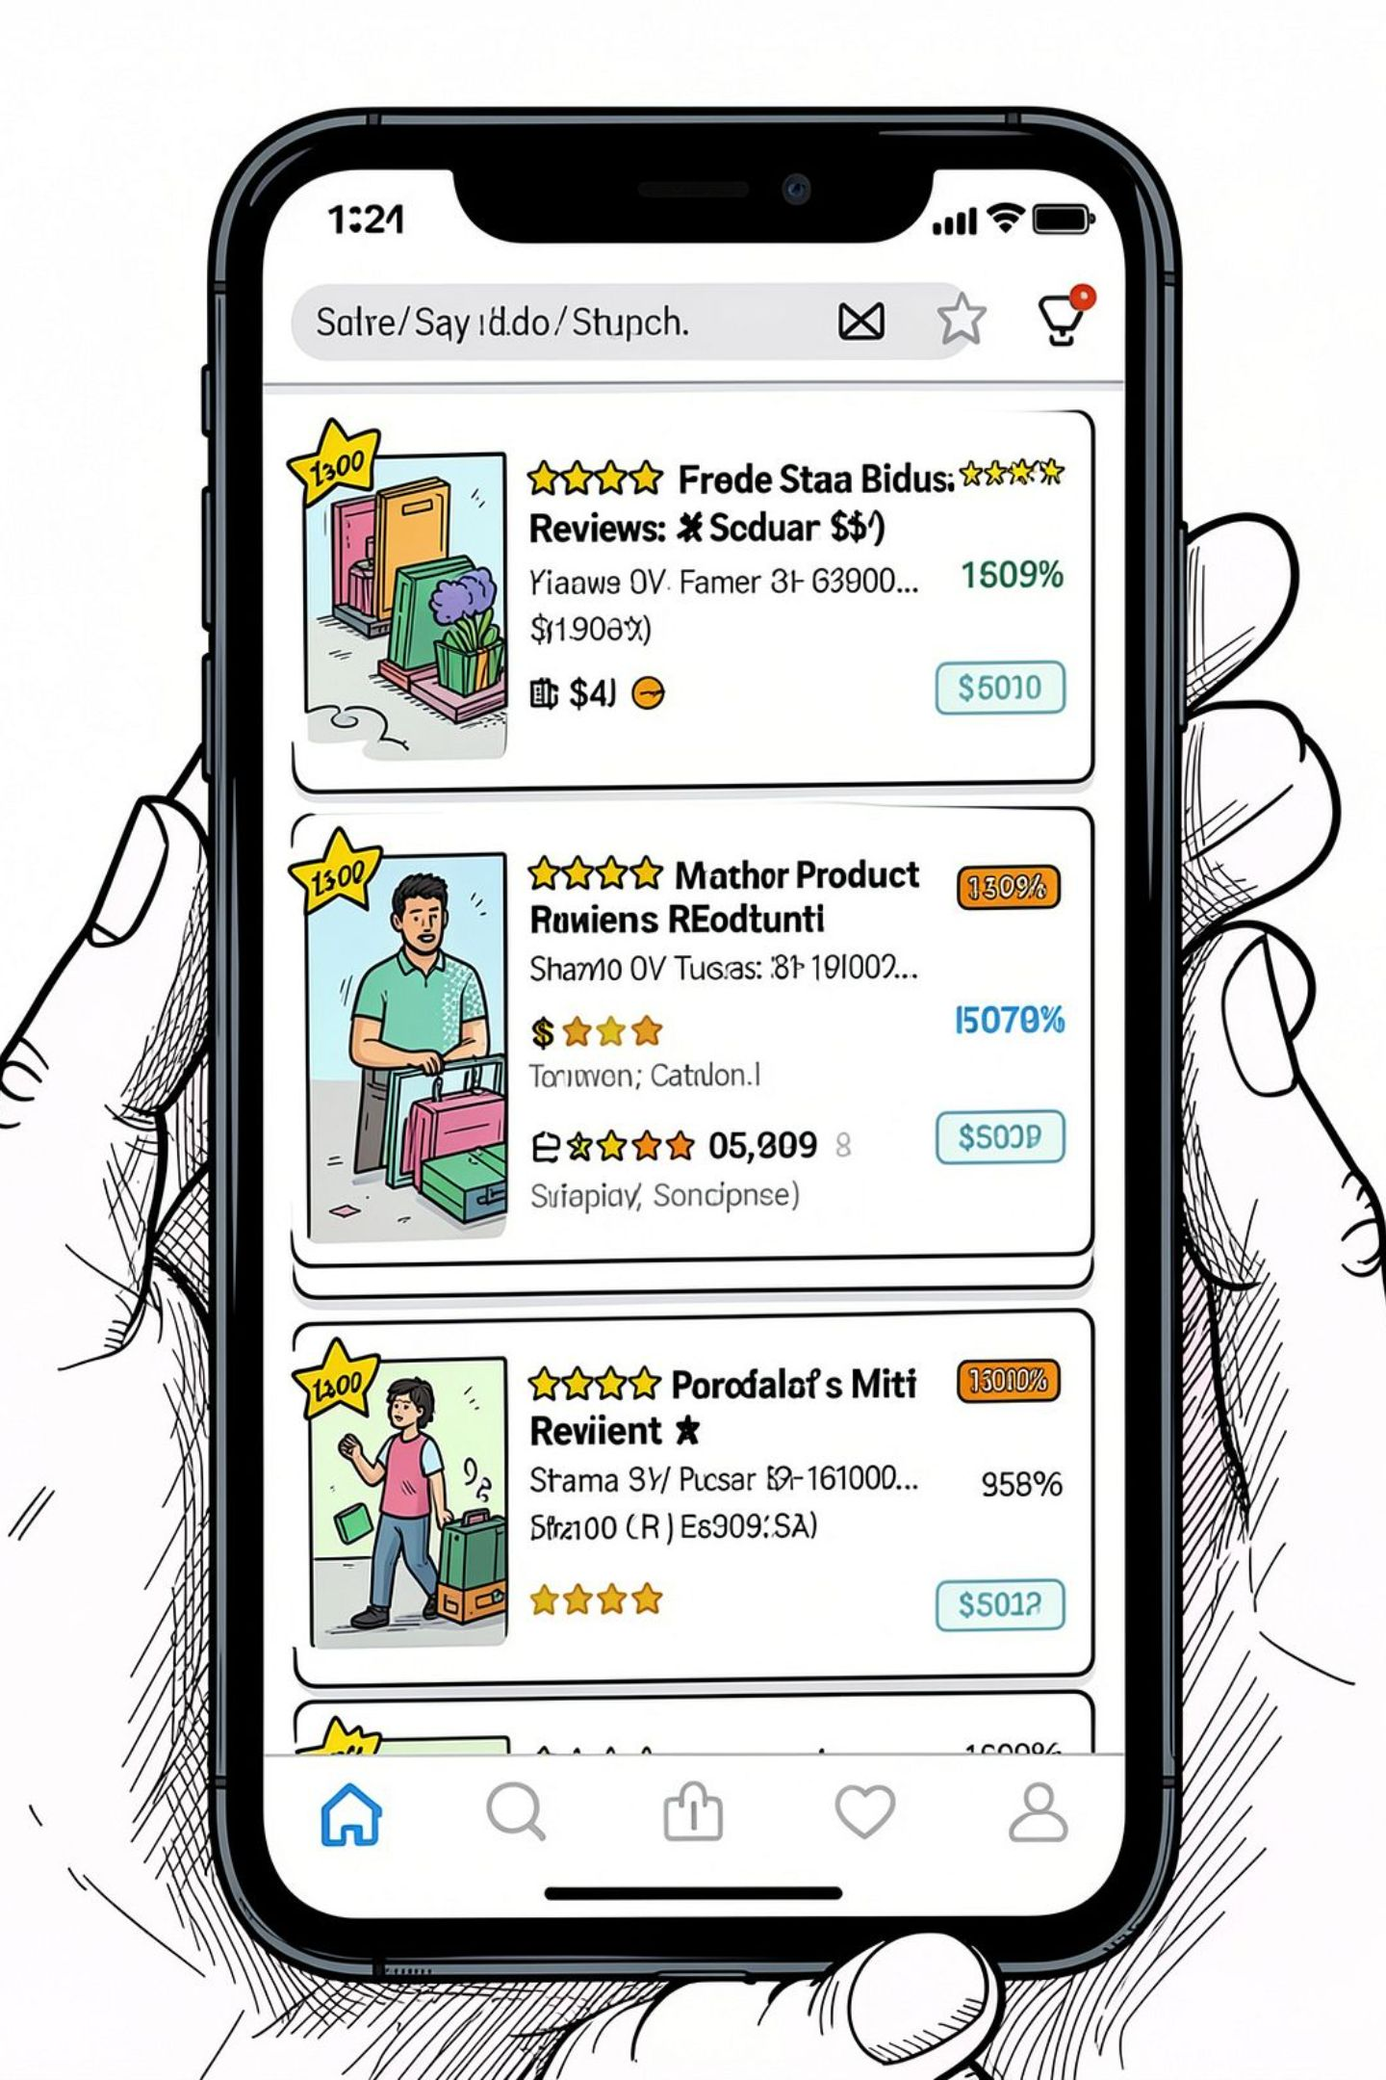
Top-Rated & Discount-Dependent Products
⭐ Top 5 by Rating
Gloves — 3.86
Sandals — 3.84
Boots — 3.82
Hat — 3.80
Skirt — 3.78
🏷️ Most Discounted Products
Hat — 50.00% discount rate
Sneakers — 49.66%
Coat — 49.07%
Sweater — 48.17%
Pants — 47.37%

Slide 7
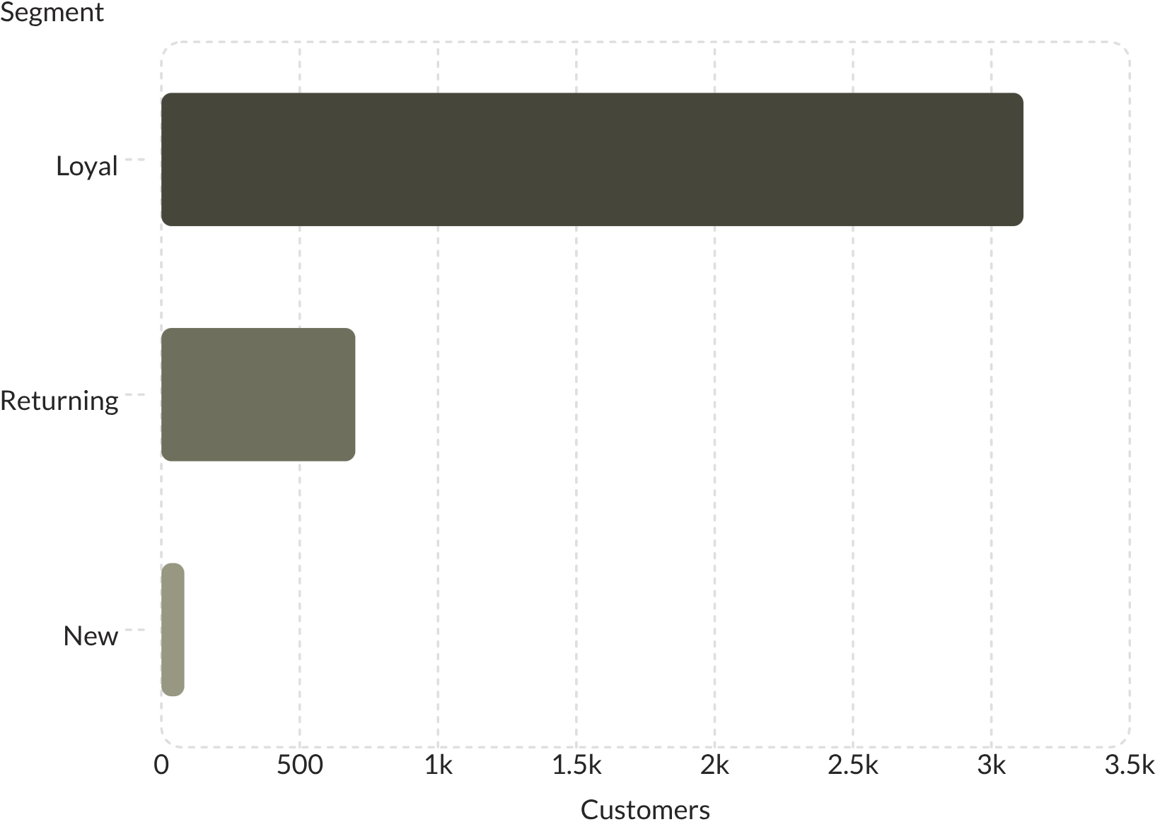

Customer Segmentation
Segment Breakdown
Customers classified by purchase history into three segments:
Loyal — 3,116 customers (dominant segment)
Returning — 701 customers
New — 83 customers (smallest, high-growth opportunity)
Of customers with 5+ purchases, 958 are subscribers vs. 2,518 non-subscribers — a clear conversion opportunity.

Slide 8


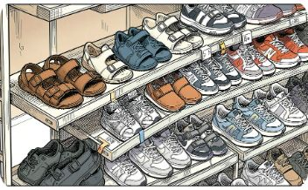
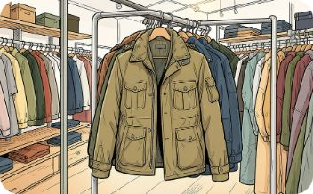
Top Products by Category
Accessories
Clothing
Footwear
Outerwear
Jewelry — 171 orders
Sunglasses — 161 orders
Belt — 161 orders
Blouse — 171 orders
Pants — 171 orders
Shirt — 169 orders
Sandals — 160 orders
Shoes — 150 orders
Sneakers — 145 orders
Jacket — 163 orders
Coat — 161 orders

Slide 9
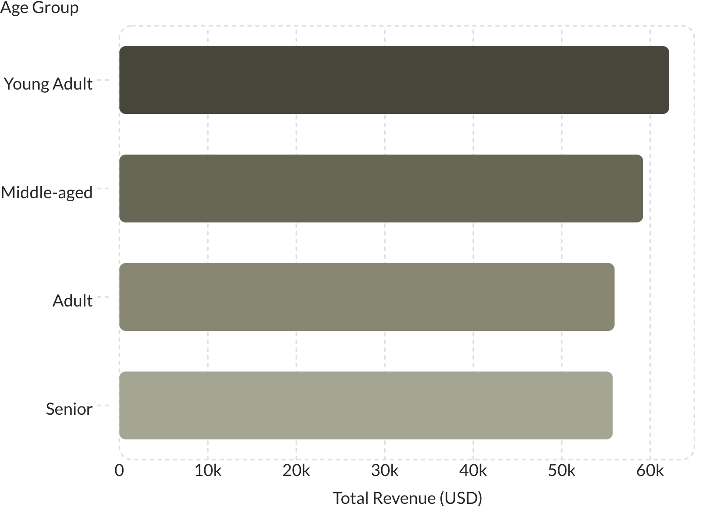
Revenue by Age Group
Key Takeaway
Young Adults lead revenue at $62,143, followed closely by Middle-aged ($59,197). Revenue is relatively evenly distributed across all age groups, suggesting broad market appeal.
Sales volume mirrors revenue trends: Young Adult (900), Middle-aged (850), Senior (800), Adult (750).

Slide 10





Power BI Dashboard & Business Recommendations
An interactive Power BI dashboard visualizes all insights — 3.9K customers, $59.76 avg purchase, 3.75 avg rating — with filters for subscription, gender, category, and shipping.
Boost Subscriptions
Loyalty Programs
Review Discount Policy
Promote exclusive subscriber benefits.
Reward repeat buyers to grow the Loyal segment.
Balance sales lifts with margin control.
Targeted Marketing
Product Positioning
Focus on high-revenue age groups and express-shipping users.
Highlight top-rated and best-selling products in campaigns.

