Slide 1


Prof. Dr. Hikmat Ullah Khan Department of Information Technology
Data Mining
classification Naïve Bayes
UNIVERsity of sargodha, sargodha

Slide 2


Lesson from Holy Quran

Slide 3
Classification
Classification
The training data (observations, measurements, etc.)
labels indicating the class of the observations
Training data is used to Learn from the data
Test data evaluates the learning
New data is classified based on the training set
Applications
Classification / Prediction
Detection /recognition

Slide 4
Clustering
clustering
No concept of Class label
The class labels of training data is unknown
Given a set of measurements, observations, etc. with the aim of establishing the groups in the data
Groups are also known as Clusters
Aim is to group
Max intra cluster Similarity
Min Inter cluster Similarity

Slide 5
Prediction Problems:Classification vs. Regression
Classification
predicts categorical class labels
classifies data (constructs a model) based on the training set and the values (class labels) in a classifying attribute and uses it in classifying new data
Numeric Prediction or Regression
models continuous-valued functions, i.e., predicts unknown or missing values
Typical applications for Decision making
Credit/loan approval:
Medical diagnosis: if a tumor is cancerous or benign
Fraud detection: if a transaction is fraudulent
Sentiment : which category it is, positive, negative, neutral
Prediction: Match result, weather, stock market etc

Slide 6
Classification—A Two-Step Process
Model construction: describing a set of predetermined classes
Each tuple/sample is assumed to belong to a predefined class, as determined by the class label attribute
The set of tuples used for model construction is training set
The model is represented as classification rules, decision trees, or mathematical formulae
Model usage: for classifying future or unknown objects
Estimate accuracy of the model
The known label of test sample is compared with the classified result from the model
Accuracy rate is the percentage of test set samples that are correctly classified by the model
Test set is independent of training set (otherwise overfitting)

Slide 7
Process (1): Model Construction
Classification
Algorithms
Training
Data
Classifier
(Model)
IF rank = ‘professor’
OR years > 6
THEN tenured = ‘yes’
7

Slide 8
Process (2): Using the Model in Prediction
Classifier
Testing
Data
Unseen Data
(Jeff, Professor, 4)
Tenured?
8

Slide 9
Attributes/Dimesions/Features

Slide 10
Bayesian Theorem: Basics
Let X be a data sample (“evidence”):
Let H be a hypothesis that X belongs to class C
Classification is to determine P(H|X), the probability that the hypothesis holds given the observed data sample X
P(H) (prior probability), the initial probability
E.g., X will buy computer, regardless of age, income, …
P(X): probability that sample data is observed
P(X|H) (posteriori probability), the probability of observing the sample X, given that the hypothesis holds
E.g., Given that X will buy computer, the prob. that X is 31..40, medium income

Slide 11
Bayesian Theorem
Given training data X, posteriori probability of a hypothesis H, P(H|X), follows the Bayes theorem
Informally, this can be written as
posteriori = likelihood x prior/(evidence)

Slide 12
Towards Naïve Bayesian Classifier
This can be derived from Bayes’ theorem
Since P(X) is constant for all the classes, we have only

Slide 13
Naïve Bayesian Classifier: Training Dataset
Class:
C1:buys_computer = ‘yes’
C2:buys_computer = ‘no’
Data sample
X = (age <=30,
Income = medium,
Student = yes
Credit_rating = Fair)

Slide 14
Naïve Bayesian Classifier: Training Dataset
P(C_{i}): P(buys_computer = “yes”) = 9/14 = 0.643
P(buys_computer = “no”) = 5/14= 0.357
X = (age <= 30 , income = medium, student = yes, credit_rating = fair)

Slide 15
Naïve Bayesian Classifier: An Example
P(C_{i}): P(buys_computer = “yes”) = 9/14 = 0.643
P(buys_computer = “no”) = 5/14= 0.357
Compute P(X|C_{i}) for each class
P(age = “<=30” | buys_computer = “yes”) = 2/9 = 0.222
P(age = “<= 30” | buys_computer = “no”) = 3/5 = 0.6
P(income = “medium” | buys_computer = “yes”) = 4/9 = 0.444
P(income = “medium” | buys_computer = “no”) = 2/5 = 0.4
P(student = “yes” | buys_computer = “yes) = 6/9 = 0.667
P(student = “yes” | buys_computer = “no”) = 1/5 = 0.2
P(credit_rating = “fair” | buys_computer = “yes”) = 6/9 = 0.667
P(credit_rating = “fair” | buys_computer = “no”) = 2/5 = 0.4
X = (age <= 30 , income = medium, student = yes, credit_rating = fair)

Slide 16
Naïve Bayesian Classifier: An Example
P(C_{i}): P(buys_computer = “yes”) = 9/14 = 0.643
P(buys_computer = “no”) = 5/14= 0.357
Compute P(X|C_{i}) for each class
P(age = “<=30” | buys_computer = “yes”) = 2/9 = 0.222
P(age = “<= 30” | buys_computer = “no”) = 3/5 = 0.6
P(income = “medium” | buys_computer = “yes”) = 4/9 = 0.444
P(income = “medium” | buys_computer = “no”) = 2/5 = 0.4
P(student = “yes” | buys_computer = “yes) = 6/9 = 0.667
P(student = “yes” | buys_computer = “no”) = 1/5 = 0.2
P(credit_rating = “fair” | buys_computer = “yes”) = 6/9 = 0.667
P(credit_rating = “fair” | buys_computer = “no”) = 2/5 = 0.4
X = (age <= 30 , income = medium, student = yes, credit_rating = fair)
P(X|C_{i}) : P(X|buys_computer = “yes”)= 0.222 x 0.444 x 0.667 x 0.667 = 0.044
P(X|buys_computer = “no”) = 0.6 x 0.4 x 0.2 x 0.4 = 0.019

Slide 17
Naïve Bayesian Classifier: An Example
P(C_{i}): P(buys_computer = “yes”) = 9/14 = 0.643
P(buys_computer = “no”) = 5/14= 0.357
Compute P(X|Ci) for each class
P(age = “<=30” | buys_computer = “yes”) = 2/9 = 0.222
P(age = “<= 30” | buys_computer = “no”) = 3/5 = 0.6
P(income = “medium” | buys_computer = “yes”) = 4/9 = 0.444
P(income = “medium” | buys_computer = “no”) = 2/5 = 0.4
P(student = “yes” | buys_computer = “yes) = 6/9 = 0.667
P(student = “yes” | buys_computer = “no”) = 1/5 = 0.2
P(credit_rating = “fair” | buys_computer = “yes”) = 6/9 = 0.667
P(credit_rating = “fair” | buys_computer = “no”) = 2/5 = 0.4
X = (age <= 30 , income = medium, student = yes, credit_rating = fair)
P(X|Ci) : P(X|buys_computer = “yes”) = 0.222 x 0.444 x 0.667 x 0.667 = 0.044
P(X|buys_computer = “no”) = 0.6 x 0.4 x 0.2 x 0.4 = 0.019
P(X|C_{i})*P(C_{i}) : P(X|buys_computer = “yes”) * P(buys_computer = “yes”) = 0.028
P(X|buys_computer = “no”) * P(buys_computer = “no”) = 0.007
Therefore, X belongs to class (“buys_computer = yes”)

Slide 18
Naïve Bayes Classifier: Comments
Advantages
Easy to implement
Good results obtained in most of the cases
Disadvantages
Assumption: class conditional independence, therefore loss of accuracy
Practically, dependencies exist among variables
E.g., hospitals: patients: Profile: age, family history, etc.
Symptoms: fever, cough etc., Disease: lung cancer, diabetes, etc.
Dependencies among these cannot be modeled by Naïve Bayes Classifier

Slide 19
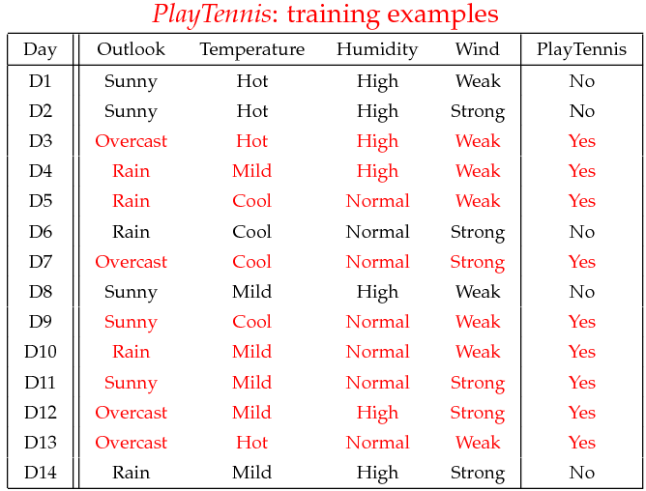
Exercise

Slide 20
Task
Given a new instance, predict its label
x’=(Outlook=Sunny, Temperature=Cool, Humidity=High, Wind=Strong)

Slide 21

Lesson

