Slide 1


Prof. Dr. Hikmat Ullah Khan Department of Information Technology
Data Mining
Rapidmiber
Tool tutorial
UNIVERsity of sargodha, sargodha

Slide 2
Content
Introduction
Preprocess
Loading
Visualizing
Apply model
Testing Model
Results
Performance of naïve Bayes and k-nn

Slide 3
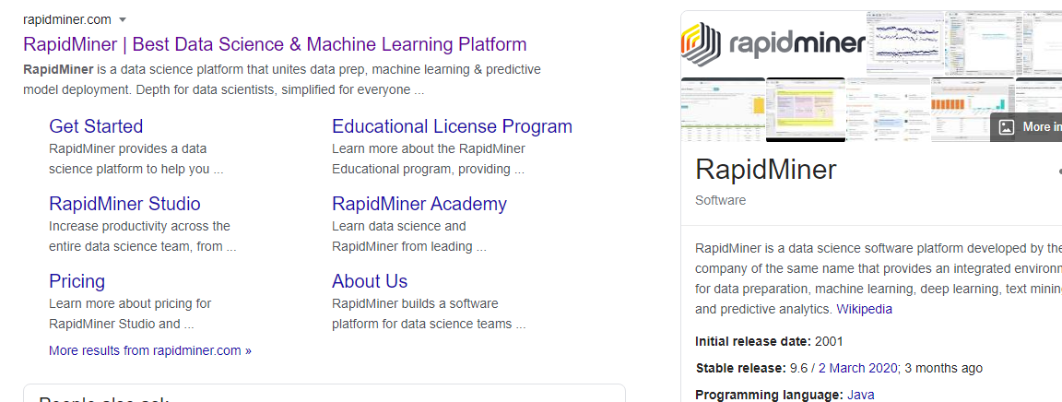
RapidMiner – Best Data Science Platform

Slide 4
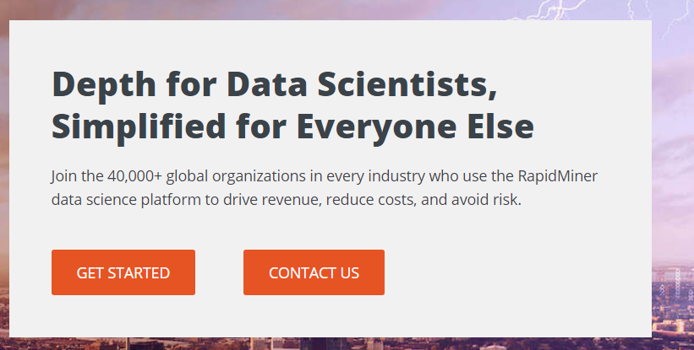
Why RapidMiner

Slide 5
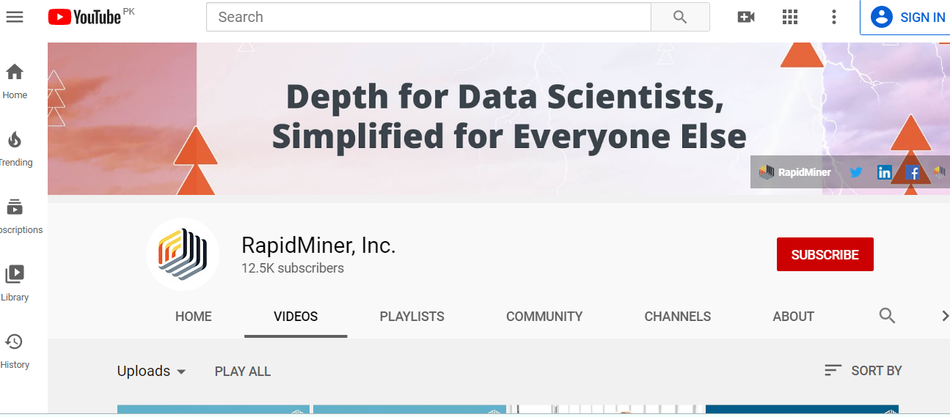
Subscribe – Best Source for RapidMiner learning

Slide 6
Introduction
RapidMiner is a Data mining software platform developed by the company of the same name.
That provides an integrated environment for
data preparation
Classification and all other main data mining processes and tasks using latest algorithms
Integration of Code as well
It is used for business and commercial applications as well as for research.

Slide 7
Download Rapiminer
Website:
https://my.rapidminer.com/nexus/account/index.html#downloads
Written in Java
Java API for using RapidMiner from other programs
Support Windows, Mac OS X and Linux

Slide 8
Data Set
Customer churn
Downloaded from
http://static.rapidminer.com/educatio...
Number of attributes = 7
Number of Examples= 999

Slide 9
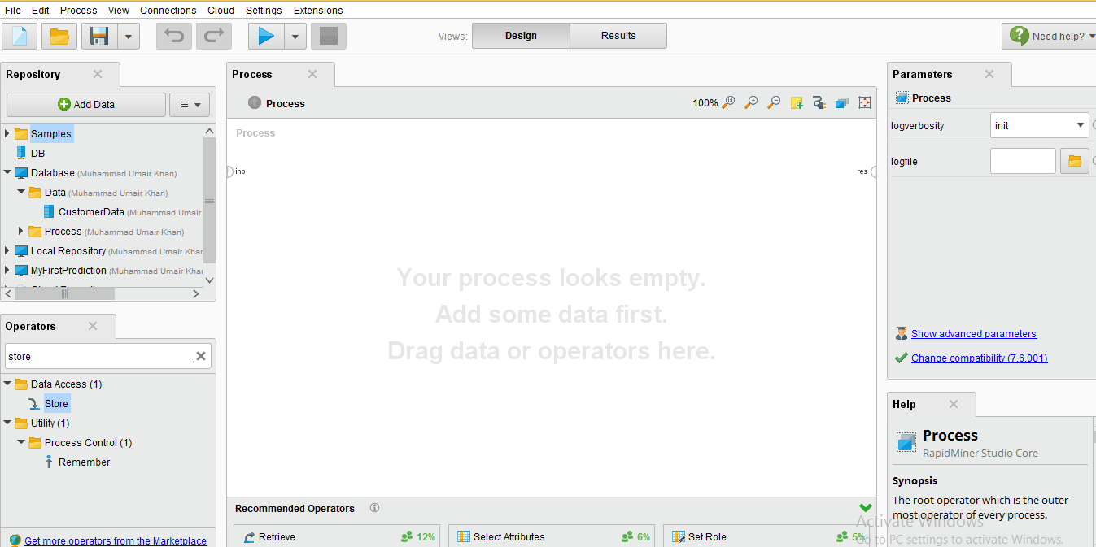
Preprocess
Views Section
in this section we store data and process
In this section
We add
parameter
to our data
From this section
We apply model
And algorithems
Help
About
process

Slide 10
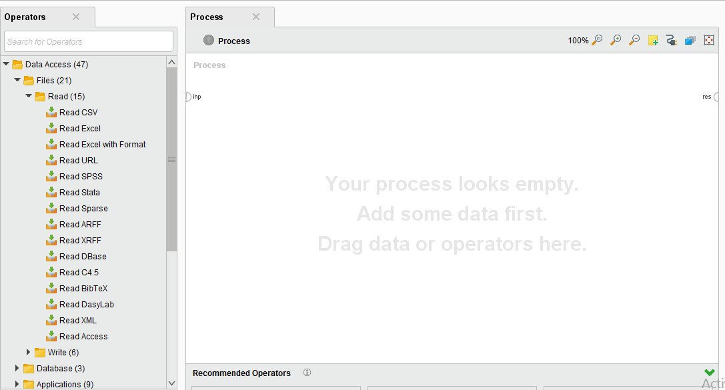
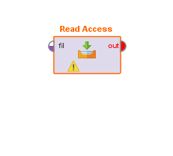
Adding Access data
Pick and Drop

Slide 11
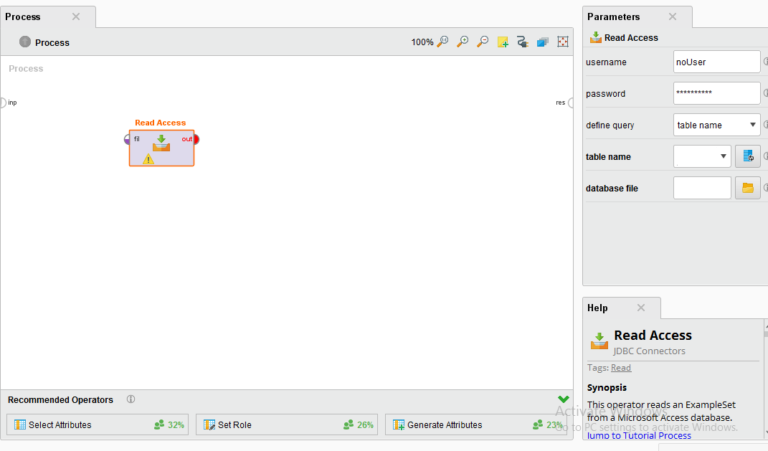
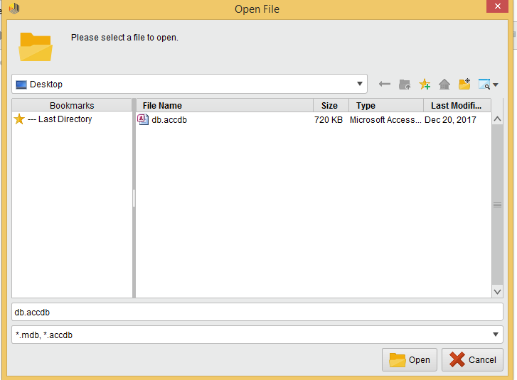
db

Slide 12
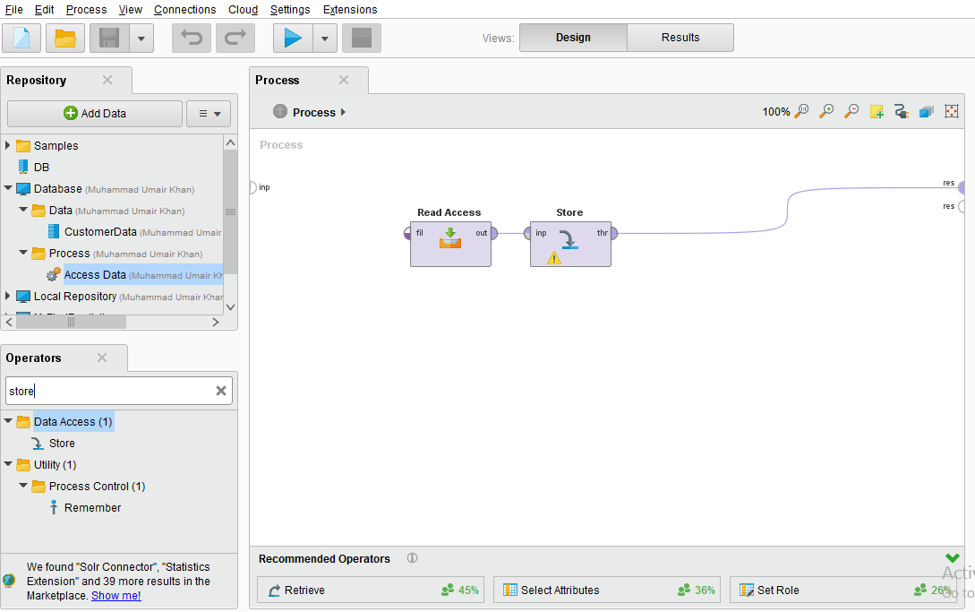
Store

Slide 13
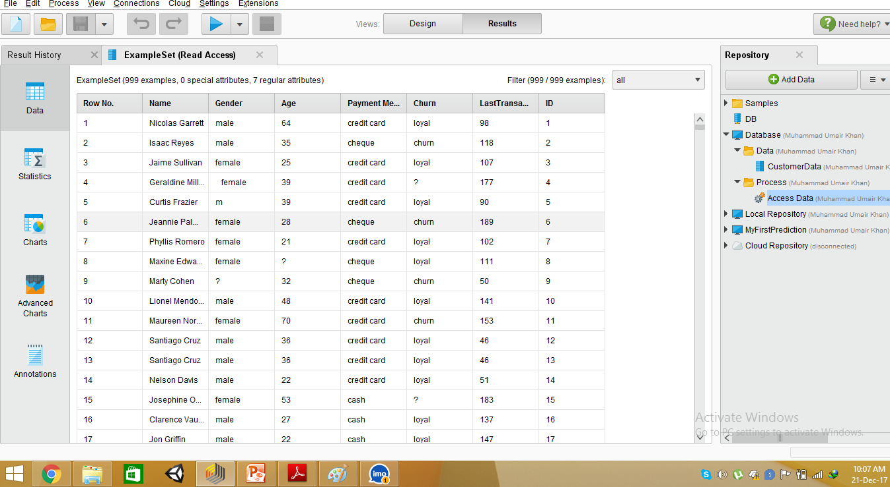

Slide 14
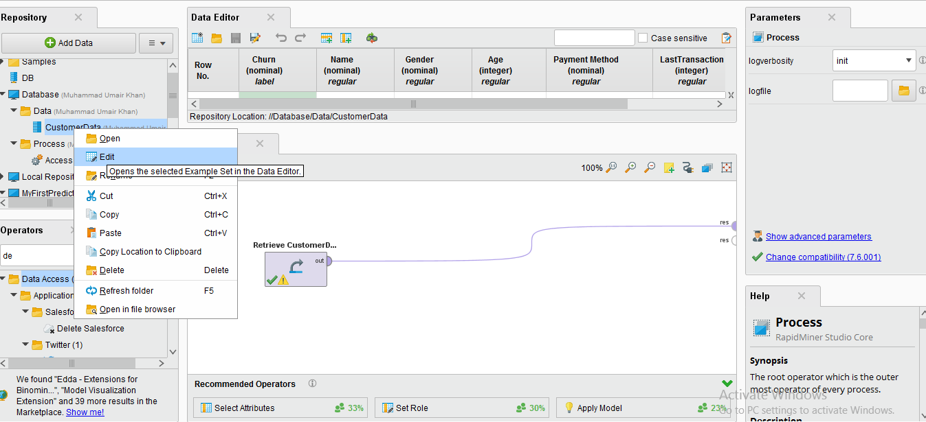
Visualizing data

Slide 15
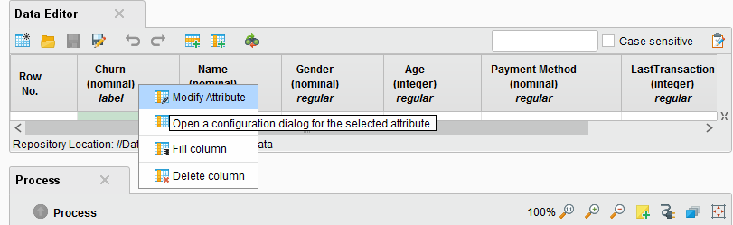
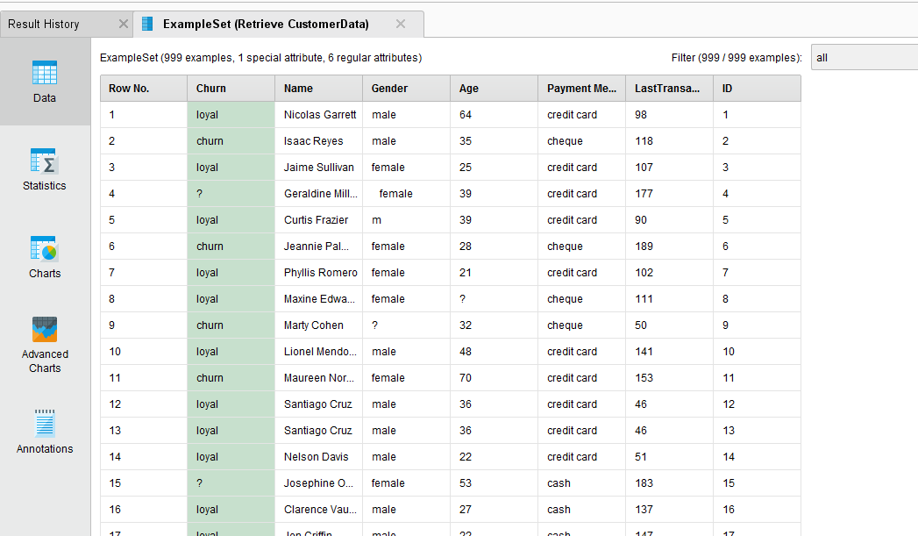

Slide 16
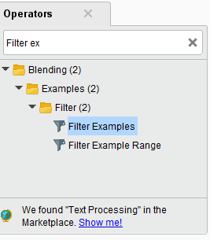
Creating models
Building a decision tree
Missing data in special attribute
Using ETL is short for extract, transform, load, three database functions. Remove missing data

Slide 17
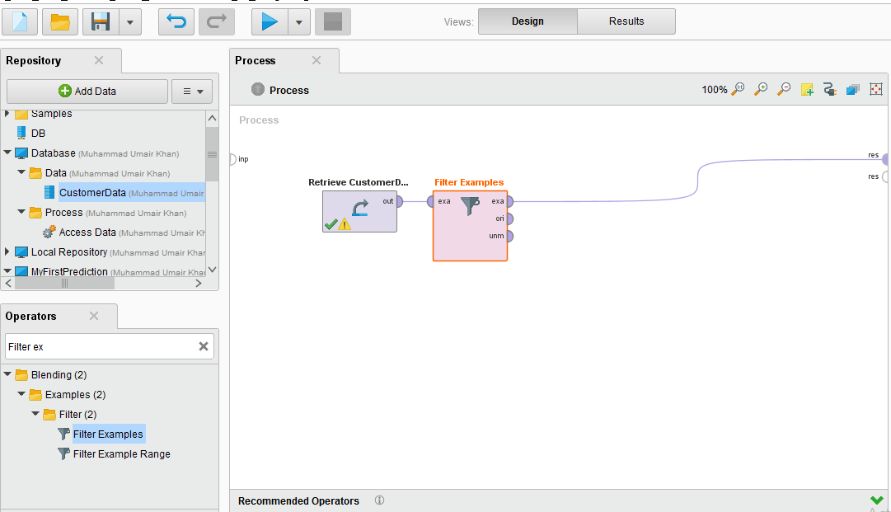

Slide 18
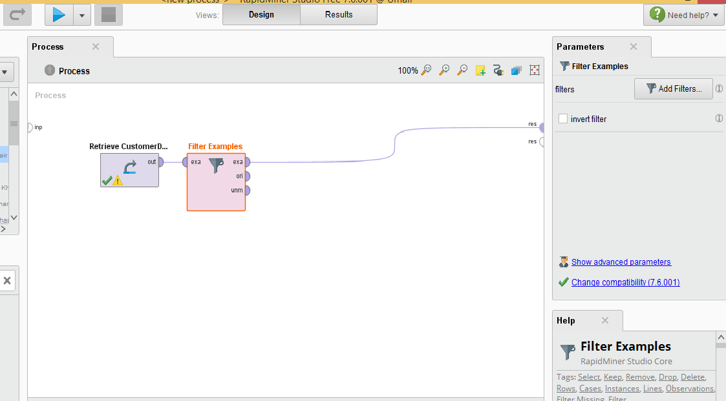
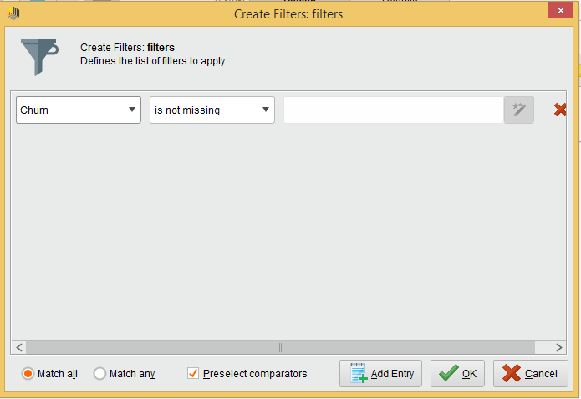

Slide 19
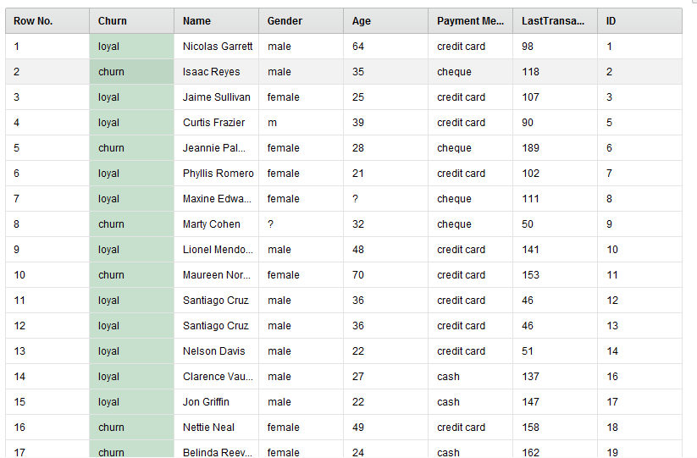
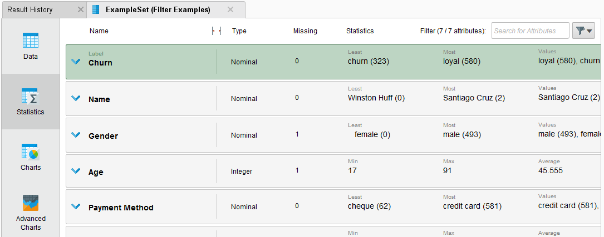

Slide 20
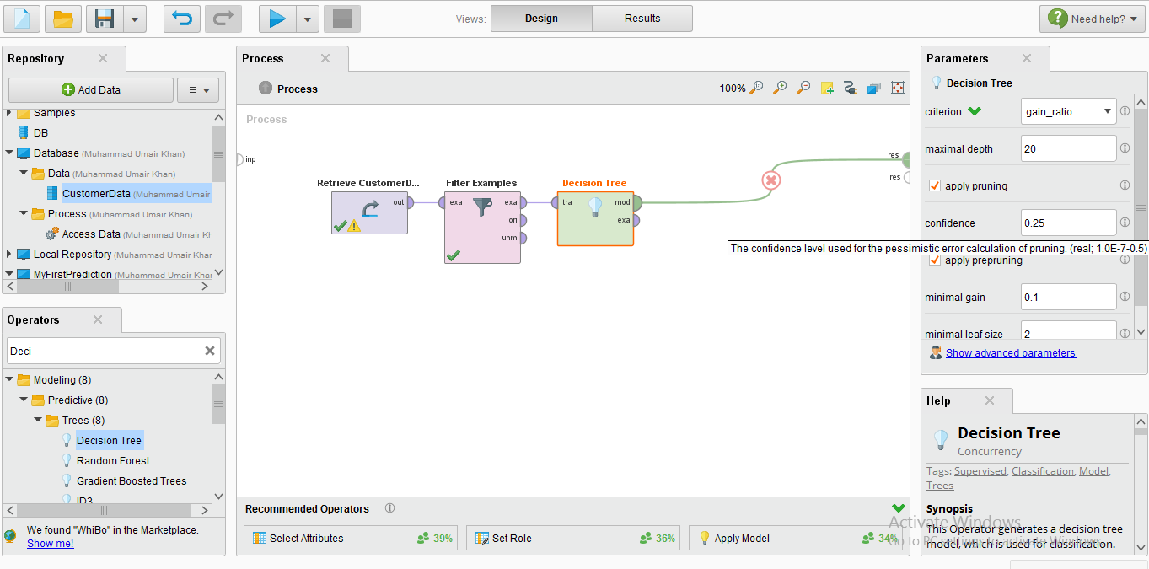
Decision Tree

Slide 21
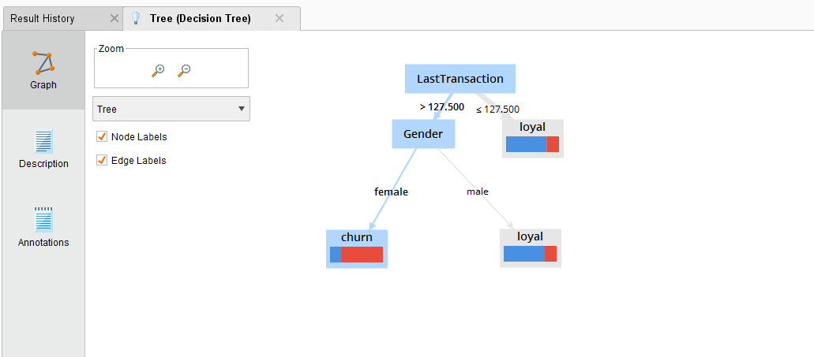
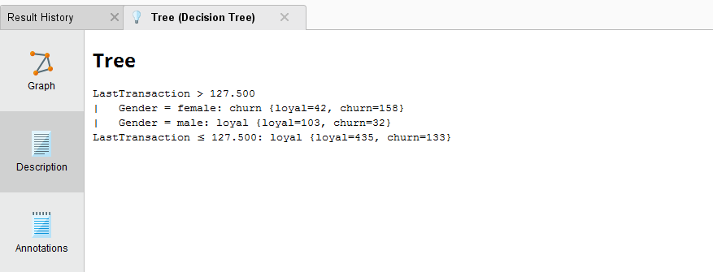
Decision Tree

Slide 22
Apply model
To predict the missing data
Creating the process

Slide 23
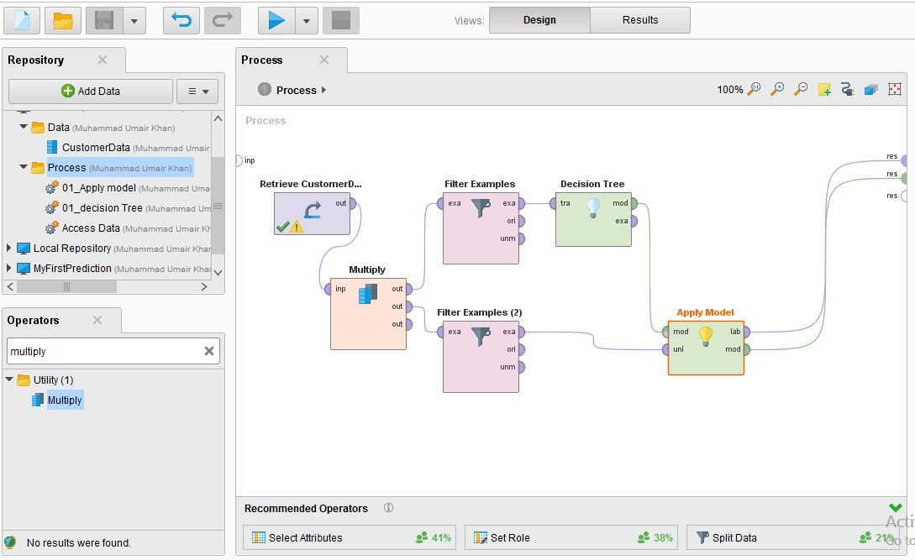

Slide 24
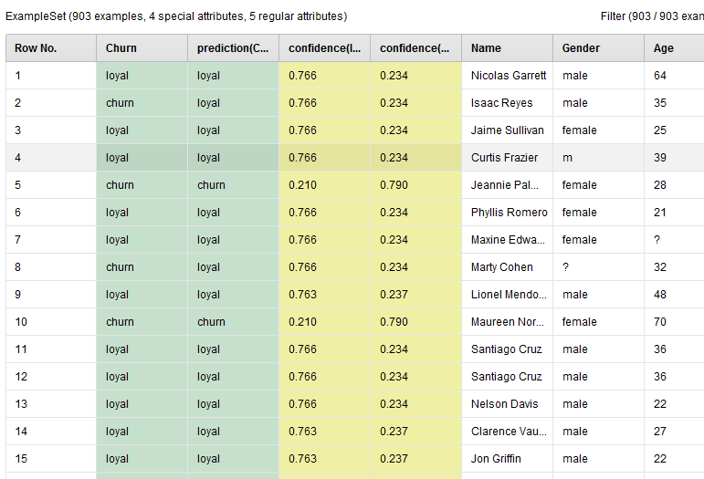

Slide 25
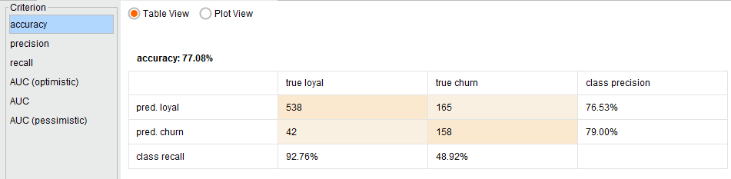
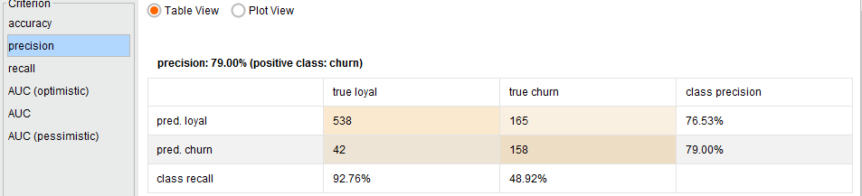
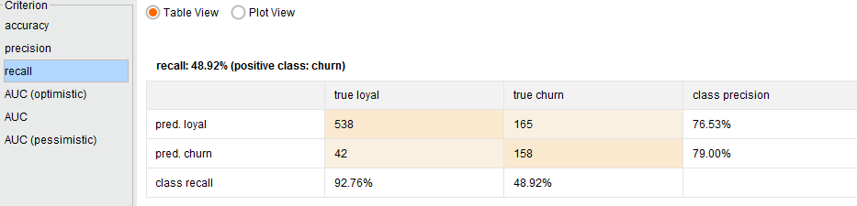
Adding performance

Slide 26
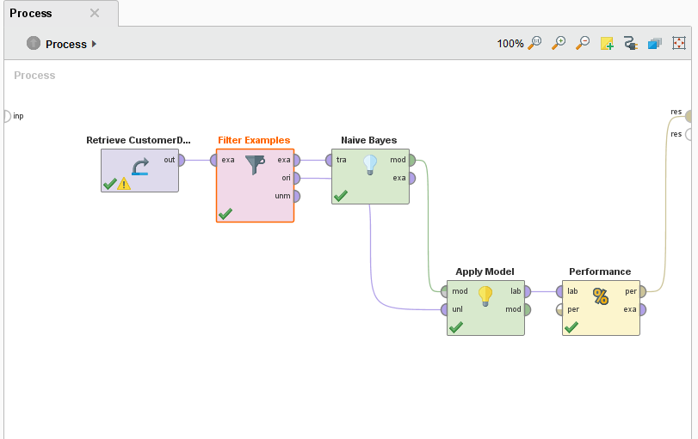
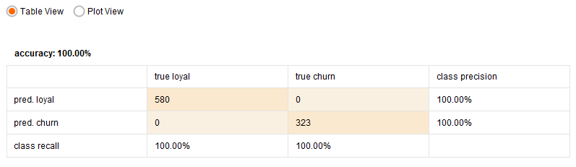
Navie Bayes

Slide 27
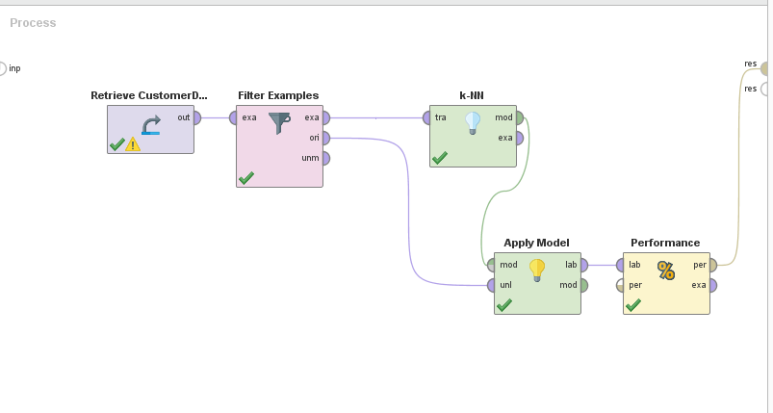
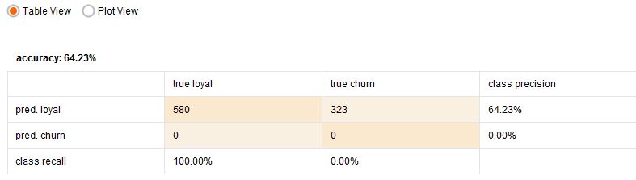
K-NN

Slide 28
Recommended Videos and Tutorials
Database Connections
https://www.youtube.com/watch?v=c2DNmaPGGLQ
Text Association Rules
https://www.youtube.com/watch?v=1gcUI8QVDNc
Recommendations Systems
https://www.youtube.com/watch?v=2vsE6N6TNtI
RapidMiner with Python and pyCharm
https://www.youtube.com/watch?v=XvG6GwWPhD8
Outlier Detection
https://www.youtube.com/watch?v=AArY8P2RHtg

Slide 29
Assignment
Semester 2:
Each Student should select at least one Topic for presentation
Prepare topic/Video from RapidMiner Channel or Any other Video on YouTube chanel/Tutorial on Web
Present 10min Presentation on how to do it using RapidMiner
Main aim is Tutorial – for accomplishing that research task
Video length is expected to be more than 25min
Semester 3:
Should cover the topic with respect to their Area of Research
RECOMMENDER SYSTEMS , SENTIMENT ANALYSIS, ANY OTHER TOPIC YOU LIKE
For instance Scientometrics, should cover more on Database connectivity, data exploration etc
ML/DM/DL should cover feature engineering, auto model, association rule mining, etc
PhD:
Deep Learning
Role of RapidMiner in Research

Slide 30
Recommender Links
How to Cure the Model Impact Epidemic
https://www.youtube.com/watch?v=44A8VhPsKrk&ab_channel=RapidMiner%2CInc.
Automatic Feature Engineering
https://www.youtube.com/watch?v=Ol0ZXN-GFTo&list=PLssWC2d9JhOYHckv8GFQIlgaOfwvlaZZh&index=4&ab_channel=RapidMiner%2CInc.
Auto Model
https://www.youtube.com/watch?v=uq36VLMju-4&list=PLssWC2d9JhOYHckv8GFQIlgaOfwvlaZZh&index=12&ab_channel=RapidMiner%2CInc.
ML with Objective Optimization
https://www.youtube.com/watch?v=oSLASLV4cTc&list=PLssWC2d9JhOYHckv8GFQIlgaOfwvlaZZh&index=13&ab_channel=RapidMiner%2CInc.
Rapidminer and Tableau
https://www.youtube.com/watch?v=OyOrPQqrFeI&list=PLssWC2d9JhOYHckv8GFQIlgaOfwvlaZZh&index=15&ab_channel=RapidMiner%2CInc.
Deep Learning using RapidMiner
https://www.youtube.com/watch?v=rJCU8ODRwyg&list=PLssWC2d9JhOYHckv8GFQIlgaOfwvlaZZh&index=16&ab_channel=RapidMiner%2CInc.
Text analytics
https://www.youtube.com/watch?v=gt06_STeTYA&list=PLssWC2d9JhOYHckv8GFQIlgaOfwvlaZZh&index=33&ab_channel=RapidMiner%2CInc.

Slide 31


