Slide 1
Visualization of Traffic Crash Data in Iowa
CRP 558 Final Project
Saad Tarik

Slide 2
Goals
Create thematic maps for counties in Iowa that shows traffic crashes from 2011 to 2013
The thematic maps include
Total number of crashes
Damage of properties in USD
Types of crashes in 2013

Slide 3
Data and Technology
Data used: Historical traffic crash statistics from Iowa Department of Transportation
Years of Analysis: 2011 to 2013
Technology used:
HTML
JavaScript
jQuery
Leaflet
JSON and geoJSON
ArcMap Spatial Analysis
Bootstrap panels

Slide 4
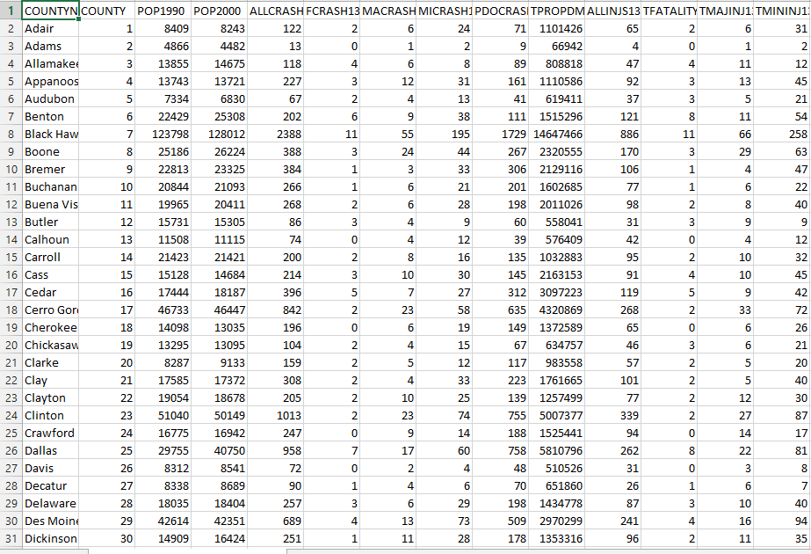
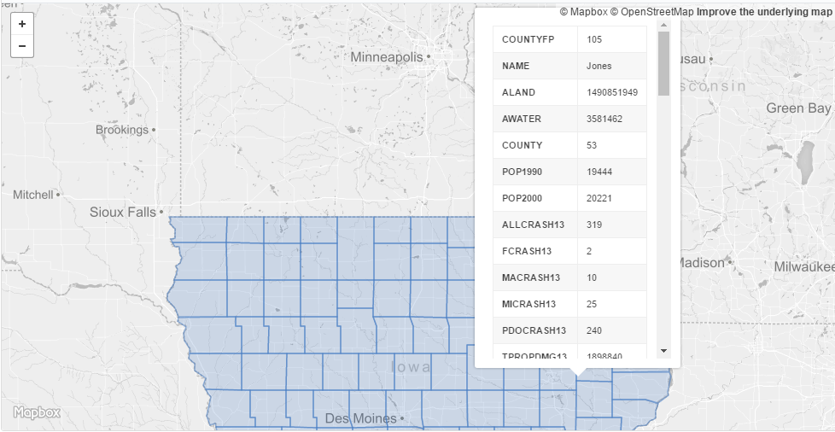
Development
Conversion of .csv data to geoJSON
Spatial join with Iowa counties shapefile
Filter data for the years 2011-2013
Convert to geoJSON
CSV data
Converted to geoJSON

Slide 5
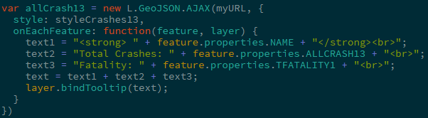
Filtering data
Filtered the variables of interest using jQuery
Total number of crashes
Total fatalities
Total property damage in USD
Types of crashes
Alcohol and drugs
Normal bus
School bus
Pedestrian
Truck
Motorcycle
Data filtering example

Slide 6
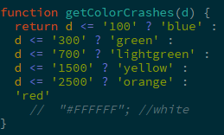
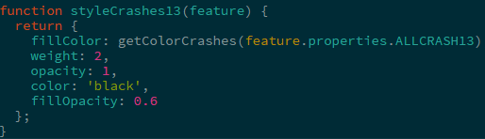
Classify and assign colors
Each dataset were assigned classes and colors
Define styles

Slide 7
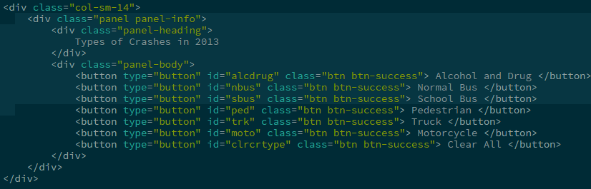
Bootstrap panels
Panels were created using bootstrap for
Map
Buttons

Slide 8
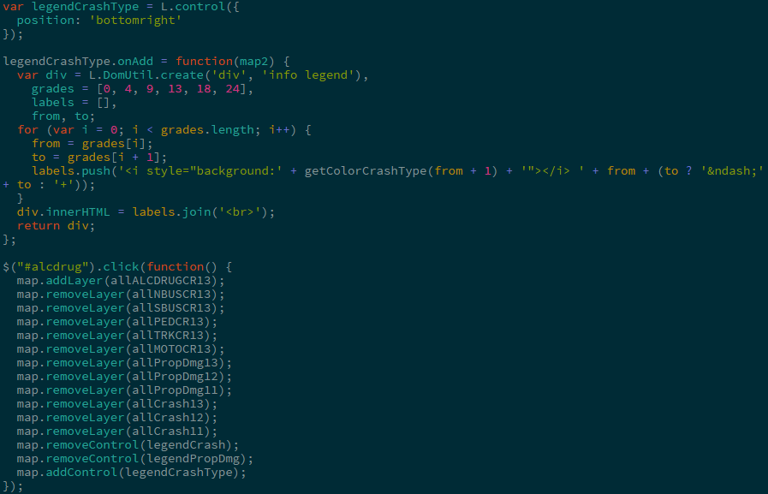
Legends
Legend controls were created to interact with active layers

Slide 9
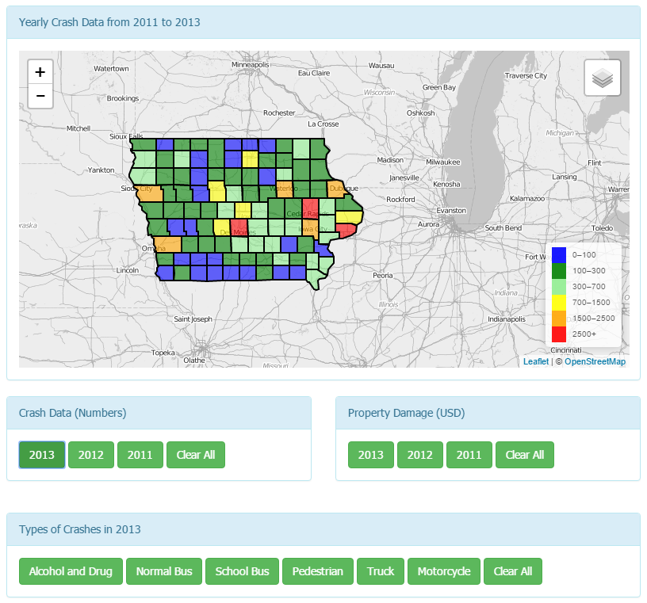
Final Product
Thematic map
Total crashes filtered by year
Fatality information in tooltip
Total property damage filtered by year
Types of crashes in 2013

