Slide 1

Java project “Random Surah Generator”
Presented by :
Raja Abdulrahman(bs-se-e-21-81)
Saadullah(bs-se-e-21-61)
Java project :
Random Surah Player
Presented by:
(BSSE-E2-21-81) Raja Abdulrahman
(BSSE-E2-21-62) SaadUllah

Slide 2
Code with explaination
1.import java.io.File;
This line imports the File class from the java.io package. The File class represents a file or directory on the computer's file system and provides methods for working with them.
2.import java.util.Random;
This line imports the Random class from the java.util package. The Random class is used for generating random numbers, which will be used to select an audio file randomly in this program.
Code with explanation

Slide 3
4. private static final String AUDIO_DIRECTORY = "D:\\Surah"; // Replace with your audio directory
This line defines a constant string variable called AUDIO_DIRECTORY. It stores the directory path where your audio files are located. You'll need to replace "D:\Surah" with the actual location of your audio files on your system.
5.private static final String[] SUPPORTED_EXTENSIONS = {".mp3", ".wav"}; // Add more extensions if needed
This line defines a constant string array called SUPPORTED_EXTENSIONS. It stores a list of supported audio file extensions for filtering. You can add more extensions (e.g., ".ogg", ".flac") if needed.

Slide 4
6.public static void main(String[] args) {
This line defines the main function, which is the entry point of the program.
The function is declared as public, meaning it can be accessed from anywhere outside the class.
It's declared static, meaning it can be called without creating an instance of the class.
The function is void, indicating it doesn't return any value.
The String[] args parameter is used to receive command-line arguments (not used in this code).

Slide 5
7.File audioDirectory = new File(AUDIO_DIRECTORY);
This line creates a new File object called audioDirectory that represents the directory path specified in the AUDIO_DIRECTORY constant.
8.if (!audioDirectory.isDirectory()) { ... return; }
This is an if statement that checks if the provided directory exists and is actually a directory.
!audioDirectory.isDirectory() checks the opposite (negation) of isDirectory(). So, it checks if the path is not a directory.
If the path is not a directory, an error message is printed indicating the issue, and the program exits using return;.

Slide 6
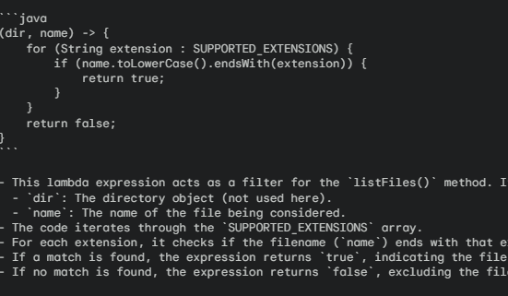
9.File[] audioFiles = audioDirectory.listFiles((dir, name) -> { ... });
This line retrieves all files from the audioDirectory using the listFiles() method. However, it also uses a lambda expression for filtering.

Slide 7
10. if (audioFiles.length == 0) { ... return; }
This is another if statement that checks if the audioFiles array is empty (no audio files found after

Slide 8
import java.io.File;
import java.util.Random;
public class RandomAudioPlayer {
private static final String AUDIO_DIRECTORY = "D:\\Surah"; // Replace with your audio directory
private static final String[] SUPPORTED_EXTENSIONS = {".mp3", ".wav"}; // Add more extensions if needed
public static void main(String[] args) {
File audioDirectory = new File(AUDIO_DIRECTORY);
if (!audioDirectory.isDirectory()) {
System.out.println("Error: " + AUDIO_DIRECTORY + " is not a directory.");
return;
}
// Filter audio files based on extensions
File[] audioFiles = audioDirectory.listFiles((dir, name) -> {
for (String extension : SUPPORTED_EXTENSIONS) {
if (name.toLowerCase().endsWith(extension)) {
return true;
}
Entire Code

Slide 9
}
return false;
});
if (audioFiles.length == 0) {
System.out.println("No audio files found in the directory.");
return;
}
// Select a random audio file
Random random = new Random();
int randomIndex = random.nextInt(audioFiles.length);
File selectedAudio = audioFiles[randomIndex];
// *Note:* This code snippet only selects the audio file. futher it need to use a media player library like jplayer or Os specific APIs to play the audio.
System.out.println("Playing random audio: " + selectedAudio.getName());
}
}

Slide 10
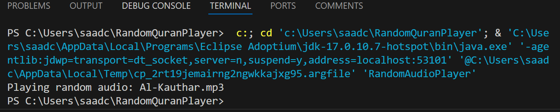
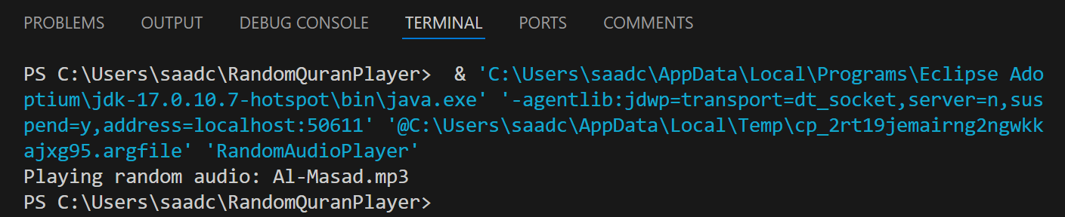
Code Output > Selecting Random Surah

Slide 11
“ Thanks For the opportunity ” we’ll work on it, and re-submit the code with more and complete progress soon
BSSE-E2-21-62
Saad Ullah BSSE-E2-21-81
Raja Abdulrahman

