Slide 1
SALES LEADERSHIP · DIGITAL ASSISTANT
Asistente
The operating system for sales leaders. Know what to do today — and act on your whole team from one place. Simple, from the phone.
Sales-team management platform
Proposal · June 2026

Slide 2
AGENDA
What we'll cover.
A walkthrough of the problem, the solution and the plan.
01
The problem
Why the leader's communication gets lost today
04
How it works
The loop: signals → engine → action
02
The solution
What the Assistant is and how it feels
05
Where we're going
Phased roadmap and what's still missing
03
See it today
The clickable prototype: leader & agent apps
06
What we need
To move forward together
Asistente · Proposal 2026 1 / 18

Slide 3
01 · THE PROBLEM
The leader is drowning.
Managing ~1,300 agents by hand and by memory.
📱 Too much WhatsApp — Everything comes in through one channel and important things slip through.
🚪 Who's leaving? — No early visibility on agents about to quit or who needs help first.
🐢 Slow onboarding — New agents take long to produce, and there's no view of where they get stuck.
🧠 Run from memory — Follow-ups, reminders and decisions all in the leader's head → stress, no scale.
THEY DON'T NEED MORE INFORMATION. They need to know where to act today.
Asistente · Proposal 2026 2 / 18

Slide 4
01 · BEFORE VS AFTER
How each flow changes.
From scattered and manual to prioritized and measured.
TODAY · WITHOUT THE APP
WITH ASISTENTE
✉️ Messages that get lost — WhatsApp floods, nothing measured
❓ No idea who's at risk — Reacts late, loses agents
📋 Onboarding by hand — No view of who's stuck
🗂️ Data in the head — Forgotten follow-ups
🔔 One triaged inbox — Reply from the app, every message tracked
🎯 A single Score per agent — See risk at a glance
🏆 Game-like onboarding — Funnel shows where each one is
⚡ Act in 1–2 taps — Everything auto-recorded
Asistente · Proposal 2026 3 / 18

Slide 5
02 · THE SOLUTION
What it feels like to use it.
Three ideas drive everything — plus the WhatsApp inbox at the core.
⚡
Visible urgency
On open, see what to do now — color-prioritized 🔴🟠🟡🟢.
👆
Direct action
Reply, call, assign, recognize — like a digital wallet.
🎯
Radical simplicity
One thing at a time. Built for a non-technical user.
THE THREE PILLARS
🛡️ Control — See the whole team's status at a glance (Agent Score 0–100).
🔭 Follow-up — Turn data into actions: who to call, who to help, who's leaving.
🚀 Development — Game-like onboarding toward the first sale.
Asistente · Proposal 2026 4 / 18

Slide 6
02 · THE AGENT SCORE
One number per person.
It sums up each agent so the leader doesn't analyze 1,300 people.
82
0–100
Activity 30%
Training attendance 20%
Goal compliance 30%
🟢 HEALTHY
Interaction 20%
Asistente · Proposal 2026 5 / 18

Slide 7
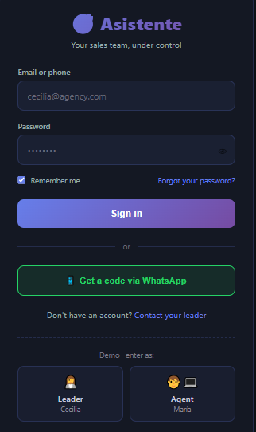
03 · SEE IT TODAY · ACCESS
The login.
💡 KEY POINT Simple sign-in, multi-language (EN / ES / PT) and a WhatsApp-code option — on brand with how agents already communicate.
Asistente · Proposal 2026 6 / 18

Slide 8
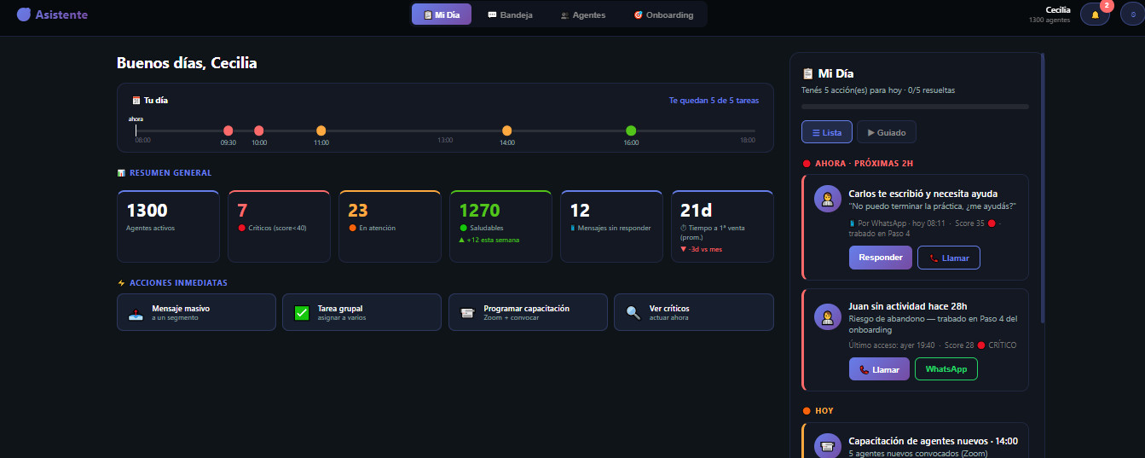
03 · SEE IT TODAY · MY DAY
What to do today, at a glance.
💡 KEY POINT Day timeline (what's left and when) + team summary + quick actions + a prioritized task list with a step-by-step guided mode.
Asistente · Proposal 2026 7 / 18

Slide 9
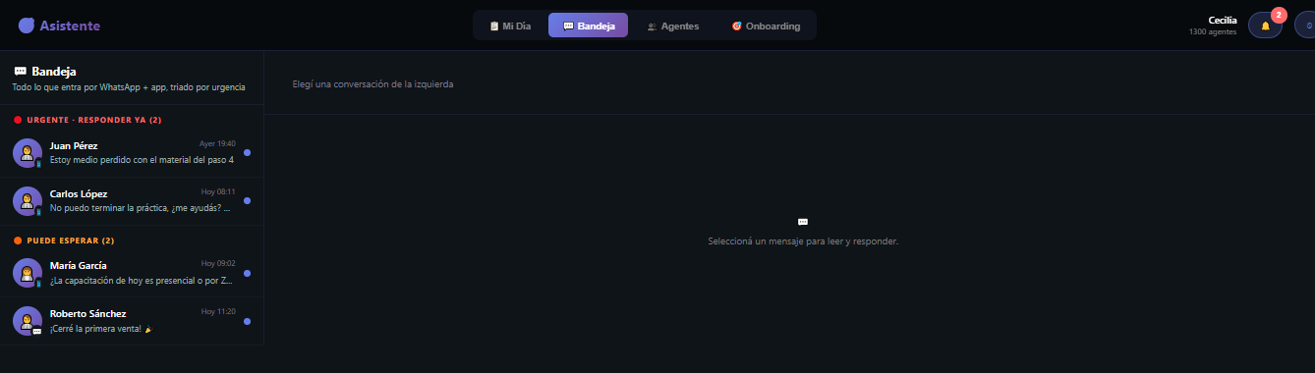
03 · SEE IT TODAY · INBOX
WhatsApp, triaged.
💡 KEY POINT Every incoming message sorted into Urgent / Can wait / Answered — the leader reads and replies from one place.
Asistente · Proposal 2026 8 / 18

Slide 10
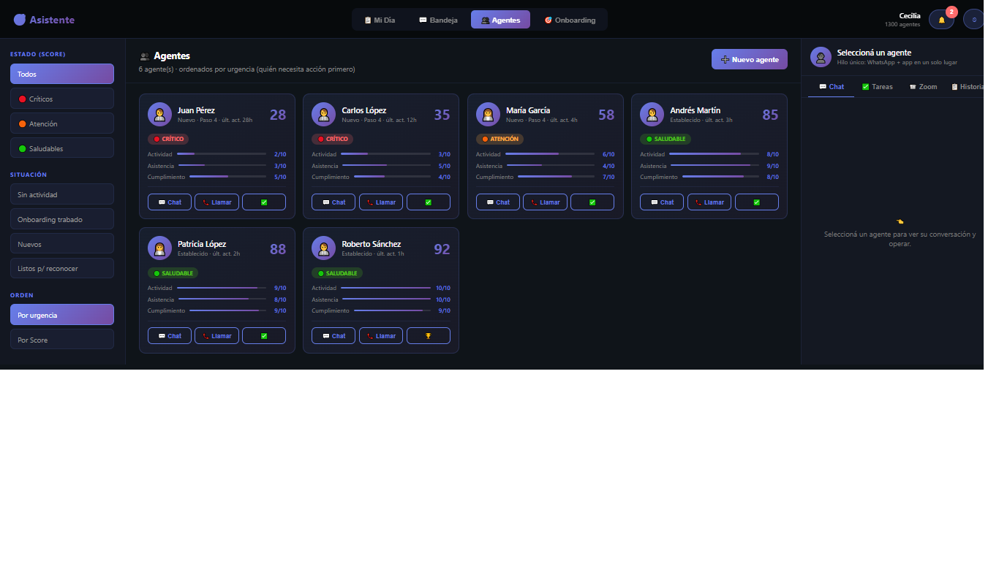
03 · SEE IT TODAY · AGENTS
The whole team, by urgency.
💡 KEY POINT One Score (0–100) per agent, filters by status, and communication built into each card.
Asistente · Proposal 2026 9 / 18

Slide 11
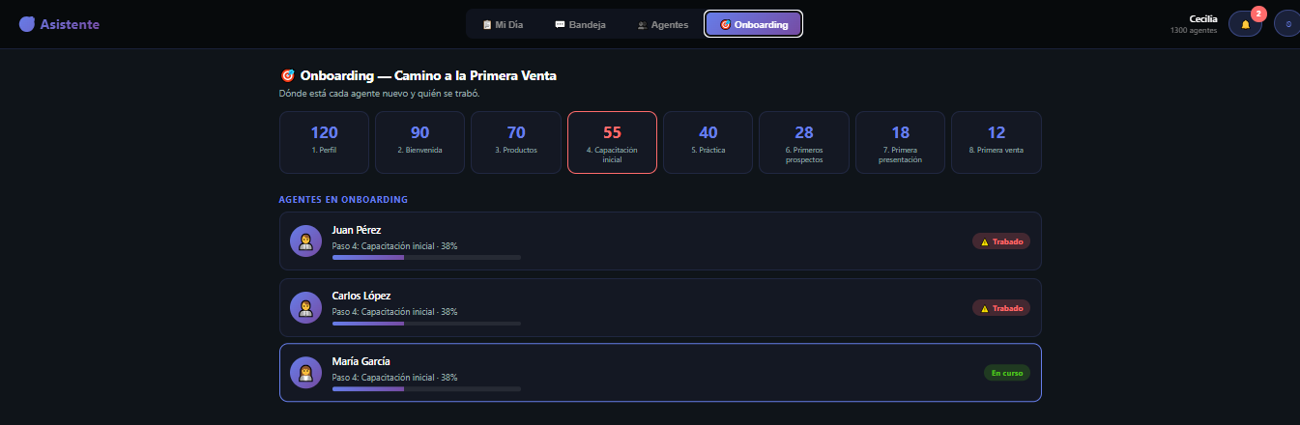
03 · SEE IT TODAY · ONBOARDING
Who's stuck on the way to the first sale.
💡 KEY POINT A funnel of the 8 steps and a flag on every agent who got stuck — so the leader acts before they quit.
Asistente · Proposal 2026 10 / 18

Slide 12
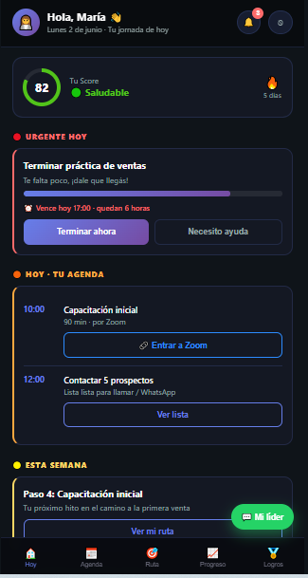
03 · SEE IT TODAY · AGENT APP
The agent's pocket coach.
💡 KEY POINT
The agent sees their Score, today's urgent task, agenda, learning path and alerts. Game-like and mobile-first.
Asistente · Proposal 2026 11 / 18

Slide 13
04 · HOW IT WORKS
A closed loop.
Every message and action feeds the system back.
1
Signals in
WhatsApp · activity · Zoom · production
2
Engine calculates
Agent Score + prioritized alerts
3
Leader acts
'What to do today' in 1–2 taps
4
Recorded
History feeds back into the system
→
→
→
The Agent Score and the alerts are computed automatically — never typed in by hand. That's the intelligence of the system.
Asistente · Proposal 2026 12 / 18

Slide 14
05 · WHERE WE'RE GOING
Phased roadmap.
Value early: Phase 1 solves ~80% of the pain without AI.
Phase 0 · Discovery
In progress
Validate data access, team structure, WhatsApp number, agenda.
Phase 1 · MVP
Next
Dashboard + Score + Inbox + Alerts + Onboarding, on a real database.
Phase 2 · Automation
Later
WhatsApp API, automatic Zoom attendance, WFG data, push, mass messaging.
Phase 3 · Intelligence (AI)
Future
24/7 assistant, sales simulator, churn prediction, meeting summaries.
Asistente · Proposal 2026 13 / 18

Slide 15
05 · WHAT'S STILL MISSING
Honest about the road ahead.
Presented as next phases, not gaps.
🔌 Real integrations — WhatsApp Business API, Zoom attendance, WFG production data, push.
⚙️ The backend — Database, the engine that computes Score & alerts, and security (US data region).
📱 Platform decision — App stores vs installable web app — defines the technical path.
🌐 Full multi-language — Login already shows it; extend across the whole app (English by default).
Asistente · Proposal 2026 14 / 18

Slide 16
06 · WHAT WE NEED FROM YOU
To close Phase 0.
Five questions that unlock the whole design.
1
What does your day look like, and how do you manage your agenda today?
2
How are your ~1,300 agents organized? (by leader, cohort, product…)
3
Which WhatsApp number do agents write to today?
4
What data does WFG give you, and how do you access it?
5
How do you onboard a new agent, and what data do you have on each?
Asistente · Proposal 2026 15 / 18

Slide 17
This isn't a CRM or a course platform.
It's the operating system a sales leader needs to stop drowning — and to scale a team without losing control.
We start with what hurts most and delivers value fast. The rest is an expansion, with a clear path.
Asistente · Proposal 2026 16 / 18

Slide 18
Thank you.
Questions, comments, next steps.
Contact Saady Pacheco
saadypacheco@gmail.com
Clickable prototype: login.html · dashboard-v5-mi-dia.html · agente.html
Asistente · Proposal 2026 17 / 18

