Slide 1
HDI · SF Bay Area · Vendor-health tooling
Pulse
Production-grade vendor-health monitoring for IT ops.
Thirty SaaS vendors. Sixty-second cadence. Two hundred seventy-six tests.
Built at Box IT as a Platform Engineer transition proof point.
Saagar Patel · Box IT
github.com/saagpatel/ITServiceHealth · MIT

Slide 2
01 · PROBLEM
The vendor-health signal is broken at the operator's desk.
30+ SaaS vendors
Status pages lag reality
Identity, productivity, collaboration, engineering, HR, finance, sales, marketing, support. Every outage reaches the help desk before the status page does.
Vendors mark themselves green while users flood #it-help. RSS is stale. JSON APIs don't agree on a schema. Manual updates go stale within the hour.
Slack becomes the war room
Leadership asks: is it us?
No dedup. No severity routing. Alerts arrive on the same channel as brownouts, flapping pollers, and vendor maintenance windows no one acknowledged.
Exec walks up to the big screen and wants one number. The NOC wall shows 80 service tiles and a timeline. That is not the meter a director reads.
Pulse · HDI SF Bay Area
02 / 10

Slide 3
02 · WHAT WE BUILT
One dashboard. Two views. Production-graded.
Pulse polls every vendor, normalizes five states, detects changes, writes audit events, and posts one clean Slack alert per real incident. Two views off the same data: Executive for the conference room, Engineer for the triage desk.
v1
Poll loop · 5-state normalizer · Slack Block Kit · React UI · dep graph · timeline · SLA
v2 · phase 0-1
Bearer-token admin auth · stamina retries · purgatory circuit breakers · poller_health · unknown-on-blind
v2 · phase 2
Flap suppression · dedup window · tier routing · dependency correlation · maintenance windows
v2 · phase 3
structlog JSON · Prometheus /metrics · Sentry · Healthchecks.io dead-man's switch
v2 · phase 4
aiosqlite pool · Litestream streaming · daily VACUUM INTO · retention · WAL checkpointing
v2 · phase 5-6
TanStack-style polling · Executive/Engineer toggle · PWA · a11y · CI · Caddy · Keychain
30
60 s
276
~1 s
SaaS vendors
poll cadence
tests passing
RPO · Litestream
Pulse · HDI SF Bay Area
03 / 10

Slide 4
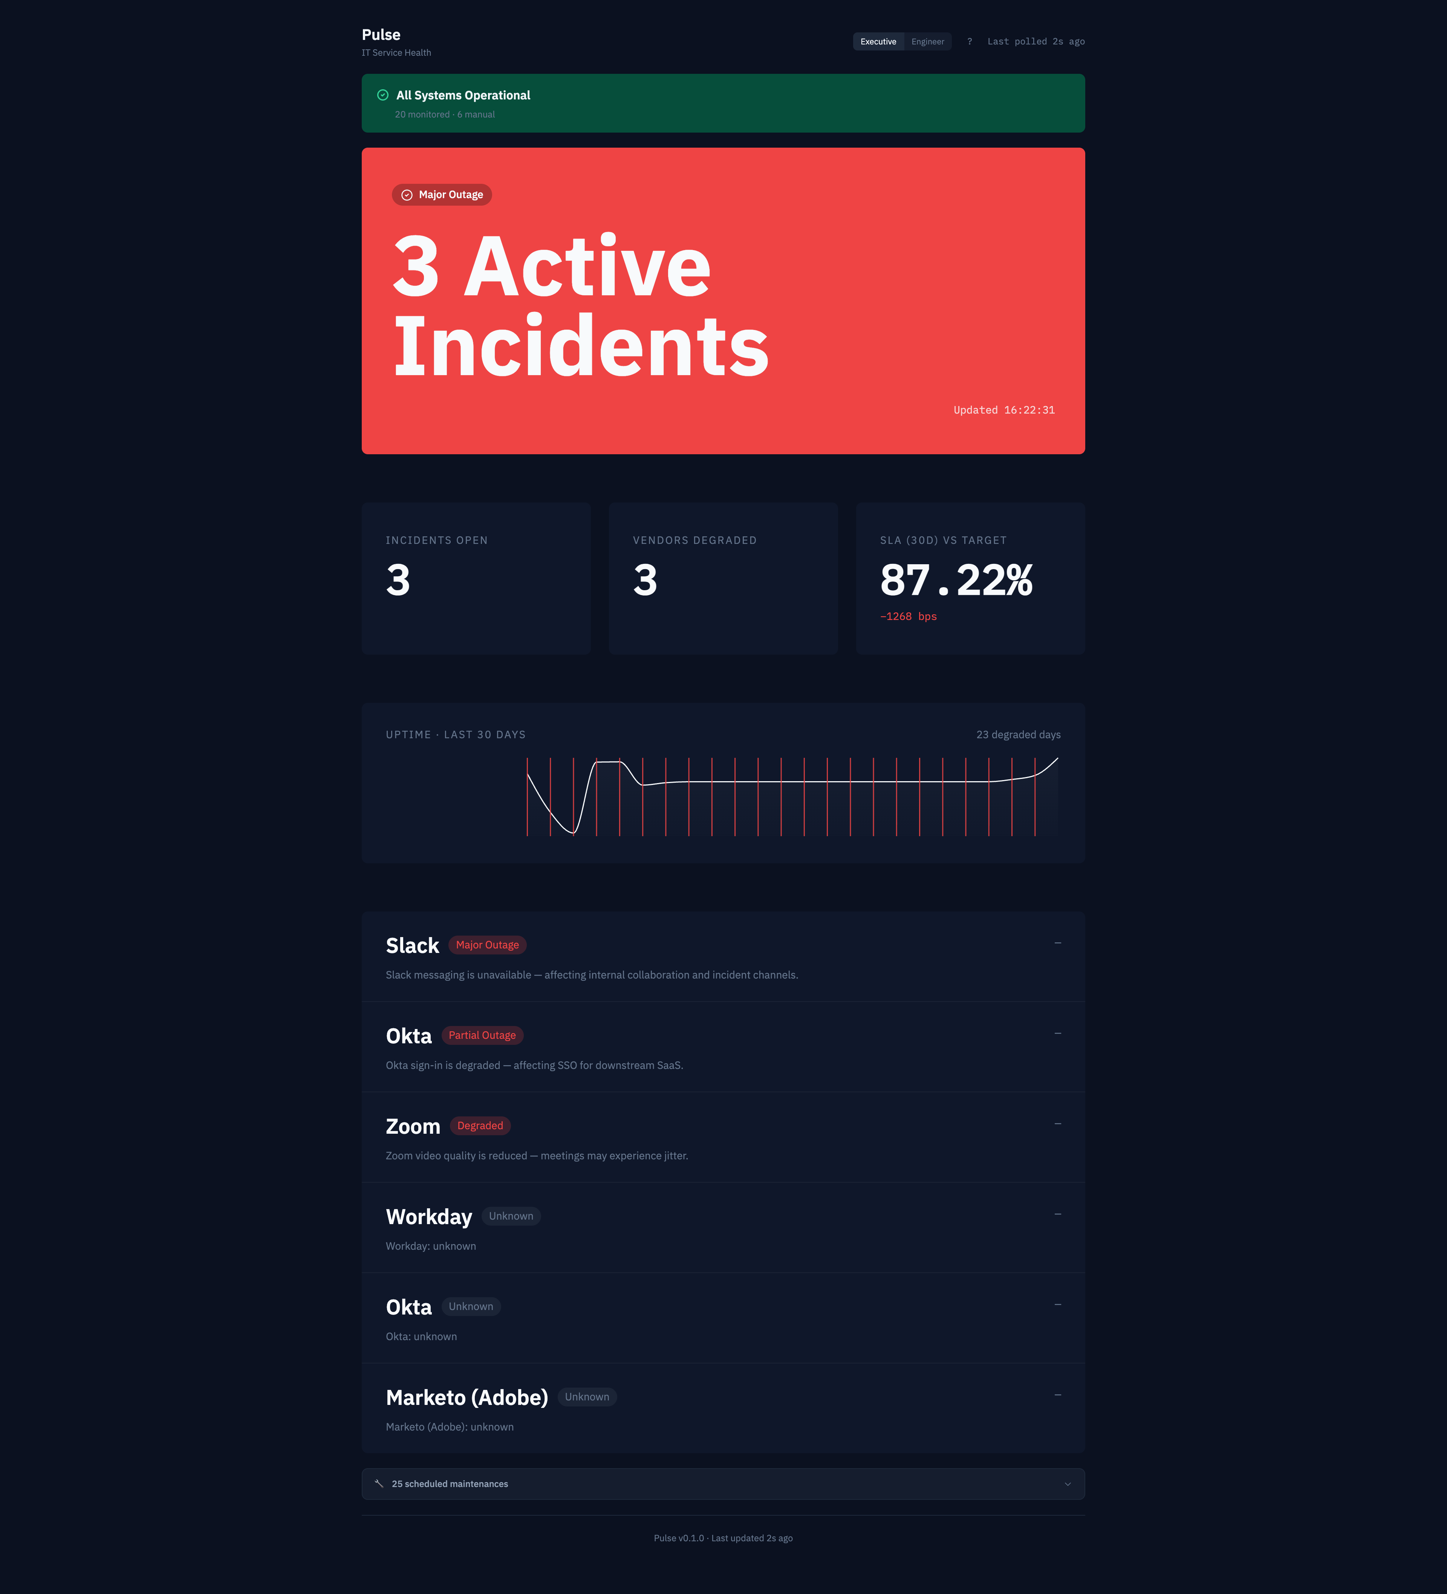
03 · EXECUTIVE VIEW
One panel. Three meters. Read it from the back of the room.
Executive view · rendered at 1920x1080 · 2 active incidents
Pulse · HDI SF Bay Area
04 / 10

Slide 5
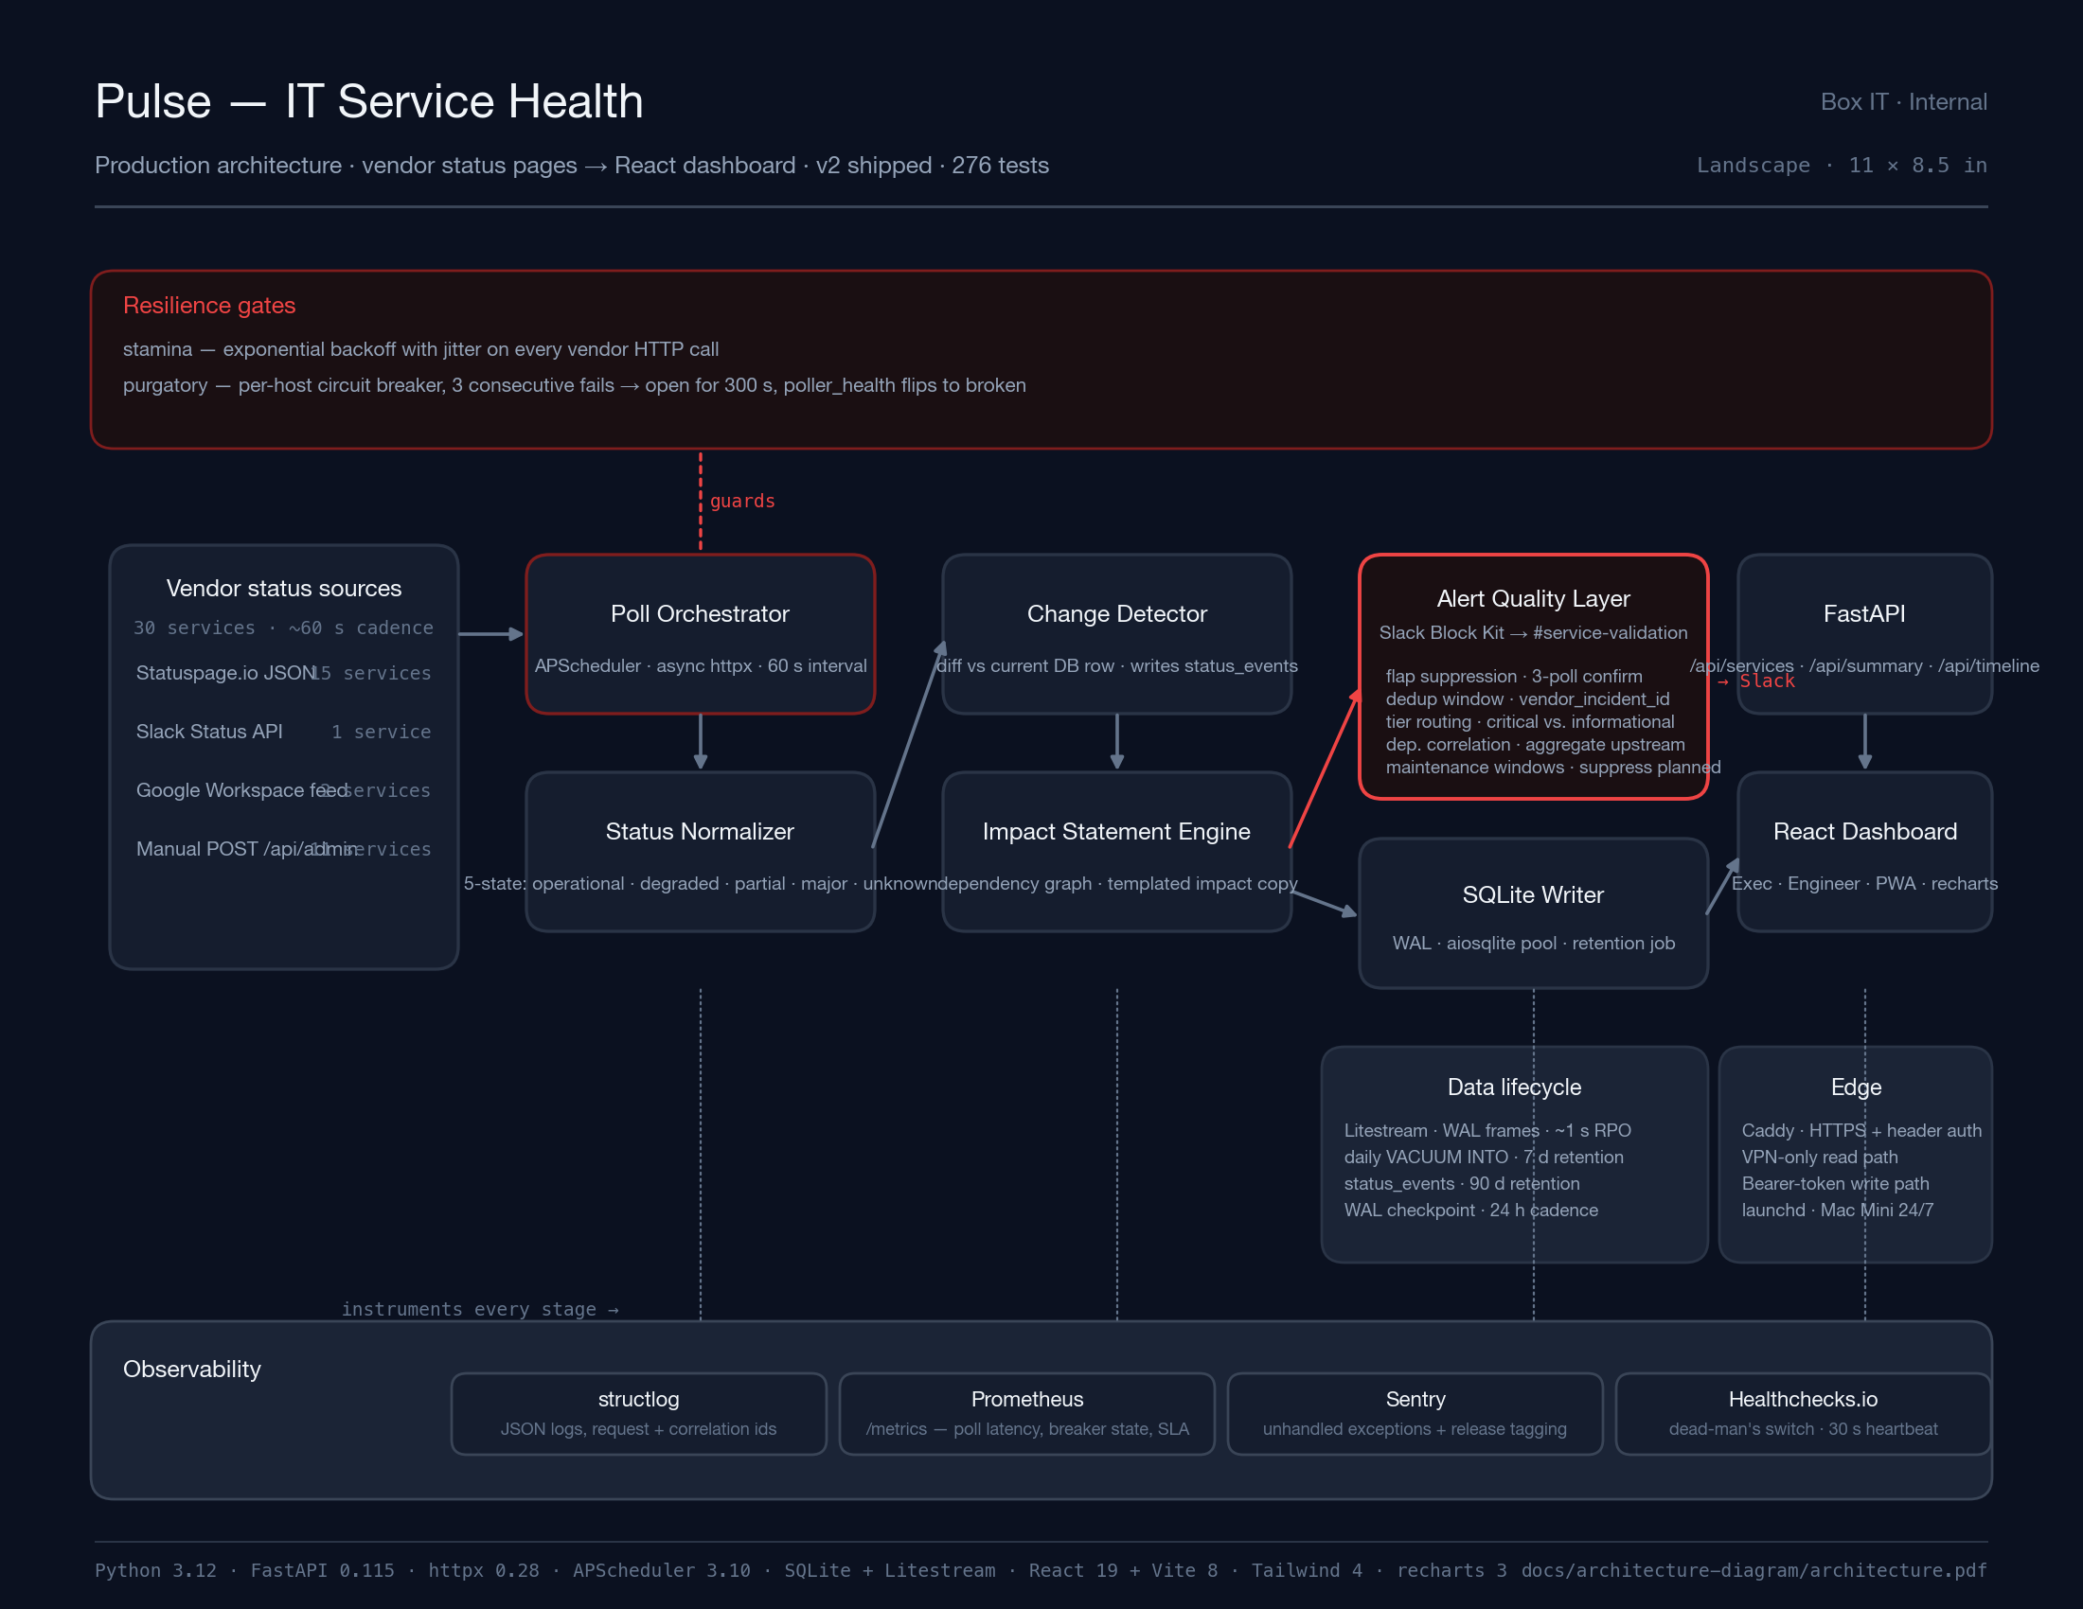
04 · ARCHITECTURE
Vendor pages → resilient poll → alert hygiene → dashboard.
Landscape architecture · resilience + alert + observability lanes
Pulse · HDI SF Bay Area
05 / 10

Slide 6
05 · RESILIENCE
Vendor APIs misbehave. The poller does not.
stamina
purgatory
Exponential backoff with jitter on every outbound call.
Per-host circuit breaker. Blind is not operational.
· retry budget · 3 attempts with exponential base 0.5 s
· 3 consecutive failures · breaker opens for 300 s
· jitter · ±250 ms so we don't synchronise across services
· half-open probe · one attempt after TTL before closing
· timeout · 10 s read · 5 s connect · no blocking I/O
· poller_health flips · service renders as unknown, not operational
· observability · every retry labeled with vendor + attempt
· Slack notification · separate channel from incident alerts
Rule: if we cannot see the vendor, we do not claim they are up. This is the single dashboard bug you cannot ship with.
Pulse · HDI SF Bay Area
06 / 10

Slide 7
06 · ALERT HYGIENE
One message per real incident. No one wakes up twice.
01
Flap suppression
3 consecutive confirming polls before worsening alerts fire. Minimum state duration of 600 s. Recovery requires 2 consecutive operational polls.
02
Deduplication
Alert dedup keyed on vendor_incident_id, not message text. One-day window by default. Same incident cannot re-page on every poll.
03
Tier routing
Critical vs informational. Tier picks destination channel and Slack priority. Degraded-brownout and major-outage do not share a notification surface.
04
Dependency correlation
When Okta goes down, we send one aggregated upstream alert instead of cascading alerts for every dependent service. Threshold is configurable.
05
Maintenance windows
First-class DB table. Scheduled vendor windows suppress alerts for the duration. Auto-populated from vendor feeds; manual windows supported.
Env-tunable: ALERT_CONFIRM_THRESHOLD_POLLS · ALERT_DEDUP_WINDOW_SECONDS · DEPENDENCY_CORRELATION_THRESHOLD
Pulse · HDI SF Bay Area
07 / 10

Slide 8
07 · OBSERVABILITY
If the dashboard were down, I would know in 30 seconds.
structlog
Prometheus
Sentry
Healthchecks.io
JSON logs
/metrics exposition
Exception capture
Dead-man's switch
Every request, poll, and alert carries a correlation id. WatchedFileHandler survives logrotate.
Poll latency, breaker state, alert dispatches, SLA percentage per service. Scrapeable by any text-format collector.
Unhandled exceptions reported with release tag. Traces optional. Default sample rate zero.
30-second heartbeat. /healthz returns 503 past 120 s. External observer notices silence even if monitoring itself is dead.
Rule: every layer reports independently. The poller, the API, the writer, and the browser all answer the question is this alive?
Pulse · HDI SF Bay Area
08 / 10

Slide 9
08 · RESULTS
Shipped. In tree. Production-graded. Boring by design.
7
production phases shipped
Before → After
276
Detection
user reports in Slack
→
60 s poll + dedup alert
tests passing
Reliability
vendor page = truth
→
blind = unknown, not green
~1 s
Exec read
80-tile NOC grid
→
one panel · three meters
RPO · Litestream streaming
Alerts
one per poll
→
one per real incident
< 30 s
p50 vendor-status detection
Backups
none
→
~1 s RPO + daily snapshot
Not shipped: LLM summarization, Splunk / JSM / ThousandEyes / Datadog. Deferred on purpose.
Pulse · HDI SF Bay Area
09 / 10

Slide 10
09 · PLATFORM ENGINEER LENS
This is what the job looks like
from this side of the help-desk.
Pulse is not a side project. It is the shape of the work: listen to vendor signal end-to-end, design resilience gates before you write business logic, refuse to claim green when you are blind, put one meter in the room that a director can read. IT support told me where the pain was. Platform engineering is what I did with it.
If you operate
If you procure
If you build
Steal the five alert-hygiene layers.
Ask vendors for these five guarantees, not feature lists.
Clone it. MIT. github.com/saagpatel/ITServiceHealth.
10 / 10

