Slide 1
UE17CS490B – Capstone Project Phase – 2
SEMESTER - VIII
END SEMESTER ASSESSMENT
Project Title : Style Consistent Kannada Font Generation
Project ID : PW21KS04
Project Guide : Prof. K S Srinivas
Project Team : Saahil B Jain - PES1201700241
Jeevana R Hegde - PES1201700633

Slide 2
Outline
Abstract
Team Roles and Responsibilities.
Summary of Requirements and Design
Summary of Methodology / Approach
Design Description
Modules and Implementation Details
Project Demonstration and Walkthrough
Test Plan and Strategy
Results and Discussion
Lessons Learnt
Conclusion and Future Work
References

Slide 3
Abstract
Problem Statement
The project is to automate the generation of new fonts for the Kannada scripts while taking inspiration from existing fonts from English language.

Slide 4
Abstract
Introduction
Indian languages currently have a limited set of fonts available to choose from.
Creation or generation of new fonts is at present, a manual process.
This can tend to be a tedious, expensive and time-consuming process.

Slide 5
Abstract
Introduction and objective
Our project goal initially was mainly to automate the generation of new fonts for the Kannada scripts while simultaneously ensuring generation of ಮಾತ್ರಗಳು (maatras) and ಒತ್ತಕ್ಷರಗಳು (otaksharas).

Slide 6
Abstract
Introduction and objective
Our current objective leans towards taking inspiration from existing fonts from a language such an English which has an abundance of styles and inculcating these in creating new fonts for Kannada.
This is essentially Style-Transfer.

Slide 7
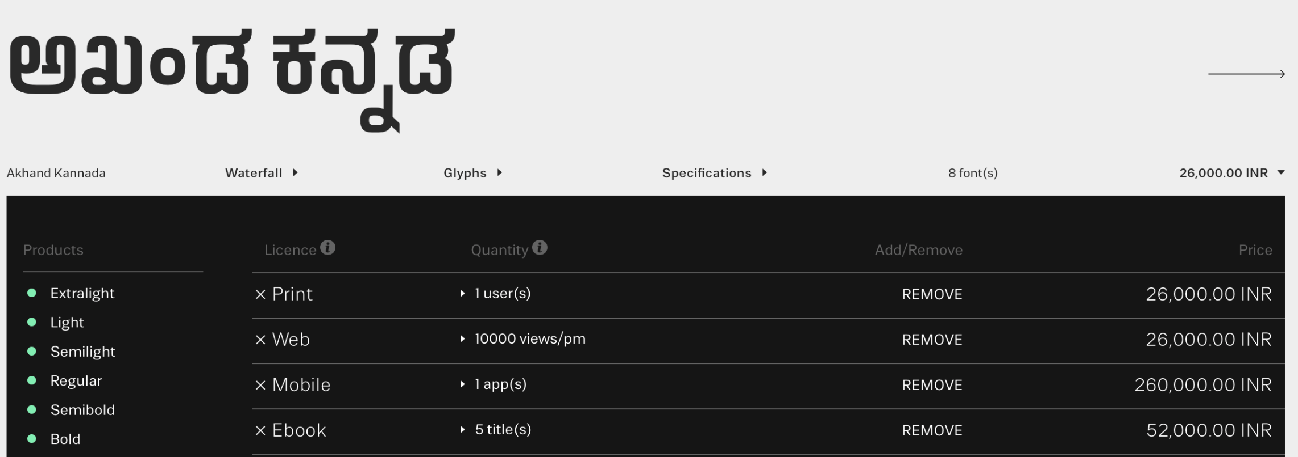


Abstract
Scope
Indian Type Foundry (ITF) is a company which manually creates customized fonts for various languages.
The charges range from 26,000INR - 2,60,000INR for a specific typeface.

Slide 8
Abstract
Scope
Currently font generation is done where the designers must manually draw and further trace Glyphs (characters) using software tools such as Font Developer.
Our project aims to automate this process which makes the process less time-consuming, more efficient(using style consistency) and provides a varied set of options to choose from at a cheaper price.
For each font, the time varies from a couple of hours to a couple of days.

Slide 9
Abstract
Adopted approach
For the generation of the fonts, we went ahead with Neural Cellular Automata approach. Here, the update rule is learnt using its neighbours (for each cell) and this is repeated multiple times to generate a new font.
Style transfer is done using Neural Style Transfer where this incorporates the style from whichever English font’s character is provided as input as provides consistently styled output for the Kannada character.

Slide 10
Team Roles and Responsibilities
Phase | Student Name | Contribution
Literature survey | Jeevana | Typeface Completion with GANs (Research paper)
 | Saahil | Attribute to Font (Research Paper) , Multi-Content GANs (Research paper)
Data collection | Jeevana | Wrote script to collect glyphs of some English and Kannada fonts using python
 | Saahil | Wrote script to crop glyphs to enhance image using python
 | Both | Collected and cleaned a few fonts for English and Kannada
Testing new methods | Jeevana | Testing Neural Style Transfer - Generated Locomo fonts for Kannada
 | Saahil | Testing Autoencoders and Multi-Content GANs: Dropped due to limitations
Generating Fonts | Jeevana | Generated Picket fonts for Kannada
 | Saahil | Generated Schmalfette fonts for Kannada
Cleaning fonts | Both | Cleaned the fonts generated using script

Slide 11
Summary of Requirements
Summary of Requirements
Basic Glyph of all letters with all maatras and ottaksharas of the Kannada Script.
Glyph of at least one complex letter (“g”, “b”, “R”) of target font of English.
A GPU to generate fonts, as time to generate on CPU would be extremely large. Google colab/ Kaggle notebooks would provide sufficient GPU power.

Slide 12
Strengths and Weaknesses
State of the art review:
As per the current manual method of doing this,
Strengths:
Customized to user’s expectations
In case of specific word, there is not need to generate fonts for all characters.
Weaknesses:
Time-consuming
Expensive
Lesser variety

Slide 13

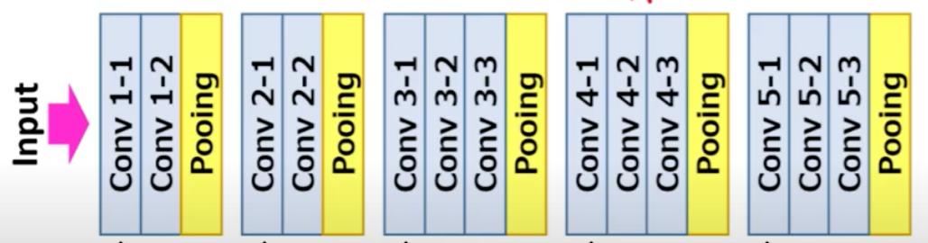
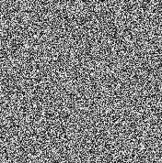

Summary of Approach
Proposed approach: Neural style transfer
Model Architecture:

Slide 14
Summary of Approach
Details of the approach:
The inputs include the style image, target character and the generated image.
The three inputs are passed to the Neural network iteratively and the loss calculated is back propagated.
The output of each iteration is passed as input to the next iteration.
The process is repeated until the generated image is satisfactory.

Slide 15
Summary of Approach
Benefits:
Automated
Fast
Can take inspiration from not just fonts but also from a variety of sources.
Many options to choose from with different style inputs.
Drawbacks:
The fonts generated might need little cleaning.
GPU is required.
Each letter is generated individually, so learning from one letter can’t be used to generate a second letter.

Slide 16
Design Description
We Initially tried out multiple methods including GANs and Convolutional Autoencoders. However, these methods had their own limitations:
GANs were dependent on a large amount of data being available, which is not available for Indian languages such as Kannada.
Convolutional Autoencoders were able to achieve style transfer to some degree, however the performance plateaued after a certain depth of the model and the results weren’t satisfactory.
Hence, the algorithm we use is - Neural style transfer.

Slide 17


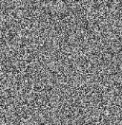

Design Description
Neural style transfer is an iterative optimisation technique that takes three images as input:
Target image- which is the character of the Kannada script we want to convert to the desired font.
Content image- which is the actual generated image which is passed iteratively through the network.
Style image- which is an alphabet of English in the desired font style, in this case ‘g’ in Locomo style .

Slide 18
Design Description
For every iteration, a loss is calculated and back propagated through the network.
These three input images are passed iteratively through the network till the result, that is the content image is satisfactory.

Slide 19
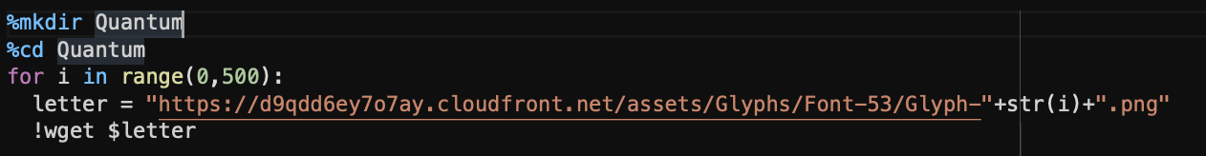
Modules and Implementation Details
Module name: Data collection
Technology used: Wget which is a computer program that retrieves content from web servers.
Description:
Collecting data includes collecting multiple fonts of English language and a few available fonts of Kannada language. Our code fetches all the characters from ITF where we only need to provide the link to the glyph page of the font we need.

Slide 20
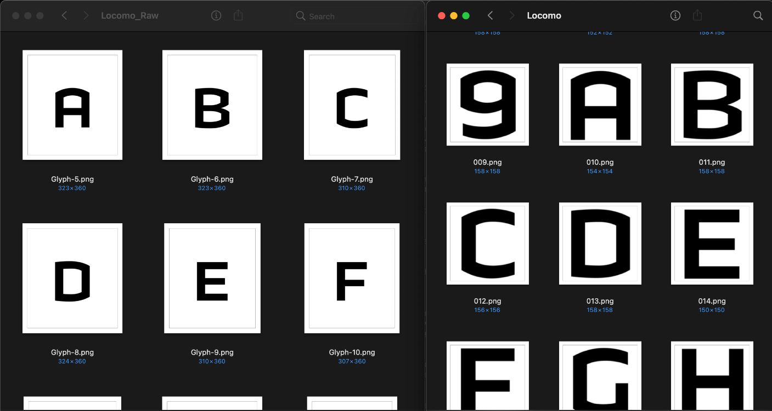
Modules and Implementation Details
Module name: Data cleaning
Technology used: Python
Description:
Once, these glyphs are downloaded, we get rid of the additional padding for the images to be visible clearly to our model. We also ensure images are centered and have an aspect ratio of 1:1 (meaning they are squares).
Before
After

Slide 21
Modules and Implementation Details
Module name: Generating fonts
Technology used: Python
Description:
The most important step of our project is actually generating the fonts. We need to iterate over the set epochs each time, we provide the three images and input to the network.
Calculate the loss over the output and finally backpropagate this loss.

Slide 22
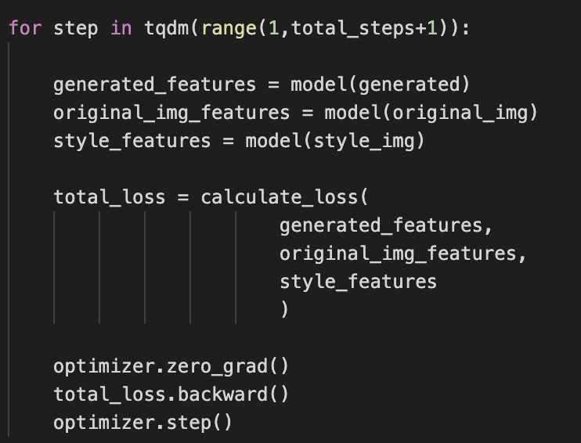
Modules and Implementation Details
Generation of fonts:

Slide 23
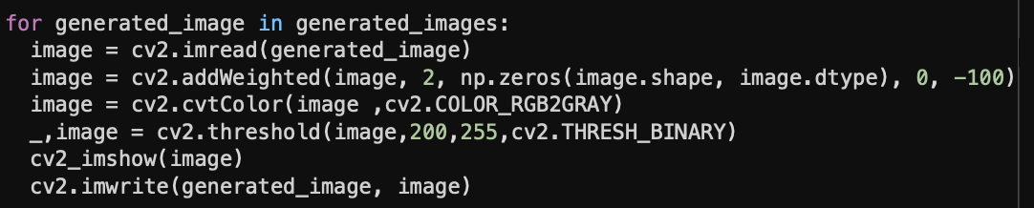
Modules and Implementation Details
Module name: Cleaning generated fonts
Technology used: Python
Description:
The generated fonts are cleaned and refined to obtain expected results.

Slide 24
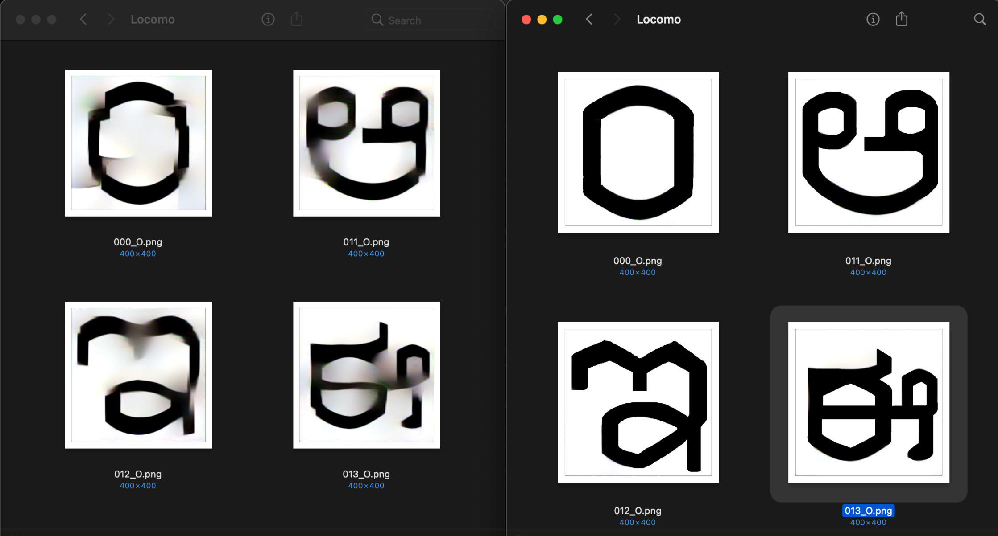
Modules and Implementation Details
Before
After

Slide 25
Project Demonstration
Demonstration walk through

Slide 26
Test Plan and Strategy
Non-functional performance test:
We wrote a script to help us evaluate the loss function.
This script took two font styles as input and took all combinations of letters pairs of the first font and second font as well as all combination of letter pairs of the second font with itself. Loss was calculated for each pair and the results were compared.
Ideally the style losses for combinations of letters pairs of the first font and second font should be really high and style loss of letter pairs of the second font with itself should be minimal.

Slide 27
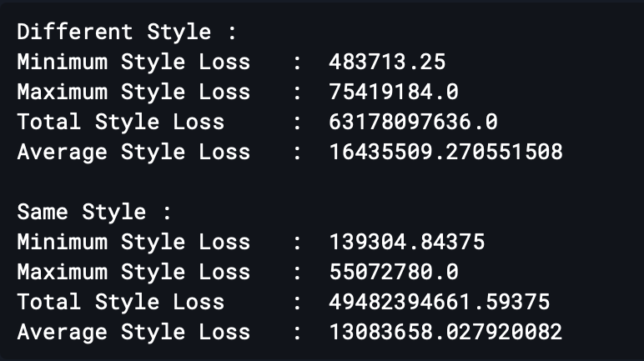
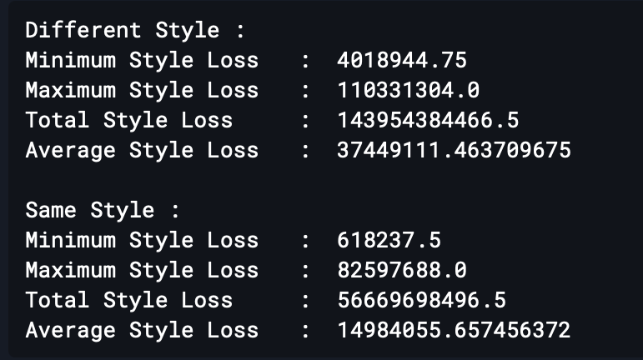
Test Plan and Strategy
Choosing the right Loss Function:
Default Style Loss Function
New Style Loss Function
Ratio of average style loss = 8:10
Ratio of average style loss = 4:10

Slide 28
Test Plan and Strategy
Content loss- Difference in structure of generated image and input image
Style loss- Difference in style of the generated image and style image
Content loss
Style loss
G - Generated Image
T - Target Image
S - Style Image
BS - Basic Style Image
Lcontent(G,T) = ½ || G^{[l]} - T^{[l]} ||²
diff_G = G - T
diff_S = S - BS
GGij = Σ diff_Gik diff_Gjk
SSij = Σ diff_Sik diff_Sjk
Lstyle(GG,SS) = Σ(GGij - SSij)²
Ltotal = α Lcontent(G,T)+ β Lstyle(GG,SS)
Total loss

Slide 29
Test Plan and Strategy
Algorithm:
style_loss = original_loss = 0
for gen_feature, orig_feature in zip( generated_features, original_img_features):
original_loss += torch.mean((gen_feature - orig_feature) ** 2)
for style_features in style_features_all:
for gen_feature, style_feature in zip(batch_size, channel, height, width = gen_feature.shape
generated_diff = gen_feature - orig_feature
style_diff = style_feature - base_feature
GG = generated_diff.view(channel, height * width).mm(
generated_diff.view(channel, height * width).t())
SS = style_diff.view(channel, height * width).mm(
style_diff.view(channel, height * width).t())
style_loss += torch.mean((GG - SS) ** 2)

Slide 30
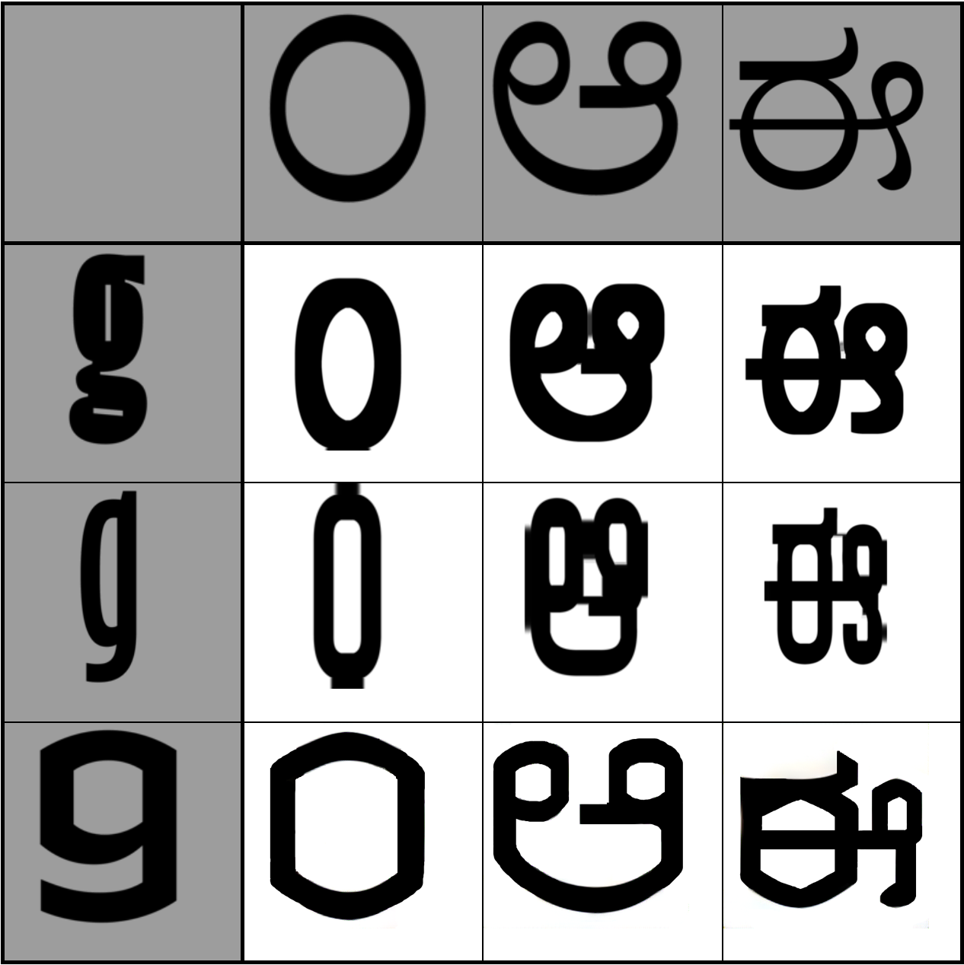
Results and Discussion
Results and Discussion
Results
Top row: Input letters
First column: Style input
Schmalfette
Picket
Locomo
Other boxes: Generated output

Slide 31

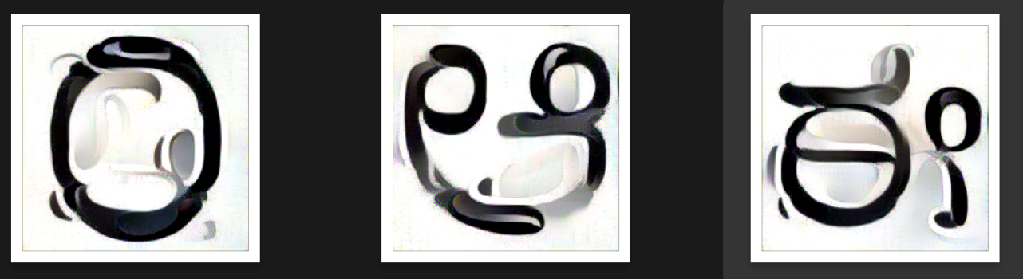
Results and Discussion
Discussion
We have obtained results as per initial estimated plan and hence there is no deviation from what we expected.
We obtained good accuracy for certain styles as seen in the previous slide-
Schmalfette
Picket
Locomo
However, for some fonts such as Zina, we could not meet the required set of expectations.

Slide 32
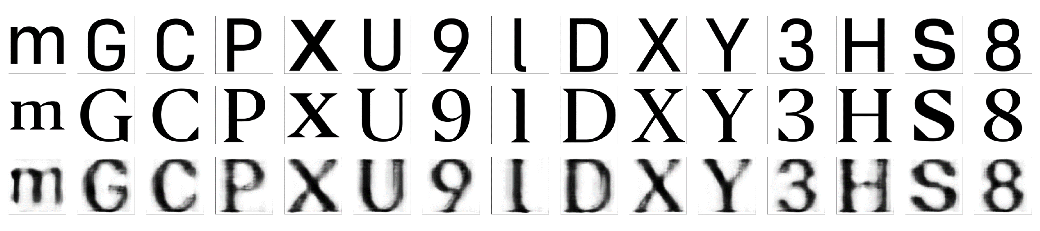
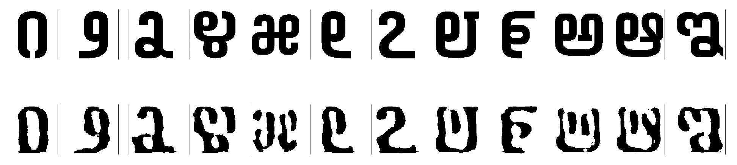
Results and Discussion
Comparison of results with Autoencoders
We did obtain some results with Autoencoders. However, the performance plateaued beyond a certain point and hence we could not achieve the results which we were anticipating.
Training data
Sharpened results

Slide 33
Schedule
Week numbers | Planned work | Actual work
Week 1 | Literature survey and definite problem formulation. | As per plan.
Week 2 | Literature survey on proposed architecture. | Did literature survey + revisited previous semester’s work to understand how to integrate.
Week 3 | Obtaining and cleaning dataset. | As per plan.
Week 4 | Build basic model for Style Transfer. | Tried various approaches to build the basic model.
Week 5 | Train basic model for Style Transfer. | Trained the various models for style transfer.
Week 6 | Perform style Transfer for each alphabet of Kannada Script. | As per plan.

Slide 34
Schedule
Week numbers | Planned work | Actual work
Week 7 | Incorporating maatras for every letter. | As per plan.
Week 8 | Testing | As per plan.
Week 9 | Enhanced model creation after testing | Stuck to the Neural style transfer method and enhanced the results for it.
Week 10 | Fine tuning and documentation. | As per plan.
Week 11 | Fine tuning and documentation. | As per plan.

Slide 35
Documentation
Status of the below documents:
Project report finalized by Guide – YES
IEEE format of paper ready for submission – 100% complete
Conferences we are you targeting -
ICMLAS 2021 : Scopus-Indexed Springer International Conference on Machine Learning and Autonomous Systems.
ICCCMLA 2021 : International Conference on Cybernetics, Cognition and Machine Learning Applications.
ICIRCA : 3rd IEEE International Conference on Inventive Research in Computing Applications.
ICCVBIC 2021 : 5th International Conference on Computational Vision and Bio Inspired Computing.

Slide 36
Documentation
Video of your project – 100% complete
Add the Github repository link- https://github.com/saahil-jain/Font_Style_Transfer.git
A3 size Poster of your project to be shown- 100% complete
All artifacts of your project uploaded in the CSE Project repository- NO (link was just provided)

Slide 37
Lessons Learnt
Choice of loss function is extremely important and can vary based on data and not just tasks.
On a broader aspect for a research project, background work matters a lot to define the scope of our project.
Consider different approaches not just theoretically but also practically before opting for one.
Issues we overcame:
In Neural style transfer, the default style loss function is used for Art images. So, it focuses on colours and shapes. But in our dataset, colours aren’t considered. Hence, we developed our own loss function.
The generated images had some noise, so we further did image processing on them to improve the quality and meet our expectations.

Slide 38
Conclusion and Future work
Conclusion
The required datasets for both Kannada and English language were obtained.
The datasets were then cleaned and labelled accordingly.
A basic model was built and trained using two approaches – Neural Style Transfer and Autoencoders.
Results were obatained for both models and comparison was made.
Neural Style Transfer provided us with better results and hence that approach was carried forward.
Style transfer has been achieved with the approach.
Enhancement has been done using image processing for intricate details of the Kannada language and results were obtained.
Fine tuning and documentation has been completed.

Slide 39
Conclusion and Future work
Future work-
Our future plans for the project is to convert these generated glyphs as fonts which can be integrated to any sort of wording software tool.
This can also work as a Proof of Concept (POC) for other Indian languages which have the same limitations in font as Kannada.
Next Steps-
Applying for conferences and getting a paper published.

Slide 40
References
Research Paper
[1] Samaneh Azadi, Matthew Fisher, Vladimir Kim, Zhaowen Wang, Eli Shechtman, Trevor Darrell, “Multi-Content GAN for Few-Shot Font Style Transfer”, Dec. 01, 2017. [Online]
Available: https://arxiv.org/pdf/2006.06676.pdf [Accessed Jan. 16,2021]
Research Paper
[2] Yonggyu Park, Junhyun Lee, Yookyung Koh, Inyeop Lee, Jinhyuk Lee, Jaewoo Kang, “Typeface Completion with Generative Adversarial Networks”, Dec. 13, 2018. [Online],
Available: https://arxiv.org/pdf/1811.03762.pdf [Accessed Jan. 05, 2020]

Slide 41
References
Research Paper
[3] Yizhi Wang, Peking University, “Attribute2Font”, May. 16, 2020. [Online],
Available: https://arxiv.org/pdf/2005.07865v1.pdf [Accessed Jan. 22, 2021]
Research Paper
[4] Leon A. Gatys, Alexander S. Ecker, Matthias Bathge, “A Neural Algorithm of Artistic Style”, Sep. 02, 2015. [Online],
Available: https://arxiv.org/pdf/1508.06576.pdf [Accessed Feb. 01, 2021]

Slide 42
Thank You

